Slide 1
The Array Editor
An editor for general arrays

Slide 2
Do you remember when you first learned about nested arrays?
You probably quickly learned to use DISPLAY to see the structure of nested arrays.
But if you’re like me, you found it frustrating that there was no way to edit nested arrays.
Over the years we have become accustomed to editing only 2 dimensional simple arrays.
Imagine how different our lives would be if we had an editor for multi-dimensional nested arrays…

Slide 3
What is the Array Editor?
A new way to work with arrays that supports:
Viewing arrays with any shape, rank, or depth
Typing changes in simple array elements
Applying APL structural primitives
Copying and pasting arrays
Searching
Isolating the data that interests us
Infinite undo and redo

Slide 4
Yes, but what is the Array Editor?
It’s an external function. The right argument is the array to be edited. The result is the modified array. It works like this:
array←'ABC' (1 2 3) result←AEDIT array 0 result 1 2 3 ABC
(The array was rotated during the edit session.)

Slide 5
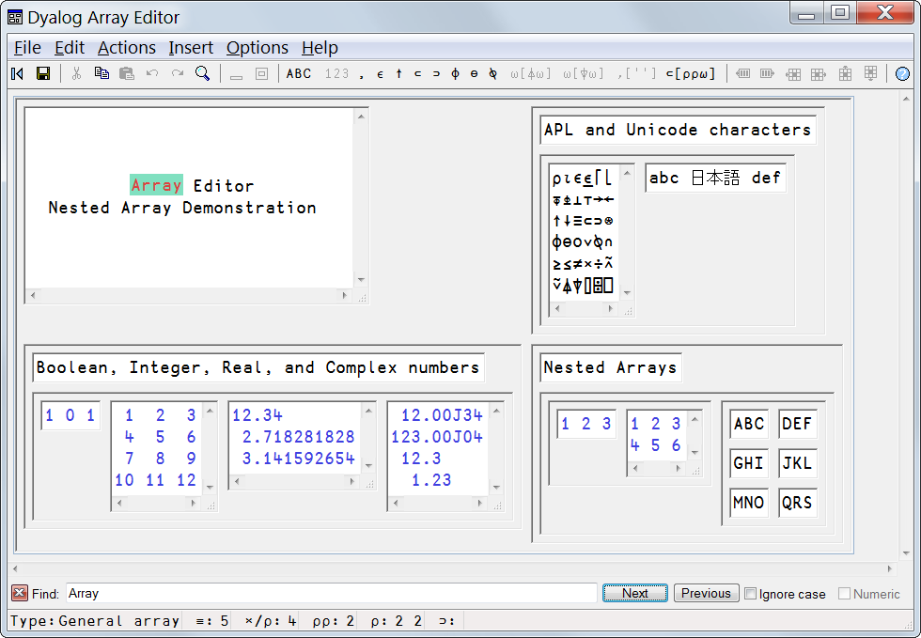
Yes, but what is the Array Editor?!
It’s a GUI program that looks like this:

Slide 6
Supported Data Types
Nested Arrays
Unicode Characters
Boolean numbers
Integer numbers
Real numbers
Complex numbers
High precision decimal numbers

Slide 7
Structural Limitations
Size – None
Length – None
Rank – None
Depth – None
The Array Editor is only limited by memory and the hardware’s capabilities.

Slide 8
Restrictions
Changing the lengths of dimensions of arrays with rank greater than 2, other than the number of columns, is not supported, yet.
Characters that require multiple UTF-16 code units are not supported.

Slide 9
Additional Restrictions for Dyalog
Namespaces are not supported.
Internal representations returned by ⎕OR are not supported.
Using lower case e and j in numbers is not supported.
Only one instance of the Array Editor may be running at a time in a single interpreter.

Slide 10
Supported Dialects
Available now:
APL2
APLX 32 and 64 bit (in beta)
Dyalog 32 and 64 bit (in Unicode edition 13.2)
MatLab 32 and 64 bit (in beta)

Slide 11
Demonstration Time

Slide 12
Things to think about
What does it mean to insert data when editing arrays with rank greater than 2?
Should new columns and rows be added at the same position in all the planes?
Do we need a way to increase the length of any other dimensions?
I need your opinions!

Slide 13
More things to think about
Slicing along axes is nice, but what about reordering the axes?
How about naming axes and reordering the names applies dyadic transpose?

Slide 14
What else can we expect?
I’m porting the Array Editor to these languages:
APL2000
Java(SmartArrays)
Mathematica
If you’re interested in using the Array Editor with any other languages, please let me know!

Slide 15
Using this technology
The Array Editor has a hierarchical infrastructure:
Interface to the interpreter’s calling mechanism
Conversion between internal data formats
Frame window - menu, toolbar, find, status bar
Array Editor control
Edit control for selected simple array
These can all be supplied as separate components.

Slide 16
For more information…
Go to http://www.davidliebtag.com.
Write to david@davidliebtag.com.
Get the new release of Dyalog!
Download free evaluation copies for other dialects from davidliebtag.com:
http://www.davidliebtag.com/downloads/Array Editor for APLX.zip
http://www.davidliebtag.com/downloads/Array Editor for MatLab.zip

Slide 17
Thank You

