Slide 1
Introduction to Link
Morten Kromberg

Slide 2
What is Link?
According to https://github.com/dyalog/link

Slide 3
All you need to Know about Link…
To declare that your source is in C:\linkdemo
]link.create # C:\linkdemo
To import code that you do not intend to modify, from C:\linkdemo\myapp into the namespace "myapp":
]link.import myapp C:\linkdemo\myapp
… and then proceed to use APL normally … but without having to remember to type )SAVE at the end of your day.

Slide 4
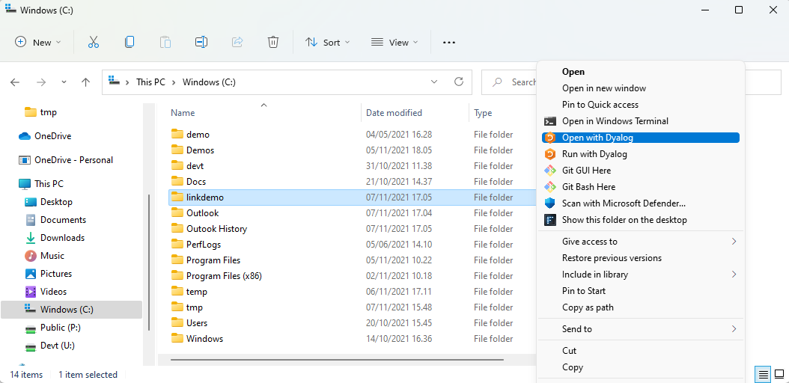
Time for a Demo
Under Linux, you can use LINK_DIR="linkdemo" dyalog

Slide 5
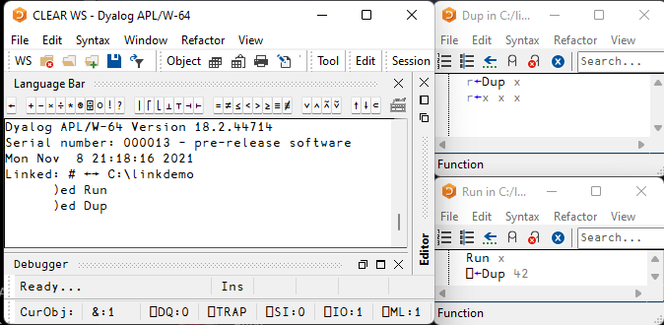
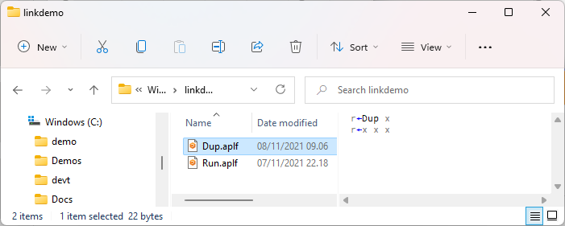
Workspace + Source are Synchronised

Slide 6
Workspace + Source are Synchronised
Changes made "in APL" using the APL Editor are immediately written to file
Changes made to the files using external tools (editors, source code management systems, etc) are immediately brought in to the workspace

Slide 7
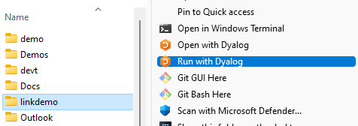
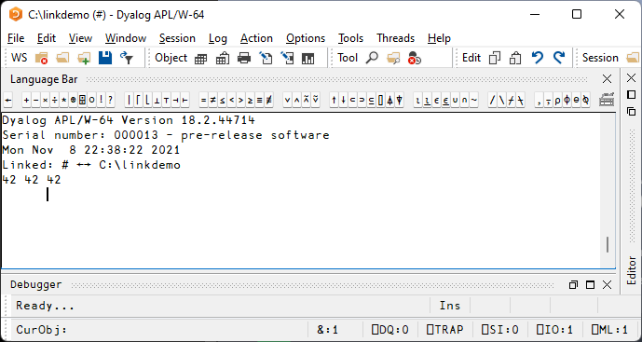
"Run with Dyalog" calls function Run

Slide 8
Launching from Shell
$ dyalog LOAD="blah"

Slide 9
Launching from Shell
$ dyalog LOAD="blah"

Slide 10
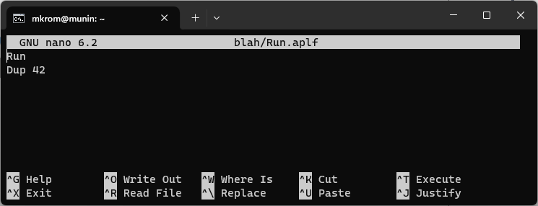
Command Shell, Continued…

Slide 11
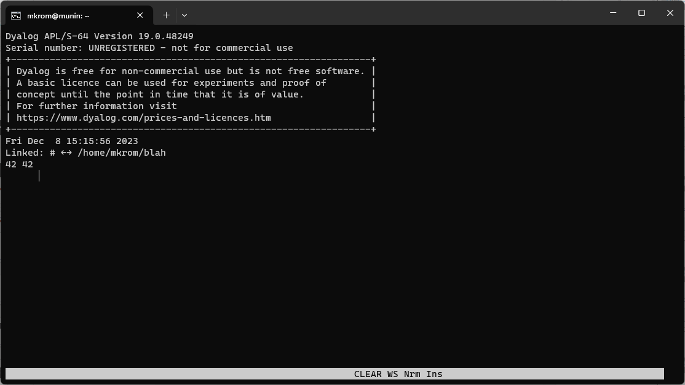
Launching from Shell
$ dyalog LOAD=blah

Slide 12
Load but do not Run …
Set an empty LX= to avoid calling Run on startup
$ dyalog LOAD=blah LX=

Slide 13
Converting an Existing System
This is a regular workspace
)load c:\demos\linkdemo\myapp
)fns
Main Mean Root StdDev
⍪¨1 1 0 0⊂⎕CR¨⎕NL -3

Slide 14
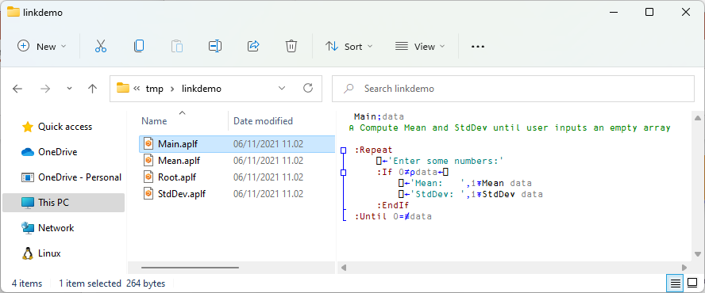
Exporting (from WS to File)
]link.export # c:\tmp\linkdemo Exported: # → c:\tmp\linkdemo

Slide 15
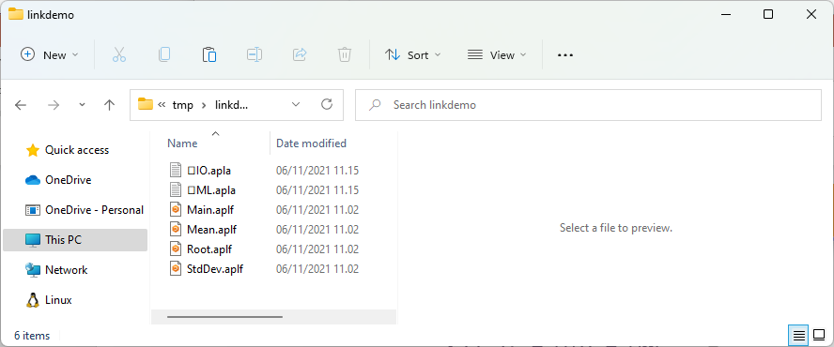
[System] Variables
]link.add ⎕IO ⎕ML Added: #.⎕IO #.⎕ML

Slide 16
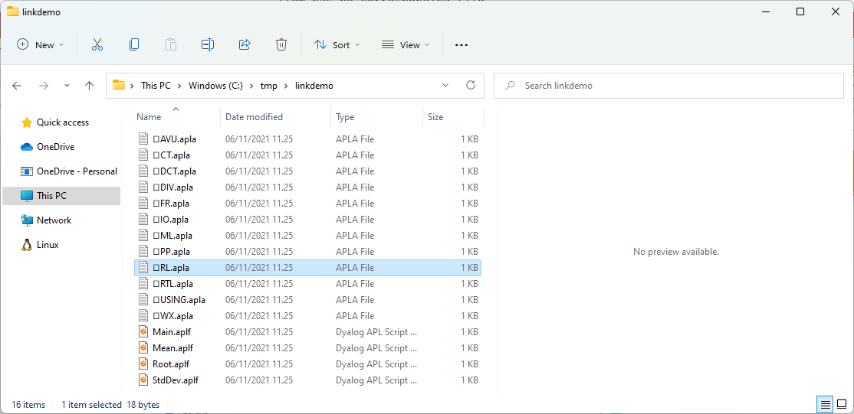
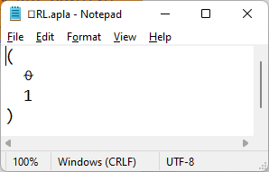
-sysvars
]export # c:\tmp\linkdemo –sysvars Exported: # → c:\tmp\linkdemo
Exports all system variables
with namespace scope

Slide 17
]link.create replaces )LOAD
]link.create # c:\tmp\linkdemo Linked: # ←→ c:\tmp\linkdemo
)fns Main Mean Root StdDev
Main Enter some numbers: ⎕:
1 2 3 4
Mean: 2.5 StdDev: 1.1 Enter some numbers: ⎕:
⍬
←→
Shows that link is
Bi-directional
(Currently requires .NET)

Slide 18
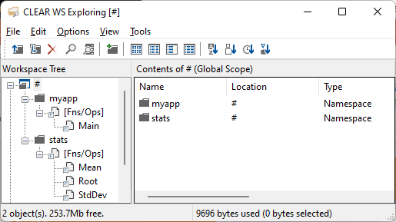
Adding Structure
)fns
Main Mean Root StdDev
⍪¨1 1 0 0⊂⎕CR¨⎕NL -3

Slide 19
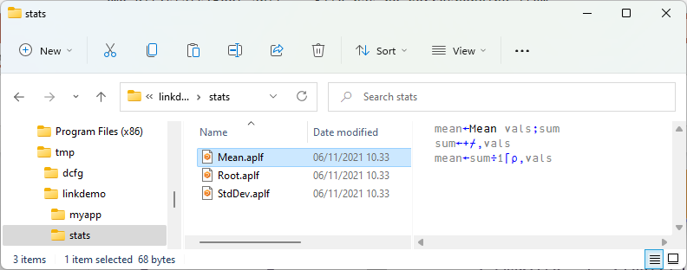
Adding Structure
You could change the directory structure using File Manager…

Slide 20
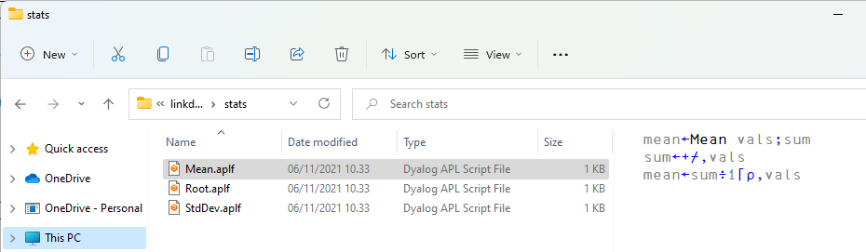
OR…
⎕MKDIR 'c:\tmp\linkdemo\myapp' ⎕MKDIR 'c:\tmp\linkdemo\stats'
]link.export Main c:\tmp\linkdemo\myapp Exported: #.Main → c:/tmp/linkdemo/myapp/Main.aplf
statfns←'Mean' 'Root' 'StdDev' ⍪{⎕SE.Link.Export ⍵ 'c:\tmp\linkdemo\stats'}¨statfns Exported: #.Mean → c:/tmp/linkdemo/stats/Mean.aplf Exported: #.Root → c:/tmp/linkdemo/stats/Root.aplf Exported: #.StdDev → c:/tmp/linkdemo/stats/StdDev.aplf
Oh, and delete the old files

Slide 21
Adding Structure
Namespace structure
≡
Directory
Structure *
* Unless you use -flatten

Slide 22
Adding Structure

Slide 23
The –flatten switch
You can have a directory structure to organize your code
… but ignore it when loading into the workspace
No namespace structure is created
]link.create # c:\tmp\linkdemo -flatten Linked: # ←→ c:\tmp\linkdemo
)fns Main Mean Root StdDev

Slide 24
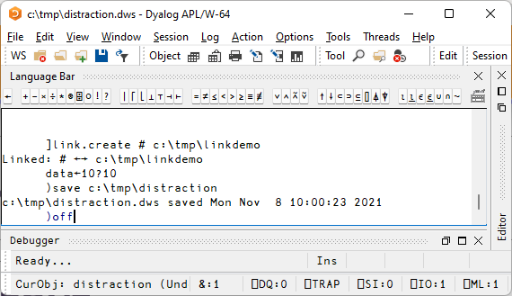
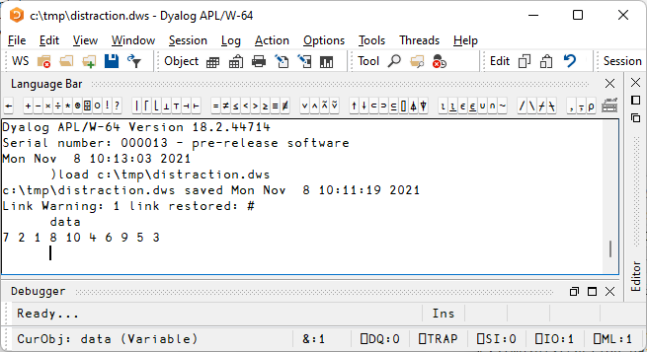
Link vs. Workspaces

Slide 25
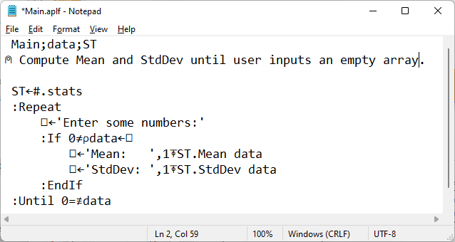
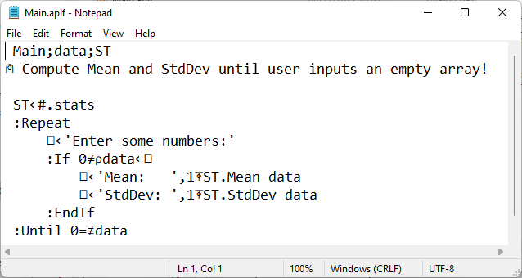
Saved Workspaces

Slide 26
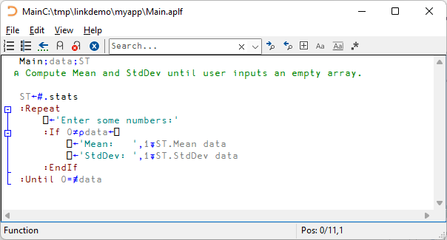
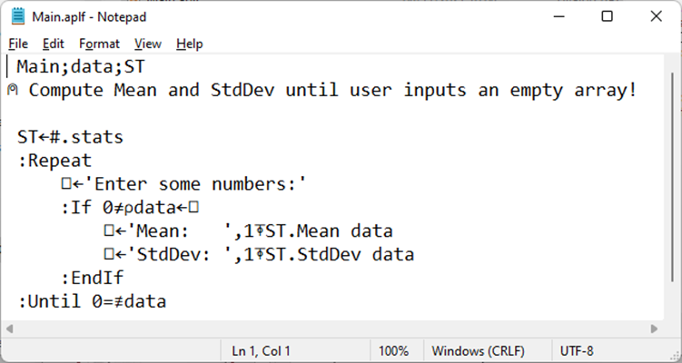
Saved Workspaces

Slide 27
Saved Workspaces

Slide 28
Saved Workspaces

Slide 29
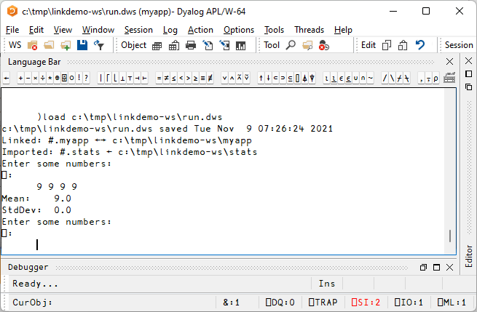
Optional "Bootstrap" Workspace

Slide 30
Saved Workspaces
OK for
Pausing work
Crash analysis
Not recommended as
Storage for source code

Slide 31
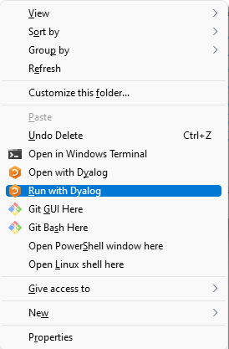
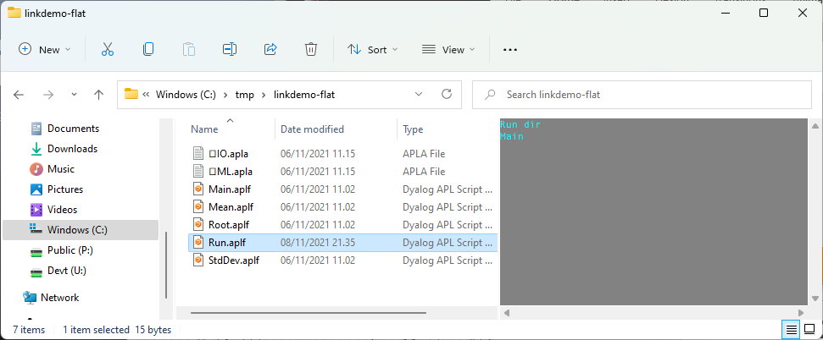
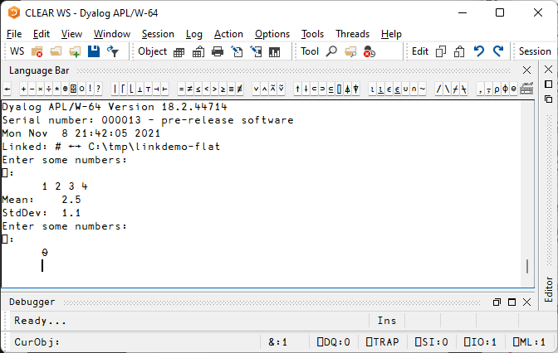
Launching using Text Only

Slide 32
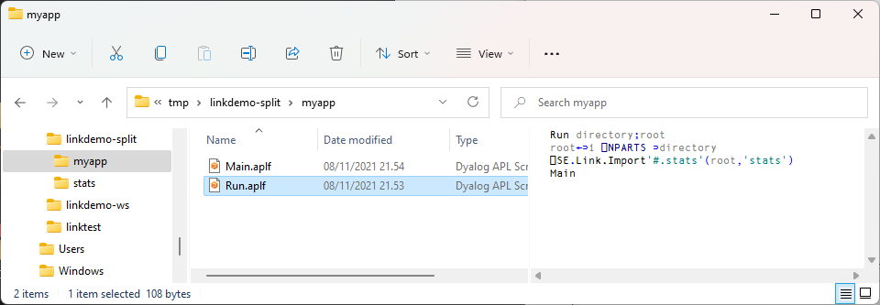
Launch Directory is passed to Run

Slide 33
Reminder: Launching from Shell
$ dyalog LOAD="/mnt/c/linkdemo"

Slide 34
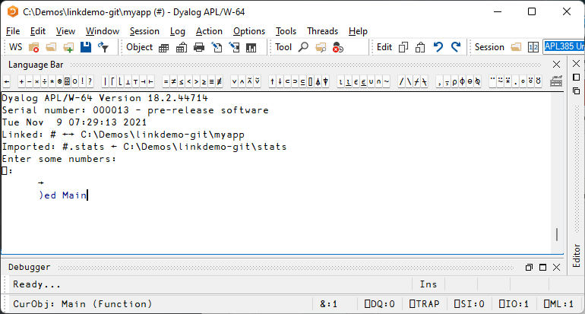
GitHub, VS Code + Link

Slide 35
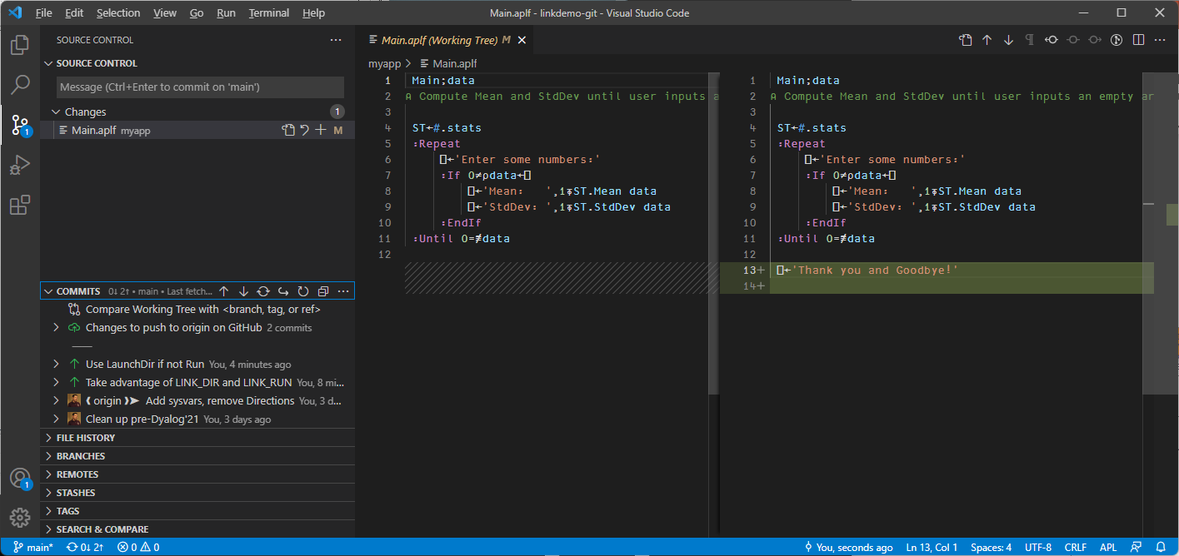

Slide 36
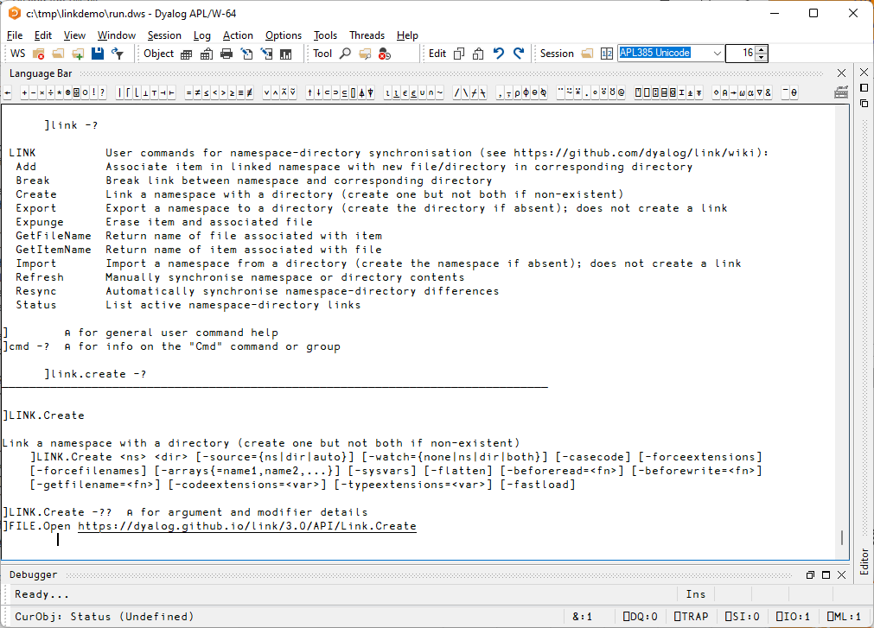
Documentation

Slide 37
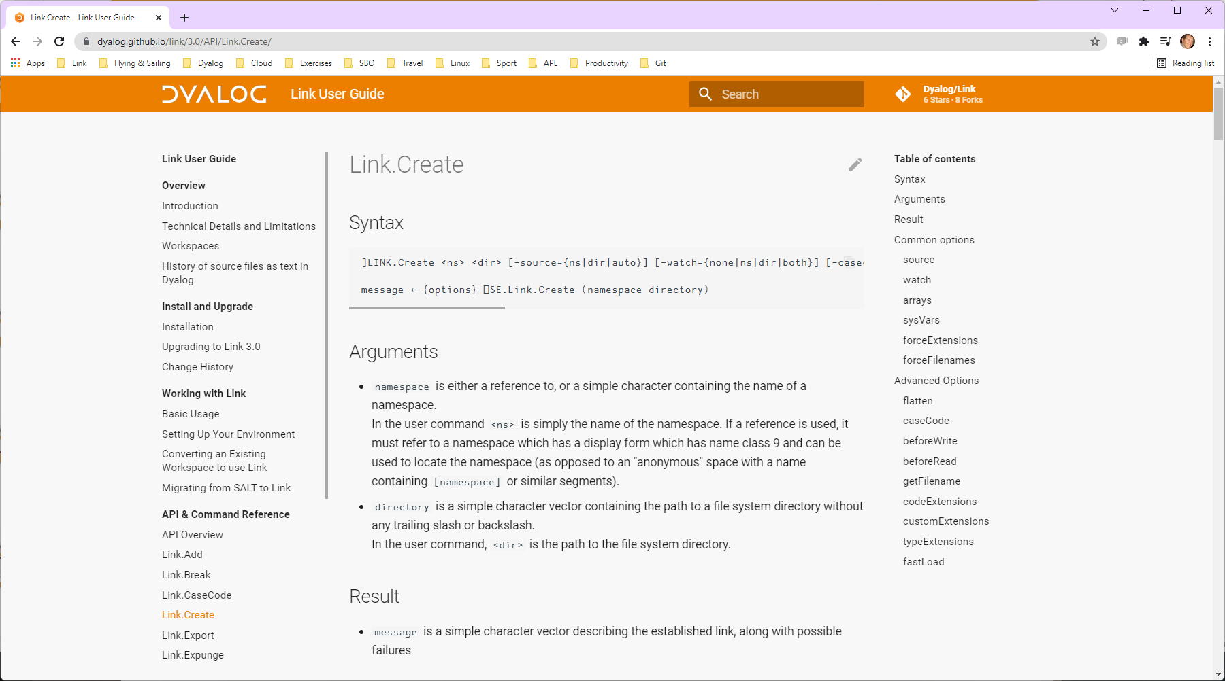

Slide 38
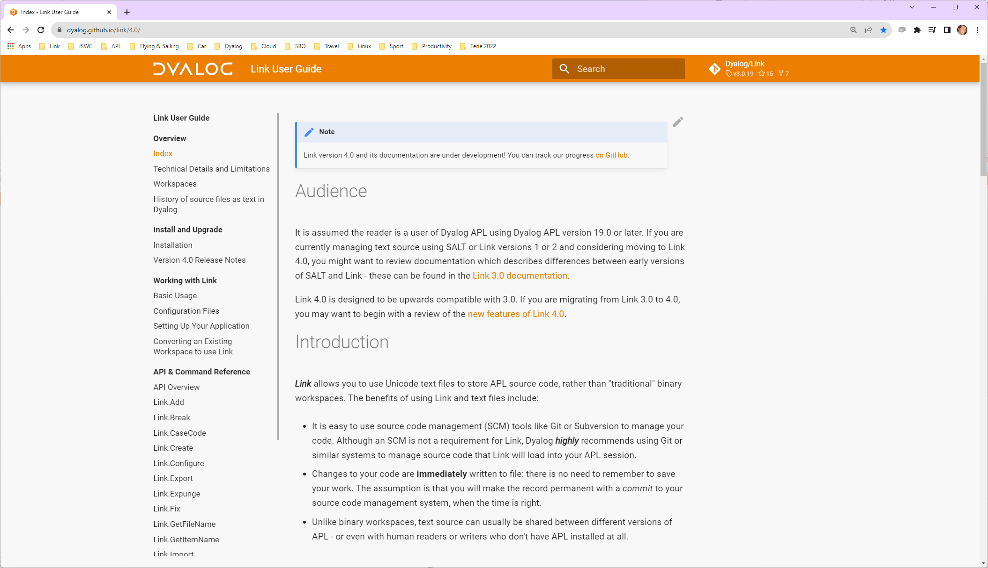

Slide 39
Highlights of Link 3.0 (Dyalog 18.2)
LOAD=
Handles "Resync" of saved workspaces
Supports names that differ only in case using "case coding"

Slide 40
Link v4.0 (Dyalog v19.0)
Link v4.0 Highlights
Configuration Files (incl "Global" config)
Link a single Class or Namespace file
As opposed to a folder
Create/Export/Import default to current namespace if none supplied
Support for character vectors, matrices and vec-of-vecs in simple text files
Link now being used by APL interpreter to load user code at startup
Array Notation processing done in C

Slide 41
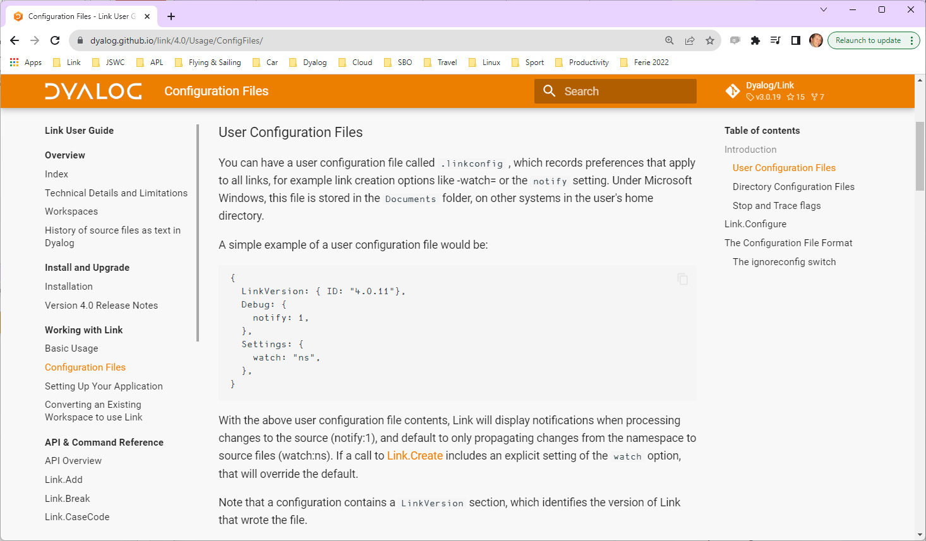
Link Road Map
Link v4.0 Highlights
Configuration Files (incl "Global" config)
Link a single Class or Namespace file
As opposed to a folder
Create/Export/Import default to current namespace if none supplied
Support for character vectors, matrices and vec-of-vecs in simple text files
Link now being used by APL interpreter to load user code at startup

Slide 42
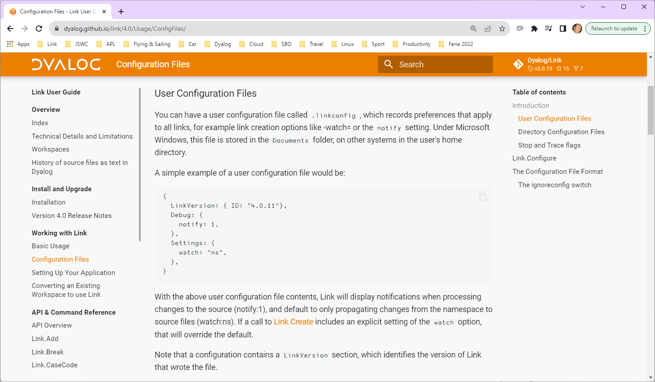
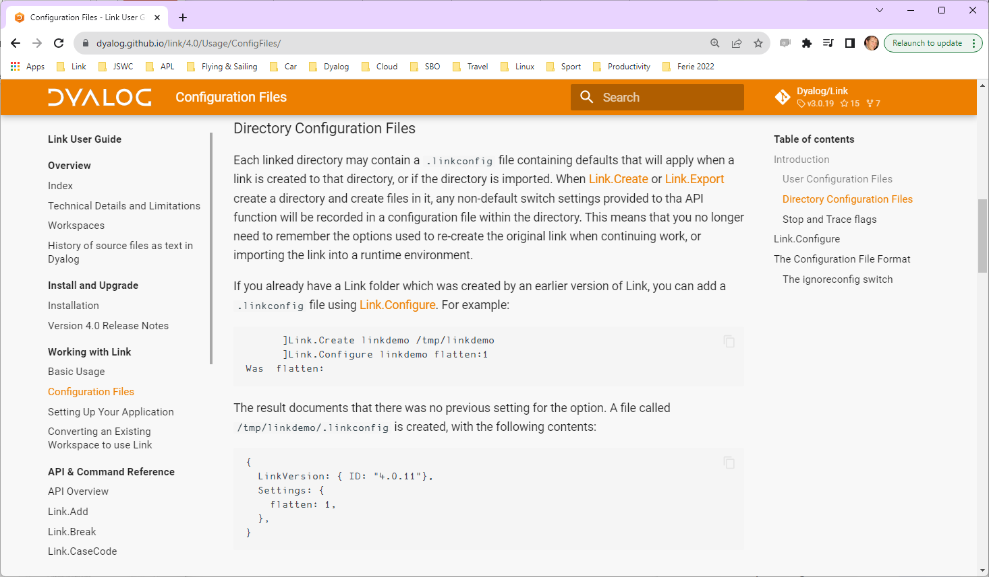

Slide 43
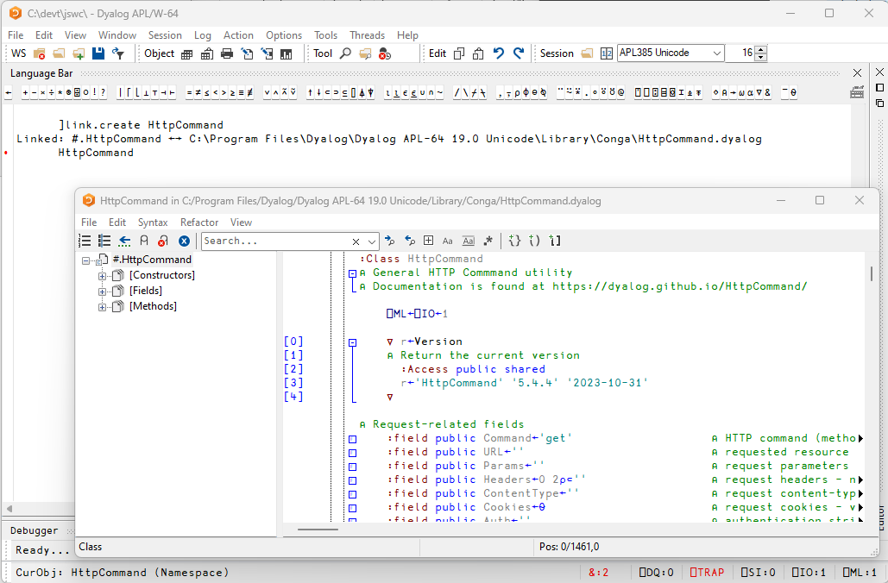
Link v4.0
Link v4.0 Highlights
Configuration Files (incl "Global" config)
Link a single Class or Namespace file
As opposed to a folder
Create/Export/Import default to current namespace if none supplied
Support for character vectors, matrices and vec-of-vecs in simple text files
Link now being used by APL interpreter to load user code at startup
Array Notation processing done in C

Slide 44
Link v4.0 (Dyalog v19.0)
Link v4.0 Highlights
Configuration Files (incl "Global" config)
Link a single Class or Namespace file
As opposed to a folder
Create/Export/Import default to current namespace if none supplied
Support for character vectors, matrices and vec-of-vecs in simple text files
Link now being used by APL interpreter to load user code at startup
Array Notation processing done in C

Slide 45
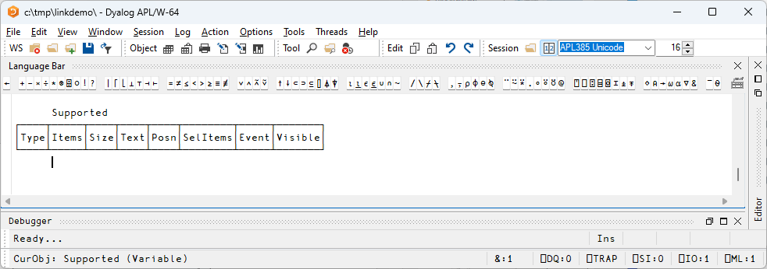
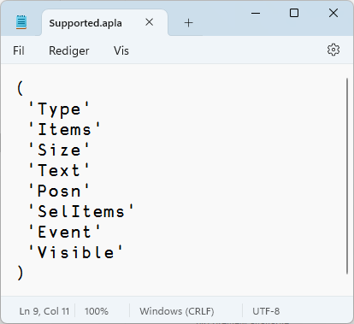
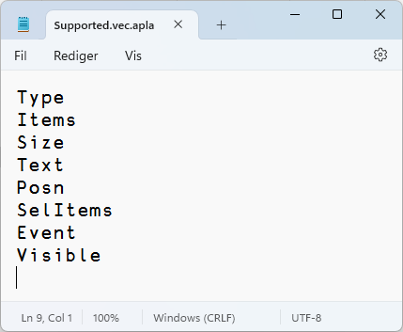
Character Arrays in "Simple" Files

Slide 46
Link v4.0 (Dyalog v19.0)
Link v4.0 Highlights
Configuration Files (incl "Global" config)
Link a single Class or Namespace file
As opposed to a folder
Create/Export/Import default to current namespace if none supplied
Support for character vectors, matrices and vec-of-vecs in simple text files
Link now being used by APL interpreter to load user code at startup
Array Notation processing done in C

Slide 47
Link Road Map
Link 5 & 6
Crawler which will periodically compare workspace to source folders
Reduces / avoids need for .NET "File System Watcher"
Postponed from v3.0 to v4.0, and now from v4.0 to v5.0
"Create a proper API"
Probably v6.0

Slide 48
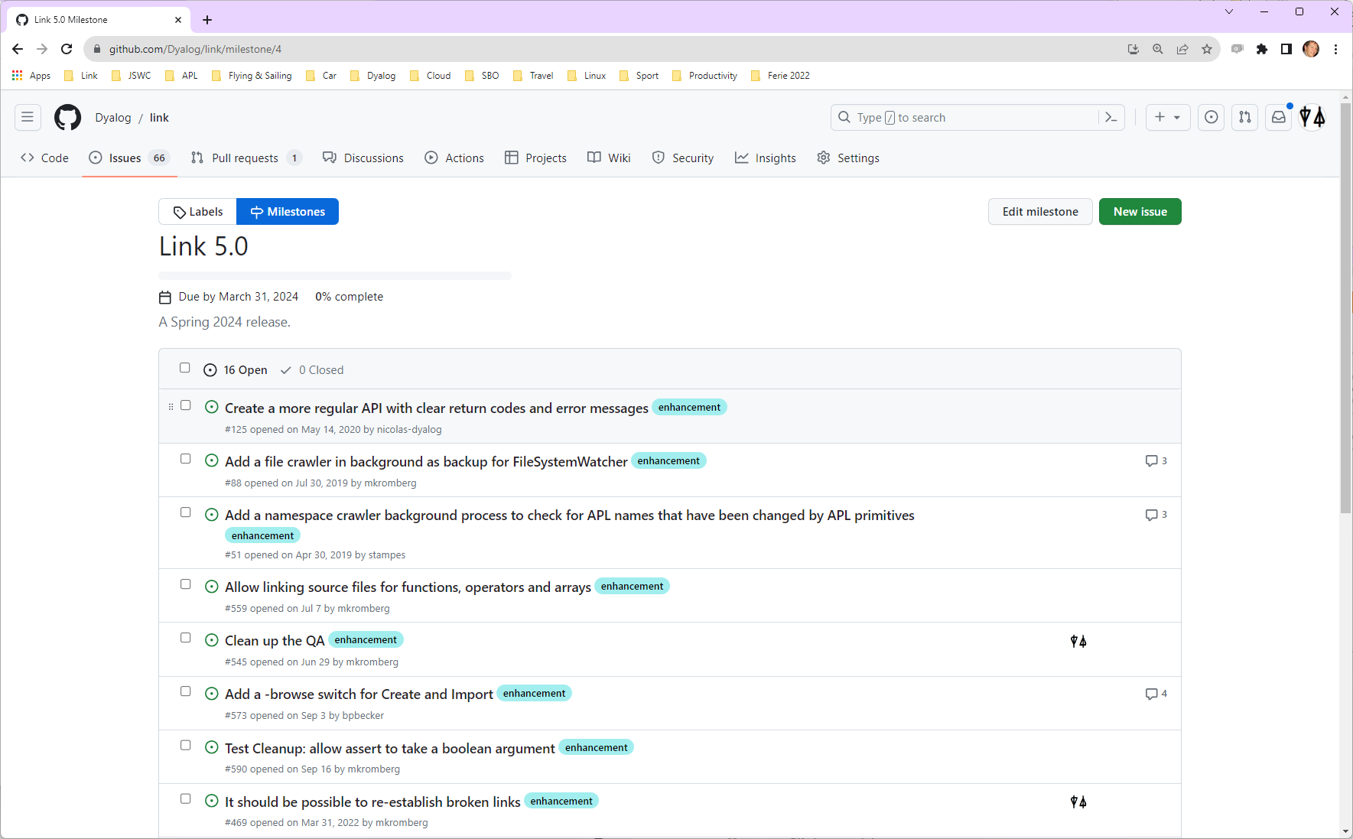

Slide 49
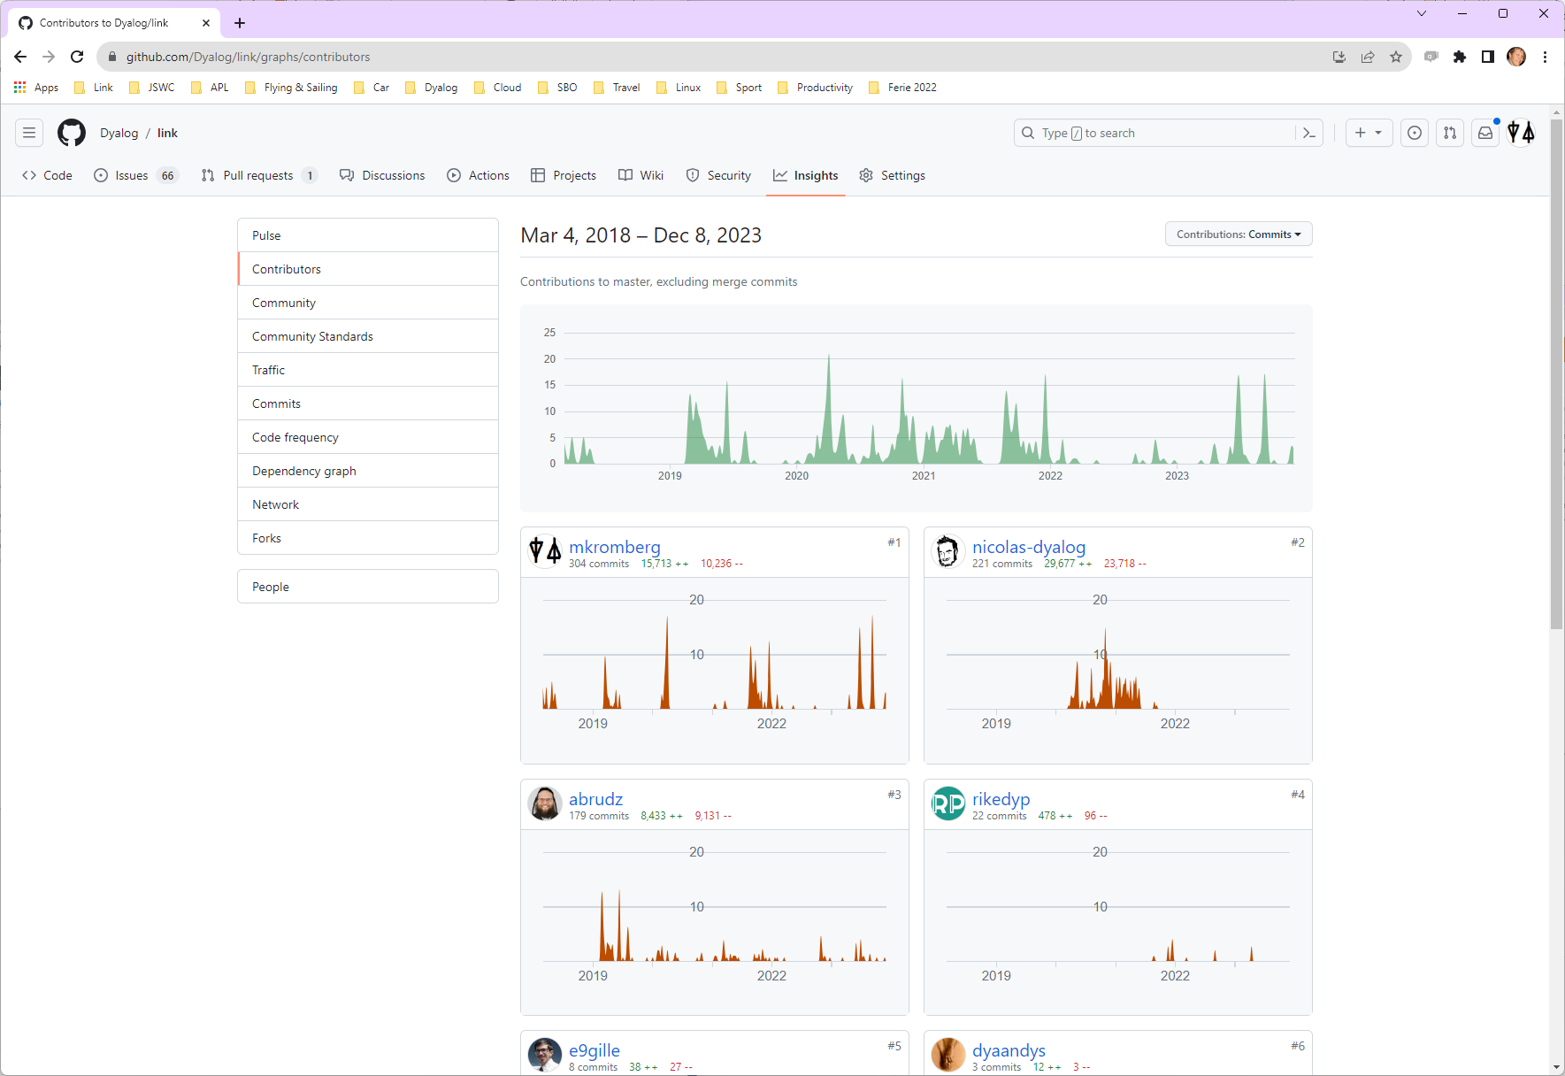

Slide 50
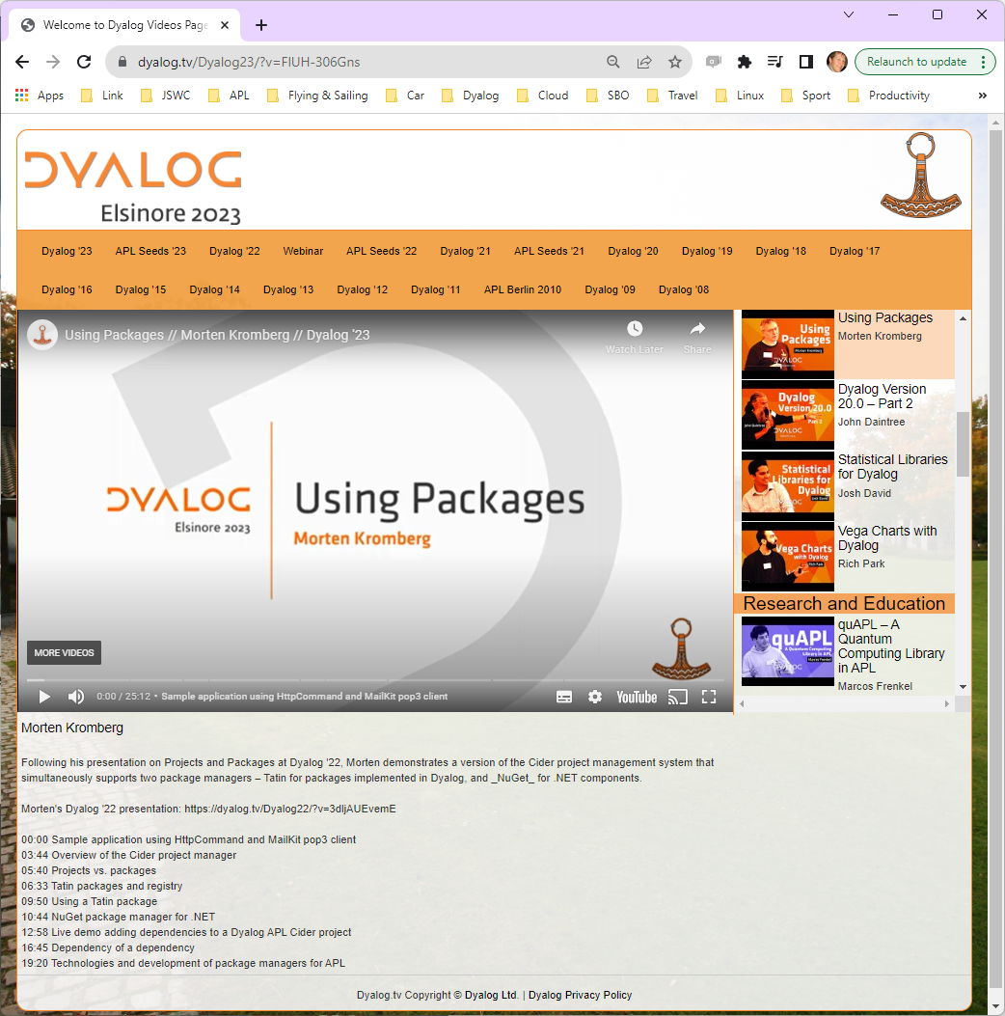
Recommended Viewing

Slide 51
Conclusion
Link enables the use of many valuable 3rd party tools with APL source
These tools can give you MUCH better control of your source code
… all without losing any of our Inalienable Rights

