Slide 1
Welcome
Gitte Christensen

Slide 2
Gitte Christensen, MD Dyalog Ltd
Cand. Scient. Biology

Slide 3
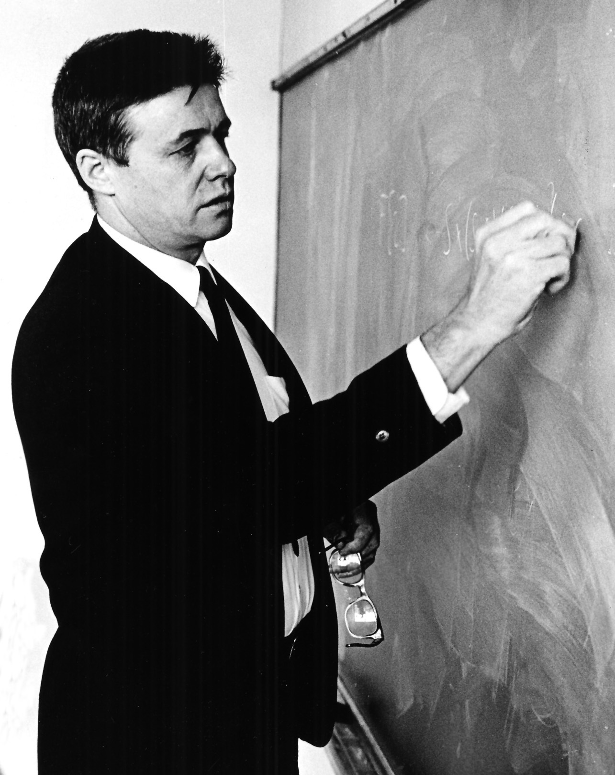
What is APL?
An executable notation and a tool of thought which continues to enable people with good ideas to bring those ideas to life with computers.
1 2 3 + 4 5 6
5 7 9

Slide 4
Dyalog Ltd
Dyalog interpreter and application development platform
Dedicated to the evolution and promotion of APL
Bringing the benefits of APL to a wider audience

Slide 5
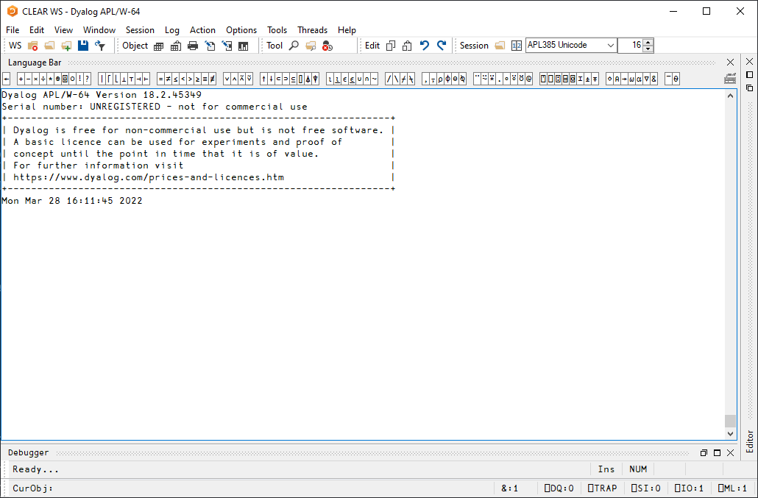
Dyalog Interpreter and IDE

Slide 6
APL Core with Many Tools
Functional programming {⍺+⍵}
Object-oriented programming ⎕NEW
.NET ⎕USING
Convert between formats ⎕JSON, ⎕CSV, ⎕XML
Datetimes ⎕DT
Regular expressions ⎕R, ⎕S
Graphics ⎕CY'sharpplot'
GUI ⎕WC, github/dyalog/DUI
SQL (ODBC) ⎕CY'sqapl'
TCP/IP ⎕CY'conga'
Parallel Computing ⎕CY'isolate'
New: import directly from the web
]Get github.com/Dyalog/Jarvis/blob/master/Source/Jarvis.dyalog

Slide 7
New Basic License
From Dyalog v18.2, the Non-commercial licence is replaced by a Basic licence
A Basic Licence is a free licence that allows APL users to have a copy of the latest Dyalog technology for personal or non-commercial use and experimentation.
Allows distribution of Dyalog along with your work under the terms of the Royalty-Based Run-Time Licence, which will apply as the default run-time licence.
Fee is 2% of gross APL-based revenue
No fee if revenue < GBP 5,000 in a calendar year
Multiple alternative commercial license schemes are available

Slide 8
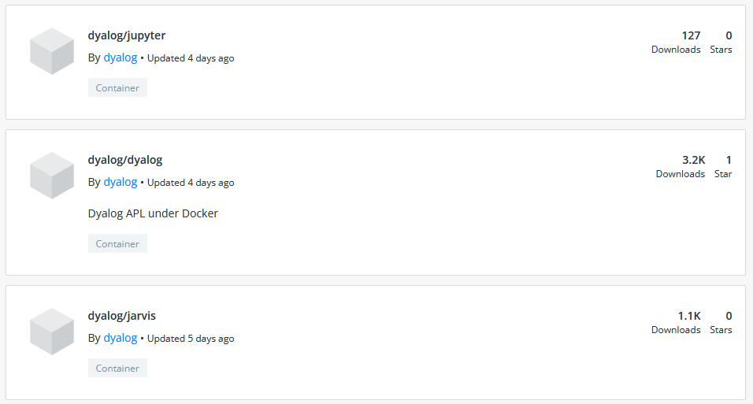
Ways to Distribute your APL App
Executable desktop applications
Web services
Docker containers
hub.docker.com/u/dyalog

Slide 9
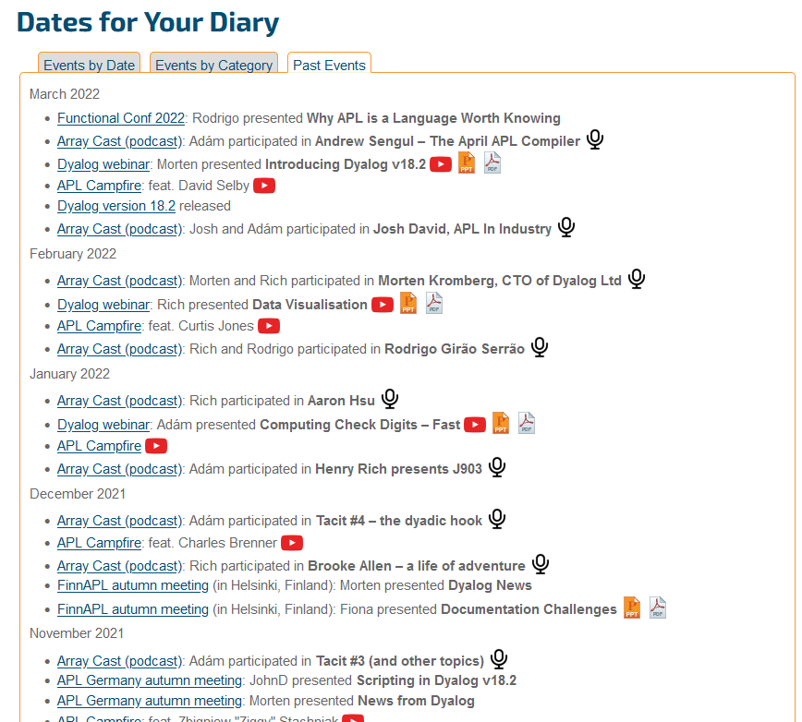
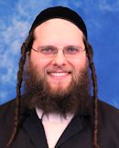
Outreach and Evangelism

Slide 10
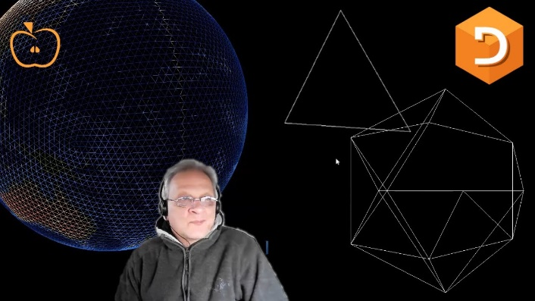
Dyalog.tv/APLSeeds21

Slide 11
So who uses APL?
Production
Management
Finance
Medicine
Science
Simulation
Computer Science
People solving new problems, or solving them in a new way
People solving problems or manipulating data in environments where the conditions are constantly changing

Slide 12
So who uses APL?
Asset Management SimCorp (DK & IT)
Tegra118 (US)
Manufacturing
Just-in-Time Production Planning (Auto)
Propeller Design (Marine Engines)
Energy
Refinery Optimisation
Product Design
Business Intelligence
KCI Corp (US)
Carlisle Group
IBM Cognos Planning
Medicine
Medical Records
Pharmaceutical Production Modeling
Gaming
Stormwind (Finland)

Slide 13
APL Seeds '22
We hope you enjoy this event

Slide 14
Growing APLers
Rich Park

Slide 15
Planting Seeds

Slide 17
Learning APL
dyalog.com/getting-started.htm

Slide 18
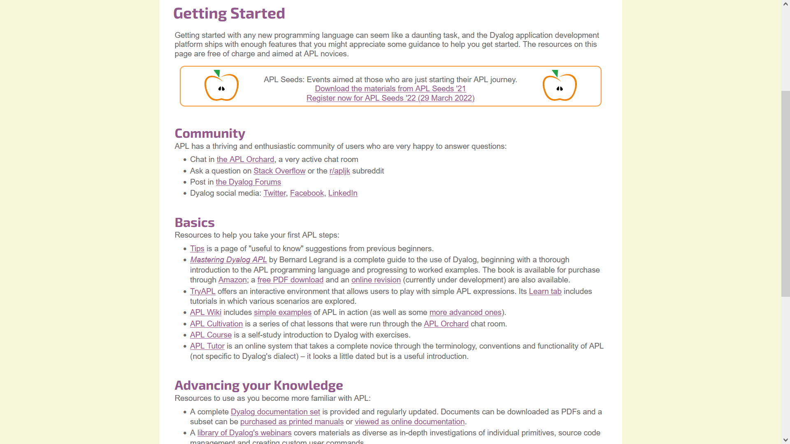

Slide 19
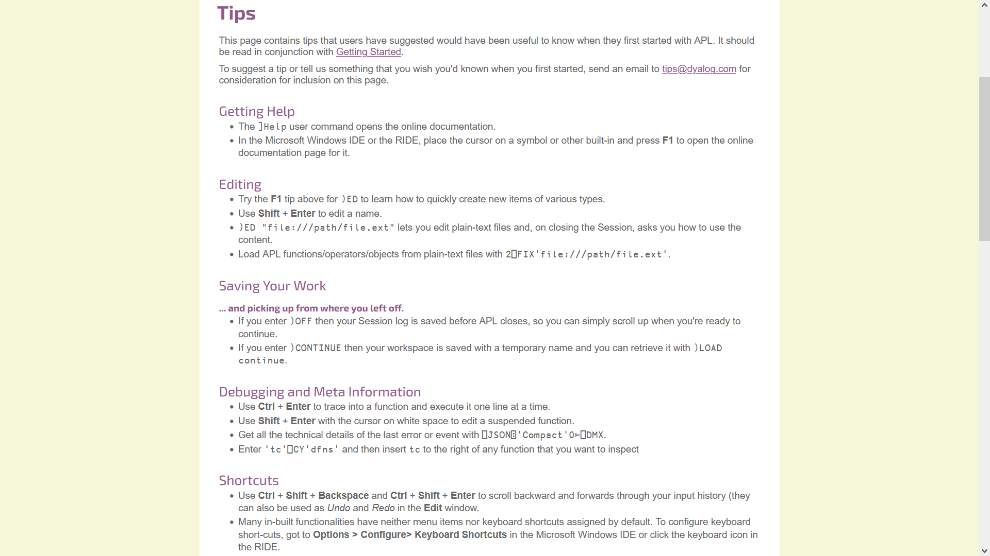

Slide 20
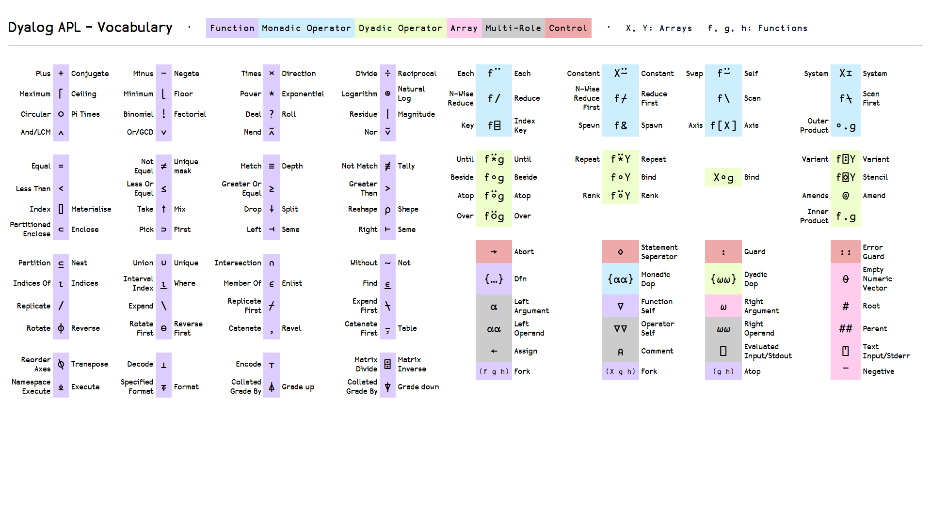
awagga.github.io/dyalog/voc

Slide 21
Learning APL
dyalog.com/getting-started.htm
apl.wiki/learning_resources
mastering.dyalog.com
tryapl.org
dyalog.tv
New: xpqz.github.io/learnapl

Slide 22
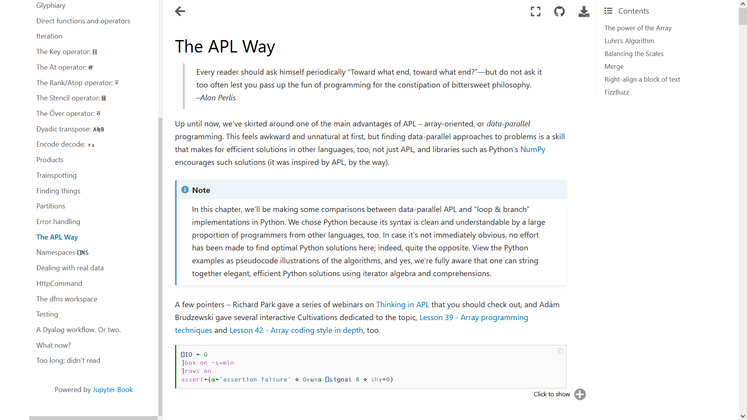

Slide 23
Loamy Earth
dyalog.com/getting-started.htm
apl.wiki/learning_resources
mastering.dyalog.com
tryapl.org
dyalog.tv
New: xpqz.github.io/learnapl
Coming soon: tutorial.dyalog.com revamp

Slide 25
Loamy Earth
dyalog.com/getting-started.htm
apl.wiki/learning_resources
mastering.dyalog.com
tryapl.org
dyalog.tv
New: xpqz.github.io/learnapl
Coming soon: tutorial.dyalog.com revamp
course.dyalog.com

Slide 27
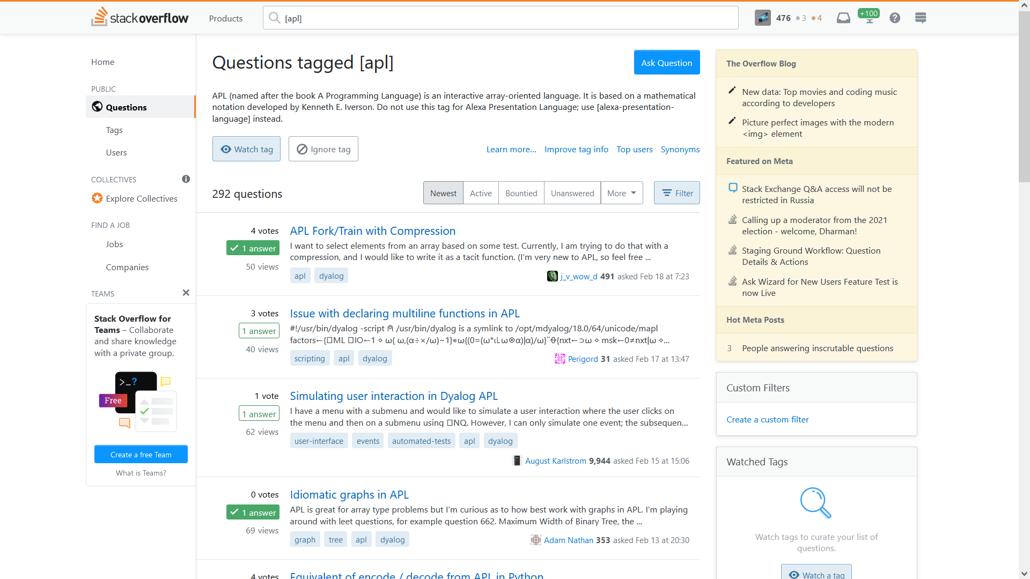

Slide 28
The APL Farm on
discord.gg/cYbMMw5D

Slide 29
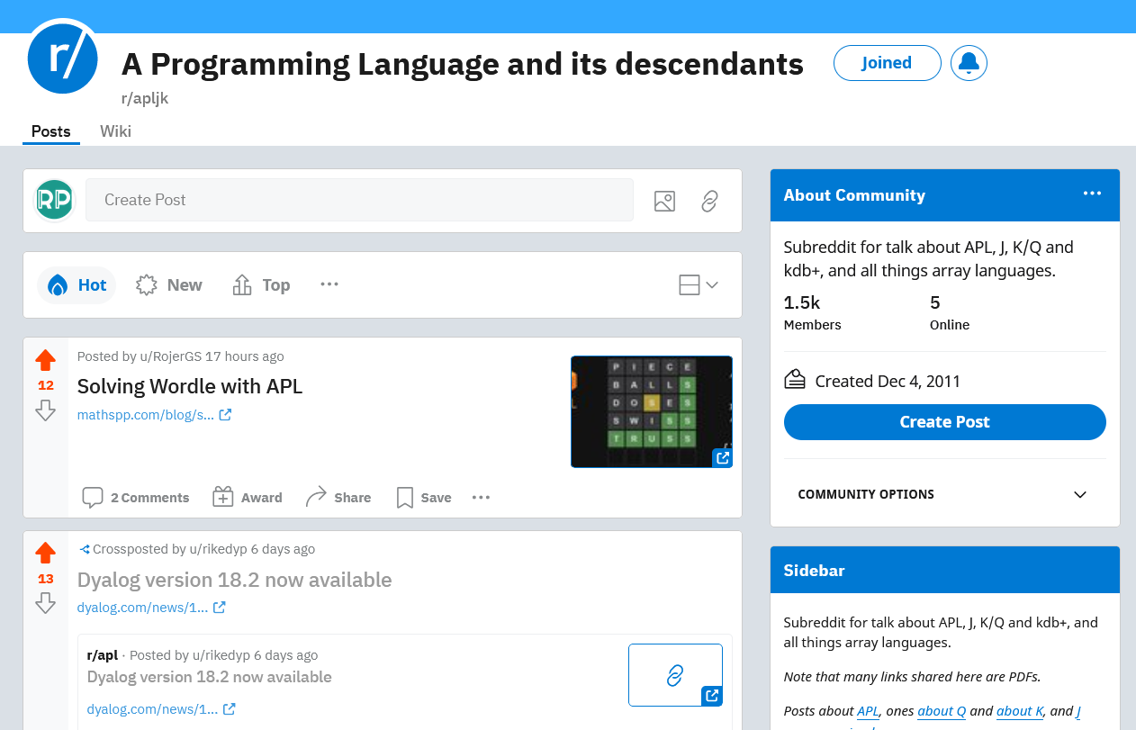
reddit.com/r/apljk

Slide 30
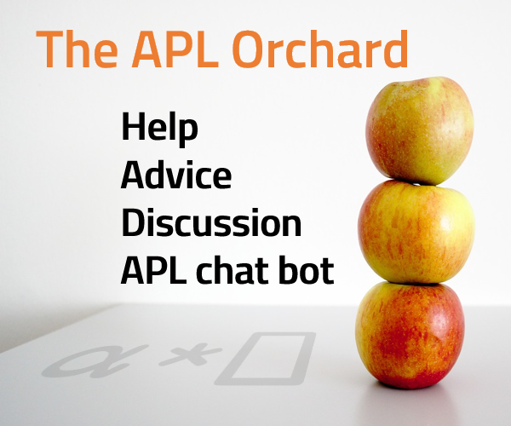
apl.chat
New: Weekly APL Quest!
Fridays at 15:00 UTC

Slide 31
APL Problem Solving Competition
Cash Prizes for Students (Total USD 6,500)
Win free registration for Dyalog '22 Portugal
Spread the word for a chance to win Referral Awards
Meaty Problems
Start now at contest.dyalog.com
Submit by Friday 29 July 23:59 BST

Slide 32
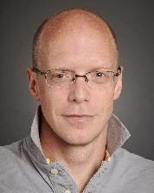
Today's Programme
13:30 Easy to Learn, Worth Mastering
Rich Park
14:10 What's a k-mer?
Stefan Kruger
15:00 April: An APL Compiling to Common Lisp
Andrew Sengul
16:00 The Array Cast
Conor Hoekstra et al
17:00 Zoom Meetup
Room ID: 825 178 58157
Passcode: 175914
Links
apl.wiki/forums
apl.wiki/community

