Slide 1
What the APL is a k-mer?
Stefan Kruger
⍨
Notes:
Hi. Today, I'll show how APL can be a good tool in the field of Bio-informatics -- totally new to me, I hasten to add

Slide 2
I write stuff on array languages
⍨
xpqz.github.io/learnapl
xpqz.github.io/cultivations
xpqz.github.io/kbook
⍣
k
⍨
Notes:
I've dabbled in array languages for a while, and mostly by accident I ended up writing down my experiences. Learn APL was my collated notes from my own learning journey, and since then I've also compiled Adammm Brudzewski's interactive Cultivation sessions into a book, and written a bit about the k language, too. Check them out!

Slide 3
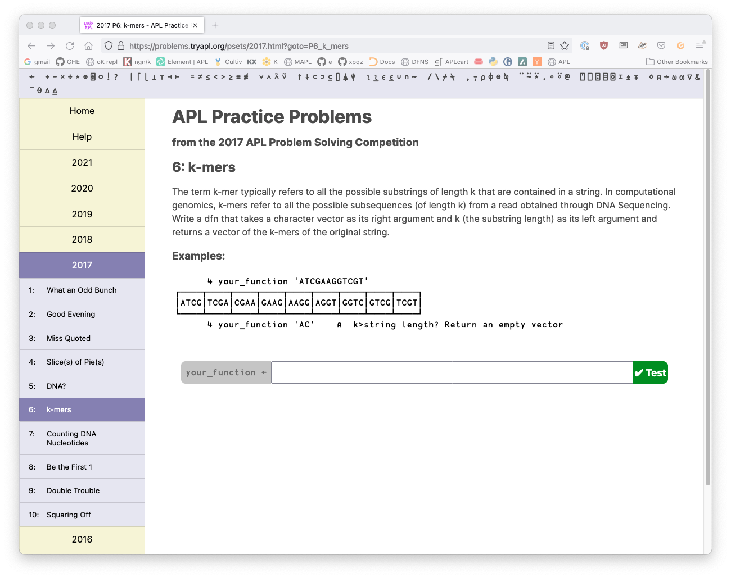
?????
⍨
Notes:
But this talk is about APL in the field of bioinformatics. First, let me stress that I'm no biologist, and I only discovered this fascinating field via the annual Dyalog problem competition, where such problems appear on a regular basis, for example in 2017. And hot off the press, the '22 edition, just launched, appears to have a couple, too. Coincidence?

Slide 4
Bioinformatics?
“
Computational and statistical analysis to decipher biology from genome sequences and related data, including both DNA and RNA sequence as well as other "post-genomic" data
Wikipedia
⍨
Notes:
Wikipedia has the following definition.

Slide 5
Bioinformatics?
A DNA-string is just a vector...
A field ideally suited to learning APL!
...even if you don't know your k-mers from your spliced motifs
⍨
Notes:
But in our context, a DNA-string is just a vector
As such a rich seam to mine if you're interested in exploring APL as a tool for problem solving
As an added bonus, you'll definitely learn some biology, too!

Slide 6
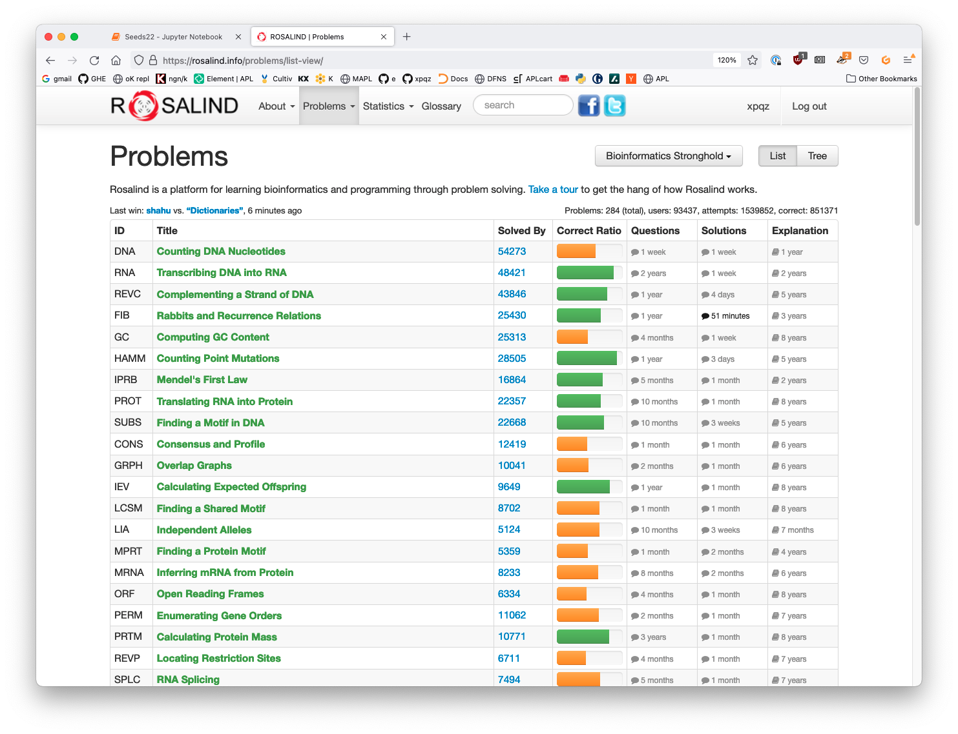
⍨
Notes:
The bioinformatics problems that occasionally appear in Dyalog's competitions are borrowed from, or inspired by, Project Rosalind, a sprawling problem collection. Here's my home screen showing in green text some of the problems I've managed to solve so far. Note also the "correct ratio" coloured bar -- it gives a broad indication of the difficulty of the problem, as does the "solved by" number.

Slide 7
Project Rosalind
Bioinformatics problem collection: rosalind.info
Automated results check; language independent
No walk-over, but solution ratios indicate difficulty
Also: strict 5 min time limit, including data download and result upload
⍨
Notes:
You can find it on rosalind.info.
The way it works is that you pick a problem and randomised test data. You apply your solution in a language of your choice and upload your results. You'll get a thumbs up or down.
Some of the problems are proper hard. Start off on the ones that have a green solution ratio.
Some problems also require significant compute investment -- note that there is a 5 min cutoff

Slide 8
Writing good APL
Clarity > efficiency, where opposed
Actual performance can depend on Dyalog version and actual processor features
⍨
Notes:
Today, I'll try to show code that's clear and obvious. Squeezing top performance out of Dyalog is a bit of a dark art, and whilst clarity is my main aim, I'll try also to highlight how different approaches compare in terms of efficiency. I'm using the last 18.2 beta -- I've not had a chance to update to the actual just released 18.2 yet. And -- as always -- I'm on a low-end, aging Mac.

Slide 9
Skipping this!!
https://problems.tryapl.org/psets/2017.html?goto=P6_k_mers
⍨
Notes:
So let's try solving a few of these kinds of problems, starting with Problem 6 from the 2017 Dyalog competition, and then move on to a couple of actual Rosalind problems.
We're asked to write a function that returns the kmers of a string for a given size -- all possible substrings of length k. And we're skipping the requirement to return empty if k>data length

