Slide 1
Doing boring stuff in APL
User commands, HTTP and JSON
Notes:
Today I’m talking about how I use APL in my day job, doing pretty dull, day to day stuff that you probably would reach for Python or similar languages for. I have gradually over time rewritten a considerable chunk of my utility scripts from Python to APL, and I’d like to show some simple examples on how you could do so, too.

Slide 2
Notes:
When you start out in APL, it’s easy to think that it’s all about maths, super-tight numeric algorithms and array transformations. And don’t get me wrong — this is APL’s home turf, and it’s very good at it.

Slide 3
Notes:
However, at least in my job, problem domains look very different: complexity generally arises from the data, rather than the algorithms you apply. We deal in dirty, incomplete, convoluted data from multiple sources that needs to be cleaned up, and perhaps aggregated, but rarely do we do something more algorithmically complex than sorting and sums.

Slide 4
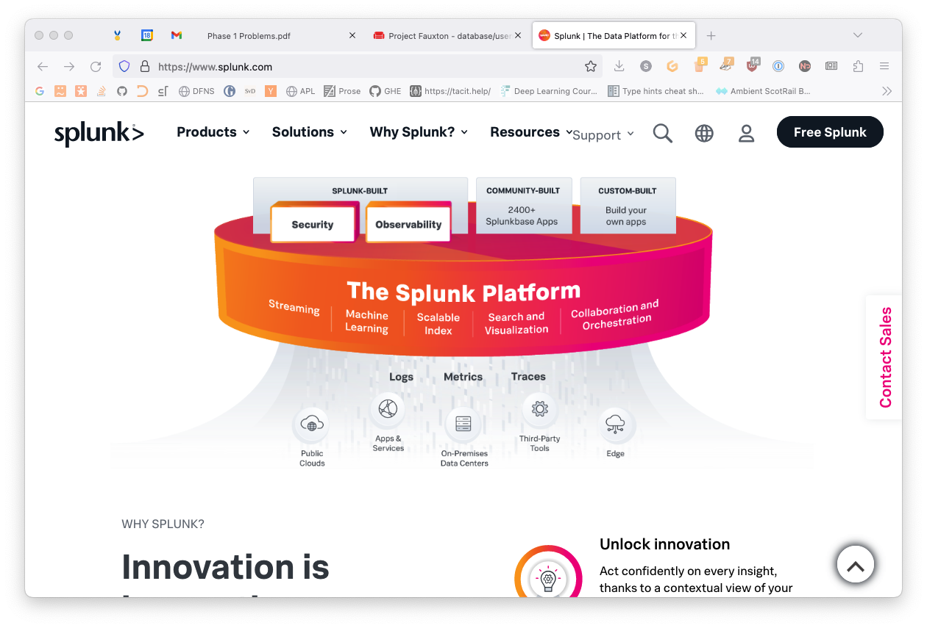
Notes:
Perhaps you need to pull data from a logging aggregator like Splunk?

Slide 5
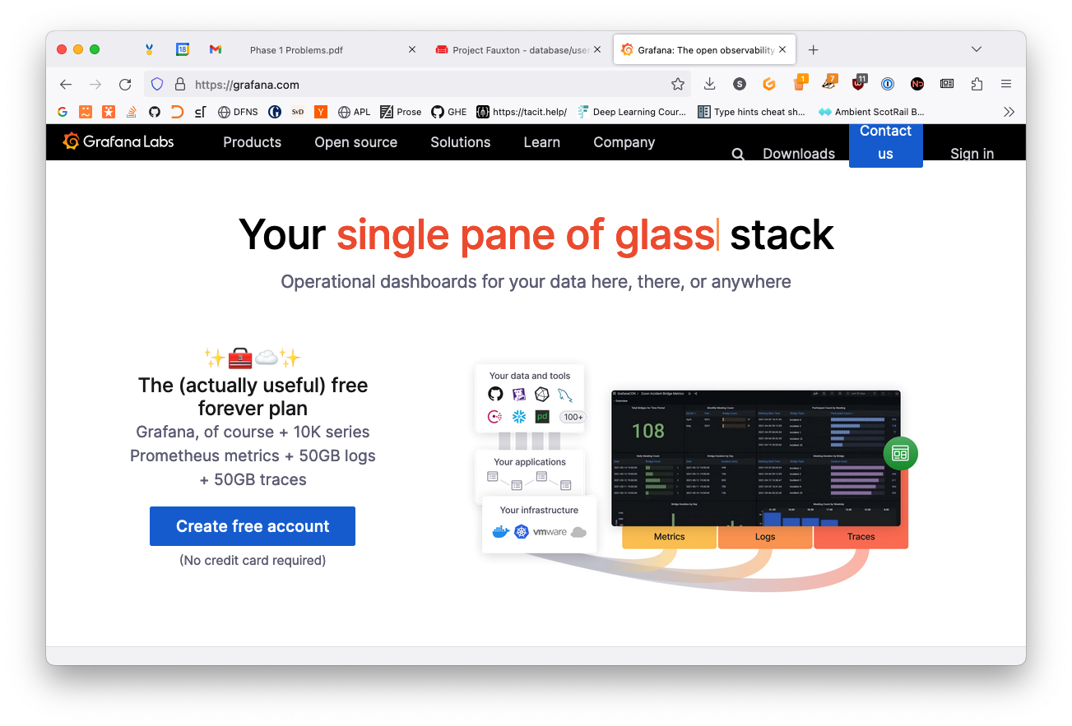
Notes:
…or Grafana?

Slide 6
Notes:
It’s usually messy.

Slide 7
Notes:
…and then query some niche key value store — of which there are many —, and combine the result sets in some way?

Slide 8
Notes:
Why would you choose APL instead of something like Python? Well, as it turns out, APL has an advantage in that once you do get your data into the session, it’s pretty convenient if you want to carry on working with it beyond the functions your program exposed.

Slide 9
Dyalog
CouchDB
GET /{DATABASE}/{DOCID}
Notes:
I’m going to show a simple example that uses a single data source, CouchDB. Our little application honesty won’t actually do that much beyond fetching and displaying data stored in CouchDB. For our purposes, all we care about is that CouchDB exposes an HTTP API that responds with JSON, and as such it can represent a whole class of the types of data sources you probably deal with.

Slide 10
docker run --ulimit nofile=2048:2048 -d -p 5984:5984 \
--env COUCHDB_USER=admin --env COUCHDB_PASSWORD=admin \
couchdb --with-haproxy -n
http://127.0.0.1:5984/_utils
Notes:
I’m running a local CouchDB single node in a docker container on this machine, started with the following incantation. The database console lives on underscore utils.

Slide 11
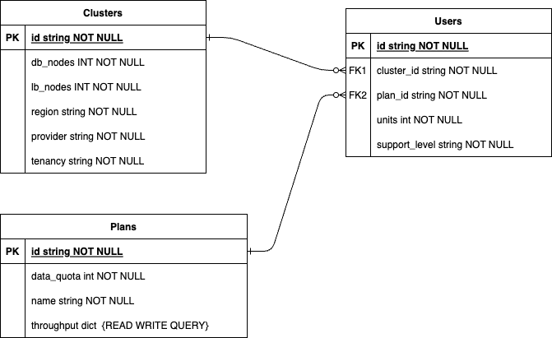
Notes:
So let’s set the scene: we’re the provider of cloud database service that lets users purchase throughput capacity. As the provider, we provision a bunch of servers, called nodes, that group into clusters of different sizes. Each such cluster can host a set of customer accounts, but each account much reside on a single cluster. Each user has a capacity plan, and many users will share a plan.

Slide 12
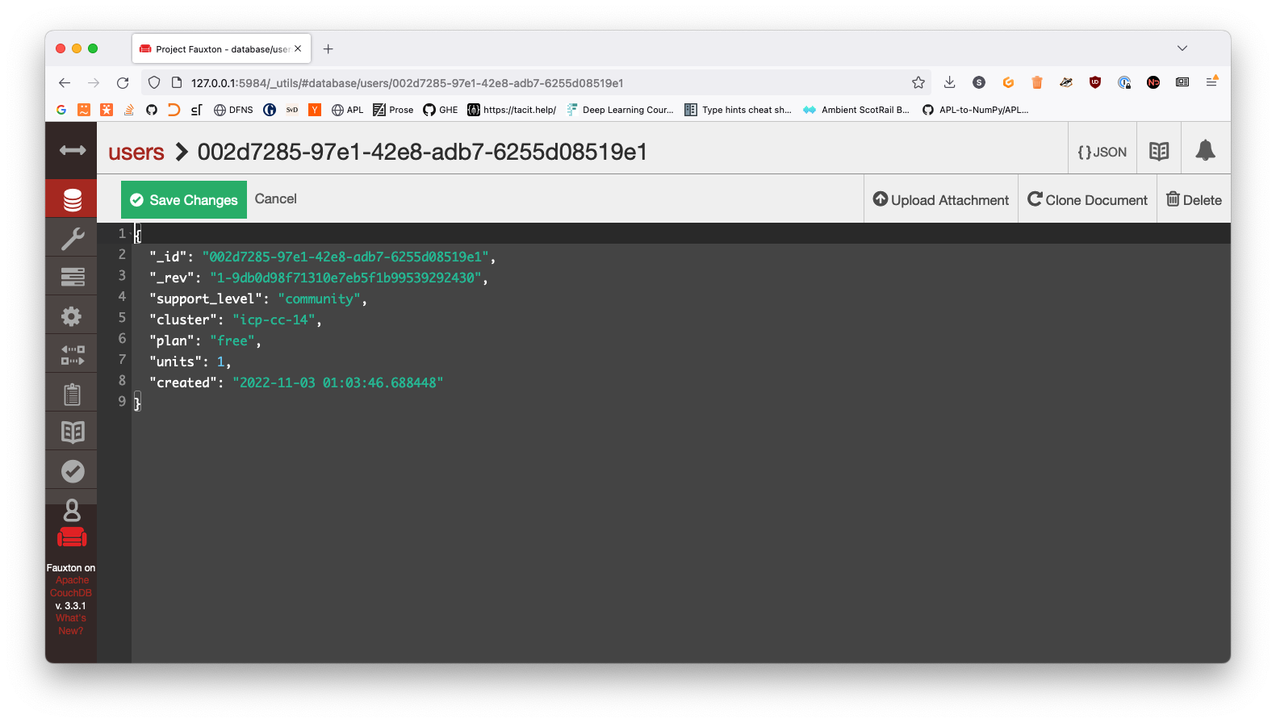
Notes:
Here’s an example of a user document from a local dockerized CouchDB where I’ve generated a bunch of random data for this model.

Slide 13
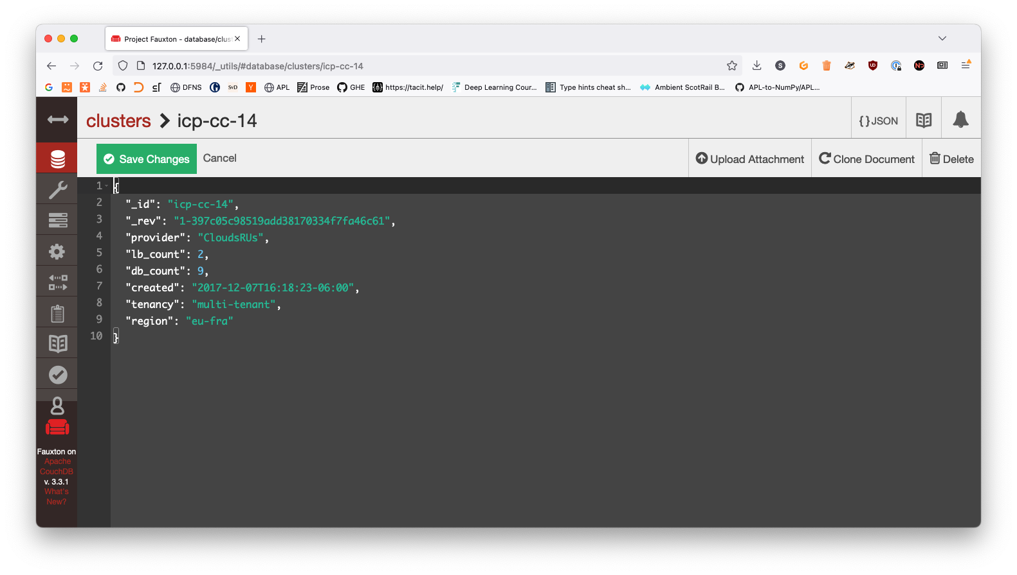
Notes:
And a cluster document. As you can see, it’s just JSON.

Slide 14
Notes:
And finally, an example plan document

Slide 15
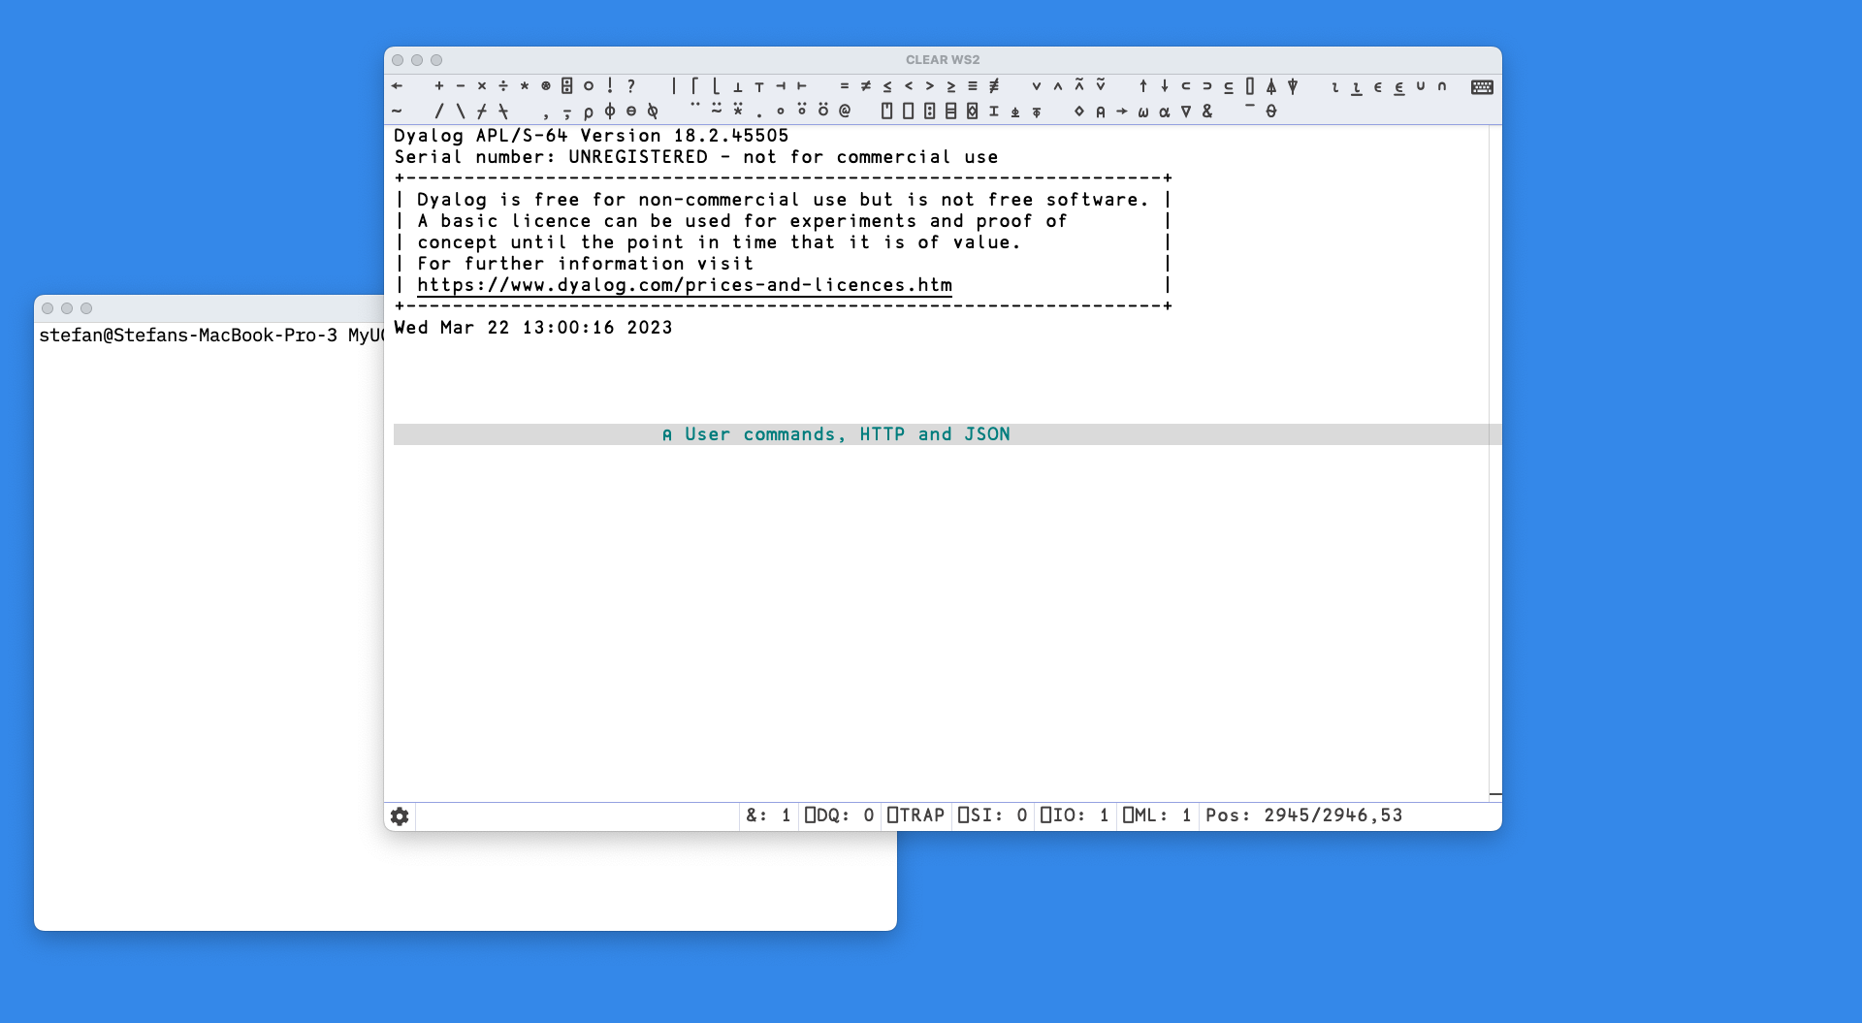
Notes:
So let’s write some code!

Slide 16
Let’s wrap this up
Notes:
Dyalog user commands are convenient wrappers for functionality you want to reuse, and pretty easy to write. They allow you bring datasets into the APL session for further processing. Dyalog’s HTTPCommand and quad-json are very nicely put together, and make dealing with remote JSON data sources a breeze, even if you might not think APL at first for doing such processing.
As an anecdotal data point, one of my Python applications of this type runs to just over 5000 lines, whereas the APL user command version came out as just under 300. It’s not an entirely fair comparison: the python code does a bit more, and is careful with logging and authentication, but still.
Our example was extremely basic — it didn’t really do much apart from fetching data and displaying it as it was. A more real application of this type will probably need to fuse several disparate data sources and run some aggregations.

