Slide 1
Closing Session
Adám Brudzewsky

Slide 2
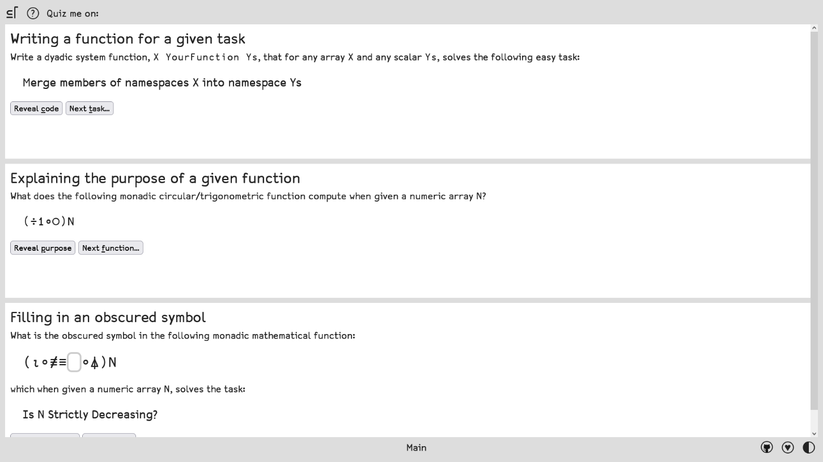
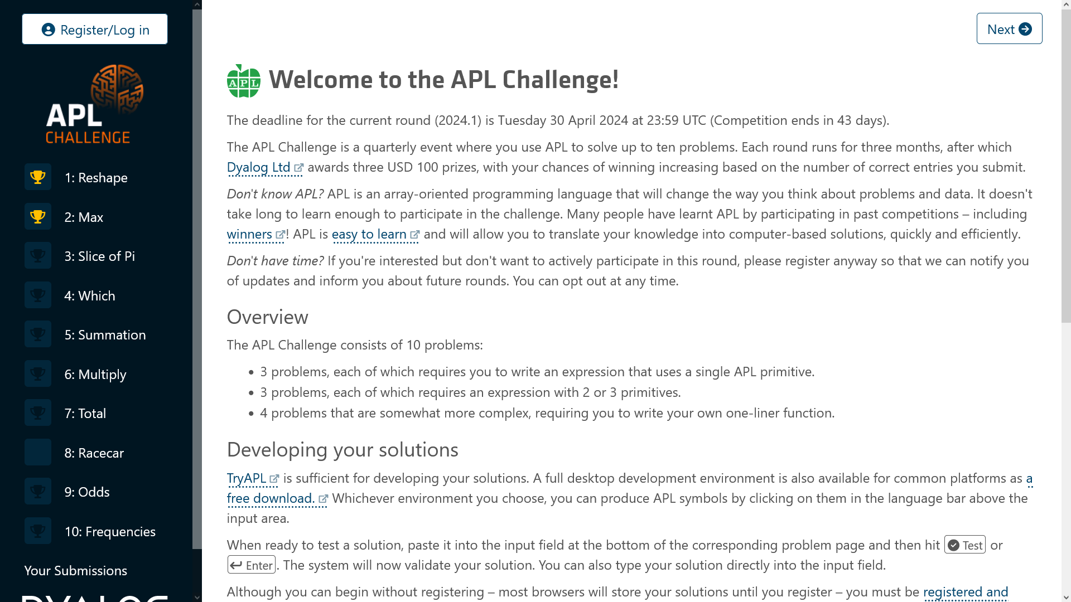
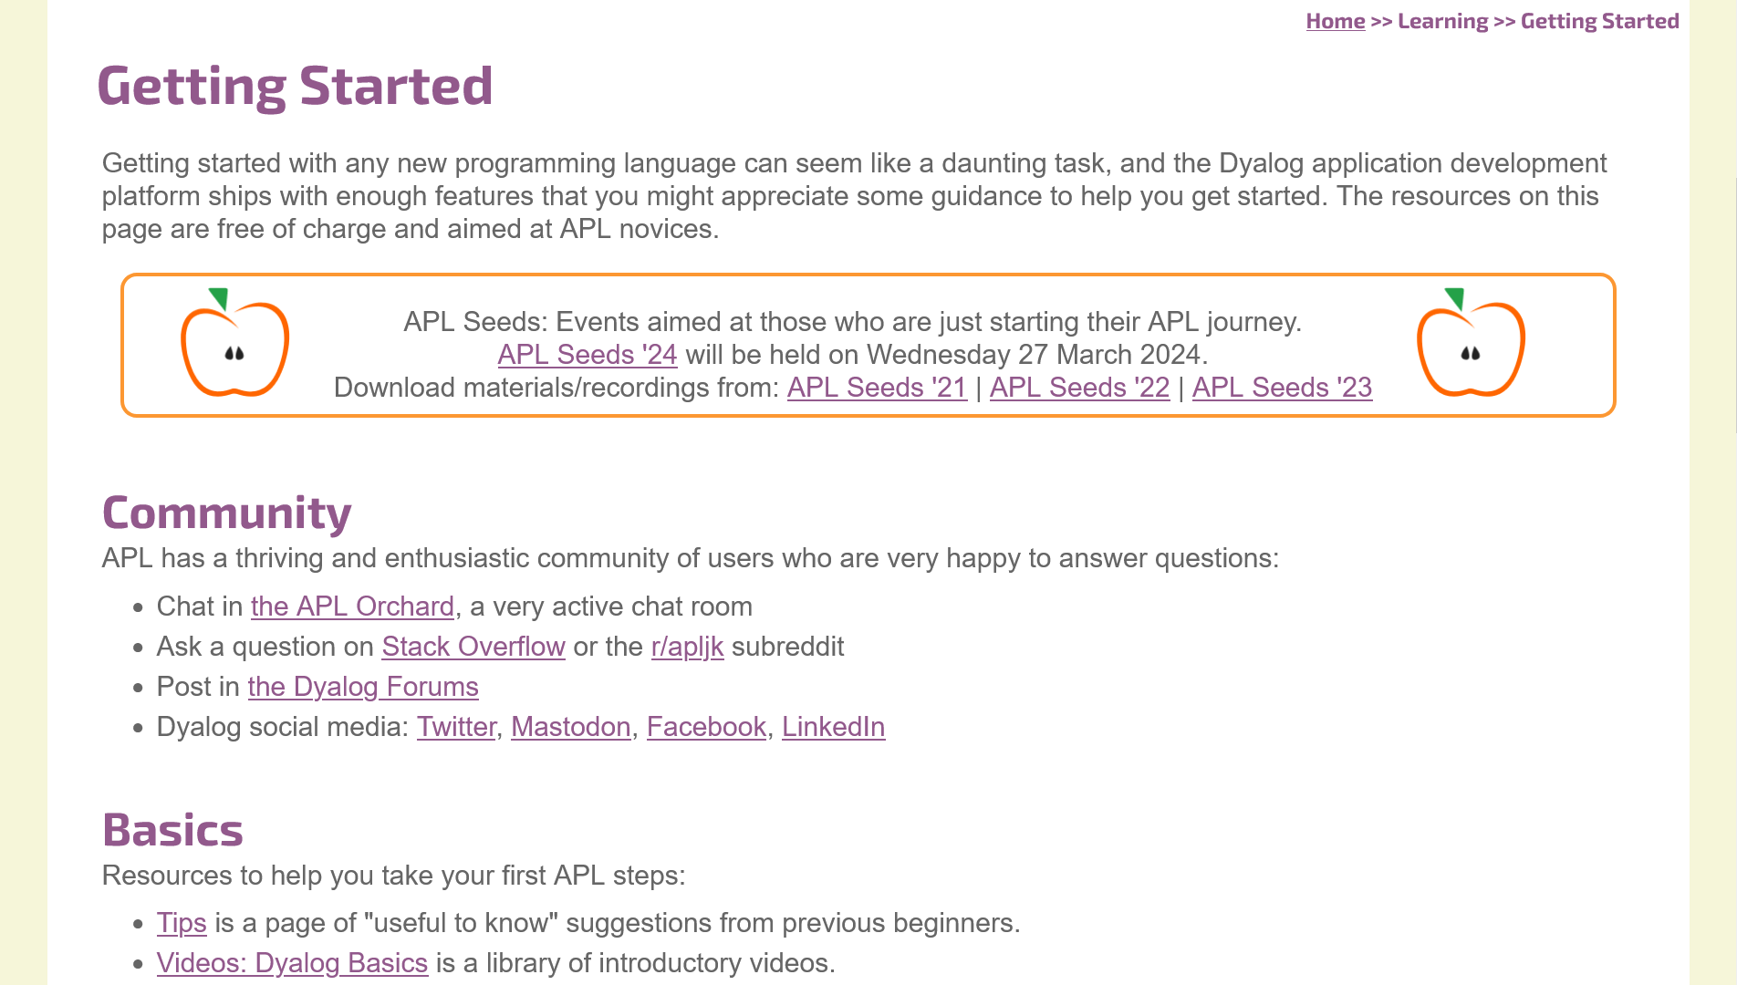
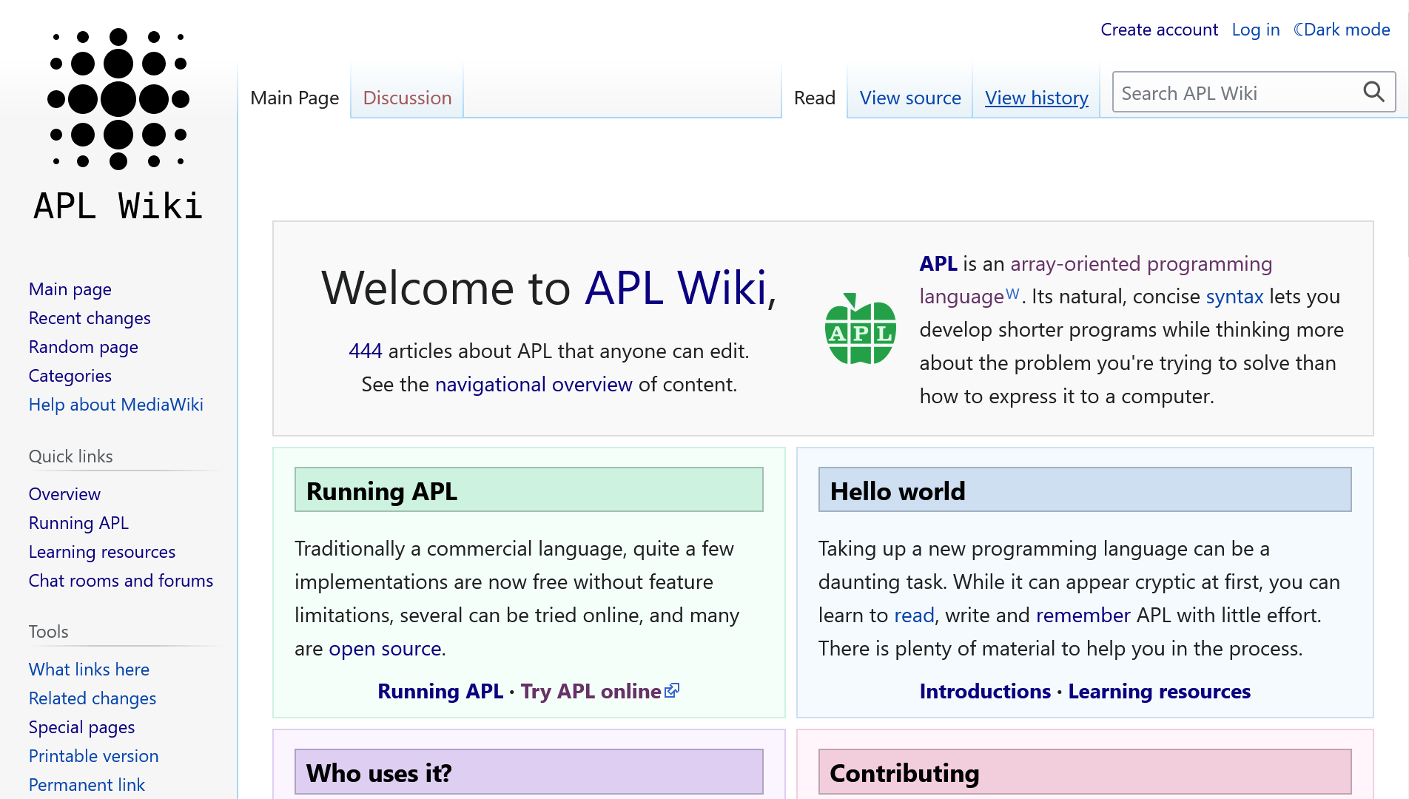
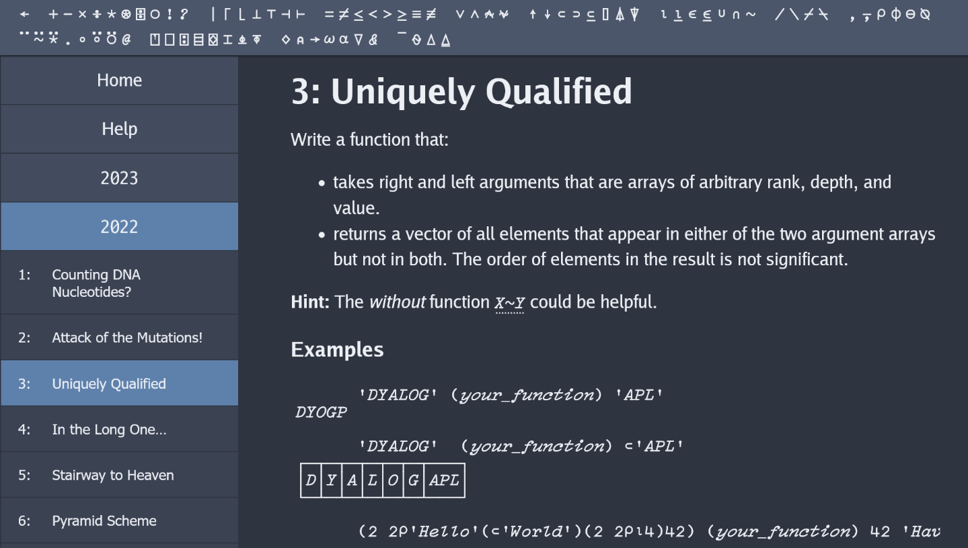
Continuing Your APL Journey
dyalog.com/getting-started.htm
challenge.dyalog.com
apl.quest
aplcart.info/quiz
apl.wiki

Slide 3
👉︎ dyalog.com/getting-started.htm 👈︎

