Slide 1
Parallelization and Tuning

Slide 2
Rough Timetable
09:00-09:05 Introduction
09:10-09:50 Dyalog Tuning Tools (Jay Foad)
Break
10:00-10:45 Parallel Each (Michael Hughes)
Break
11:00-11:30 Tuning Tips (Morten Kromberg)
11:30-? Hands-On Tuning

Slide 3
Introduction
So... Did anyone bring some code for us to parallelize or tune?
Over to Jay

Slide 4
Worth Mentioning
Set process priority to ”high” before doing timings
Get laptop out of ”power saver” mode ☺
Call ⎕WA before doing timings
Parallel I-Beams
]cputime user command
)copy dfns cmpx
⎕PROFILE improvements

Slide 5
Parallel I-Beams
Set #Threads (default=all) 1111 ⌶ threads
Set array size limit (default=32768) 1112 ⌶ size

Slide 6
Tuning Topics
Avoid Repetition
Don’t work close to WS FULL
Consider the Order of Dimensions
Progressive Filtering
Manipulate Indices Rather Than Data
Use composition or dfns with each

Slide 7
Avoid Repetition
:For ...
C[(X=0)/⍳⍴X]←B[(X=0)/⍳⍴X]
:EndFor
I←(X=0)/⍳⍴X :For ...
C[I]←B[I]
:EndFor

Slide 8
Don’t Work Close to WS FULL

Slide 9
Order of Dimensions
bool←1000 1000⍴0 1 1 0 int8←1000 1000⍴⍳127 int32←1000 1000⍴⍳1E6
cmpx 'int32[;index]' 'int32[index;]' int32[;index] → 3.8E¯4 | 0% ⎕⎕⎕⎕⎕⎕⎕⎕⎕⎕⎕⎕⎕⎕⎕⎕⎕⎕⎕⎕⎕⎕⎕⎕⎕⎕⎕⎕⎕⎕⎕⎕⎕⎕⎕⎕⎕⎕⎕⎕ * int32[index;] → 2.1E¯4 | -44% ⎕⎕⎕⎕⎕⎕⎕⎕⎕⎕⎕⎕⎕⎕⎕⎕⎕⎕⎕⎕⎕⎕
cmpx 'int8[;index]' 'int8[index;]' int8[;index] → 1.3E¯4 | 0% ⎕⎕⎕⎕⎕⎕⎕⎕⎕⎕⎕⎕⎕⎕⎕⎕⎕⎕⎕⎕⎕⎕⎕⎕⎕⎕⎕⎕⎕⎕⎕⎕⎕⎕⎕⎕⎕⎕⎕⎕ * int8[index;] → 4.8E¯5 | -64% ⎕⎕⎕⎕⎕⎕⎕⎕⎕⎕⎕⎕⎕⎕
cmpx 'bool[;index]' 'bool[index;]' bool[;index] → 1.6E¯3 | 0% ⎕⎕⎕⎕⎕⎕⎕⎕⎕⎕⎕⎕⎕⎕⎕⎕⎕⎕⎕⎕⎕⎕⎕⎕⎕⎕⎕⎕⎕⎕⎕⎕⎕⎕⎕⎕⎕⎕⎕⎕ * bool[index;] → 1.2E¯5 | -100%
cmpx '+⌿bool[;index]' '+/bool[index;]' '(+⌿bool)[index]' +⌿bool[;index] → 1.3E¯3 | 0% ⎕⎕⎕⎕⎕⎕⎕⎕⎕⎕⎕⎕⎕⎕⎕⎕⎕⎕⎕⎕⎕⎕⎕⎕⎕⎕⎕⎕⎕⎕⎕⎕⎕⎕⎕⎕⎕⎕⎕⎕ * +/bool[index;] → 6.2E¯5 | -96% ⎕⎕ (+⌿bool)[index] → 6.8E¯4 | -48% ⎕⎕⎕⎕⎕⎕⎕⎕⎕⎕⎕⎕⎕⎕⎕⎕⎕⎕⎕⎕⎕

Slide 10
Incremental Filtering

Slide 11
Index Manipulation

Slide 12
Use Composition with Each
If you can’t avoid nested arrays...
T←3⍴⊂1E6⍴¨0.1 0.2 0.3
cmpx '⌊0.5+T' '⌊∘(0.5∘+)¨T'
⌊0.5+T → 1.2E0 | 0% ⎕⎕⎕⎕⎕⎕⎕⎕⎕⎕⎕⎕⎕⎕⎕⎕⎕⎕⎕⎕⎕⎕⎕⎕⎕⎕⎕⎕⎕⎕⎕⎕⎕⎕
⌊∘(0.5∘+)¨T → 6.1E¯1 | -50% ⎕⎕⎕⎕⎕⎕⎕⎕⎕⎕⎕⎕⎕⎕⎕⎕

Slide 13
Maintain Your Skills
Stay Up-to-date with Idioms and Performance Enhancements
Read Classical Texts:
Roy Sykes’ ”Whizbangs”
Bob Smiths ”Boolean Partition” Techniques
Follow comp.lang.apl
Frequent tuning ”challenges”

Slide 14
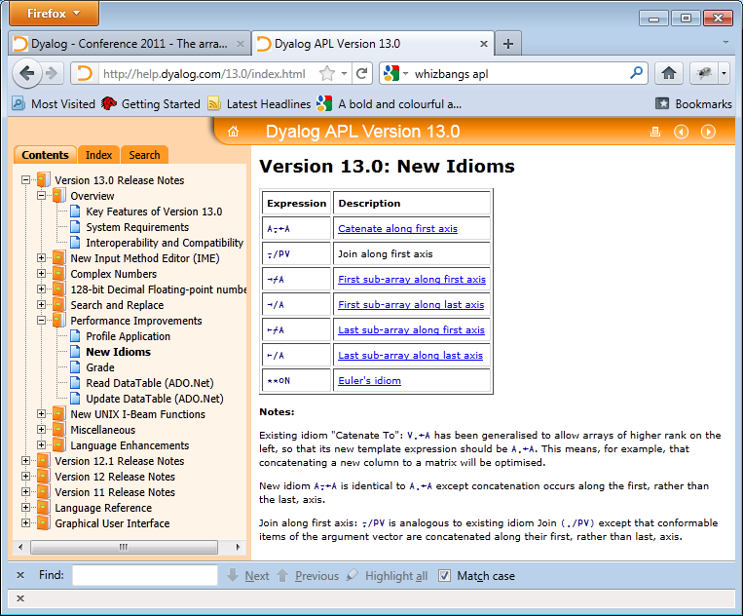
Stay Up-To-Date with Idioms

Slide 15
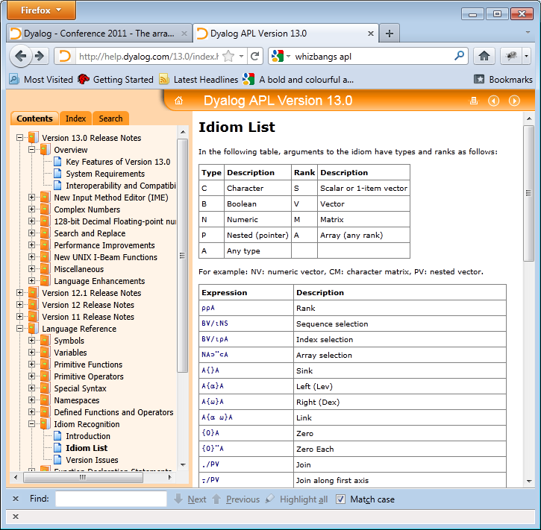

Slide 16
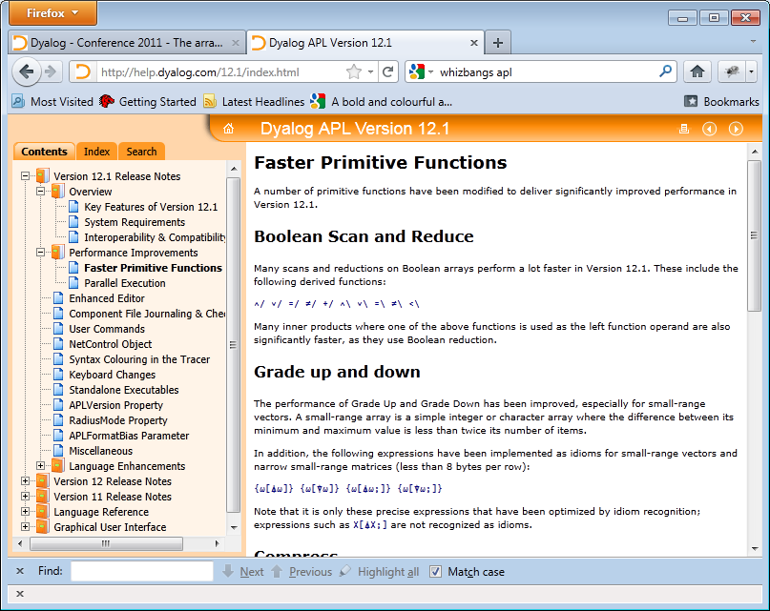
Read the Release Notes

Slide 17
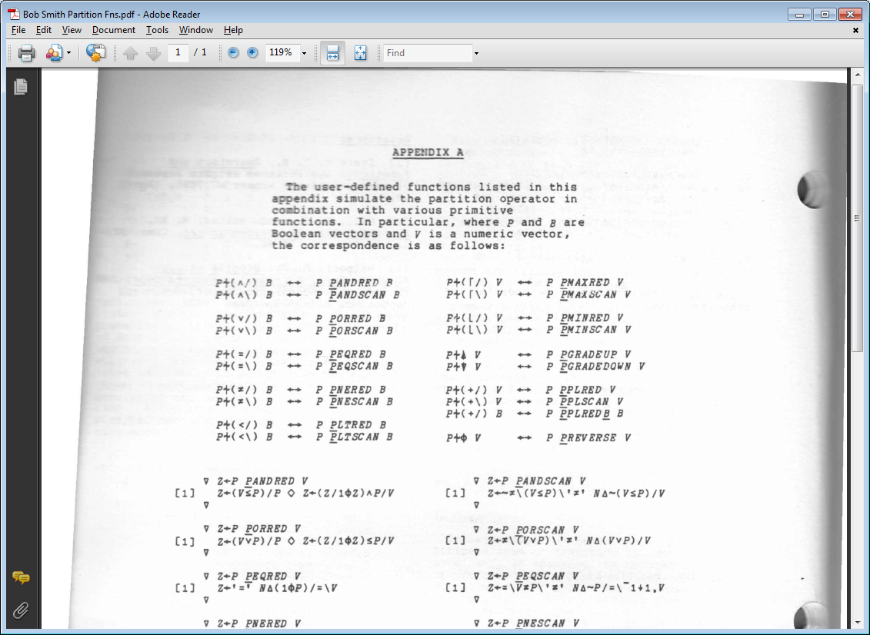
Read The Classical Texts

Slide 18
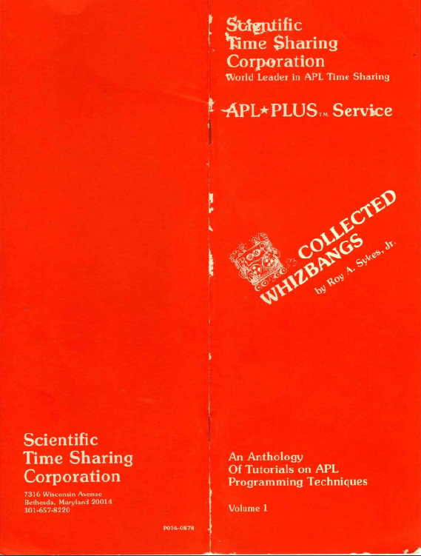
Still Highly Recommended!
APL Plus
Collected
WhizBangs.pdf
(Roy Sykes still rocks!)

Slide 19
Beware of Old Techniques...
Some techniques are obsolete ...
⍷ and ⎕S/⎕R replace old ”text tricks”
Dyalog APL suports scatter-point indexing
Many tricks to avoid dyadic ⍳ are no longer necessary
Nested Arrays vs Partitioning

Slide 20
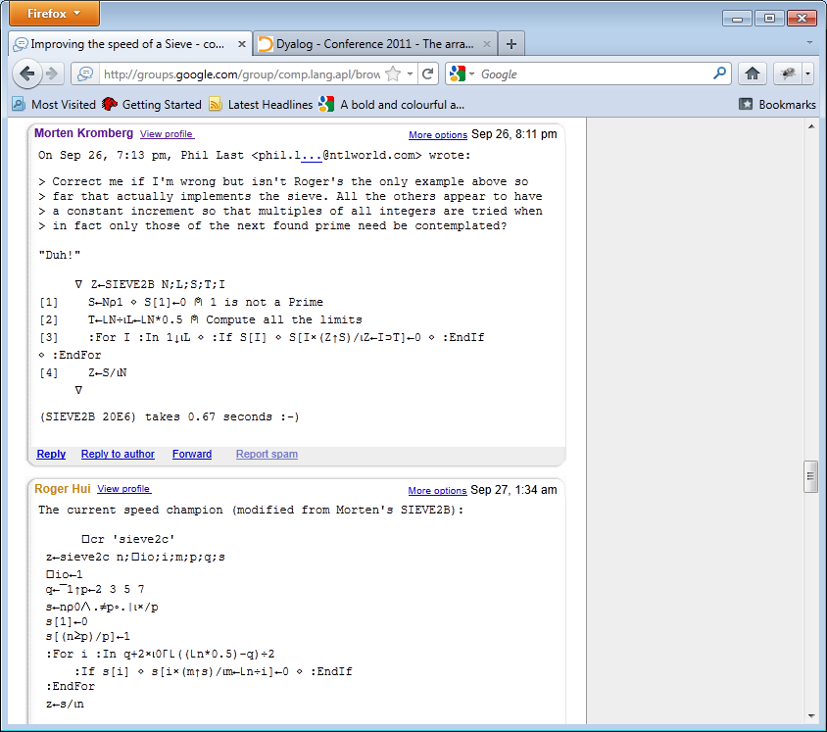
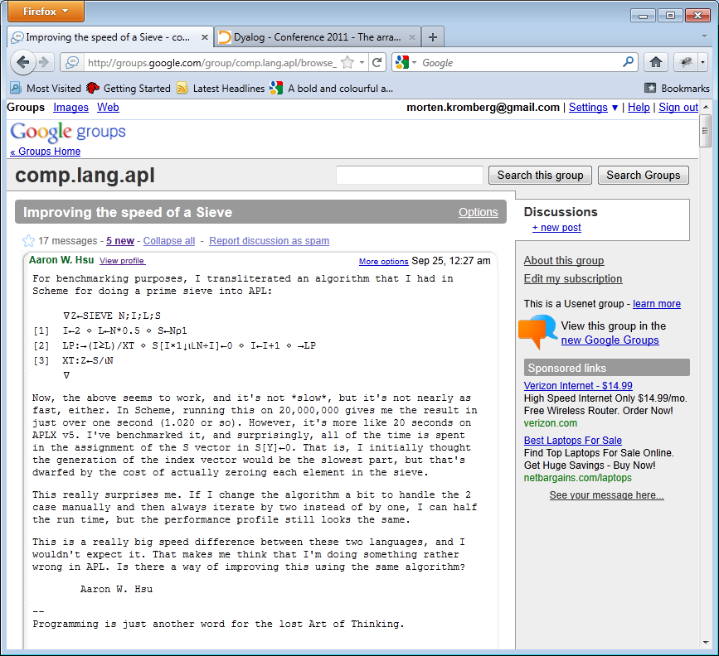
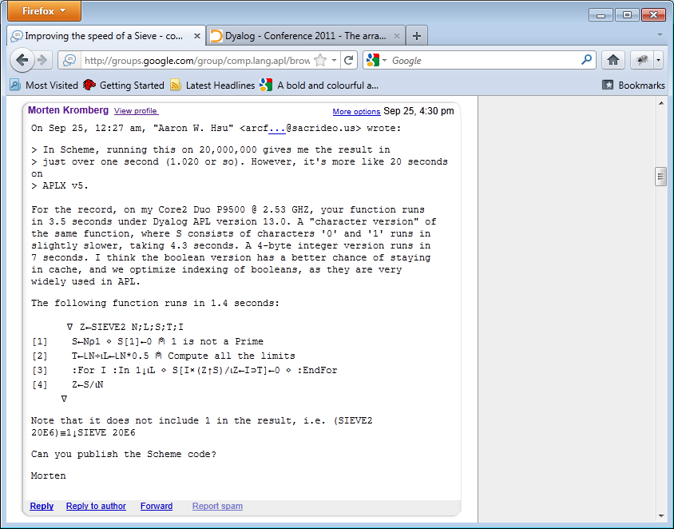
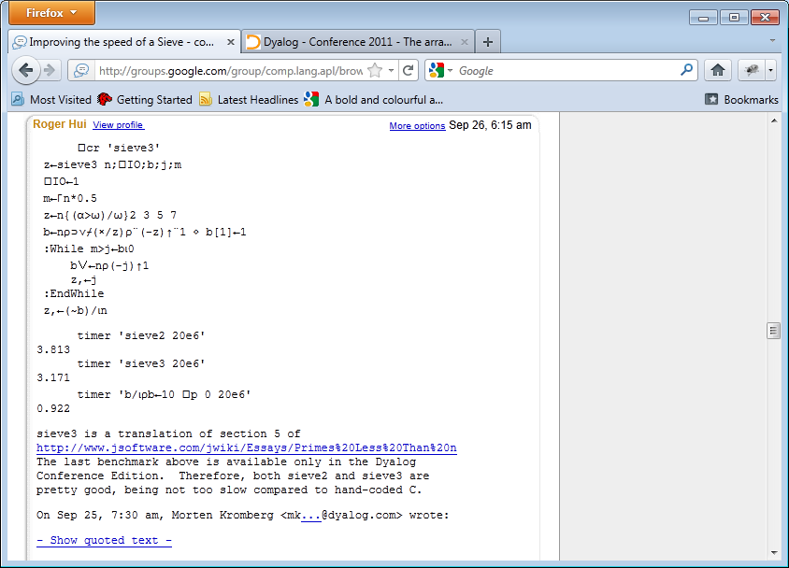
Follow comp.lang.apl

Slide 21
Tuning Examples

Slide 22
