Slide 1
Migrating APL2 Mainframe to Dyalog APL
Jonas Stensiö, Peter Simonsson, Lars Wentzel
Aplensia AB

Slide 2
Hercules Story
We have recently migrated a 20 years old VM mainframe APL2 system to a Dyalog APL Windows platform
It has been done during a short period of time and without major changes in the system functionality or its user interface.
Notes:
Hercules Story
We had the large Hercules system that was over 20 years old. It was based on IBM mainframe VM and APL2. Just over a week ago the migration to Windows was ready. Now the new system is up and running. It is on Windows and based on Dyalog APL.
The migration was done during a short period of time. We haven't done any major changes in functionality of the system.

Slide 3
What is Hercules?
The Volvo Cars system for planning of car production
The main output is the monthly Master Production Schedule
The Long Range Plan – 9 years – is also done here
It manages capacities – production and material
Notes:
What is Hercules?
Hercules is the Volvo Cars system for planning of the car production.
The main output is the monthly master plan: MPS – Master Production Schedule. It is a detailed plan of how many cars with a detailed specification are to be produced per market, factory and week during the next 13-15 months. The plan is done based on market requirements, available production capacity and material supplier capacity on critical components. The main use of the plan is to break it down to Bill Of Material, which is used to send out material forecasts to the suppliers.
Hercules also contains other functions e.g.
- Functions for Long Range Planning – 9 years
- Handling of production and material capacities used for order slotting and for checking theforecasted volumes.

Slide 4
Hercules Main Functions
Market Plans
Order Scheduling
Capacities
Information Distributer
Master Production Schedule
(MPS)
Hercules
Analysis
Long Range Plan (LRP)
Excel Clients
Guidelines for Orders
Notes:
Hercules Main Functions
This is an overview of all the functions of Hercules. In addition to the previously mentioned functions Hercules does we have
Market Plans – Retail Orders, Retail Deliveries and Wholesale Deliveries – as a first step to make the industrial plan MPS - and in order to do financial planning.
Guidelines for ordering made for the ordering system. Based on order capacities it will give the expected lead time for each order and thus you can present the customer with a delivery time.
For many users within Volvo Cars there are general analysis functions for the volumes plans.
The information is not only used within the Hercules system but distributed to other system for e.g. Material Planning, Data Warehouse functions etc.
For some functions we use Excel with Add-ins working towards a central server.

Slide 5


What is Volvo Cars?
A well known premium car company
The core values are quality, design, environment and safety
Head office and product development in Gothenburg
Main production sites are Ghent, Gothenburg and soon Chengdu
Car production last year 450 000.
Notes:
What is Volvo Cars
Volvo Cars is a well known car company producing cars in the premium segment. On the picture you see the latest presented car, which is a relatively small car called V40 Cross Country.
The core values of Volvo Cars are quality, design, environment and safety. Volvo cars is since long well-known for being a leading maker of advanced safety systems.
The head office and product development is in Gothenburg.
The main production units of cars are in Gothenburg, Ghent and soon in Chengdu in China.
Last year – 2011 – around 450 000 cars were produced.
Volvo Cars is now owned by Chinese investors mainly from the Chinese automotive company Geely.

Slide 6
Hercules Figures
Number of users: 300
Lines of code: 425,000
No of user screens: 468
No of tables: 290
Many integrations with 17 other systems
Notes:
Hercules Figures
Hercules is a very large system. Volvo Cars has a way of describing the size of a system by counting the number of users, lines of code, screens, tables and integrations.
The number of direct users are not so high. There is a small core of expert users that do most of the work. The remaining user mostly analyze data.
The number of lines of code is very high. This is partly because all the basic code for screen handling is generated by the code generator Dialog. But there is also lots of complicated logic for batch runs intricate interactive functions as well as some automatic services. Most of the code is APL but part is also VBA-code in the Excel add-ins. From earlier done comparisons we know that one line of APL code will do as much as 5-10 lines of code in other languages.
Hercules interact with 17 systems using several integrations with each system.
Hercules uses 25 on-line services (web-services) towards the product data system in order to handle all configuration rules.
It gets information from other system like order and sales statistics.
It sends out the plans and other information to be used elsewhere.

Slide 7
Original Technology
Mainframe VM IBM APL2
SHAREFILE/AP from Manugistics
Bought tools for searching (rowfind) and editor
GDDM for 3270 screens
Interactive Excel add-ins using an APL server
Dialog code generator
A large set of base and standard functions
Web-services towards the product data system
Files sending and receiving using the in-house Volvo VCOM
Notes:
Original Technology
The Hercules system used traditional technology common with most mainframe APL2 systems i.e. APL2 and GDDM.
But in addition to this we used a number of special components that we needed.
All data storage was handled by the Sharefile/AP component file system once developed by Manugistics. This was an essential tool to handle the planning data which is the core of Hercules.
I addition to this we use a mainframe version of ROWFIND. It was specifically ordered for Hercules and developed by Manugistics.
Other bought components were the iedit and powercode functions developed by Interprocess.
For all handling of dialogs the Dialog code generator developed by Cybex was used.
For most of the file transfer the Volvo in-house tool VCOM was used.

Slide 8
The Ideas Behind Migration
Discussions started 4 years back
System is working well. Continuously enhanced and updated
No plans to create a new system
Technology was declining. Support for several components poor or non-existent
Running costs were high
No possibility to develop a new user interface
Wish to harmonize APL platforms at Volvo Cars
Notes:
The Ideas Behind Migration
The migration discussion started four years back. The system was working well and we continuously updated and enhanced the system.
There were no plans to replace Hercules. The car industry was in trouble. This included Ford, the owner of Volvo Cars at that time. There was also a history of failures of some large system development projects to replace other systems. So it was not a time to make a new system.
At the same time the technology in Hercules was declining. The upgrades of APL2 were few. The owner of Sharefile was a very small company with limited support. Some of the other components were totally without support.
Running cost were high in the mainframe. We had experience with another system that we could run an APL system much cheaper using a Windows server.
There was no possibility to develop a new Graphical User Interface, we were stuck with GDDM and 3270 screens.
Finally Volvo Cars IT wanted to harmonize the APL platform used in this system and some other important APL applications in order to better support them in the future.

Slide 9
Focus
Secure the platform
Migrate rather than re-write
Do it quickly
Notes:
Focus
In order to secure the platform the decision was to migrate the system rather than re-write it.
It should also be done during a limited time.
From that point we can move on to change more.

Slide 10
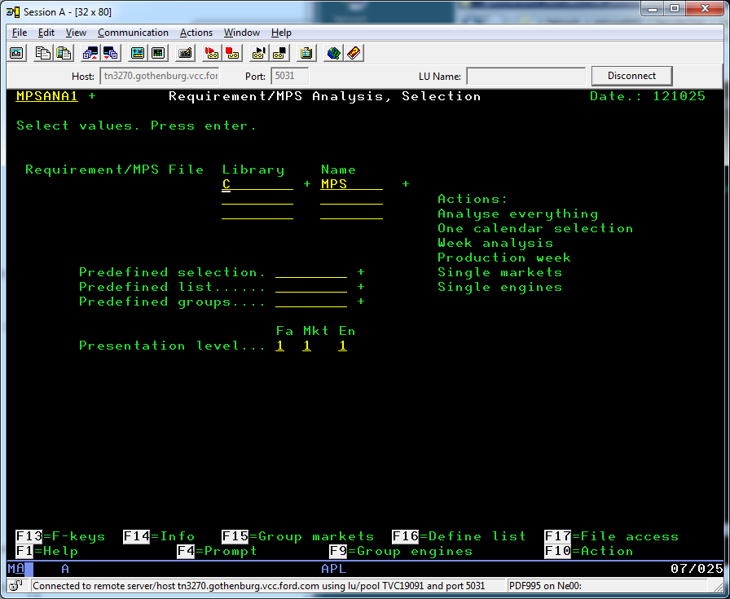
Old User Interface
Notes:
Old User Interface
This is an example of the old user interface.

Slide 11
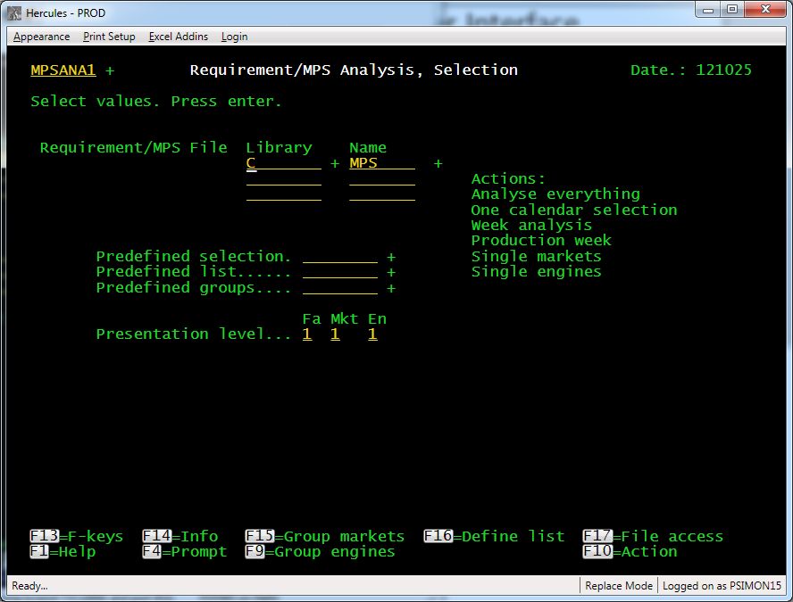
New User Interface
Notes:
New User Interface
And this is the same screen with the new user interface in Windows.

Slide 12
What We Did
Dyalog APL Windows
Code migration – syntax differences exist
New naming conventions using name-spaces
3270 screen emulation
Dyalog File Server
Authentication
Integrations using WebSphere MQ
Batch process handling
Notes:
What We Did
What we did was to move all the APL-code from APL2 to Dyalog APL. There are a number of problems with this e.g. that syntax differences exist. More about that later.
We wanted to fully utilize the name-spaces so we put packages of functions in name spaces. Functions for file-handling were called FI∆GET. With namespaces they are now called #.fi.Get.
In order to move forward quickly we decided to not re-write the more than 400 screens. So we needed a 3270 emulator in Windows. The idea was that a new GUI can be introduced step by step if where required and there is money for it.
We had decided to use thick clients so lots are things are processed in the users workstations. So we needed a replacement of the old Sharefile system from Manugistics. The main reason not to use the Dyalog component files directly was that we needed to protect the files.
The authentication needed to be solved in a new way.
For the integrations which were sending and receiving files we wanted to get out of the in-house VCOM system and move over to the new standard WebSphere MQ. This required some extra work.
We also needed to solve the batch process handling so we copied a solution for another APL system.

Slide 13
Before Migration
CPAM
VM Hercules
Other systems
User Session
Performs all interactive operations
Batch
sessions
User PC
Global Client
PC Communication
3270
Sharefile server
Stores code and data.
Excel add-in
Excel server
MVS
VCOM
SNA
External
communication
Notes:
Before Migration
Before the migration the users logged on to their own user sessions in VM using IBM Personal Communications.
For some specific tasks there were Excel add-ins used to pull data out into Excel, work with it there and then send it back into Hercules.
The Excel add-ins where serviced through HTTP-queries by four server sessions running in VM.
There where also a number of sessions to handle batch jobs and processing of incoming files.
Communication with other systems all went through MVS using a mix of different technology, but most of them used the in-house VCOM.
All data storage as well as the major part of the application code was stored in SHAREFILE.

Slide 14
After Migration
CPAM
Windows Hercules server
Other systems
Client/Excel server
Handles login, sending of mails,
forwards queries to other systems,
submits batch jobs, et.c.
Batch
queue
User PC
Client
Emulates 3270.
Logs on to client server.
Fetches code from server.
Does all processing
except for batch jobs
Dyalog File server
Stores code and data.
MQ
Handles all
external
communication
Excel add-in
Notes:
After Migration
After the migration the users log on by starting up an application execuatble installed on their PC. The executable fetches all code from the server, thus it has no application logic and only needs to be replaced for Dyalog upgrades.
The client is a fat client, i.e all processing of data (except batch jobs) in the application is done locally in the client, and the server is only contacted to perform tasks that the client cannot do itself, such as sending mails, send queries to other systems, sumbit batch jobs, et.c.
SHAREFILE has been replaced with Dyalog File Server.
We have developed (or rather adapted the existing solution from another system) batch queue handing and set up all external communication to go through WebSphere MQ.

Slide 15
Code and Data Transfer
SHAREFILE -> Dyalog component files using SCAR (Self-Contained Array) and FTP
ATS function from IBM and the SCAR functions in SQAPL workspace from Dyalog.
Code in transfer format, ⎕TF
Full and incremental data transfers
To save time during go-live.
6 hours to transfer 30GB of production data
Notes:
Code and Data Transfer
For transfer of code and data from VM to Windows we have made use of SCAR (Self-Contained Array) format.
On the VM side we created a set of functions to read the SHAREFILE component files, convert them to SCAR using the ATS function supplied by IBM and writing the result into CMS files. The files where then sent over to Windows through FTP, picked up on the Windows side, converted into APL using the SCAR functions in Dyalog’s SQAPL workspace and saved into Dyalog component files.
The configuration file aplunicd.ini had to be tuned somewhat to get all character correct, but with that done this was a very quick way of moving data. Total time to transfer 30GB of production data and converting it into Dyalog component files was about 6 hours.
For transfer of code we made use of the same functions, only with the additional step of first converting the code into transfer format using the []TF function in APL2. The transfer format of the code was written down into component files that were transferred and read into Dyalog APL where variables and functions were created by simply doing an execute on the transfer format strings.
To save time on the go-live weekend we first did a full data transfer one week ahead, saving a record of files transferred and the update timestamp each file had when transferred. Then on the go-live weekend we only needed to retransfer files that had been changed since the complete transfer one week earlier.

Slide 16
Code Migration
Code language differences, e.g.
  Selective assignment more limited in Dyalog - (A/B)[;⍳3]←
  Nesting of left argument for bool/¨A B
  Index Range - A B[x]
Additional functionality differ, e.g.
  Formatting
  Error trapping
  Optional left argument in functions
Namespaces and new naming conventions
  New names on functions
  New function calls
Notes:
Code Migration
Code migration was needed for three main reasons
There are several language differences that you have to take care of and actually change the code.
The three main differences are:
Selective assignment in Dyalog is much more limited. You cannot e.g. do the following: (A/B)[;⍳3]←
Compress ¨ is a bit funny in APL2 and Dyalog is different. bool/¨A B can be done in APL2 while in Dyalog you must enclose the boolean vector.
Index range is different and if you write A B[x] in APL2 you must write A (B[x]) in Dyalog.
Additional functionality like formatting, error trapping and optional left argument in functions are different.
Naming and namespaces.
We wanted to use namespaces for groups of functions. All our basic functions needed to be renamed and all calls to them needed to be changed.

Slide 17
Code Migration Tooling
Automatic translation
A large part could be done this way
Diagnostics
To find use of incompatible code requiring a manual re-write
Migrated code generator creates new code
Notes:
Code Migration Tooling
Our wish was to migrate the code as automatic as possible. For this purpose we developed tools that automatically changed the code. This was possible to a high degree but for e.g. the selective assignment problem, for formatting and error trapping we could not do it easily. So we developed tools to find these special situations and give diagnostic messages for them and then they were rewritten manually.
The code generator was re-written to generate code with correct Dyalog syntax and using the new namespaces and naming conventions.

Slide 18
Testing and Testing Tools
Low level testing
Focus on running through all lines of code.
In basic functions we tested all lines using monitor function
System testing
For core dialog code we used an extended interactive tool using monitor.
System integration testing
Testing all sending and receiving to and from other systems.
Comparing the results.
User testing
A user reference group did this.
Running new and old systems in parallel
Notes:
Testing and Testing Tools
Testing for was done in several ways. The basic thought about testing was the original code was correct and that the logic was there from the old system. But since we needed to change parts of the code manually it was necessary to test that this was done correctly. The basic approach was to run through all or most lines of code.
At the real low level we did actually run through each single line of code. This was done with our basic functions and standard functions altogether 600-700. For this we used a small set of functions utilizing the ⎕MONITOR function in Dyalog APL.
On a higher level of the system we concentrated on a core set of interactive user functions – dialogs. These were also tested using an extended and more interactive tools also using ⎕MONITOR.
System integrations testing was of course important since we had changed all file sending and receiving to use MQ. This meant a lot of work with the other systems and with Integration Center at Volvo Cars IT. A large part of this was testing.
Finally we had user testing by a reference group. This also prepared the users for the switch over. The user tested the 3270 emulator, the performance and did catch remaining bugs. The last two weeks the old and new systems were run in parallel with the same data.

Slide 19
3270 Emulation
Emulation rather than rewrite
More than 400 screens
Windows Presentaion Foundation (WPF)
Chosen over ⎕SM and Dyalog APL GUI.
Subset of GDDM (Graphic Data Display Manager)
Features of IBM Personal Communications
Block selection of text on the screen, being able to position the cursor anywhere, freely resizable window, etc.
Excel OLE Automation
Notes:
3270 Emulation
Rather than rewriting the user interface of over 400 screens, we decided to emulate the 3270 user interface.
Some first attempts were made with the Screen Map ([]SM) functions in Dyalog, but given it had some problems and Dyalog not being very keen on supporting it for the future, we eventually decided to go for developing our own emulator with Windows Presentation Foundation (WPF).
As the application only made use of as small subset of the GDDM (Graphic Data Display Manager) functions, implementing a basic emulation of it was fairly straight-forward. But implementing everything around it that users were used to from IBM Personal Communications took a lot more time. Block selection of text on the screen, being able to position the cursor anywhere, freely resizable window, etc.
The application also made use of some graphics functions to produce on-screen graphs, but that was early decided to be unnecessary given that no one actually used those function any more - Excel had taken over.
A lot of work is being done in Excel, thus there is a need to get data from the application into Excel. One way is the Excel add-ins and another is export of data from the application screens to Excel. In VM that was done by sending the data in Excel format (or actually tab-separated values saved as .XLS) as mail attachment to the users inbox. With the move to Windows we could instead make use of the Excel OLE object thereby adding the option to directly open an Excel sheet filled with data. That also added the possibility to do some formatting of the produced Excel sheets.

Slide 20
Dyalog File Server
Provides the same functionality as SHAREFILE
Only minor code changes needed
Data over the network means small reads get costly.
Testing
  Functional testing
  Load tests
Notes:
Dyalog File Server
For data storage we needed a replacement for SHAREFILE/AP. While the component files in Dyalog APL provides almost the same functionality as SHAREFILE/AP does, there was a need for a secure and robust client/server setup.
Here we got help from Dyalog with the development of DFS (Dyalog File Server).
With the use of DFS only minor code changes were needed in the application. There were changes in the calling of the F-functions (FTIE, FREAD, etc) of course, but we also needed to make some adaption of code that made excessive amounts of data accesses.
In VM the access to data was local and hence a large amount of small reads took no time at all. But since with the DFS data is sent over the network those small reads get costly.
Extensive testing was necessary since the DFS was being developed in parallel with our migration project and partly based on our requirements. This included both functional testing as well testing performance, stability and load.

Slide 21
Authentication
Domain user id instead of ACF2-ID
IWA (Integrated Windows Authentication)
Available with Conga 2.3. We made our own implementation to also handle Excel addins (VBA).
SSPI (Security Support Provider Interface)
Used to establish an authenticated connection between client and server using a challenge-response protocol (NTLM).
No need for the user to logon
Notes:
Authentication
On VM everyone had an ACF2-ID to logon with, and this was also used for the Excel add-ins. On Windows we needed to make use of the domain user ids and for that we needed an authentication mechanism.
We took lesson from Dyalog’s development of the DFS, where they decided to implement IWA (Integrated Windows Authentication) as part of Conga (which is now available for everyone with the official release of Conga 2.3). Based on their code we implemented the same authentication method for use both between clients and server as well as between Excel add-ins and the server.
The solution makes use of SSPI (Security Support Provider Interface) to establish an authenticated connection between client and server using a challenge-response protocol (NTLM).
The big advantage of using IWA is that the users don’t have to log on to the specific application. Instead the user credentials of the current logged on Windows user is used. Thus, only if you need to log on as a different user from the current Windows user, you have to enter username and password.

Slide 22
Integrations
WebSphere MQ
Most integrations where changed to use MQ.
Migrated in two steps
  First outbound integrations. Connections were set up to send to receiving systems with no changes required in these.
  On go-live the old system was shutdown and configured to forward all incoming files to the new system.
  After successful go-live the inbound integrations where switched over one by one.
FTP
Web services
Notes:
Integrations
Most of the integrations made use of the in-house developed solution VCOM. All these integrations as well as a few using other methods such as VM Sendfile where changed to use WebSphere MQ, which is today the standard solution at Volvo Cars.
All the integrations were prepared, configured and tested well in advance in both Test and QA environments. In production the migration was executed in two steps.
First, before go-live, all outbound integrations were set up and tested. From the new production environment simple ping-tests were done by sending a small test file to each downstream system, just to verify the connection. Up till this point (with one exception) no changes were required in the receiving systems production environments.
During go-live, the old system was shutdown and instead configured to automatically forward any incoming file to the new system.
Then, after successful go-live, the inbound integrations were switched over one by one. Over a period of two weeks one system at a time installed changes to start sending to the new system instead of the old one.
For a few integrations that were using FTP already we have for now kept it. These of course required no more effort than a simple change of FTP parameters.
Same goes for web-services, nothing more than configuration changes was needed.

Slide 23
Project Organization and Manning
Early stage with preparation and technical ideas
Peter Simonsson, Lars Wentzel Hercules staff
Morten Kromberg Dyalog. DFS etc.
Final project
Project manager part time
Technical project manager and team leader Satyam.
Two developers Satyam Code migration
Peter Simonsson Technical set up and components
Michael Hughes 3270 emulation and authentication
Dyalog File server, authentication, misc.
Lars Wentzel Minor testing and reference group
User reference group
Steering group

Slide 24

Swedbank
One of Sweden’s largest banks
Organizational structure
Stand-alone banks
Notes:
Swedbank
Our second client is Swedbank. It is one of the largest banks in Sweden.
It has a somewhat atypical organization structure. The corporate group consists of a large number of companies. In addition to this, it is connected to a number of stand-alone banks with whom it shares IT resources (applications).
Here follows the presentation of the migration that we did for Swedbank.

Slide 25
MARS System
Management Accounting and Reporting
Internal financial control and reporting
External financial statement
Organizational structure
Two types of users:
Administrators
End-users
Notes:
MARS System
The MARS system is used for management accounting and reporting. Most of the reports produced by the system are for internal use. The system also delivers data that is used to produce the external financial statement.
The system is also the supplier of the organizational structure. The structure is used to produce reports for different organizational units and levels.
There are two types of users, administrators and end-users. Administrators are responsible for designing and producing reports. End-users are using the system to view reports.

Slide 26
History
System dates back to the 80’s
Excel add-in created in 2001
Windows client application in 2006
Server application migration in 2010
Notes:
History
The system dates back to the 80’s. In the beginning, it was a single APL workspace which each user opened in its own session. Reports were created and could be viewed in the session.
In the year 2001, an Excel add-in was created. Now end-users could connect to an APL2 server and get the reports directly into Excel. Administrators still worked in APL sessions.
Back then, there were no intentions to shut down the mainframe but it was decided that a new Windows user interface should be built for the administrators. This was more of a new application than a migration. All parts of the old user interface were to be included in the new application. But most functions were redesigned with greater usability in mind. Also, many new functions have been added to this application over the years.
In 2010, the migration of the server application was initiated. The main motivation was to cut costs.

Slide 27
MARS Figures
Number of users: 4,500
Administrators: 8
Transactions per month: 350,000
Transactions per day (peak): 35,000
Lines of code: 260,000

Slide 28
Client Application
Dyalog APL
Windows MDI application
One application - many sub applications
Demo
Notes:
Client Application
The client application is written in Dyalog APL. It is a classic Windows MDI application. It consists of a number of sub applications for various purposes.

Slide 29
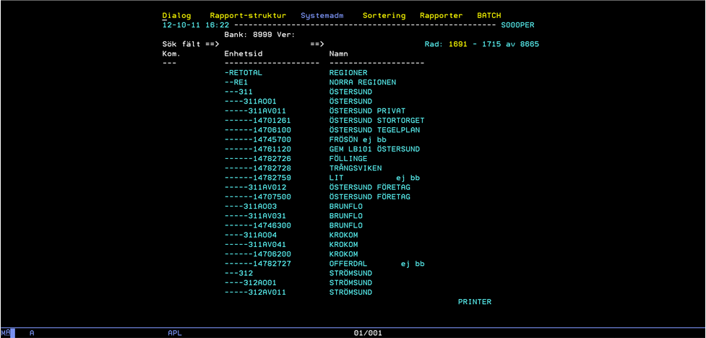
Old User Interface
Notes:
Old User Interface
This is an example of the old user interface. It shows the dialog for editing the organizational structure.
Each line represents an organizational unit. The tree structure is visualized by the dashes in the left column. Lines can be cut and pasted, but there is no easy way to actually move a unit from one place to another.
Editing the details of a line, in this case a unit, typically involves opening a new dialog.

Slide 30
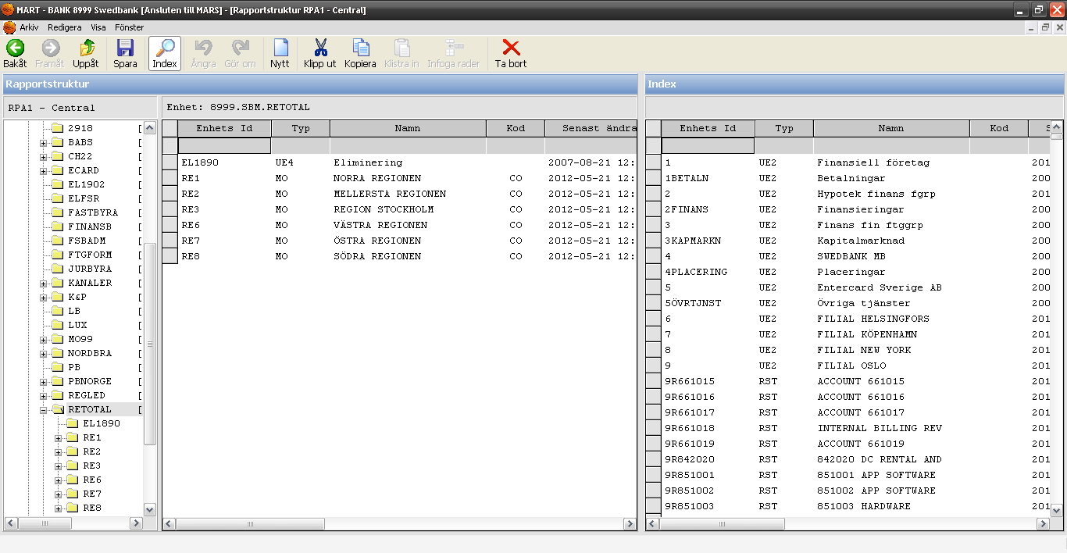
New User Interface
Notes:
New User Interface
This is an example of the new user interface. It shows the dialog for editing the organizational structure.
The tree structure is visualized in the tree view to the left. The selected unit is displayed in the middle. The idea was to make it look like the Windows Explorer. On the right is a table of all units in the organization.
Units can easily be moved from one place to another. Undo/Redo functionality everywhere in the application.
We make heavy use of the Grid control. Anywhere where information can be presented in table form we use the Grid control.

Slide 31
MARS - Server Application Migration
Cutting cost
Performance at least equally good
More modern environment
Version handling
Authentication and encryption
Notes:
MARS - Server Application Migration
The project was started with the motivation of cutting cost.
Performance and stability should be at least equally good.
Moving to a modern environment was desired.
Code should be version handled.
Client applications should use secure methods for authorization and authentication (and messaging).

Slide 32
Result
Costs were reduced from €1.4M to less than €200k
Performance doubled
Virtual machine
Notes:
Result
After the migration the hardware costs had been reduced from €1.4M to less than €200k. The performance had roughly doubled.
The new server runs in a virtual machine. It and has already been moved once from one data center to another. The move was performed without any downtime.

Slide 33
Before Migration
User PC
MART client
Dyalog APL
Excel add-in
VM MARS
MARS server
APL2
Master session
7x Slave sessions
z/OS
DB2
Solaris
Teradata interface
Dyalog APL
CMS file system
Stores code, batch jobs
and log files.
SUSE
VM Batch
APL2 Batch sessions
Teradata
Notes:
Before Migration
This is a picture of the architecture before the migration.
The client applications communicated with the APL2 server. Requests were sent using the HTTP protocol without encryption. Security was poor because the user id was sent along with the message and authorization was based on that.
The server consisted of 8 APL2 sessions working in parallel to handle requests. Some requests could initiate batch jobs. Batch jobs were created in the file system and handled by VM Batch sessions.
The system uses two shared data sources. One of them is DB2 which is directly accessible from VM using an IBM SQL workspace. The other is Teradata which could not be directly accessed from VM. In order to access Teradata, we used a Dyalog APL server. The server was running on UNIX and relayed SQL requests to Teradata using the Dyalog SQAPL interface.

Slide 34
After Migration
User PC
MART client
Dyalog APL
Excel add-in
Windows MARS
IIS
Integrated Windows Authentication
z/OS
DB2
MARS server
Dyalog APL
Master process
15x Slave processes
SUSE
File system
Stores code, batch jobs
and log files.
Teradata
Notes:
After Migration
This is a picture of the architecture after the migration.
To increase the application security, we decided to use Integrated Windows Authentication. Back then, there was no support for this in Conga. Therefore, we decided to use IIS on the server. Client applications communicated with IIS which in turn relayed the requests to the Dyalog server.
IIS handles all the security. Messages are encrypted and the user is properly authenticated with the Windows user id. This is a single sign-on system. The user does not need to log on when using our applications.
The Windows server consists of 16 Dyalog processes. We have implemented a Windows service that is responsible for starting all the processes and keeps them running.
Since there is no VM Batch in Windows, we had to implement our own batch handling. We did this in the Dyalog server so batch jobs are executed just like regular requests.
Finally, we used the Dyalog SQAPL interface to access our data sources. This eliminated the need for the UNIX server.

Slide 35
Load Balancing and Batch Handling
Master-Slave model
Requests are categorized as slow or fast
Batch job is a third type
Separate queue for each type
Separate set of slave processes
Batch queue on disk
Child jobs
Notes:
Load Balancing and Batch Handling
The server uses the Master-Slave model. One master process controls 15 slave processes.
When a request comes in, the header is received by the master. The master enqueues it and assigns it to a slave when one is available. The slave then fetches the header and the body of the message. The body of the message never goes through the master.
All valid requests are categorized as being slow or fast jobs. A fast job should not take more than a few seconds to be executed. Slow jobs, on the other hand, may take some minutes and are more likely to be waiting in queue. Batch jobs are categorized as a third job type.
The master has three job queues, one for each type. Each queue has a dedicated set of slave processes. This ensures that jobs that are categorized as being fast, never get queued up very long. This also ensures that batch jobs are executed independently of regular requests.
The batch queue is stored in the file system. In case the server goes down or is restarted the batch queue is restored and the jobs are resumed.
A job can create new batch jobs. In this case, the newly created jobs become children of the first. The parent is not considered to be completed until all child jobs have completed.

Slide 36
AXML
XML format for APL arrays
Handles any APL array except those containing pointers
Messaging between Dyalog APL and APL2
Messaging between servers and clients
Storing APL data in text files
Example:
’Hello’ ’World’ => <nested>Hello<b/>World</nested>
Notes:
AXML
We have developed an XML format for APL arrays. We call this format AXML. It can serialize any regular APL array. The only exception is arrays containing objects or other types of pointers.
The format was developed in order to simplify messaging between our Dyalog client and APL2 server. A request may contain an AXML serialized array in the body of the message.
When communicating with APL2, one needs to take the different character encodings into account. We choose to implement our own character translation functions for this.
This format is also used in communication between our server processes. Furthermore the format is used to store data in text files. Now that we no longer communicate with APL2 we have replaced the character translation functions. We now use UTF-8 encoding instead.

Slide 37
Subversion
Implemented own Subversion tool
Code modules
Module dependencies
Functions and classes as text files
Variables as XML files
Load/Save workspace
Notes:
Subversion
We use Subversion for version handling of workspaces. For this we have developed a tool.
Code is divided into modules. In our Subversion tool, a module is a directory. A module can contain functions, classes, variables and subdirectories. When loaded into Dyalog APL each module has its own root namespace. Subdirectories represents sub namespaces.
Modules can have dependencies to other modules. When a module is loaded, all of its dependents and their dependents and so on are also loaded.
Functions and classes are stored as regular text files. This is done in the same way as in SALT. Variables are stored as XML files using our AXML format.
A session is started by loading a module, the project main module. When this happens a workspace is created dynamically. Different projects can share the same code modules.
When changes are made in the workspace, the tool keeps track of those changes. Saving the workspace means saving those changes. Working with the tool is much like the regular way of loading and saving a workspace.
With the tool you can also make commits, full or partial, directly from within the Dyalog session. If a module is loaded, namespace names can be used to specify what to commit.

Slide 38
Lessons Learned
Start with the existing developers
Use external specialists
Clean up the system
Set up and learn your new platform
Organize your code
Prepare the tools
Find technical traps including performance
Migrate a minor system first to learn
Involve users and other systems
Decide on testing and testing tools

Slide 39
Aplensia
info@aplensia.com

