Slide 1
October 20-24

Slide 2
Robot Wars Andy Shiers Jason Rivers Morten Kromberg
Dyalog’13

Slide 3
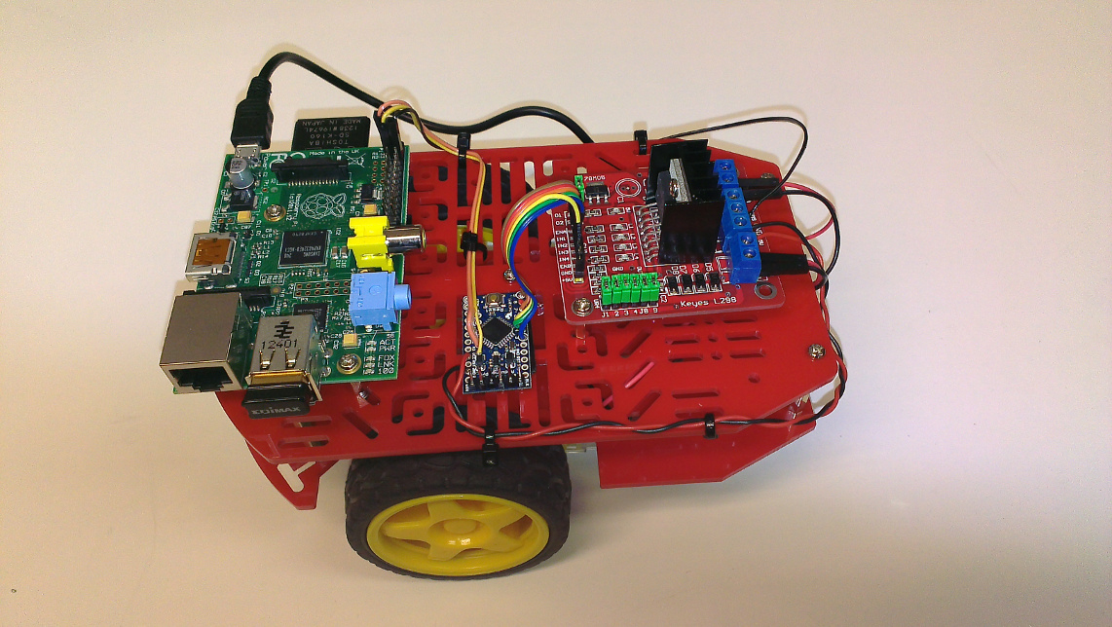
C3Pi
Raspberry
Pi
Motor
Controller
Ard-
uino

Slide 4
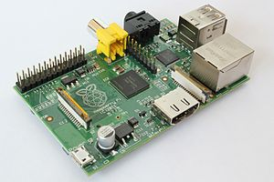
Raspberry Pi
Educational Computer, price: €25
Over 10,000 1,000,000 manufactured
Model A: ~500mw, 256MB RAM, 1 USB
32-bit ARM Linux
Mostly programmed in Python, but now...

Slide 5
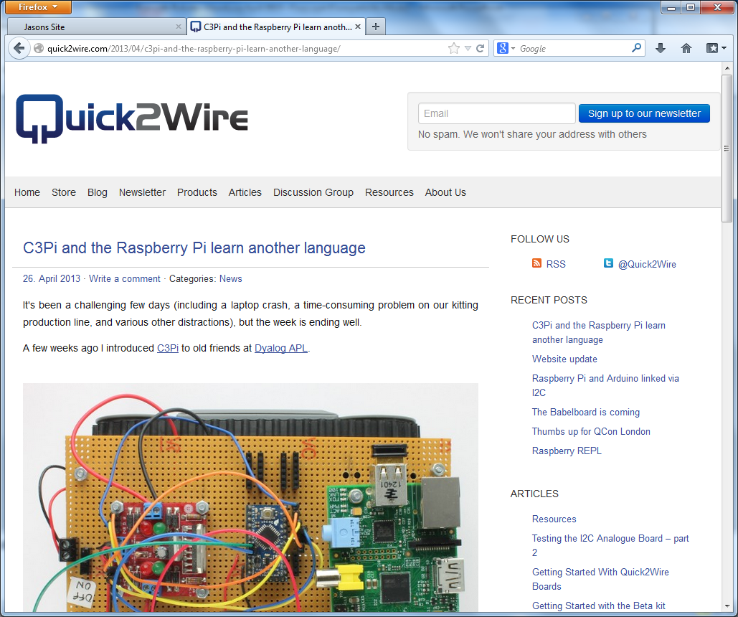

Slide 6
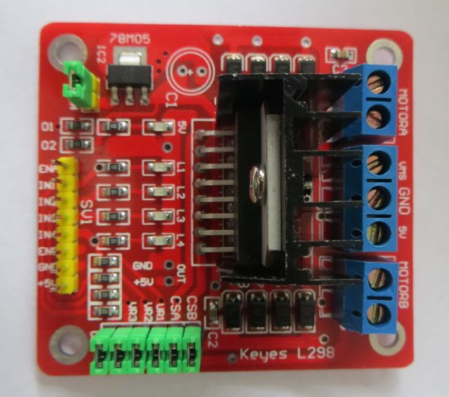
Motor Controller
2 motors
1 power level analog pin for each motor
1 forward, 1 back digital pin
(6 pins to control)

Slide 7
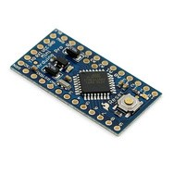
Arduino
Raspberry Pi & APL cannot easily generate ”Pulse Width Modulation” etc in real time
Arduino (Italian ”Open Source Hardware” project) is used as a ”front end processor”
A dozen I/O pins, programmable in C
Running a simple ”command interpreter”, receiving commands via the I2C bus

Slide 8
I2C Bus
Pioneered by Philips in TVs in 1980’s
Common BUS which allows a master and several ”slaves” to share 2 wires
The most widely used bus for connecting devices at ”reasonable” speed

Slide 9
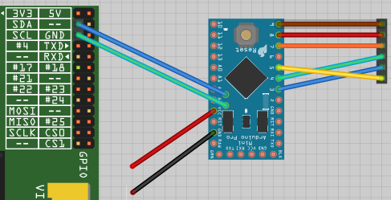
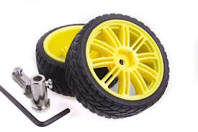
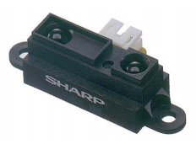
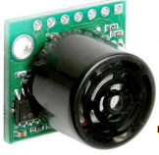
Pi → Arduino → Motor+Sensors
Robot Hardware Overview
Pi I2C Bus Arduino I/O Pins
Motor/Wheels
Infrared Sensor
Ultra- Sonic Sensor (”Sonar”)
Power
Servo Motor to Turn Sonar

Slide 10
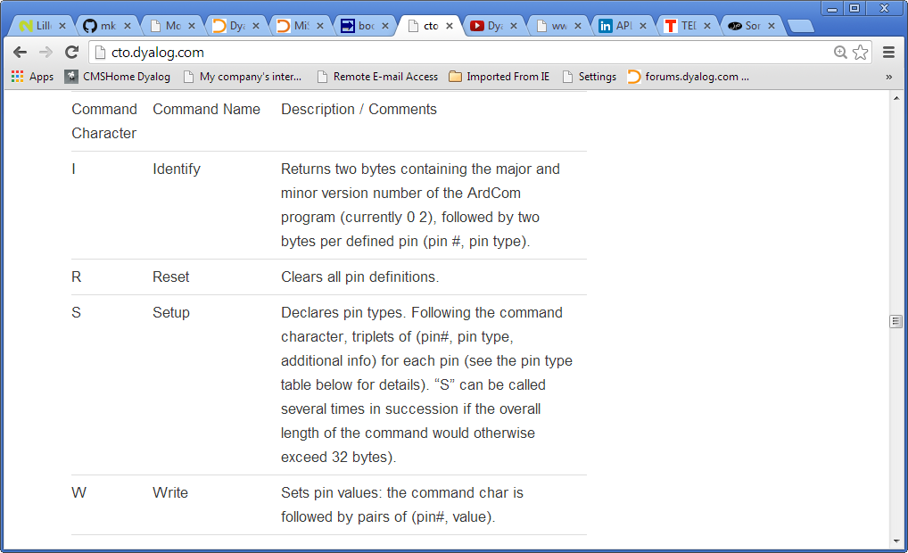
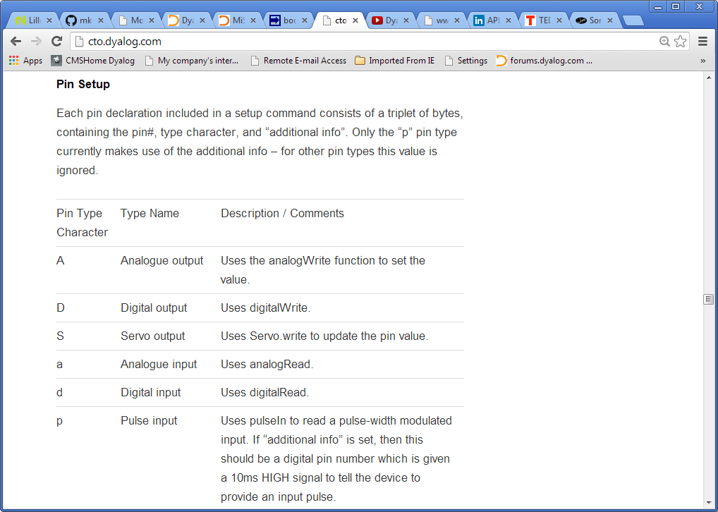

Slide 11
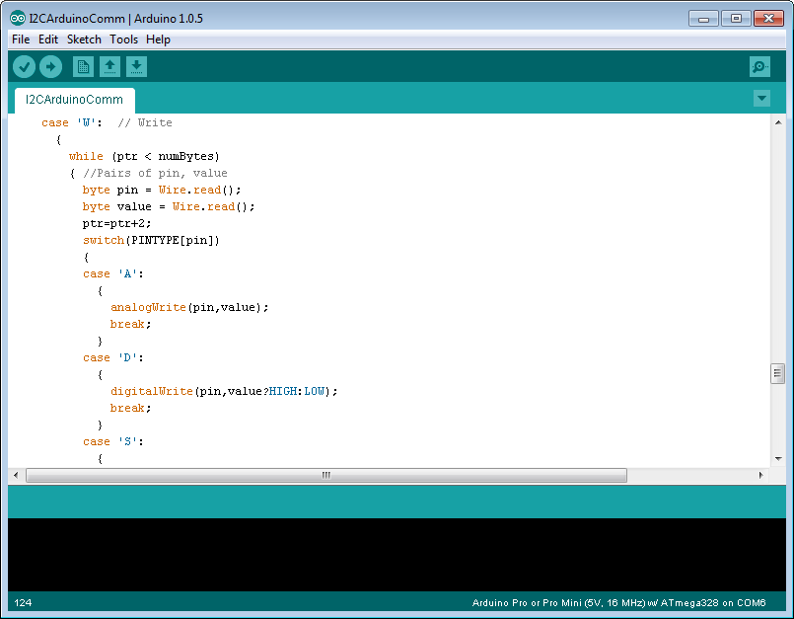
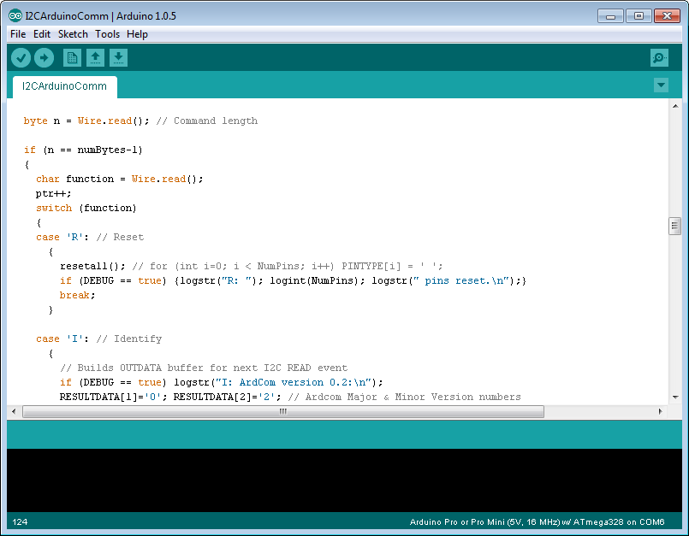
Robot Software Overview
Raspberry Pi
Arduino
DyaBot (APL)
ArdCom (APL)
I2C.so (C)
ArdCom (C)
Bot.Speed←¯10 10
Send 'W' 3 1 4 0 8 1 7 0 5 116 6 115
WriteBytes 4 (13 87 3 1 4 0 8 1 7 0 5 116 6 115) 255

Slide 12
Software Required
Dyalog APL 13.2 for ARM Linux running on the Raspberry Pi
Available free from Dyalog since mid-May (use standard Linux apt-get to install)
APL to I2C Interface Library Arduino Command Interpreter DyaBot and ArdCom APL Classes
https://github.com/aplpi
Recommended: MiServer
https://github.com/MiServer

Slide 13
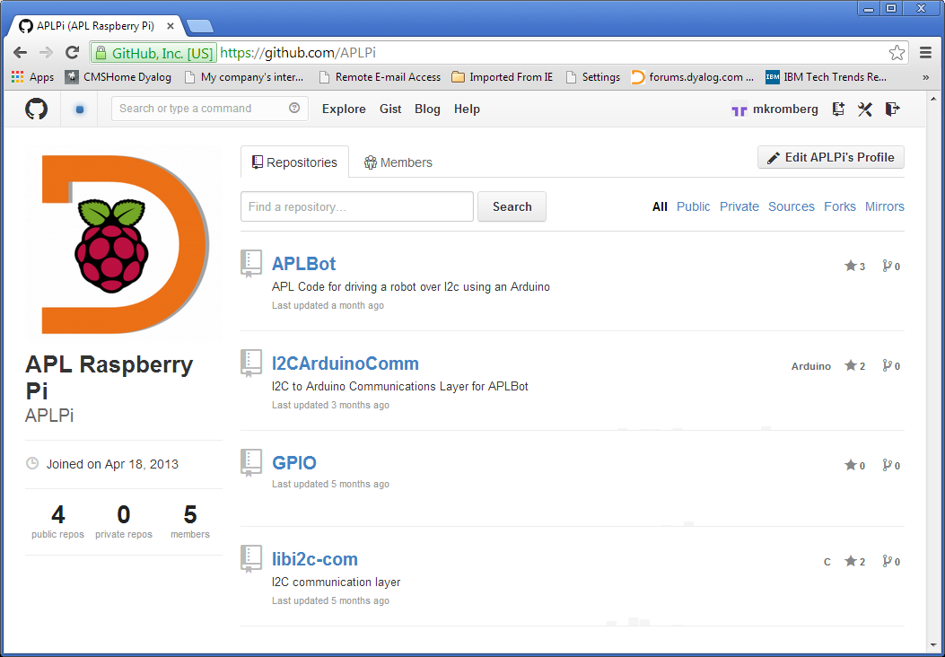

Slide 14
Low Points
Broken Wires
Debugging Arduino C
If you use a servo, one of the pins can no longer be used as an analog output

Slide 15
Low Points...
This short video shows what can happen to a poor abused little Dyabot when it returns from trans-continental expeditions...

Slide 16
SLAM Simultaneous Localization And Mapping
(Excerpt of a TED Talk by Vijay Kumar)
http://www.ted.com/talks/vijay_kumar_robots_that_fly_and_cooperate.html?quote=1563
relevant material starts 12 minutes into Vijay’s talk

Slide 17
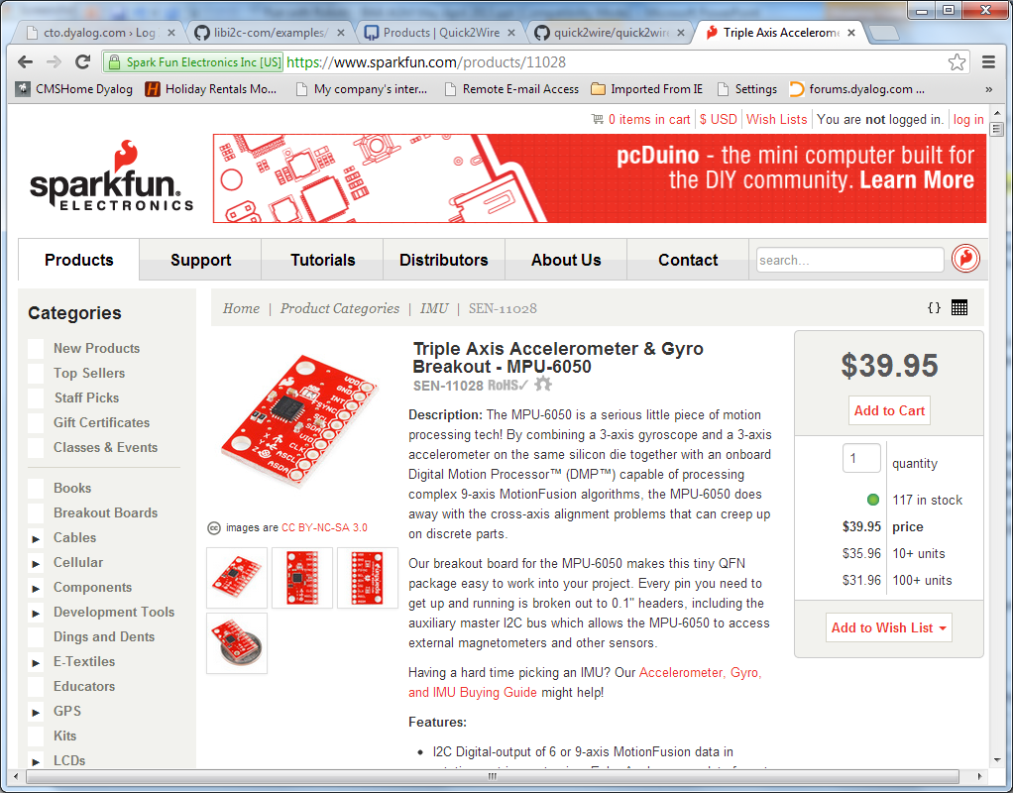
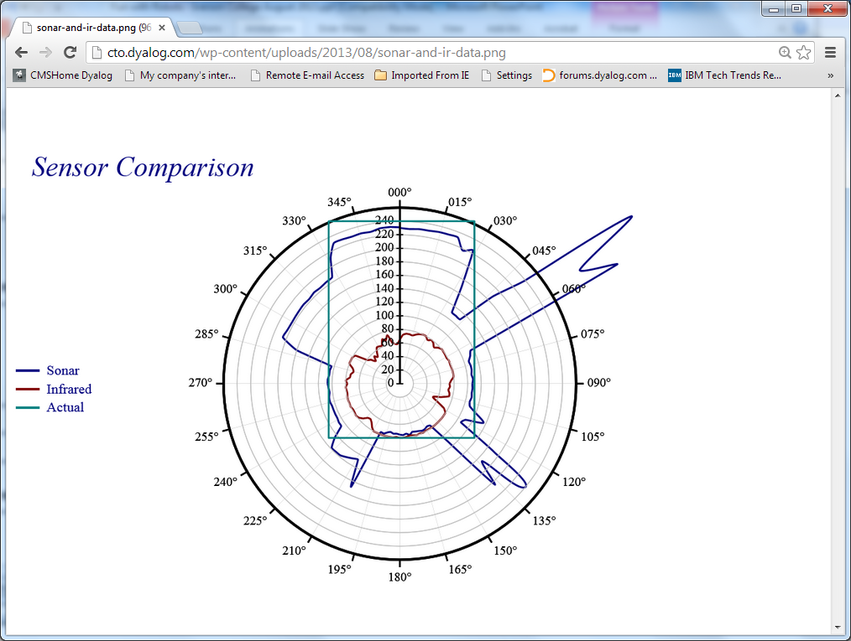
Our Goal
Write 2D ”Simultanous Localization and Mapping” (SLAM) software in APL
Sensors
Infra-red collision detector http://www.youtube.com/watch?v=OxGqX-0Ezmo
Sonar on a Servo for mapping distance to objects
Accelerometer / Gyro / Compass for orientation
Camera

Slide 18
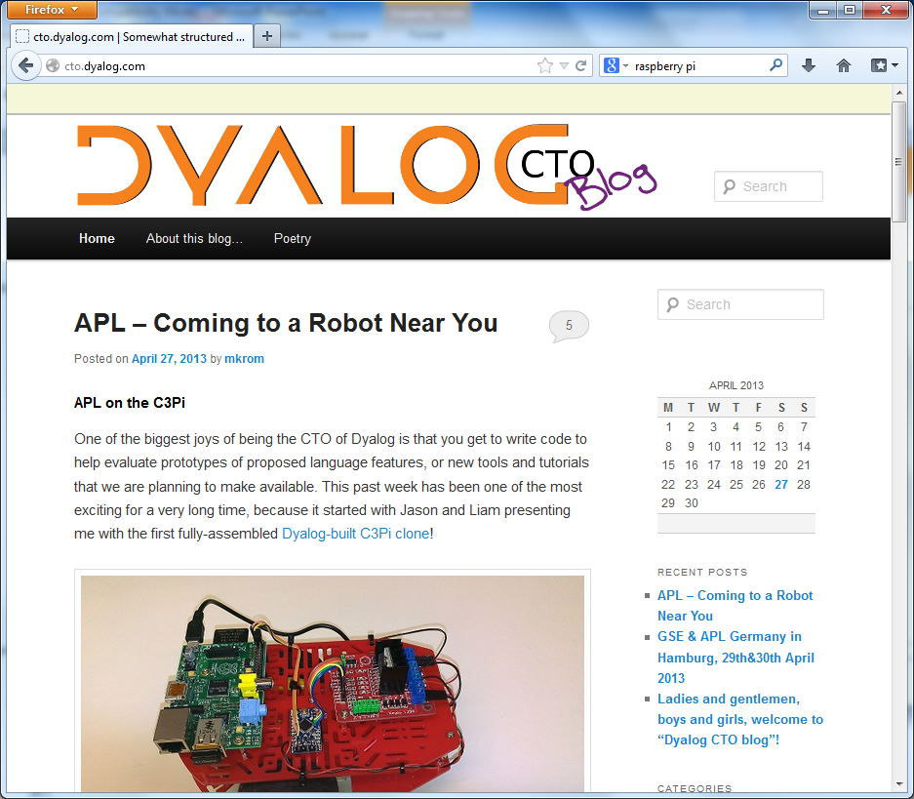
Plans
Keep working towards 2D Slam
Accelerometer & Gyro is next
Have some fun on the way there
Blog about it:
Project description and instructions on how to build your own robot at: http://cto.dyalog.com

Slide 19
Some High Points
The Camera!
⎕SH 'raspistill -rot 90 -h 60 -w 80 -t 0 -e bmp -o ahead.bmp‘
⍝ Open Native File tn←'ahead.bmp' ⎕NTIE 0 ⍝ Read 4 Int32s from offset 10 (offset hdrsize width height)←⎕NREAD tn 323 4 10 ⍝ Read data as 1-byte characters
data←⎕NREAD tn 80 (width×height×3) offset data←⎕UCS(height width 3)⍴data ⍝ Ints 0-255

Slide 20
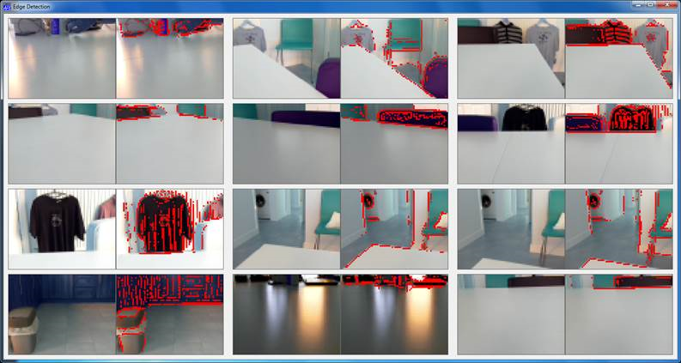
Edge Detection
∇ r←kernel AK data;shape ⍝ Apply Kernel shape←⍴kernel r←(1-shape)↓⊃+/,kernel×(¯1+⍳1↑shape)∘.⊖ (¯1+⍳1↓shape)∘.⌽⊂data ∇ EdgeDetectAll ⍝ 3x3 ”kernel” ¯1 ¯1 ¯1 ¯1 8 ¯1 ¯1 ¯1 ¯1
⍝ Apply Kernel to r, g, b separately
edges←EdgeDetectAll∘AK¨⊂[1 2]rgb
⍝ Edge if any r, g or b result is >75% of original edges←∨/(↑[0.5]edges)>0.75×1 1↓¯1 ¯1↓rgb

Slide 21
Staying On The Table
This short video demonstrates the “DyaBot” driving on a dinner table – where the slightest navigational error could mean a 3-foot plunge and certain death!

Slide 22
Live Demo!

Slide 23
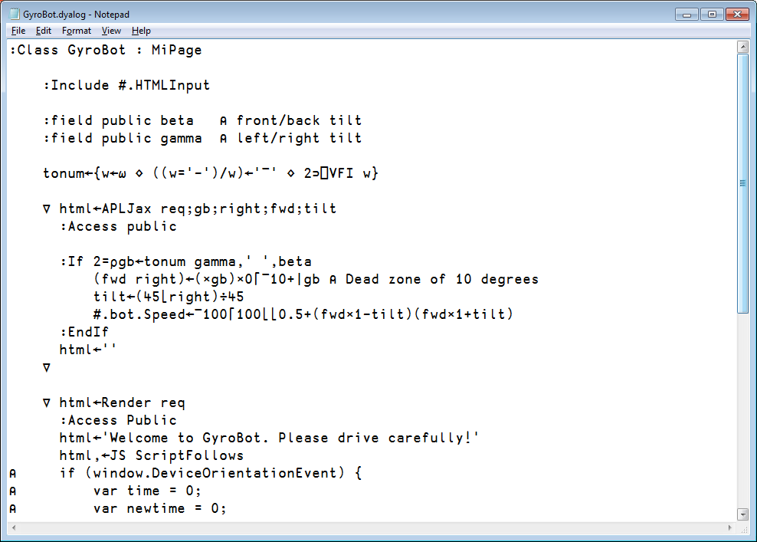
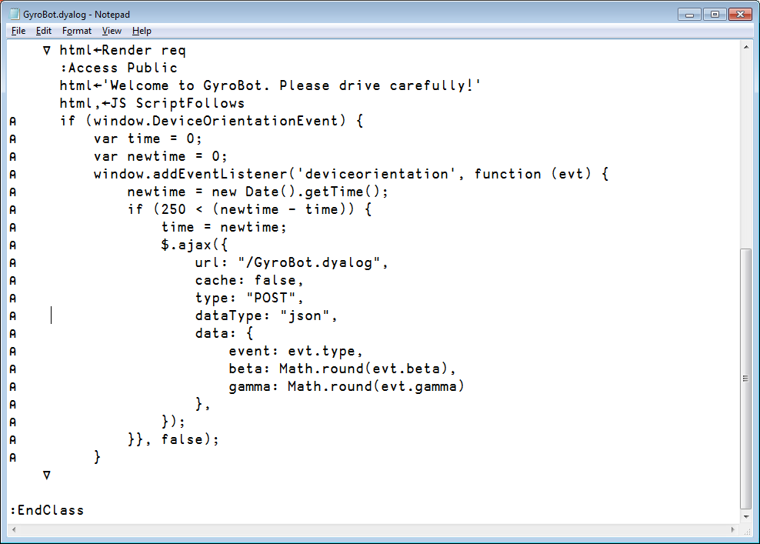
GyroBot MiServer Page

Slide 24
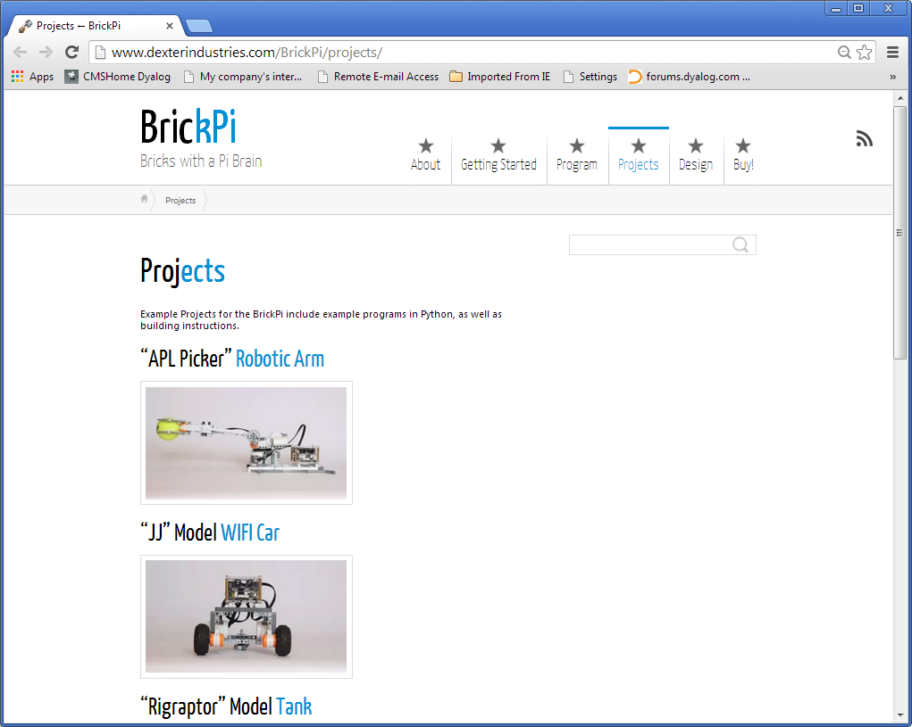
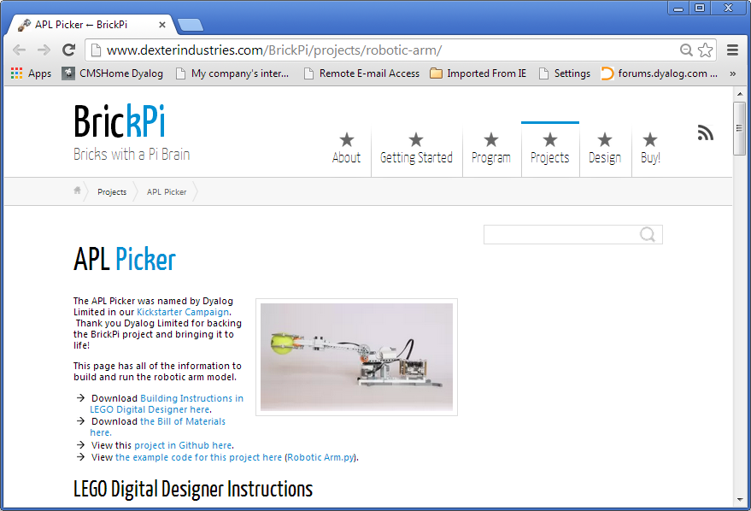
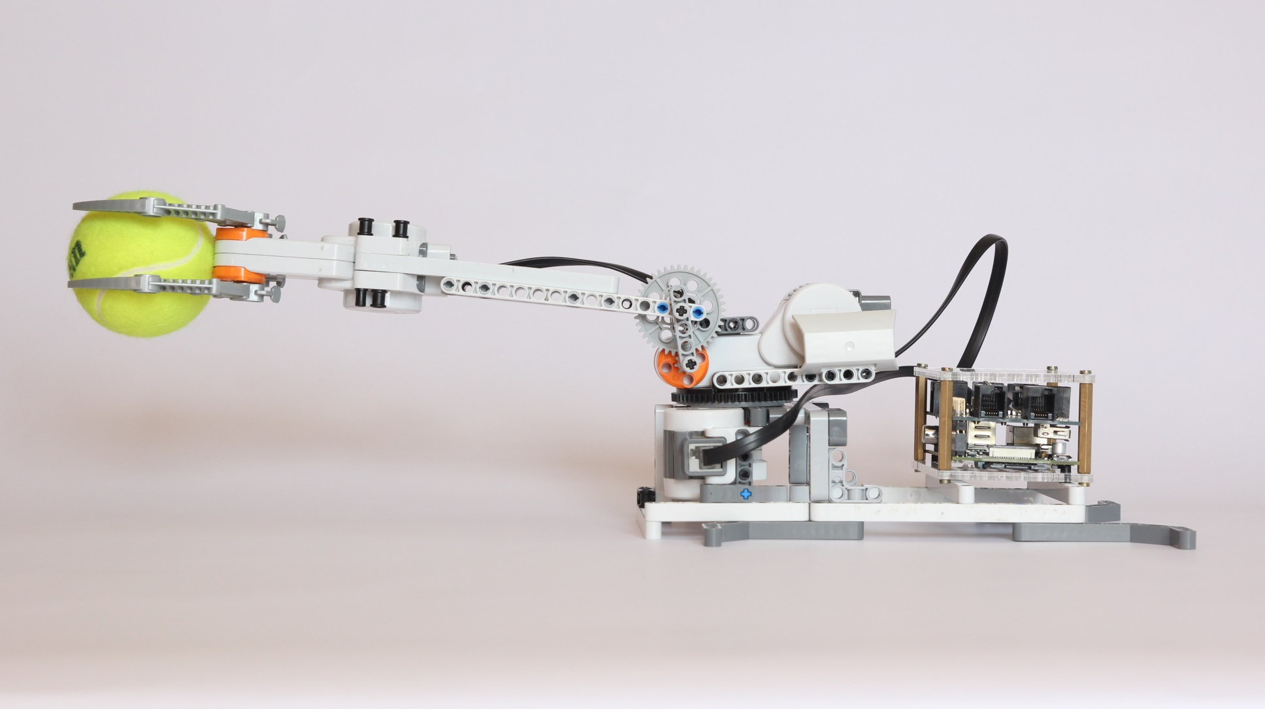
t

Slide 25
Follow the adventure at...
http://cto.dyalog.com

