Slide 2
Welcome to
To 78 delegates from:
United States | 23
United Kingdom | 21
Italy | 15
Sweden | 5
Denmark | 5
Canada | 4
Finland | 3
South Africa | 1
Russia | 1
Grand Total | 78

Slide 3
US Conference Delegates
 |  | 2013 | 2011 | 2009 | 2007
United States |  | 23 | 37 | 47 | 41
United Kingdom |  | 21 | 16 | 15 | 13
Italy |  | 15 | 21 | 7 | 7
Denmark |  | 5 | 4 | 5 | 5
Sweden |  | 5 |  |  | 6
Canada |  | 4 | 6 | 7 | 3
Finland |  | 3 | 2 | 1 | 3
Russia |  | 1 | 3 | 1 | 2
South Africa |  | 1
Germany |  |  | 1 | 1 | 2
Austria/Switzerland |  |  |  | 1 | 1
France |  |  |  | 1
Astralia/New Zealand |  |  |  | 2 | 1
Grand Total | 78 |  | 90 | 88 | 84

Slide 4
US Conference Delegates
 |  | 2013 | 2011 | 2009 | 2007
United States |  | 28 | 37 | 47 | 41
United Kingdom |  | 25 | 16 | 15 | 13
Italy |  | 15 | 21 | 7 | 7
Finland |  | 8 | 2 | 1 | 3
Denmark |  | 6 | 4 | 5 | 5
Sweden |  | 5 |  |  | 6
Canada |  | 4 | 6 | 7 | 3
Russia |  | 2 | 3 | 1 | 2
South Africa |  | 1
Germany |  |  | 1 | 1 | 2
Austria/Switzerland |  |  |  | 1 | 1
France |  |  |  | 1
Astralia/New Zealand |  |  |  | 2 | 1
Grand Total | 94 |  | 90 | 88 | 84

Slide 5
Agenda
...... I found the one-on-one interaction with the Dyalog developers extremely helpful
....... and the ability to interact with members of the community and from Dyalog is absolutely invaluable.
From last years questionaire: It would be good to know who the Dyalog people are .....

Slide 6
Agenda
Dyalog
Who we are
What we do

Slide 7
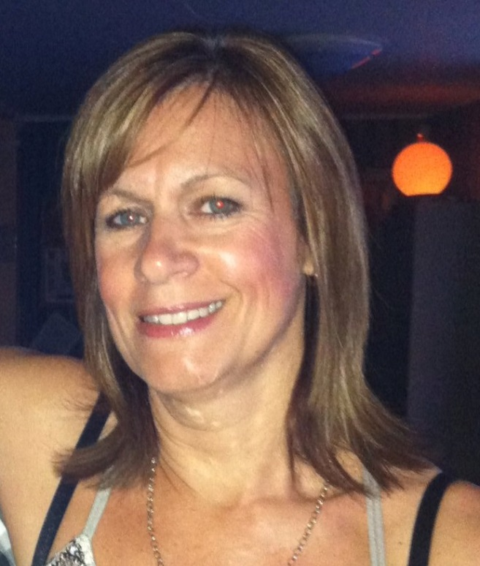
First things first
Karen is running this show
and she is the one you want to ask about stuff ☺
She will make household announcements each morning starting now:

Slide 8
Monday October 21st
Dyalog Dinner
6:30pm – meet on Oceanfront Patio to
walk down together
7:00pm – dinner at JB’s on the Beach
(next to Deerfield Beach Pier)

Slide 9
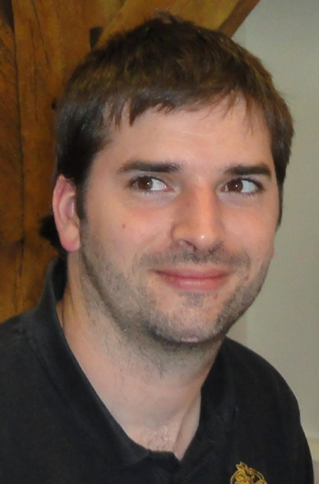
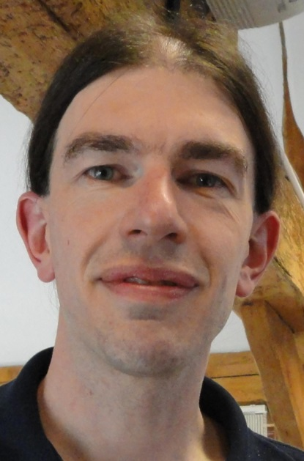
First things first
Jason and Jonathan are managing the technical setup
Those of you who are giving presentations please see them for any questions about wiring you up

Slide 10
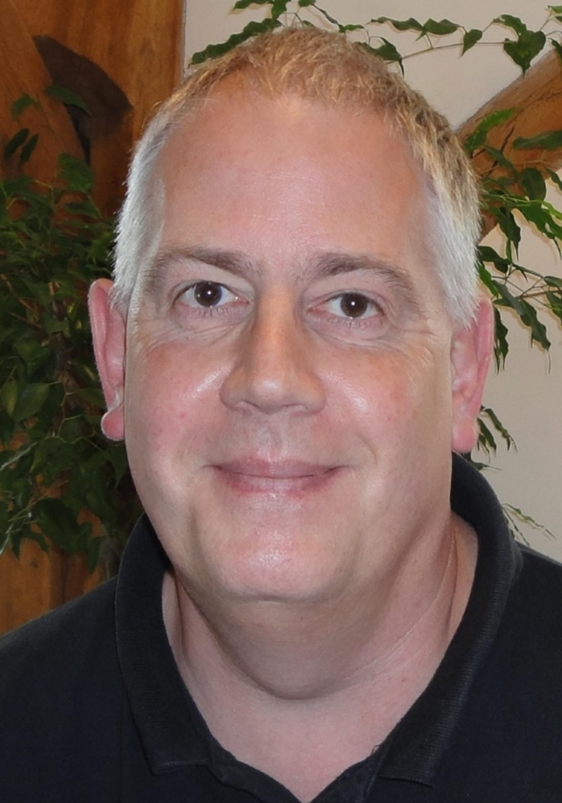
Secondly
Andy is our operations guy in addition to being our Unix guru.
And of most importance to you: He is managing the DSS support and he is in control of our “incident lists” ☺

Slide 11
The Mission
To allow people with ”other skills than programming” to be key contributors to the Programming Process
To allow Software Engineers to feel comfortable with all aspects of the use of APL as a major or minor component of a Software Solution

Slide 12
The Customer
Today, 8 of our 10 biggest customers are software vendors themselves
They expect to be able to produce high-performance, scalable, secure multi-user applications which will fit into a corporate IT-infrastructure
They expect to be able to recruit new APL’ers

Slide 13
The Mission
To allow people with ”other skills than programming” to be key contributors to the Programming Process
To allow Software Engineers to feel comfortable with all aspects of the use of APL as a major or minor component of a Software Solution

Slide 14
Talk to the others
Object Orientation
Better paradigm for talking to the environment
.NET support
Consume vast library of resources
.NET assemblies
Package APL code to be consumed by others
WPF
The successor to Win32 and WinForms on Microsoft Windows

Slide 15
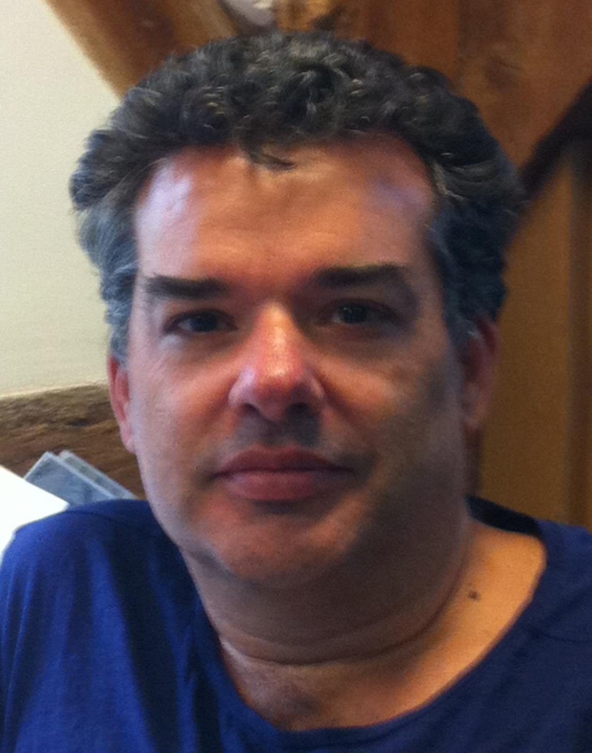
Talk to the others
John Daintree
Chief Architect and
implementor of these
interfaces

Slide 16
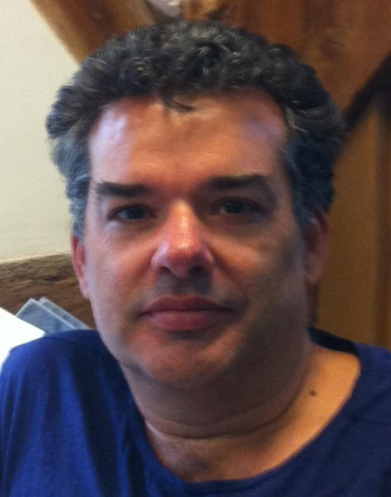
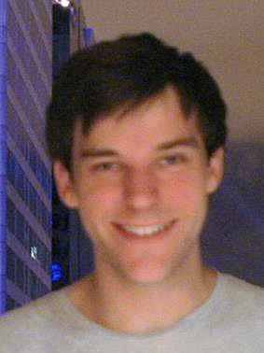
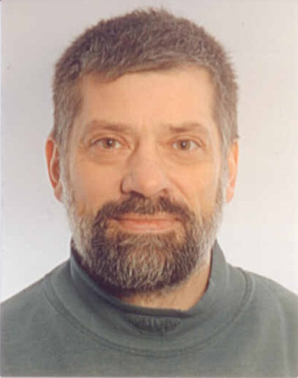
Talk to the others (yourself)
RIDE
a long time underway
Microsoft didn’t help
We now have a ”big” team working on it:

Slide 17
Be like the others
Unicode
APL-char problem solved
64-Bit
Since 2005 – now becoming standard
Source Code Management

Slide 18
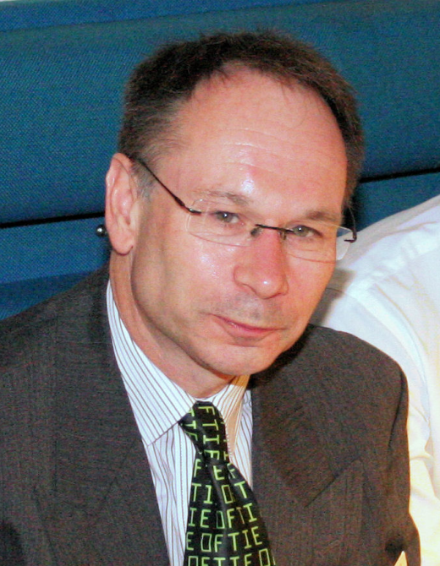
Be like the others
Journaling Component Files
Coping with network deficiencies
Dyalog File Server (“ShareFiles” for Dyalog)
High performance, secure Component Files

Slide 19
Be like the others
SQL interface - SQAPL
TCP/IP comm with SSL Support and Windows Single Signon (Conga v2.3)
Security across open networks

Slide 20
Be fast and furious
APL applications compete quite well with applications developed in other languages when it comes to speed.
Growing amounts of data and requirements for new functionality require even more speed - and we cannot rely on the processors to provide that any more.

Slide 21
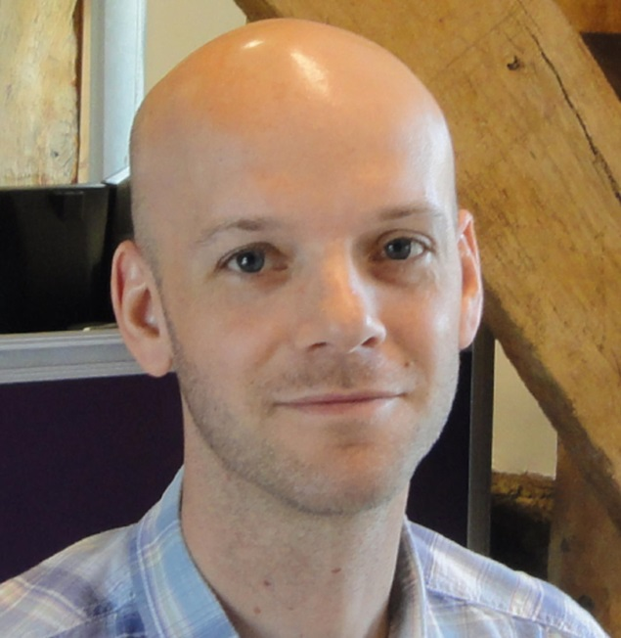
Be fast and furious
Measuring speed is important
“APLMON” and ⎕Profile
Interpretative speed
Reduce overhead on small functions
Look at memory management
Compilation of APL
Working with Aaron Hsu

Slide 22
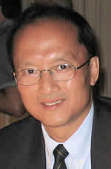
Be fast and furious
Primitive function performance

Slide 23
The Mission
To allow people with ”other skills than programming” to be key contributors to the Programming Process
To allow Software Engineers to feel comfortable with all aspects of the use of APL as a major or minor component of a Software Solution

Slide 24
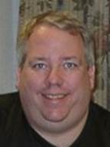
Tools
MiServer v. 3
New OO Framework
SAWS
StandAlone Web Service
DFS
Dyalog File Server

Slide 25
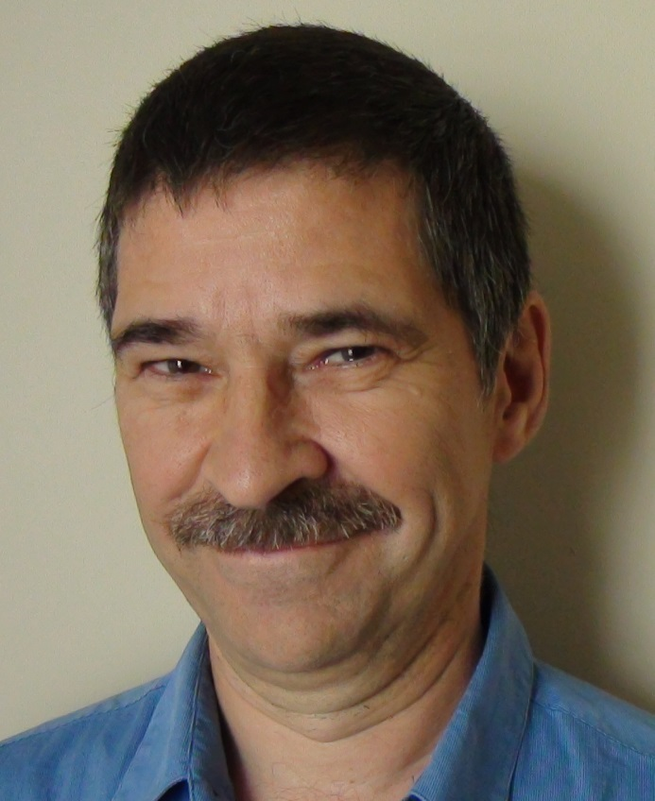
Tools
SALT
Code Management
User Commands
Utility Functions
Web Lectures

Slide 26
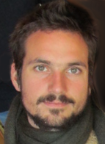
Tools
SharpPlot

Slide 27
APL the Language
Moving towards parallel computing with Dyalog v.14
Language constructs for expressing parallelism
Functional programming to facilitate compilation

Slide 28
APL the Language
Function Trains
Rank and Key

Slide 29
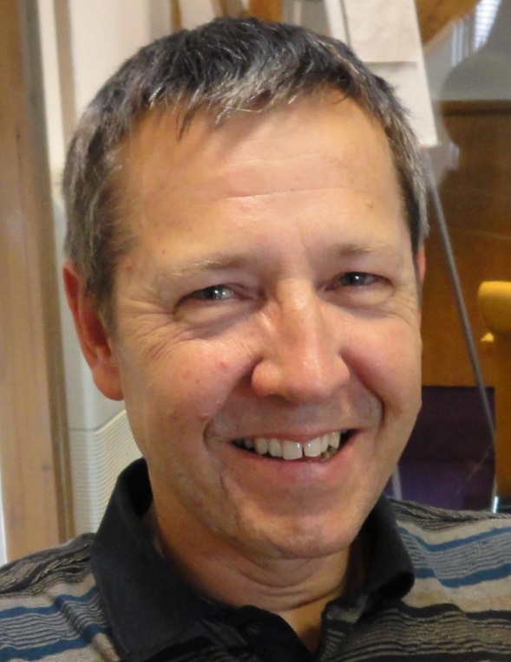
APL the Language
Futures and Isolates

Slide 30
The Customer
Today, 8 of our 10 biggest customers are software vendors themselves
They expect to be able to produce high-performance, scalable, secure multi-user applications which will fit into a corporate IT-infrastructure
They expect to be able to recruit new APL’ers

Slide 31
New APL’ers
Annual APL contest
New format
2 stages – introductory and problem set
~100 participated in stage 1
13 completed stage 2
We believe that our customers could benefit from looking at the contestants when they recruit

Slide 32
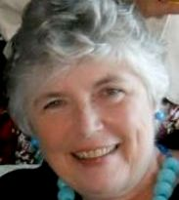
New APL’ers
Pat Buteux joined last year as US Marketing and Sales
Pat has been following our educational license holders closely since she joined
She is also responsible for the Scavenger Hunt

Slide 33
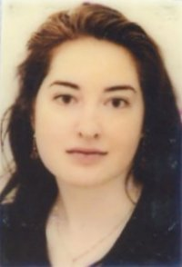
New APL’ers
Fiona Smith joined this year as Documentation Manager
She now know what a new APL programmer needs
The reference card is her initiative
It is version 1 so please evaluate and give us feedback.
She cultivates our vocabularies

Slide 34
New APL’ers
Fiona Smith joined this year as Documentation Manager
She now know what a new APL programmer needs
The reference card is her initiative
It is version 1 so please evaluate and give us feedback.
She cultivates our vocabularies
Pre-prandial

Slide 35
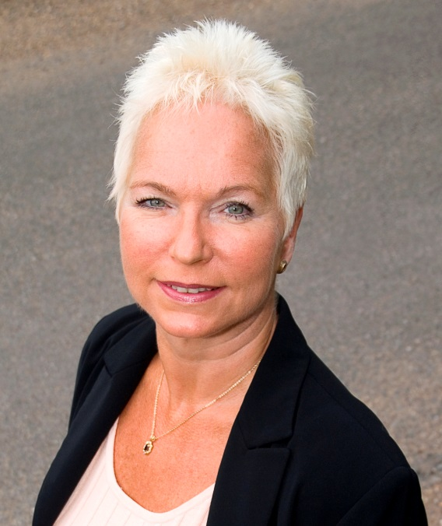
New APL’ers and Old
New website in the works
Targeted at
better captivating newcomers
providing platform for know-how sharing
organising material better
Vibeke is in charge of the site and is always chasing good APL stories

Slide 36
Welcome to Dyalog’13
Enjoy the conference
Enjoy the Customer presentations
Enjoy the previews of Dyalog v.14

Slide 37
Welcome to Dyalog’13
Enjoy the conference
Enjoy the Customer presentations
Enjoy the previews of Dyalog v.14
Enjoy your network

