Slide 1
October 20-24

Slide 2
Agenda
Review of 2012-2015 Strategy
User Interfaces
Upcoming Releases
New Platforms
No Demos
Notes:
Speed up primitive functions and operators
Many significant speed-ups in v14.0
Reduce parser overhead
New parser [optionally] used for ”simple” functions in v14.0
Reduce memory management costs
Adapt to characteristics of modern CPUs
(This task never ends)

Slide 3
Strategy 2012-2015
Performance
Performance
Portability
Portability
Functional Power
Parallel Computing
Functional Power
Parallel Computing
Needs of New Users
Needs of New Users
Application Frameworks
Application Frameworks
User Interfaces
Notes:
Performance
Many significant speed-ups in v14.0
New parser [optionally] used for ”simple” functions in v14.0
Portability
RIDEs and Native Dyalog implementations for Windows, AIX, Linux plus Mac OSX and Android
MiServer 3.0 and SAWS
Parallel Computing
Asynchronous Namespaces (”Isolates”) and ”Futures”.
Funded research into ”concurrent dfns” compiler
Functional Power
Function Trains, Tally, Rank, Key, Extended Iota
New Users
SharpPlot Graphics in the Session, Interfaces to R and NAG
Application Frameworks
Miserver 3.0, MiServer & SAWS behind IIS & Apache
WPF Tools, Crypto-Library

Slide 4
User Interfaces
Many new hardware and software ”opportunities” are presenting themselves
The RIDE provides a modern, cross-platform user interface for developing APL solutions
Some APL applications will be written without a UI, embedded within other tools
But many users will want to develop new User Interfaces using APL

Slide 5
Native or Cross Platform?
If you are targeting a single platform (like Windows Desktop), OR
Your market dictates a look and feel specific to each platform you need a front-end on
You probably need one or more native interfaces
WPF/.NET
XAML/WINRT
Cocoa
Java
APL
APL
APL
APL

Slide 6
Native or Cross Platform?
If you need a UI on all platforms: desktop, phablets, browsers, AND
Your UI needs to be decent but not *flashy*
You can do it with a single cross platform UI
ON
HTML/JavaScript
APL

Slide 7
Native UI in APL
Microsoft Windows Desktop
It is safe to continue with Win32/⎕WC; Dyalog will continue to enhance and support this as required
NOT portable: MainWin and WINE versions abandoned
Windows Presentation Foundation provides a modern replacement with many advantages
Similar XAML-ased UI is available on WINRT (Win8 New UI)
Dyalog will provide WPF tools, samples and a Tutorial
Other Native Interfaces
Bridges to Java, WinRT, Mono, [Cocoa etc] will eventually provide access to native libraries

Slide 8
Cross-Platform in APL
HTML5/Javascript is the most rapidly growing technology today
MiServer 3.0 will allow the development of decent HTML5/Javascript apps in pure APL
Target any browser from APL running on Windows, Linux, AIX plus future APL platforms
A Java Bridge will eventually provide access to Cross-Platform UI Libraries
A possiblity for v14.1, in 2015 (NOT decided)

Slide 9
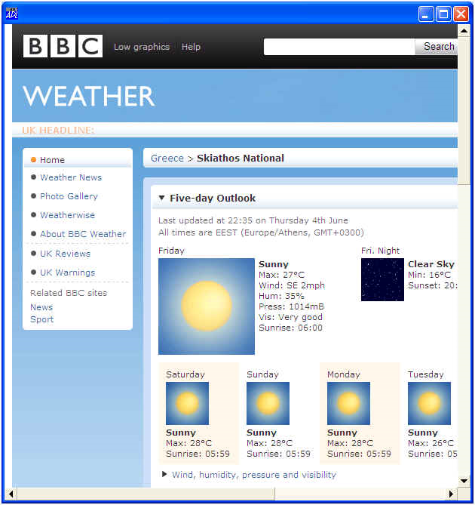
Embedded HTML Engines
HTML rendering engines are available as controls under COM, .NET, Java, Cocoa, etc.
Embedding a rendering engine allows an HTML/JS solution to be used ”natively”
⎕using←'System.Windows.Forms,... '
'f' ⎕wc 'Form'
'f.wb' ⎕WC 'NetControl' 'WebBrowser' f.Size
f.wb.GoHome

Slide 10
Embedded HTML Engines
RIDE will embed an HTML engine
We are aiming to support:
Development & Testing using RIDE stand-alone
”Native” deployment using .NET/COM/Java-embedded HTML Engines
Multi-user applications using a proper MiServer
(Behind IIS/Apache if relevant)
(all using the same application code base)

Slide 11
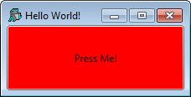
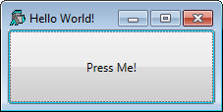
Data Binding
Data Binding is a term used to describe direct links between business logic data and UI element properties
In WPF/XAML, you can connect the colour of a button to your variable ColorName with a simple declaration: <Button Background="{Binding Path=ColorName}"> Press Me!</Button>
ColorName←'red'
For properties that the user can modify, application data is immediately updated on change (and an event can be triggered)

Slide 12
Data Binding, continued...
Version 14.0 adds support for direct data binding of APL data to Microsoft.Net components (that support data binding)
We are aiming to add dynamic databinding to MiServer in 2014 (possibly via ”knockout.js”)

Slide 13
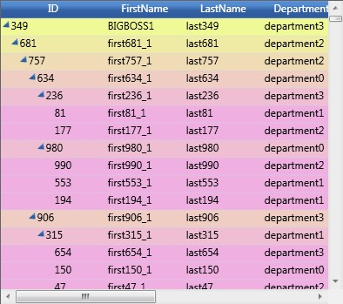
Third Party Controls
State-of-the art application development requires professional control libraries
The base systems like WPF and HTML (etc) only provide rudimentary controls
A rich ”eco-system” of companies provides such add-ons
You may have heard of some of these:
Mindscape | Component Art
DevExpress | SyncFusion
Infragistics | Xceed
Telerik | Actipro
Divelements | Binary Mission
Ice Blue

Slide 14
Libraries
Syncfusion is a leading vendor of ”enterprise class” components for many platforms
ASP.NET, Mobile, Silverlight, WinForms, Windows Phone, WinRT, WPF, Javascript and Windows 8
Dyalog has acquired the rights to bundle the WPF and Javascript libraries with APL
WPF 100+ controls: grids, charts, guages, menus, calendars, editor plus file format library for Excel, Word and PDF
Javascript 30+ controls

Slide 15
Libraries
Dyalog users have the rights to distribute these controls as components of applications written in APL
Under the same terms as the Dyalog Licence that is being used (including non-commercial and educational licences)

Slide 16
We Think...
Most existing APL applications need:
A single ”primary” desktop interface
Currently almost always Microsoft Windows
Some cross platform features
Our goal is to make this as easy to build with WPF & HTML/JS as it is with ⎕WC today
Future applications may need multiple native interfaces
We will also provide tools for this, but not with the same urgency

Slide 17
In other words...
Our goal is to provide a complete set of tools for Native (initially Windows only) and Cross-Platform UI development
WPF and Syncfusion Tools & Tutorials
Microsoft.Net Data Binding
MiServer 3.0 with Syncfusion JS
Even if you have no immediate need, please take a look and let us know how close we are getting to ”as easy as ⎕WC”

Slide 18
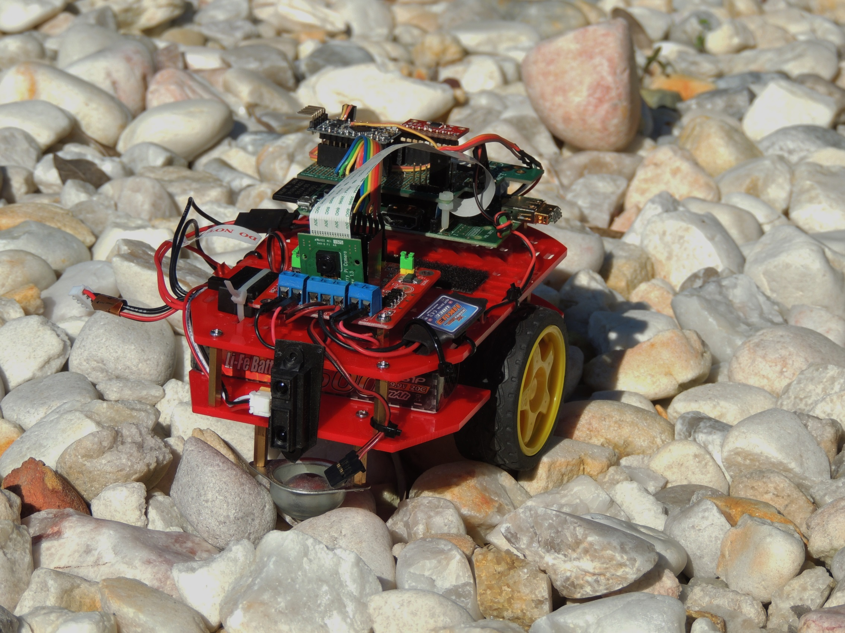
Blue Hills

Slide 19
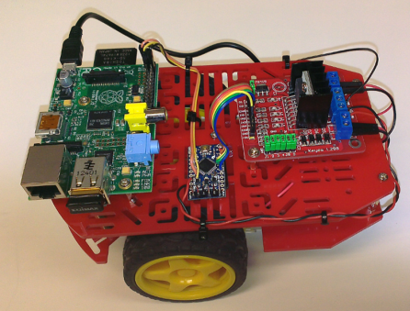
Raspberry Pi Version
Dyalog APL v13.2 was released for the Raspberry Pi / ARM Linux / in June
Free and Unregistered
$ apt-get install dyalog
Intent: Demonstrate that APL is not just a language for financial applications
Generate some excitement / new interest

Slide 20
New Interest in APL
Open-source APL activity is increasing
Enhancements to NARS2000 (Bob Smith - USA)
GNU APL (”open-source APL2” by Jürgen Sauermann – Germany)
NGN APL (dfns in coffeescript by Nick Nickolov - Bulgaria)
Co-Dfns compiler at University of Indiana
(OK, funded by Dyalog, but still...)
Iverson College:
Emily Bache’s report: http://coding-is-like-cooking.info
TDD Framework by Gianfranco Alongi

Slide 21
New Interest – In Numbers
Download Counts for 2013 to Date
Raspberry Pi version: 115
Unregistered version: ~1,100 downloads
Registered ”Non-commercial” ~50, Educational ~250
Open-Source systems:
NGN APL: ~2,000 visitors, 105 ”github stars”
NARS2000: 877 downloads in the last 12 months
GNU APL: Statistics not available
John Scholes’ Game of Life in APL on YouTube
Approaching 100,000 views
http://tryapl.org
6,000 sessions, 3,600 different users since January

Slide 22
Nick Nickolov, author of NGN APL (https://github.com/ngn/apl)
”If it hadn't been for the YouTube videos and TryAPL, I wouldn't be infected with array orientedness today.”
NB: dfns

Slide 23
The Impact of Fi
We now have a full-time technical writer (PLUS Pete!)
Short-term deliveries have included:
Raspberry Pi documentation
Decision to release a documented R interface in Q1
Printed Materials for the Conference
The Dyalog Reference Card, much more to come!
More Fundamentally
Standardis(z)ation of Terminology
The Big User Command Rename
New default Migration Level ← 1

Slide 24
UCMD Renaming
User Commands were accumulated from many sources; naming was ”irregular”
User Commands are no longer an experiment
We have a Technical Writer to help us ☺
We have performed a one-time re-naming exercise on user command names & modifiers
From now on, UCMD names will be stable

Slide 25
New Default Migration Level
From version 14.0, the default Migration Level (⎕ML) in a clear workspace will be 1
Almost no change compared to ML 0:
Monadic ∊ means enlist, not type
TryAPL.org has used ML 1 from the start
All new Dyalog documentation, tools and samples will be developed in ML 1
Older documents will be revised over time

Slide 26
Migration Level, continued...
Dyalog no longer has a goal of eventually making ML 3 (maximum APL2 compatibility) the default
Full compatibility with APL2 functionality remains an important goal
Selective specification enhancements
Missing axis cases
Dyalog is looking at providing additional tools to help APL2 conversions, such as AP emulators

Slide 27
Version 14.0 Features
Function Trains
Key
Rank and Tally
Enhanced Dyadic Iota (“rowfind”)

Slide 28
Version 14.0 Features
Microsoft.Net DataBinding
Primitive Performance Enhancements
Component File Speed-Ups and Enhancements
Run as a Windows Service without additional tools or wrappers

Slide 29
Component Files
Read multiple components in one operation, for example: ⎕FREAD TN (⍳8)
More efficient use of buffers
Compressed Components

Slide 30
Primitive Speed-Ups
x (⍳∘1 ≥) y [1.3-∞] times faster In general, (⍳∘b comp) where b is 0 or 1 and comp is one of < ≤ = ≠ ≥ >
{≢⍵}⌸y [2.5-3] Frequency count
x+.×y [2.5] Visual Studio 2012 C Compiler
"bit-mover” [1.3-23] Used in: x⍴b x↑b x↓b bv⌿b bv⍀b b,c b⍪c x⊖b b,←c b⍪←c b[x;] (⊂x)⌷b {⍵[⍋⍵;]}b {⍵[⍒⍵;]}b
b⍳0 b⍳1 [780] Used in several scans, including ∧\ and ∧\.

Slide 31
Experimental Features
Included in v14.0, but subject to change:
Futures and Isolates
New Parser for simple functions
Independent of v14.0:
Aaron Hsu’s Co-Dfns Compiler

Slide 32
Upcoming Releases
Version 14.0 for Microsoft Windows, IBM AIX, and Linux, in Q2/14
Mac OS/X and maybe Android by Q4/14
RIDE v1.0 for Windows and Linux in Q2/14
Mac OS/X and Android by Q4/14
MiServer 3.0 with Object Oriented, possibly "Data Bound” GUI: Q2/14 ("continuous releases”)
DFS 2.0 with Online Backup and Restore in Q1/14
Interface to R: Q1/14
Interfaces to NAG and kdb+: Experimental, available on demand

Slide 33
Support for New Platforms
RIDE v1.0 will be available for Windows and Linux in Q2 (with Version 14.0)
It is our goal to support APL and RIDE on two additional platforms in 2014:
Mac OSX
Android
Preview versions will be avalable earlier; contact sales@dyalog.com

Slide 34
To be added to the list ...
Signed, encrypted deployment of APL and applications written in APL
Define APL project and library structures
Supported by SALT, RIDE, ODE
... Eclipse, Visual Studio, EMACS, ...

Slide 35
Strategy 2012-2015
Performance
Performance
Portability
Portability
Functional Power
Parallel Computing
Functional Power
Parallel Computing
Needs of New Users
Needs of New Users
Application Frameworks
Application Frameworks
User Interfaces
Notes:
Performance
Many significant speed-ups in v14.0
New parser [optionally] used for ”simple” functions in v14.0
Portability
RIDEs and Native Dyalog implementations for Windows, OS/X, Linux, Android
MiServer 3.0
Parallel Computing
Asynchronous Namespaces (”Isolates”) and ”Futures”.
Funded research into ”concurrent dfns” compiler
Functional Power
Function Trains, Tally, Rank, Key, Extended Iota
New Users
SharpPlot Graphics in the Session, Interfaces to R and NAG
Application Frameworks
Miserver 3.0, MiServer & SAWS behind IIS & Apache
WPF Tools, Crypto-Library

Slide 36
The Elevator Pitch
Develop mechanisms for XAML-style and HTML-based UI which are at least as easy to use as ⎕WC
Put APL on all relevant hardware and software platforms
Keep running APL expressions faster – and take advantage of parallel hardware
Provide secure mechanisms for data storage and application deployment

Slide 37
For more Information
Performance
Tuesday 10.30: Jay Foad Reducing Interpreter Overhead
Tuesday 11.15: Eugene Ying (Fiserv Inc) Optimising APL Expressions
Tuesday 13.00: Paul Grosvenor (Optima Systems) COSMOS Performance Improvements
Tuesday 15.45: Roger Hui, Morten Kromberg Primitive Performance

Slide 38
For more Information
Parallel Computing
Tuesday 08.30: Morten Kromberg Parallel Language Features in v14.0
Tuesday 13.45: Aaron Hsu (University of Indiana) Co-Dfns Compiler

Slide 39
For more Information
Functional Power
Tuesday 09.00: Roger Hui Rank and Friends
Tuesday 09:30: John Scholes Train Spotting in Version 14.0

Slide 40
For more Information
Portability
Monday 11.15: John Daintree, Andy Shiers The Remote IDE Version 1.0
Monday 15.45: Brian Becker Towards Industrial Strength Web Applications
Tuesday 15.00: Alexei Miroshnikov (Infostroy Ltd) To Unicode or Not To Unicode
Thursday 14.00: Brian Becker MiServer MasterClass (Workshop)

Slide 41
For more Information
Needs of New Users
Wednesday 08.30: Morten Kromberg Interfaces to R, Q and NAG
Wednesday 09.30: Fiona Smith Documenting Dyalog APL
Wednesday 13.00: Aaron Hsu (University of Indiana) Computer Science Outreach and Education with APL
Thursday 08.30: Nicolas Delcros The Future of SharpPlot and RainPro
Thursday 14.00: Nicolas Delcros Introduction to SharpPlot (Workshop)

Slide 42
For more Information
Application Tools
Monday 16.45: Richard Smith V14.0 File System Enhancements
Tuesday 16.45: Morten Kromberg Dyalog File Server Version 2.0
Wednesday 09.00: Dan Baronet User Command Update
Wednesday 11.00: Gianfranco Alongi (Ericsson) Test Driven Development (TDD) in APL

Slide 43
For more Information
User Interfaces
Monday 13.00 & 15.15: John Daintree & Michael Hughes WPF, parts I & II
Monday 14.00: Chad Church (Syncfusion) The Syncfusion Libraries
Wednesday 10.30: Valentina Settimi (APL Italiana) Applying Version 13.2 GUI Features to SOFIA
Thursday 10.15: Illse Nell (Riskflow) Cash Flows for Business and Personal Use
Thursday 11.15: Tomas Gustafsson (Stormwind.fi) The Stormwind Simulator

Slide 44
October 20-24

