Slide 1
October 20-24

Slide 2
Dyalog File Server
Version 2.0
Morten Kromberg
CTO, Dyalog LTD
Dyalog’13

Slide 3
Agenda
What is the DFS?
Motivation & Benefits
Version 2.0 Features
DFS Road Map
Availability

Slide 4
Recap: What is DFS?
The Dyalog File Server
A ”plug compatible” replacement for direct access to component files (DCF).
(and from v2.0, also ”native files”)
A Client/Server system in which file operations are only possible by communicating with DFS Server Processes
No direct access to component files from client
However, the underlying storage mechanism *is* ”normal” component files.

Slide 5
DFS Architecture Diagram
HTTP Monitor (Browser)
Monitor
Provides monitoring and instrumentation
Exposes HTTP Interface
V2.0
Locks Server
Handles all FHOLD and NLOCK requests
Backup Server
Takes backups
APL Client Session 1
Master Server
Manages Login requests
APL Client Session 2
File Server 2 /test
File Server 2 Delegate 1 Performs long-running tasks like FCHK or FCOPY on behalf of a server
APL Client Session n
File Server 1 /prod
File Handler Thread 1
File1
File3
File Handler
Thread 2
File2

Slide 6
Features
Dyalog Component File Functions
Dyalog Native File Functions
Additional File & Folder utilities
SHAREFILE/AP features
FHIST, FUSERNO, FWHOIS
(but no ”Library Number” concept)
Management Console / Admin API

Slide 7
DFS Security
Access to the DFS requires a login
DFS has a table of valid users
Users can either have passwords validated by DFS itself, or using ”Integrated Windows Authentication”

Slide 8
Issues with DCF
System administrators must create file shares to accomodate APL applications
Security: The DCF essentially requires full access to the underlying files
Access Matrices only apply to access via DCF
Notepad, vi and EMACS ignore them ☺
Data is exposed and vulnerable
DCF is quite sensitive to network reliabiliy and performance
In particular, File Holds / Locks can perform badly

Slide 9
Benefits of DFS (1/2)
Security: The DFS only allows access to files through validated channels.
Architecture allows encryption and compression.
Access matrices have absolute authority
Other constraints can be added
No file shares are required
A handful of TCP ports is all you need for file system access

Slide 10
Benefits of DFS (2/2)
Ability to monitor file system activity
Who has that file held (or tied)? (& Kill them!)
DFS recovers automatically from network glitches and server restarts
If the server session is still active, no problem
If closed, reconnection happens unless FHOLDS existed
File Holds are queued by a separate process
Simultaneous connections from one client session
Two threads can be independent clients of the file system
Can do independent FHOLDs

Slide 11
Potential Longer Term Benefits...
Server-side compression and caching
Server-side ”Stored Procedures”
Mirroring to a 2nd DFS installation for Disaster Recovery
Transactions

Slide 12
Implementation
>90% of DFS-related code is written in APL
Monitor is a MiServer application
Some extensions to Conga and the Component Files Integrated Windows Authentication
Support for single server task ”representing” multiple clients
Backups
Over time, more C code may be used, however ...
Keeping the core in APL allows
Stored procedures
Other user-defined extensions
... rapid progress ☺

Slide 13
Current Performance
Sometimes slower on reads due to lack of caching
Faster on writes due to use of exclusive ties on the server
Faster and (MUCH more predictable) on FHOLD with high user loads
Current target is to have better overall performance than Windows LAN files
Long term target is to be competitive on all platforms.

Slide 14
Performance Figures
Transactions Per Second (per client)
”Transaction” (on 10k components):
⎕FHOLD tn ⍝ Start Transaction data←⎕FREAD tn,cn ⍝ Read
data ⎕FREPLACE tn,cn ⍝ Update
⎕FHOLD ⍬ ⍝ ”Commit” Hardware: i7 server & i7 laptop client.
Platform | 1 client | 2 clients | 3 clients | 4 clients
⎕FNS on LAN | 28<32<34 | 15<20<23 | 5<15<21 | 3< 9<23
DFS | 46<51<59 | 25<34<38 | 20<22<24 | 15<16<17

Slide 15
DCF – DFS Differences
DFS Access Matrix is always enforced; you can not log in as ”user 0”.
(Optionally), all DFS functions that refer to user numbers report user names: FHIST, FRDAC, FSTAC, FRDCI

Slide 16
DCF – DFS Differences
DFS FLIB reports exclusively tied files
So will ⎕FLIB in v13.2
DFS FHIST does not record latest file tie
From 13.2, ⎕FHIST will also not do this
DFS can tie more than 253 files at once
DFS file holds are not released on return to immediate execution
Not a bug, it’s a feechure

Slide 17
Features of v2.0
Online Backup and Restore
Detailed Performance Monitor
Improved performance of long-running tasks
FCOPY, FCHK, MCOPY, MMOVE, ...
Faster FLIB
Support for Native File Functions
Including a number of extensions
Bootstrap applications direct from DFS

Slide 18
Online Backup and Restore
”24x7x365” operations: Backup and Restore without taking DFS down
Takes snapshot of all component files managed by DFS, at a single point in time
Slight performance degradation during backup
Files updated while backup is in process will grow due to requirement to have old&new data available
Restored files must not be tied
Use monitor to identify (& if necessary kill) tasks using a file

Slide 19
V2.0 Speedups
Faster FLIB: Configuration switch to rely on ”.DCF” extension
”Delegate Processes” to handle long-running tasks:
FCHK, FCOPY
MCOPY, MMOVE, MDELETE
Queueing system rewritten

Slide 20
Bootstrap Mechanism
DFS server will support download of application ”manifests” via HTTP
Bootstrap loader can maintain APL applications without a network share

Slide 21
Native File Functions
Full set of Native File Functions supported by Dyalog APL
Several extensions
Metadata: NLIB, NATTRIBUTES, SPACE
Manage folders with NMKDIR, NRMDIR
Handle multiple files and/or folders with MCOPY, MDELETE, MMOVE

Slide 22
Extended File/Folder Fns
Function Name | Description
MCOPY | Copy multiple files or folders
MDELETE | Delete multiple files
MMOVE | Move (rename) multiple files
NATTRIBUTES | Return and set file attributes
NLIB | Directory listing
NMKDIR | Create a directory (folder)
NRMDIR | Delete an empty directory
SPACE | Return the free space on a drive

Slide 23
Native File Issues
Lots of small file operations may perform poorly (no client-side cache)
For component files, security is enhanced (access matrices have absolute authority)
For native files, user ”impersonation” is not possible
All file access is peformed using DFS server account
Use of native files via DFS is probably only recommended for some applications

Slide 24
Performance Monitor
For each file operation DFS will log:
File and User/Session Ids,
Time of Day, Number of open files at time of op
Elapsed time and CPU consumption in main process and in ”delegate”
Length of file operation queue and time spent in it
Number of bytes transmitted in & out
Monitoring can be switched on & off from the web monitor

Slide 25
Performance Analysis
Web monitor provides on-line analysis of last 15 minutes of data
Off-line analysis of historical data

Slide 26
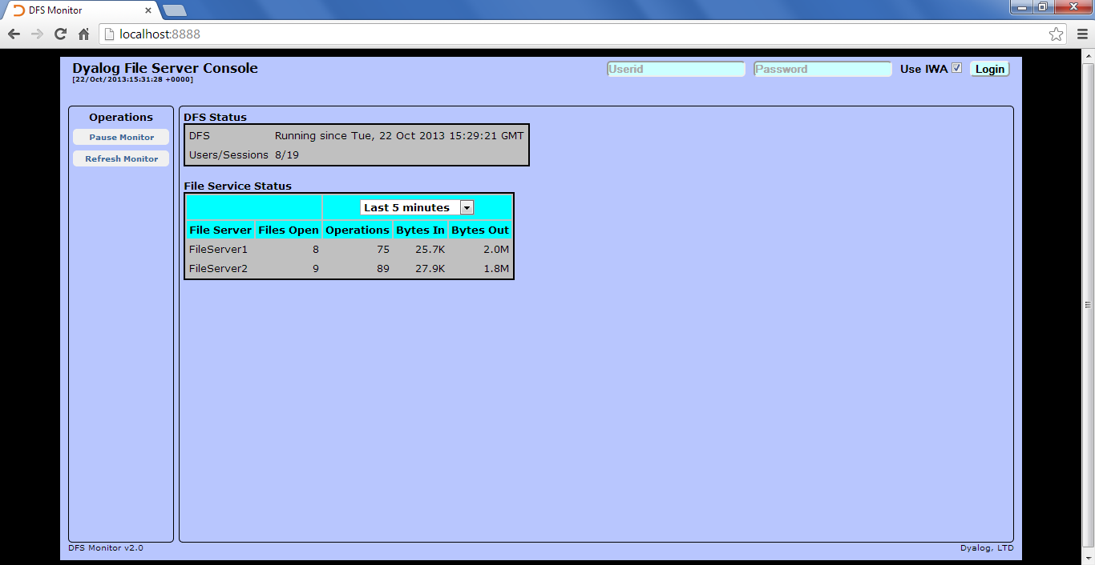
Monitor Screen Shots

Slide 27
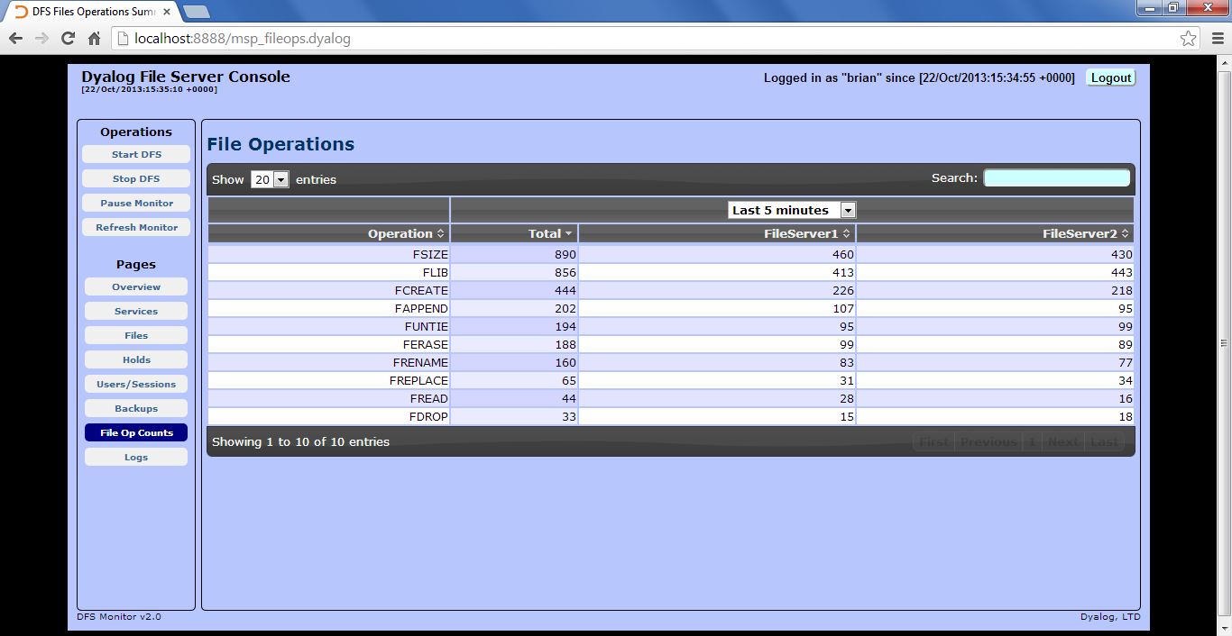
Monitor Screen Shots

Slide 28
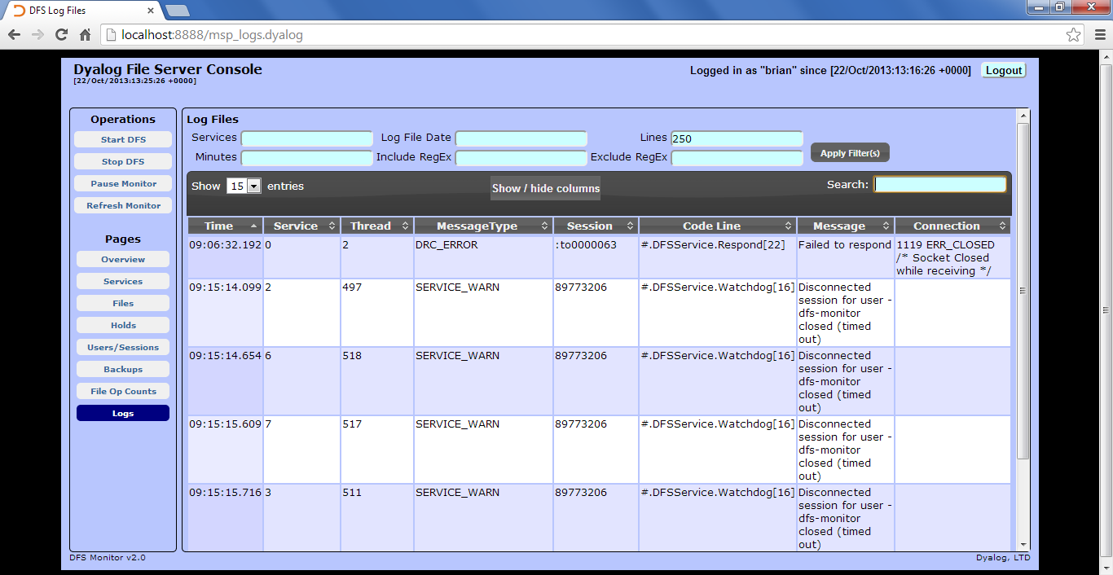
Monitor Screen Shots

Slide 29
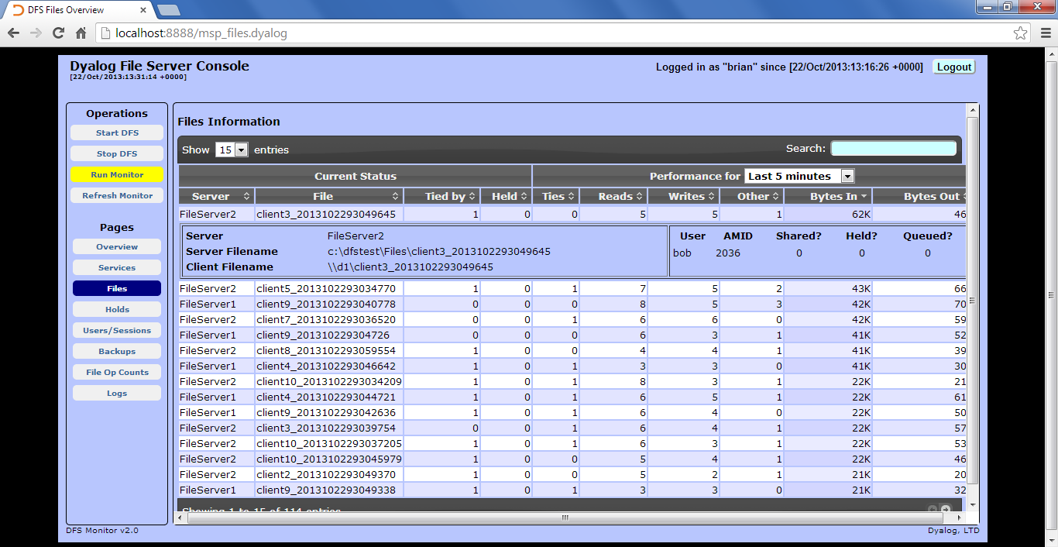
Monitor Screen Shots

Slide 30
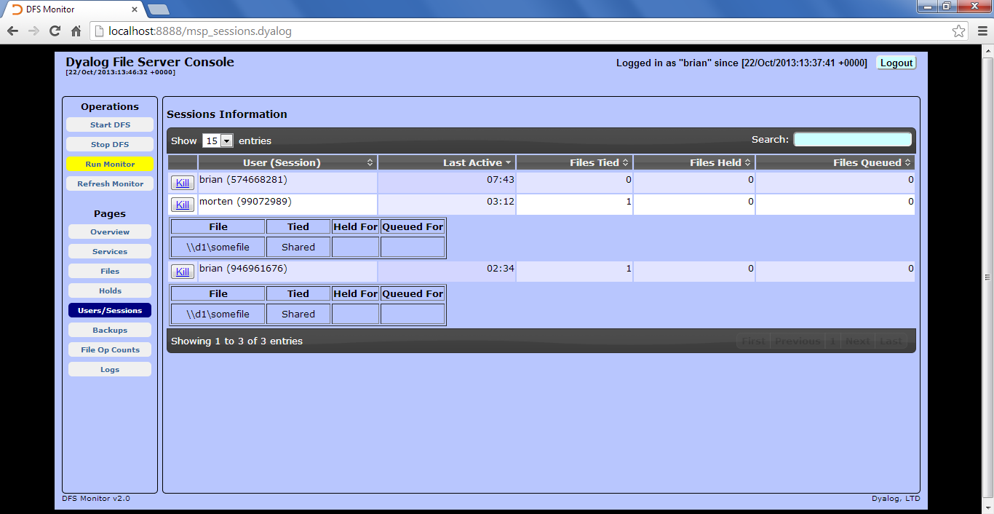
Monitor Screen Shots

Slide 31
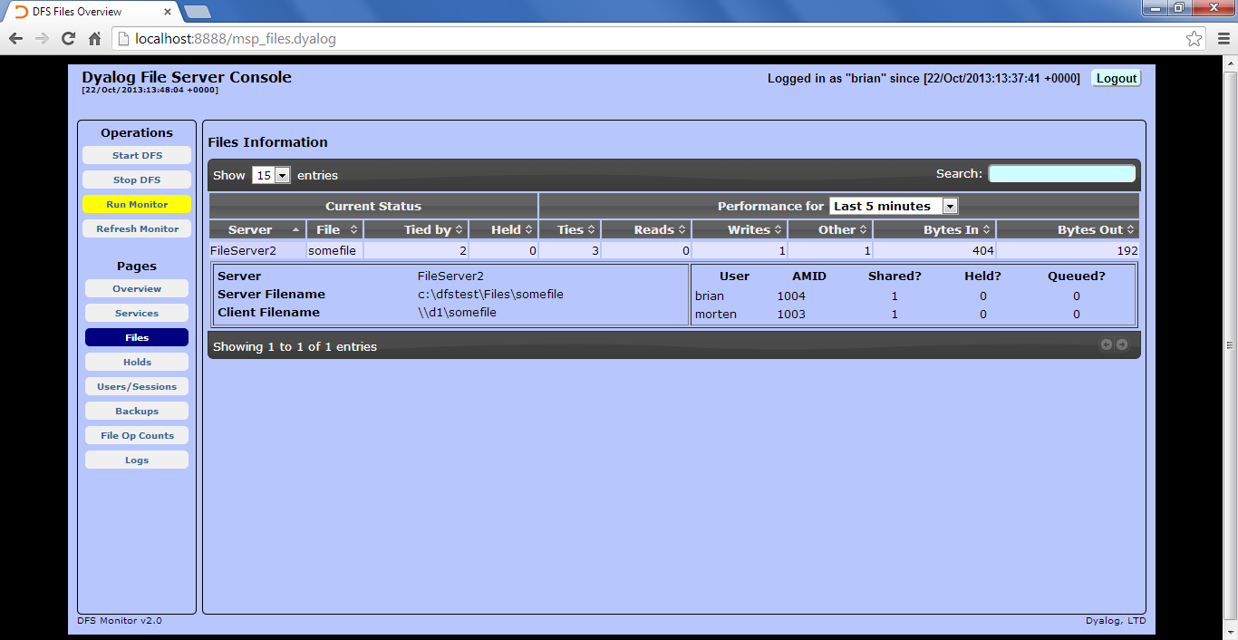
Monitor Screen Shots

Slide 32
Monitor Screen Shots

Slide 33
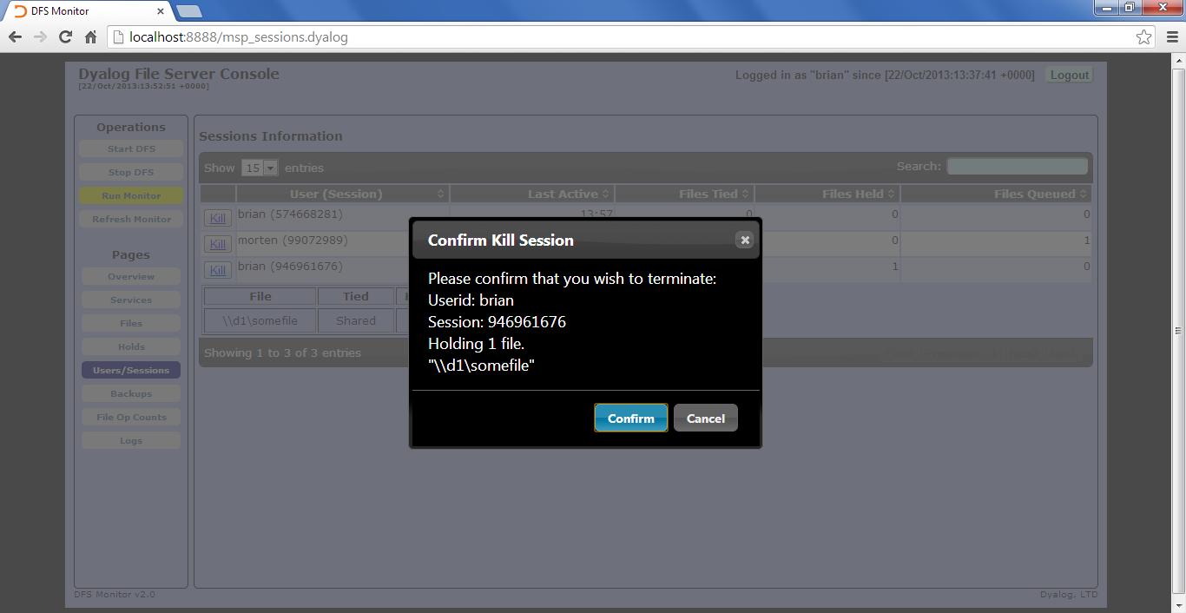
Monitor Screen Shots

Slide 34
DFS Road Map
Performance, Performance, Performance
Client and Server-side caching
Multiple file operations in a single operation
”Stored Procedures” (server-side APL)
Compression
”Transactions”
For example, (⎕FHOLD tn) could trigger the beginning of a transaction and (⎕FHOLD ⍬) be a ”commit”.
Mirroring / Disaster Recovery Features

Slide 35
Availability
V1 released in October 2013: Launch customer ”in production” for over a year, 2nd customer at work
General Availability scheduled on V2.0 release in Q1/2014
Requires Dyalog APL v13.2 for backup feature
Not bundled with APL – sold separately as add-on to runtime licences
Annual licence for 50-user server: £3,000/32bit, £4,500/64bit

