Slide 1
Welcome from Optima Systems
COSMOS performance improvements
^{Paul Grosvenor}
^{Deerfield Beach 2013}
^{Tuesday October 22nd}

Slide 2
The Problem
Lots and lots of data (568Tb largest encountered so far)
Even today the traditional researcher works, thinks and reports in 2D
Analysis based on assumptions which hide meaning
Outdated protocols
Federated (composite) database

Slide 3
What is COSMOS
Largely written in APL
Data visualisation tool
Top down view of the data lake
It has been described as a Thesis generator
Currently targeted at US electronic medical records (EMR data)
Built in “canned queries” – e.g. survivability

Slide 4
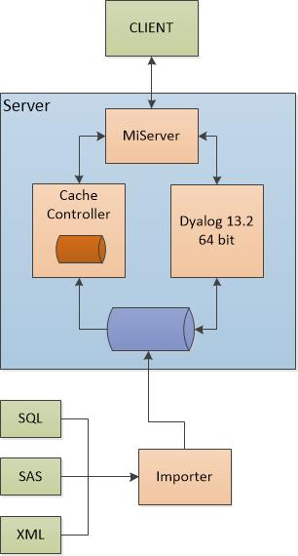
COSMOS version 1

Slide 6
More Problems
Scalability
Security
Performance
Performance
Performance
Got to be Sexy

Slide 7
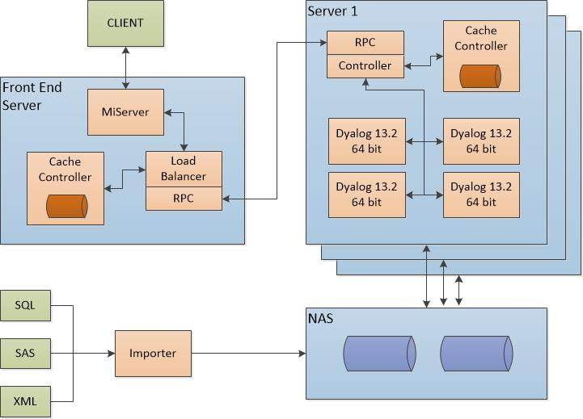
COSMOS now

Slide 8
Some Solutions to the COSMOS Problem
Much help from Dyalog – and APL of course
Caching enquiries
Mapped Files
Flash client side interface
Syncfusion
Special Casing vs generalisation
Refactoring

Slide 9
A typical example
drug←23
patients←(23 26 28) (15 16 19 23) (34 35 124)
drug=patients
1 0 0 0 0 0 1 0 0 0

Slide 10
A simple test
seed←1000?1000
counts←?nubs⍴items
vec←counts⍴¨⊂seed
:For x :In ⍳100
a←100=¨vec
b←(⊂100)=¨vec
c←100∘=¨vec
d←100⍷¨vec
e←(⊂100)⍷¨vec
f←100∘⍷¨vec
:If ∧/a∘≡¨b c d e f
:Continue
:Else
∘
:EndIf
:EndFor

Slide 11
[x=nVectors] timings
vectors | items | 100=vec
10 | 10 | 0.2
10 | 100 | 0.3
10 | 1000 | 0.8
10 | 10000 | 5.5
10 | 100000 | 49
10 | 1000000 | 706
10 | 10 | 0.2
100 | 10 | 1.8
1000 | 10 | 17
10000 | 10 | 169
100000 | 10 | 1705
1000000 | 10 | 17514

Slide 12
[x=nVectors] timings

Slide 13
[x f nVectors] timings
23=¨(21 22 23) (23 23 24 25) (12 13 14 123)
0 0 1 1 1 0 0 0 0 0 0
(⊂23)=¨(21 22 23) (23 23 24 25) (12 13 14 123)
0 0 1 1 1 0 0 0 0 0 0
23∘=¨(21 22 23) (23 23 24 25) (12 13 14 123)
0 0 1 1 1 0 0 0 0 0 0
23⍷¨(21 22 23) (23 23 24 25) (12 13 14 123)
0 0 1 1 1 0 0 0 0 0 0
(⊂23)⍷¨(21 22 23) (23 23 24 25) (12 13 14 123)
0 0 1 1 1 0 0 0 0 0 0
23∘⍷¨(21 22 23) (23 23 24 25) (12 13 14 123)
0 0 1 1 1 0 0 0 0 0 0

Slide 14
[x f nVectors] timings
vectors | items | 100=¨vec | (⊂100)=¨vec | 100∘=¨vec | 100⍷¨vec | (⊂100)⍷¨vec | 100∘⍷¨vec
10 | 10 | 0.3 | 0.2 | 0.3 | 0.3 | 0.3 | 0.4
100 | 10 | 1.9 | 1.9 | 2.8 | 2.2 | 2.2 | 3
1000 | 10 | 17.6 | 17.7 | 27.4 | 21 | 21 | 30.5
10000 | 10 | 169.9 | 170.6 | 266 | 204.5 | 205.6 | 304.9
100000 | 10 | 1846 | 1851 | 2905 | 2134 | 2155 | 3248
1000000 | 10 | 18447 | 17511 | 27589 | 21342 | 20870 | 30768

Slide 15
[x f nVectors] timings

Slide 16
[x f nVectors] timings
vectors | items | 100=¨vec | (⊂100)=¨vec | 100∘=¨vec | 100⍷¨vec | (⊂100)⍷¨vec | 100∘⍷¨vec
10 | 10 | 0.3 | 0.3 | 0.4 | 0.3 | 0.3 | 0.4
10 | 100 | 0.3 | 0.3 | 0.4 | 0.6 | 0.6 | 0.7
10 | 1000 | 0.7 | 0.7 | 0.9 | 3.3 | 3.3 | 3.4
10 | 10000 | 4.3 | 4.2 | 4.7 | 27 | 27 | 27
10 | 100000 | 53 | 53 | 53 | 350 | 350 | 350
10 | 1000000 | 341 | 341 | 344 | 2243 | 2253 | 2241

Slide 17
[x f nVectors] timings

Slide 18
[x ⍳ y] Example
23=(21 22 23) (23 23 24 25) (12 13 14 123)
0 0 1 1 1 0 0 0 0 0 0
1=(,23)∘⍳¨(21 22 23) (23 23 24 25) (12 13 14 123)
0 0 1 1 1 0 0 0 0 0 0

Slide 19
[x ⍳ y] Example
vectors | items | 100=vec | x ⍳ y
10 | 10 | 0.2 | 0.7
10 | 100 | 0.3 | 1.4
10 | 1000 | 0.8 | 9
10 | 10000 | 5.5 | 84
10 | 100000 | 49 | 569
10 | 1000000 | 706 | 6975
10 | 10 | 0.2 | 0.7
100 | 10 | 1.8 | 5.2
1000 | 10 | 17 | 42
10000 | 10 | 169 | 418
100000 | 10 | 1705 | 4113
1000000 | 10 | 17514 | 43347

Slide 20
[x ⍳ y] Example

Slide 21
Index Assignment
bool←1000000⍴0
bool[index]←1
int←1000000⍴⍳10
int[index]←1

Slide 22
Index Assignment
indices | bool[index]←1 | int[index]←1
10 | 0.1 | 0.1
100 | 0.2 | 0.2
1000 | 1.4 | 0.5
10000 | 13 | 3.2
100000 | 127 | 31.2
1000000 | 1267 | 335

Slide 23
Index Assignment

Slide 24
Boolean Operations
bool←items⍴0 1 0 1
bool=0
1 0 1 0 1 0 1 0 1 0
bool<1
1 0 1 0 1 0 1 0 1 0
bool≤0
1 0 1 0 1 0 1 0 1 0

Slide 25
Boolean Operations
items | bool=0 | bool<1 | bool≤0
10 | 0 | 0 | 0
100 | 0 | 0 | 0
1000 | 0.2 | 0.2 | 0.2
10000 | 2 | 2 | 2
100000 | 16 | 16 | 16
1000000 | 160 | 160 | 160
10000000 | 1590 | 1590 | 1590

Slide 26
So What ?
Generalisation or Special Casing
Up to 10x speed-up
Be aware of your data
Caching of previous queries
Lots faster
Mapped Files
Much better memory handling
Data shared across processes
Up to 1.5x speed-up

Slide 27
A Case in Point
Version 1 analysis – 20 million records – 15 minutes
(DCF files and integer pointers)
Version 2 analysis – 50 million records – 3 minutes
(Mapped files and Boolean masks)
Version 3 analysis – 150 million records – 45 seconds
Latest version - >300 million records – circa 30 seconds
n.b. SQL and federated dataset pool – 2 weeks

Slide 28
Thank You and Questions
Contact us:
^{Optima House, Mill Court,}
^{Spindle Way,}
^{Crawley,}
^{West Sussex RH10 1TT}
^{Tel: 01293 562 700}
^{Fax: 01293 562 699}
^{info@optima-systems.co.uk}
^{www.optima-systems.co.uk}

