Slide 1
To Unicode or Not To Unicode
Alexey Miroshnikov

Slide 2
Should I ?
NO !

Slide 3
Should I ?
What you get is your application
Slower
Bigger
Less compatible! *
* It is related to the file format (UTF-8, …) rather than the codding (Unicode).
There are no visible benefits for your clients !

Slide 4
Just for yourself
Get rid of shared ⎕AV element usage
Get rid of *.DIN , *.DOT hassles and the keyboard layout switching
Get rid of multilingual support “nightmare” in Dyalog
⎕NXLATE
⎕NQ ’.’ ‘SetUnicodeTable’
MAPCHARS
APLUNICD.INI*
⎕AVU*

Slide 5
Yes, but I never used any of those why should I ?
You sell (or going to) to Asia, Eastern Europe, some exotic markets
It is imminent and unavoidable
Start planning !

Slide 6
Two views on the conversion
Going out (Codepage 1252)
Coming in (Codepage 1251, …) Specific DIN/DOT tables, keyboard layouts, non-standard ⎕AV, specific fonts, ⎕AV position sharing

Slide 7
GAMA
Leading portfolio management solution in Russia and post-USSR market
20 years at the market place

Slide 8
To be considered
Encoding Unicode
File format
ANSI, UTF-8, UTF-16, …

Slide 9
What exactly ? Not just apl code
Application:
Infrastructure
APL code
3rd party software
Database

Slide 10
What exactly ? Not just apl code
Infrastructure:
Config files
Menus
Help files
Import/Export profiles
Text inside the application code
Logs
Dyalog related files (APLUNICD.INI …)

Slide 11
What exactly ? Not just apl code
Config files
If it is Windows Registry based – no problem. If it is something like old good INI file …
Menus
Depends on the implementation. In our case an action for a menu item is a number – the action code, but in some cases it is an APL expression that later interpreted by the application
Help files
Depends on implementation
Import/Export profiles
Sometimes with the APL expressions
Text inside the application code
In our case it is almost none – all in application dictionaries

Slide 12
What exactly ?
Logs
Include traditional logging, events logging, messaging.
Big troubles! We had something like 6 “about the same” logging feature implementations inside one application!
Some Dyalog related files
APLUNICD.INI …

Slide 13
Is it your problem only?
NO! There is lots of data at the client site which you don’t have a direct access to.

Slide 14
The APL code. How many ?
Functions: 10603
Variables: n/a
Files: 500
⎕AV ⍝ 297 times
⎕DR ⍝ 278 times(⎕DR, ⎕dr, PLUS.dr)
⎕NREAD ⍝ … and related - a lot !

Slide 15
Just a sample
→(⎕av[27]≠⎕nread T,82 1,S-1)↑S1
⎕UCS⍳⎕AV[27]
106
→((⎕UCS 106)≠⎕nread T,82 1,S-1)↑S1
⍝ but what about
⎕AV[MyDelimiter]
⍝ what is the file and it’s new format ?
⍝ you can’t proceed without information
⍝ there are 870 82s in code

Slide 16
How much ?
Start: 17.12.2012 to finish by 23.02.2013, then 15.03.2013, then 25.04.2013, then 01.07.2013.
The Unicode version was shipped 19 July 2013.
The development team:
2 the most experienced developers + 1 good developer on “intelligent” tests.
There is no point to use any but the best developers due to the work specifics – the decision making.
The test team: 3 people

Slide 17
When ?
We were delaying the Unicode project for quite while – for about 3 years…
We’ve started when we realized that the pause in the financial activity caused by the global crises is going to be long… Now or never!

Slide 18
IS IT EASY?
Yes and No.
UNDERESTIMATION
Usually very misleading. Could be damaging considering usually limited time spot selected for implementation.
VERSIONS, VERSIONS
Keep a single version at any price – it is less expensive than a re-start.

Slide 19
TRAPS
Don’t trust 3rd party software
Any step should be reversible
Conversion to Unicode is not the code optimization!

Slide 20
CONCIDER TO
Develop an utility for an “intelligent” update of all files to the 62bit Unicode format. Don’t forget the files at the client locations.
Develop an utility where you can specify not only the ⎕AVU table for a file but for each single component
Develop a procedure for checking all files at the client site as backups still exist !

Slide 21
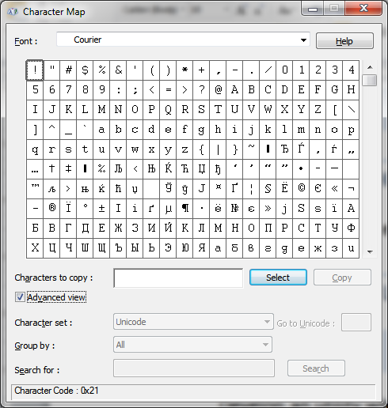
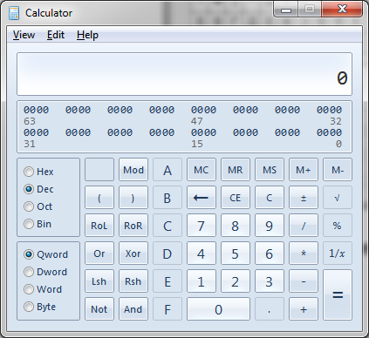
TOOLS
Nothing special. In our case the most used were

Slide 22
utilities
Detect encoding utilities
It is a headache…
MLang
We did not really use it but you might. http://msdn.microsoft.com/en-us/library/aa767865(v=VS.85).aspx
Could be useful for
•Code page and locale enumeration from the MIME database.
•Code page, locale, and character set information retrieval.
•Character set conversion between different multibyte character sets, as well as to and from Unicode.
•A method of working with a set of code pages at once.
•A way to determine which code pages contain a given character or string.
•Detection of which possible code pages and languages text data is written in.
•Custom font creation to display characters from a variety of character sets at once.
•Locale-aware line breaking for console-based applications.

Slide 23
Utilities
Native files
We decided to minimize their usage. Changed to .NET
Logging
Consider a good logging third party software
Windows Events Log Pop-up messages Cross platforms iPad/iPhone messaging E-mail
NLog

Slide 24
Internet resources:
Unicode charts: http://www.unicode.org/charts/
Good reading: UTF-8 Everywhere: http://www.utf8everywhere.org/
Reference information like: http://www.science.co.il/language/Locale-Codes.asp
…and a lot of information like: http://en.wikipedia.org/wiki/Ukrainian_alphabet

Slide 25
Thank you
Take it easy
and good luck with Unicode !

