Slide 1
I {α + ω} APL
How I Won the Dyalog Programming Contest
Yanqing Chen
Oct. 2013
Notes:
This is a quite simple and clear title, sh why I’m standing here and what I’m going to talk ☺
But this is not in a good apl style.
Let’s change the title to be more aplly, a-p-l-l-y.

Slide 2
About me
I am a PhD student at Stony Brook University, New York.
I come from Shanghai, China.
I like playing musical instruments.
I major in Computer Science.
I do research in the field of Natural Language Processing with Professor Steven Skiena.
I title myself as an algorithm person.
Notes:
Piano lovers. Finger agilities. Help speed up typing ☺

Slide 3
How I get in touch with APL
Back to the year of 2009, I happened to expose -- very very little part of myself to APL programming.
res←0
:If 0<⍴Y
:For X :In ⍳⍴Y
res←res + Y [X]
:EndFor
res←res÷⍴Y
:EndIf
Notes:
Being an algorithm guy, I focus mainly on the correctness and effectiveness of an algorithm.
This is something I wrote at that time and I thought I was successful! I wrote a program in APL and I know how to write loop and I know how to check condition and I know how to type these strange characters bla bla bla
This was the real story. I didn’t realize the true power of APL at the first glance but please don’t laugh at me ☺

Slide 4
More APL
In the year of 2011, my friend introduced me to Dyalog programming contest.
Fortunately, this time I found a powerful tutorial – “Mastering Dyalog APL” by Bernard Legrand
This book successfully tweak my thought of APL and help me learn APL from the scratch.

Slide 5
Powerful Script!
Strange symbols in APL represent different script!
While other people construct their castle from regular bricks, APL programmers actually start from a pile that already being arranged for different uses.
Programming is easier and the code is even shorter.

Slide 6
Array-oriented thinking
The other important part in APL.
Make the operators work on vectors of input!
Avoid unnecessary loop expressions.
Clean code and neat logic.
Notes:
But More or less, popular languages will have basic scripts/functions.
e.g. C++ have standard library, java has packages.
This is not the only thing that makes APL outstanding.
Array-oriented idea is the other important part in APL.

Slide 7
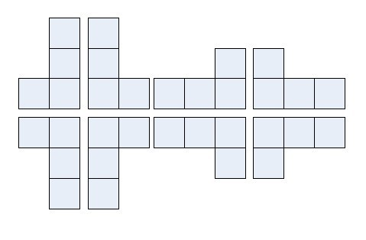
Polyominoes
Given two polyominoes, check if one is some combinations of rotation and/or reflection of the other.
Tell if a 0-1 matrix represents a valid polyominoes.
Generate all distinct valid N-ominoes.
Notes:
Let’s see how these two features affect APL code.
Here is the first section of problems in this year’s Dyalog programming contest phase 2.
I’m not going to cover phase 1 puzzles cuz they are designed for new APL programmers, helping them get used to APL symbols and functions.
This is the Math/CS section and the problems are all about polyominoes.
What is polyominoes? It is a plane geometric figure formed by joining one or more equal squares edge to edge.
It may be regarded as a finite subset of the regular square tiling with a connected interior.
Polyominoes are classified by how many cells they have.

Slide 8
Rotate? Reflect?
The core part might be getting all possible polyominoes q which can be obtained from original polyomino p given operations of flip and rotate ☺
q←⍎¨((⊂[1]2 2 2⊤-1-⍳8)/¨(⊂'⌽⊖⍉')),¨(⊂'p')
One line of 42 characters!
Notes:
It might be hard to implement in other programming languages but in APL we have basic matrix operations.
r←p1 SimilarPoly p2
⍝ 2013 APL Problem Solving Competition stub function for Math/CompSci Low Difficulty Problem
r←(Regularize p1)≡(Regularize p2)
⍝ Check if the regularized forms of two polyominoes are the same
r←Regularize p;values
⍝ Find the regularized form of a polyomino
p←(∨⌿p)/(∨/p)⌿p
⍝ Remove blank lines/columns
⍝ Since polyominoes are connected, this operation keep the original form unchanged
p←⍎¨((⊂[1]2 2 2⊤-1-⍳8)/¨(⊂'⌽⊖⍉')),¨(⊂'p')
⍝ Apply rotations and reflections to create 8 polyominoes sharing the same regularized form
p←({⍵[2]≤⊃⍵}¨⍴¨p)/p
⍝ Keep polyominoes whose height≥width
values←{2⊥,⍵}¨p
⍝ Calculate base 2 coded value for each remaining polyominoes
r←⊃p[⊃⍒values]
⍝ Return the regularized form, which is the polyomino with largest

Slide 9
Regularize
Among these possible results, I need a “regularized shape” so that only similar polyominoes share same regularized shape.
Pick the one with largest encoding value from q:
⊃q[⊃⍒{2⊥,⍵}¨q]
Still one line!

Slide 10
Almost done!
Now I have a regularized form for any polyomino p!
Of course there are some other steps to finish this function:
p← (∨⌿ p)/(∨/ p)⌿p
--Remove blank lines/columns, before rotating
q ← ({⍵[2]≤⊃⍵}¨⍴¨q)/q
--Reform and check shapes, after rotating
Notes:
What we need to do is to check if two polyominoes share the same regularized form, simple and easy.
But basically it is done!

Slide 11
ValidPoly
If a matrix p contains only one 4-connected part, then it is valid.
I need a function, FindConnectedParts, to label all connected parts in a 0-1 matrix p. After that the valid judgment can be written as:
3>⍴∪,FindConnectedParts p
Notes:
Next question is to tell if a given matrix represents a valid polyomino.
r←ValidPoly p
⍝ 2013 APL Problem Solving Competition stub function for Math/CompSci Medium Difficulty Problem
r←3>⍴∪,FindConnectedParts p
⍝ If there are more than 2 different labels including 0, then it is illegal
r←FindConnectedParts p
⍝ Find all connected parts of 0-1 matrix using BFS
r←(BFSOneStep⍣(+/+/p))(p>0)×(⍴p)⍴⍳⍴,p
⍝ First create a dual form of the original matrix where each cell has a different label
⍝ Extend using BFS enough times so that all connected parts share one label
r←BFSOneStep p
⍝ Given a matrix showing the label of each cell
⍝ Label 0 represents unavailable cell
⍝ Extend one step using BFS to merge connected parts
r←(p>0)×p⌈((1↓p)⍪0)⌈(0⍪¯1↓p)⌈(1↓[2]p,0)⌈(0,¯1↓[2]p)
⍝ Find the label of the up/down/left/right cell
⍝ Get the largest label among all distance-1 cells for each cell in the matrix
⍝ Keep label 0 unchanged

Slide 12
FindConnectedParts
First I give all non-empty cells in p with a different label.
Then the idea is to apply Breath-First-Search enough times.
(BFSOneStep⍣(+/+/p))(p>0)×(⍴p)⍴⍳⍴,p
Notes:
By reshaping an index array and get rid of empty cells.
Since at least one cell will change its label in a successful BFS step, the total number of BFS steps we need is the total number of non-empty cells in p.
While in a single BFS step, I want each cell to find the largest label from its neighbors.

Slide 13
BFSOneStep
I try to shift the label in 4 different directions:
(p>0)×p⌈((1↓p)⍪0)⌈(0⍪¯1↓p)⌈(1↓[2]p,0)⌈(0,¯1↓[2]p)
And keep those which labeled 0 unchanged.
We are all set with the help of these two 1-line-functions!

Slide 14
Generate N-0minoes
This is kinda recursive – remind me of Mathematical Induction
A valid N-omino can be constructed by adding 1 unit block to a (N-1)-omino, and there is a initial status N=0
So here is my logic:
r←({∪⊃,/AddOneBlock¨⍵}⍣n)(⊂0 0⍴0)
Notes:
The third question to generate distinct polyominoes that have exactly n unit blocks.
Starting from the very beginning (N = 0), add one block each time to create a set of valid (N+1)-ominoes, and count the number of distinguished items.

Slide 15
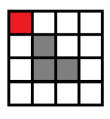
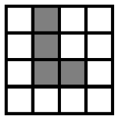
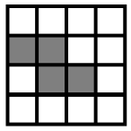
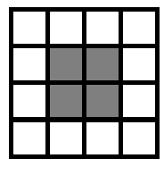
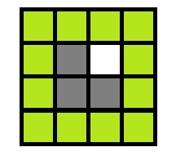
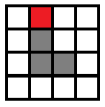
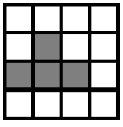
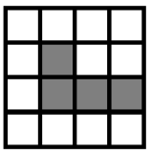
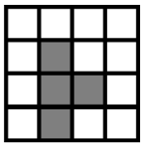
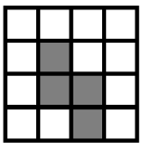
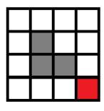
Add One Block
…

Slide 16
AddOneBlock
p←0⍪(0,p,0)⍪0
tmp←(⊂p)∨¨⊂[1 2]((⍴p)⍴⍳⍴,p)∘.=⍳⍴,p
tmp←((1++/+/p)=+/¨+/¨tmp)/tmp
r←∪,Regularize¨(⊃¨ValidPoly¨tmp)/tmp
Slightly longer? But it is still in 4 lines of code!
Notes:
Now I need another function, given input as a valid polyomino p, output a set of valid polyominoes by adding 1 unit block to it.
First I extend the matrix by 1 in all 4 directions so that I can find all possible ways of adding blocks.
Then I create that many 1-unit-blocks, one for each position in extended matrix and apply the union operation.
I have to get rid of some operations. For example, putting a block on one of the existing blocks – This kind of operations can be caught if the total number of blocks is not increaing. Or, create invalid polyomino – I need previous Check Valid Polyomino function.
Finally, since I want only distinct ones, I will apply the Regularize function.

Slide 17
Math/CS section cleared!
Awesome script functions!
Combination of single character script can finish 80% of the job ☺
Notes:
As a programmer, I have to say that APL has an amazing library of script functions.
Imagine how much C++/Java programmer have to do to finish even the matrix rotation/ reflection.
With the help of those strange characters, I am able to finish implementation both fast and reliably.
Though the code contains only several lines, but all my ideas are compressed in it.

Slide 18
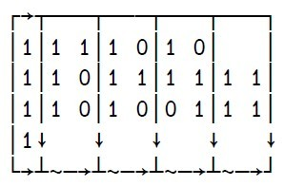
Dimension
I consider this to be a very important experience in programming APL.
Display function
For each operator (¨), nested array.
Notes:
A 2-d matrix containing 1-d vector in each cell is definitely not the same as a 3-d matrix, even the expressive power is equivalent.

Slide 19
Is that enough?
I am a CS student and I finished CS section, but…
Nothing can stop me from peeking what is inside Engineering section.
Plus, I’m really getting addicted to APL ☺ – let’s go to the Duck test!

Slide 20
The Duck Test
Given an 0-1 matrix, find the center of gravity using a specific coordinate.
Help robot locate object on the ground!
A real test! Recognize and locate all ducks!
Notes:
I think people are all excited about the Robot war demo!
This Engineering section introduce us a pattern recognition problem which can be applied on the Raspberry Pi.

Slide 21
Find center of gravity
A simple simulation.
Calculations on X-axis and Y-axis are independent.
This is the coordinates in Screen coordinates.
(n m)←⍴p
((+/(-((m+1)÷2)-⍳m)×+⌿p)(+/(((n+1)÷2)-⍳n)×+/p))÷(+/+/p)

Slide 22
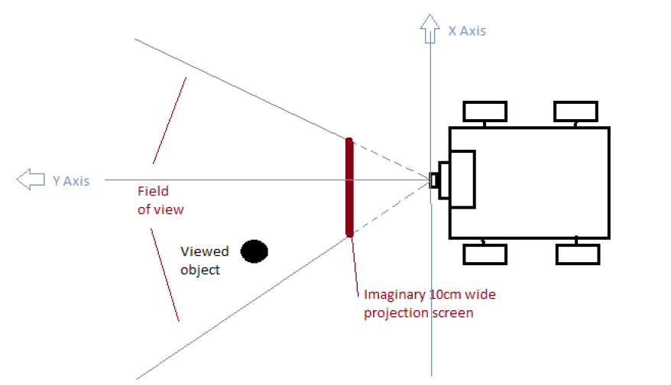
Optical Illustration
3-d coordinates (x, y, z)
Camera: (0, 0, 10) Center of screen: (0, 5, 10)
Screen: (-5, 5, 6) (-5, 5, 14), (5, 5 6), (5, 5, 14)
A point ($X_{s},Y_{s})$ in screen coordinates will be
($X_{s}$, ${5, 10+Y}_{s})$ in 3-d coordinates
The projection point on the ground ($X_{g},Y_{g}) follows:$
$\frac{X_{s}−0}{5−0}=\frac{X_{g}−0}{Y_{g}−0}$ and $\frac{{(10+Y}_{s})−10}{5−0}=\frac{0−10}{Y_{g}−0}$
Notes:
A 2-d space parallel to x axis
First find the absolute position of projection point on the screen, measure in centimeter:
(x y)←((FindCG img)+0,⊃MinMax img)×(8 5)÷⍴img

Slide 23
Locate
Thus the true point on the ground for a given screen system point (x y) is, by optical transformation:
(x×¯10÷y)(¯50÷y)
While the point (x y) on the screen we need to find is:
(x y)←((FindCG img)+0,⊃MinMax img)×(8 5)÷⍴img
Notes:
This is another simulation process.

Slide 24
MinMax
This function is used to find the top most coordinates and the bottommost coordinates.
tmp←(∨/img)/((1+⍬⍴⍴img)÷2)-⍳⍬⍴⍴img
⍝ List of Y values having observed points
Return top/bottom values as:
(⌊/tmp)(⌈/tmp)

Slide 25
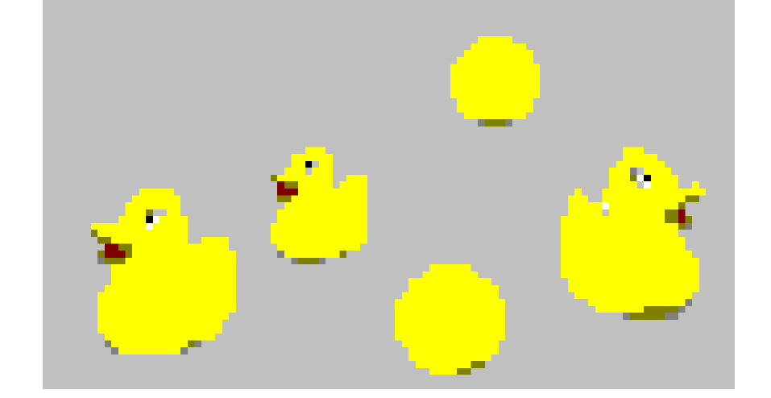
Ducks and balls
What is the feature of ducks and balls?
Both contain a connected parts of yellow pixels
What is the difference between ducks and balls?
Ducks have a connected parts of non-yellow pixels
inside its yellow body
Notes:
ans←FindDucks img;q;r;s
⍝ 2013 APL Problem Solving Competition stub function for Engineering High Difficulty Problem
q←FindConnectedParts img=11
⍝ Find yellow connected parts -- yellow balls and yellow ducks
r←FindConnectedParts img≠11
⍝ Find non-yellow connected parts, including background, shade and duck features
s←1-{(⍵<0)/⍵}∪,{⍵-BFSOneStep ⍵}q∨(r>0)∧(r<8000)
⍝ Consider only those non-yellow non-background enclosed connected parts as duck features (eyes)
⍝ List all duck labels
q←⊂[2 3]s∘.=q
⍝ Create one image for each detected duck
ans←((⍴s),2)⍴⊃,/Locate¨q
⍝ Locate the relative position
ans←ans,(1.6÷⊃⍴img)×ans[;2]×1+{⊃¨(¯1↑¨⍵)-1↑¨⍵}MinMax¨q
⍝ Estimate height of ducks using the top and bottom observed points
⍝ Applying optical transformation according to the geometry

Slide 26
FindDucks
q←FindConnectedParts img=11
r←FindConnectedParts img≠11
s←1-{(⍵<0)/⍵}∪,{⍵-BFSOneStep ⍵}q∨(r>0)∧(r<8000)
⍝ Consider only those non-yellow non-background enclosed connected parts as duck features (eyes)
Notes:
Here q is the connected parts labels for all possible ducks and balls,
r is the connected parts labels for background and duck features.
The next step to calculate s is somewhat tricky – I assume that the bottom-right pixel is always a part of background and all background is a single connected part.
Then I apply BFSOneStep (which is used in Math/CS section, for each cell find largest label in its neighbors) on connected parts in q and r except backgrounds.
If this is a duck, I will find the some changes on the boundary of duck body and its eye feature.
Now in s there are all detected ducks’ labels.
ans←FindDucks img;q;r;s
⍝ 2013 APL Problem Solving Competition stub function for Engineering High Difficulty Problem
q←FindConnectedParts img=11
⍝ Find yellow connected parts -- yellow balls and yellow ducks
r←FindConnectedParts img≠11
⍝ Find non-yellow connected parts, including background, shade and duck features
s←1-{(⍵<0)/⍵}∪,{⍵-BFSOneStep ⍵}q∨(r>0)∧(r<8000)
⍝ Consider only those non-yellow non-background enclosed connected parts as duck features (eyes)
⍝ List all duck labels
q←⊂[2 3]s∘.=q
⍝ Create one image for each detected duck
ans←((⍴s),2)⍴⊃,/Locate¨q
⍝ Locate the relative position
ans←ans,(1.6÷⊃⍴img)×ans[;2]×1+{⊃¨(¯1↑¨⍵)-1↑¨⍵}MinMax¨q
⍝ Estimate height of ducks using the top and bottom observed points
⍝ Applying optical transformation according to the geometry

Slide 27
FindDucks
Locate ducks’ projection points
q←⊂[2 3]s∘.=q
ans←((⍴s),2)⍴⊃,/Locate¨q
⍝ Estimate height of ducks using the top and bottom observed points, applying optical transformation according to the geometry
ans←ans,(1.6÷⊃⍴img)×ans[;2]×1+{⊃¨(¯1↑¨⍵)-1↑¨⍵}MinMax¨q
Notes:
Now things become simple. I have all the detected ducks, what I have to do is get their projection point on the ground using Locate function.
What’s more, I have to estimate the height of the duck – which can be done by calculate the height of the duck on the screen using MinMax function, and convert it to 3-d coordinates system by applying optical transformation.

Slide 28
Eng section Cleared
This part of the contest is more practical.
Not just solving an algorithm issue ☺ Feels like the program can be actually used in real situations
http://cto.dyalog.com, Raspberry Pi Robot

Slide 29
Broadcasting & Overloading
Restricted a lot on the flexibility of programming if NO broadcasting/overloading.
--multiply a matrix with an integer without changing the type.
--create vectors of similar dimensions together and apply array-oriented operations
The programmer have to be familiar with the dimensions of the variables.
Notes:
In C++/Java or other programming language, the variables are predefined and you can never broadcast them.
That restricted a lot on the flexibility of programming.
By broadcasting, I can multiply a matrix with an integer without changing the type.
By broadcasting, I can create vectors of similar dimensions together and apply array-oriented operations
The programmer have to be familiar with the dimensions of the variables.

Slide 30
Predator and Prey simulation
Simulate a 1-varible recursive function.
Simulate a 2-varible recursive function and predict the trend.
Simulate a matrix recursive function.
Notes:
According to my experience, Bio section contains much more code than Math/CS and Eng section ☺
No offense, Biologist are still respectful.

Slide 31
NextGen
:Trap 0
r←0⌈N×1+B×Neq-N
:Case 11
r←⌊/⍬
:EndTrap
⍝ If an DOMAIN ERROR occurs, return the maximum number
Notes:
This is where I learn how to use Trap.
Though it remind me of my For loop 4 years ago (since it looks like C++ and java) but it is really good to have a way to deal with exceptions.
You do not want your program to halt unexpectedly ☺

Slide 32
GenX
¯1↑({B Neq(NextGen ⍵)}⍣A)B Neq N
⍝ Apply NextGen for a certain number of generations
Notes:
Recursive array – keep everything in the same format.

Slide 33
PredPrey
⍉(({⍵⍪PredPreyNextGen,(¯1)↑⍵}⍣(gen-1))1 6⍴Neq N R P S C)[;2 4]
⍝ Apply PredPreyNextGen for a specific number of generations
⍝ Accumulate results in the matrix
⍝ Return two columns of N and P history

Slide 34
PredPreyNextGen
r←PredPreyNextGen(Neq N R P S C);Nnext;Pnext
Nnext←0⌈(N×1+(R-1)×1-N÷Neq)-C×N×P
Pnext←0⌈S×N×P÷Neq
r←Neq Nnext R Pnext S C
⍝ According to the formula, calculate the next generation of predators and preys

Slide 35
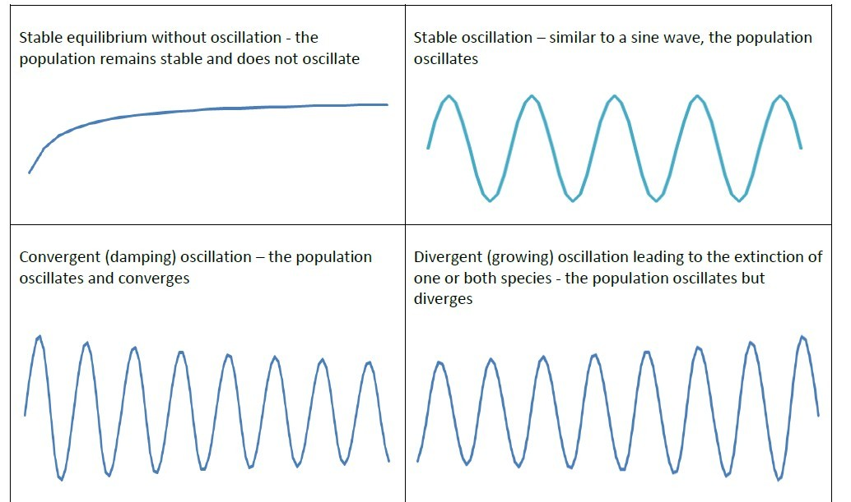
OutcomeType
There are 4 types of outcomes.
Notes:
r←OutcomeType p;outstring;q;X;Y;Z
⍝ 2013 APL Problem Solving Competition stub function for Biology Medium Difficulty Problem 2
p←p[1;]
q←(((2↓p)<(1↓¯1↓p))∧(1↓¯1↓p)>(¯2↓p))/(1↓¯1↓p)
⍝ Pick all peak values of prey populations
X←+/(1↓q)>¯1↓q
Y←+/(1↓q)<¯1↓q
Z←+/(1↓q)=¯1↓q
⍝ Decide outcome type according to the trend of peak values
⍝ divergent←peak going up
⍝ convergent←peak going down
⍝ oscillation←peak keep unchanged
⍝ equilibrium←no peak values
outstring←'equilibrium' 'oscillation' 'convergent' 'divergent'
⍎((Z=0)∧(X+Y)=0)/'r←outstring[1]'
⍎((Z>0)∧(X+Y)=0)/'r←outstring[2]'
⍎((Y>0)∧(X=0))/'r←outstring[3]'
⍎((X>0)∧(Y=0))/'r←outstring[4]'

Slide 36
OutcomeType
p←p[1;]
q←(((2↓p)<(1↓¯1↓p))∧(1↓¯1↓p)>(¯2↓p))/(1↓¯1↓p)
⍝ Pick all peak values of prey populations
X←+/(1↓q)>¯1↓q
Y←+/(1↓q)<¯1↓q
Z←+/(1↓q)=¯1↓q

Slide 37
Bunnies and Foxes on an island
N*N matrix where each cell is a dwelling place
In each round:
-- calculate the procreate rate for predators and preys in each dwelling place
-- simulate the birth and death of an individual
-- simulate the migration procedure that allow an individual to move to an adjacent cell.

Slide 38
Around
r←mat Around n;x1;x2;y1;y2
⍝ Calculate observed density around the n-th cell in mat within a 7×7 area
(x1 y1)←1⌈¯2+(⍴mat)⊤n-1
(x2 y2)←(⍴mat)⌊4+(⍴mat)⊤n-1
⍝ Indexes of max/min X/Y
r←(+/,mat[((x1-1)+⍳x2+1-x1);((y1-1)+⍳y2+1-y1)])÷(x2+1-x1)×(y2+1-y1)
⍝ Calculate weighted average as observed density
Notes:
Input: a matrix and an integer index. Index numbers ordered first in row then in column.
Output: Density in the indexed cell.

Slide 39
Density
r←Density mat
⍝ Calculate Observed Density of the matrix
r←(⍴mat)⍴,⊃¨(⊂mat)Around¨⍳⍴,mat

Slide 40
Live
r←Live(m n)
⍝ Given a procreate/die rate n in percentage, and individual number n
⍝ Simulate the action of each individual and accumulate the number of next generation
⍎(m=0)/'r←0'
⍎((n<0)∧(m>0))/'r← m- +/ (-n)≥?m\100'
⍎((n≥0)∧(m>0))/'r← m× ⌊n÷100 ⋄ n←100 ⊤ n ⋄ r←r+ m++/ n≥?m\100'

Slide 41
Procreate
r←Procreate(observe prob)
⍝ Given observed count matrix and procreate/die probability matrix
⍝ Simulate the populations of the next generation
r←(⍴observe)⍴Live¨⊂[1](,observe),[0.5](,prob)

Slide 42
Migrate
r←Migrate p;q;s
r←(⍴p)⍴0 ⋄ q←(⍴p)⍴5 ⋄ q←(¯1+1↑q)⍪(1↓¯1↓q)⍪(¯1+¯1↑q) ⋄ q←(¯1+1↑[2]q),(1↓[2]¯1↓[2]q),(¯1+¯1↑[2]q)
3 4 4 4 … 4 3
4 5 5 5 … 5 4
4 5 5 5 … 5 4
…
3 4 4 4 … 4 3
Notes:
r←Migrate p;q;s
⍝ Migrate simulation for each individual
⍝ Can only deal with matrix with n>1 and m>1
r←(⍴p)⍴0
q←(⍴p)⍴5
q←(¯1+1↑q)⍪(1↓¯1↓q)⍪(¯1+¯1↑q)
q←(¯1+1↑[2]q),(1↓[2]¯1↓[2]q),(¯1+¯1↑[2]q)
⍝ Pre-processing, create moving probability matrix
s←(⍴1↓p)⍴RandomPick¨⊂[1](,1↓p),[0.5](,1↓q)
(r p q)←(r p q)-((-s⍪0)(0⍪s)(0⍪s≥0))
⍝ Simulate those individuals that moving up
s←(⍴¯1↓p)⍴RandomPick¨⊂[1](,¯1↓p),[0.5](,¯1↓q)
(r p q)←(r p q)-((-0⍪s)(s⍪0)((s≥0)⍪0))
⍝ Simulate those individuals that moving down
s←(⍴1↓[2]p)⍴RandomPick¨⊂[1](,1↓[2]p),[0.5](,1↓[2]q)
(r p q)←(r p q)-((-s,0)(0,s)(0,s≥0))
⍝ Simulate those individuals that moving left
s←(⍴¯1↓[2]p)⍴RandomPick¨⊂[1](,¯1↓[2]p),[0.5](,¯1↓[2]q)
(r p q)←(r p q)-((-0,s)(s,0)((s≥0),0))
⍝ Simulate those individuals that moving right
r←r+p
⍝ Merge those stay

Slide 43
RandomPick
r←RandomPick(m n)
⍝ Util simulating function
⍝ m individual each have n evenly distributed choices
⍝ Similate how many among them made the first choice
r←0 ⋄ ⍎(m>0)/'r←+/1=?m\n'

Slide 44
Migrate
s←(⍴1↓p)⍴RandomPick¨⊂[1](,1↓p),[0.5](,1↓q) ⋄ (r p q)←(r p q)-((-s⍪0)(0⍪s)(0⍪s≥0))
s←(⍴¯1↓p)⍴RandomPick¨⊂[1](,¯1↓p),[0.5](,¯1↓q) ⋄ (r p q)←(r p q)-((-0⍪s)(s⍪0)((s≥0)⍪0))
s←(⍴1↓[2]p)⍴RandomPick¨⊂[1](,1↓[2]p),[0.5](,1↓[2]q) ⋄ (r p q)←(r p q)-((-s,0)(0,s)(0,s≥0))
s←(⍴¯1↓[2]p)⍴RandomPick¨⊂[1](,¯1↓[2]p),[0.5](,¯1↓[2]q) ⋄ (r p q)←(r p q)-((-0,s)(s,0)((s≥0),0))
r←r+p

Slide 45
PredPreyIsland
r←PredPreyIsland(island Neq R S C);o_prey;o_pred;len;tmp;p_prey;p_pred
⍎(0=(+/+/island[1;;])×+/+/island[2;;])/'r←(island Neq R S C) ⋄ →0'
len←⊃⍴,island[1;;]
(o_prey o_pred)←Density¨⊂[2 3]island
tmp←len 6⍴⊃,/PredPreyNextGen¨⊂[1]6 len⍴⊃,/((len\Neq)(,o_prey)(len\R)(,o_pred)(len\S)(len\C))
Notes:
r←PredPreyIsland(island Neq R S C);o_prey;o_pred;len;tmp;p_prey;p_pred
⍝ Simulate the whole island, for one generation
⍎(0=(+/+/island[1;;])×+/+/island[2;;])/'r←(island Neq R S C) ⋄ →0'
⍝ If one species extinct, return current status
len←⊃⍴,island[1;;]
(o_prey o_pred)←Density¨⊂[2 3]island
⍝ Calculate Observed population density for prey and predator
tmp←len 6⍴⊃,/PredPreyNextGen¨⊂[1]6 len⍴⊃,/((len\Neq)(,o_prey)(len\R)(,o_pred)(len\S)(len\C))
⍝ Apply PredPreyNextGen to all cells, using same Neq/R/S/Chart and differnet N/P values.
p_prey←(⍴o_prey)⍴400⌊⌊100×(tmp[;2]-,o_prey)÷,o_prey
p_pred←(⍴o_pred)⍴200⌊⌊100×(tmp[;4]-,o_pred)÷,o_pred
⍝ Get the probability matrix of procreate and die for prey and predator
o_prey←Migrate Procreate island[1;;]p_prey
o_pred←Migrate Procreate island[2;;]p_pred
⍝ Simulate next generation for each individual on the map
r←(o_prey,[0.5]o_pred)Neq R S C
⍝ Reform output format

Slide 46
PredPreyIsland
p_prey←(⍴o_prey)⍴400⌊⌊100×(tmp[;2]-,o_prey)÷,o_prey
p_pred←(⍴o_pred)⍴200⌊⌊100×(tmp[;4]-,o_pred)÷,o_pred
o_prey←Migrate Procreate island[1;;]p_prey
o_pred←Migrate Procreate island[2;;]p_pred
r←(o_prey,[0.5]o_pred)Neq R S C
⍝ Reform output format
Notes:
Fibonacci

Slide 47
BunnyFox
r←island BunnyFox(gen Neq R S C)
r←⊃((PredPreyIsland⍣gen)island Neq R S C)

Slide 48
Bio section cleared!
All simulations
Lines of codes greatly distinguished from the other two sections
Quite open as a real project from biologist
If the description could be better ☺

Slide 49
Nice experience!
I enjoyed the contest!
It’s always good to have background varieties.
Real problems in different fields are attractive.

Slide 50
Nice experience!
APL code provide a direct way of showing your thought.
I feel that there are still much to learn.
I tried less than 70% of the content from “Mastering Dyalog APL”.
APL can do much more than I thought before.
Notes:
Though the contest problem set covers quite a large range of basic APL commands
Which means I don’t even have a chance to try many of them.
And also, during the conference, I found APL can do much more than I thought before. Like parallel computing, compressing, encoding-decoding, file system and APL applications. These are “professional” and I’ll never experience them from the aspect of a basic algorithm person.

Slide 51
Thank you!
Notes:
Thanks dyalog for offering me the chance ☺
Any more questions?
That’s it, thank you!

