Slide 2
Note to self:
Don’t complain about your slot being in the morning after the banquet:
Be glad you didn’t have to talk straight after John Scholes.
Mention up-front that you were totally lost when the kid explained the APL
contest solution. Admit that you did not even understand the questions.

Slide 3
RISKFLOW is all about
CASHFLOW MANAGEMENT

Slide 4
2015

Slide 5
$ 1.00

Slide 6
$6.00

Slide 7
$1.50

Slide 8
Like our software, SA offers unlimited
SCENARIO ANALYSIS

Slide 9
Whale Watching

Slide 10
Horseback riding

Slide 11
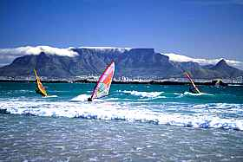
Beach sports

Slide 12
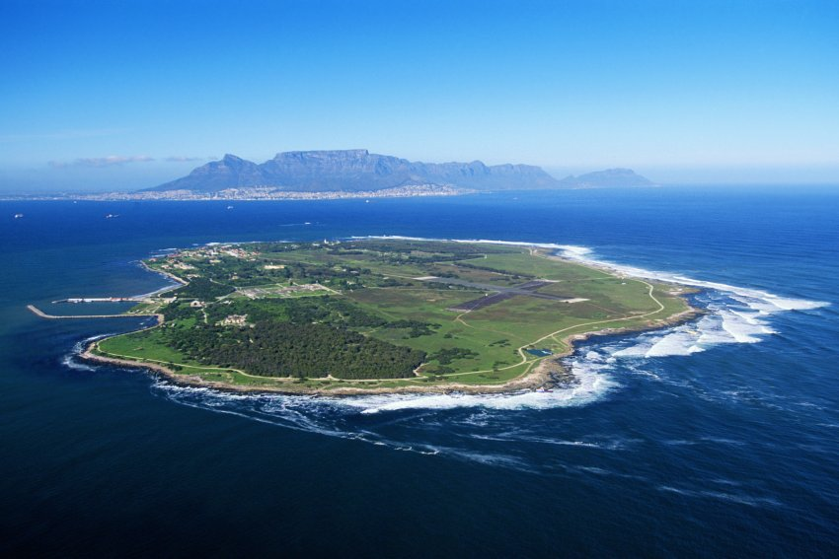
Visit Robben island

Slide 13
Our suggested development approach :

Slide 14
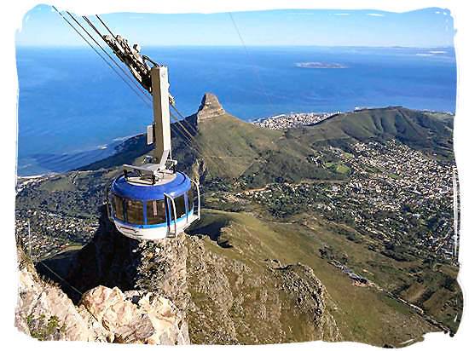
explore

Slide 15
prototype

Slide 16
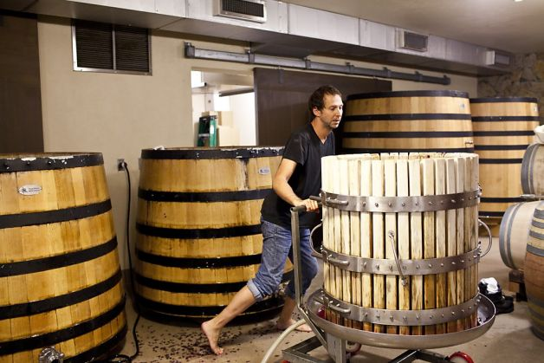
develop

Slide 17
test

Slide 18
Ensure testing is thorough

Slide 19
You can never test enough

Slide 20
Go live

Slide 21
We take optimization seriously:
:if you=European
Only 8 – 10 hours flight from anywhere in Europe to SA
˄
Direct flights from 9 European capitals
˄
No time zone difference
:else
The above was unfortunately only optimized for Europeans
:endif
Still, you’ll be able to walk on the wild side

Slide 22
Note to self:
Remember
Flight delays due to employees stealing power cables is
only funny if you are South African

Slide 23
CFO –
Cash Flow Optimizer
Why
What
How

Slide 24
CFO – WHY
Of the 52,98 million South Africans over the age of 18,
13.56 million - 25.6% - is unemployed. (Mid 2013 stat)
Government job creation programs have not been successful – the only way forward is development of the SMME sector (Small, Medium, Micro Enterprises)
In SA, 5 out of 7 businesses formed in 2011 have already failed.
Without financial literacy, this will not improve
All 3rd world countries have similar problems

Slide 25
Cashflow Optimizer App
“Cash flow management is fundamental to business success. Cash flow management means financial literacy—the ability to read and make sense of financial statements. Many small-business owners go under because they can’t tell the difference between profit and cash flow. Profit may be phantom cash flow. Actual cash flow is to a business what blood is to the human body.”
- Robert T. Kiyosaki, Rich Dad Poor Dad

Slide 26
CFO – What
Already had spreadsheet solution
Overwhelming to use
Very last century UI

Slide 27
CFO – What
Get a sexy front-end
Cater for touch devices
Use a proper database
Host it on the cloud
Use APL for the calcs
KISS

Slide 28
NOTE TO SELF
At this point,
Mention the following:
If the App was live, the developers would have been doing
the presentation, in which case it would have been a technical one.
In case anyone asks a technical question, refer them to 1 above

Slide 29
CFO – How
Front-end :PHP
HTML5
JavaScript
CSS
Data server: C#
Database: MS SQL
Calc engine: Dyalog APL

Slide 30
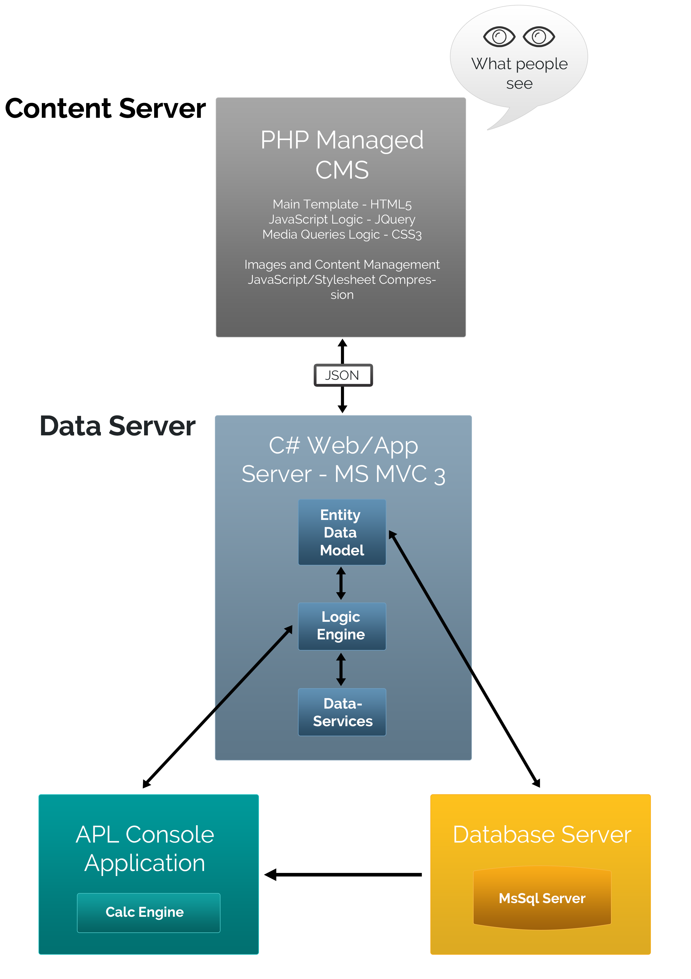

Slide 31
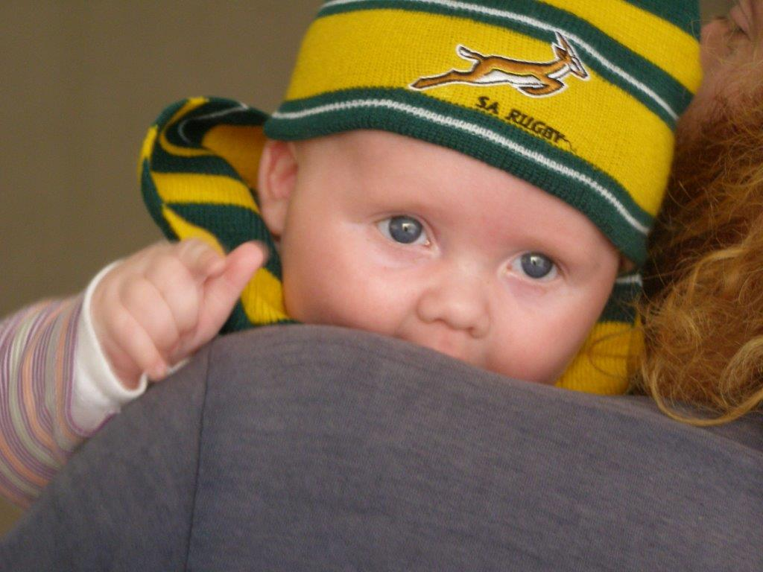
WHY NOT DO ALL OF IT IN APL?

Slide 32
Performance issues
The first change involved page generation, which was moved from the front-end to the web service.
Instead of using Java Script templates, which were slow to build with the amount of data that was being sent, the web service now makes use of C# and Razor to generate all the content views.
AND THEN
A casual conversation (between an old pre Y2K APL programmer and the database guys) lead them to discover the wonderful world of vectors!

Slide 33
SQL Vectors
Originally all data was stored as individual entries in the database. This meant that for a given question, e.g. “Vehicle Loan", each month's value was saved in a separate record. Data is generated for 60 months, thus 60 records. Furthermore each question has assumptions associated to it, which meant even more records, averaging about 180 records for a single question for a single user.
With approximately 100 questions and default data being generated for each registered user, the amount of data in the database grew exponentially leading to degraded performance.
First we limited records to a single entry per question. This was achieved by storing a comma-separated string of all 60 values in one entry, thereby decreasing the amount of records from 180 to only 3: 1 for the question and 1 each for its assumptions.
Next we only stored data as was needed, eliminating the storing of default values. Now when a user edits the value for a question, a check is made by the web service to see if an entry exists. If not, a new entry is added and the APL DLL is invoked.
These two changes drastically improved data storage,
ensuring that the app will be capable of accommodating a large user base.

Slide 34
Cashflow Optimizer App
Target Market
Individuals & SMEs
Educational organizations

Slide 35
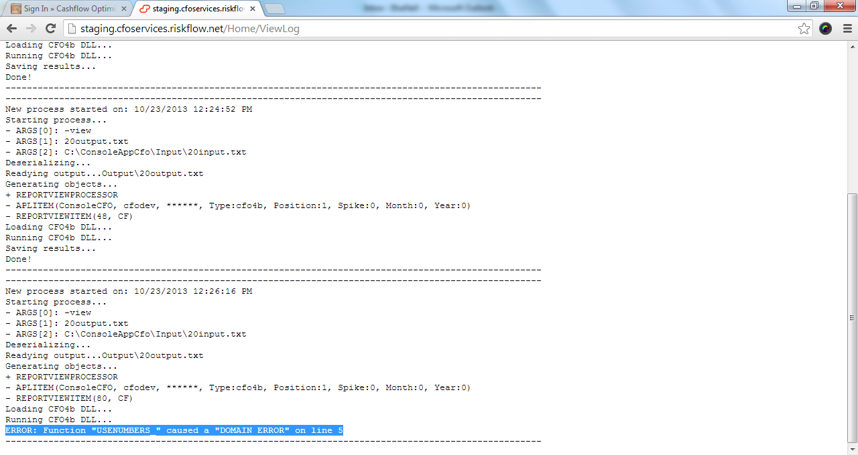

Slide 36
Managing Tomorrow’s Cash Flow Risks Today!
Please check out our app:
https://app.riskflow.net/

