Slide 2
News from the Documentation Department
Fiona Smith
Documentation Manager

Slide 3
Agenda
Documentation
Long-term plans
Short-term plans
Social Media
Strategy (the “why?”)
Channels (the “how?”)

Slide 4
Documentation: Long Term
New templates
Cohesive set of documents
Comprehensive coverage
Terminology standardisation
More beginner-level documents
Greater range of deliverable formats

Slide 5
Documentation: Short Term
New documents
DFS
RIDE
Update/Rework existing documents
MiServer

Slide 6
Social Media Strategy
How to make Dyalog and APL attractive to a new generation of users?
Conventional marketing techniques no longer relevant
Keep everyone informed and make information easily accessible
Different channels for different audiences

Slide 7
Social Media Channels (1 of 3)

Slide 8
Social Media Channels (2 of 3)
Website: http://www.dyalog.com/
Front page panels for big stories
Front page Twitter feed
Full news articles
Calendar of upcoming events
Forum and blog
Links to all other social media

Slide 9
Social Media Channels (3 of 3)
We contribute to:
http://lambda-the-ultimate.org/
https://groups.google.com/forum/#!forum/comp.lang.apl
https://www.linkedin.com/groups?home=&gid=1805002
Also:
e-mails to registered users
news articles on website
DYALOGue
papers/videos/seminars/external conferences
What else?

Slide 10
Your Input
Documentation and social media is for the users; your feedback matters!
fiona@dyalog.com
docs@dyalog.com
media@dyalog.com
website@dyalog.com

Slide 11
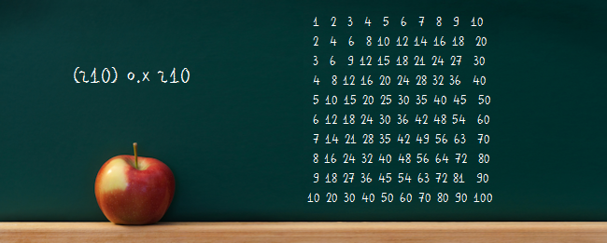
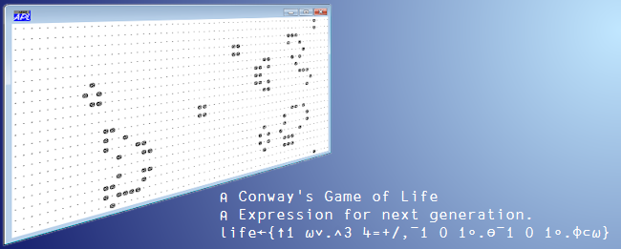
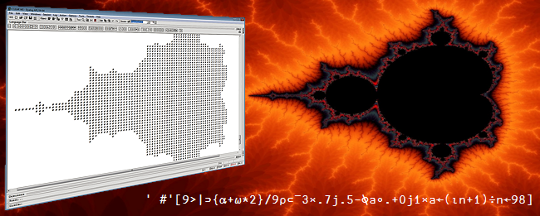
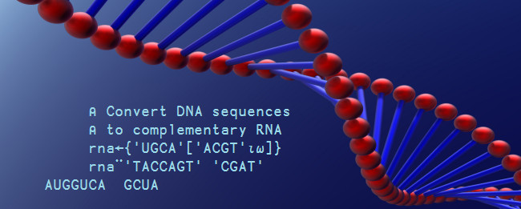
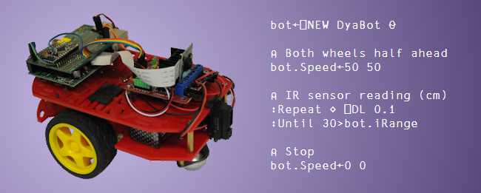
Banners: APL In Action

Slide 12
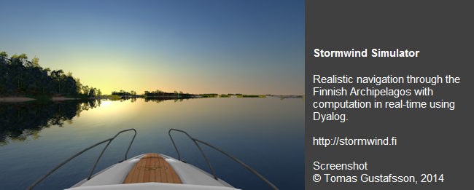
Banners: Dyalog In Action

Slide 13
Useful Links
Twitter: https://twitter.com/DyalogAPL
FaceBook: https://www.facebook.com/DyalogAPL
LinkedIn: https://www.linkedin.com/company/dyalog-ltd-
Blog: http://www.dyalog.com/blog/
Forum: http://www.dyalog.com/forum/
YouTube:
https://www.youtube.com/user/DyalogConference
https://www.youtube.com/channel/UCRFAE1uHnrhXlSkoaAgKsIQ

