Slide 1
School LASER with NFC
By Ziggi of Laser Learning

Slide 2
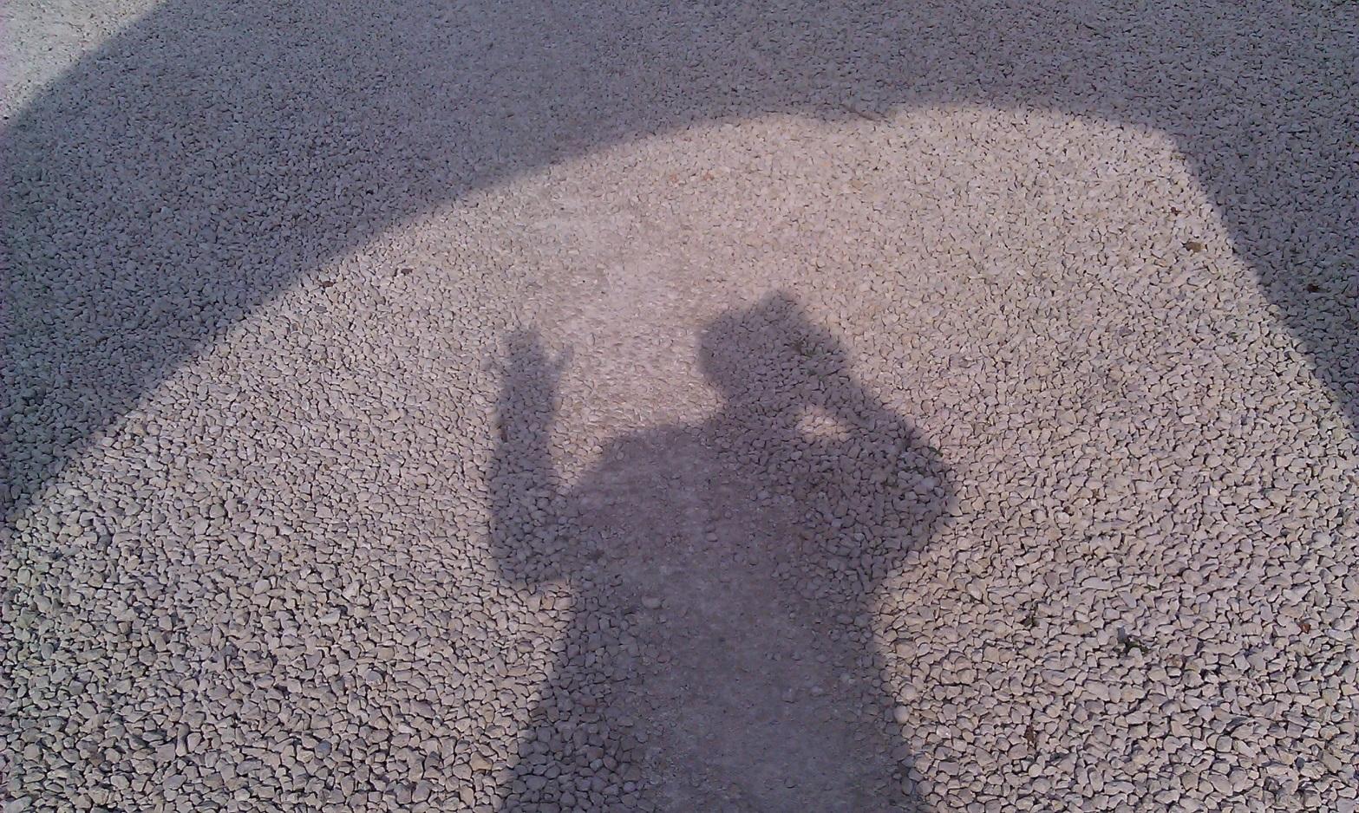
Who is Ziggi ?

Slide 3
2009
2008
2014

Slide 4
Welcome to Langley Hall Primary Academy
Pupils from the age of 4 to 11

Slide 5
June 2010 Bid put in to open a free school in Langley July 2010 Confirmed as one of the first 24 Free Schools to move forward to opening Feb 2011 School building secured Sept 2011 Langley Hall opens with 182 children (1 form entry) Sept 2012 School doubles in size to 364 Feb 2013 Permission given for expansion Sept 2013 School expands to 676 pupils on 2 sites Sept 2014 School now full with 728 pupils
The story so far …

Slide 6
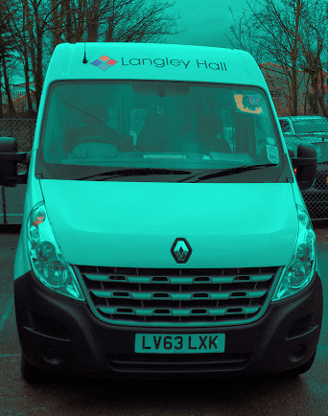
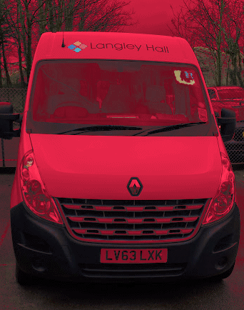
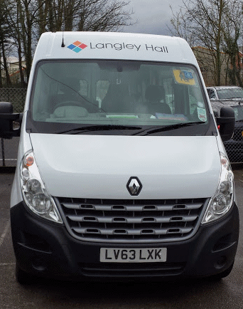
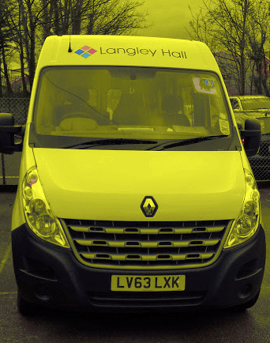
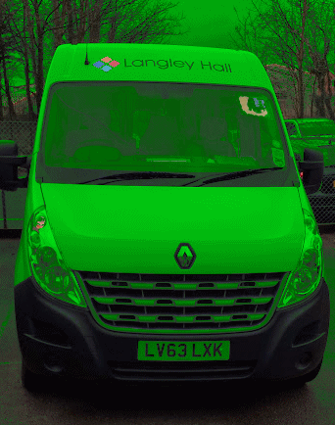
Buses

Slide 7
Near Field Communication
Each pupil is given:
A tie or hat sticker
A tag for the bag
A wrist band
NFC readers are placed in key locations
Bus drivers are given NFC enabled mobiles

Slide 8
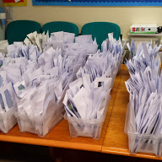
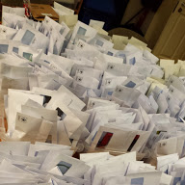
The Bands/Tags

Slide 9
Once NFC is in place
Lunch orders
Medical information
Key alerts
Day’s itinerary
Club registration
And much, much more…….
But what to call them…?

Slide 10
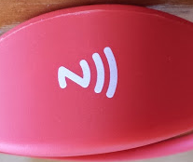

Slide 11
ZIGGI-BANDS

Slide 12
ZIGGI-BANDS
No personal data is stored on the band/tag
All devices must have secure login
All connection details on devices must be encrypted.
Proof of concept Easter 2014
Must be fast
History is kept

Slide 13
School LASER
Communication between staff, parents & pupils
Homework Diary
Calendar
Notice board
After School Clubs booking

Slide 14
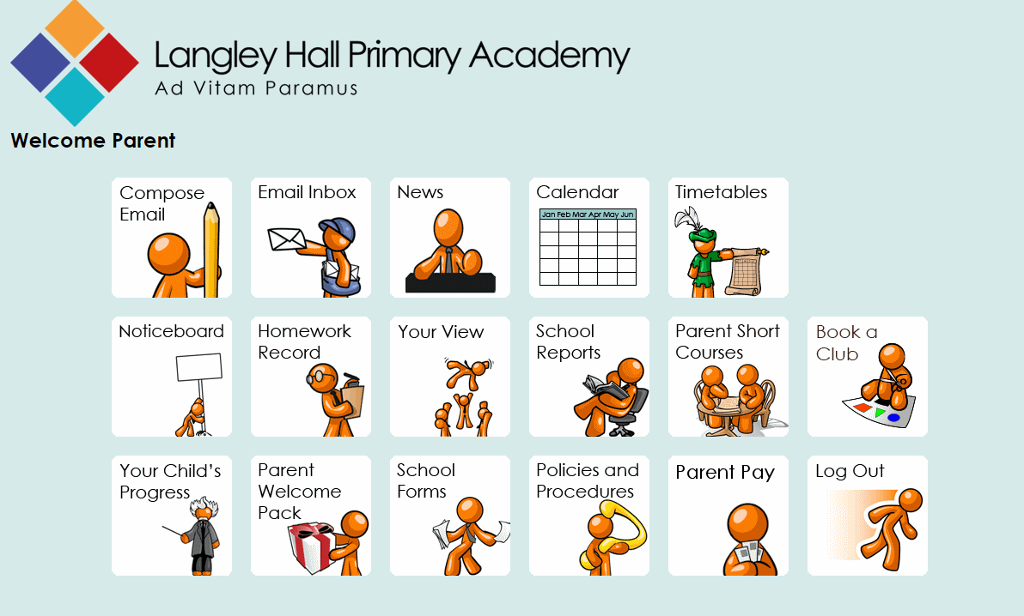
Parent View

Slide 15
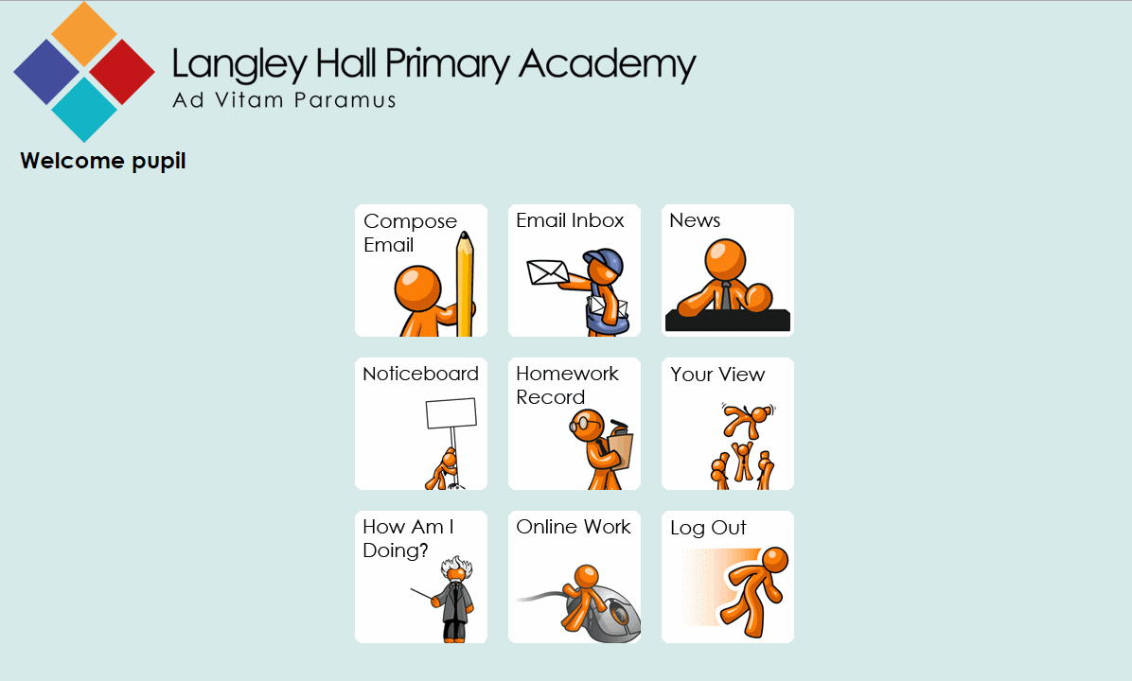
Pupil View

Slide 16
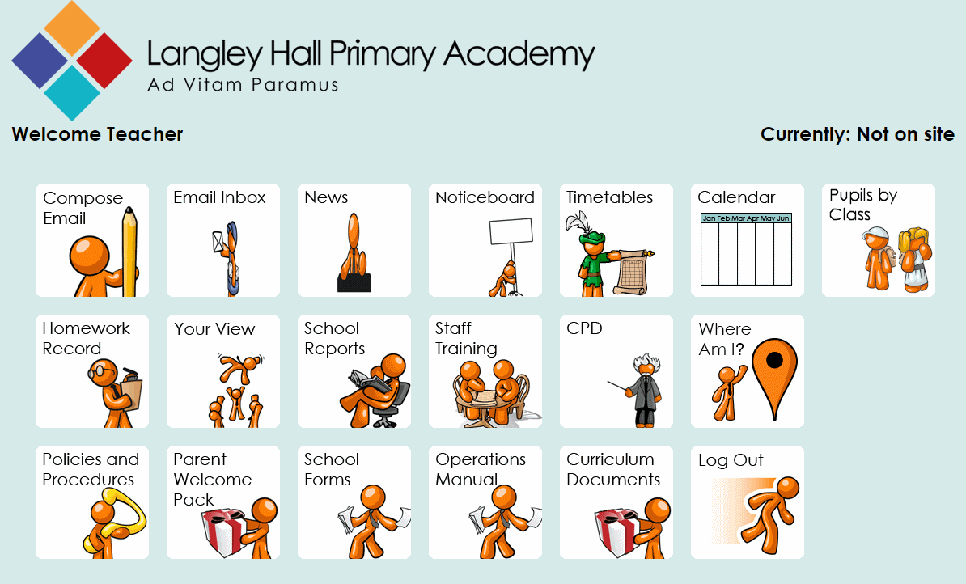
Teacher View

Slide 17
Locations & Buses
Upper School
Lower School
Lunch Hall
Swimming Pool
Super Stars
School Trips
Red Bus
Green Bus
Blue Bus
Yellow Bus
White Bus

Slide 18
Device Mode
Front Desk – Location Tag
Identify
Identify and tag at location
Board bus
Alight from bus (get off bus)
Canteen

Slide 19
Stop waffling on and demo the system Ziggi!!!!

Slide 20
Langley Hall Lunch order for 25th Sept 2014
Many thanks - The LHPA School LASER
 | N/A | Meat Course | Vegetarian | Jacket potato
Michelangelo | 1 | 10 | 8 | 8
Leonardo | 0 | 13 | 9 | 4
Raphael | 0 | 10 | 11 | 4
Donatello | 1 | 13 | 8 | 4
Rembrandt | 0 | 14 | 6 | 6
Turner | 1 | 7 | 10 | 9
Constable | 0 | 12 | 4 | 9
Reubens | 0 | 12 | 5 | 9
Kauffman | 0 | 13 | 8 | 6
Blake | 1 | 13 | 4 | 9
Goya | 1 | 6 | 11 | 8
Beale | 0 | 10 | 11 | 5
Lower School Sub-Total | 5 | 133 | 95 | 81
Monet | 1 | 5 | 8 | 12
Degas | 0 | 8 | 7 | 9
Dali | 0 | 8 | 4 | 14
Renoir | 1 | 6 | 8 | 10
Matisse | 1 | 3 | 9 | 15
Kandinsky | 1 | 7 | 6 | 10
Miro | 0 | 6 | 7 | 12
Rousseau | 2 | 10 | 4 | 10
Cassat | 0 | 8 | 6 | 13
Klee | 0 | 9 | 9 | 9
OKeefe | 0 | 8 | 10 | 8
Van Gogh | 1 | 6 | 3 | 16
Hepworth | 0 | 6 | 5 | 14
Picasso | 1 | 7 | 9 | 9
Warhol | 0 | 9 | 7 | 10
Rego | 0 | 6 | 7 | 13
Upper School Sub-Total | 8 | 112 | 109 | 184
TOTAL | 13 | 245 | 204 | 265

