Slide 1
SharpLeaf Flowing automated reports to paper
Nicolas Delcros

Slide 2
The SharpPlot package
Publication-quality automated graphics
Output formats : PS, EPS, PDF, SVG, EMF*, PNG*, BMP*, GIF*
Forward-going state machine
PostScript-oriented
Not restricted by OO model
Cross-Platform
.Net Assembly and APL workspace

Slide 3
SharpLeaf
Page-based reporting tool
Typographic and tabulation engine
Width-constrained downward flow
Alpha version as of SharpPlot v2.70
Official release at v3.00 (end of 2015)

Slide 4
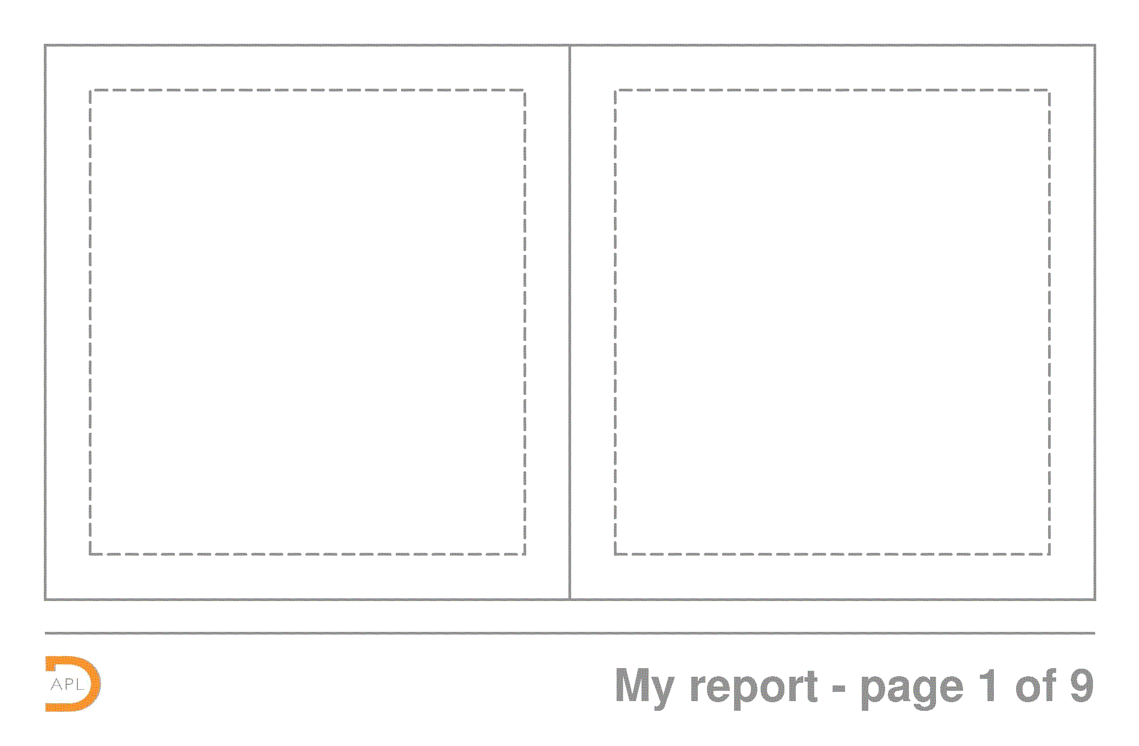
Document and Page Layout
Paper Size and Fill

Slide 5
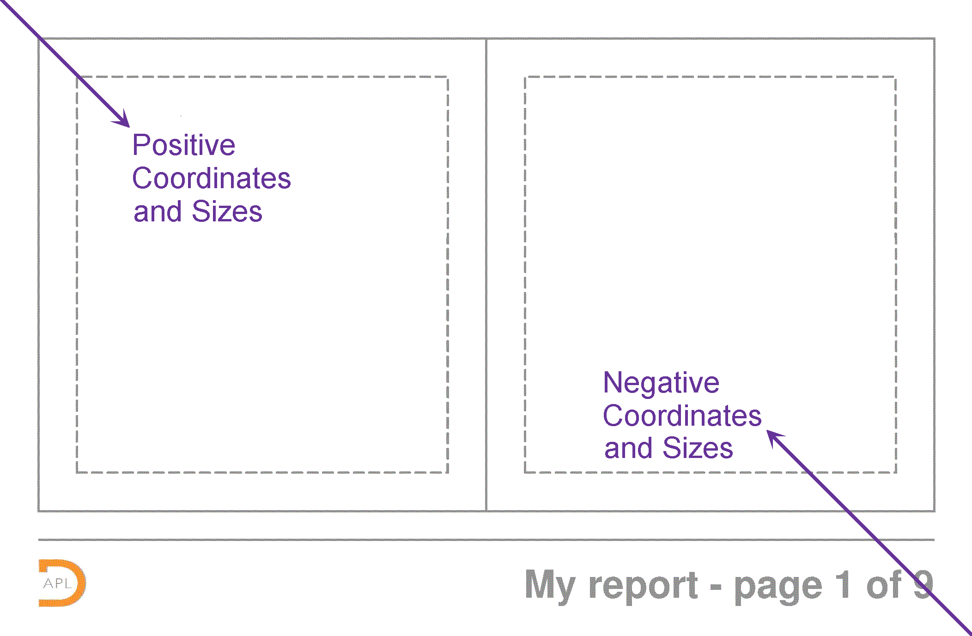
Document and Page Layout

Slide 6
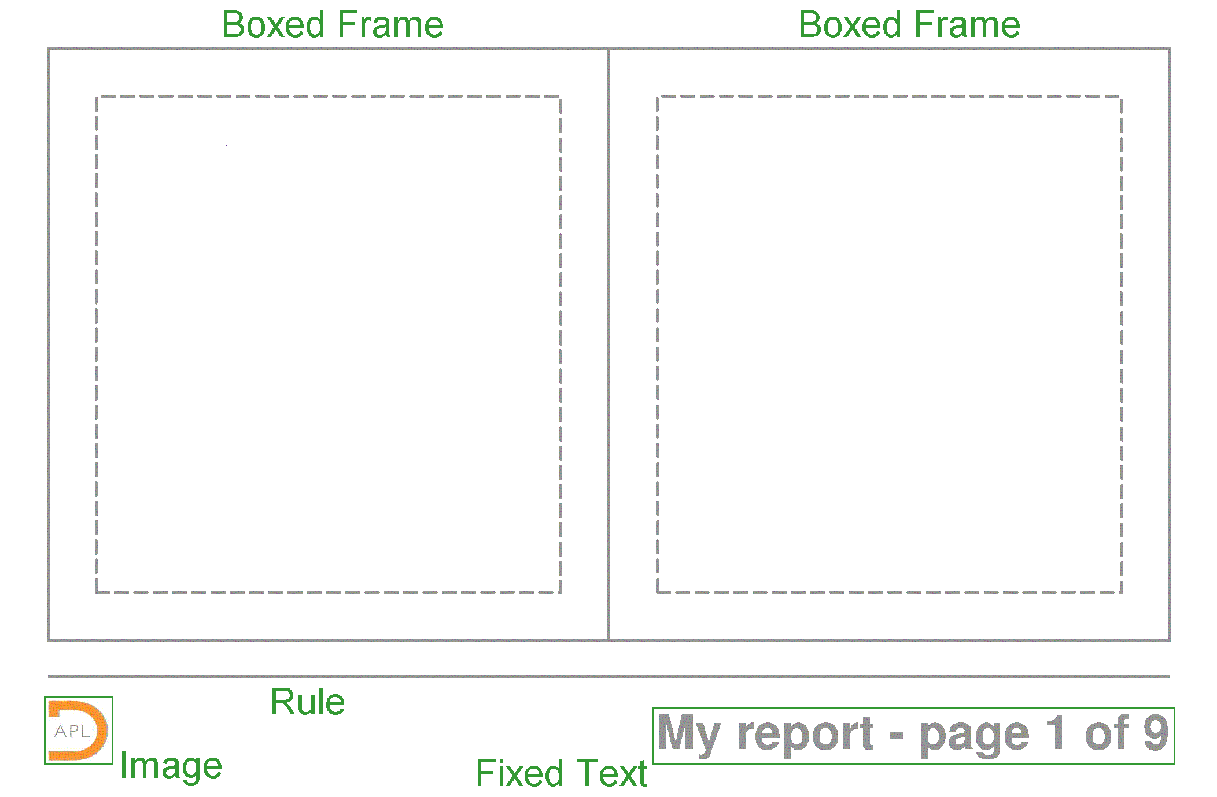
Document and Page Layout

Slide 7
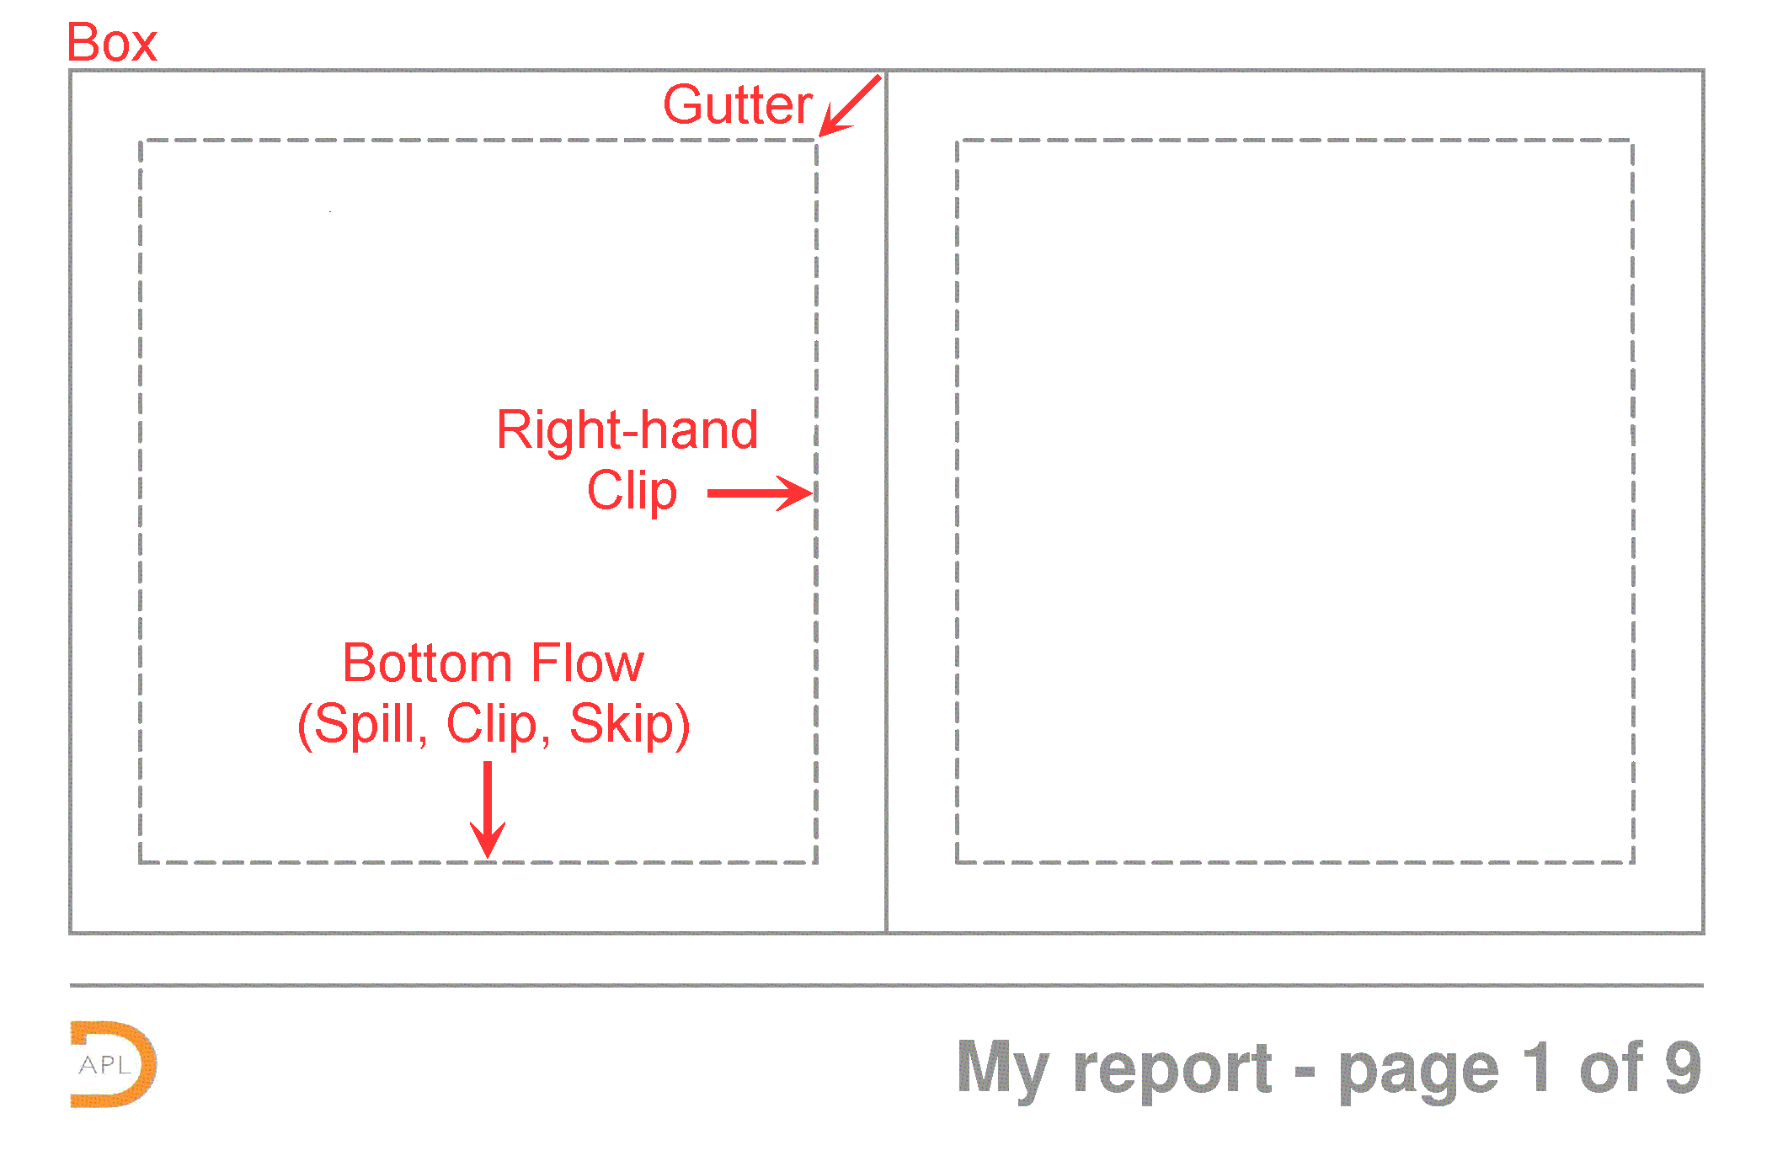
Document and Page Layout

Slide 8
Document and Page Layout

Slide 9
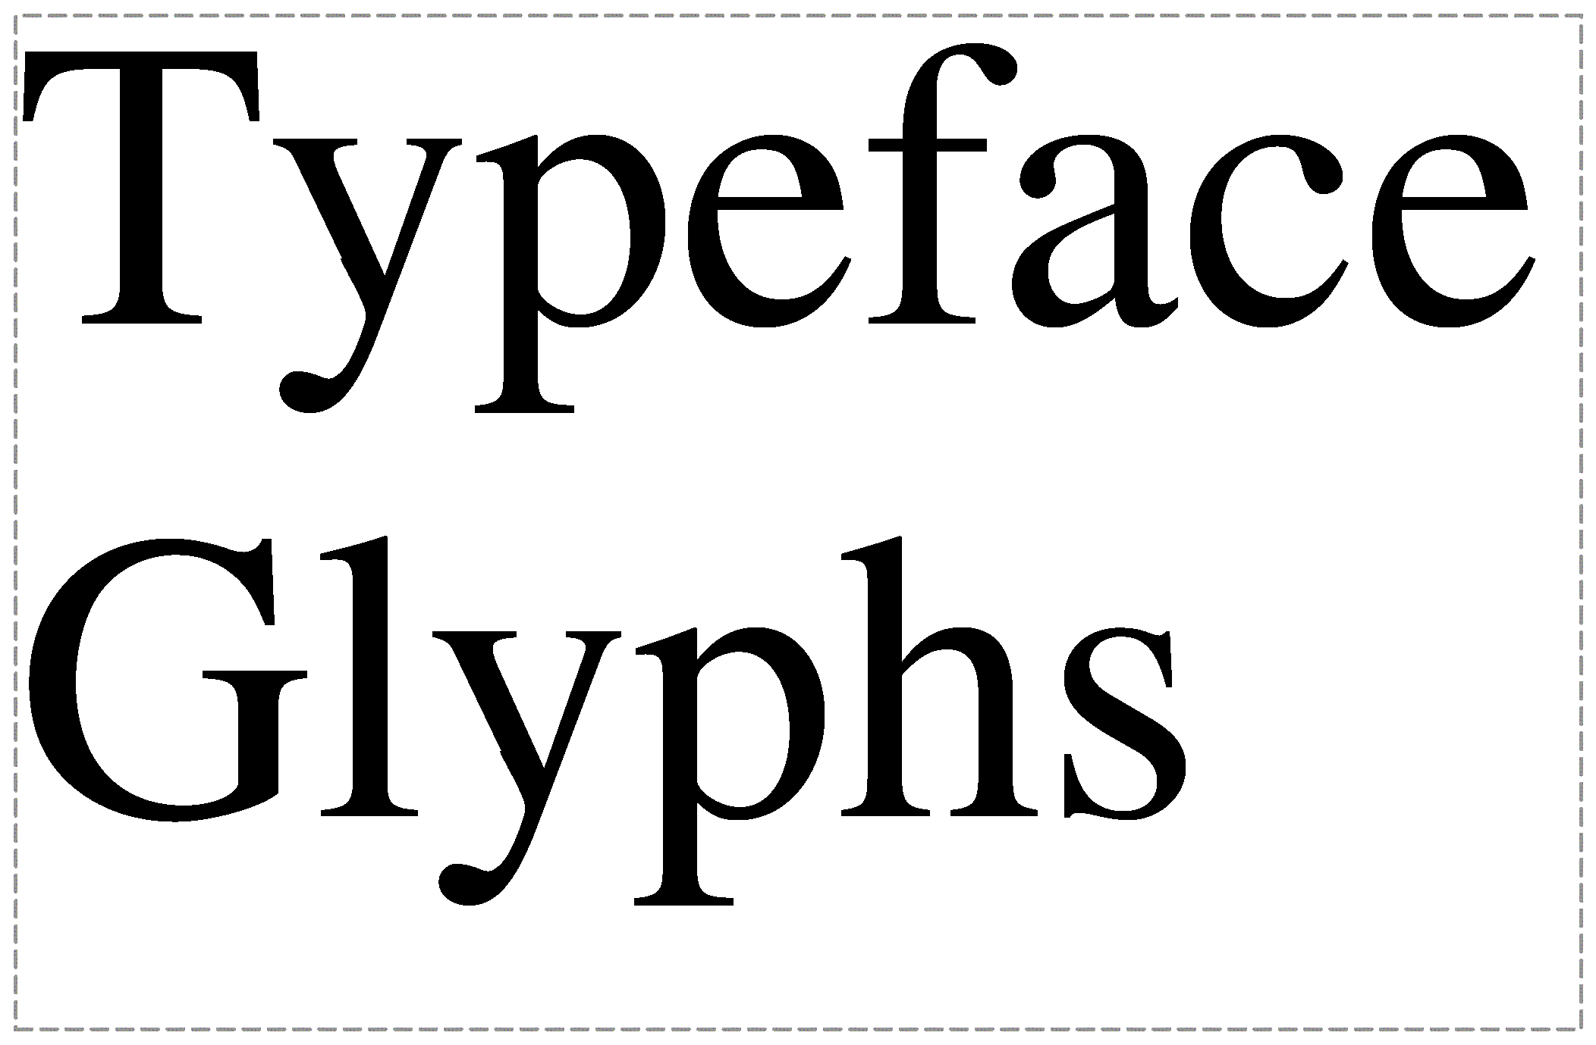
Font
Font Name, Style, Color

Slide 10
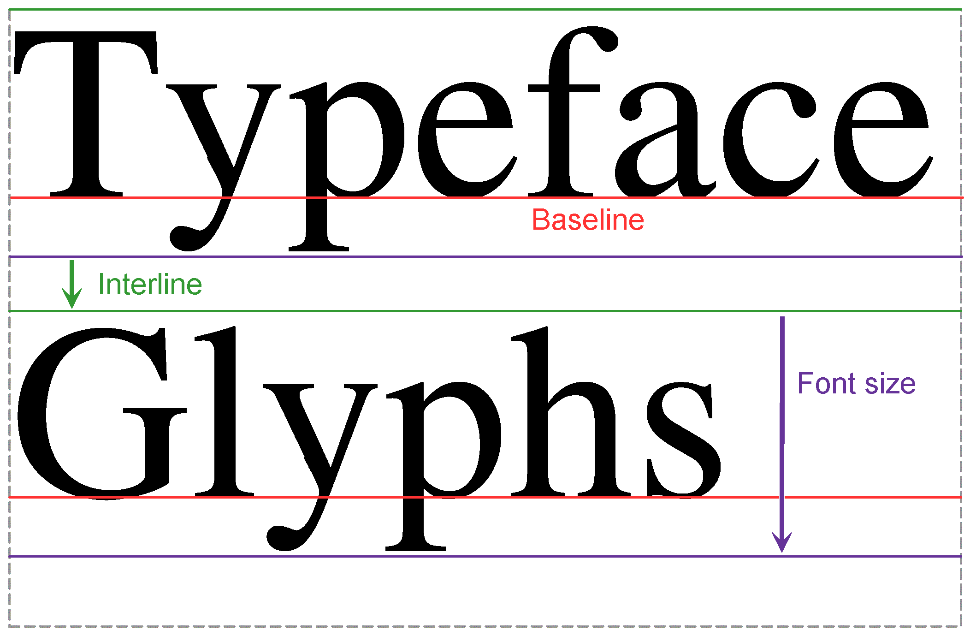
Font

Slide 11
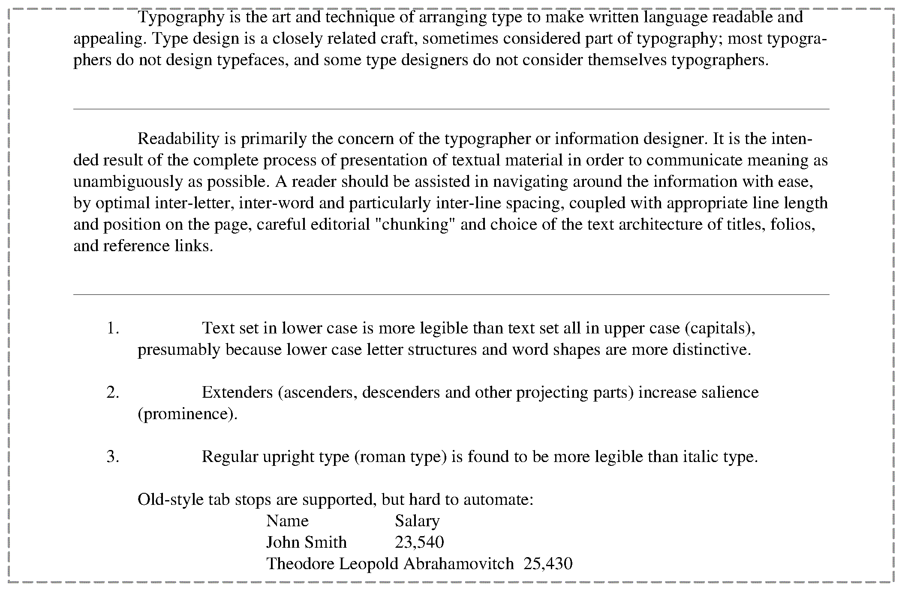
Paragraph

Slide 12
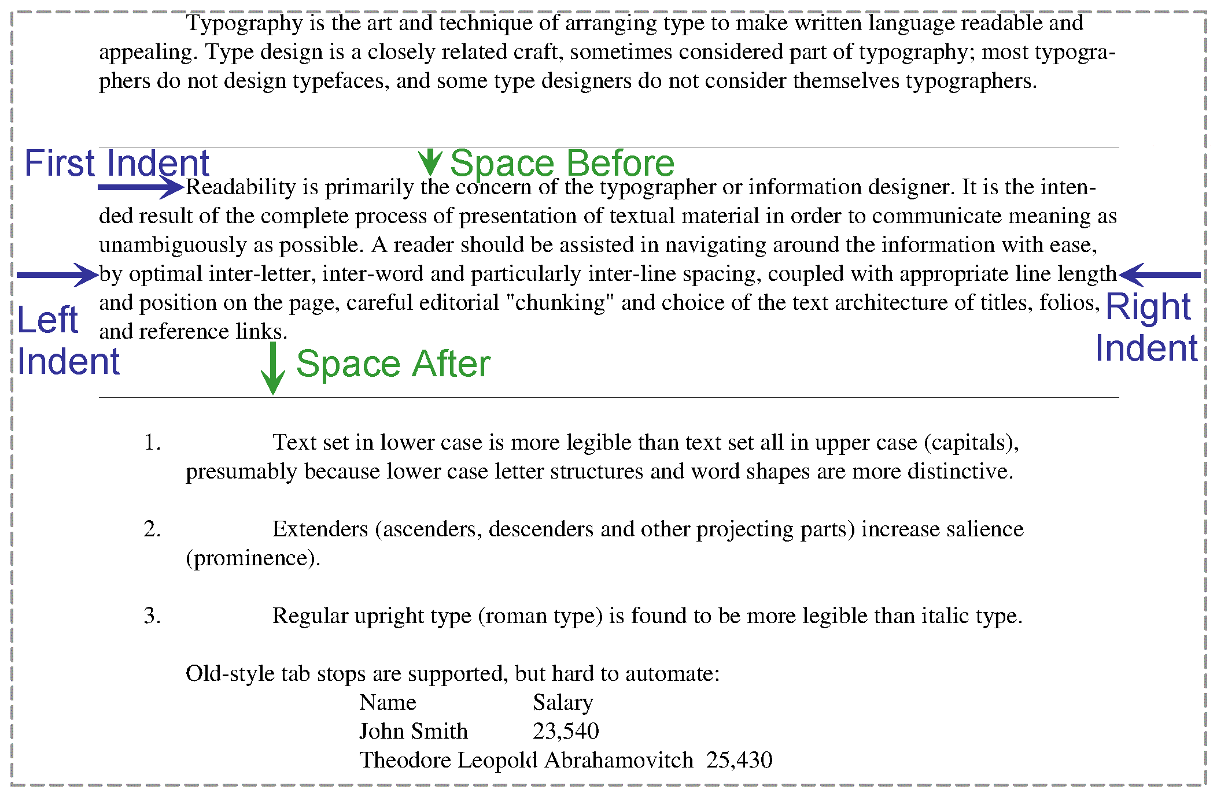
Paragraph

Slide 13
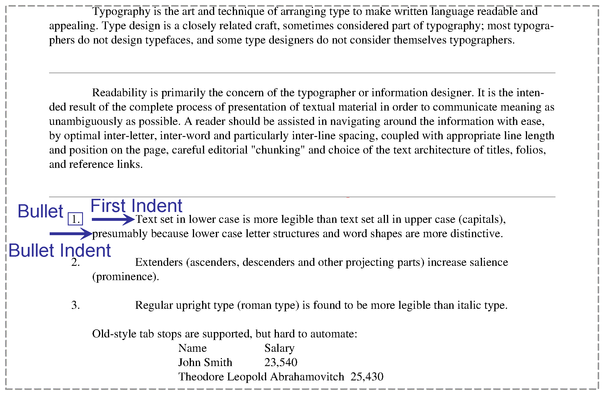
Paragraph

Slide 14
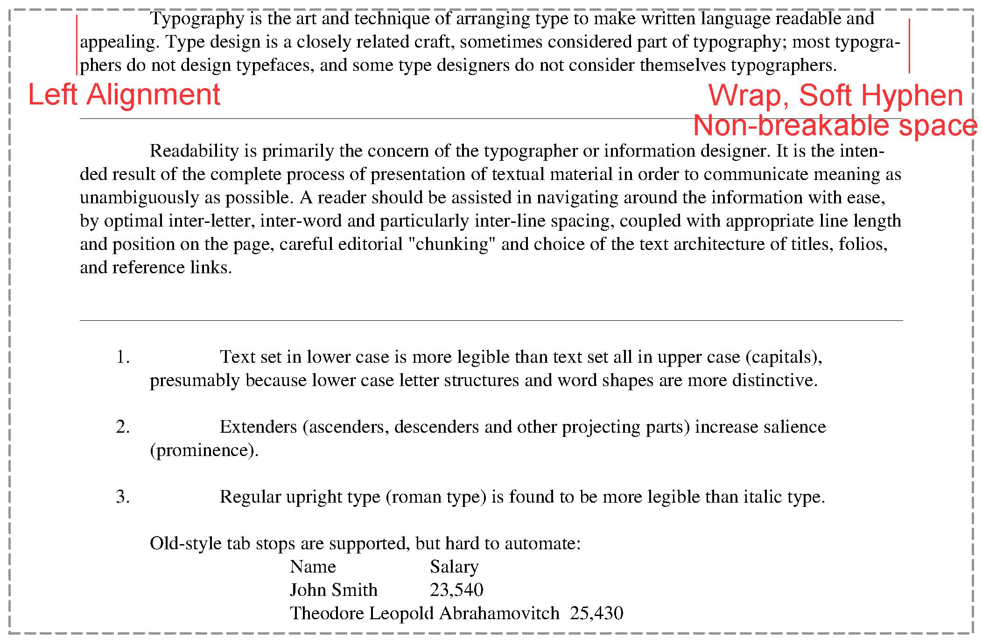
Paragraph

Slide 15
Paragraph

Slide 16
Widow and Orphan control

Slide 17
Widow and Orphan control

Slide 18
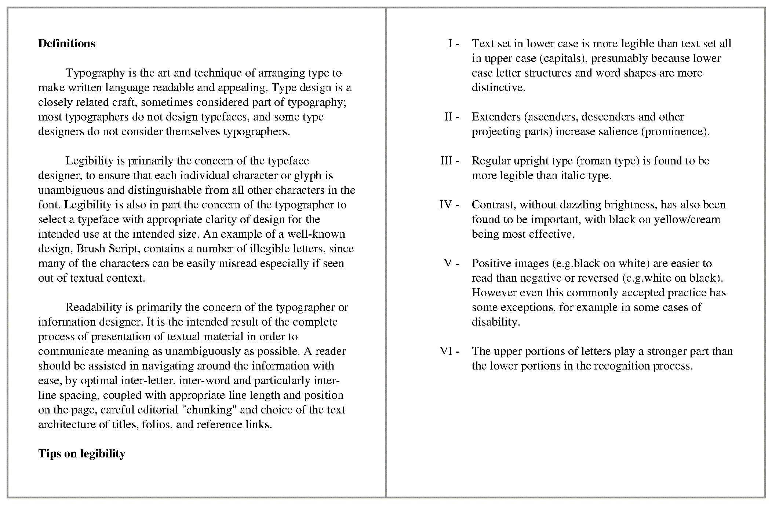
Widow and Orphan control

Slide 19
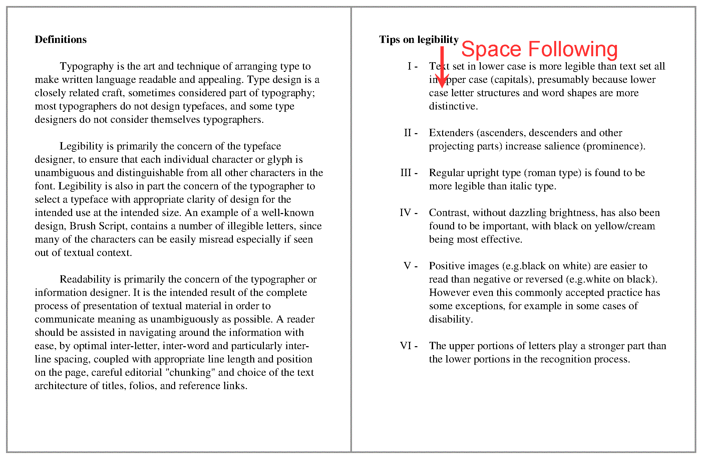
Widow and Orphan control

Slide 20
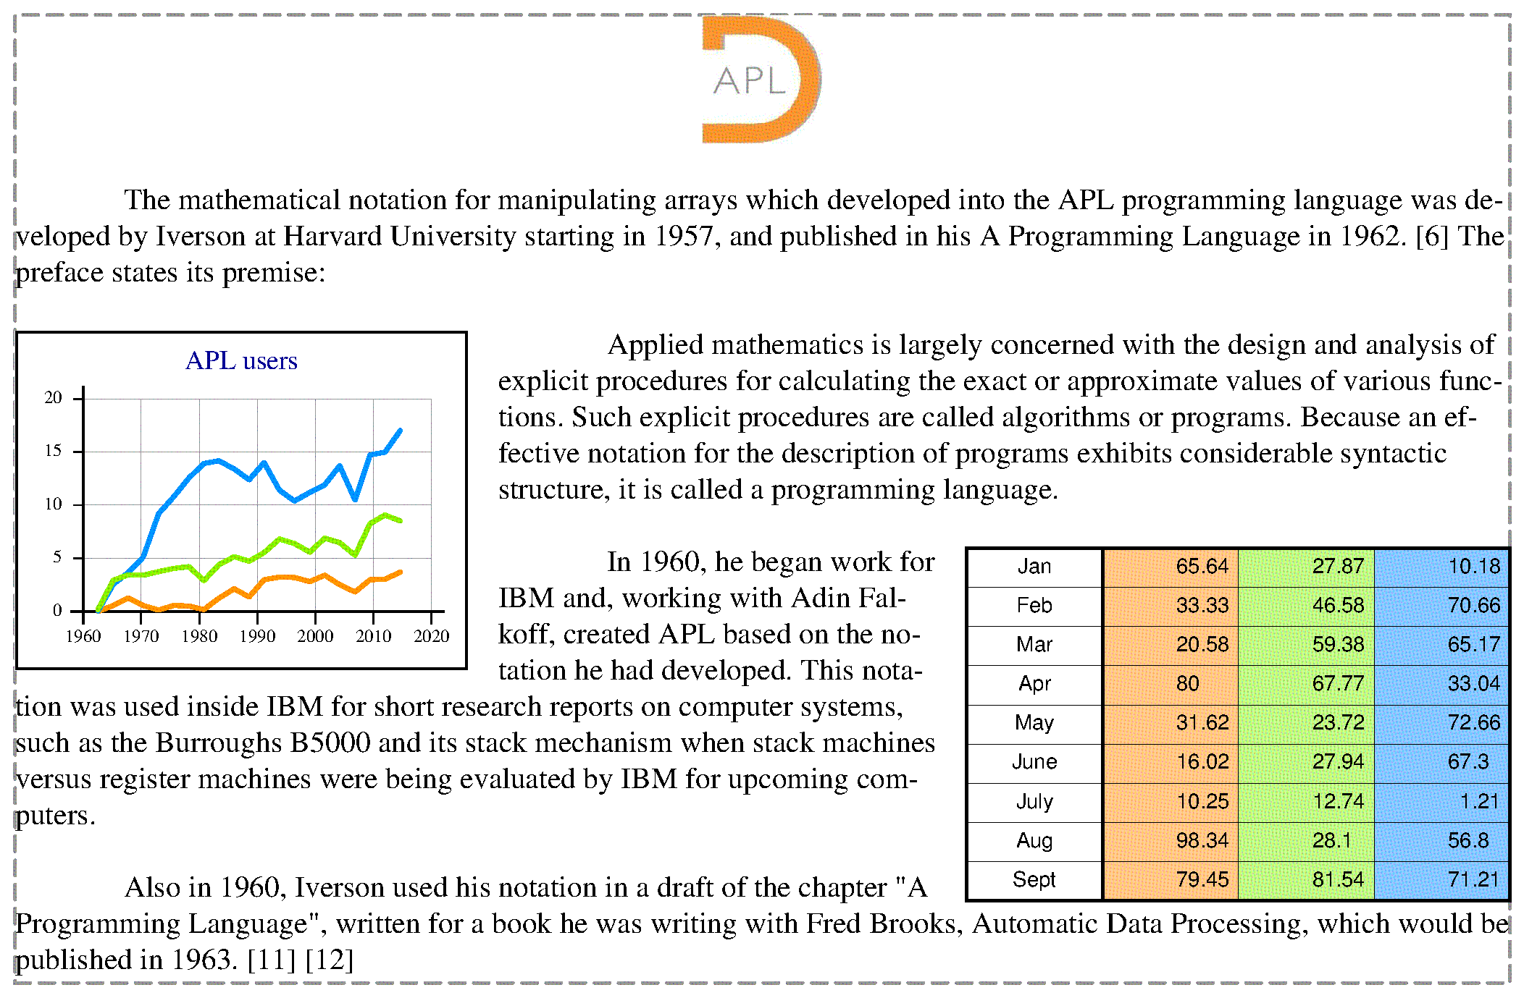
Inclusions

Slide 21
Inclusions

Slide 22
Decorations

Slide 23
Decorations

Slide 24
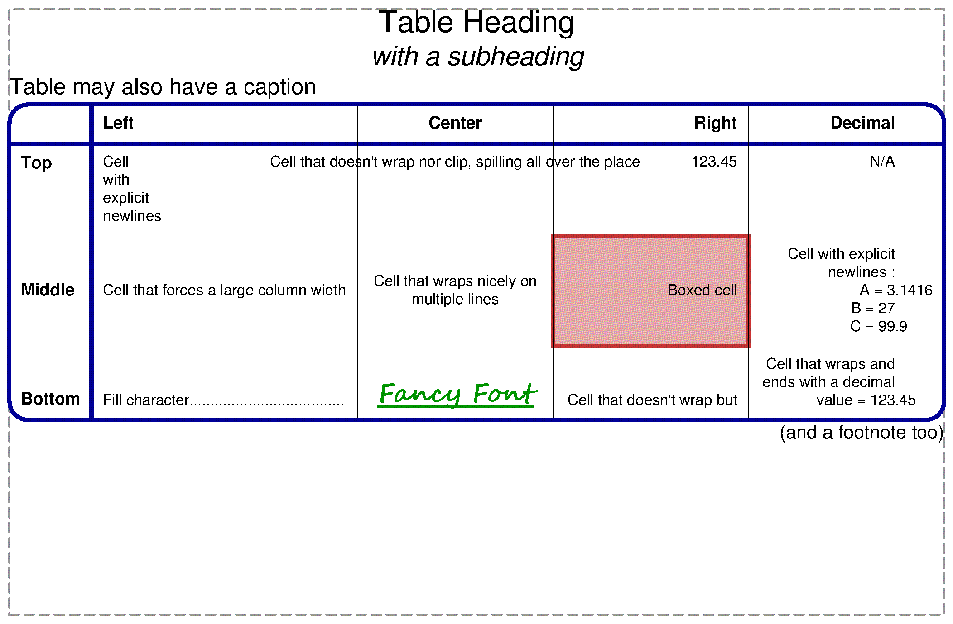
Tables

Slide 25
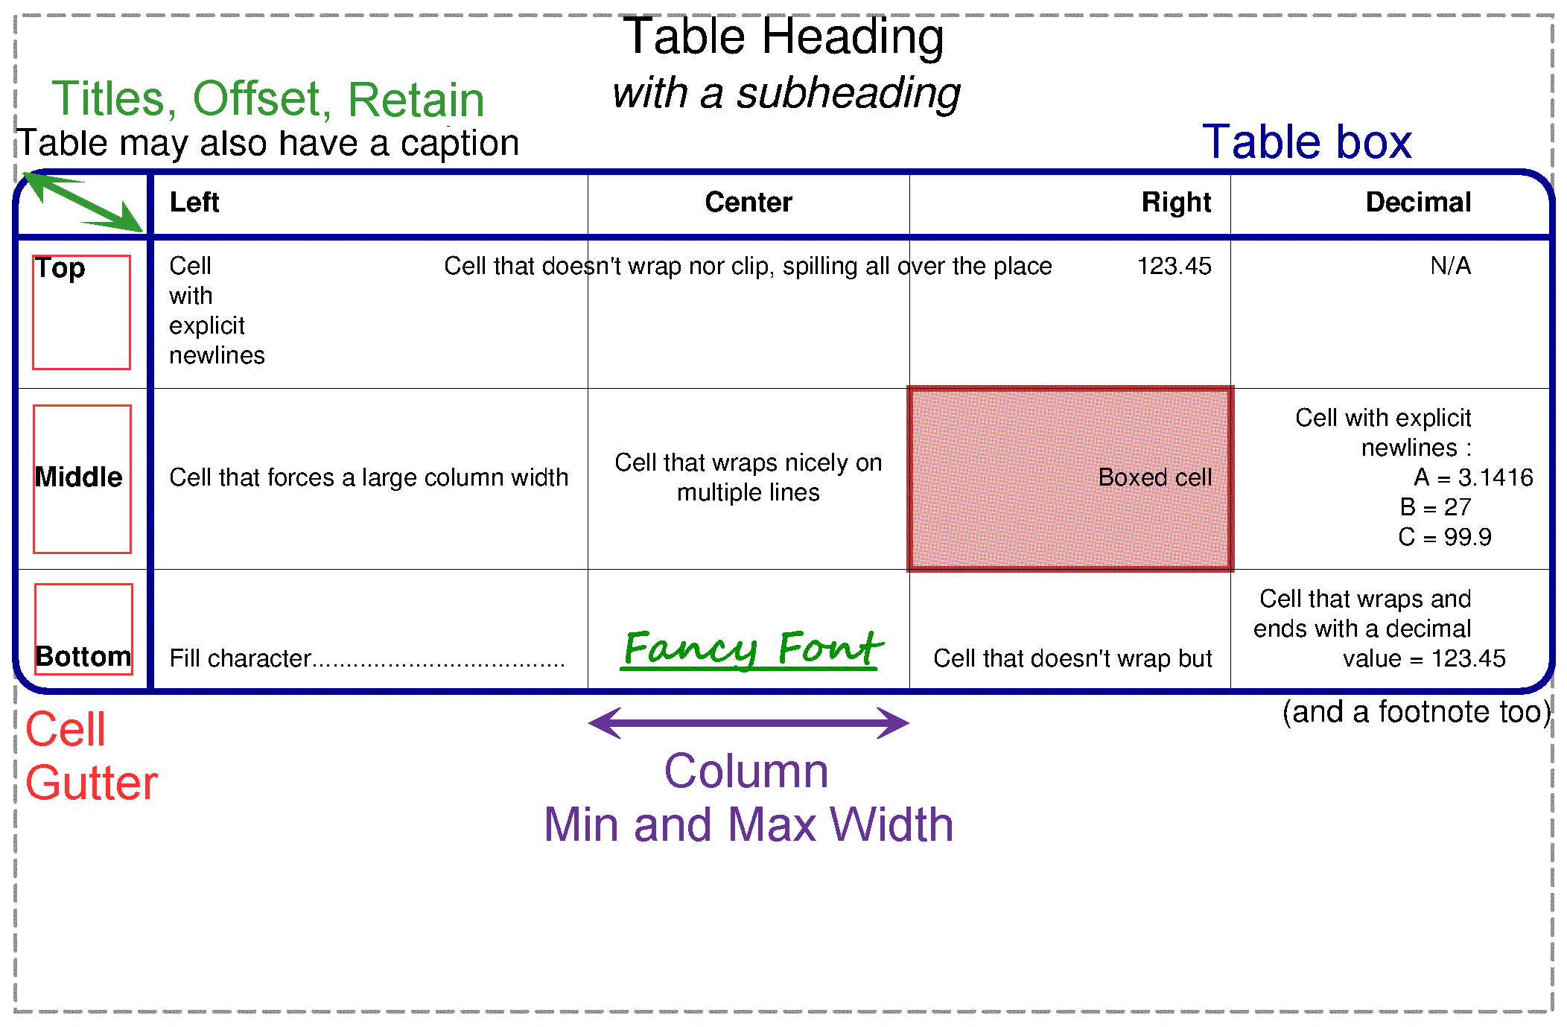
Table-wide settings

Slide 26
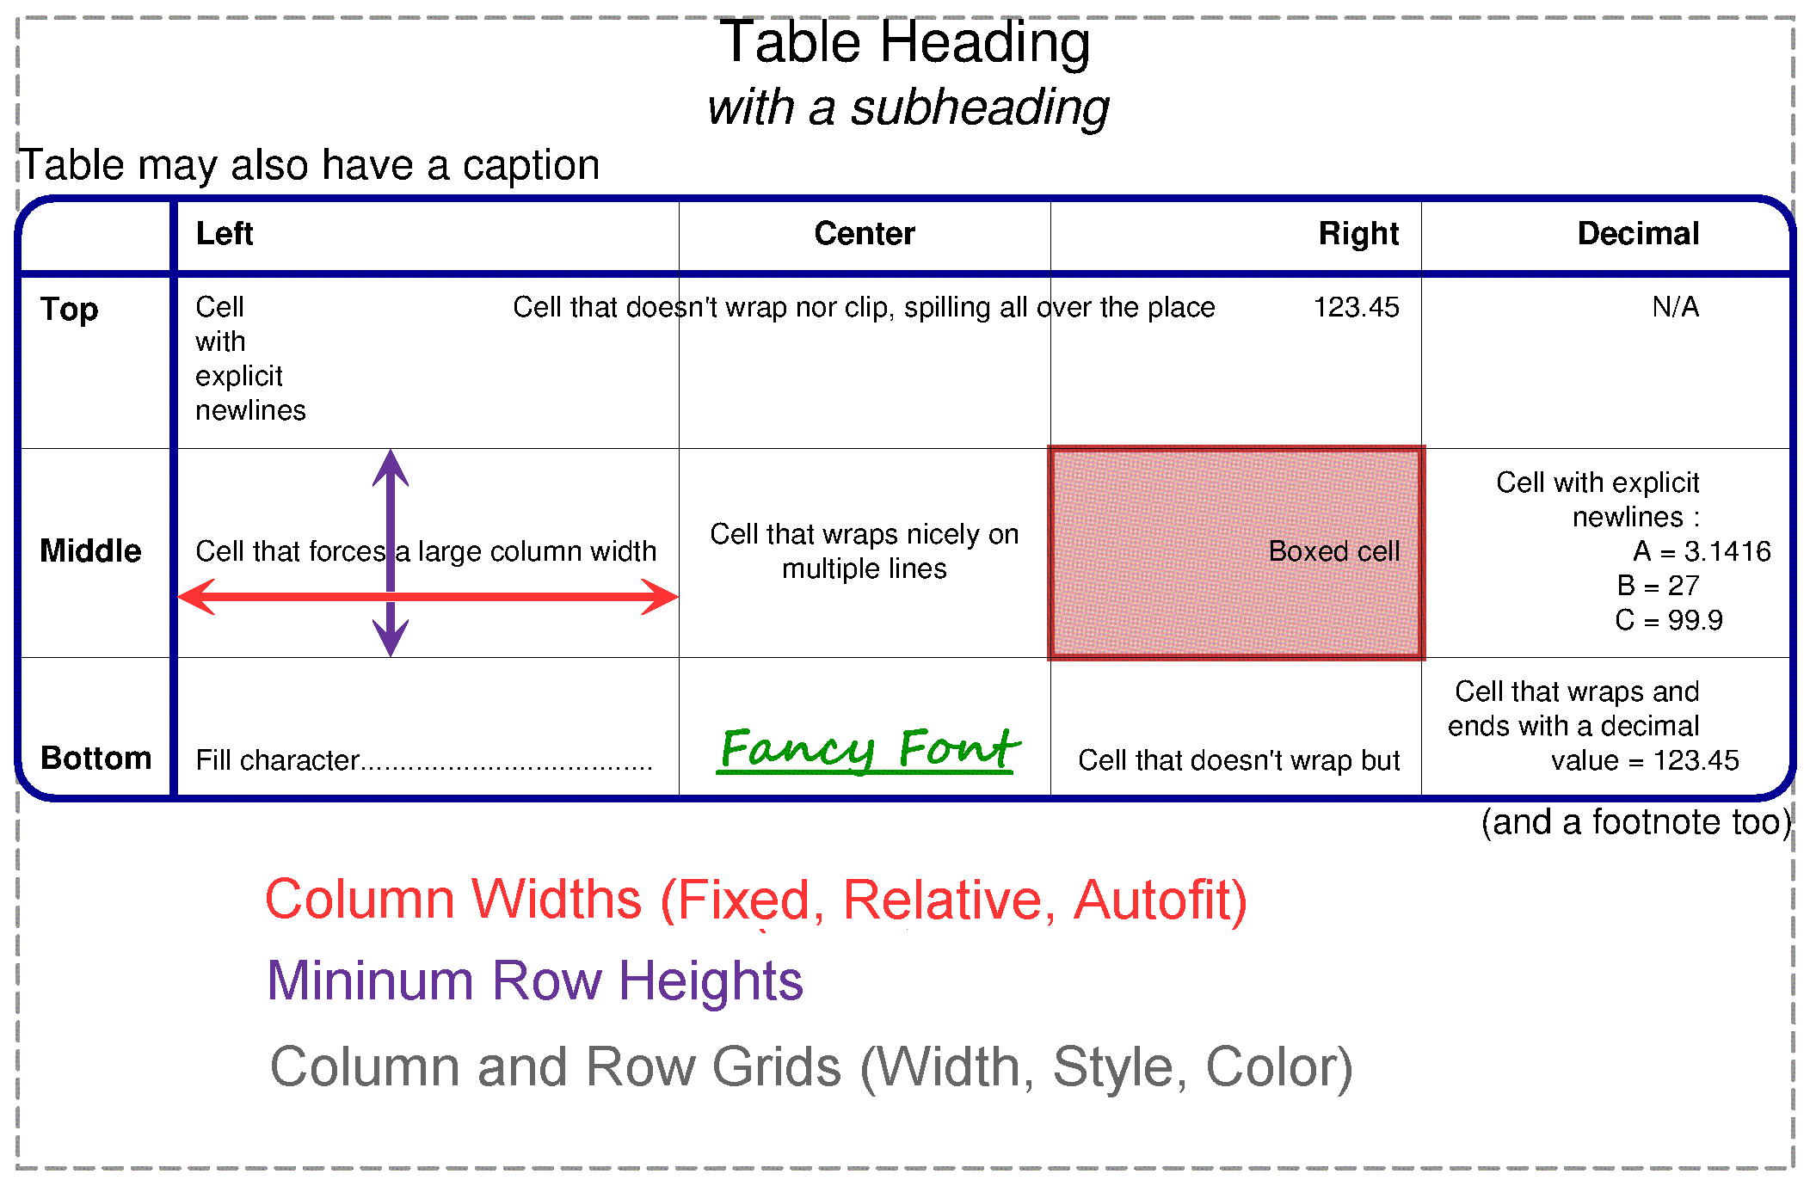
Column- and Row-wise settings

Slide 27
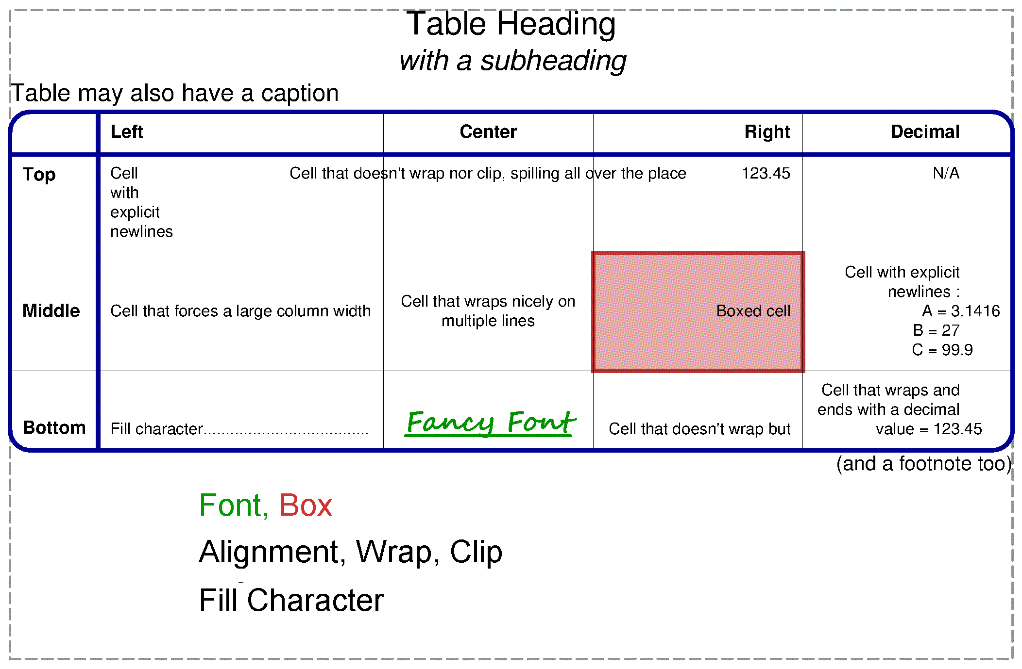
Cell-wise settings

Slide 28
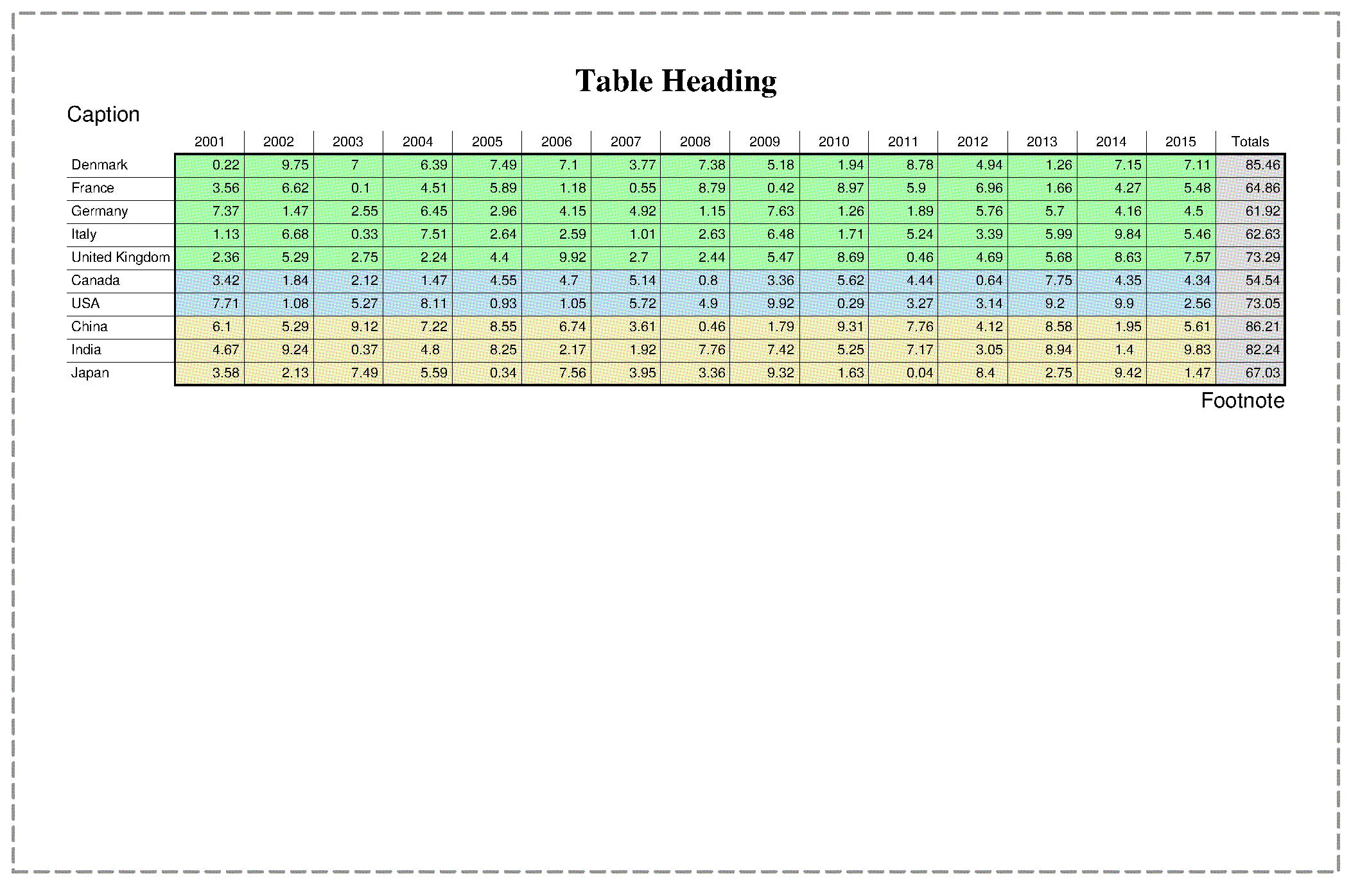
Filling tables

Slide 29
Filling tables

Slide 30
Filling tables

Slide 31
Filling tables

Slide 32
Filling tables

Slide 33
Flowing tables

Slide 34
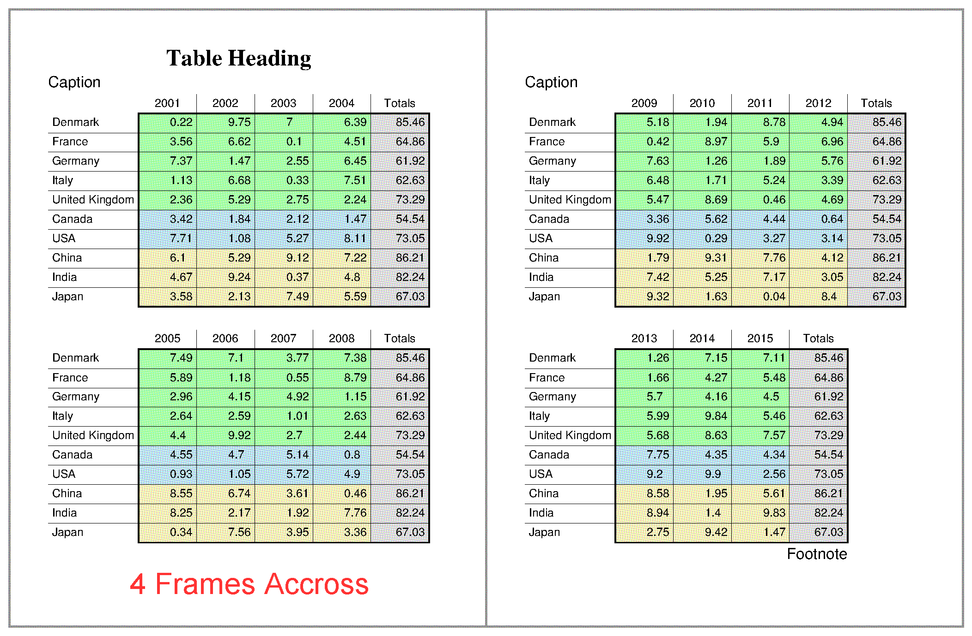
Flowing tables

Slide 35
So what ?
Download the alpha version from my.dyalog.com
Comments on the API
Requests for enhancement
Bug reports
Features missing from alpha :
SVG and raster output
Table cell merging

