Slide 1
Road Map - The User Experience
Morten Kromberg CXO, Dyalog Ltd.

Slide 2
CHIEF
E
E C
X N
P E
E I
R
E I
P E
X N
E C
E
OFFICER

Slide 3
Believe in Climate Change?
Under any circumstances :
Cloud computing is over us!
The good news is...
We have been preparing for some time...

Slide 4
Parallel Computing with Isolates
An Isolate tastes, smells, looks like a Dyalog namespace, except that...
Expressions executed in the isolate run in a separate process from the main interpreter thread (”in parallel”)
I3←¤¨3⍴⊂''
I3.X←(1 2 3)(4 5)6
I3.({(+/⍵)÷≢⍵}X)
2 4.5 6
X←1 2 3
X←6
X←4 5

Slide 5
How Isolates Work…
Computers
Dyalog (Application)
Dyalog (APLProcess)
Namespaces
CONGA / TCP Sockets
Another Computer
A 2-Core Computer
Isolate Process 1
A Dyalog Application
Isolate Process 1
Isolate 3
Isolate 1
1
2
3
4
Isolate Process 2
Isolate Process 2
iss←isolate.New¨4⍴⊂⍬
AddServer ...
Isolate 4
Isolate 2

Slide 6
How Isolates Work…
Computers
Dyalog (Application)
Dyalog (APLProcess)
Namespaces
CONGA / TCP Sockets
A VM in the Cloud
A 2-Core Computer
Isolate Process 1
A Dyalog Application
Isolate Process 1
Isolate 3
Isolate 1
1
2
3
4
Isolate Process 2
Isolate Process 2
iss←isolate.New¨4⍴⊂⍬
AddServer ...
Isolate 4
Isolate 2

Slide 7
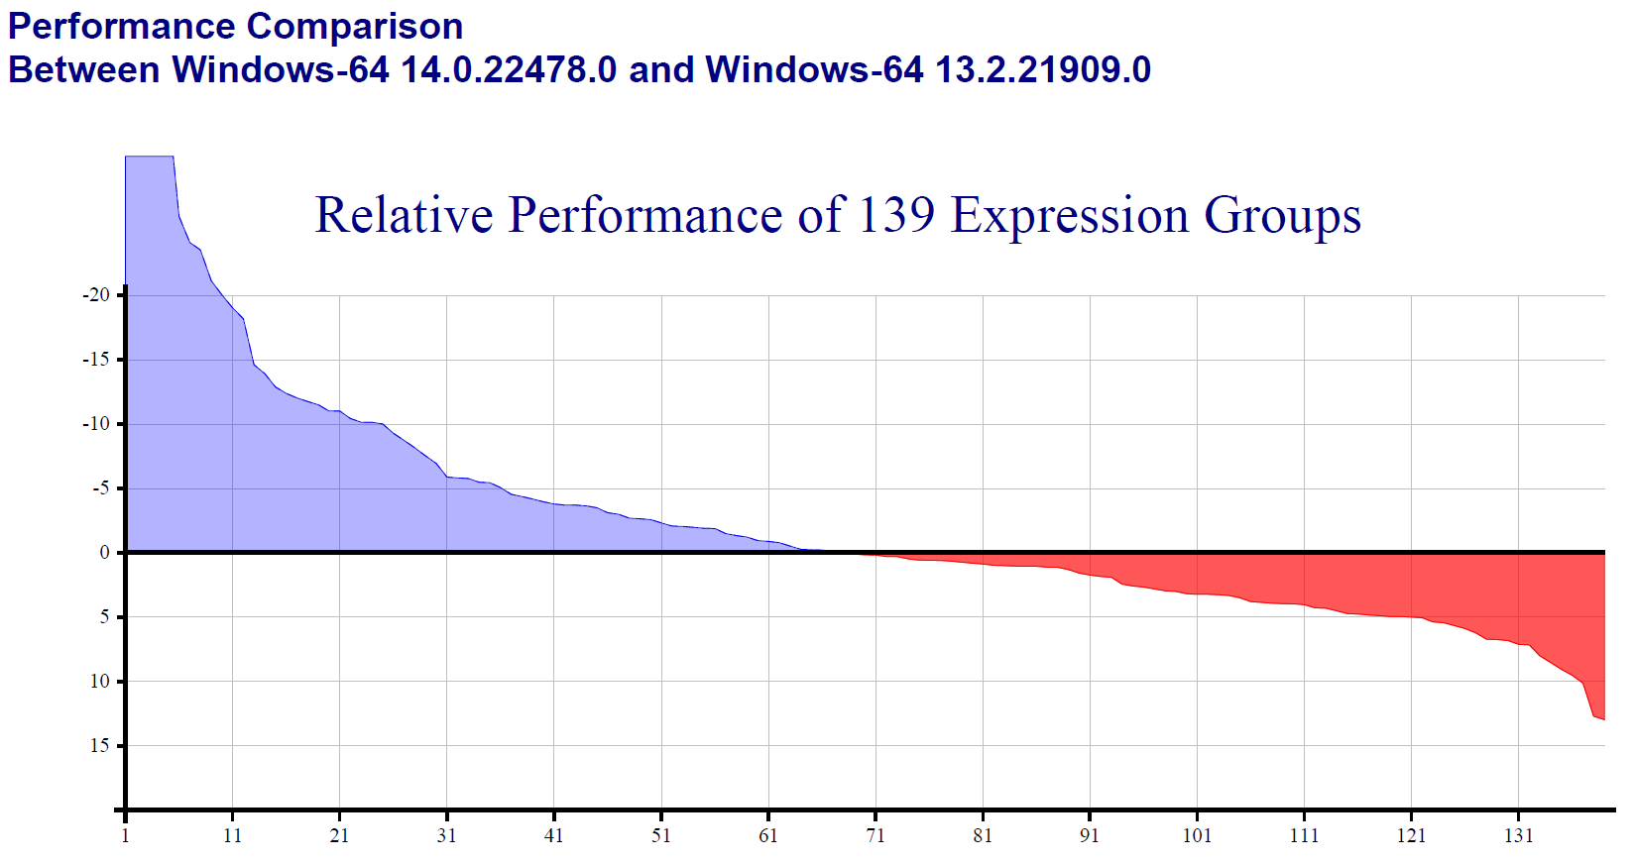
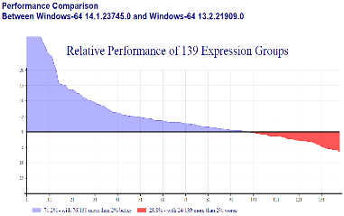
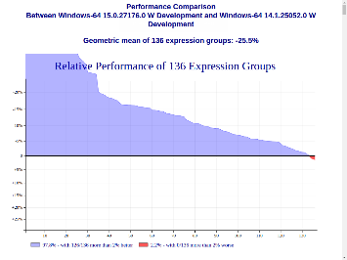
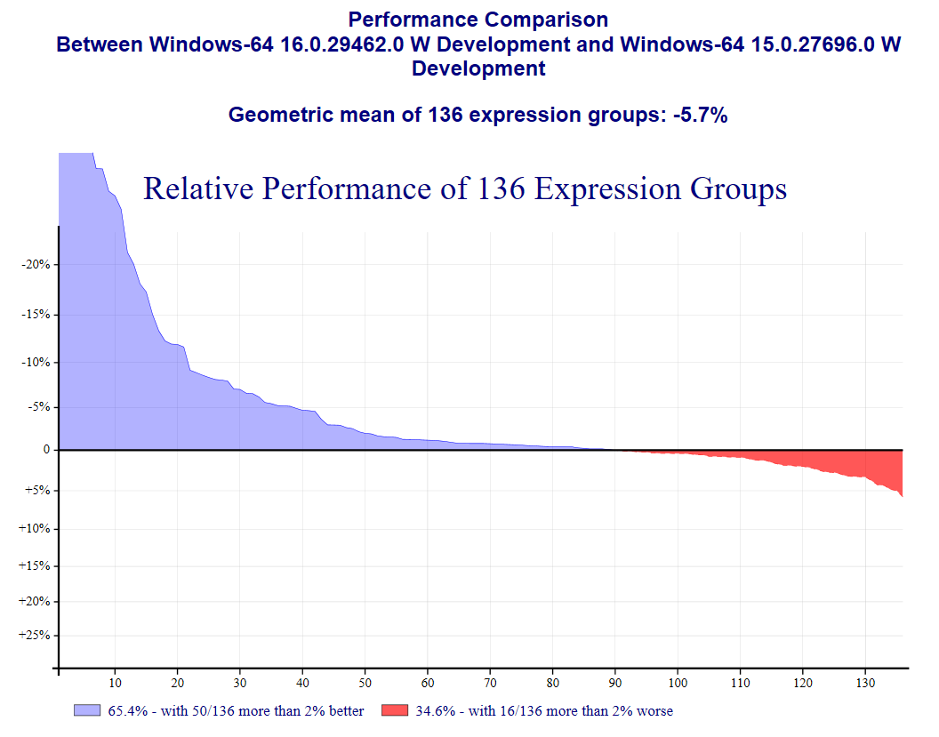
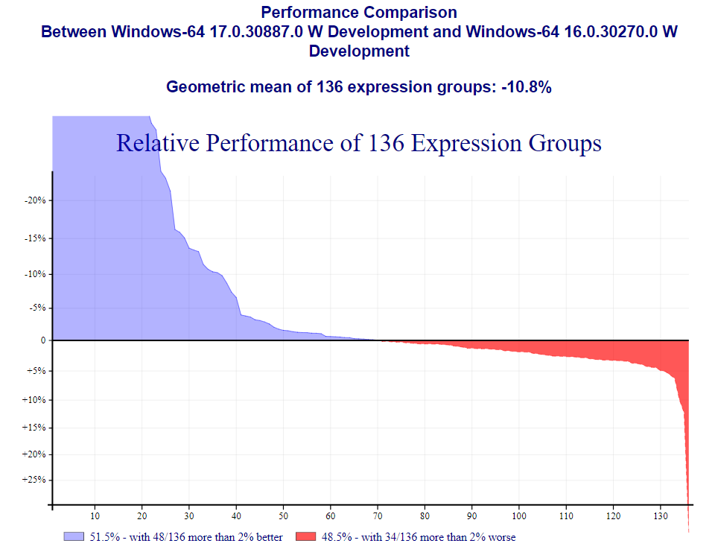
Raw Performance In the cloud, the true cost of computing is measured in Watts
14.0
14.1
15.0
16.0
16⅗

Slide 8
Cloud = Linux "(or similar)"
Prepare to deploy to UNIX-like environments, even if you develop on Windows or macOS
Linux uses less Watts (less memory)
macOS and Android are UNIXes
Cloud-friendly Microsoft OSes are also UNIX-like
We are working hard to make using the same code on all platforms easier
For example, cross-platform file functions in v15.0

Slide 9
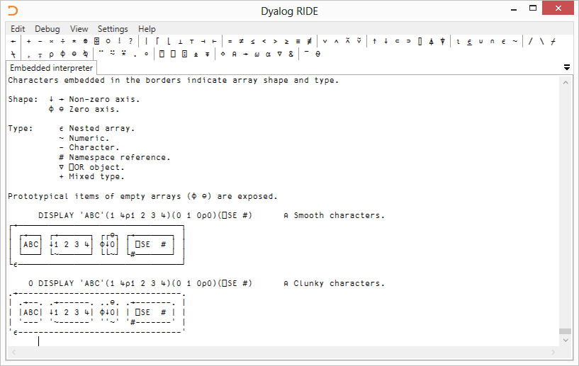
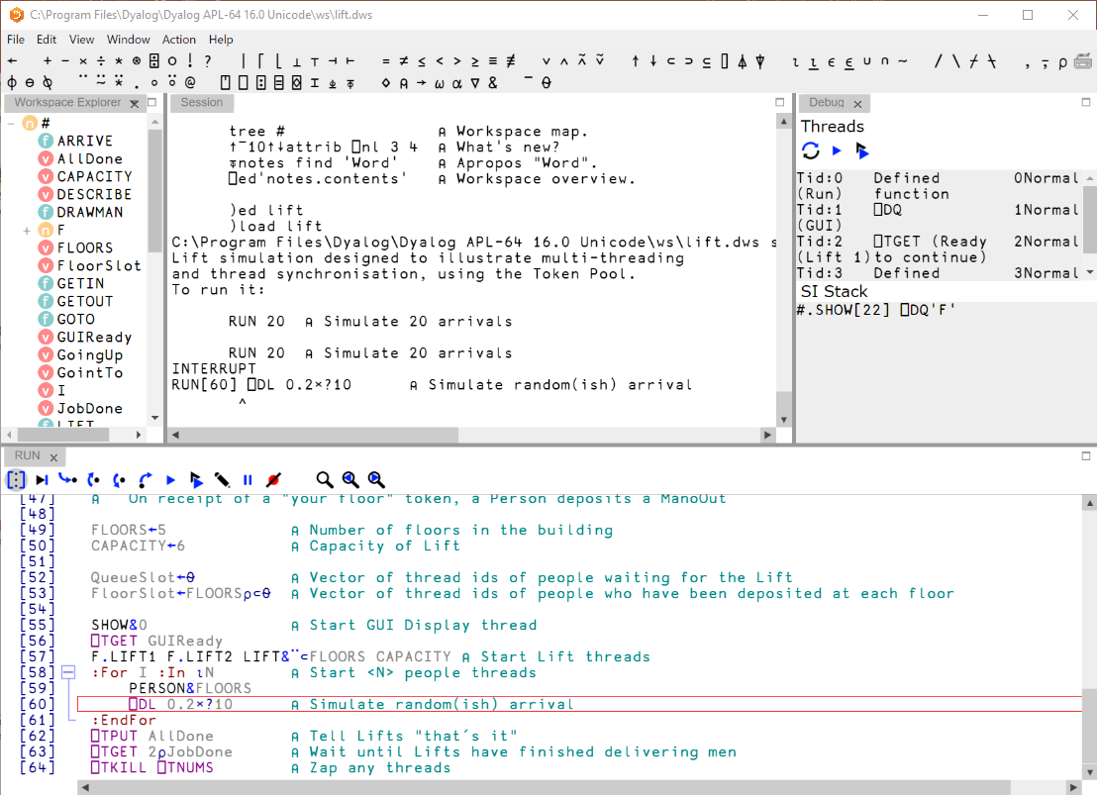
Cross-Platform Development Environment
2013 Conference Edition
RIDE 4.x

Slide 10
Preparing for Extreme Weather
We need a new generation of developers
(and managers)

Slide 11
Managers Need
Manager Experience
To be able to recruit & train APLers, and to market APL internally
See evangelism and newbie sections
To use industry standard tools and methodologies, like
Source code management
Continuous deployment
APL Source Code in text files is KEY to supporting the above

Slide 12
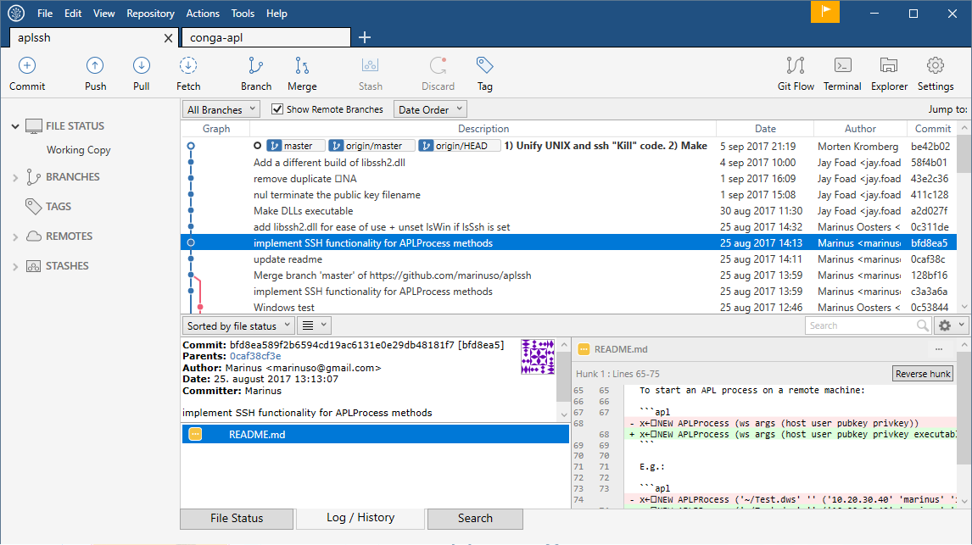
Managers Need
To be able to recruit & train APLers, and to market APL internally
See evangelism and newbie sections
To use industry standard tools and methodologies, like
Source code management
Continuous deployment
APL Source Code in text files is KEY to supporting the above

Slide 13
Managers Need
Manager Experience
To be able to recruit & train APLers, and to market APL internally
See evangelism and newbie sections
To use industry standard tools and methodologies, like
Source code management
Continuous deployment
APL Source Code in text files is KEY to supporting the above

Slide 14
Newbies Need
Newbie Experience
To be recruited by managers
See evangelism section
To use industry standard tools and methodologies, like
Source code management
Continuous deployment
APL Source Code in text files is KEY to supporting the above

Slide 15
We All Need
Developer
Productivity
New and old developers need a modern set of libraries to build upon
The demands of modern platforms make sharing more important than ever before
Libraries need to be easy to
find, share AND contribute to
load and integrate into applications
We believe GitHub is a good place to start

Slide 16
GitHub
Apparently, some people are intimidated by GitHub
We will of course also include all important libraries with each Dyalog installation
The use of GitHub will be optional, use it if...
You like it (apparently, some people do!)
You want to see all the changes to the source code
Or even better, you want to contribute (OK, you can also e-mail the new code to us)

Slide 17
What IS GitHub?
GitHub is a web-based source code management system
Optionally, you can make repositories public and accept contributions
If that sounds scary, close your eyes for the next minute or so
(but it *is* a bit important if you want to help reach that new generation of users)

Slide 18
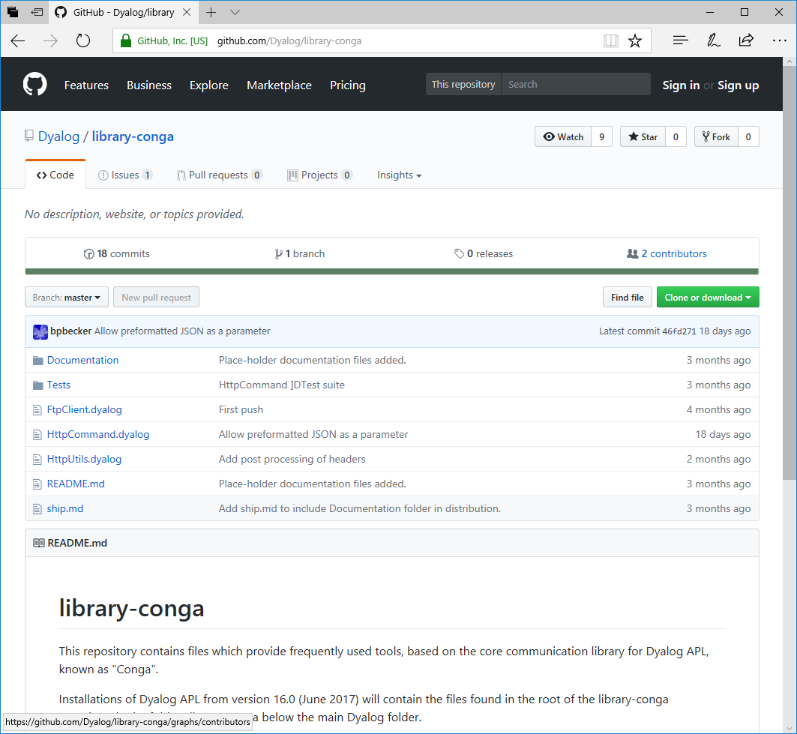
⍝ In a standard v16.0 installation:
]list [dyalog]/Library/Conga
Type Name Versions Size Last Update
FtpClient 8088 2017/07/17 3:21:04
HttpCommand 27688 2017/07/17 3:21:04
HttpUtils 31573 2017/07/17 3:21:04
<DIR> Documentation 2017/08/27 15:15:32
]load HttpCommand
#.HttpCommand
url←'http://www.hasthelargehadroncolliderdestroyedtheworldyet.com/atom.xml'
atom←HttpCommand.Get url {(⍵[;1]∊⊂'content')⌿⍵[;2]} (⎕XML atom.Data)[;2 3]
NOPE.

Slide 19
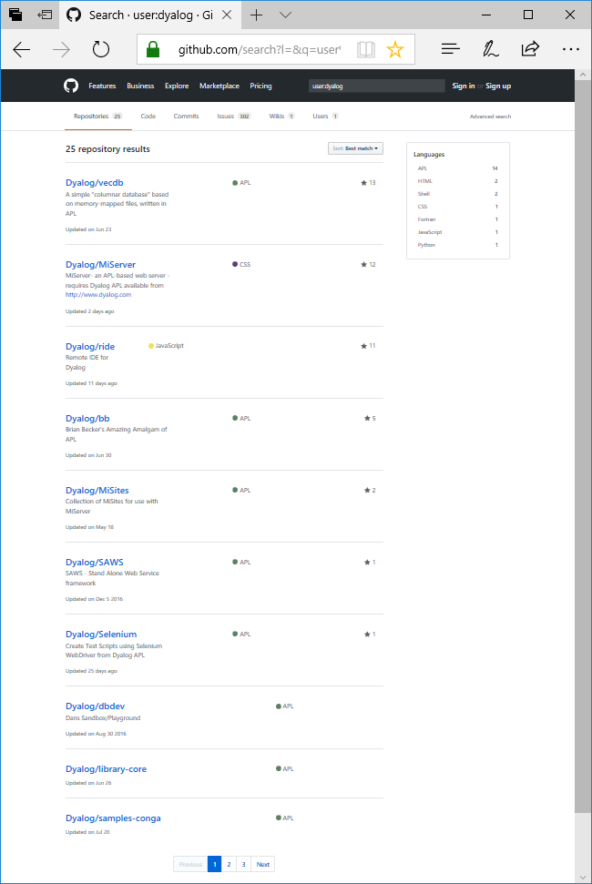
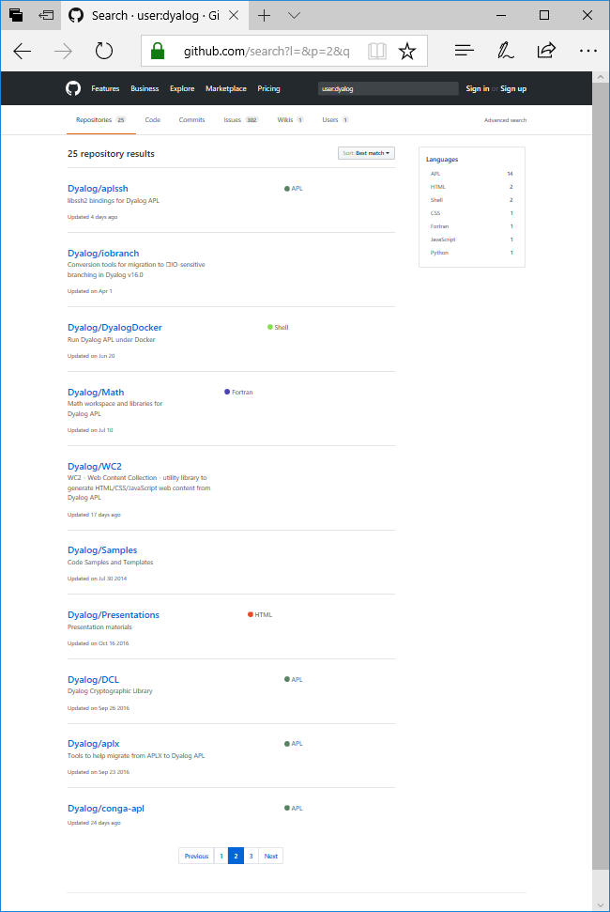
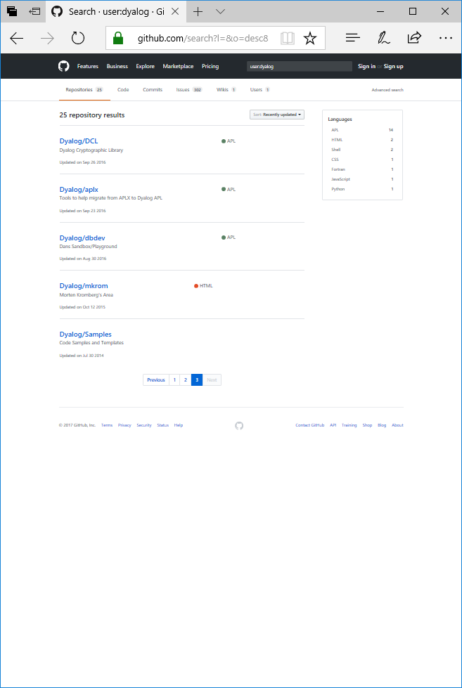

Slide 20
OK, safe to open eyes again...

Slide 21
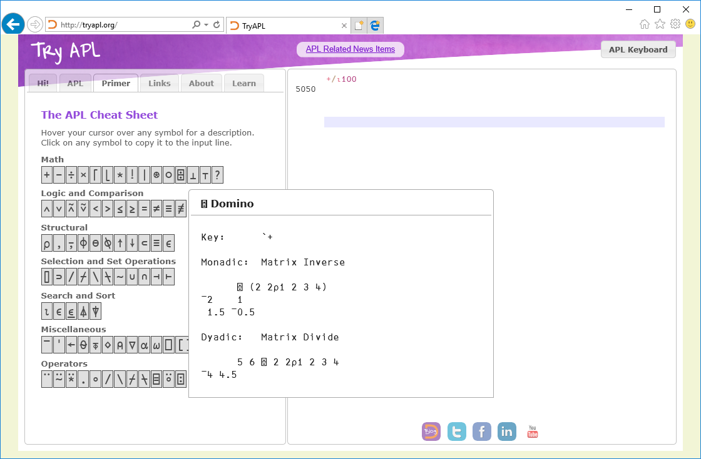
Learning APL

Slide 22
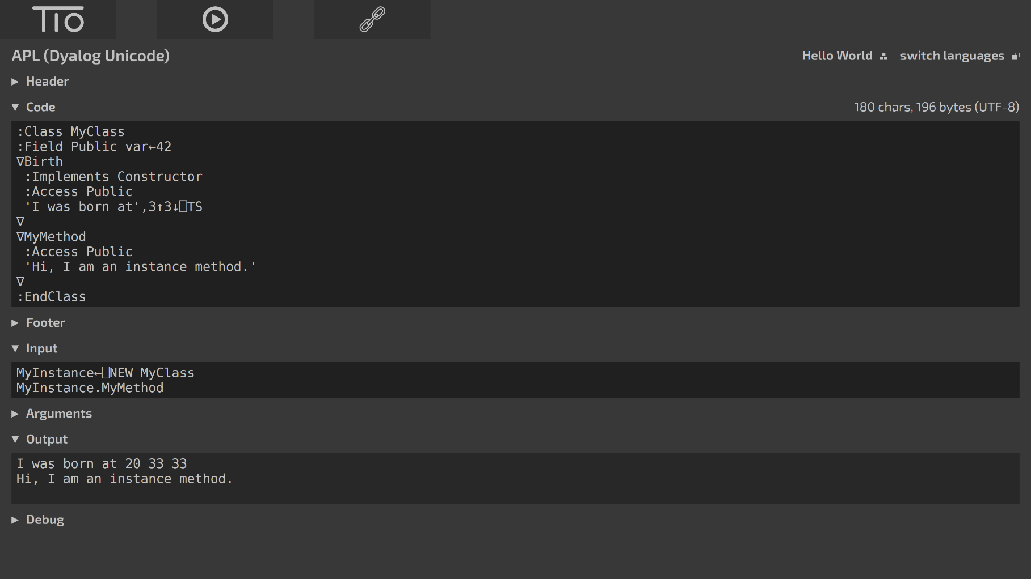
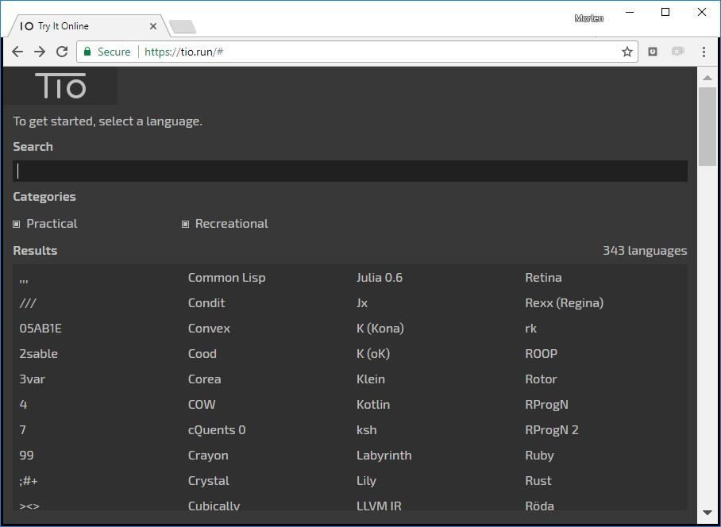
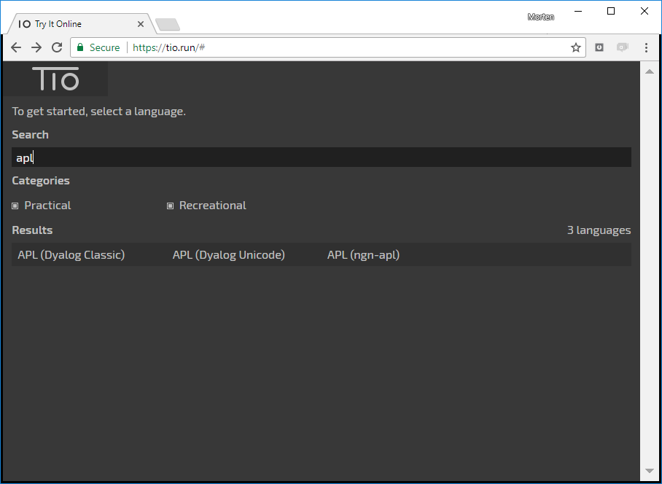
Learning
APL

Slide 23
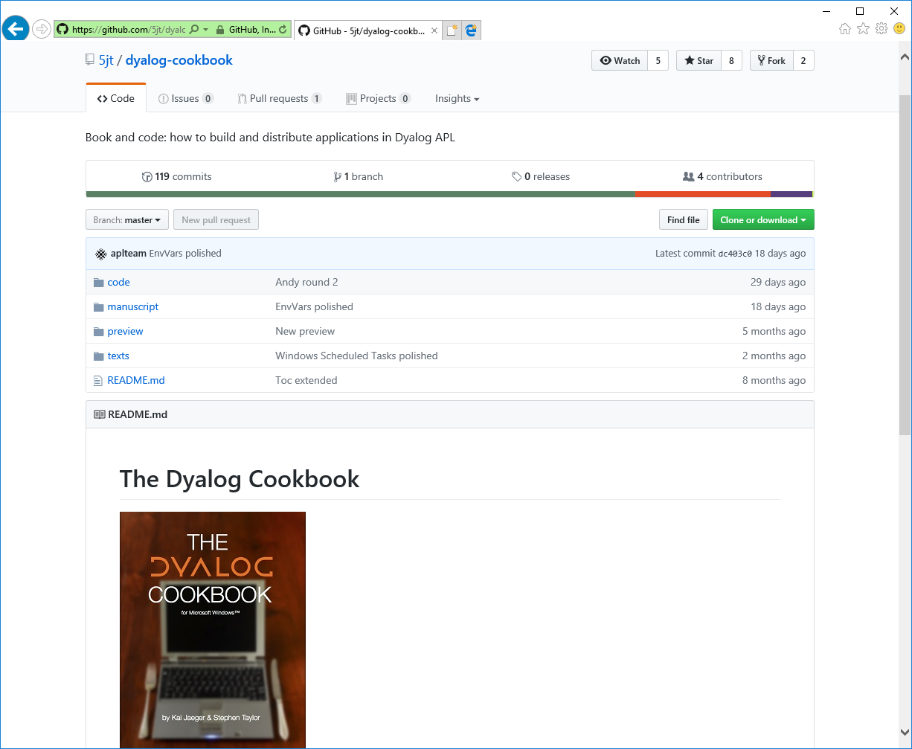
Learning
APL

Slide 24
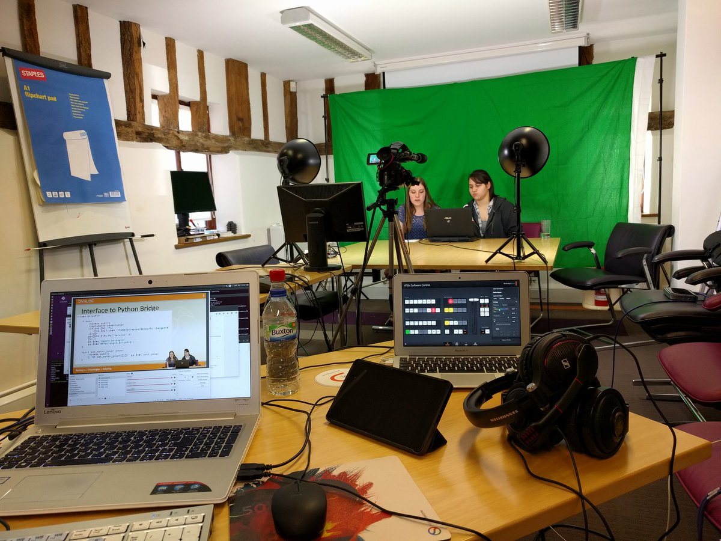
Webinars
4 monthly webinars so far; next one in October "Podcasts" also planned.

Slide 25
Webinars so far
Date (2017) | Subjects Covered
May 18th | ⎕NGET/⎕NPUT, ⎕CSV (Richard Smith) HTMLRenderer preview (Morten Kromberg)
June 29th | Version 16.0 Highlights (Morten)
July 27th | Closer look at new primitives in v16.0 (John Scholes & Morten Kromberg)
August 17th | Summer Intern Party: Robots and the APL to Python Interface (Stephanie Buettner, Becca Murray and Marinus Oosters)
Dyalog'17 | Streaming Monday AM & Weds PM
October 19th | Let us know what you'd like

Slide 26
The latest weapon added to our arsenal...
Jupyter Notebooks allow you to mix "markdown" text with expressions executed in a programming language
http://localhost:8888/notebooks/Introduction%20to%20SharpPlot.ipynb
Please join us in creating Notebooks that demonstrate the power of APL!
Thanks to Technology Partner in Belgrade for the prototype!
Will be available to play with very soon

Slide 27
What Next?
Work on Performance, Documentation and Quality
Industrial Strength support for APL Source in Text Files
Notation for Array Constants
Tools to build workspaces and other runtime "artifacts" from Source
More Libraries & Interfaces
HTML Generation with Data Binding
New Excel Interface that does not use COM
MatLab, Julia bridges
Integration - Cross Platform
APL as a shared library (DLL/SO)
APL as a scripting language (#!)

Slide 28
CXO Dreams
A startup switch to start dyalog.exe as a Web Service
HTMLRenderer integrated with RIDE
Cross-platform tools to launch remote processes using SSH and PowerShell
This will give us...
Portable applications on desktops, mobile and cloud-based platforms
Whether the UI is rich, simple or NONE
Secure, scalable personal OR corporate applications for modelling AND high performance production apps
APL every- where!

Slide 29
Version 16.0: A Milestone Release
16.0
Some new technologies are still quite fresh:
Source code libraries & tools
The HTMLRenderer
RIDE 4.0
However, we are confident that they are important steps in the direction of
Supporting new platforms including the cloud.
Attracting the next generation of developers - and managers!
Release

Slide 30
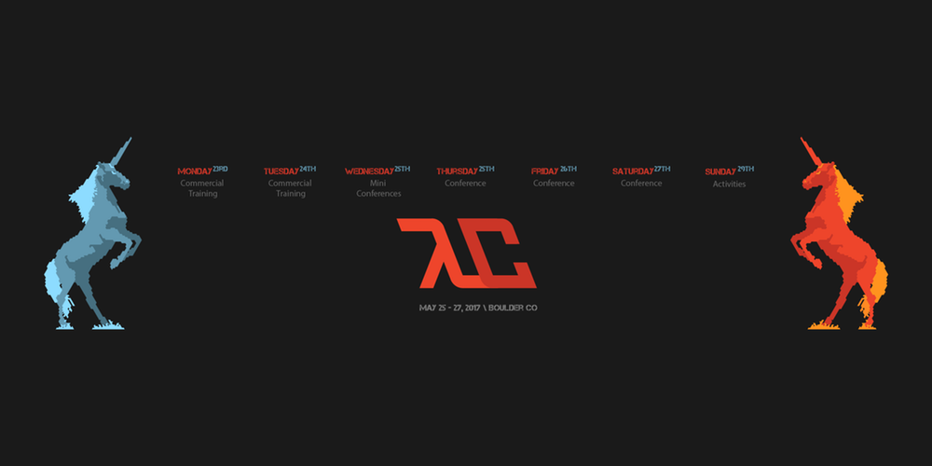
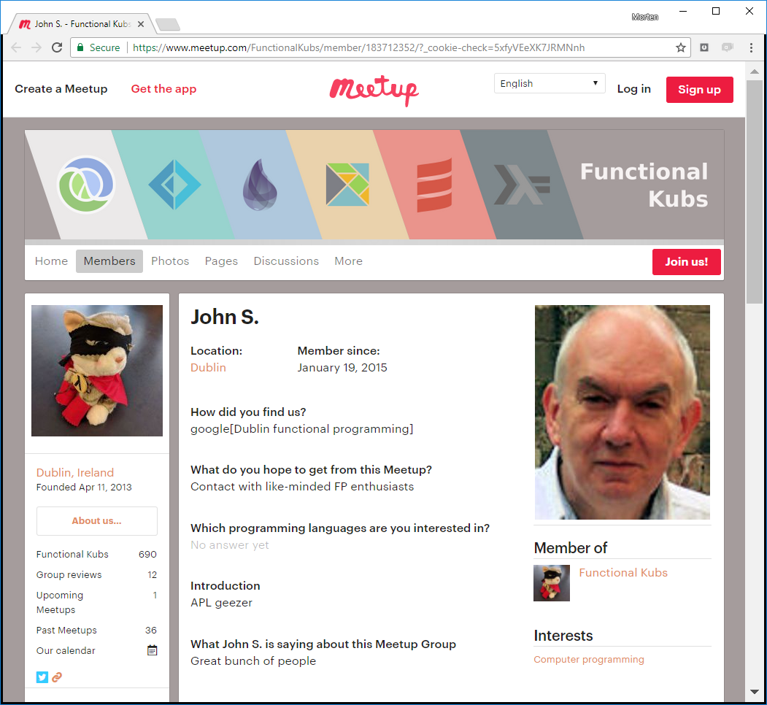
Evangelists

Slide 31
Quotes from Code Golfers

Slide 32
Now Jay will tell us more about how the development team will make our dreams come true

