Slide 1
Multi-Platform User Interfaces using HTMLRenderer
Brian Becker APL Tools Group

Slide 2
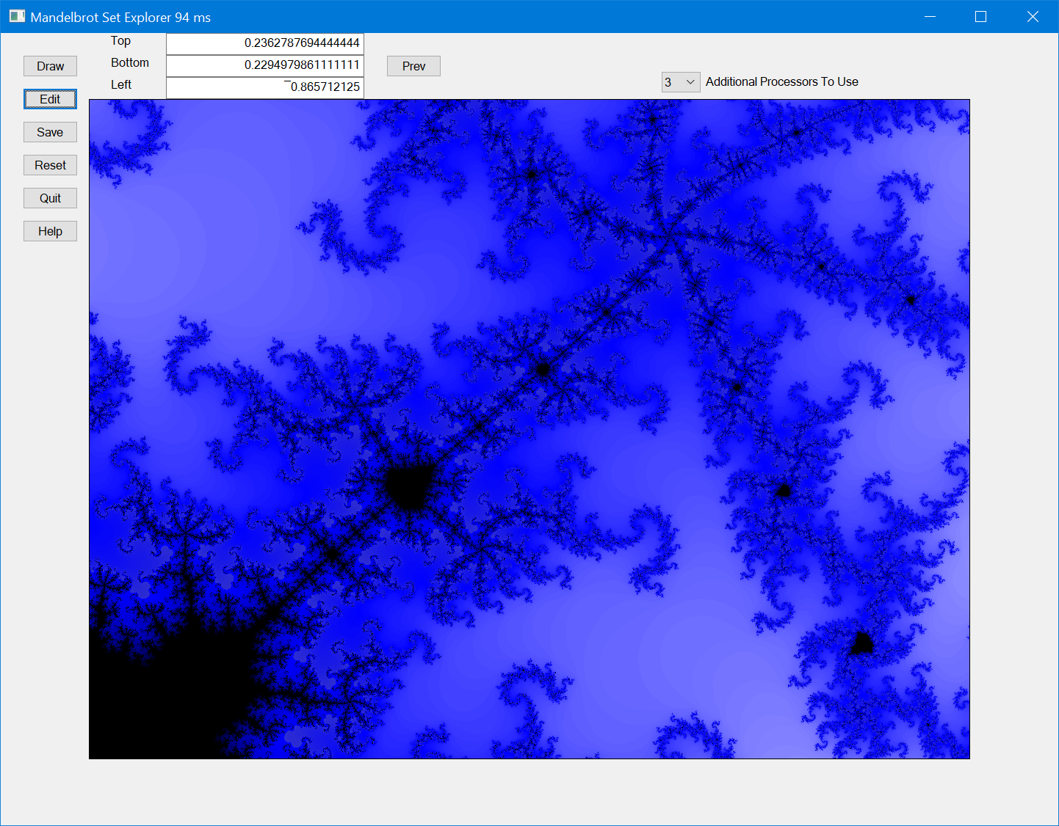
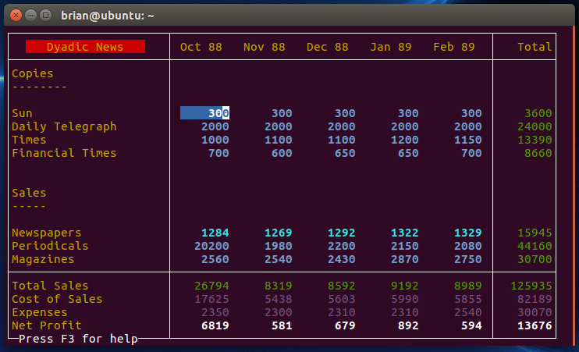
The GUI Challenge…
Your challenge
Cross-platform applications
⎕WC is great for Windows, but what about others?
Dyalog's challenge
Provide the same functionality across platforms
Make it easy to use
Different platforms, Different technologies
Windows – Win32, WPF, ActiveX
Mac – Cocoa
Linux, Raspberry Pi – X Window
Notes:
Mandelbrot Explorer I developed when trying to teach myself Dyalog GUI
If you want to go for that retro 80's style user interface, you can always use ⎕SM

Slide 3
Introducing HTMLRenderer
A new GUI object
'R' ⎕WC 'HTMLRenderer' 'Hello <b><i>World!</i></b>'
'R' ⎕WC 'HTMLRenderer' ('URL' 'http://www.dyalog.com')
Available wherever¹ Dyalog APL runs
Make it as easy² to use as ⎕WC
Think of HTMLRenderer as a cross-platform replacement for ⎕WC
⎕WC uses Win32
HTMLRenderer uses HTML/CSS/JavaScript
¹ Win, Mac, Linux now
Pi soon
Android planned
² or easier!
Notes:
AIX is not mentioned because it's not a desktop environment. You would use MiServer

Slide 4
All you need is…
A way to create HTML/CSS/JavaScript content
You could roll your own
You could use WC2
WC2 is an interface between HTMLRenderer and Dyalog's HTML creation library
Dyalog's challenge
Provide the same functionality across platforms - HTMLRenderer
Make it easy to use – WC2
Notes:
All you need is… Love?
HTML – content CSS – styling
JavaScript – content manipulation, event handling, "programming"
Paul Mansour's Rumba has some HTML generating features

Slide 5
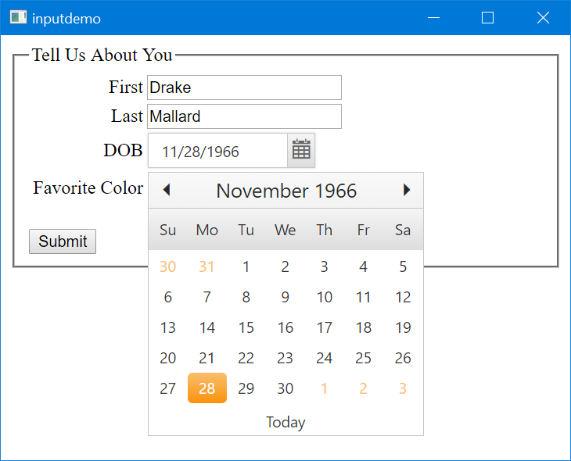
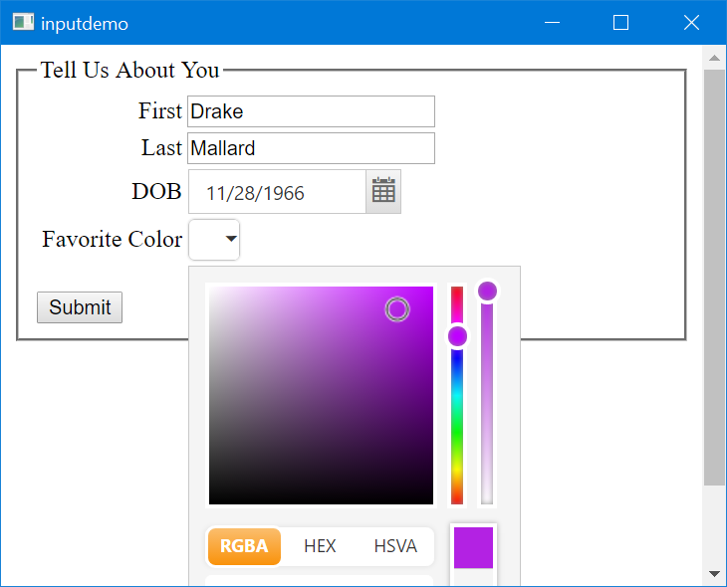
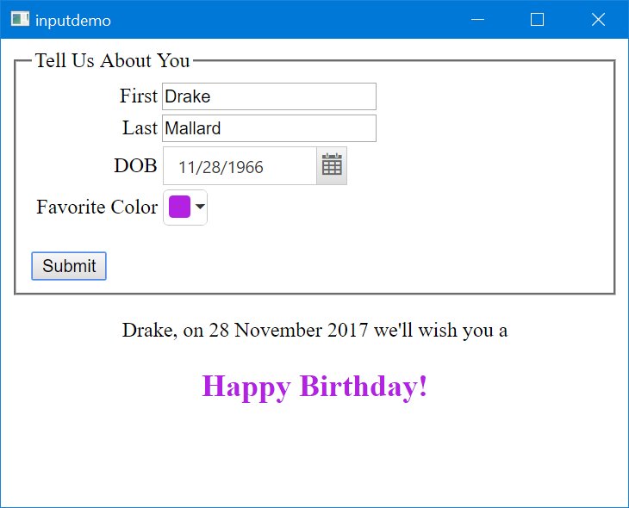
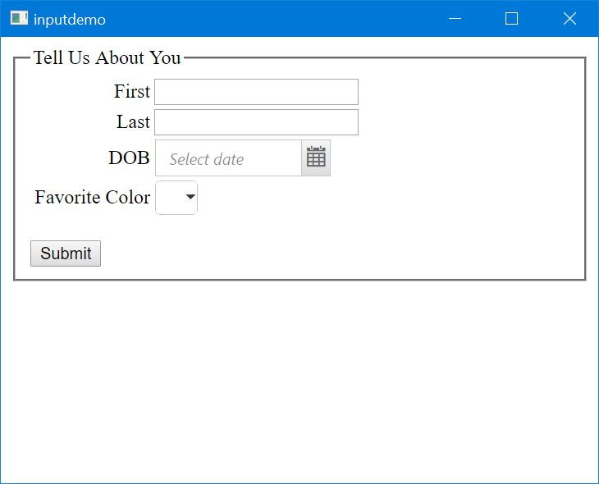
WC2 in Action

Slide 6
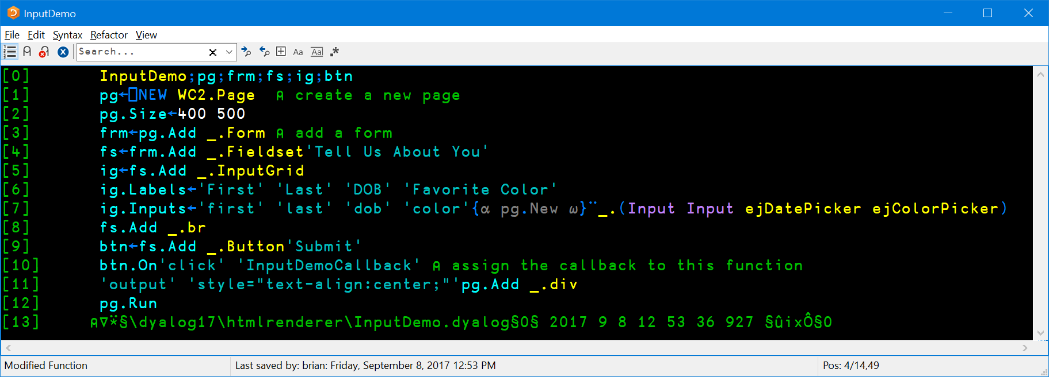
WC2 in Action

Slide 7
WC2 in Action

Slide 8
Run a MiServer MiSite with HTMLRenderer
Same content
Run it on the Internet
Run it locally on the desktop, tablet, phone, etc
WC2.Run '' 'MiSitePath'
Not going to demo today
No time to show it
Not working as I'd like
Okay, there's a bug
Maybe two
But it'll work soon

Slide 9
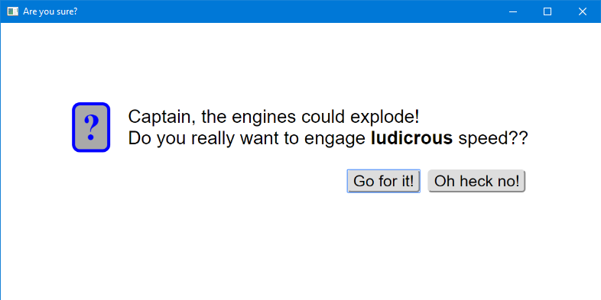
Building Standalone Components - MsgBox
mb←⎕NEW MsgBox
mb.Caption←'Are you sure?'
mb.Style←'query'
mb.Text←'Captain, the engines could explode!<br>Do you really want to engage <b>ludicrous</b> speed??'
mb.Btns←'Go for it!' 'Oh heck no!'
mb.Run

Slide 10
Experimental
HTMLRenderer itself is not experimental
We expect it to continue to exist as is with backward-compatible upgrades and bug fixes.
What is experimental are the tools and frameworks we are developing for use with HTMLRenderer
We need to write additional documentation
We need real-life application of the tools
We need your feedback
Don't hold back, start using it!

Slide 11
Contrasting WC2 and ⎕WC
⎕WC remains a good choice
Layout may be easier with WC2
"Responsive" layout is much easier
Extensibility - adding additional components
⎕WC has .NET, ActiveX
WC2 has several built-in (Syncfusion, jQuery, Datatable, Bootstrap) and a gazillion resources available
It's easy! It's fun! You can do it to! (Please do!)
WC2 has some catching up to do
Documentation, supporting materials, demos, tutorials
Reliability
⎕WC has a 25 year head start ☺
WC2 has been around for over 3 years
If you're Windows only
No 'Posn' or 'Size'
Adapting to different screen sizes and orientations
1 gazillion = a lot
Syncfusion renewed for 5 years
And John Daintree
And we've been using it all that while

Slide 12
HTMLRenderer Future
HTML/JavaScript/CSS is here to stay
HTMLRenderer is here to stay
If you want to develop GUI front ends
For platforms other than Windows desktops
Linux, Mac, Android
Tablets, Phones, TV's, Refrigerators, IoT
This is technology we think you need to learn and embrace
And help guide us in what tools you need
Notes:
Even so, you don't need to all become experts

Slide 13
One more thing…
Anyone want to see a demo?

