Slide 1
Parallel Execution in a Monolith Application
Lars stampe Villadsen, SimCOrp A/S
Dyalog USER CONFERENCE 2017
Notes:
Assuming that you have all the time in the world and no customers then you would probably be able to get your application designed to run in parallel fashion with well-defined components and clear interfaces between components – but what do you do when this assumption does not hold?
Lars gives an introduction to the way in which SimCorp tries to utilise the power of the modern PC HW and use more than one CPU and still work within the boundaries set by a 25-year-old application.

Slide 2
Agenda
Ideal world and reality
Isolates and futures revisited
Sketch of solution
“Live Demo”
Would it not be nice if…

Slide 3
Ideal world and reality

Slide 4
Ideal world and reality
Parts of our code is 25 years old
Almost 100 % traditional functions
A rewrite will most probably not be done on in APL
We have state and caches all over
We use []NA and .Net as an integral part of the application
We have load-balancing implemented via extra sessions communicating via TCP and/or database
Start of application takes 10+ seconds (even more for developers)

Slide 5
Isolates and futures revisited

Slide 6
Isolates and futures revisited
Morten have demoed these a lot of times:

Slide 7
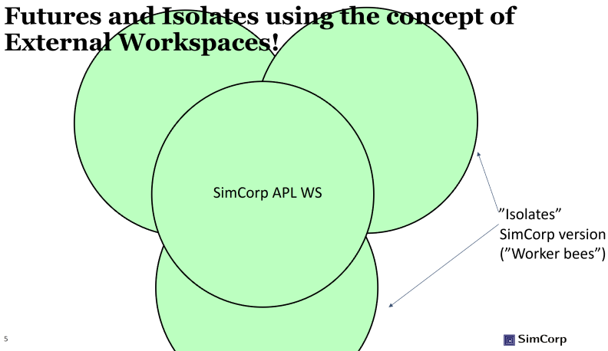
Isolates and futures revisited
Our impression of the reality in the application:

Slide 8
Sketch of solution

Slide 9
Sketch of solution
Objectives
Require no installation for ordinary application developers
Gain scaling in number of CPU’s
Fit into coding standards
Have low maintenance

Slide 10
Sketch of solution
Implementation
Implement ‘Class like’ constructor for each “Slave/Isolate/WorkerBee”
Cut down start-up to a minimum
Use external shared codepage, Conga, Dyalog RPC WS and APLProcess
Implement distribution of ‘chunks’ to be executed in parallel.

Slide 11
SimCorp Dimension WS
Notes:
Where we really could benefit from Isolates, is to spawn clones of main WS to split up and parallelize e.g. calculations (aka “worker bees”)

Slide 12
SimCorp Dimension WS
Functions
Global variables (simple)
Static caches
Namespaces
Classes
Notes:
Where we really could benefit from Isolates, is to spawn clones of main WS to split up and parallelize e.g. calculations (aka “worker bees”)

Slide 13
SimCorp Dimension WS
Shared code page(SCF)
Functions
Global variables (simple)
Static caches (some)
Static caches(others)
Namespaces
Classes
8666⌶shared_code_file
⊃¨⍴¨⎕NL¨ ⍳9 unchanged
⎕WA bigger as all functions is outside WS
First call to SCF functions is sligthly slower
Notes:
Where we really could benefit from Isolates, is to spawn clones of main WS to split up and parallelize e.g. calculations (aka “worker bees”)

Slide 14
SimCorp Dimension WS
SCF, APLProcess
'APLProcess'⎕CY wsid
slaves[i]←⎕NEW APLProcess(wsid args runtime)
Notes:
Where we really could benefit from Isolates, is to spawn clones of main WS to split up and parallelize e.g. calculations (aka “worker bees”)

Slide 15
SimCorp Dimension WS
SCF, APLProcess
'APLProcess'⎕CY wsid
slaves[i]←⎕NEW APLProcess(wsid args runtime)
wsid: ”rpcserver.dws”
⎕LX: start conga on
port in ”args”

Slide 16
SimCorp Dimension WS
SCF, APLProcess,Conga
Conga communication

Slide 17
SimCorp Dimension WS
SCF, APLProcess,Conga
Inject ”fast start-up function” and execute.
This will attach to the SCF

Slide 18
SimCorp Dimension WS
SCF, APLProcess,Conga
Repeat a ”reasonable” number of times
…

Slide 19
SimCorp Dimension WS
SCF, APLProcess,Conga
Call in parallel
dbSelect arg ⍝ (n⊃args)
(0 parallelEachExecute dbSelect ) args
dbSelect ¨ args
…
dbSelect arg ⍝ (2⊃args)
dbSelect arg ⍝ (1⊃args)

Slide 20
SimCorp Dimension WS
SCF, APLProcess,Conga
Call in parallel
dbSelect arg ⍝ (n⊃args)
(0 parallelEachExecute dbSelect ) args
…
dbSelect arg ⍝ (2⊃args)
dbSelect arg ⍝ ((n+1)⊃args)

Slide 21
DB access?
Global caches?
Parent WS
##
Various state variables
Notes:
Where we really could benefit from Isolates, is to spawn clones of main WS to split up and parallelize e.g. calculations (aka “worker bees”)

Slide 22
“Live Demo”

Slide 23
Would it not be nice IF…

Slide 24
Would it not be nice IF…
In C#:
string[] lines = File.ReadAllLines(txtProxyListPath.Text);
List<string> list_lines = new List<string>(lines);
foreach (string line in list_lines)
{
//My Stuff
}
PARALLEL (In .Net 4.0 released April 12th 2010)
string[] lines = File.ReadAllLines(txtProxyListPath.Text);
List<string> list_lines = new List<string>(lines);
Parallel.ForEach(list_lines, line =>
{
//Your stuff
});
In APL:
lines←⎕NGET txtProxyListPath.Text
:For line :In lines
⍝ ... My stuff
:EndFor
PARALLEL??:
lines←⎕NGET txtProxyListPath.Text
:For line :InParallel lines
⍝ ... My stuff
:EndFor

Slide 25
QUESTIONS?
Thank you
(lars.s.villadsen@simcorp.com)

Slide 26
get additional template slides
HOW TO access the timesaver in 3 steps
To see additional template slides click on the blue button ‘Add Slides SimCorp’ in the top bar.
Then select a category in the ‘slide category’ widget, to access the below 7 slide categories
Click on the ‘insert slides’ button to add the selected slide to your presentation
To access all images, please open the hyperlink: Image Library
FRONTPAGES & BREAKERS
EXTRA SLIDES
PRODUCT MODEL
ICONS
FLOWS AND COMPOSITIONS
GRAPHS
COLORS
IMAGES

Slide 28
LEGAL
disclaimer
The contents of this presentation are for general information and illustrative purposes only and are used at the reader’s own risk. SimCorp uses all reasonable endeavours to ensure the accuracy of the information.
However, SimCorp does not guarantee or warrant the accuracy, completeness, factual correctness, or reliability of any information in this publication and does not accept liability for errors, omissions, inaccuracies, or typographical errors.
The views and opinions expressed in this publication are not necessarily those of SimCorp.
© 2017 SimCorp A/S. All rights reserved. Without limiting rights under copyright, no part of this document may be reproduced, stored in, or introduced into a retrieval system, or transmitted in any form, by any means (electronic, mechanical, photocopying, recording, or otherwise), or for any purpose without the express written permission of SimCorp A/S.

