Slide 1
‘17 Elsinore

Slide 2
A Quick Introduction

Slide 3
The Talking Points
Working for a small APL shop in SA
Some of the changes and challenges
The importance of libraries

Slide 4
Riskflow

Slide 5
Riskflow
Cube³⁶⁰ and Basel⁺
fmbTrade
CFO (CashFlow Optimiser)

Slide 6
Changes in the Game

Slide 7
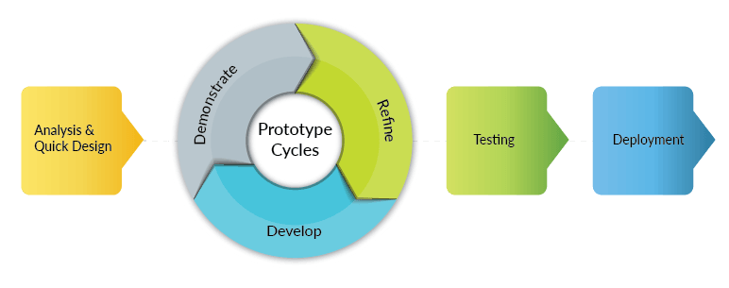
From Prototype to Production

Slide 8
From Prototype to Production
Prototype
Production
Develop
Demo
Refine
Test
Build
Deploy
VS

Slide 9
Testing Takes Time

Slide 10
Having a Code Base You Trust

Slide 11
Tools and Libraries
Moving seamlessly from prototyping cycle to production cycle requires good general libraries

Slide 12
Accidental Libraries

Slide 13
IFS
Adding Functionality
GUI Upgrade
.dll
RESTful

Slide 14
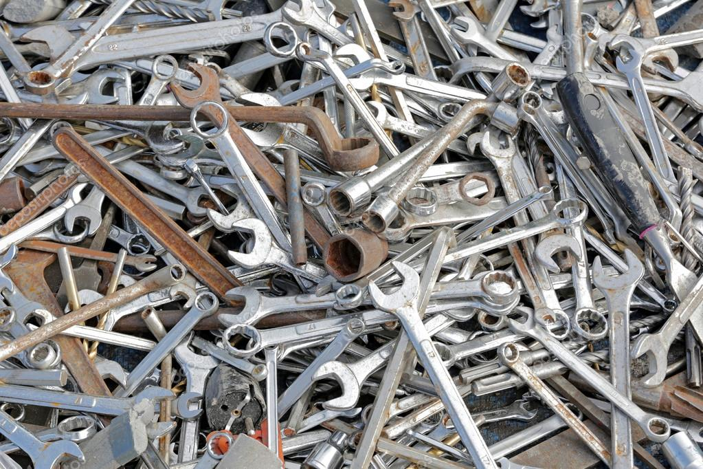
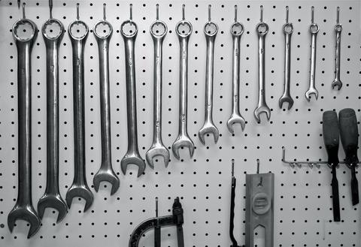
Shift in Approach

Slide 16
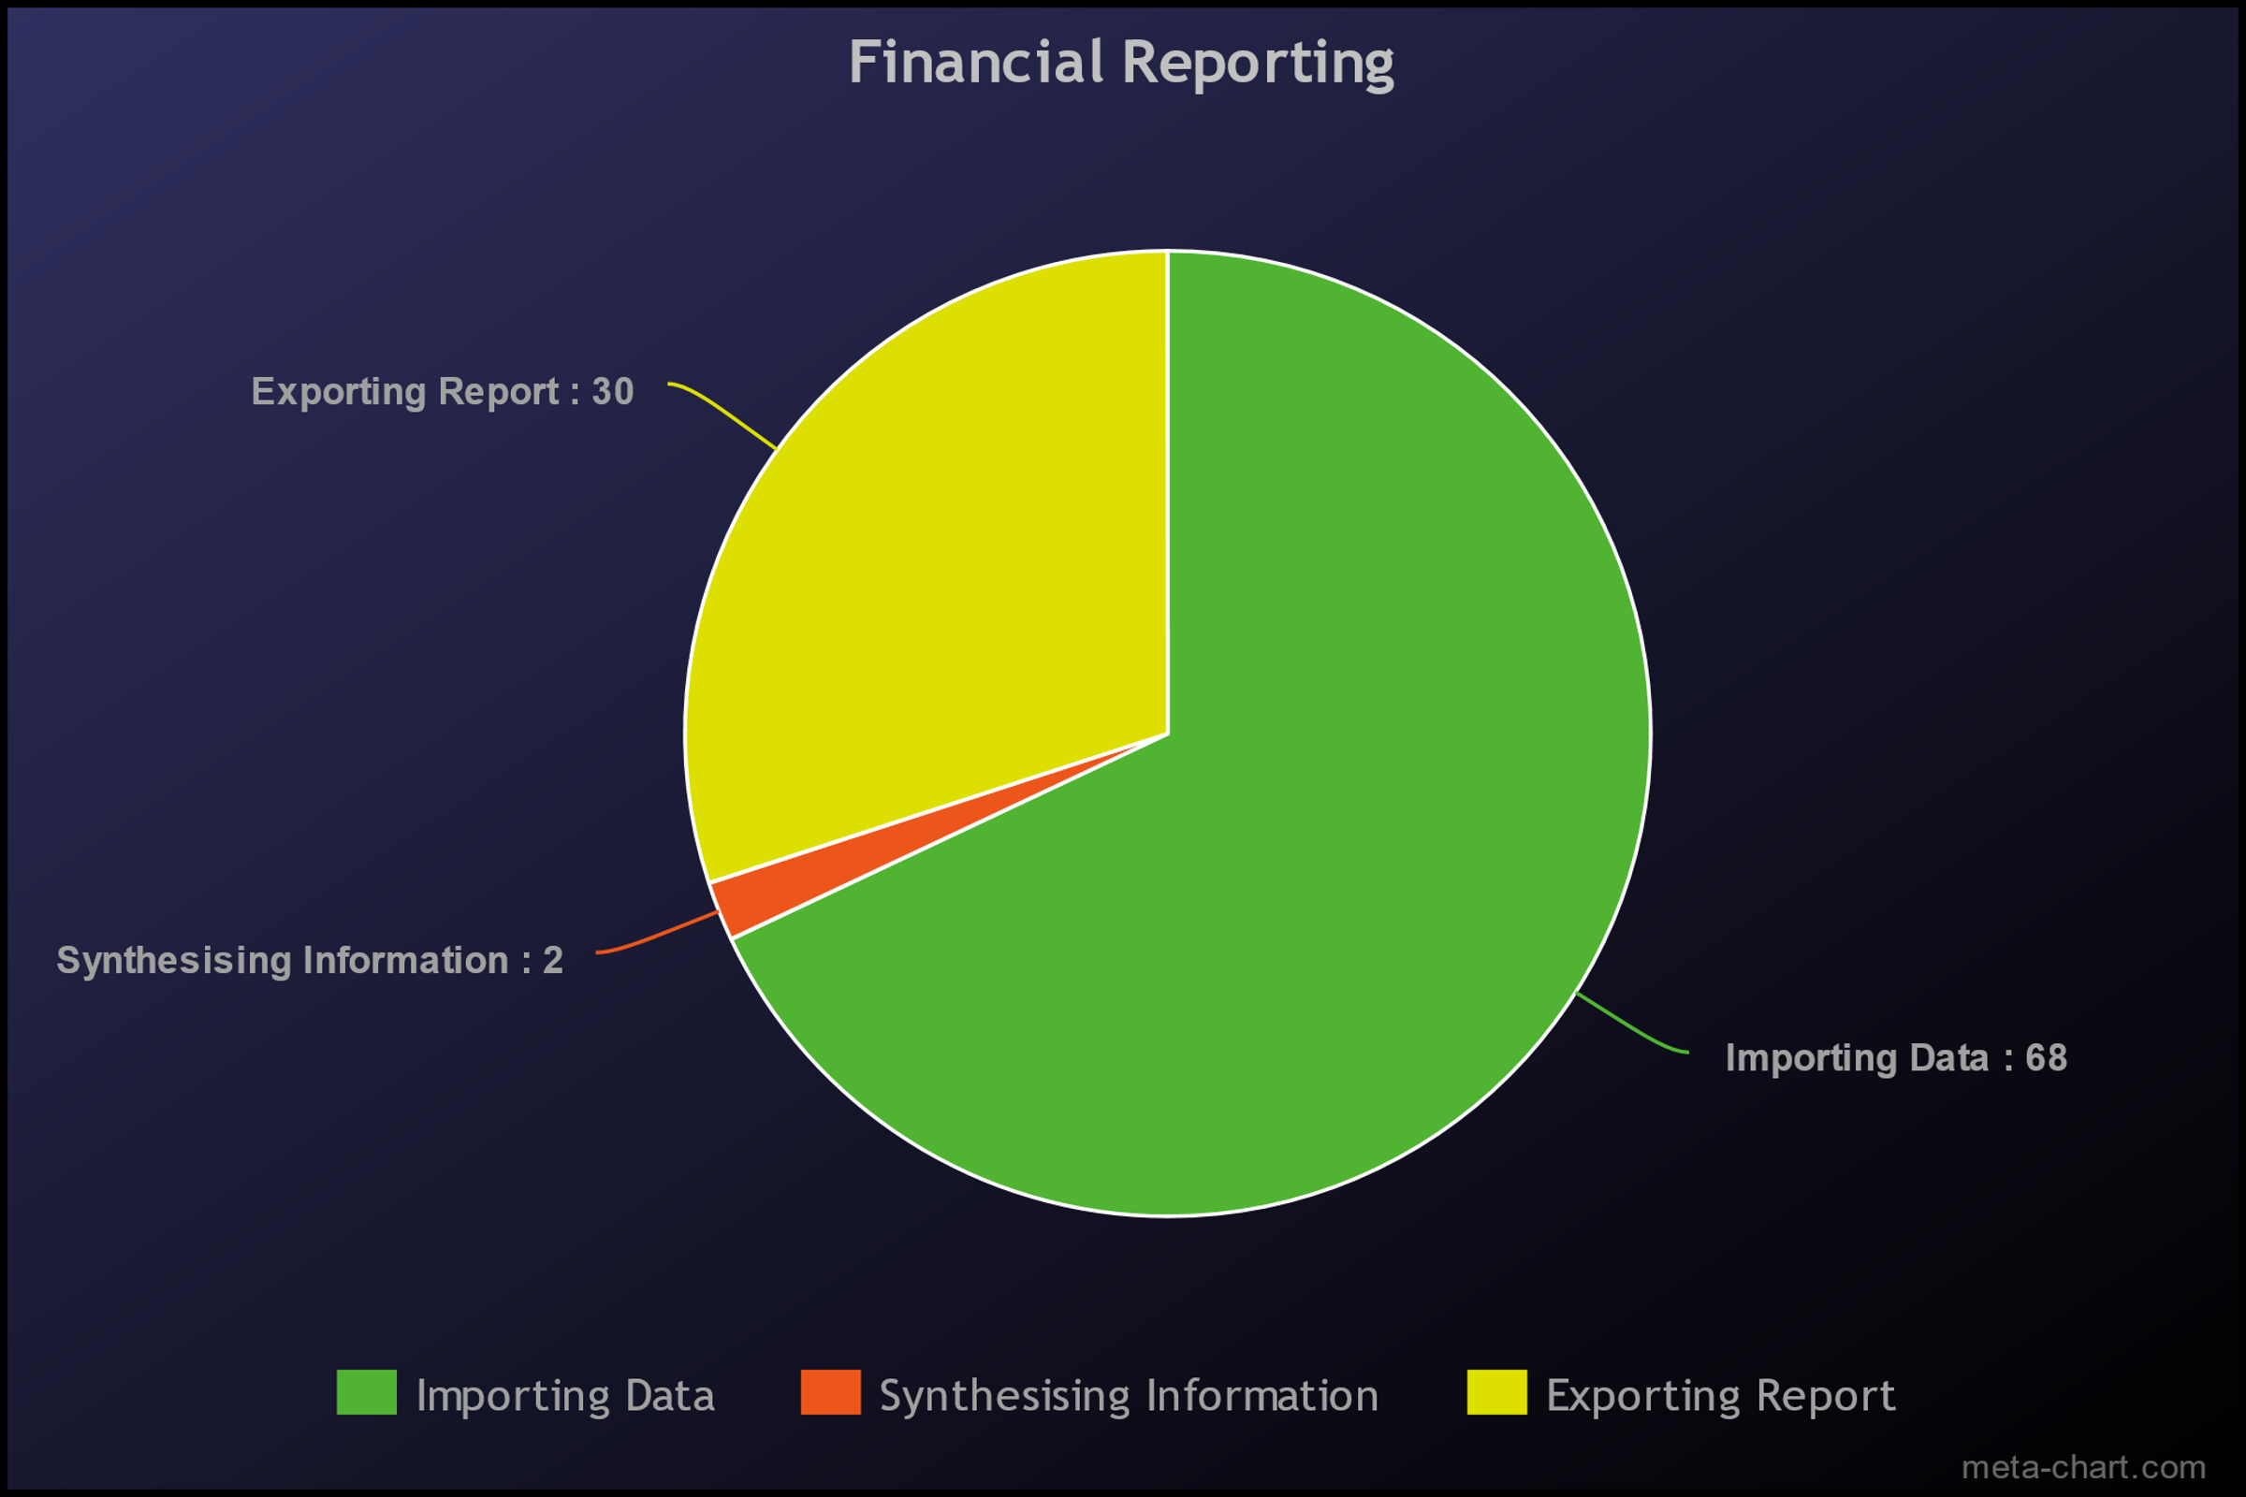
Building Deliberate Tools
What do I do a lot of:
Importing
Exporting
Builds
Files

Slide 17
Tools for General Use
Database handling
CSV handling
Build handling

Slide 18
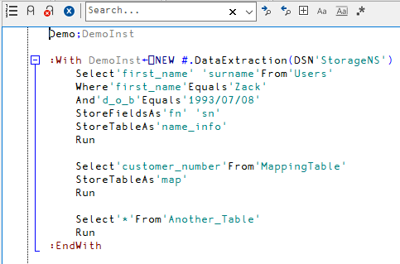
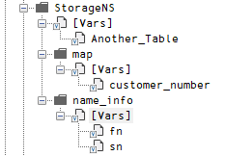
Database Data

Slide 19
Other Operations
Where [field] …
Or [field] …
And [field] …
Equals [value]
Is [operation, value]
Valid operations:
=><≤≥≠ (as a glyph or a phrase)
Apply [insert_function_ref] To [field]
Apply [insert_function_ref] ToEach [field]
[ASC/DESC] OrderBy [field] (ASC = 1, DESC = 2)

Slide 20
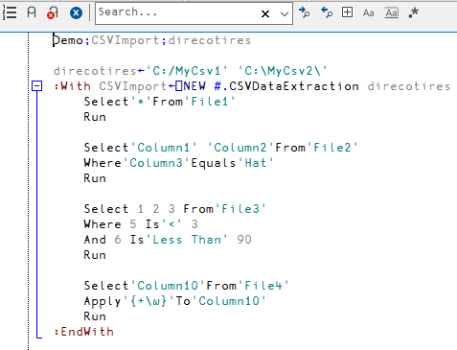
CSV Data

Slide 21
Fine Tuning
Specifying data types for colums
Strict or soft matching
Files
Column headings
Has header or not
Remove empty rows or columns

Slide 22
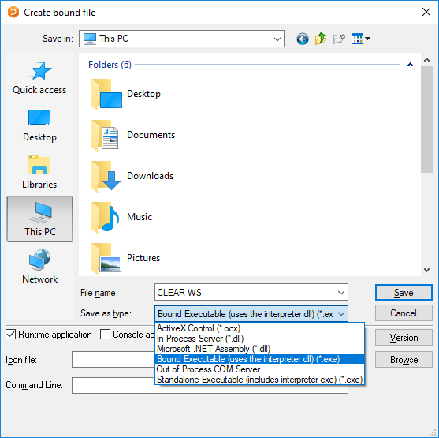
Build Tool

Slide 23
Build Tool
2 ⎕NQ '.' 'Bind' <filename> <type> <flags> <resource> <icon> <cmdline>

Slide 24
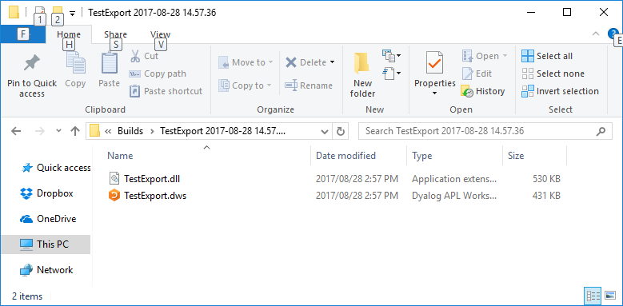
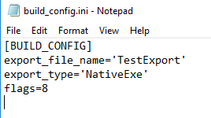
Build Tool

Slide 25
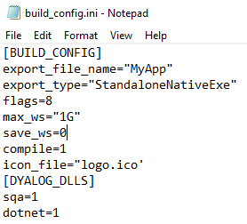
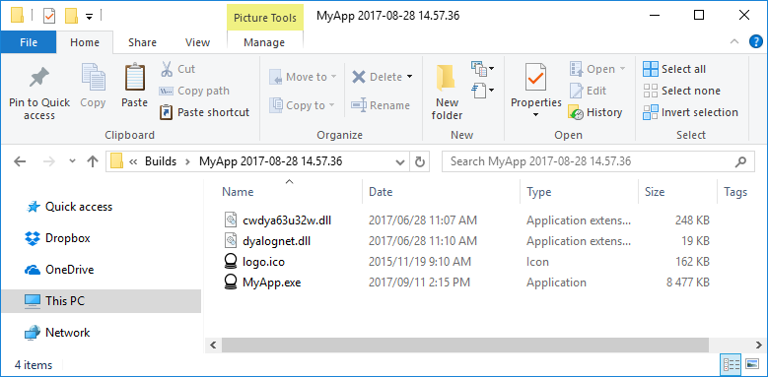
Build Tool

Slide 26
GitHub
https://github.com/Riskflow/DataExtraction

Slide 28
Fin.

