Slide 1
tl;dr
https://xpqz.github.io/learnapl/
Notes:
Thank you, Morten!
I wrote an introductory text to APL, and if you're impatient, you can find it here.

Slide 2
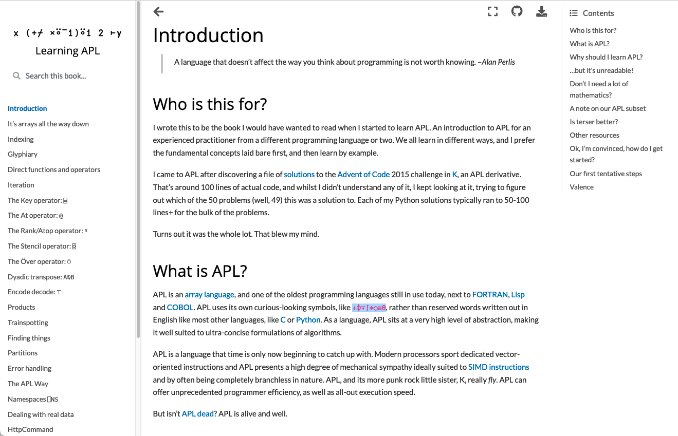
Notes:
It starts off like this. Go check it out, and please reach out to me if you have feedback or spot errors.

Slide 3
Notes:
Hello. I'm Stefan Kruger, and I'm here to tell you a bit about how I discovered APL, and why I came to write a book about it.
This talk will cover the ground making up the first and last chapters of the book, skipping over most of the actual APL in the middle.

Slide 4
Stefan Kruger
CS person who spent far too long at university
Mac zealot
Day job at planet-sized mega corp. Ken himself worked for us...
Mostly teach customers how to stop shooting themselves in the foot
One of those New APLers™ Morten talked about in a blog post a few months back...
Notes:
I guess I'm a computer scientist. A lapsed computer scientist. I did a PhD on something about Fourier transforms back in the day. I've worked as a software developer since the late 90s in various shapes, languages, and companies. Nowadays, I work for a very large International company making Business Machines. Ken himself used to work here. I help customer engineering teams when they run into problems. Whilst long in the business, I'm fairly new to APL. One of those New APLers. And yes, I make no excuses for robustly advocating for the Mac platform.

Slide 5
APL? What's that then?
Notes:
I discovered APL through a programming competition known as Advent of Code -- every December there is an advent calendar of little code problems set, two per day. There is a bunch of us at work who tend to take part.

Slide 6
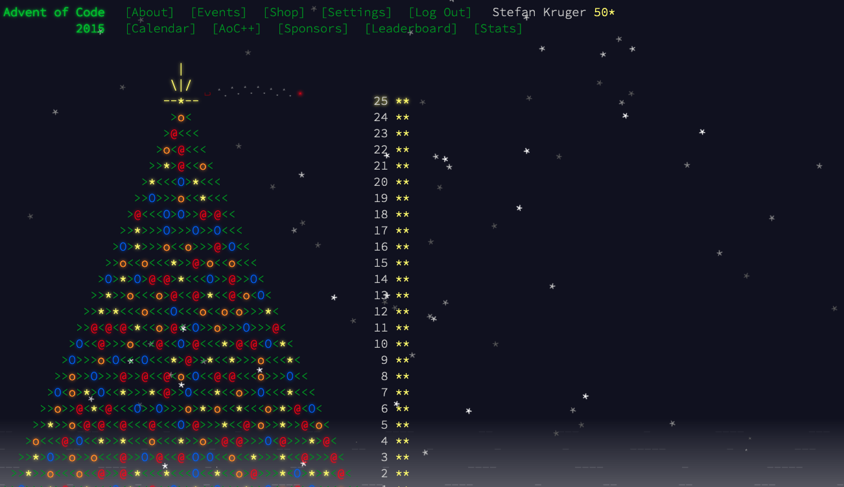
Notes:
Here's the completed 2015 score sheet. It's covering the topics you'd expect to encounter in your first year of Computer Science. Basic algs and data structures, but with a sprinkling of clever twists. A couple of them every year tend to be proper hard. Solutions tend to run to 20 - 100 lines of code in something like Python.

Slide 7
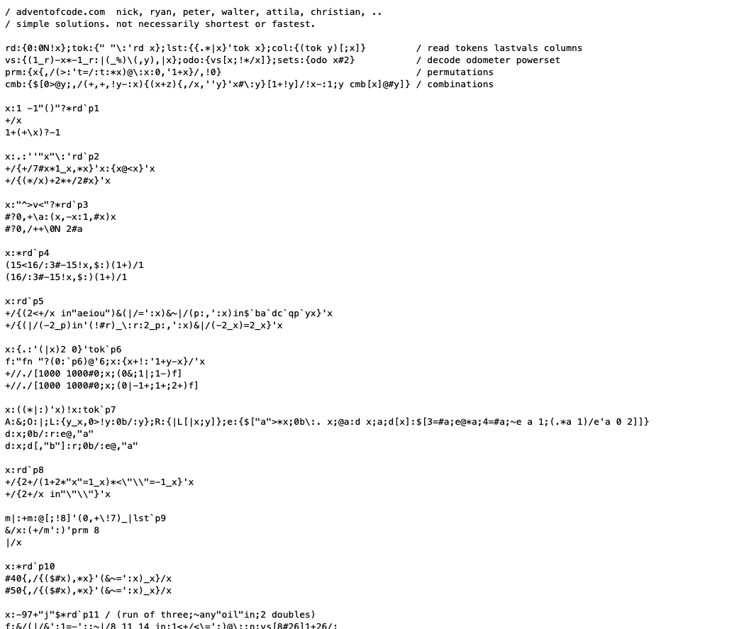
k?
~100 loc
IMPOSSIBLE!
ALL OF THEM?
Notes:
Whilst working my way backwards over the years where I hadn't taken part, I came across the following file. It said "advent of code" at the top, and it was apparently written in a language called "K". I'd never heard of it, and curiously, I could not understand a single thing. Normally, I expect to be able to read most languages. The page ran to about 100 lines of code, about what I'd expect a Python solution to one of the harder problems to come out as. Which problem was this? It dawned on me that it was ALL of them. I couldn't understand how this was possible.

Slide 8
K is sorta APL+Lisp...?
Notes:
So I started digging a bit. Someone claimed that K is an extremely stripped form of APL, but with a bit of inspiration from Lisp and no funky glyphs. Now, I had actually heard of APL back in my university days. It piqued my interest.

Slide 9
APL: the...
of array langs
Notes:
As it turns out, APL is the daddy! The OG of array languages. If I wanted to explore this style of programming, going back to the roots seemed to be the way to go.

Slide 10
⍨ ⍤ ⍥ ⊢ ⍉ ⍣ ∇ ← ⍬
Notes:
As a casual observer, it was love at first sight! The expressive power. The pretty symbols. Here are some of my favourites.

Slide 11
⍨
Notes:
Especially this one. My face throughout the process.

Slide 12
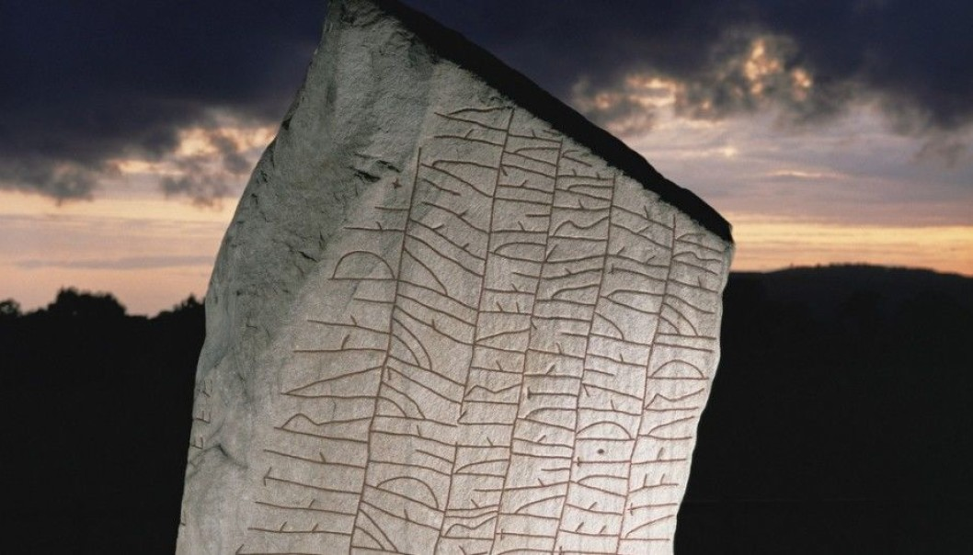
APL
Notes:
The feeling that APL was all magic runes, chiselled by viking mages into slabs of granite. It felt at the same time both ancient and modern.

Slide 13
Notes:
That inscription can be written out as this.

Slide 14
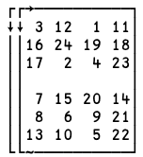
Notes:
If you evaluate it, you get the following:
Experts still debate what the numbers mean, but the vikings clearly understood array-oriented programming.

Slide 15
APL has a reputation:
Notes:
As we're all aware, APL has a reputation.

Slide 16
It's for mathematicians

Slide 17
Unreadable

Slide 18
Write-only

Slide 19
Impossible to learn

Slide 20
Community is a Council of Wizards

Slide 21
One of these is true

Slide 22
The Council of Wizards
The APL Orchard
⍎⌽⍕⌈*○≡⍬
Notes:
I certainly felt like there is a secret guild of Array Magicians hiding in plain sight, speaking in tongues. From Latvia to South Korea, via India and Portugal, they walk amongst us. They gather in obscure corners of the internet.

Slide 23
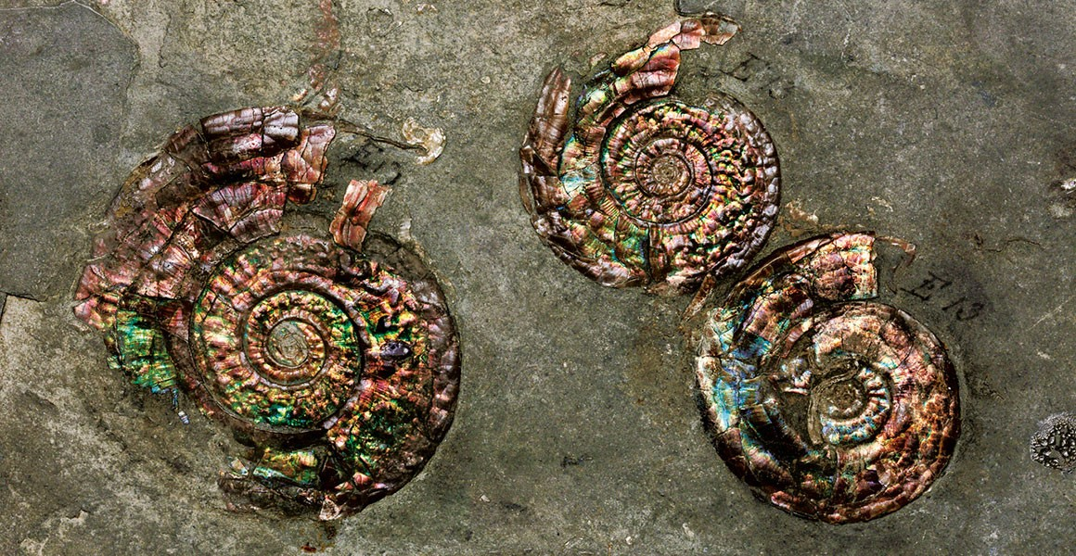
Isn't it dead?
...or at best a living fossil?
Notes:
Another thing you hear as an APLer is that it's a dead language -- the Latin of programming -- or at best a living fossil. Whilst it's not topping any popularity lists, it's alive and well, and perhaps a language who's time has come: APL offers unprecedented "mechanical sympathy" to modern processors. I came across a couple of quotes I'd like to share with you.

Slide 24
“
Old technologies that have stuck around are sharks, not dinosaurs. They solve problems so well that they have survived the rapid changes that occur constantly in the technology world. Don't bet against them.
–Justin Etheredge
Notes:
Justin Etheredge was talking about relational databases, but his point is valid for APL, too. It takes a lot for a technology to really stay the course.

Slide 25
“
Old technologies that have stuck around are sharks, not dinosaurs. They solve problems so well that they have survived the rapid changes that occur constantly in the technology world. Don't bet against them.
–Justin Etheredge
Notes:
Surviving technologies have survived for a reason.
Another quote that resonated with me is from Aaron Hsu

Slide 26
“
Good APL follows a set of best practices that directly contradict and conflict with traditional programming wisdom. Indeed, APL design patterns appear as Anti-patterns in most other programming languages.
–Aaron Hsu
Notes:
He said that....

Slide 27
This cognitive dissonance is one reason why some “computer people” hate APL.

Slide 28
Edsger Dijkstra
APL is a mistake,
carried through
to perfection
Notes:
Like the self-styled godfather of computer science, Edsger Dijkstra. Dijkstra said many things about APL, not one of them flattering.
A 'bag of tricks', he said, encouraging the programmer to think of problems as puzzles, requiring them to find the correct trick rather than to express their ideas elegantly. It's fitting that the algorithm which bears his name is infuriating to implement in APL without resorting to tradfns.

Slide 29
For me, it's the main draw

Slide 30
Learning APL
...is an act of
REBELLION
Notes:
I interpreted this as: learning APL today is an act of rebellion. It's a hard no to verbosity, gang-of-four design patterns, object orientation nonsense. It's two fingers to megabytes of code to do the simplest of tasks.
It felt like I'd come home.

Slide 31
Learning APL
Notes:
So I set about trying to teach myself APL. I've taught myself countless programming languages over the years. How hard can it be?

Slide 32
Not hard:
Notes:
The things I thought were going to be hard weren't hard.

Slide 33
Learning to type
Notes:
Like learning to type APL on a keyboard. Everyone always bangs on about what a barrier of entry this is. It's not.

Slide 34
What glyphs mean
Notes:
And the same for figuring out what the glyphs mean. I think in this regard, APL is actually easier than the situation we have in J or K, even though those languages use normal symbols.

Slide 35
Coding right to left
Notes:
Going with the execution flow of APL soon comes naturally, too.

Slide 36
Hard:
Notes:
The actual hard bits were things I didn't even know existed

Slide 37
Data-parallel problem solving; thinking in arrays
Notes:
The APL Way, if you like -- in the beginning I desperately grasped for the iterative parts of APL, leading to code that's both ugly and slow. Solving problems the APL way feels incredibly alien at first. Fast, idiomatic APL is crushingly slow translated to another language. Conversely, techniques that are fast in other languages are slow in APL. This takes time to sink in.

Slide 38
Performance intuition
Notes:
At a more microscopic level, Dyalog has magic optimisations here and there, and hitting those -- mostly by luck -- can REALLY make your code fly. Change a single glyph, and it crawls. I still struggle with this.

Slide 39
Reading tacit code
Notes:
It's still quite hard for me, a few years down the line. Powerful, compact, efficient - sure. Easy to read, write and understand? It makes me appreciate better what it must be like being dyslexic.

Slide 40
1↓,⊢⍤/⍨1(⊢∨⌽)0,≠
From APLCart
Notes:
Here's a train I picked from AppleCart. You might be able to understand that at a glance. I still resort to pen and paper.

Slide 41
1↓,⊢⍤/⍨1(⊢∨⌽)0,≠
┌─┼───┐
1 ↓ ┌─┼─────┐
, ⍨ ┌───┼─────┐
┌─┘ 1 ┌─┼─┐ ┌─┼─┐
⍤ ⊢ ∨ ⌽ 0 , ≠
┌┴┐
⊢ /
CMC: rewrite as a dfn
Notes:
Here's a little exercise for you - a Conference Mini Challenge: rewrite that train to a dfn. Here's the parse tree. We can perhaps return to this later.

Slide 42
1↓,⊢⍤/⍨1(⊢∨⌽)0,≠
APL is a beautiful thing!
Notes:
But APL is a beautiful thing.,

Slide 43
Why are there so few books?
1↓,⊢⍤/⍨1(⊢∨⌽)0,≠
Notes:
One thing that struck me is that there weren't any intro to APL books that I could find. At least not ones that spoke to me.

Slide 44
Why are there so few books?
I know how to program
I am impatient
Show me examples! I'll figure out how they work
MDAPL: at the time outdated, too long, too "trad" (IMHO!)
Kudos to Rodrigo for bringing MDAPL into the modern era!
Notes:
I like to learn from books, and my bookshelf contains some classics I've accumulated over the years. As a reader, ......,
There is of course MDAPL - but at the time outdated, very long, and devotes a large volume of pages to the parts of Dyalog I wasn't ready to tackle.
Highlight Rodrigo's efforts on bringing MDAPL into the modern era.

Slide 45
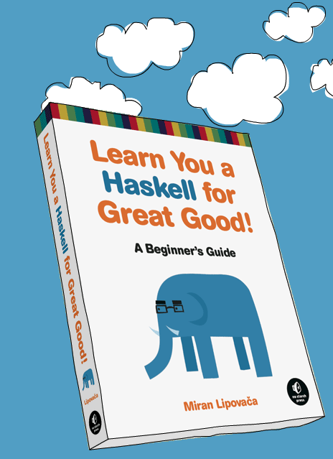
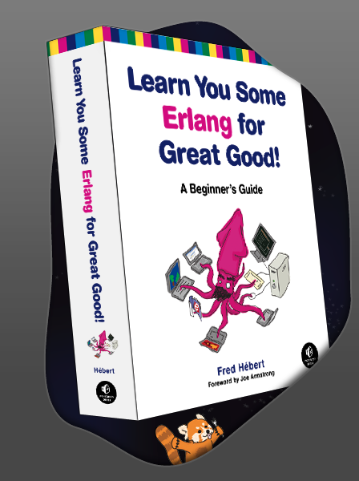
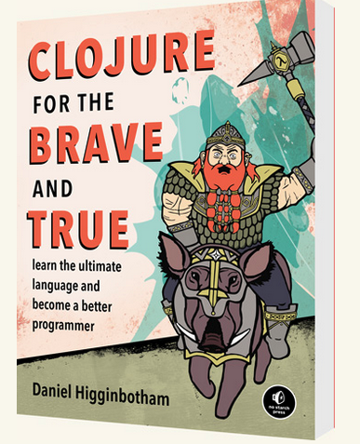
Something like these
APL
Notes:
Here are some examples of books I've read and enjoyed when learning new languages. They're focused, not exhaustive, a bit humorous, and examples-led. The Erlang book is especially good, I think.

Slide 46
Can I do something about this?
Notes:
So it struck me -- could this be a way for me to contribute, rather than sit on my ass whining about the lack of books?

Slide 47
(Disregarding the fact I barely know the language)
Notes:
Leaving to one side for the moment the fact that I barely know the language.

Slide 48
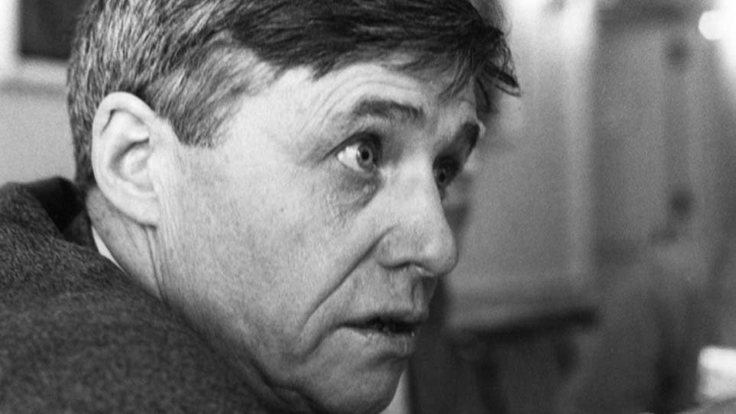
"Ask not what APL can do for you...
...ask what you can do for APL"
Notes:
As Ken himself probably never said.... but he should've! Now, whilst I've not written books on programming languages before, I've written some other stuff over the years: papers, oodles of blog posts on various topics, a phd thesis, technical documentation...

Slide 49
The Plan
⎕IO←0
Task 0: Plow through the back catalog of APL Orchard "Cultivations"
Task 1: read every APL-related paper I can find by Roger Hui
Tasks 2015 - 2020: do all previous Advent of Code problem sets in APL -- this took me best part of a year... I do have a day job!
Task ??: start writing, learn on the job, hope for the best
Notes:
I needed a plan, and I needed to seriously upskill -- I'm going to spare you most of the details of that process. Starting from zero, I studied the back catalog of Orchard Cultivations, Adam's impromtu fast-paced lecture series covering basically the whole of D - gold mine for the learner.
Next, reading Roger's papers. Roger very sadly passed away recently; a huge loss for the array community. Then work through various problem collections. Some of the AoC ones were hard-going for my lacking skills, even if I'd done them before in a different language. When I look through my AoC solutions now, I can see my own skills improving.

Slide 50
What did I learn?
Notes:
So looking back, what did I learn?

Slide 51
Well, I picked up APL
Notes:
Well, I picked up APL, and it's an invaluable tool to have in your tool chest. My progress had its ups and downs, but ultimately not that different from learning any other language.

Slide 52
I've become a better programmer.
Notes:
Perhaps the most surprising thing is that a whole new problem solving approach is there for me, even in other languages.

Slide 53
APL fits my mindset

Slide 54
but then again, my other hobby is regular expressions
Notes:
Perhaps this says more about me than about APL

Slide 55
(dramatic pause)
Notes:
I'd like to change tack for a bit

Slide 56
What could be better?
Notes:
Let's talk about what could be better -- and I really don't intend to talk about the sharp corners of APL itself: you're already familiar with those and the reasons why Dyalog are weary of smoothing them off.

Slide 57
Biased observations from a "New APLer" perspective
Notes:
Let me stress that what follows are my biased observations from a "New APLer" perspective.

Slide 58
...on a Mac
Notes:
and to further complicate things, on a Mac. And all of what follows is on the current version! John's talk just now addresses some of these issues in the upcoming 18.2...

Slide 59
It's awkward to fit Dyalog into a modern* workflow
emacs, 1978; vim, 1991; git, 2005; VS Code, 2015
*
Notes:
The truth is.....
For some definition of modern. Emacs was launched in 1978. vim 1991. git 2005. VS Code, 2015.

Slide 60
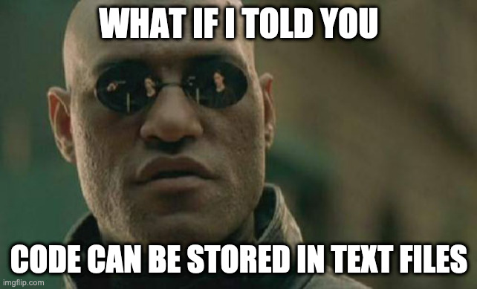
Notes:
Text is an excellent medium in which to store source code, and basically ALL tools are based on this assumption. This somehow passed APL's parallel universe by. Dyalog is now on its 18th major release, and it's only just starting to catch up.

Slide 61
Don't get me wrong: it can be done

Slide 62
To work with code as text
Install a completely separate application stack, Microsoft's .NET Core
Install latest version of the LINK library (tricky on a Mac)
Use LINK to map a directory on the disk containing my code to a namespace
To execute a text file from the terminal command line.... (pre-18.1/2). On a Mac... good luck
To be fair, once set up, it works
Notes:
To be fair -- once it's set up, it works nicely, and in my beta version of 18.1, LINK is finally bi-directional, so that I can edit code with external tools, and have the interpreter do the right thing. But you have to be a pretty sophisticated Dyalogger to get to this point. And really, I had no desire to install a complete .NET stack on my machine just for this.

Slide 63
Other languages:
Point interpreter to file
Code in a text file
Notes:
In most other dynamic languages, you point the interpreter at a file, and it starts at the top, evaluates the code it finds line by line until it finishes (or crashes). It's a nice, simple model.

Slide 64
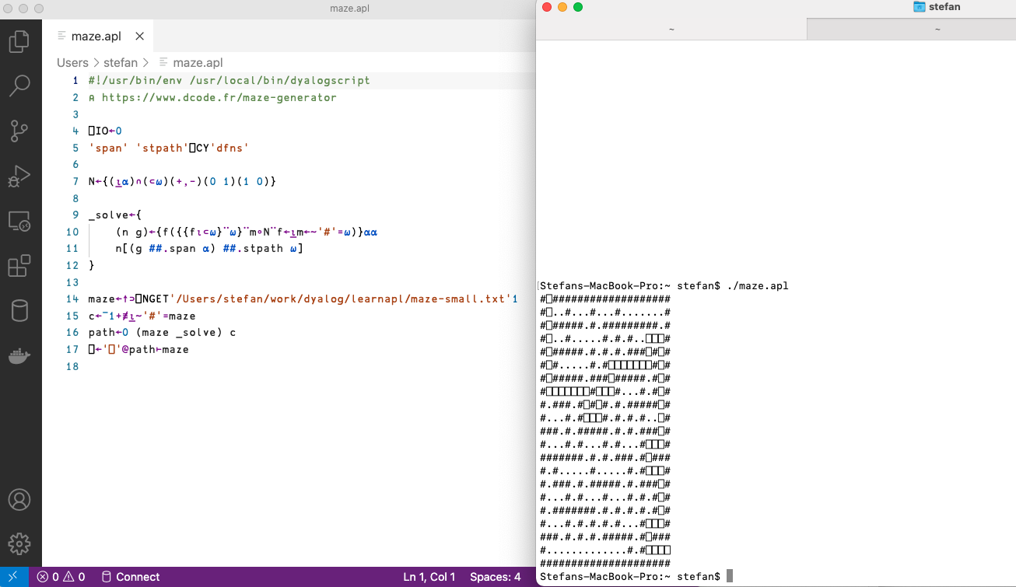
Great things are coming!
Point interpreter to file
Execute on the command line
APL in a text file!
Notes:
But great things ARE just over the horizon: LOOK: I can execute a text file with APL code!

Slide 65
Notes:
This is a game changer for me. The 18.1/2 release makes great strides in practical usability. The greatest Dyalog yet?

Slide 66
Make it easier for me to use tools I already use
Notes:
My plea to Dyalog boils down to this. Be a good citizen on the platforms you support. Make it easy to integrate, cooperate and communicate with common tools, protocols and systems. Let me edit and debug APL with the editors used by millions of users.

Slide 67
Be better at Mac
Notes:
The Mac is the "third" platform for Dyalog, in every sense of the word. Software engineers in big companies use Macs, even if they never develop software FOR Macs. Why? They're cost-effective, and easy for enterprise IT departments to manage and deploy. We develop on Mac, and deploy to Linux in the Cloud.

Slide 68
It's a *nix workstation

Slide 69
Yes, really.
Notes:
It really is. A Mac isn't an "appliance" - don't treat it as one. Dyalog's view is that Business/finance use Windows, engineering/science use Linux, and ... MacOS is for "other". I'd like to challenge that assumption, as I think it's a missed opportunity for Dyalog.

Slide 70
Give me a tarball, not an "app"
Notes:
The way Dyalog installs on a Mac makes it hard to use for multi-engineer software development projects, as it can't realistically be used from the command-line. It's impossible to string together in polyglot pipelines.

Slide 71
Treat the Mac exactly like Linux!
Notes:
Treat the Mac EXACTLY like you treat Linux.
I have just under a dozen different language interpreters and compilers installed, all of which install on the Mac just like they do on Linux. And as a bonus, much easier for Dyalog's own release engineering, too!

Slide 72
Final thoughts

Slide 73
⍝⍴⌊
Notes:
I've enjoyed my own APL journey enormously. It forced me to reexamine some calcified patterns in my own brain on what programming should be like. I wish I'd discovered it earlier.

Slide 74
Writing a book is an excellent way of learning APL
Notes:
When writing a book, notionally for others, you soon discover the bits you don't understand, and you can't really move on before you do.

Slide 75
If a single person finds it useful, it was worth it

Slide 76
I'm not a traditional Dyalog user
Notes:
But the truth is,

Slide 77
I don't build big GUI-driven applications in OO-APL

Slide 78
Not a "domain expert"
Notes:
(whatever that really means)

Slide 79
I hope that Dyalog sees a future for APL as a tool also for the rest of us:

Slide 80
...coders, toolsmiths, data analysts, ad-hoc scripters in polyglot environments
Notes:
quiet!

Slide 81
who see APL as a refuge from the ills of OO

Slide 82
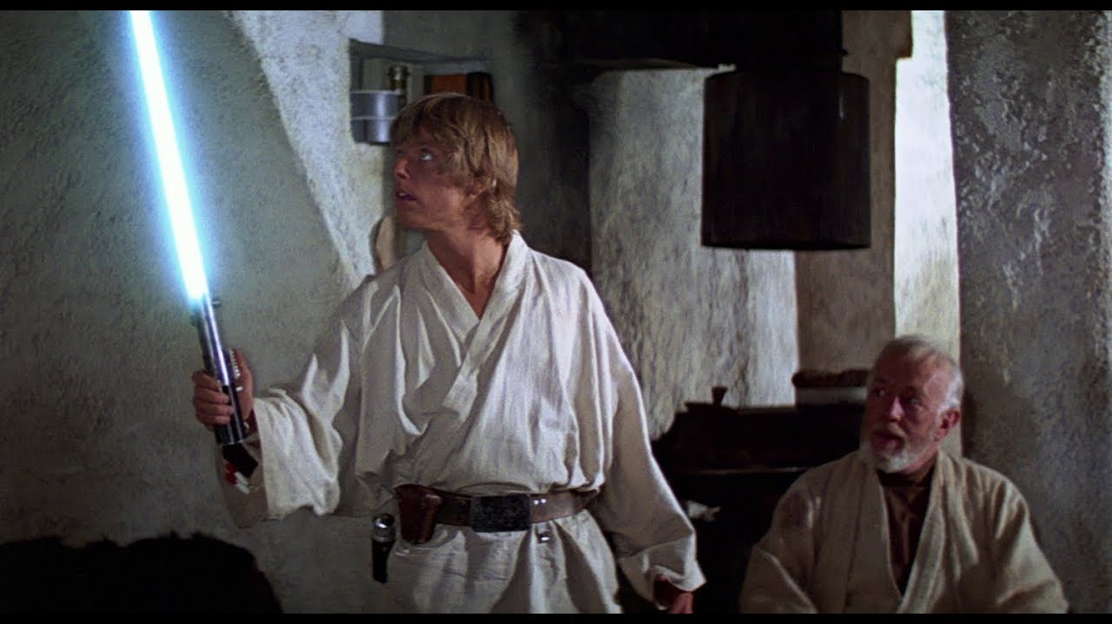
An elegant weapon for a more civilized age
∧∨⍳↓↑⍲⍱⍟⊖⍉⌽⍋⍒⍫Ï⍸⍥⌷⍙

Slide 83
1↓,⊢⍤/⍨1(⊢∨⌽)0,≠
┌─┼───┐
1 ↓ ┌─┼─────┐
, ⍨ ┌───┼─────┐
┌─┘ 1 ┌─┼─┐ ┌─┼─┐
⍤ ⊢ ∨ ⌽ 0 , ≠
┌┴┐
⊢ /
{1↓(x∨1⌽x←0,⍺≠⍵)/⍺,⍵}
Notes:
So, back to the Conference Mini Challenge. Any ideas what it does? Morten? This expression trims leading, trailling and repeating characters given by left argument from the right argument. Here's the dfn I give in the book -- you probably have something smarter by now.

Slide 84
1↓,⊢⍤/⍨1(⊢∨⌽)0,≠
{1↓(x∨1⌽x←0,⍺≠⍵)/⍺,⍵}
Notes:
Which is preferable? I'll leave that to you.

Slide 85
My thanks to Rodrigo and Rory who kindly helped with proofing
*any remaining errors or lies are mine alone
Notes:
Any remaining errors or lies are mine alone.

Slide 86
and the whole lot at the APL Orchard, without whom, etc

Slide 87
Thank you
https://xpqz.github.io/learnapl/

