Slide 1
The Road Ahead
Morten Kromberg

Slide 2
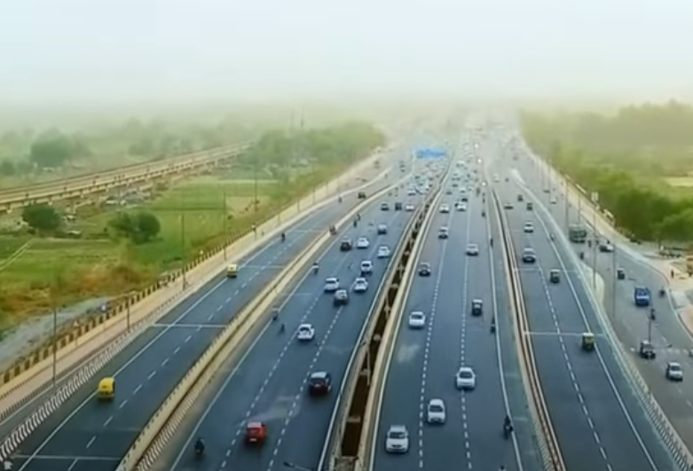
Ten Lane Highway
Building the Team
Training & Evangelism
Consulting
Source in Text Files
Service Orientation
Cross-Platform UI
[Microsoft].NET
New Target Platforms
Compiling APL
APL Language

Slide 3
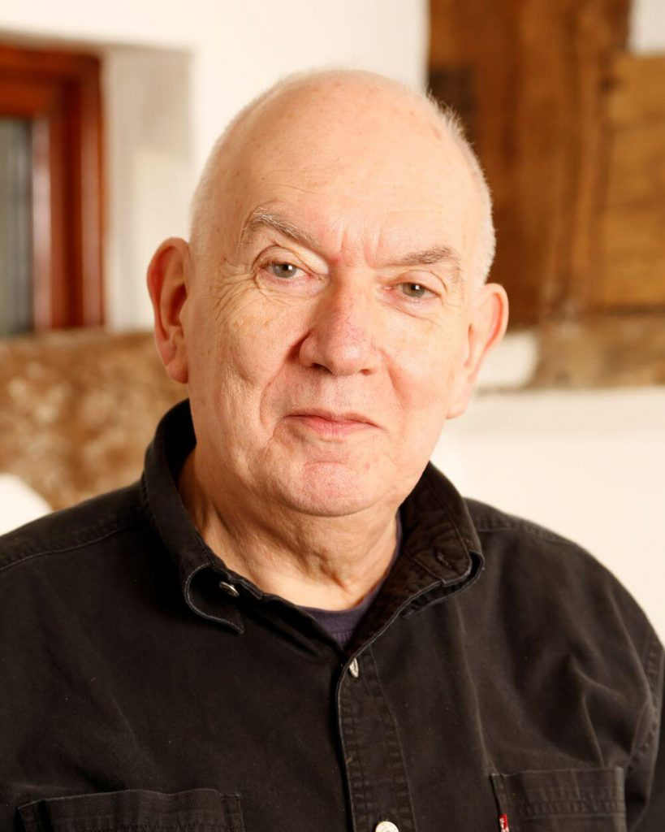
1. [Re]Building the Team
We stand upon the shoulders of Giants
John Scholes (1948-2019)
Roger Hui (1953-2021)

Slide 4
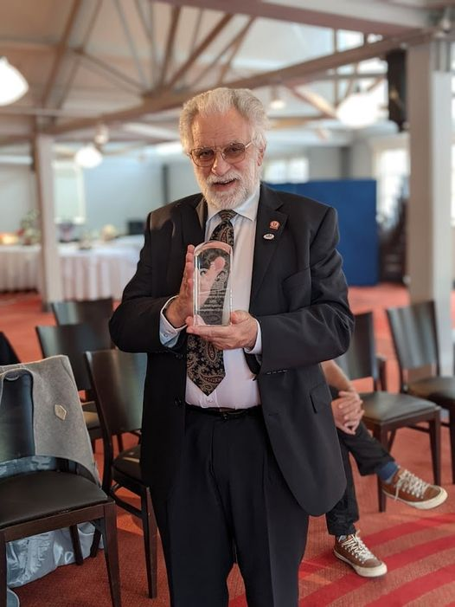
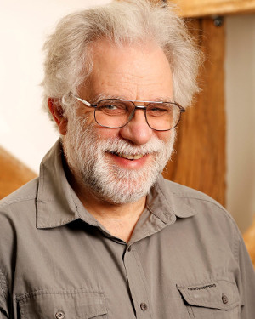
Still Going Strong…
With John Scholes, Geoff Streeter wrote Dyalog APL v1.0 in 1981-1983
Geoff is in good health
Now working 3 days per week
And still volunteering at night…
However, Geoff has announced that he intends to retire in April'23
We hope to welcome him back for a retrospective talk at Dyalog'23

Slide 5
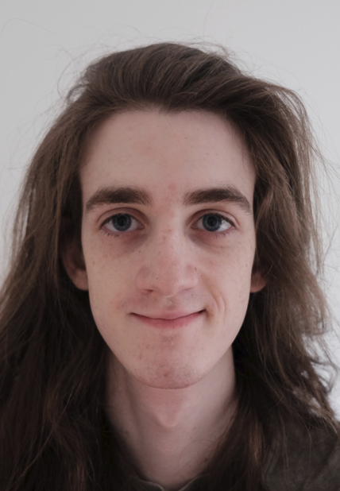
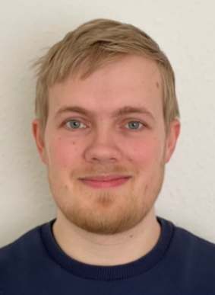
Dyalog … The Next Generation
⬅ February, May, July & September 2022

Slide 6
Dyalog … The Next Generation
⬅ Worked with "Plan 9"

Slide 7
Software Security Process
Building Security in Maturity Model
Compare own routines to industry practices
Implement and continuously review practices that reduce security risk
Dyalog's processes will treat potential computational errors as threats on par with classical security threats
Hope to publish an Audit Report in 20222023

Slide 8
1. Building the Team
Talks by recent recruits…
Monday 16:15 Plan 9 from Outer Space (Peter Mikkelsen)
Tuesday 15:00 Performance Improvements in Set Operations (Karta Kooner)

Slide 9
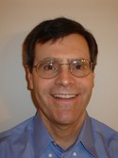
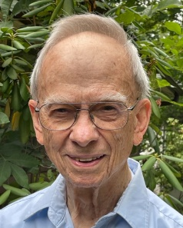
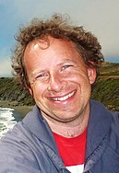
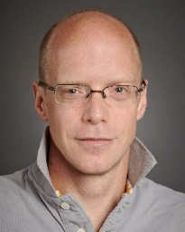
2. Training & Evangelism
mastering.dyalog.com Rodrigo Girão Serrao
course.dyalog.com Rich Park
tutorial.dyalog.com Gary Bergquist + Andrew Sengul
xpqz.github.io/learnapl Stefan Kruger (IBM)

Slide 10
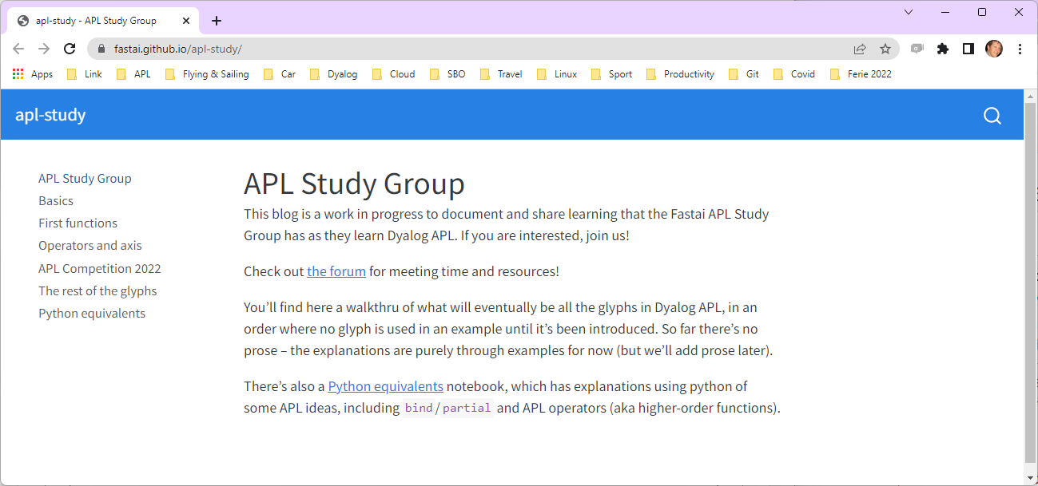

Slide 11
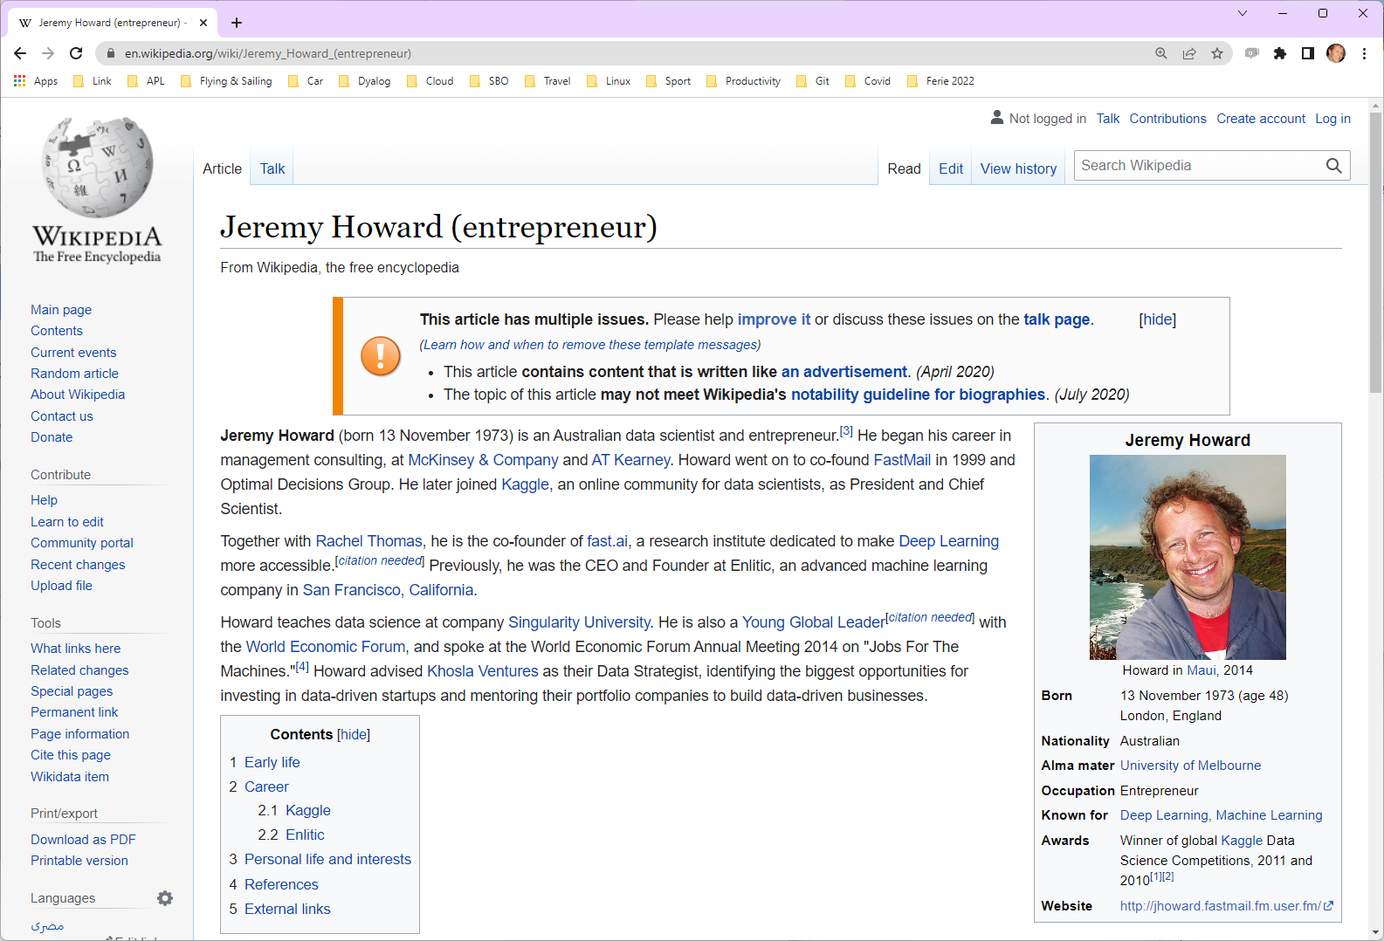

Slide 12
Training & Evangelism
We trained a group of 24 developers in India last year (via Zoom)
The materials prepared for this exercise are available free of charge at course.dyalog.com
This will be the case for all training materials that we are creating
We are also considering running on-line courses – contact us if you need training!

Slide 13
Basic Licence
Replaces non-commercial licence
Allows distribution of Dyalog along with your work, under the default royalty licence
Fee is 2% of gross APL-based revenue
No fees due if revenue < GBP 5,000 in a calendar year
Multiple alternative commercial licence schemes are available
For GBP 150 per year, you can subscribe to the Dyalog Support Service (DSS)

Slide 14
Basic Licence
Perhaps the most important "feature" of v18.2 – intended for
non-commercial use
education
personal projects & experiments
sharing your experience
proof of concepts / trials
participating in programming competitions for cash prizes
fun

Slide 15
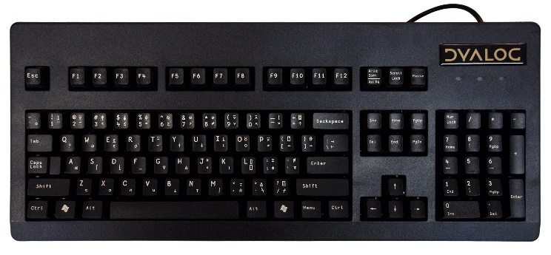
Keyboarding on all platforms
Issues:
Dyalog IME does not work with Windows Universal Windows Platform applications
APL keyboards do not work in RIDE (backtick still works) under Wayland (Linux)
New users report that "ctrl" is problematic as the APL key
Immediate Solutions:
Keyboards for Windows which use different "APL" keys (Alt, AltGr, etc)
Backtick-style keyboards for all platforms
Longer Term:
A new IME which offers a similar experience across supported platforms and works in and out of the IDEs (this will take a bit longer)

Slide 16
2. Training & Evangelism
Thursday 11:15 Dyalog and Academia (Jesús Galàn López and Gitte Christensen)
Thursday 11:45 What – Another APL Book? (Ray Polivka)
Thursday 12:05 Growing APLers (Rich Park)

Slide 17
3. Consulting
We started building a consulting group in the USA in 2019
Paused due to Covid and other factors
We expect to resume recruiting APL consultants in the USA next year
Get in touch
… if you need consulting (also outside the USA)
… know someone interested in an APL career

Slide 18
4. Source in Text Files
Here he goes again

Slide 19
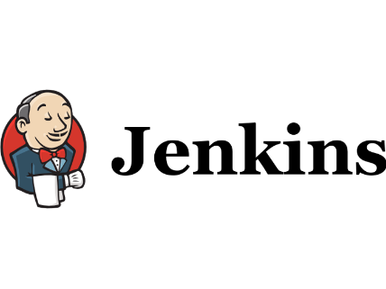
Why is Text Source ?
Important

Slide 20
4. Source in Text Files
Done:
Link 3.0 included with v18.2
Compatible with v18.0
Will replace SALT
Launch APL from text source
No workspace required
Right-click on a function or namespace source file in Windows Explorer and run it
Also supported in containers
HashBang/Shebang scripting
Project Managers:
Acre
Dado
Cider
Package Manager:
Tatin

Slide 21
(… many more of Kai's packages skipped …)

Slide 22
4. Source in Text Files
Still to do:
Publish more [Dyalog] packages on the Tatin server
Cider Project Manager
Array Notation
Current Use:
Major customers have moved to text source
New users tend to start with text source
All new Dyalog tools are [open] text source on GitHub
Taking advantage of Continuous Integration for automated testing

Slide 23
Literal Array Notation
Constants can form part of the "source" of an application
Enumerations
[Translated] strings
Conversion tables
A notation for constants is an important piece of the "text source puzzle"
(In addition to being generally useful in code)
File Errors.apla
[ 2 'SYNTAX' 3 'INDEX' 4 'RANK'
5 'LENGTH'
6 'VALUE' ]

Slide 24
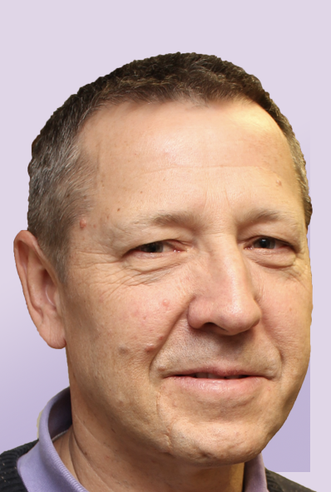
4. Source in Text Files
Sunday 09:30 SA3: Link, Text-Based Source, and Source Code Management (Morten Kromberg and Josh David)
Monday 14:15 The P words… Project and Packages (Morten Kromberg)
(also used in many other workshops and presentations)

Slide 25
5. Service Orientation
It must be easy to run APL as a service and call it from other environments.

Slide 26
Running APL as a Service
Imagine you have two pieces of business logic written in APL: sum←+/ reverse←⌽ If you start Jarvis with a reference to the namespace containing the functions, Jarvis makes them available as a "Web Service": Server←Jarvis.Run 8080 #

Slide 27
Six different examples of calling "sum":
JavaScript | var xhr = new XMLHttpRequest(); xhr.open("POST", http://localhost:8080/sum); xhr.setRequestHeader("content-type", "application/json"); xhr.send("[1,2,3,4]"); xhr.response;
PowerShell | $url = http://localhost:8080/sum $hdrs = @{'content-type' = 'application/json'} $body = '[1,3,5,7,9,11]' Invoke-WebRequest –Method Post –URI $url –Headers $hdrs –Body $body
Python | url = 'http://localhost:8080/sum' hdrs = {"content-type":"application/json"} array = [2,4,6,8] resp = requests.post(url, data=json.dumps(array), headers=hdrs) print(resp.json())
curl | curl -d "[1,2,3,4,5]" -H "content-type:application/json" http://localhost:8080/sum
APL | HttpCommand.GetJSON 'post' 'localhost:8080/sum' (⍳5)

Slide 28
5. Service Orientation
It must be easy to run APL as a service and call it from other environments.
Jarvis Web Service Framework
Replaces "JSONServer"
Supports REST and "plain" HTTP/JSON services
Widely available
https://github.com/dyalog/jarvis https://hub.docker.com/r/dyalog/jarvis https://tatin.dev
Related Improvements
Version 18.2 runs headless comfortably
Easier to use in containers
RIDE 4.4 supports debugging threaded code
⎕JSON support for converting matrices to JSON tables

Slide 29
5. Service Orientation
Continue work to make platforms more similar
Develop under Windows/macOS, deploy under Linux
.NET Bridge provides cross-platform libraries & frameworks
Unify configuration across platforms
All settings configurable via text files
Remove need for the Windows Registry
(Except perhaps to configure Windows IDE)

Slide 30
5. Service Orientation
Materials developed for Dyalog'22 workshops will be extended over the next weeks and months
We will publish a fully worked example of how to build a web service in Dyalog APL
Deployed in containers to the cloud
Scalable using several alternative mechanisms
User Sessions using 3rd Party Authentication
Encrypted Data
More webinars, webcasts & samples to come

Slide 31
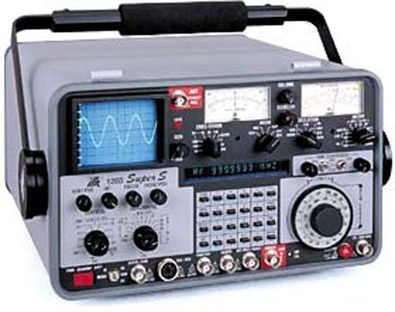
5. Service Orientation
Provide interface to monitor the state of APL processes
CPU consumption
Memory usage, Compaction counts, etc
Are any threads suspended?
)SI and Error information
Available via API and / or protocols like SNMP
First version planned for v19.0

Slide 32
5. Service Orientation
Sunday 09:30 SA2: Building Web Services with Jarvis (Brian Becker)
Sunday 14:00 SP2: Deploying Services (Brian Becker & Morten Kromberg)
Tuesday 09:30 Automatic Application Builds with AWS (Norbert Jurkiewicz)
Wednesday 09:00 Simplifying Secure, Scalable Web Services (Brian Becker)
(and used in many other workshops and presentations)

Slide 33
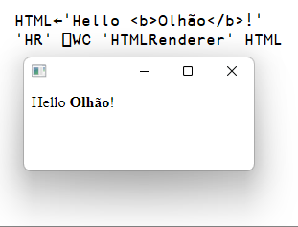
6. Cross Platform UI
When APL Services behind other GUI won't do…
Adoption of the HTMLRenderer is growing as the delivery mechanism for new UI
Appears in four [user] presentations this week
No clear choice of tool to generate HTML/JS
DUI/MiServer still has a small user base
Users are experimenting with writing own tools
… and integrating HTML/JS generated by 3rd party tools or developers

Slide 34
HTMLRenderer improvements
Most important: Find a way to easily upgrade the Chromium Embedded Framework
In the medium term, turn the HTMLRenderer into an Open Source project to allow community participation
Enhancement in v19.0
Support Multiple windows that take turns being modal

Slide 35
6. Cross Platform UI
Monday 11:40 Lift-Off from APL2 Mainframe to Dyalog in the Cloud (Gilgamesh Athoraya – Tiamatica AB)
Monday 14:45 A Modern APL Workbench (Kimmo Linna - Finnair)
Wednesday 09:30 TAMPA – Taming Mathematical Programming in APL (Stephen Mansour – Misericordia University)
Wednesday 10:00 Integrating HTMLRenderer Into Existing Applications (Norbert Jurkiewicz – The Carlisle Group)

Slide 36
7. [Microsoft].NET
As .NET celebrates 20 years of existence, Microsoft is pushing everyone to move from proprietary Microsoft.Net Framework to the new open source, cross-platform .NET. Dyalog v18.0 added a bridge to .NET 3, to complement the 20 year old bridge to the .NET framework.
Name | Platforms | Version Numbers
Microsoft.NET Framework | Windows | 1 2 4
.NET (previously ".NET Core") | Windows Linux macOS | 3 5 6 7

Slide 37
.NET Bridge
Add support for .NET 5, 6 & 7
Export APL code as .NET assemblies
v18 .NET bridge only allows USING .NET classes
Generate APL-based applications under
Linux: Amd/Intel x64 and Pi/AWS on Arm64
macOS (x64 and M1/M2)
Windows (x64 – maybe Arm64 later)
Work on support for Async features
.NET 6 is the current Long Term Support version of .NET

Slide 38
7. [Microsoft].NET
In a nutshell, the specification is that the new bridge it will work exactly the same way as the old one.
But there will be some enhancements.

Slide 39
8. New target Platforms
64-bit ARM
This low power RISC processor is gaining traction
We expect to support v19.0 on ARM64 (specifically M1 & M2 Macs)
Web Assembly (WASM)
Co-dfns will target WASM as an execution platform (no release date)
We are likely to look at whether a cut-down interpreter engine could run in the browser (no timeframe)

Slide 40
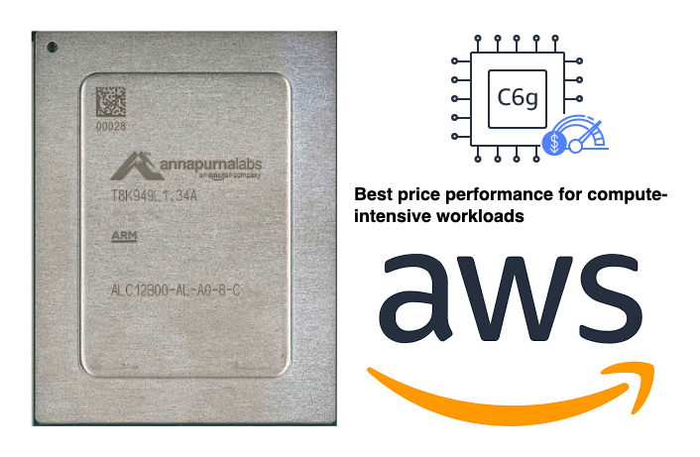
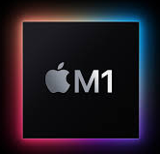
Arm64
64-bit ARM chips are appearing in places that Dyalog should support:
M1 & M2 Macs
Raspberry Pi – 64 Bit
Amazon Web Services "Graviton"
ARM64

Slide 41
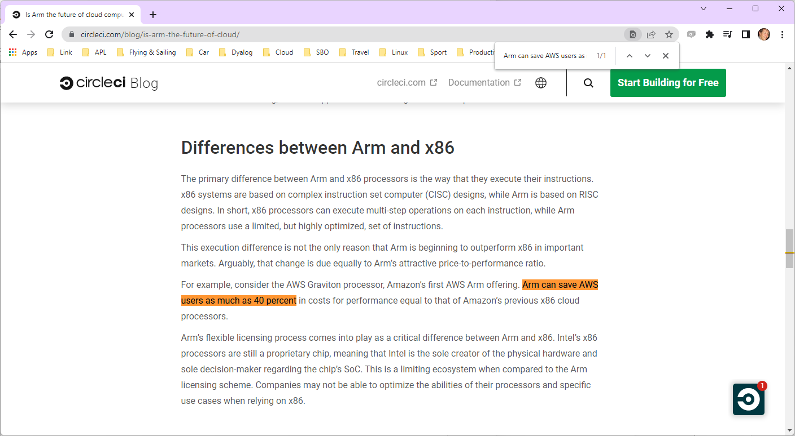

Slide 42
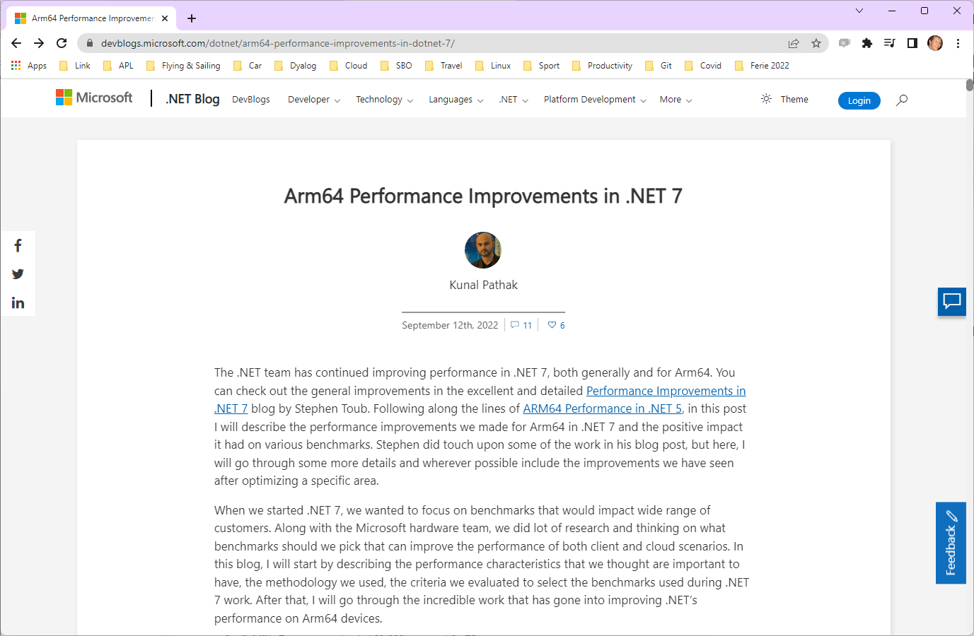

Slide 43
Web Assembly (WASM)
APL running in the browser…

Slide 44
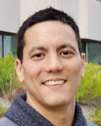
8. New Target Platforms
Tuesday 16:45 Report on Co-dfns (Aaron Hsu)
And talk to Ron about the ARM64 Port

Slide 45
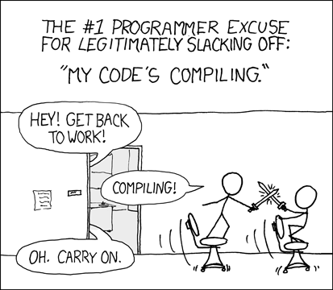
9. Compiling APL
Work on Co-dfns continues. 2023 targets:
Almost complete language support, including Control Structures & TradFns
Characters, Mixed Arrays, Complex Numbers
New backend targets: WASM/Javascript, Scheme/Lisp, Java/C#, Python
Tracing and debugging
Emphasis is as much on making APL accessible for new applications in new environments, as on compiling existing applications
Source: xkcd.com

Slide 46
9. Compiling APL
Tuesday 11:30 Implementing the Convolutional Neural Network U-net in APL (Rodrigo Girão Serrão)
Tuesday 12:00 APL on the Side (Justin Dowdy – Semantic Arts)
Tuesday 14:00 Scheduling Array Operations (Juuso Haavisto – University of Oxford)
Tuesday 16:45 Report on Co-dfns (Aaron Hsu)

Slide 47
10. APL Language
Literal Array Notation
Multiple Numeric Towers, so we have a unified model which supports
64-bit integers
Rational numbers
Carefully considering which primitives are most important to add next. Not in a hurry.
Depth, Behind, Select, Under/Dual, etc…
Primitive Candidates Select (X⊇Y) Depth (f⍥k) Behind (f⍛h) Under (f⍢g) Obverse (f⍫g)

Slide 48
10. APL Language
Thursday 10:00 Filling the Core Language Gaps (Adám Brudzewsky)
JD might present some ideas today and tomorrow…
… but I'm not allowed to say

Slide 49
Ten Lane Highway
Building the Team
Training & Evangelism
Consulting
Source in Text Files
Service Orientation
Cross-Platform UI
[Microsoft].NET
New Target Platforms
Compiling APL
APL Language

Slide 50
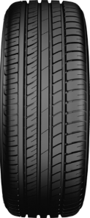
The Road Ahead
Morten Kromberg

