Slide 1
Simplifying Secure, Scalable Web Services Session D12
Brian Becker

Slide 2
Workshop Goals
Give a quick introduction to:
Jarvis – Dyalog's Web Service Framework – to expose APL functions as services
Docker: to create lightweight Virtual Machines known as "Containers"
Docker Compose: to launch and manage multiple inter-connected containers
Amazon Web Services "Elastic Container Service": to allow Docker Compose to launch containers directly to the cloud (so-called "serverless" deployment)
How to scale the system by running multiple copies of selected services
How to assign your own domain name and a certificate to your service

Slide 3
Sunday Recap
Workshop SA2 – Building Web Services with Jarvis
Jarvis – framework for REST and JSON-based web services
Important configuration settings, debugging, maintaining state
Introduced (barely) 3 versions of a "phonebook" application web service
Workshop SP2 – Deploying Services
Started with the Jarvis phonebook application web service
By the end of the workshop ~70% of the participants had a load-balanced, scaled service running on AWS.
Demonstrated running it securely using HTTPS

Slide 4
The "Plan"
Start with an application
Use Jarvis to turn it into a web service
Run the service in a Docker container
"Split" the service into 2 tiers we termed "front end" and "back end" Each running in its own container. Use Docker compose to define the containers that make up the service.
Run the new service in the cloud (on AWS)
Scale the service up by running multiple copies of the front end
Add a load balancer to distribute requests amongst the front ends
Secure the service by running HTTPS (requires a domain name and a certificate)

Slide 5
In the beginning, there was an Application…
Database
App

Slide 6
Run the app as a service
Database
Jarvis
App

Slide 7
Jarvis - JSON and REST Services
Web service framework to build REST or JSON-based services
Using the JSON paradigm, APL functions are the "endpoints" of the service
The request data (payload) is passed to your function as an APL array
Your function returns an APL array
Jarvis handles all the conversion between JSON to APL and back again

Slide 8
Jarvis in Action
]load [SA2]/Jarvis #.Jarvis reshape←⊃⍴/ hi←{'Hello ',⍵.name} j←Jarvis.New 8888 # j.Start j.Stop

Slide 9
The app as a service
The "GetUsers" endpoint being executed from a browser using a JavaScript client in Jarvis' built-in test web page.

Slide 10
Any client, anywhere
Any platform capable of issuing HTTP requests (basically everything) can interact with your web service.
They need know nothing about APL nor that APL is running the web service

Slide 11
Run it in a container
Database
Docker Container
Jarvis
App

Slide 12
A "Dockerfile" describes a Docker Image
Base Image
FROM ubuntu:22.04
ADD ./dyalog-unicode_18.2.nnnnn_amd64.deb / ADD /sp2/v7/test /myapp
RUN dpkg -i /dyalog*.deb RUN git clone https://github.com/dyalog/Jarvis /Jarvis
ENV RIDE_INIT="SERVE:*:4502" ENV CodeLocation=/myapp
CMD dyalog /Jarvis/Distribution/jarvis.dws
Files to Add
Your Code
Run during Build
Environment Vars
Run at Startup
This "Dockerfile" completely describes a machine which will run "myapp".

Slide 13
Public Docker Containers
DockerHub is to Docker as GitHub is to Git
A public repository of container images
Free unlimited public images plus one private image
Dyalog has several public containers available on DockerHub
dyalog/dyalog – Just Dyalog APL
dyalog/miserver – Dyalog APL + MiServer
dyalog/jupyter – Dyalog APL + Jupyter Notebook framework
dyalog/jarvis – Dyalog APL + Jarvis

Slide 14
Running the App in a Container

Slide 15
Docker – it can't be this easy
Run a container: docker run
Map host port 8080 to container port 8080: –p 8080:8080
Map host folder (where our web service code is) to /app in the container: –v c:\sa2\v3:/app
Set the JarvisConfig environment variable to the location of the Jarvis configuration file: –e JarvisConfig=./JarvisConfig.json5
Use the dyalog/jarvis public Docker container: dyalog/jarvis

Slide 16
Building a Container from an Image
Our Dockerfile
Build the image and tag it as "phonebook" docker build –t "phonebook" .

Slide 17
Split into Front and Back Ends
We'll call this "Two-Tier"
Database
Front End
Docker Container
Jarvis
Read Operations
App
Write Operations
Docker Compose
defines the containers
that make up a service
Docker Container
Jarvis
App
Back End

Slide 18
Docker Compose
Describes a collection of container images that make up a service.
Creates a Virtual IP network that connects the images so that they can refer to each other by name.
Supports replication of images and load balancing (more on this later)

Slide 19
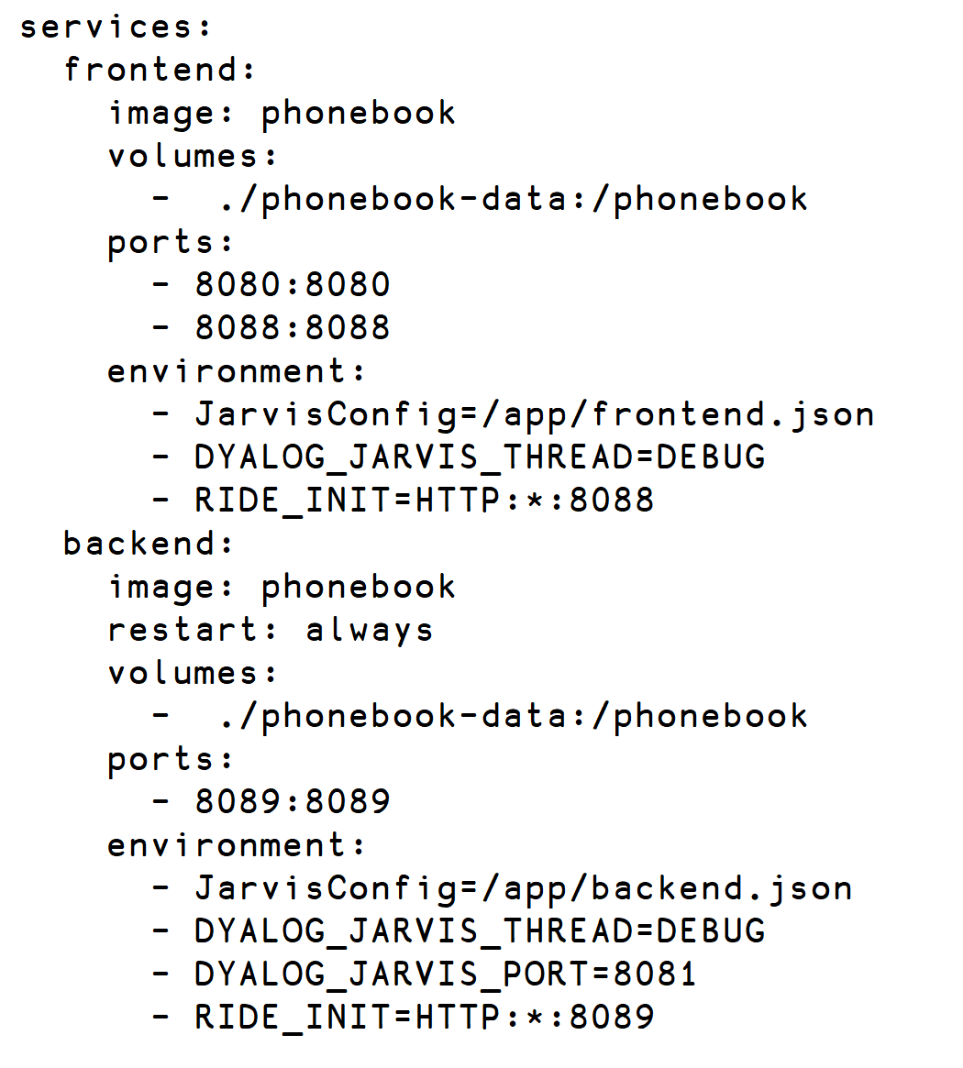
Docker Compose
Two Services

Slide 20
Docker Compose
Two Services
Same Image

Slide 21
Docker Compose
Two Services
Same Image
Same Permanent Storage

Slide 22
Docker Compose
Two Services
Same Image
Same Permanent Storage
Different Jarvis Configurations

Slide 23
Docker Compose
Two Services
Same Image
Same Permanent Storage
Different Jarvis Configurations
frontend clients access via port 8080 Zero-footprint RIDE available on port 8088

Slide 24
Docker Compose
Two Services
Same Image
Same Permanent Storage
Different Jarvis Configurations
frontend clients access via port 8080 Zero-footprint RIDE available on port 8088
backend internal only access via port 8081 Zero-footprint RIDE available on port 8089
restart if the container crashes

Slide 25
Running it locally
docker compose up –f docker-compose-local.yml
Yes, it really is that easy…

Slide 26
Try it in the cloud
"The Cloud" (AWS)
Database
Docker Container
Jarvis
Read Operations
App
Write Operations
Docker Container
Jarvis
App

Slide 27
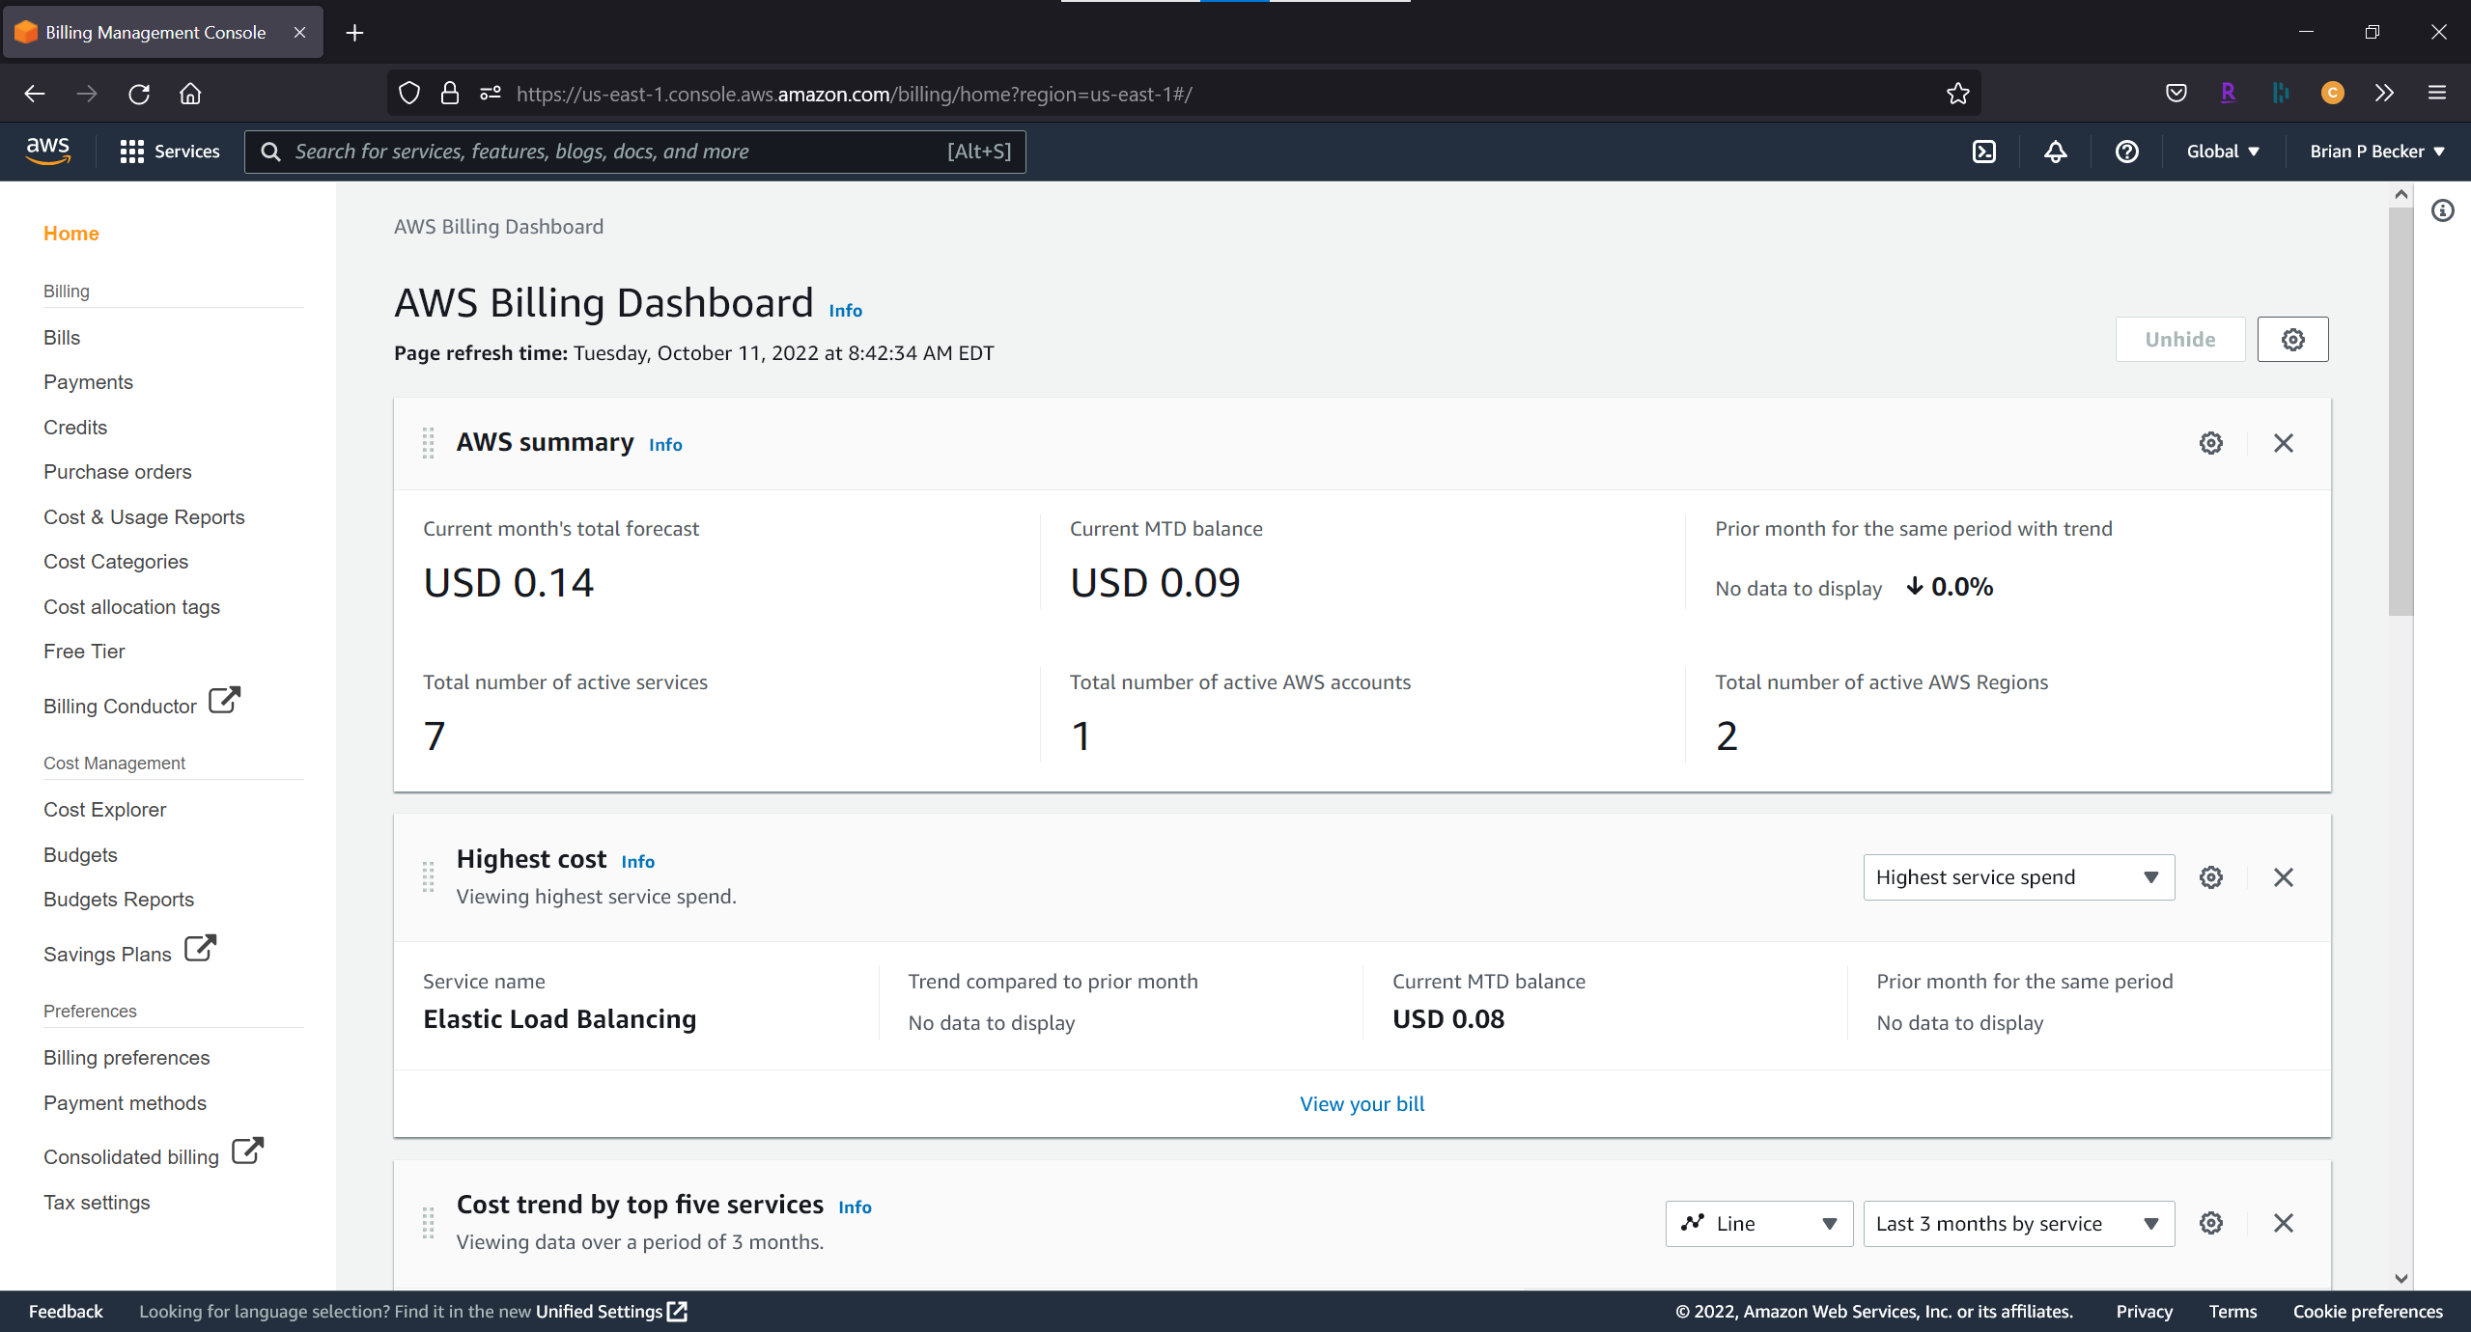
Amazon Web Services (AWS)
Acquire an AWS account (start with the free tier)
Provide credit card information
Cost to "experiment" is minimal

Slide 28
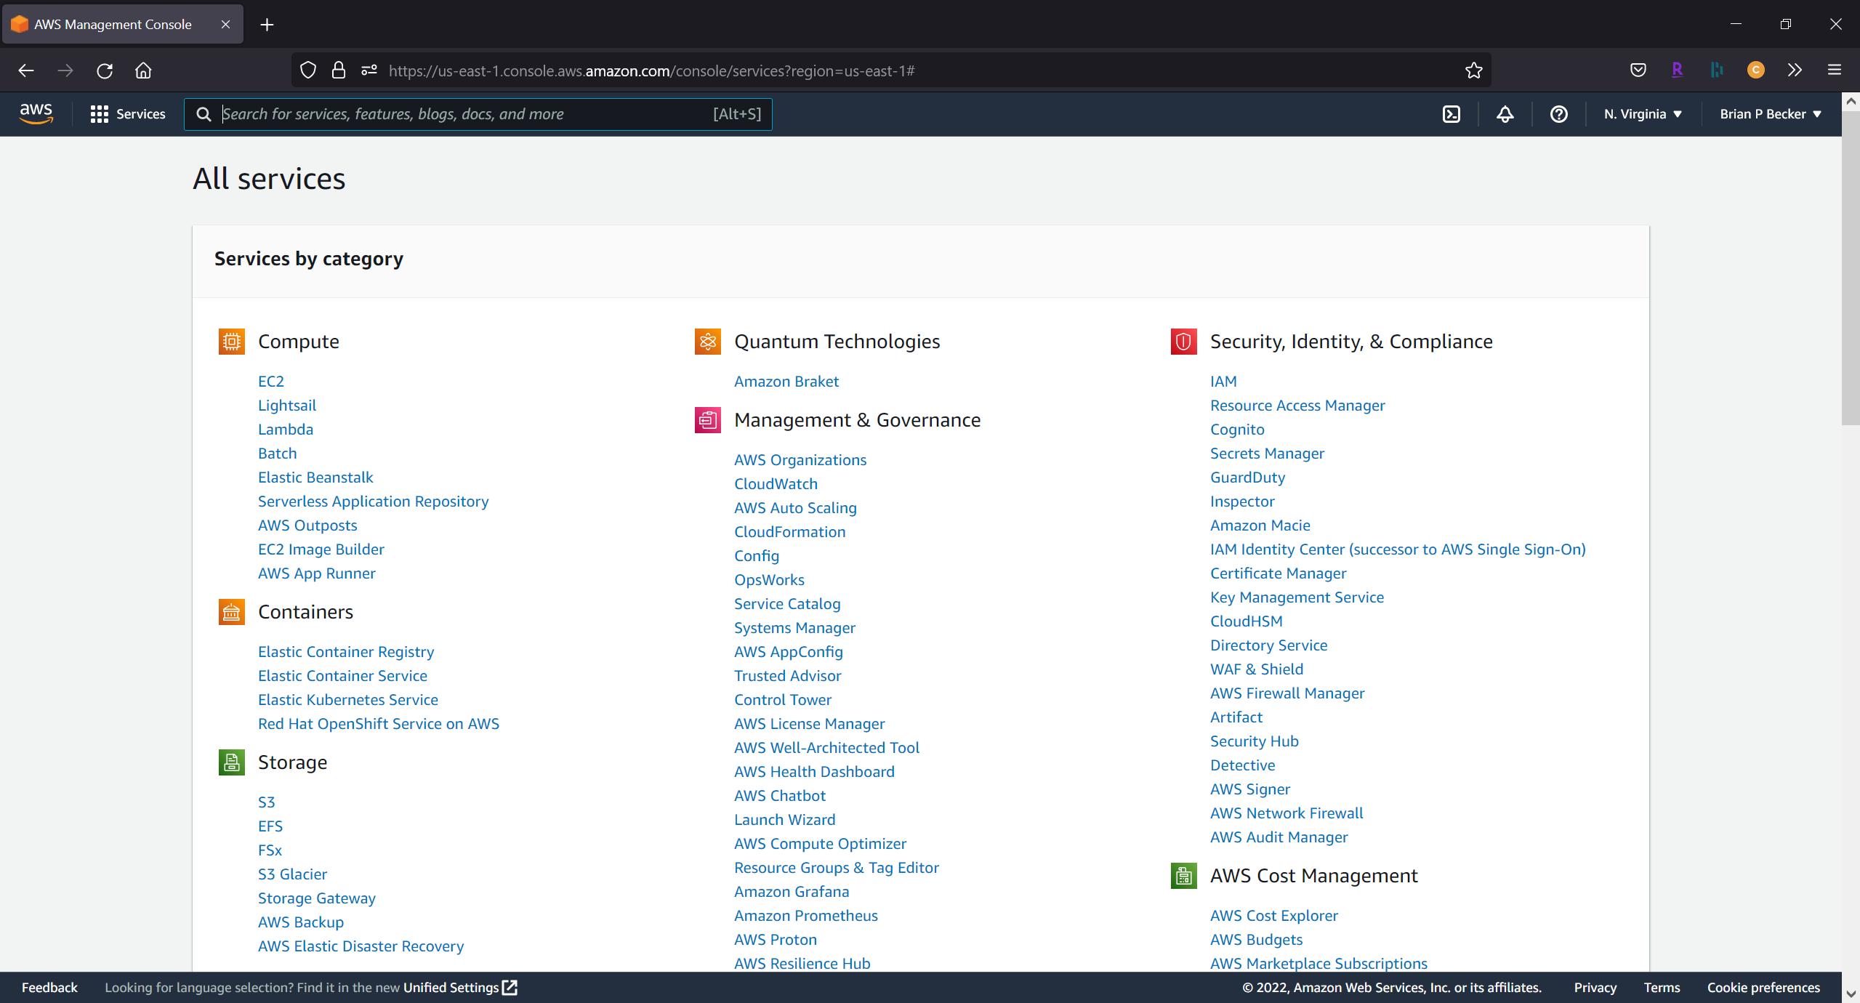
AWS Services
If you look the list of services provided by AWS, you'll find (at least I did) a dizzying number of choices, many with similar names…
Fortunately, Morten, with help from Google, Norbert and Bjørn worked out the right combination for our service.

Slide 29
AWS Configuration
Create an IAM user (Identity and Access Management)
Select Access Key credential type
Attach the AdministratorAccess policy
Download your credentials (in a .csv file)
Install the AWS CLI (Command Line Interface)
Google "install aws cli"
Download for your platform
Configure to use the IAM credentials from the above step

Slide 30
Docker/ECS
Docker Compose can be connected to the Amazon Elastic Container Service (ECS)
Create a "docker context" for ECS docker context create ecs phonebook
Switch to the ECS context docker context use phonebook

Slide 31
Upload Image to ECR
To use our phonebook container from AWS, we need to store it either in DockerHub or the Amazon Elastic Container Registry (ECR).
Since we already had a userid on AWS, we used ECR. aws ecr create-repository –repository-name phonebook
Now upload the image
Logon to the ECR server using your AWS credentials
docker tag the local phonebook image on the ECR server as [youruserid]/phonebook
docker push [youruserid]/phonebook
Or just edit and run the push.bat file in the workshop materials.

Slide 32
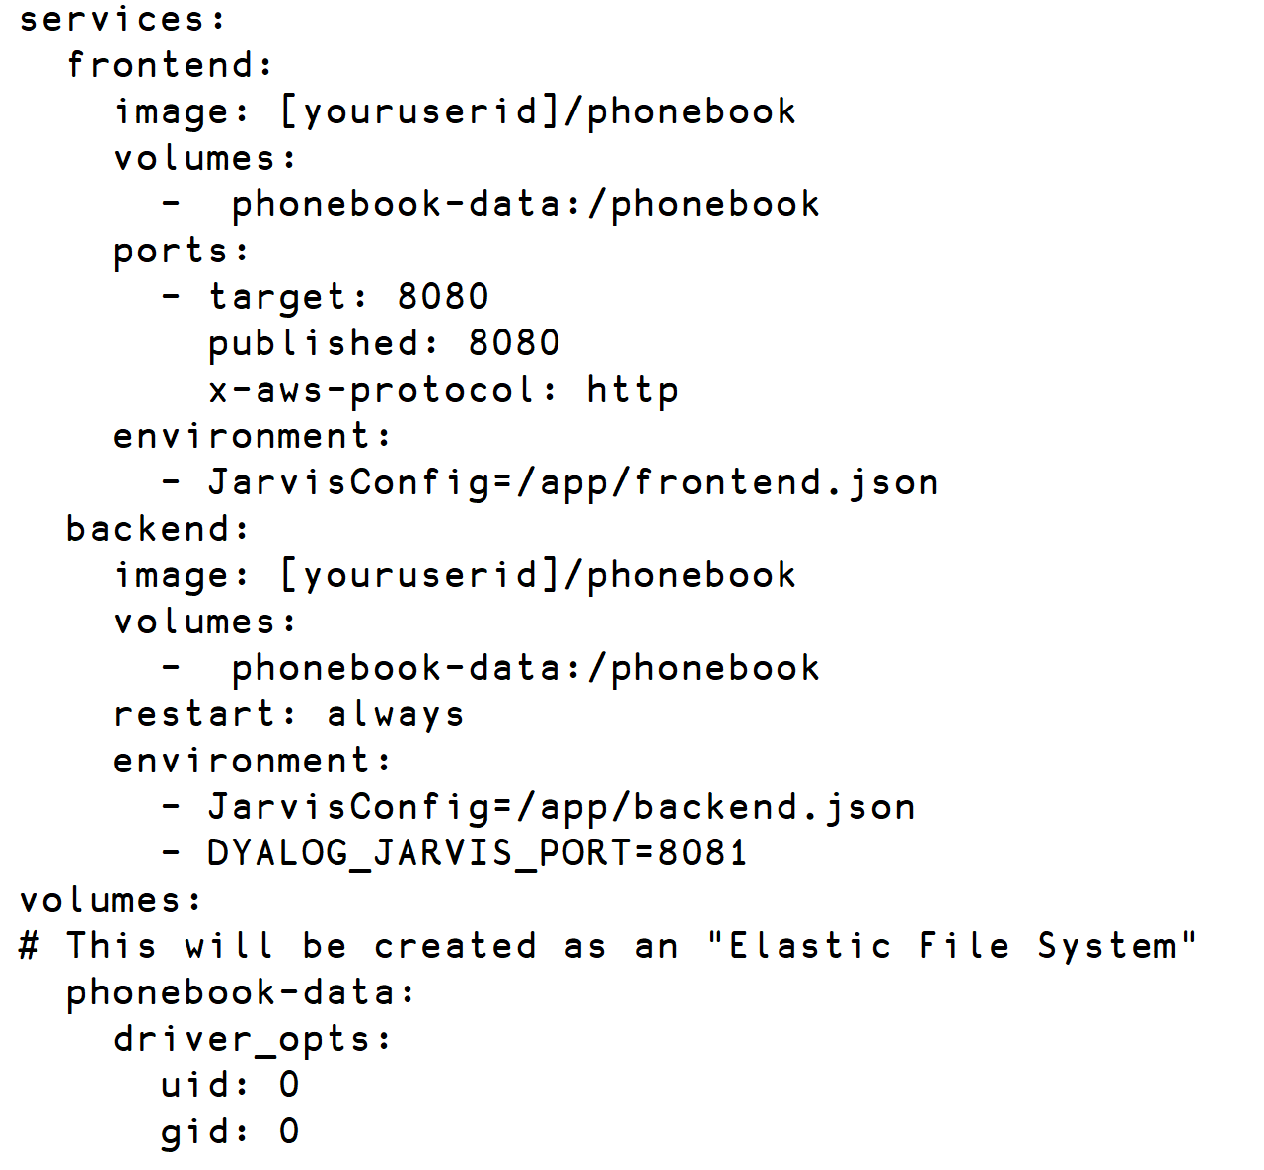
docker compose for AWS

Slide 33
Scale it up
"The Cloud" (AWS)
Database
Docker Container
Jarvis
Read Operations
App
Docker Container
Write Operations
Jarvis
App
Docker Container
Jarvis
Docker Container
App
Jarvis
App

Slide 34
Scaling the Front End
Want 2 copies of the frontend?
docker compose –p phonebook up –-scale frontend=2
You can change the scaling while the service is running

Slide 35
Load balance it
"The Cloud" (AWS)
Database
Docker Container
Jarvis
Read Operations
Load Balancer
App
Docker Container
Write Operations
Jarvis
App
Docker Container
Jarvis
Docker Container
App
Jarvis
App

Slide 36
Making a Load Balancer
This is a bit complicated…
Create an AWS security group
Add an "Ingress" for the ports you want clients to attach to
Finally create the load balancer itself
Fortunately, Morten has written a MakeLoadBalancer function that does all of this.
All you need to do is add an x-aws-loadbalancer entry to the docker compose file

Slide 37
Own it
"The Cloud" (AWS)
Database
Docker Container
Jarvis
Read Operations
Load Balancer
App
Docker Container
Write Operations
Jarvis
App
Docker Container
Jarvis
Docker Container
App
Jarvis
App

Slide 38
Using your own Domain Name
Up until now, we've had to refer to the service using a long and cumbersome hostname like http://phone-loadb-1guewkd0evw2h-887267469.eu-west-3.elb.amazonaws.com
If you register your own domain with an ISP allows you to do redirection, you can have a name more to your liking.
Morten used one.com, Brian used GoDaddy.com

Slide 39
Secure it
"The Cloud" (AWS)
Database
Docker Container
Jarvis
Read Operations
Load Balancer
App
Docker Container
Write Operations
Jarvis
App
Docker Container
Jarvis
Docker Container
App
Jarvis
App

Slide 40
Securing your service using HTTPS
Get a certificate – we used AWS Certificate Manager
ACM uses a couple simple steps to verify that you own your domain
In AWS EC2 > Load Balancers
Add a listener on port 443

Slide 41
In Summary
We learned a lot in preparing these workshops. We expect to learn more.
Have we simplified the process?
Jarvis makes it fairly easy to turn your APL code into a web service.
Docker is almost ridiculously easy. (I pinch myself every time I use it)
AWS seems daunting, but if you know the services/components to use, it's actually pretty straightforward. And we've shown you a path to get there.

Slide 42
In the near future
Updated workshop materials on GitHub.com/dyalog-training
Jarvis
Documentation completion (Nov 2022)
Training materials, samples, templates, webcasts
Webcast series breaking down the workshops into "bite-sized" chunks
We used AWS for the workshop; there are other services that can run Docker containers in the cloud – Azure, Google, IBM. We may publish similar guides for other services if our clients need it.

