Slide 1
2022 APL Problem Solving Competition
Brian Becker

Slide 2
14 Years? Really?
Fourth year running self-hosted
MiServer-based website – contest.dyalog.com
Two Phases
Ten Phase 1 Problems
One-liners with interactive validation
Six Phase 2 Problems (12 Tasks)
Generally more complex problems
Basic interactive syntax checking

Slide 3
contest.dyalog.com
Standard "off the shelf" Docker dyalog/miserver container
Running MiServer v3.1 under Dyalog v18.0
Using Dyalog utilities
HttpCommand – remote system integration
Dyalog Cryptographic Library – password hashing
Conga – used by MiServer, HttpCommand, and SMTP
DrA – error logging
SQAPL – relational database access
SMTP – sending email
Plus
Adám's Safe Executor – safely test Phase 1 submissions in real time
Industry Standard
Docker
Git/GitHub
Jenkins
Rancher
HAProxy
reCAPTCHA

Slide 8
Selected Phase 1 Feedback
Really nice thematic puzzles! Struggled more with the edge cases than the problem itself, but that might also be my lack of experience.
A nice, varied set. A little bit harder than previous years, but that seems to be a consistent trend.
The problems were a fun introduction to dyalog
As usual, interesting problems had to be solved.
Great one-liner problems

Slide 9
Selected Phase 2 Feedback
I thought it was interesting that not all problems were "slam dunk" APL aligned, thus giving a flavour of what solving real-world "boring" problems in APL is like.
I liked the variety of problems that Phase 2 had.
There was a good variety, and they ranged from easy to difficult. I felt that problem 6 wasn't array oriented at all, and it was a bit of a pain to work on (though I enjoyed doing it).
I liked the fact that there were problems of different length and difficulty level. This helped me get started by picking the problems I felt most comfortable with.

Slide 10
Be a Part of the Effort
Submit problem ideas
Contact me (brian@dyalog.com) for guidelines
Encourage and refer students to participate
If a student you refer wins a cash prize, you receive the same amount You can receive multiple referral awards
Spread the word
At local schools and universities, computer clubs, friends, neighbors, random people on the street
Previous Phase 1 and Phase 2 problem sets are available on the Dyalog website
Richard Park has led an effort to put interactively-validated previous Phase 1 sets online at https://problems.tryapl.org
Be a sponsor
Be a Beta Tester

Slide 11
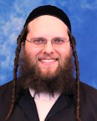
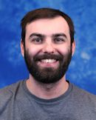
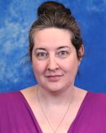
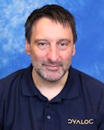
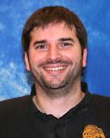
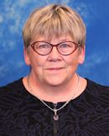
Thank you!
Our Sponsors
Beta Testers
The Team
Anonymous

Slide 12
And the winners are…
The full list of winners is available on the Dyalog website
10 - $100 prizes to the top Phase 1 participants
5 - $200 prizes to random Phase 2 participants
3rd Place $750
Dzintars Klušs - Rīgas Tehniskā Universitāte (Riga Technical University), Latvia
2nd Place $1250
Rory Kemp – Edinburgh Academy, U.K
Top non-student entry wins a delegate package to Dyalog'22
Michael Higginson, Canada
Grand Prize $2500 and an expenses-paid delegate package to Dyalog'22
Tsu-Ching Lee – National Tsing Hua University, Taiwan
Notes:
ZINN-tash closh
We couldn't arrange to have Dzintars present his work today, but we're very pleased to welcome Victor to share his work and thoughts about the competition…

