Slide 1
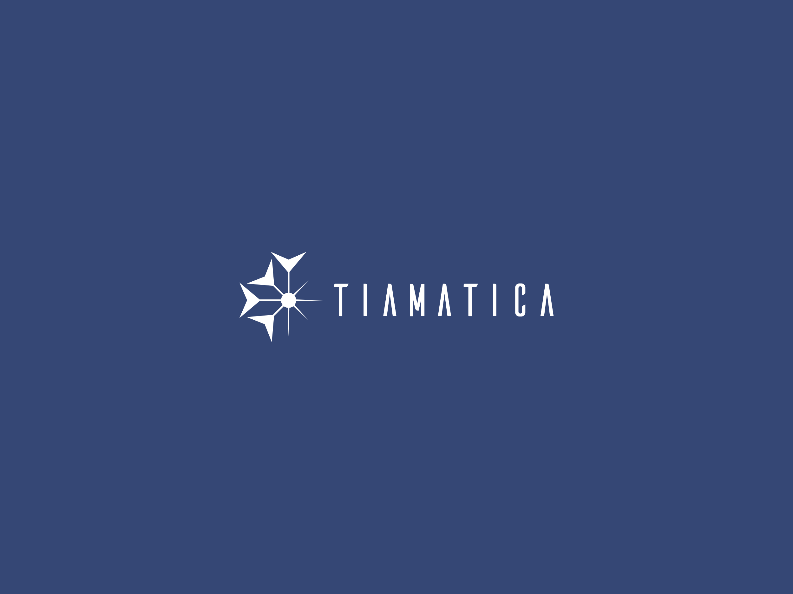
Lift-Off from APL2 Mainframe to Dyalog in the Cloud
Migration of APL2 system from mainframe to Dyalog APL on Linux
Gilgamesh Athoraya

Slide 2
The system
CAPP – Computer Aided Process Planning
Sandvik AB
APL2 v3.0.0 (LogOn)
z/OS 2.3

Slide 3
Project objective
Migrate the CAPP system off of mainframe and APL2 onto Dyalog APL on Windows and Linux.
Language differences
User interface
Database and files
Network communication (DB2, webserver, MQ, etc.)

Slide 4
System overview – Initial
MF
UI (GDDM)
Files
CAPP
(APL2)
DB2
Ext. tables
CAPP DB
MQ
Web clients

Slide 5
System overview – Current
MF
Windows
UI (GDDM)
UI (HTML5)
Files
CAPP
(APL2)
CAPP
(Dyalog APL)
Bridge
DB2
Ext. tables
CAPP DB
MQ
Web clients

Slide 6
Source control
Import APL2 source into Git (main branch)
Use backups as source for individual commits to add some history
Create “dyalog” branch for migration work
Apply migration conversion to dyalog branch
Carry on migration work in dyalog branch

Slide 7
Source control
Update “main” branch (import from APL2)
Create new “update” branch from “dyalog” for merge
Merge “main” into “update”
Git recognises conflicts, even after re-structuring in “dyalog” branch
Apply migration conversions to modified files (identified using git diff)
Review and test
Merge “update” into “dyalog” branch

Slide 8
Git graph on development
Work done on APL2
main
r0
main
r1
dyalog x0

Slide 9
Git graph on development
Work done on APL2
Work done on APL2
main
r0
main
r1
main r2
dyalog x0
dyalog x1
APL2-Dyalog conversions

Slide 10
Git graph on development
Work done on APL2
Work done on APL2
Work done on APL2
main
r0
main
r1
main r2
main r3
dyalog x0
dyalog x1
dyalog x2
APL2-Dyalog conversions
Migration work

Slide 11
Git graph on development
Work done on APL2
Work done on APL2
Work done on APL2
main
r0
main
r1
main r2
main r3
update w0
dyalog x0
dyalog x1
dyalog x2
APL2-Dyalog conversions
Migration work

Slide 12
Git graph on development
Work done on APL2
Work done on APL2
Work done on APL2
main
r0
main
r1
main r2
main r3
Merge main
into update
update w0
update w1
dyalog x0
dyalog x1
dyalog x2
APL2-Dyalog conversions
Migration work

Slide 13
Git graph on development
Work done on APL2
Work done on APL2
Work done on APL2
main
r0
main
r1
main r2
main r3
Merge main
into update
APL2-Dyalog conversions
update w0
update w1
update w2
dyalog x0
dyalog x1
dyalog x2
APL2-Dyalog conversions
Migration work

Slide 14
Git graph on development
Work done on APL2
Work done on APL2
Work done on APL2
main
r0
main
r1
main r2
main r3
Merge main
into update
APL2-Dyalog conversions
update w0
update w1
update w2
dyalog x0
dyalog x1
dyalog x2
dyalog x3
APL2-Dyalog conversions
Migration work
Merge update into dyalog

Slide 15
Language differences
Legal APL names (high minus)
Ambivalent functions
Replicate each
Control structures (conditional branch/execute)
System variables (⎕TZ, ⎕ET, ⎕FC, ⎕PR)
System functions (⎕EA, ⎕EM, ⎕ES, ⎕TS)
Format by example (‘0000’⍕)
Each operator (prototype on empty)
Bracket indexing
A B C[index]
A B (C[index])
Assign to single name
A B C←1 2 3
A B (C←1 2 3)
APL2 namespace/package

Slide 16
User interface (GDDM)
Keep UI code unchanged (GDDM control messages)
GDDM emulator in javascript (frontend)
xterm for terminal emulation
Svg.js for graphics
Support both browser (thin client) and HTMLRenderer (fat client)
WebSocket server (backend)
Bridge between shared variable access and web client
Manage async communication with client

Slide 17
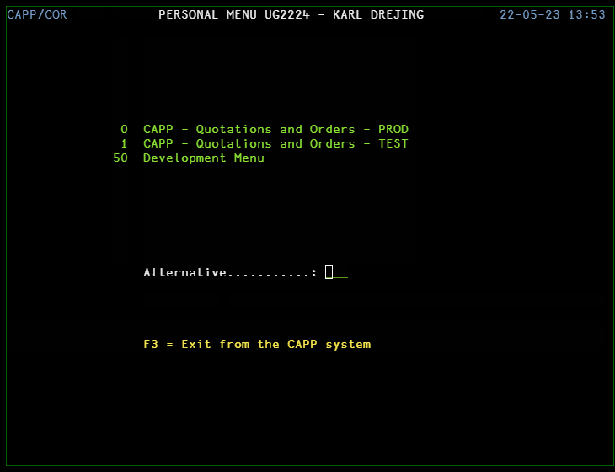
GDDM – Menus and panels

Slide 18
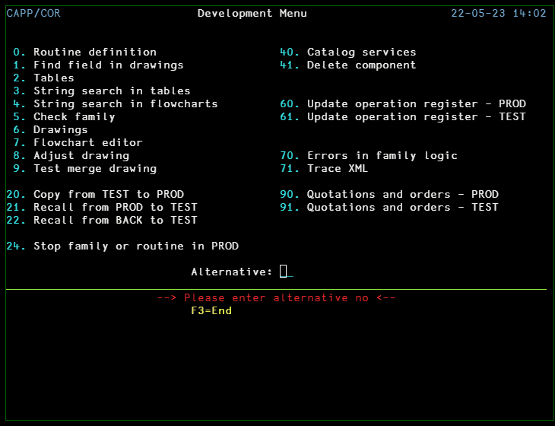
GDDM – Flowchart editor

Slide 19
Database
DB2 database shared with other systems
CAPP requires access to tables owned by other systems
APL2 tables serialised with ATR (array to record, IBM serializer) and stored in CLOB columns
DB2 columns use EBCDIC 278 (Swedish/Finnish) but APL2 ⎕AV implied

Slide 20
Database
Keep DB2 on mainframe during development of Dyalog version (to reduce performance hit for current users).
Replace ATR format with SCAR (to allow both for Dyalog and APL2)
Access DB2 from Dyalog via ODBC

Slide 21
Network comms
Encrypt all TCP/IP connections to allow secure communication between cloud and mainframe.
No native way to create secure TCP connections in APL2
AT-TLS Application Transparent - TLS Policy controlled upgrade of TCP connections to use TLS. No change required to APL code.
DB2 Connect server – add support for secure clients
MQ manager – encrypted channels

Slide 22
Cloud solution
How to build, test and deploy APL code in the cloud?
Azure Repos
Azure Pipelines
Azure Container Registry
Azure Kubernetes

Slide 23
Docker
Different requirements for build and deployment
Build/test:
Tatin
Deployment:
.NET runtime
MQ client
ODBC + DB2 driver

Slide 24
Docker architecture –Dyalog Images
Base Image | Instructions | Resulting image | Size
debian :buster-slim | Add: Dyalog ODBC Tatin | dyalog/v182 :latest | 240 MB
dyalog/v182 :latest | Add .NET Runtime | dyalog/v182 :dotnet | 430 MB

Slide 25
Docker architecture – Build and Deploy .dws
In pipeline:
Use base image to build dws
Build Docker Image for service
Base on dyalog with or w/o dotnet
Add other dependencies:
DB2 drivers
MQ Client
Add dws
Push image to Container Registry
Deploy to Kubernetes

Slide 26
Azure pipeline

Slide 27
System overview – Next step
MF
Windows
UI (GDDM)
UI (HTML5)
CAPP
(APL2)
CAPP
(Dyalog APL)
Bridge
DB2
DFS
Ext. tables
Files
CAPP DB
MQ
Web clients

Slide 28
System overview – End goal
DFS
Docker containers
Files
CAPP DB
CAPP
(Dyalog APL)
CAPP
(Dyalog APL)
CAPP
(Dyalog APL)
CAPP
(Dyalog APL)
DB2
Ext. tables
CAPP
webapp client
(HTML5)
CAPP
webapp client
(HTML5)
MQ
Web API client

Slide 29
Thanks for listening

