Slide 1
Semiglobals and multithreading are like chalk and cheese

Slide 2
Globals
Semi globals

Slide 3
Use only _real_ functions
Go fast and furious

Slide 4
DOMAIN ERROR
RANK ERROR
INDEX ERROR

Slide 8
Orders
Feedbacks
New environment
External system
Executions
(Cancellation requests)
(Allocations)

Slide 9
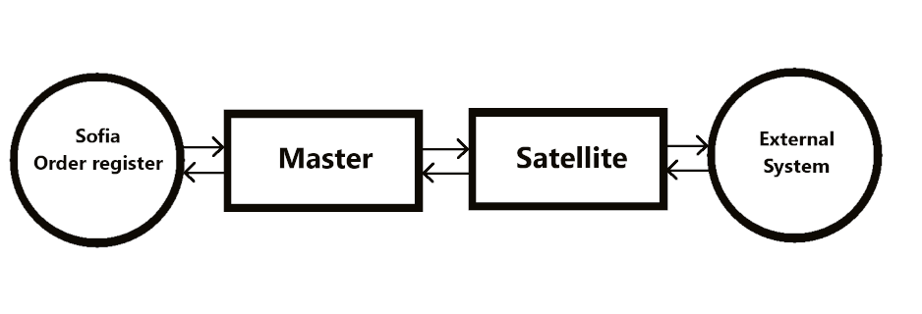

Slide 10
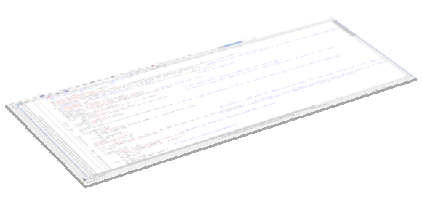
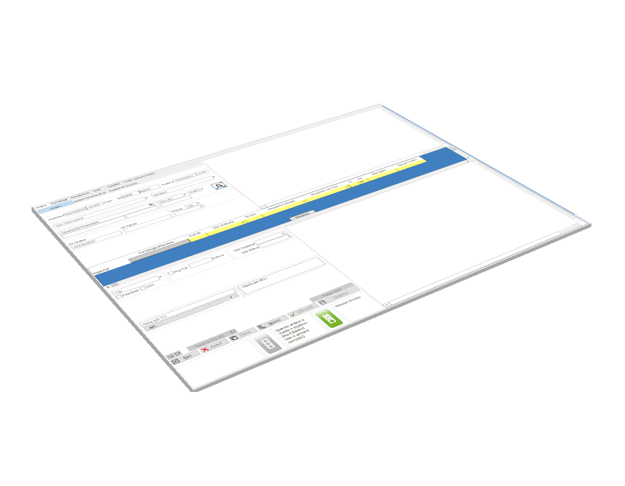

Slide 11
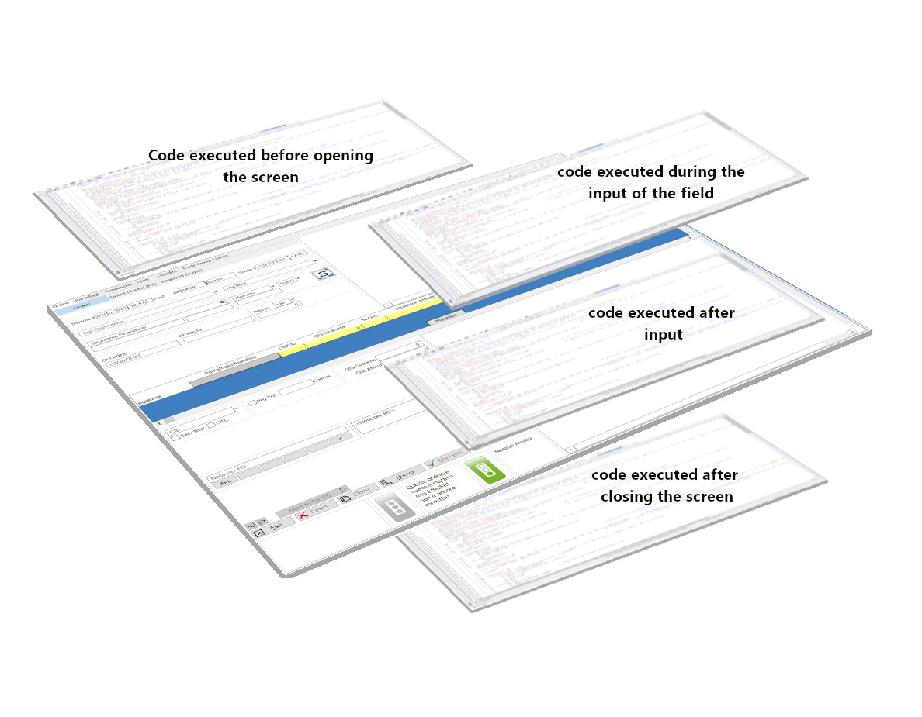

Slide 12
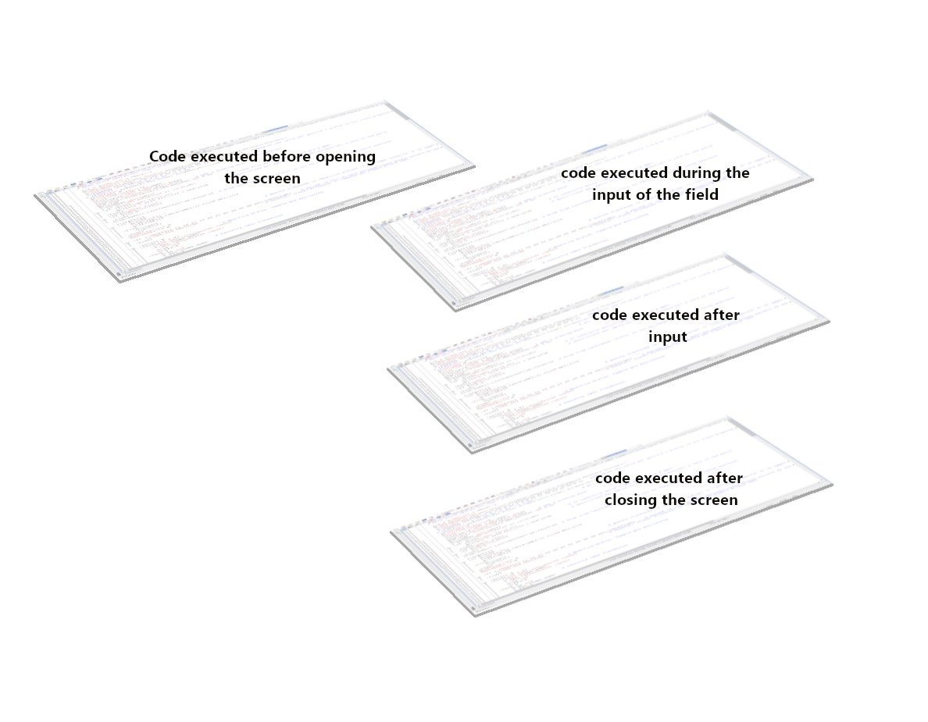

Slide 13
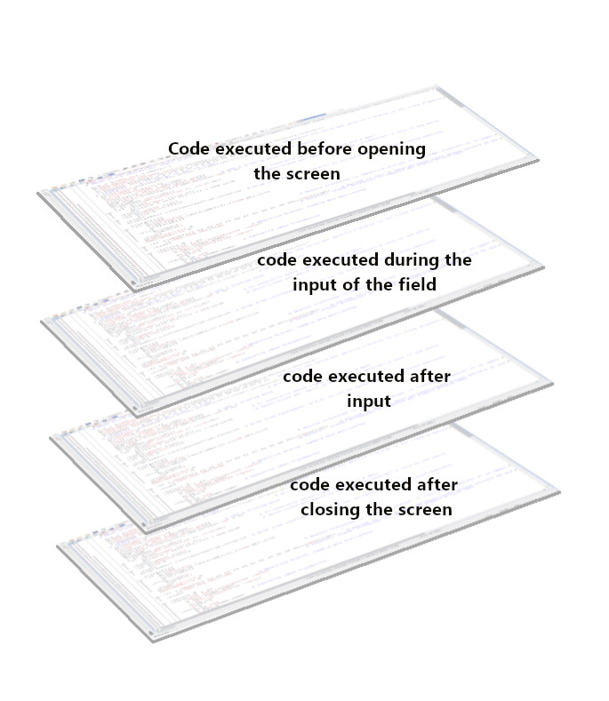

Slide 14
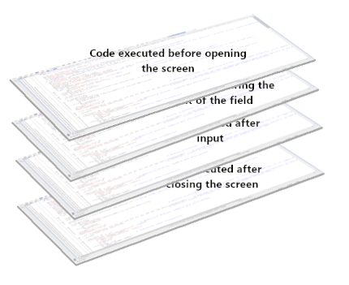

Slide 15
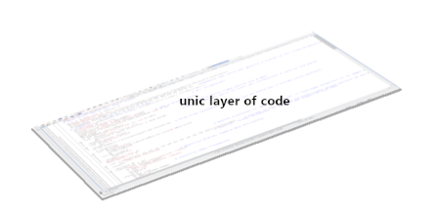

Slide 16
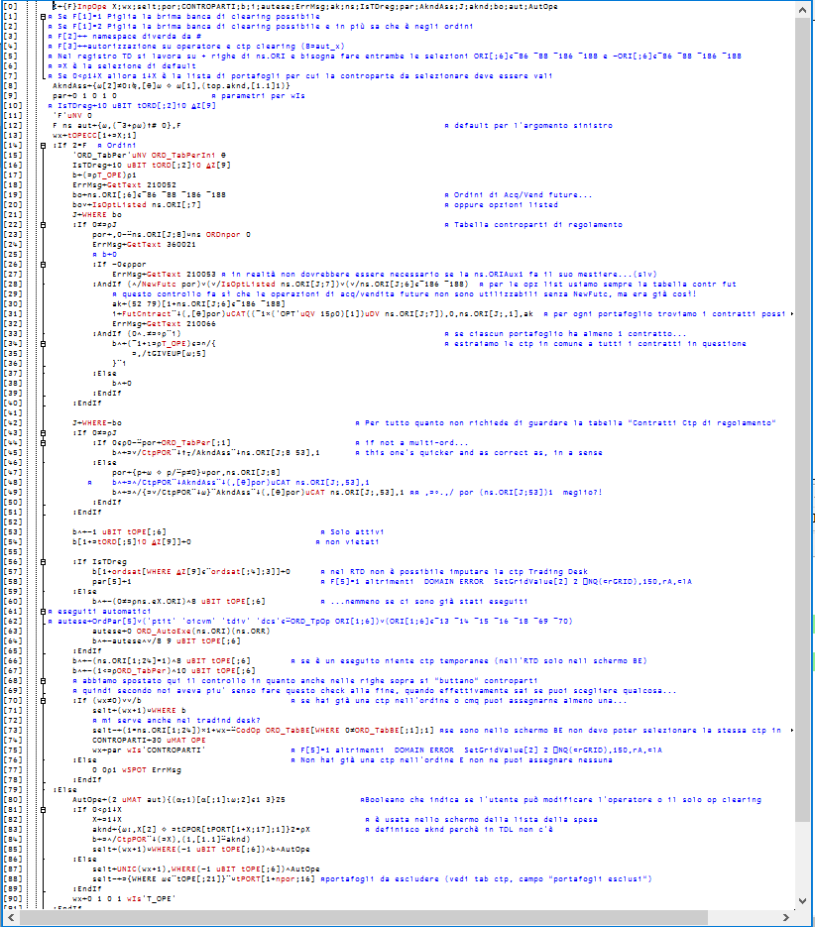
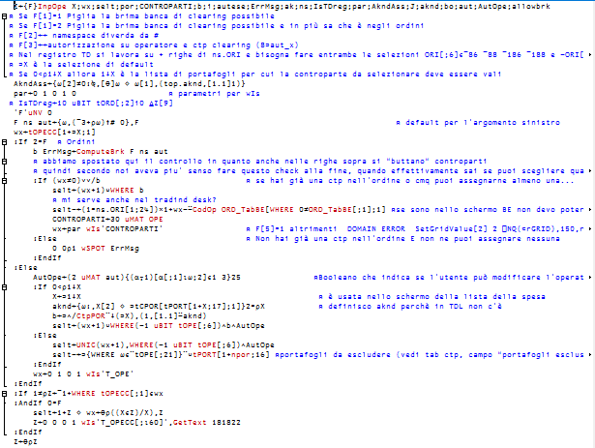

Slide 17
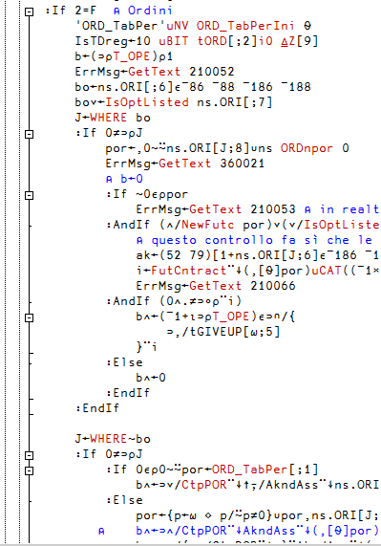
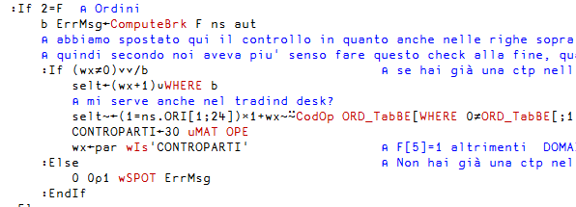
Old code
New code

Slide 18
VALUE ERROR: Undefined name
VALUE ERROR: Undefined name
VALUE ERROR: Undefined name
VALUE ERROR: Undefined name
VALUE ERROR: Undefined name
VALUE ERROR: Undefined name

Slide 19
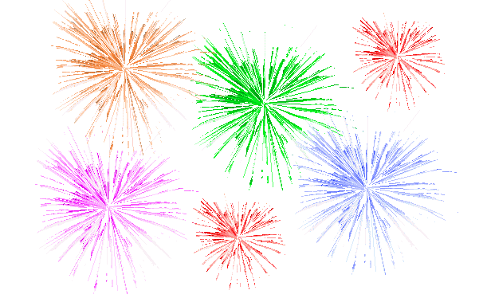

Slide 20
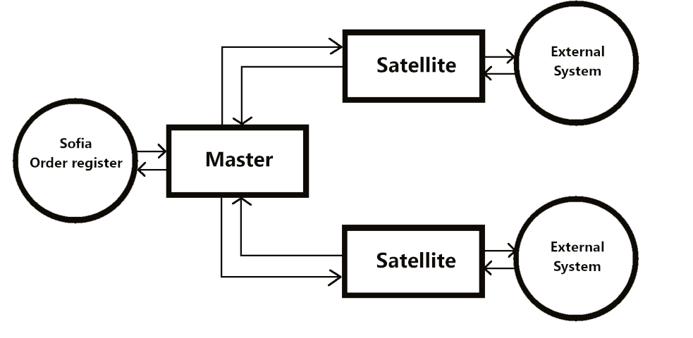

Slide 21
Master
larg, rarg
res←larg fun rarg
Satellite
res

Slide 22
Master
larg, rarg
larg, rarg
Satellite 1
Satellite 2
res←larg fun rarg
res←larg fun rarg
res
res

Slide 23
a←5
…
b←6
…
n←a+b
…
⎕←n
10

Slide 24
Variable in functions in a demo
r←l fun r
var ← ⍳6
…
…
…
Is var localized?
Are a and b localized?
Variable in functions in real life
And c and d?
r←l fun r
…
…
b ← c goo d
…
var ← a hoo b
…
And inside hoo is everything localized?
And inside goo?

Slide 25
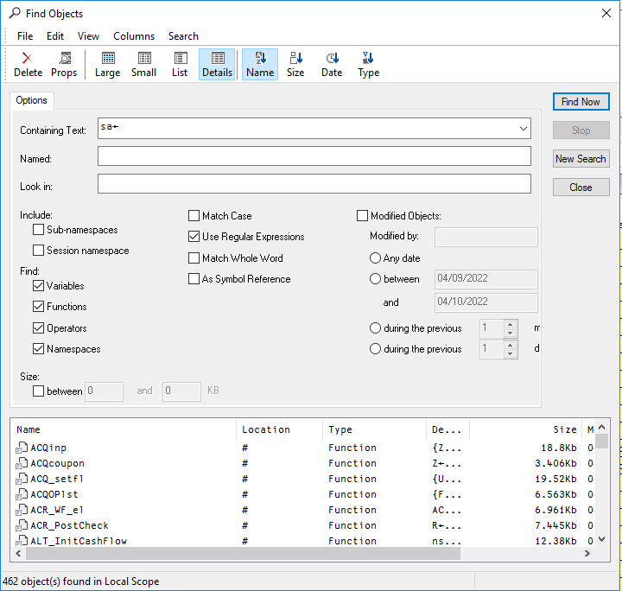
462 object(s) found in Local Scope

Slide 27
What we learned
Even if it’s scary, never avoid new developments just because you’ll have to deal with a lot of old code that has to be updated or with things you never see before
Have a way to organize the list of all semiglobals you use in the code (we used different variables: one for every Sofia environment with the list of semiglobals linked to that environment)
Use the above mentioned variable with names of semiglobals when you need to localize them all in one go; makes things easier to maintain especially when GUI is involved.
You are not alone, so ask for help: if you work in a company remember that your success in the project will also be a success for the company, so your colleagues will be happy to help in making your company successful

