Slide 1
D08 - Using Packages
Morten Kromberg

Slide 2
ToDo List
:If ~WorldDestroyed
ReadMail
:EndIf

Slide 3
Is the World Destroyed?
∇ r←WorldDestroyed
[1] r←HttpCommand.Get 'http://www.hasthelargehadroncolliderdestroyedtheworldyet.com/atom.xml'
[2] r←⎕XML r.Data
[3] r←'NOPE.'≢⊃r[r[;1 2]⍳2 'content';3]
∇

Slide 4
Read Mail
∇ r←ReadMail;server;user;pass;etc;etc;z
[1…7] ⍝ Set up user id, passwords, server address, etc etc [8] client←⎕NEW MailKit.Net.Pop3.Pop3Client
[9] starttls←MailKit.Security.SecureSocketOptions.StartTls
[10] client.Connect server 110 starttls ct
[11] client.Authenticate user pass ct
[12] 'You have ',(⍕n←client.Count),' message(s)' [13] …more stuff…

Slide 5
OUR Code
∇ r←WorldDestroyed
[1] r←HttpCommand.Get 'http://www.hasthelargehadroncollider destroyedtheworldyet.com/atom.xml'
[2] r←⎕XML r.Data
[3] r←'NOPE.'≢⊃r[r[;1 2]⍳2 'content';3]
∇
∇ r←ReadMail;server;user;pass;etc;etc;z [1…7]
[8] client←⎕NEW MailKit.Net.Pop3.Pop3Client
[9] starttls←MailKit.Security.SecureSocketOptions.StartTls
[10] client.Connect server 110 starttls ct
[11] client.Authenticate user pass ct
[12] 'You have ',(⍕n←client.Count),' message(s)' [13] …more stuff…

Slide 6
Dependencies
HttpCommand
APL Package from Tatin
∇ r←WorldDestroyed
[1] r←HttpCommand.Get 'http://www.hasthelargehadroncollider destroyedtheworldyet.com/atom.xml'
[2] r←⎕XML r.Data
[3] r←'NOPE.'≢⊃r[r[;1 2]⍳2 'content';3]
∇
∇ r←ReadMail;server;user;pass;etc;etc;z [1…7]
[8] client←⎕NEW MailKit.Net.Pop3.Pop3Client
[9] starttls←MailKit.Security.SecureSocketOptions.StartTls
[10] client.Connect server 110 starttls ct
[11] client.Authenticate user pass ct
[12] 'You have ',(⍕n←client.Count),' message(s)' [13] …more stuff…
MailKit C# Package from NuGet

Slide 7
Demo – Run It

Slide 8
First There Was The Workspace
APL Workspace

Slide 9
Then There was Link
APL Workspace
Source Code in Text Files
Link

Slide 10
Then There was Link (and git/svn etc)
APL Workspace
Source History
Source History
Source Code in Text Files
Source History
Link

Slide 11
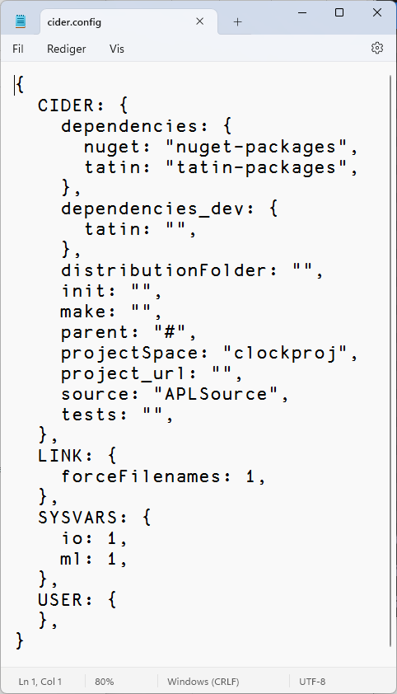
Next Step: Cider!
Load other code that we depend on
Run some code on opening the project
Run a build function
Decide where to load the code
Run tests
Set Link options to be used when loading the source code
Set ⎕IO, ⎕ML

Slide 12
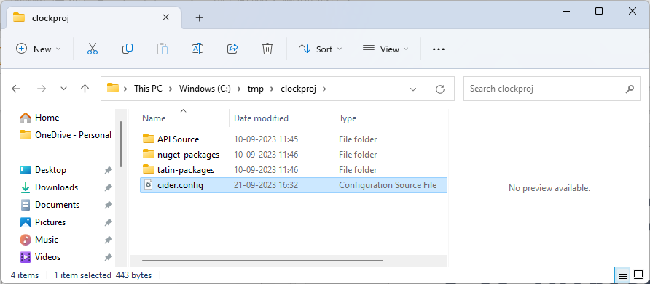
A Cider Project

Slide 13
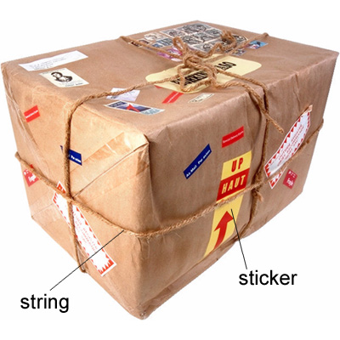
So… What is a Package?
(From Longman Dictionary of Contemporary English)

Slide 14
A Project is…
Source Code +
Dependencies (packages) loaded from a package manager
Environment configuration
Development tools and processes
Can be opened and "set up" by a Project Manager (Cider)
A Package is…
A "build" of a project...
In a standard format
Can be found, downloaded and installed by a "Package Manager"
Cider supports the development of Tatin Packages
Cider can load Tatin + NuGet Packages

Slide 15
Tatin
Package manager for Dyalog APL
A tasty way to package APLs
48 Packages
NuGet
Package manager for .NET
Related to "Chocolatey"
361,905 374,297 Packages
]z←tatin.listPackages
{⍺,≢⍵}⌸{(¯1+⍵⍳'-')↑⍵}¨3↓z[;1]
aplteam 42
davin 4
dyalog 2
¯2↑z
dyalog-HttpCommand 1
dyalog-Jarvis 1

Slide 16
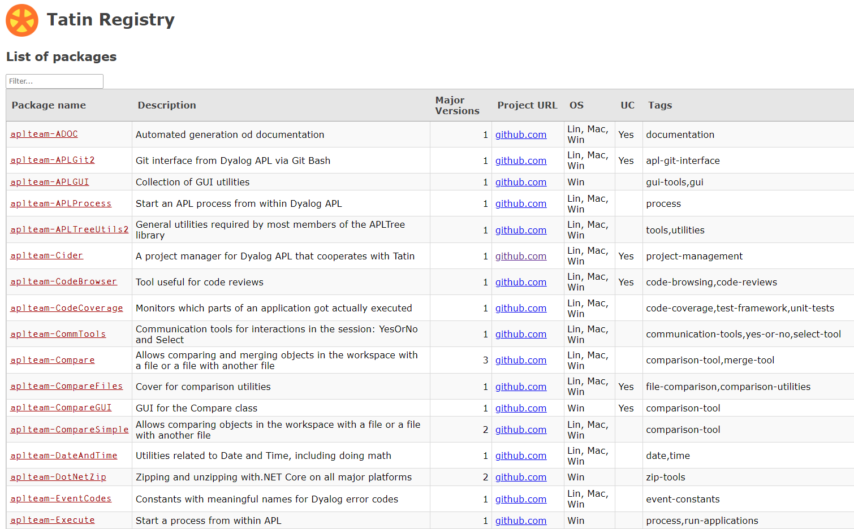
Finding Packages – www.tatin.dev

Slide 17
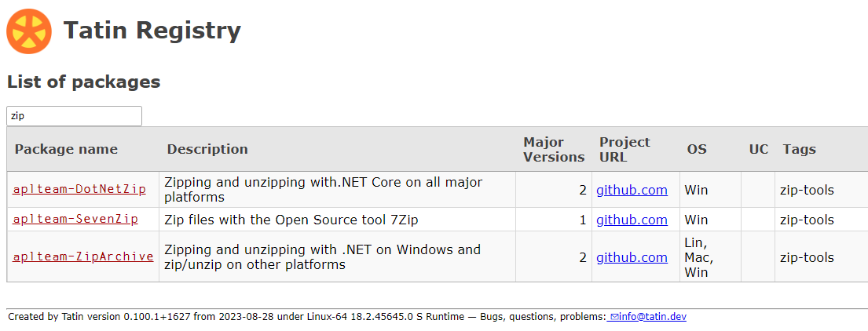
Finding Packages

Slide 18
Finding Packages
48 packages is enough to (sometimes) make it difficult to decide which one to use (and "dyalog-APLProcess" is yet to come ☺)

Slide 19
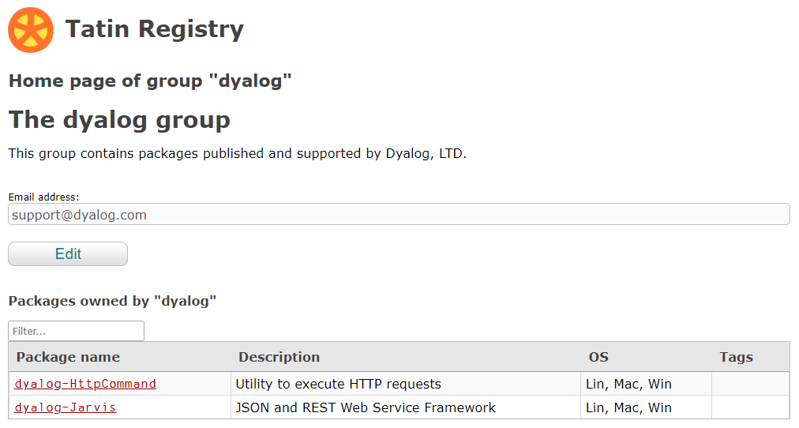

Slide 20
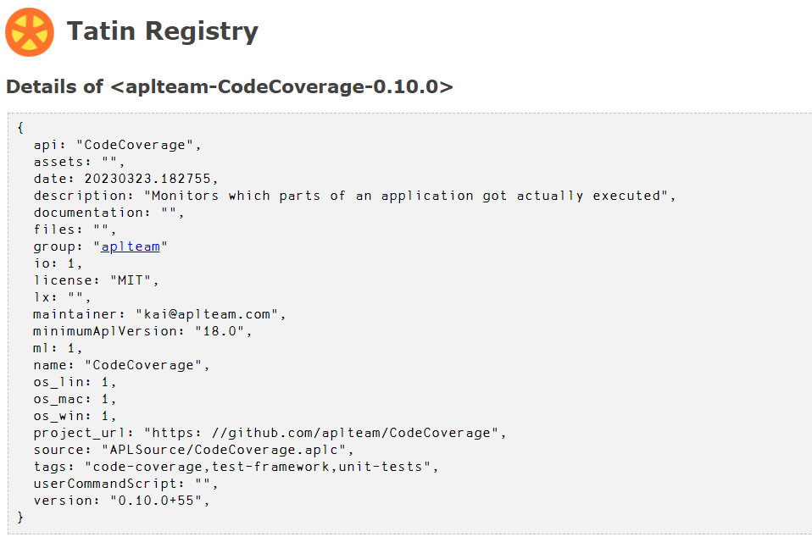
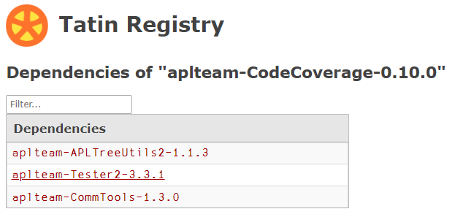

Slide 21
]Tatin.ListPackages
]tatin.listtags
tags from https://tatin.dev
--------------------------
apl-git-interface
build
calculations
chm
code-browsing
code-coverage
code-reviews
command-generation
communication-tools
comparison-tool
comparison-utilities
components
config-files
converter
copy
cryptography
date
dates … … utilities
validation
webservice
windows-event-log
windows-registry
winscp-interface
write
yes-or-no
zip-tools
]Tatin.ListPackages -group=dyalog
Registry: https://tatin.dev
Group & Name # major versions
------------ ----------------
dyalog-HttpCommand 1
dyalog-Jarvis 1
]Tatin.ListPackages -tag=crypto
Registry: https://tatin.dev
Group & Name # major versions
------------ ----------------
aplteam-HashPasswords 1

Slide 22
Adding a Tatin Dependency
Example: I use HttpCommand in just about every new project
To add it to our Cider project: ]Cider.AddTatinDependencies HttpCommand 1 Tatin dependency added: dyalog-HttpCommand-5.2.0
Since we did not specify a version, we get the latest.
A reference is created to the loaded package within our project space: D08.HttpCommand.Get 'www.dyalog.com' [rc: 0 | msg: | HTTP Status: 200 "OK" | ≢Data: 22580]

Slide 23
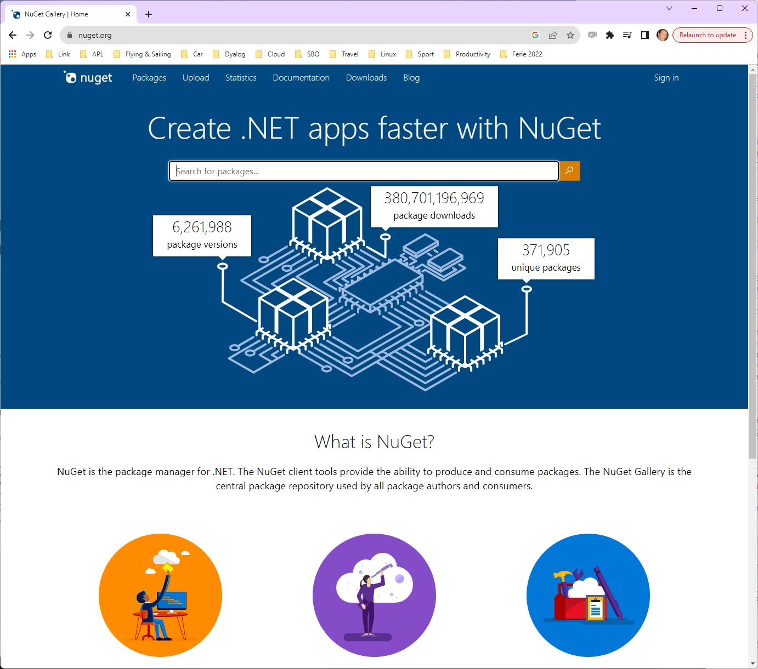
NuGet
NuGet is the .NET package manager
You can use NuGet packages from Dyalog APL, with .NET 6.0 or later

Slide 24
[Microsoft].NET History
.NET has been around for 20+ years. The old "Framework" is being replaced by an open source, cross-platform .NET, initially known as ".NET Core".
Dyalog v18.0 added a bridge to .NET Core 3, to complement the 20 year old bridge to the .NET Framework.
v18.2 was tested with "Core" 3.1 but works with 5.0 and later
v19.0 will target 8.0 (Long Term Support version due on Nov 8th 2023)
Name | Platforms | Version Numbers
Microsoft.NET Framework | Windows | 1 2 3 4.0 4.8.1
".NET Core" | Windows Linux macOS | 1 2 3
".NET" | Windows Linux macOS | 5.0 6.0 7.0 8.0

Slide 25
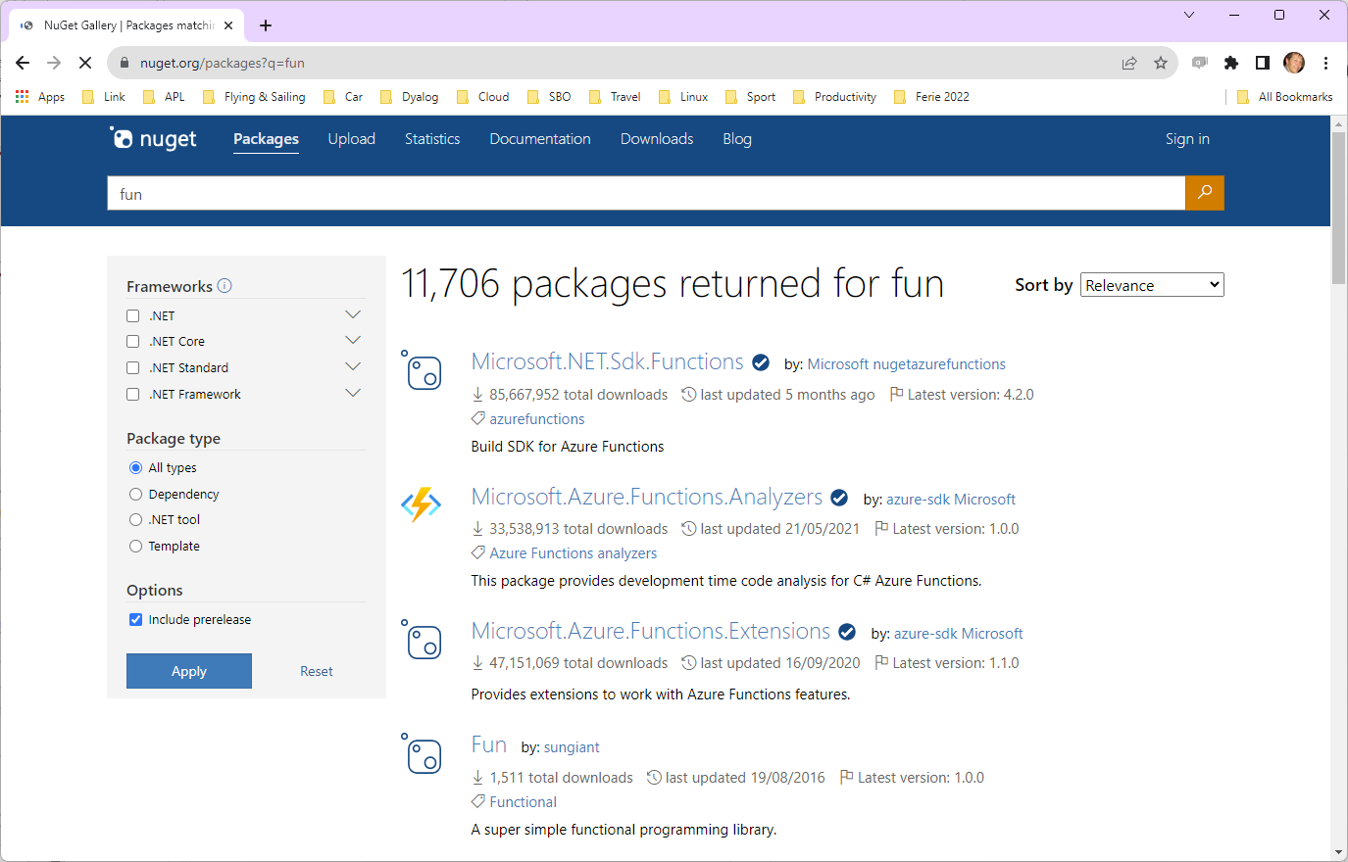
Finding NuGet Packages (HARD!!!)

Slide 26
Adding a NuGet Package
NuGet support currently requires .NET 6.0, 7.0 or 8.0 Support for "Framework" packages MAY follow
Example: NuGet contains a very simple package called "Clock".
We can add it to our Cider project (by default, we get the latest version): ]Cider.AddNuGetDependencies Clock Clock 1.0.3
A reference to a namespace hosting the .NET package is created: #.clockproj.Clock.UtcNow.(Hour Minute) 14 43
In fact, the namespace is empty except for ⎕USING: clockproj.Clock.⎕USING ,c:/tmp/clockproj/nuget-packages/published/Clock.dll

Slide 27
Demo – Build It

Slide 28
Dependencies of Dependencies
Great fleas have little fleas upon their backs to bite 'em, And little fleas have lesser fleas, and so ad infinitum.
Augustus de Morgan
Both Tatin and NuGet will automatically load such
dependencies

Slide 29
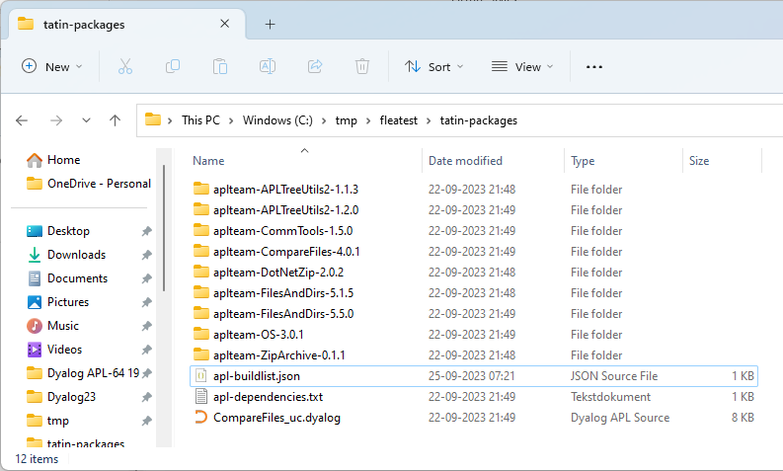
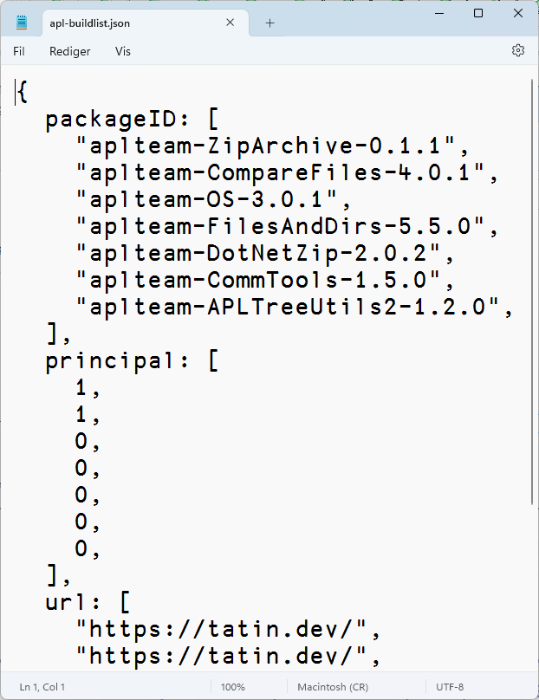
"Principal" dependencies (that we added)

Slide 30
"Lesser" fleas

Slide 31
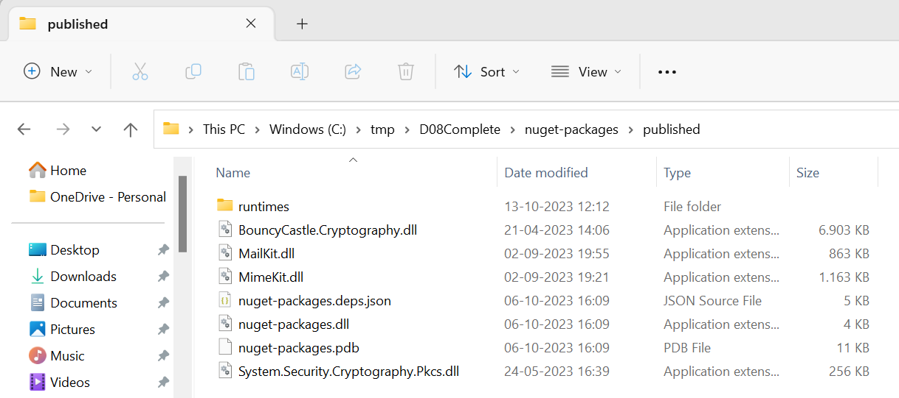
"Principal" dependencies (that we added)

Slide 32
Where Do Dependencies Go?
]Cider.OpenProject C:\tmp\fleatest
Project successfully loaded and established in "#.fleatest"
)cs fleatest
#.fleatest
⎕NL -9
CiderConfig CompareFiles ZipArchive
CompareFiles
#._tatin.aplteam_CompareFiles_4_0_1.API
⍪#._tatin.⎕nl -9
aplteam_APLTreeUtils2_1_2_0
aplteam_CommTools_1_5_0
aplteam_CompareFiles_4_0_1
aplteam_DotNetZip_2_0_2
aplteam_FilesAndDirs_5_5_0
aplteam_OS_3_0_1
aplteam_ZipArchive_0_1_1
#._tatin.aplteam_CompareFiles_4_0_1.⎕NL -9
API APLTreeUtils2 Admin CommTools ComparisonTools FilesAndDirs TatinVars
Our Dependencies
Lesser Fleas

Slide 33
dotnet command-line tool
Under Windows, Linux and macOS, .NET provides a "dotnet" command which:
Creates .NET projects that we use to define and manage dependencies (complete with a C# class that we never use)
Adds Dependencies
"Publishes" collections of DLLs that implement packages
Dyalog's NuGet support depends heavily on this
We just set ⎕USING to point to the published DLLs
The alternative is to try to replicate poorly documented .NET behaviours

Slide 34
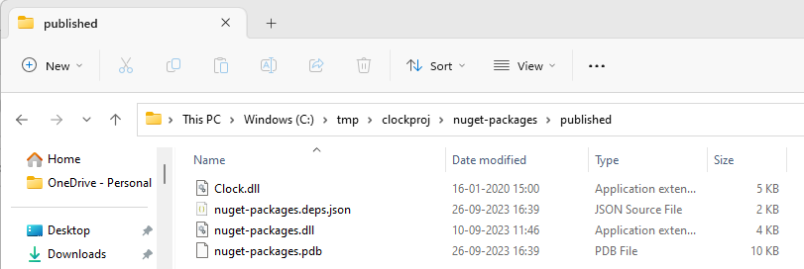
NuGet Packages – Under the Covers
NuGet DLL's go in a folder called "published"

Slide 35
NuGet Packages – Under the Covers
The dotnet command line tool has created some C# code which "pretends" to use the NuGet packages

Slide 36
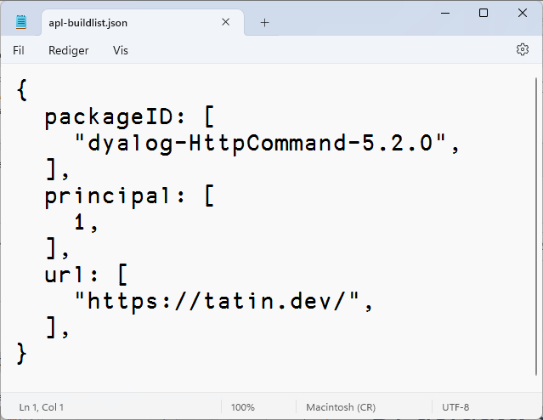
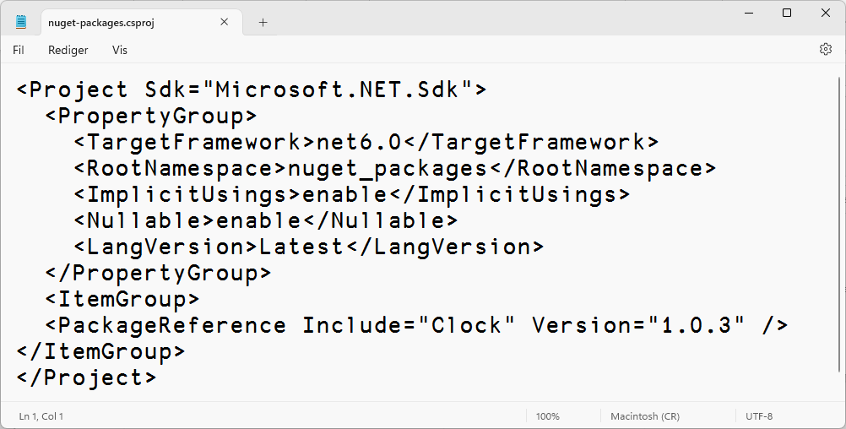
Same Same but Different
Tatin
NuGet
#.projectSpace.HttpCommand
#.projectSpace.Clock

Slide 37
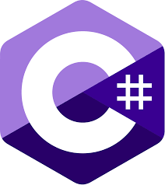
The Cast, in order of appearance
Link Synchronises Source Files and Workspace The workspace and source files are "Linked"
Cider is a Project Manager A Project is a linked source folder, a config file, plus optional dependencies
Tatin is the APL Package Manager A Package is a project wrapped up for consumption by others
NuGet is the .NET Package Manager The Dyalog.NET Bridge allows APL to use .NET libraries

Slide 38
History
Tatin development started in 2020 using the Acre project management system
We decided that we needed a "more agnostic" / "less opinionated" project management system to base Tatin development upon
Cider was born in 2021
Initially as an internal tool for Tatin development
Support for NuGet packages added in 2023
Tatin is now close to v1.0, we think
Cider still a prototype (v0.36)
Cider is likely to evolve significantly in next year or two
Cider is based on Link, which is now at v4.0

Slide 39
Cider and Tatin "To Do" lists
Review of Names & Messages
Dyalog to help with Documentation
Shell-callable API for installation
Ability to manage Local / Intermediate package stores within an organisation
Import part of a package (e.g. dfns cmpx)?
Actually running tests and builds for you

Slide 40
Link Road Map
Link v4.0 Highlights
Configuration Files (incl "Global" config)
Link single Class or Namespace file
Create/Export/Import default to current namespace if none supplied
Support for character vectors, matrices and vec-of-vecs in simple text files
Link now being used by APL interpreter to load user code at startup
Link 5 & 6
Crawler which will periodically compare workspace to source folders
Postponed from 3.0 and 4.0
And again from 4.0 to 5.0
Create a proper API
Likely to be 6.0, after the Crawler is done

Slide 41
Dyalog APL Road Map Items
In the interpreter itself…
Ability launch the APL interpreter on a Cider project and have it open & run
Create virtual environments a la Python
Isolate an APL environment including packages
Possibly add an extension to ⎕USING that allows easier references to loaded modules

Slide 42
Dyalog: Making APL more Enjoyable
Tatin
Cider

