Slide 1
Statistics in Dyalog APL
Josh David

Slide 2
Statistics in Dyalog APL
https://github.com/dyalog/pynapl
https://github.com/kimmolinna/rsconnect

Slide 4
Why the need
Heavily used in rising fields
Data Science
Machine Learning
Shift in Company Cultures
Data driven
Opportunity for APL
Figure 1

Slide 5
Where has this been?
+⌿ sum
⌈⌿ max

Slide 6
Where has this been?
⌈⌿ max
⌊⌿ min
(⌈⌿-⌊⌿) range
(+⌿÷≢) mean
y⌹x*0 mean

Slide 7
Regression ⌹
Arithmetic: $y=f\left(x\right)$
Algebra: $y=f\left(x\right)$
Regression: $y=f(x)$

Slide 8
Regression

Slide 9
Regression

Slide 10
Regression

Slide 11
Regression

Slide 12
Regression
{⍺⍠⍵*0} ⍝ Mean
{⍺⌹⍵∘.*0 1} ⍝ Linear
{⍺⌹⍵∘.*0 1 2} ⍝ Quadratic
{⍺⌹⍵∘.*0 1 2 3} ⍝ Cubic
{x y←⍵ ⋄ y⌹x∘.*⍳1+⍺}

Slide 13
Machine Learning
Figure 2

Slide 14
Open source libraries
KokoStats
TamStat

Slide 15
KokoStats
https://github.com/JoshDavid/KokoStats

Slide 16
Demo[1] KokoStats
Correlation heatmaps & Multiple linear regression

Slide 17
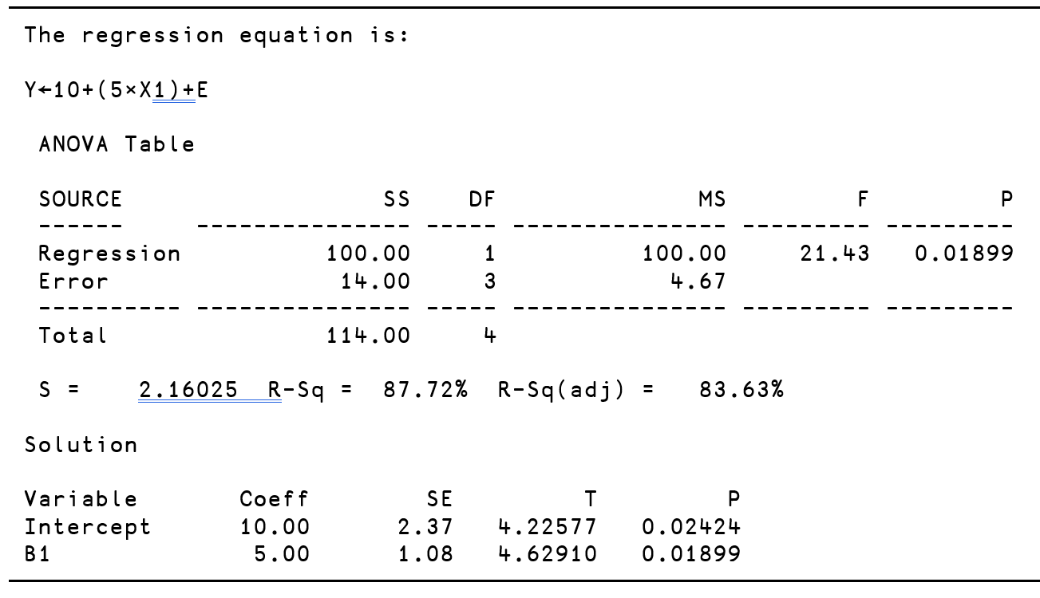
TamStat - Simple Linear Regression
⍝ Predictor Variable (X)
ADS←1 3 2 1 3
⍝ Response Variable (Y)
CARS←14 24 18 17 27
⍝ Perform linear regression
MODEL← CARS regress ADS
MODEL.B ⍝ Intercept and Slope
10 5
⍝ If dealer runs 2 ads, how many sales?
MODEL.f 2
20
MODEL.f confInt 2 ⍝ Estimate mean sales
16.925 23.075
MODEL.f predInt 2 ⍝ Predict dealer sales
12.469 27.531
report MODEL

Slide 18
The TamStat regress Operator
Design | Left Argument | Operand / Function | Right Argument | Result
Simple linear regression | Response Variable* | regress | Predictor Variable | Intercept, Slope
Multiple Linear Regression | Response Variable* | regress | Vector of Predictor Variables | Intercept, Coefficients for each predictor variable.
 |  | Response Variable | Matrix whose columns are predictor variables
 | Name of Response Variable* (Character string) | regress | Namespace containing all variables
Simple Quadratic Regression $y=b_{9}+b_{1}\left(x−\overline{x}\right)+b_{2}{\left(x−\overline{x}\right)}^{2}$ | Response Variable | ⊥ regress | Predictor Variable | Intercept, Coefficients for centered data and squared centered data
Multiple Quadratic Regression | Response Variable | ⊥ regress | Vector of Predictor Variables | Intercept, Linear, Quadratic and Interaction Coefficients
Polynomial Models | Response Variable | N ⊥ regress | Predictor Variable | Intercept, Coefficients for all powers up to N of predictor variable
Model with Indicator Variable(s) | Response Variable* | regress | Vector containing Predictor Variables and at least one Character Variable | Intercept, Coefficients for each predictor variable and (k-1) coefficients for each character variable. (k = unique character values)
Variance Stabilizing Transformations | Response Variable | fn regress [ln|sqrt|÷|arcsin] | Predictor Variable | Intercept, Coefficients
Multiplicative Regression $$y=bx^{a}$$ | Response Variable | × regress | Predictor Variable | Constant, Powers
Indicator response variable | Boolean Variable | ≠ regress | Predictor Variable | Intercept, Coefficients
Custom Regression | [None] | userFn regress | Database (Namespace) | Intercept, Coefficients
* Pseudo Left Argument - Actually an array left operand.

Slide 19
TamStat
EXCEL =1-NORM.DIST(150,120,25,TRUE)
R pnorm(150,120,25,lower.tail=FALSE)
TamStat 120 25 normal probability > 150

Slide 20
TamStat
Summary Wizard
Probability Wizard
Distribution Wizard
Statistical Tables
Confidence Intervals
Hypothesis Wizard
Sample Size Calculator
ANOVA
Regression Wizard
Chi-Square Tests
Bayesian Analysis

Slide 21
Demo[2] TamStat
Random Variable generation

Slide 22
Demo[3] TamStat UI
Distribution Wizard
Confidence interval

Slide 23
References
Figure 1:
https://www.bls.gov/ooh/fastest-growing.htm
Figure 2:
https://twitter.com/ingliguori/status/1644012090976354306

