Slide 1
Behind The Scenes
Into The Future
Stine Kromberg
Jada Andrade

Slide 2
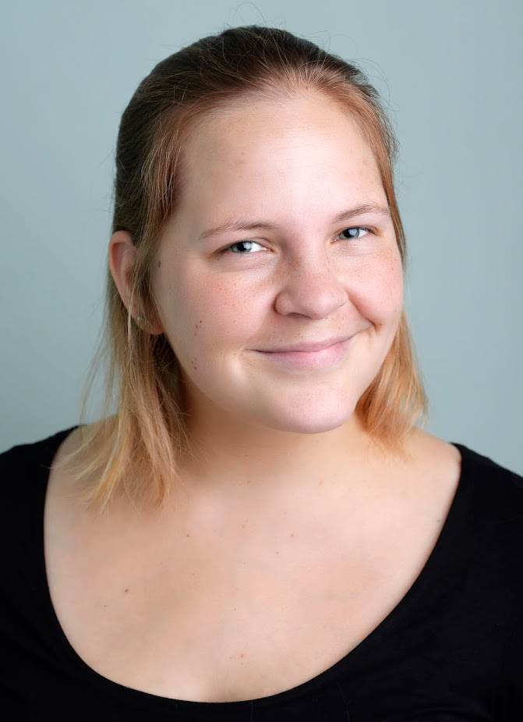
New CEO
Kirstine Kromberg aka Stine
Future CEO of Dyalog
Been with the company since May 2020
Grew up with APL – but not an APL’er
Education: MSc in Business Administration and Information Systems

Slide 3
Vision
Goal: Still be around in 10.. 20.. 50 years!
Leave the technical decisions to Morten ☺
Do a bit of spring cleaning
Take advantage of our growth
Support next generation

Slide 4
Jada Andrade
Administrative assistant Karen’s Sidekick + Internal Legal department
With Dyalog since March 2023 Around Dyalog and APL for years
Education: law and politics, Experience: administration and service
From the Cayman Islands

Slide 5
The Basics – What is a Licence?
Agreement for use and distribution
Developer vs Runtime
dyalog.com/prices-and-licences.htm

Slide 6
Current Annual Commercial Licences
Licence Type | 32-bit | 64-bit
Microsoft Windows | £850 | £1,275
macOS/Linux | - | £1,275
Windows, Linux & macOS | - | £1,375
AIX | £1,275 | £1,875

Slide 7
2024 Restructuring
Licence Type
Windows, Linux & macOS | £1,375
AIX | £1,875
2024: no more 32-bit standalone licences

Slide 8
Advantages
Streamlined: One size fits all.
Flexibility: Full access to platforms and versions
Modern: Supports current development trends
Freedom: Less influence on architectural choices

Slide 9
What Does All This Mean for You?
We will be in touch with all 32-bit users
Price increases can be eased in over 5 years
Special agreements remain
AIX stays at £1,875.00
Contact sales@dyalog.com if needed
Questions?

Slide 10
Vision
Goal: Still be around in 10.. 20.. 50 years!
Leave the technical decisions to Morten ☺
Do a bit of spring cleaning
Take advantage of our growth
Support next generation

Slide 11
Take advantage of our growth
Adding a bit of process
Rethinking the way we work
A touch of standardisation
Stay flexible and open minded

Slide 12
Vision
Goal: Still be around in 10.. 20.. 50 years!
Leave the technical decisions to Morten ☺
Do a bit of spring cleaning
Take advantage of our growth
Support next generation

Slide 13
Next Generation
5 new people added this year
2 interns
Goodbye to 2 Giants – Gitte and Geoff
Succession planning is in progress
More outreach

Slide 14
More outreach – Current users
New website
Internal knowledge sharing about customers
Developer placements with customers
User meeting

Slide 15
User meeting
Community
Communication
Training
Motivation

Slide 16
User Meetings
Survey will be sent out after Dyalog ’23
Please reply if you have any opinion on how we can improve!!
Pricing
Viking challenge
Workshops vs Presentations
Timing
Length
Location
Dyalog vs Users
Other??

Slide 17
More outreach – New users
Identify potential new users
New website
Improve tutorials and documentation
Online classes
More focus on SoMe channels
Changes to our Student Competition

Slide 18
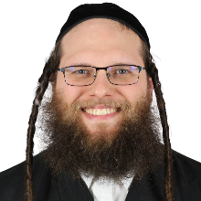
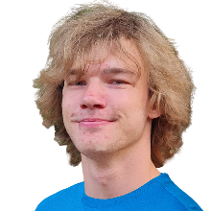
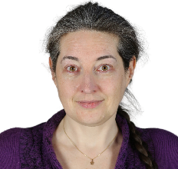
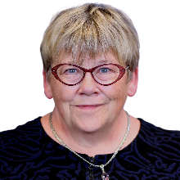
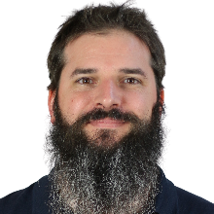
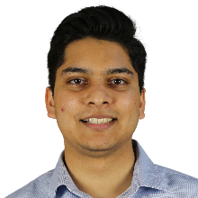
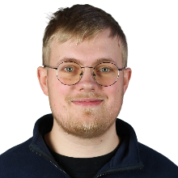
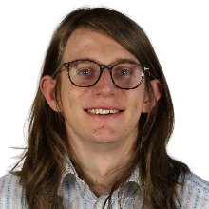
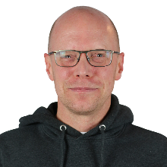
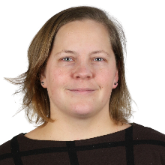
Resources
Our Sponsors
Beta Testers
The Team
Anonymous

Slide 19
Competition
New phase one
Quarterly
3 winners
10 questions
Focus on introducing people to APL and spreading the word

Slide 20
Competition
Phase 2
Case based solution
Bigger prize
Visit to UM
Potential sponsorship to keep developing the solution?

Slide 21
Save the date!
Dyalog ‘24
Where: The Golden Jubilee Hotel, Glasgow
When: September 15-19 2024

