Slide 1
SA1: Project Management using Cider and Tatin (Part 1)
Gilgamesh Athoraya, Kai Jaeger, Morten Kromberg

Slide 2
Materials to Download
From https://github.com/dyalog-training/2023-SA1 2023-SA1.pptx
Also on circulating USB stick: 2023-SA1.pptx CiderTatin folder (saves downloading & installing)

Slide 3
Dyalog: Making APL more enjoyable
Tatin
Cider

Slide 4
Dyalog: Making APL more enjoyable
Tatin
Cider

Slide 5
Dyalog: Making APL more enjoyable
Tatin
Cider

Slide 6
Hands On!
Unlike many workshops, there should be plenty of time for experimentation

Slide 7
Session 1: Introduction
09:30-10:30 ("ish", Tea & Coffee available at all times)
What is a Project and Why Would you want one?
Installing, Enabling and Upgrading
Tatin Client and Cider
One of .NET 6.0-8.0
What about Link?
Finding Cider Documentation
Creating a Project
Understanding Project Configuration Options
Opening a Project
(under the covers)
Exercise 0: Installation!
Exercises 1 & 2: Create & Open a Project!

Slide 8
Session 2: Dependencies / Packages
10:45-11:45
What is a Package?
Tatin: APL Packages
Finding Documentation
Finding and Installing Packages
"Where do they go?"
Dependencies of Dependencies
NuGet: .NET Packages
Finding and Installing
"Where do they go?"
Exercise 3: Add a Tatin Dependency (or two)!
Exercise 4: Add a NuGet Dependency

Slide 9
Session 3: BYO App + Wrap Up
12:00-13:00
Development Dependencies
Build Your Own App
Recap and Conclusions
Link, Cider and Tatin ToDo Lists
SP1 This Afternoon: Creating your own Packages
Exercise 5: Build Your Own Application

Slide 10
What is a Project
And WHY Would I Want One?

Slide 11
First, There Was The Workspace
APL Workspace

Slide 12
Then There was Link (and git/svn etc)
APL Workspace
Source History
Source History
Source Code in Text Files
Source History
Link

Slide 13
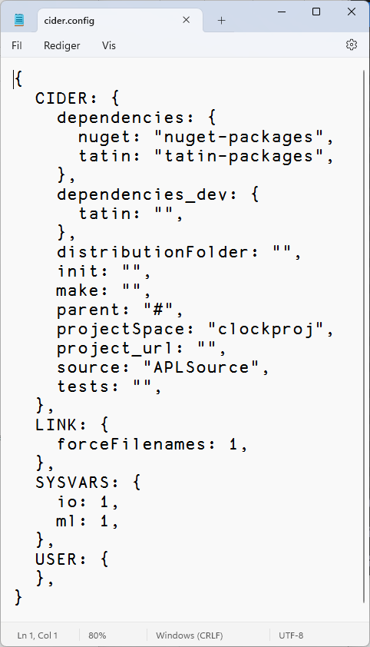
What More Could You Want?
Load other code that we depend on
Run some code on opening the project
Run a build function
Decide where to load the code
Run tests
Set Link options to be used when loading the source code
Set ⎕IO, ⎕ML

Slide 14
Cider is a Project Manager A Project is a linked source folder, a config file, plus optional dependencies
Tatin is a Package Manager A Package is a project wrapped up for consumption by others

Slide 15
History
Tatin development started in 2020 using Acre
We decided that we needed a "more agnostic" / "less opinionated" project management system
Cider was born in 2021
Initially as an internal tool for Tatin development
Tatin is now close to v1.0 (v0.98.0)
Cider still a prototype (v0.35.0)
Likely to evolve in next year or two
Cider is based on Link, which is now at v4.0.11

Slide 16
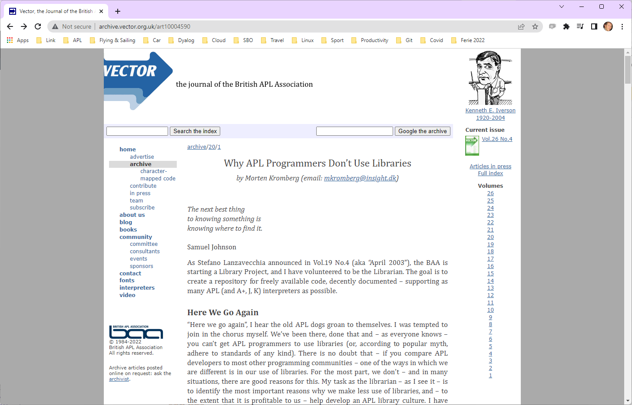
(July 2003)

Slide 17
Most Importantly
In addition to being valuable educational resources…
Packages are critical to keeping APL competitive as a tool for building modern applications
Support web protocols and components, data formats, operating system APIs, security requirements, etc
There are a few things you don't want to build from the ground up each time

Slide 18
Installing Cider and Tatin
If you have v19.0, use ]tools.activate
Or use the "CiderTatin" folder on the USB stick
Or follow normal Tatin installation instructions
… and then use Tatin to install the package Cider
(see the following slides)
]tools.activate all cmddir set to: /home/mkrom/.dyalog/dyalog.190U64.files/SessionExtensions/CiderTatin: /home/mkrom/MyUCMDs:/opt/mdyalog/19.0/64/unicode/SALT/spice Now restart APL to complete activation.

Slide 19
Cleanup If Necessary
In the following, replace …blabla… by whatever is appropriate, e.g.
Dyalog APL 18.2 Unicode
Dyalog APL-64 18.2 Unicode
Dyalog APL-64 19.0 Unicode
And mkrom by your user id.
Check for the existence of an existing installation:
]settings cmddir C:\Users\mkrom\Documents\…blabla…/StartupSession/CiderTatin; C:\Users\mkrom\Documents\MyUCMDs; C:\Program Files\Dyalog\Dyalog APL-64 19.0 Unicode\SALT\spice
Remove existing installation:
]settings cmddir "~C:\Users\mkrom\Documents\…blabla…/StartupSession/CiderTatin" (repeats old setting)
3 ⎕NDELETE 'C:\Users\mkrom\Documents\…blabla…/StartupSession/CiderTatin'

Slide 20
Installing from USB "CiderTatin"
As before, replace …blabla… by whatever is appropriate, e.g.
Dyalog APL 18.2 Unicode
Dyalog APL-64 18.2 Unicode
Dyalog APL-64 19.0 Unicode
And mkrom by your user id.
Copy CiderTatin to:
C:\Users\mkrom\Documents\…blabla…/SessionExtensions/CiderTatin
Tell UCMD system where to find it:
]settings cmddir ",C:\Users\mkrom\Documents\…blabla…/SessionExtensions/CiderTatin" (repeats old setting)

Slide 21
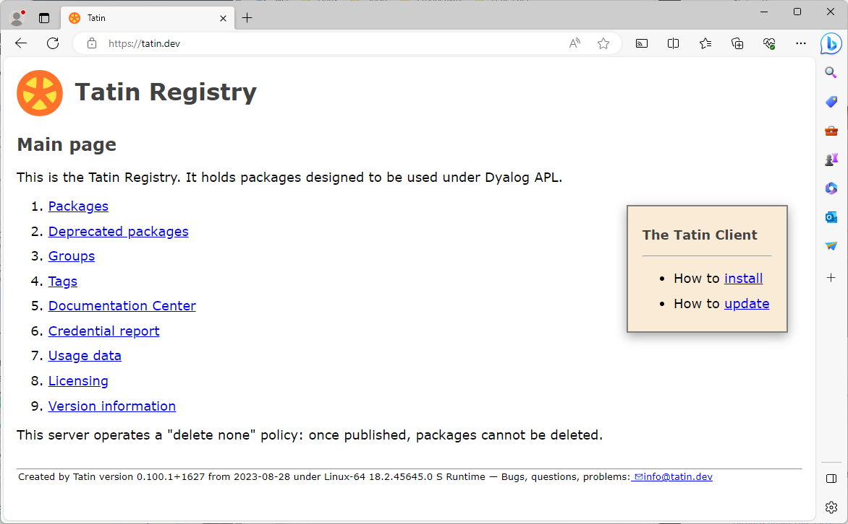
Normal Tatin Installation

Slide 22
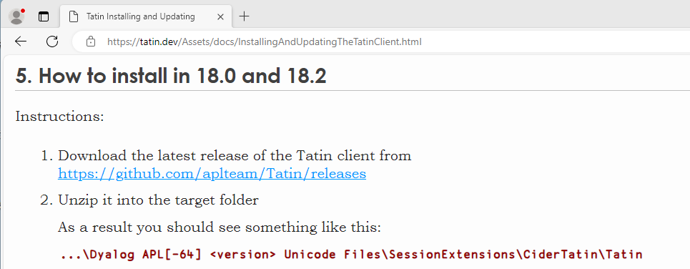
& 19.0

Slide 23
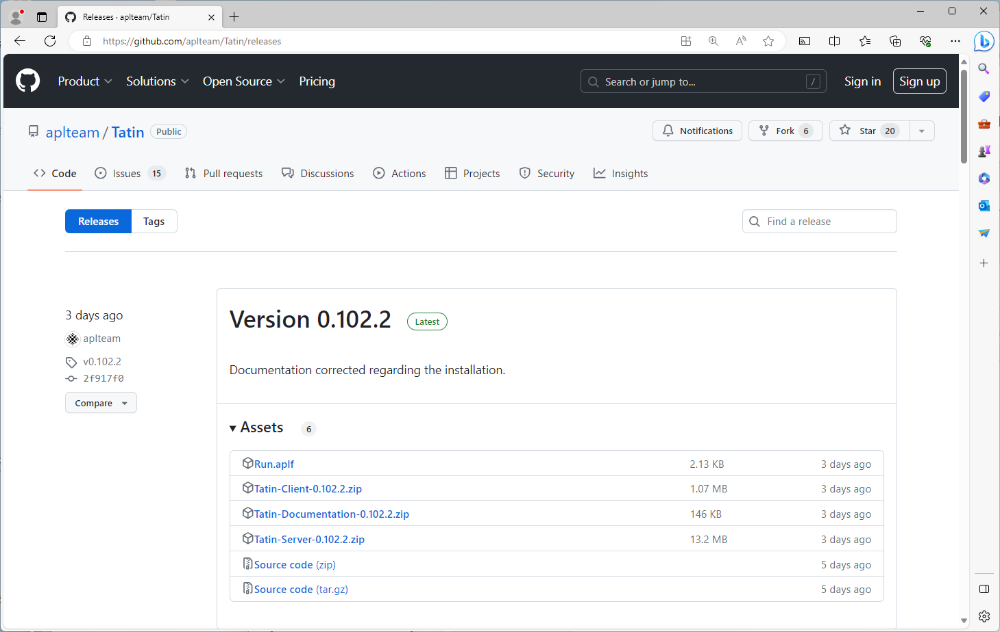

Slide 24
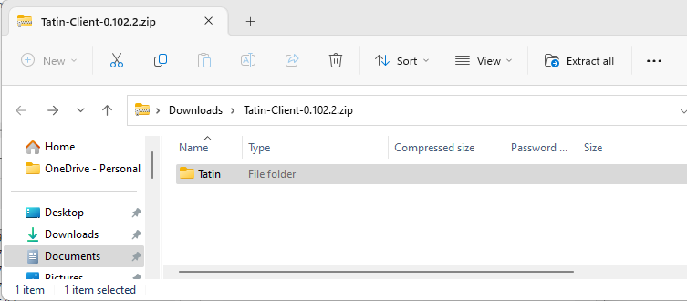
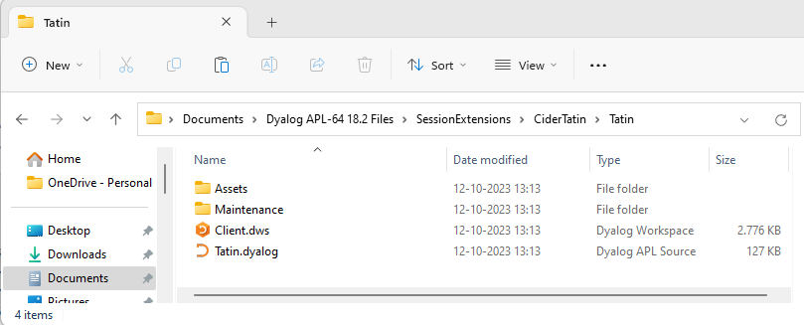
Copy & Paste
Resulting in…

Slide 25
Tell the UCMD system where to look
Replace mkrom with your user name (⎕AN)
If you are not using 64 Unicode
Replace "Dyalog APL-64 Unicode Files" below with
Dyalog APL[-64] 18.x [Unicode] Files
Under Linux or macOS, the folder name will be
/home/<⎕AN>/dyalog.<version>U<bit>.files/SessionExtensions/CiderTatin
]settings cmddir ",C:\Users\mkrom\Documents\Dyalog APL-64 18.2 Unicode Files/SessionExtensions/CiderTatin" –permanent
(displays previous setting) ]tatin.version
Tatin 0.102.3+1685 2023-10-13

Slide 26
Installing Cider
In the following, replace [Folder] with the name of the folder that Tatin was installed into. Probably something like:
C:\Users\mkrom\Documents\Dyalog APL-64 18.2 Unicode Files/SessionExtensions/CiderTatin
]tatin.installPackages Cider "[Folder]/Cider"
Sure you want to create and install into [Folder]/Cider ? (Y/n) y
Installed into blabla/CiderTatin/Cider:
aplteam-Cider-0.37.4

Slide 27
Note
These instructions make Cider and Tatin available as user commands
The APIs (⎕SE.Tatin and ⎕SE.Cider) are not available until the first call to a user command.
You can materialise them with e.g.
⎕SE.UCMD 'Cider.Version'

Slide 28
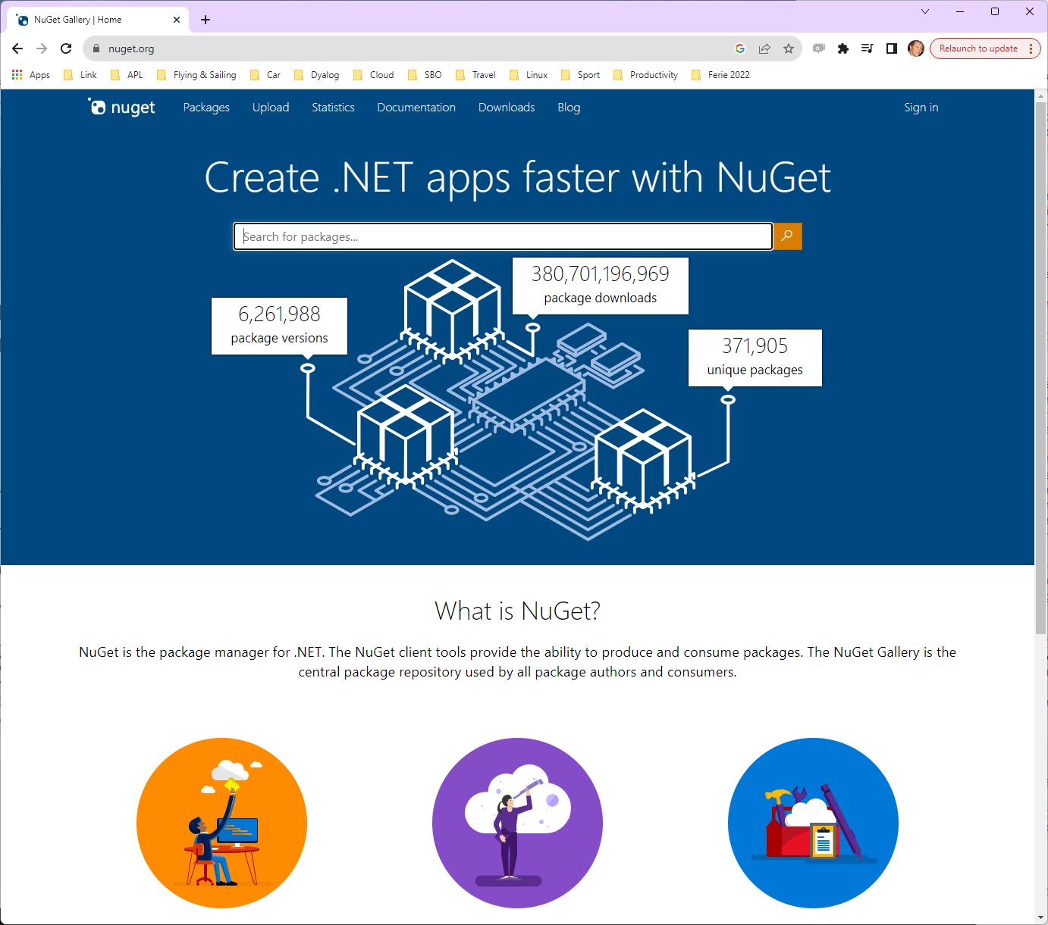
NuGet Packages
NuGet is the .NET package manager
To use NuGet packages with Dyalog APL, you need .NET 6.0 or later
(we may add support for 4.0 / "Framework" later)

Slide 29
[Microsoft].NET History
As .NET celebrates 20 years of existence, Microsoft is moving to the new open source, cross-platform .NET.
Dyalog v18.0 added a bridge to .NET 3, to complement the 20 year old bridge to the .NET framework.
v18.2 was tested with 3.1 ("Core") but works with 5.0 and later
v19.0 targets 8.0 (Long Term Support version due on Nov 8th 2023)
Name | Platforms | Version Numbers
Microsoft.NET Framework | Windows | 1 2 4.0 (aka "4.8" …)
".NET Core" | Windows Linux macOS | 3.0 3.1
".NET" | Windows Linux macOS | 5.0 6.0 7.0 8.0

Slide 30
Installing .NET
Microsoft Windows is shipped with the DotNet Framework (version 4.8) installed
.NET 6-8 need to be installed separately
Current support for NuGet packages requires .NET 6.0 or later
Version 18.2 was shipped configured for .NET 3.1, but seems to work fine with 6.0-8.0
The v19.0 .NET bridge is significantly more mature (stable/complete) than 18.2

Slide 31
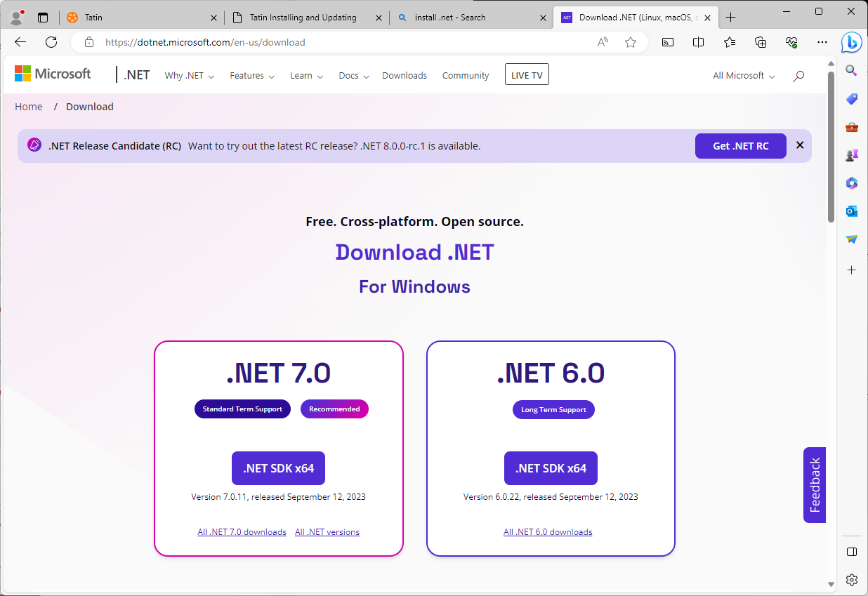
Verify the Installation

Slide 32
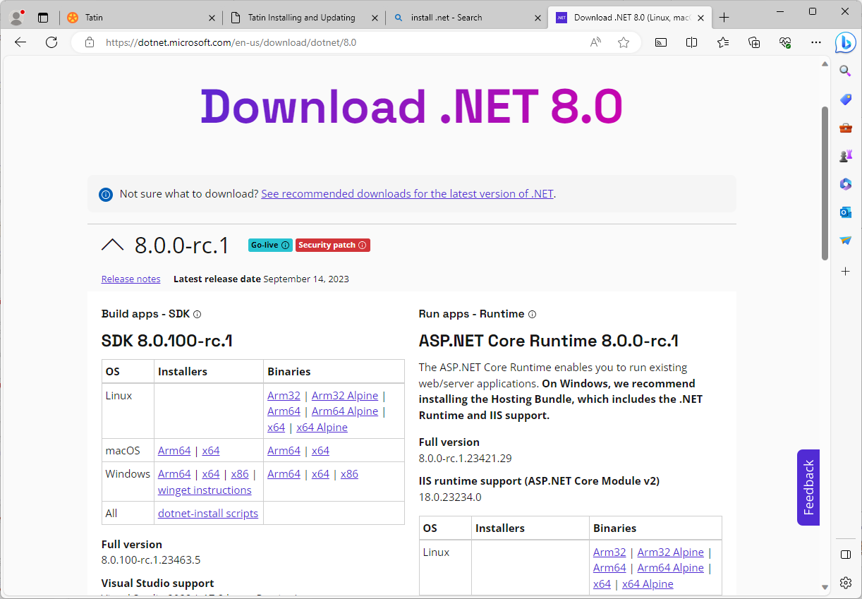

Slide 33
Configure APL to use .NET
… if you want to use NuGet packages later …

Slide 34
Pick an Installed .NET Runtime
Pick one of these
(Even Microsoft sometimes still calls it "Core" ☺)

Slide 35
DYALOG_NETCORE=1
Under Windows, APL will use the .NET Framework by default
Set DYALOG_NETCORE=1 to switch from Framework to ".NET"
Environment Variable, Command Line, Registry or Config File
Unfortunately, selecting the VERSION of .NET to use requires editing .json files in the main Dyalog folder (see next slide)
Version 18.2 defaults to .NET Core (3.1)
Version 19.0 will default to 8.0
"User Meeting Edition" defaults to 6.0 because 8.0 is a Release Candidate

Slide 36
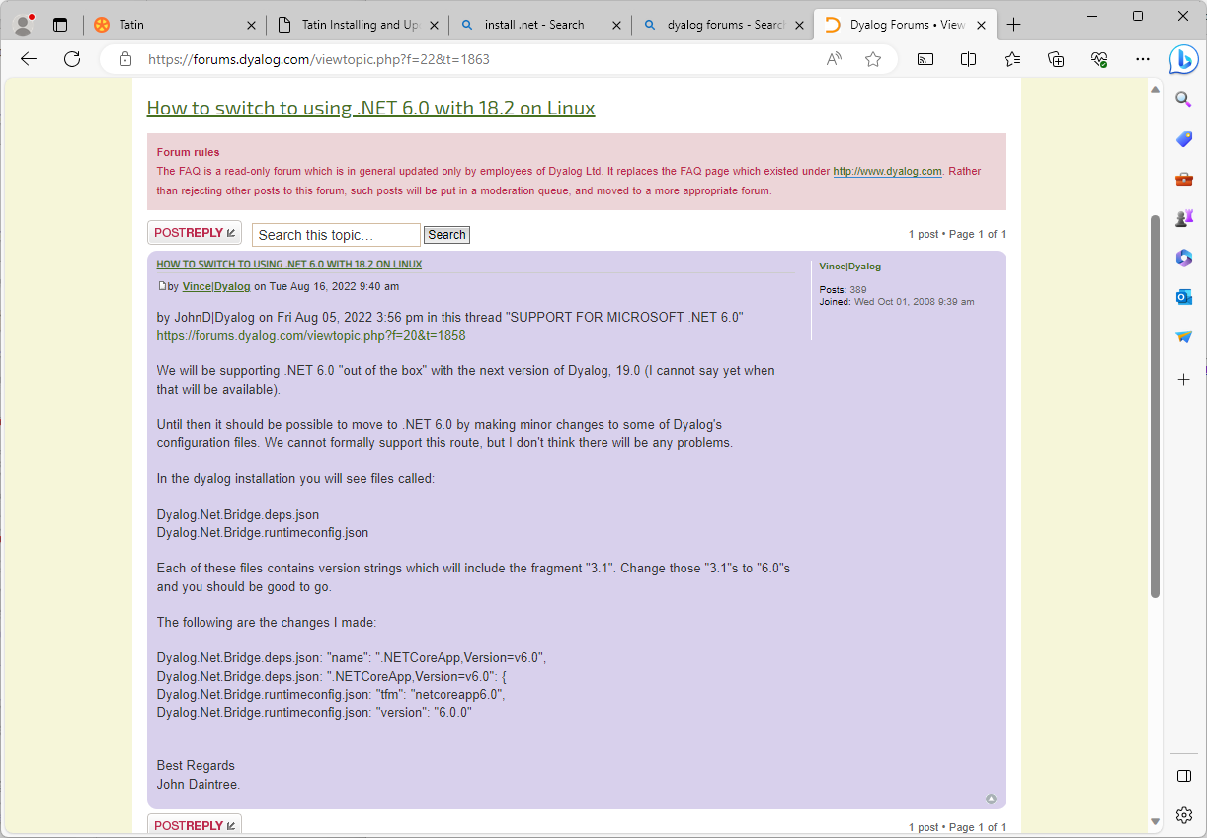
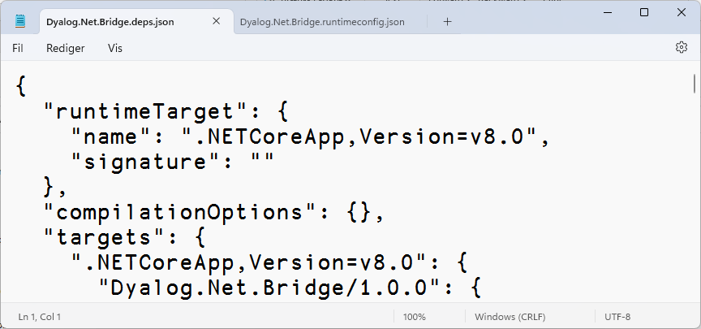
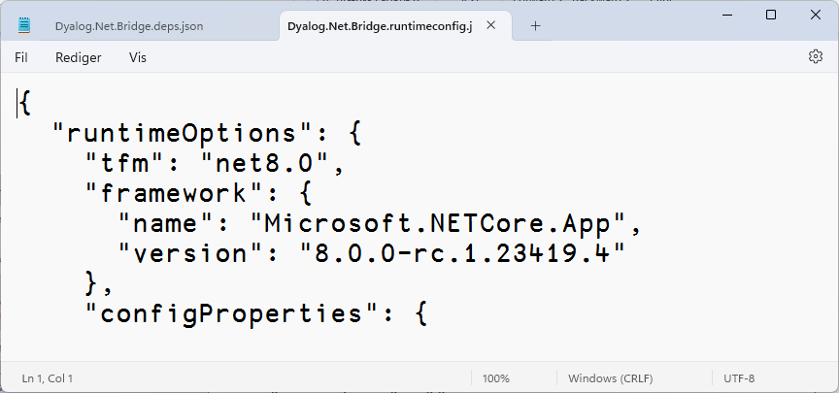

Slide 37
Updating Cider & Tatin
]Cider.UpdateCider -? Attempts to update the currently running version of Cider
]Tatin.UpdateTatin -? Attempts to update the Tatin client and reports the result

Slide 38
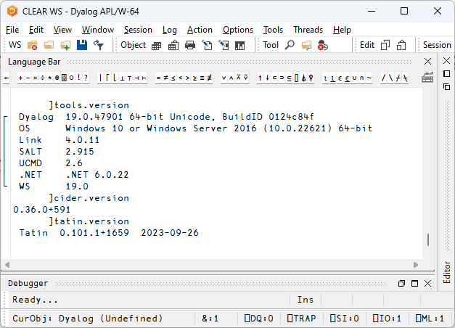
Exercise 0
Install and Verify
Tatin
Cider
.NET
Set APL up to use .NET

Slide 39
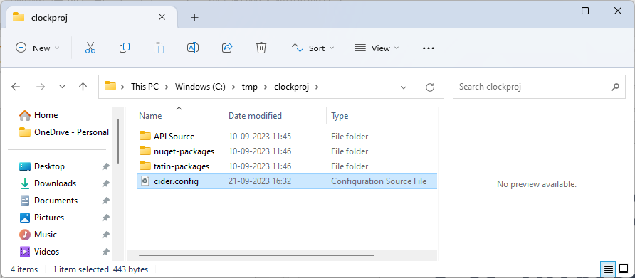
Back to Cider… What *is* a Cider Project?

Slide 40
Loading Code
(default settings in parentheses) source ("APLSource") identifies the sub-folder to be loaded (ONLY this folder will be loaded into the WS)
parent ("#") the location source will be loaded into
projectSpace (default is project folder name) name of the space to be created within parent
These three parameters decide what will be loaded, and where it will go within the workspace
You can override the last two using –parent and –projectSpace modifiers

Slide 41
Dependencies
dependencies ("nuget-packages" and "tatin-packages") names of folders that will contain the dependencies
dependencies_dev ("") name of a folder that may contain Tatin dependencies used only during development
All dependencies are loaded when the project is opened
Each folder name can be followed by =targetns if dependencies should be loaded somewhere else than projectSpace (typically done for dependencies_dev) For example tatin: "dev-packages=devtools"

Slide 42
Running Code
init ("") An APL expression to run on project open.
tests ("") An APL expression to run your tests.
make ("") An APL expression to launch your build process
Cider will run the "init" expression on project load
Cider will not currently run your tests or build processes
User commands ]cider.make & ]cider.runtests will display the settings, but leave it up to you to run things

Slide 43
Link Options and Sysvars
LINK section Includes any non-default Link options that you want set when your source is linked
SYSVARS section Allows you to declare values for system variables
Both of these sections are now unnecessary due to Link enhancements:
v3 added support for system variables
V4 uses a .linkconfig file to store non-default options within the source folder (in this case, APLSource/.linkconfig)
However, they arguably still have value as documentation of important aspects of your project configuration

Slide 44
"Convenience" options
distributionFolder ("") The target for a build process
project_url ("") A pointer to where the project is hosted, especially if it is on GitHub.
You can use these in your build functions and documentation.
When using Cider to develop Tatin packages, atin's "BuildPackage" acts on distributionFolder and will include project_url in the package description

Slide 45
[Global] Cider Configuration
Cider also has a global configuration file
At the moment, this is "work in progress", and the only configuration option stored here is…
ExecuteAfterprojectOpen: a string which is executed after opening ALL projects

Slide 46
[Global] Cider Configuration
Two functions are provided to access the global configuration file:
⎕SE.Cider.GetCiderGlobalConfigFilename
C:\Users\mkrom\.cider\config.json
⊃⎕NGET ⎕SE.Cider.GetCiderGlobalConfigFilename
{
ExecuteAfterProjectOpen: "",
}
gc←⎕SE.Cider.GetCiderGlobalConfigFileContent
≢gc.ExecuteAfterProjectOpen
0

Slide 47
Aliases
Aliases provide a way to avoid typing long folder names over and over again
fldr← 'c:\tmp\clockproj' ⍝ Long, annoying folder name ⎕SE.Cider.AddAlias folder 'clocks' ⎕SE.Cider.GetAliasFileContent '' clocks c:/tmp/clockproj ]cider.openproject '[clocks]' … Project successfully loaded and established in "#.clockproj" NB. ]Cider.ListAliases –edit

Slide 48
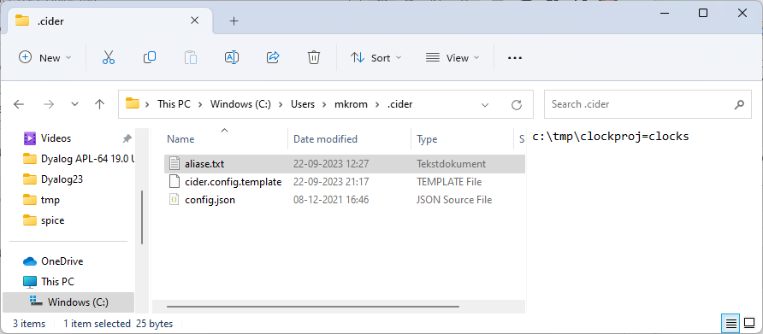
The [HOME]/.cider Folder
Contains:
Global config file config.json (ExecuteAfterProjectOpen)
Alias file aliase.txt
Template config.json file to be used when creating new projects

Slide 49
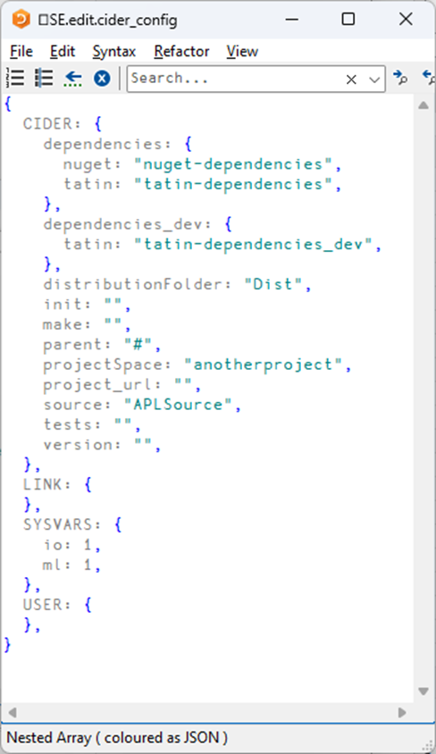
Back to the Cider Project

Slide 50
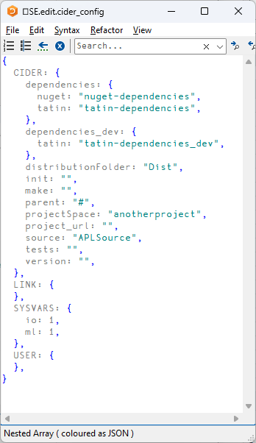
Creating a Project
From .cider/cider.config.template =>
]Cider.CreateProject c:\tmp\anotherproject "c:/tmp/anotherproject" does not exist yet - create? (Y/n) y
Project successfully created; open as well? (Y/n) y LINK:watch=both Project successfully loaded and established in "#.anotherproject"
#.anotherproject.⎕nl -⍳10 CiderConfig

Slide 51
The New Project Folder

Slide 52
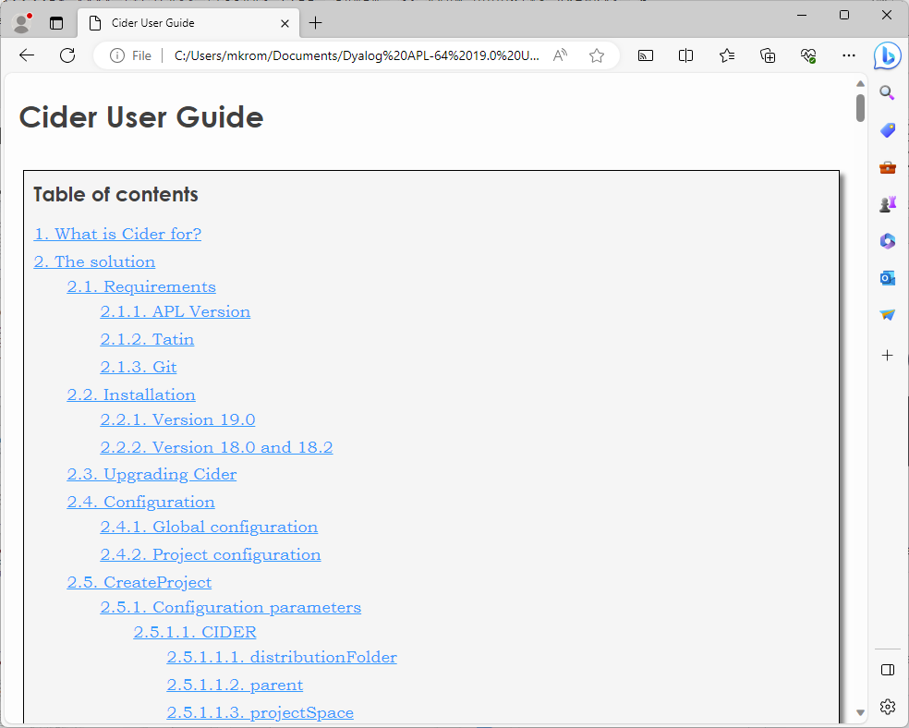
Cider Documentation
]Cider.Help --- Select document to be viewed: ----------- 1. Cider-API-Reference 2. Cider-User-Guide 3. Contributing Select one or more items (q=quit, a=all) : 2

Slide 53
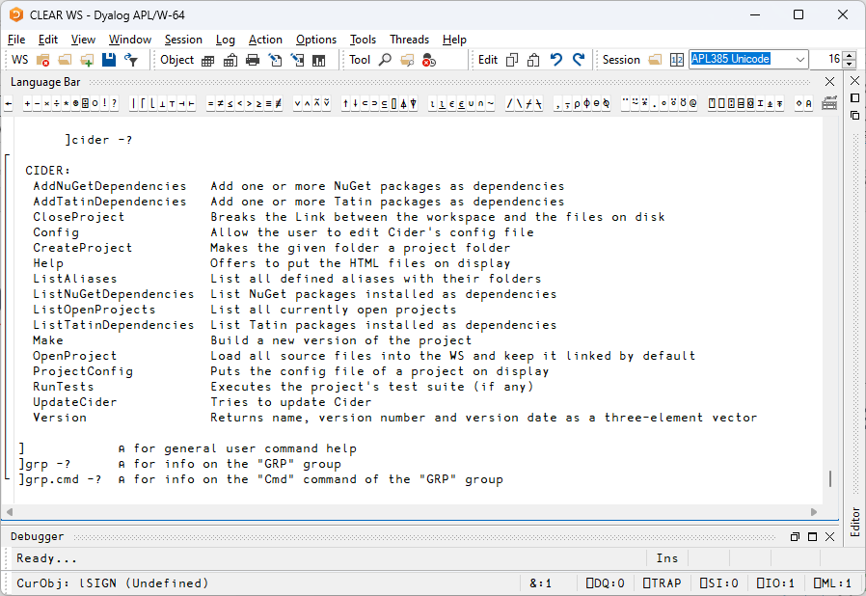

Slide 54
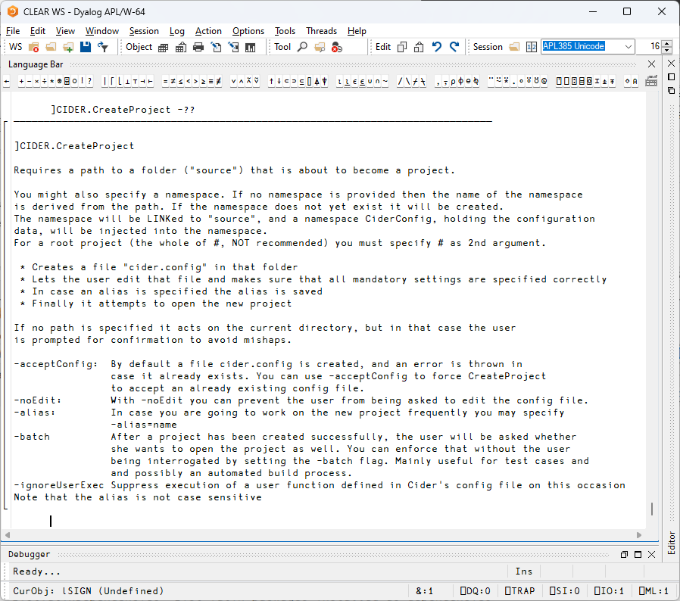

Slide 55
Exercise 1
If you get a FILE NAME ERROR, delete C:\Users\<⎕AN>\.cider\cider.config.template
Create a Project
Give it an Alias
Create a function to tell you how many functions you have in your project.
Configure the project to run that function on Open
Run ]Cider.Help and take a brief look at the documents

Slide 56
Opening a Project
]CIDER.OpenProject /folder/name
or ]CIDER.OpenProject [alias]
or ns←⎕SE.Cider.CreateOpenParms '' ns.folder←'/tmp/clockproj' ns.projectSpace←'cp'
⎕SE.Cider.OpenProject ns …blablabla… Project successfully loaded and established in "#.cp"

Slide 57
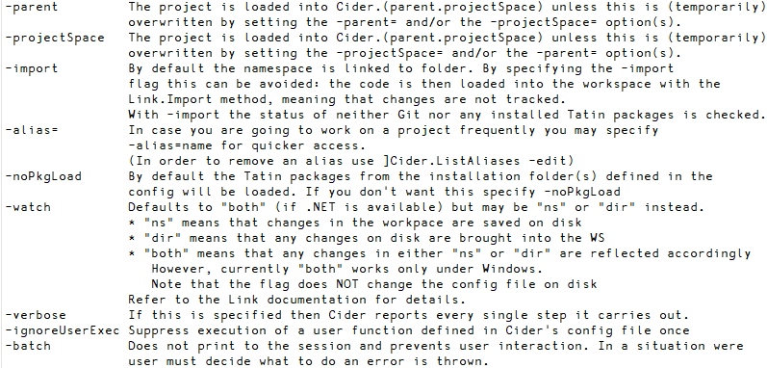
Switches (from ]OpenProject -??)

Slide 58
What Happens on Project Open?
Create a namespace according to projectSpace within the specified parent space
Set ⎕IO and ⎕ML according to ciderconfig SYSVARS section
Use Link to load all the source code from the folder named by source
Load Tatin and/or NuGet packages (more about this soon)
Inject CiderConfig namespace containing the config file settings
CiderConfig.HOME is set to the path the project was loaded from
Execute CiderConfig.init if it is non-empty
Execute ExecuteAfterprojectOpen (from GlobalConfig) if non-empty and ignoreUserExec is not 1
Display the contents of ToDo variable, if it exists
*If* the project folder is managed by Git, display the result of "git status"

Slide 59
Exercise 2
)CLEAR and open your project
Using the User Command
Using ns←⎕SE.Cider.CreateOpenParms '' ns.folder←'blah' ns.someprop←'somevalue' ⎕SE.Cider.OpenProject ns
Create a ToDo variable which reminds you to add HttpCommand as a dependency
Use ]Link.Add to save yourproj.ToDo to file
NB: Unlike functions and operators, Link does NOT save new variables by default
Close and reopen your project

Slide 60
Session 2: Dependencies / Packages
10:45-11:45
What is a Package?
Tatin: APL Packages
Finding Documentation
Finding and Installing Packages
"Where do they go?"
Dependencies of Dependencies
NuGet: .NET Packages
Finding and Installing
"Where do they go?"
Exercise 3: Add a Tatin Dependency (or two)!
Exercise 4: Add a NuGet Dependency

Slide 61
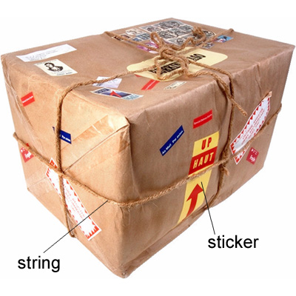
So… What is a Package?
(From Longman Dictionary of Contemporary English)

Slide 62
A Project is…
Source Code +
Dependencies (packages) loaded from a package manager
Environment configuration
Development tools and processes
Can be opened and "set up" by a Project Manager (Cider)
A Package is…
A "build" of a project...
In a standard format
Can be found, downloaded and installed by a "Package Manager"
Cider supports the development of Tatin Packages
Cider can load Tatin + NuGet Packages

Slide 63
Tatin
Package manager for Dyalog APL
A tasty way to package APLs
48 Packages
NuGet
Package manager for .NET
Related to "Chocolatey"
371,905 374,154 Packages
]z←tatin.listPackages
{⍺,≢⍵}⌸{(¯1+⍵⍳'-')↑⍵}¨3↓z[;1]
aplteam 42
davin 4
dyalog 2
¯2↑z
dyalog-HttpCommand 1
dyalog-Jarvis 1

Slide 64
Introducing Tatin
Original design by Kai Jaeger and Gilgamesh Athoraya
Developed by Kai (first lines of code written in 2020)
Funded by Dyalog
Input from various people at Dyalog
Logo by Adam Brudzewsky
Many thanks to Davin Church, the first real user of the system other than Kai himself
Paul Mansour is not to blame for the current design of Tatin, but has been an important inspiration

Slide 65
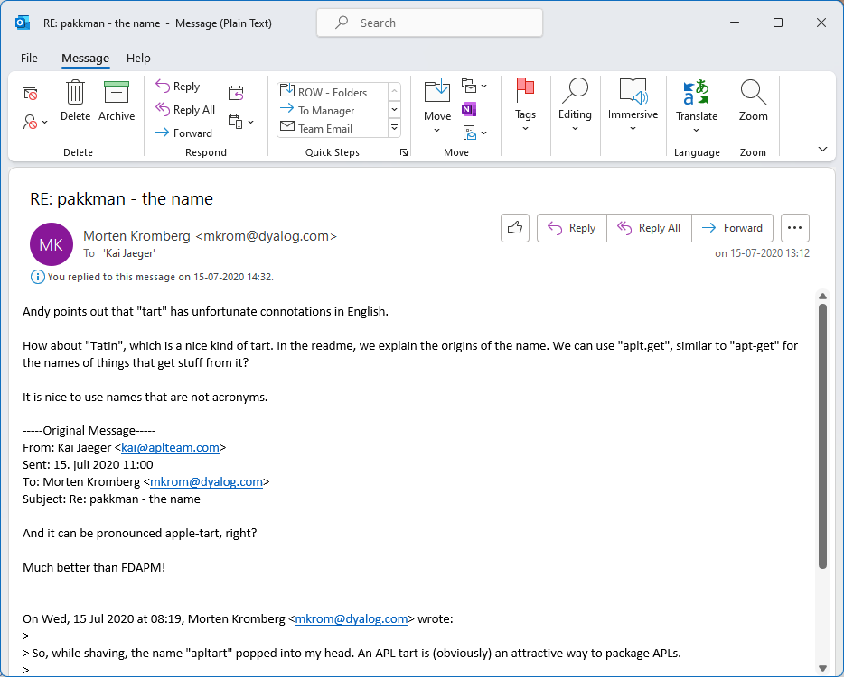
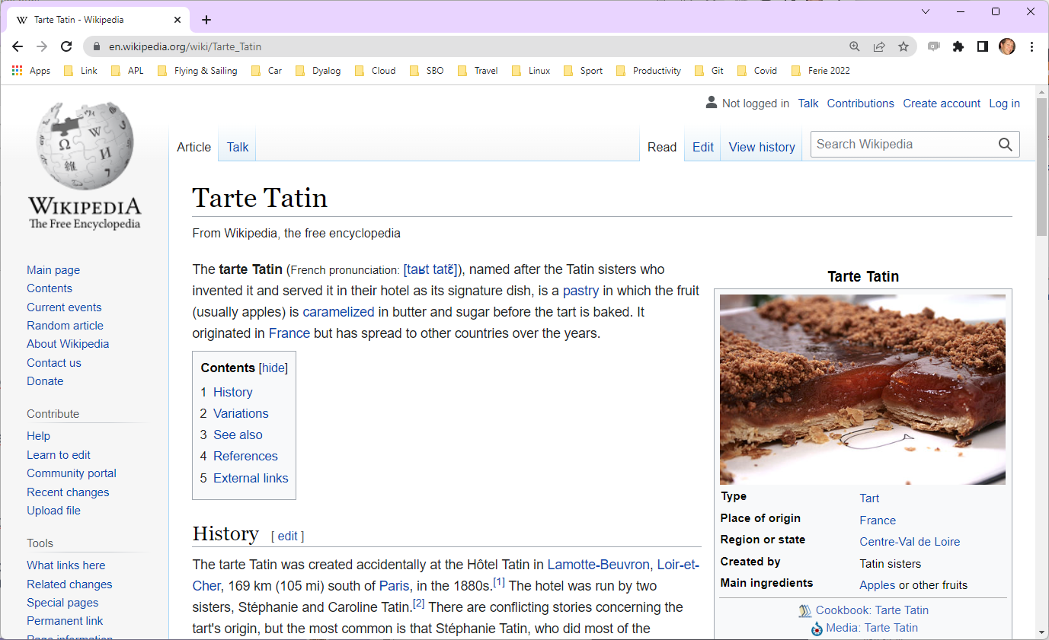

Slide 66
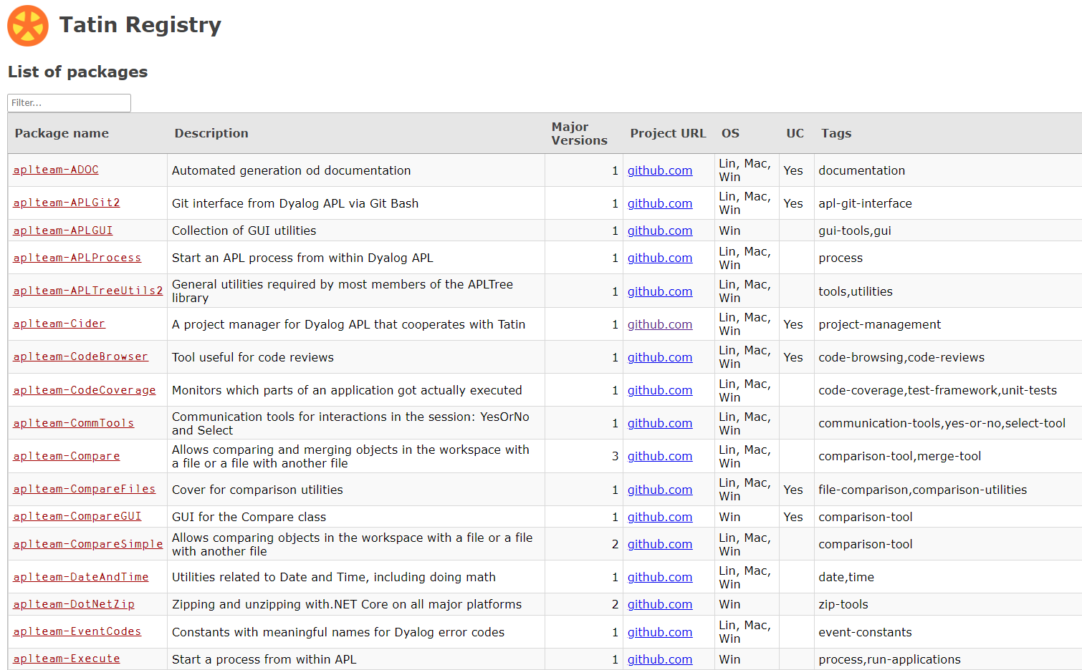
Finding Packages – www.tatin.dev

Slide 67
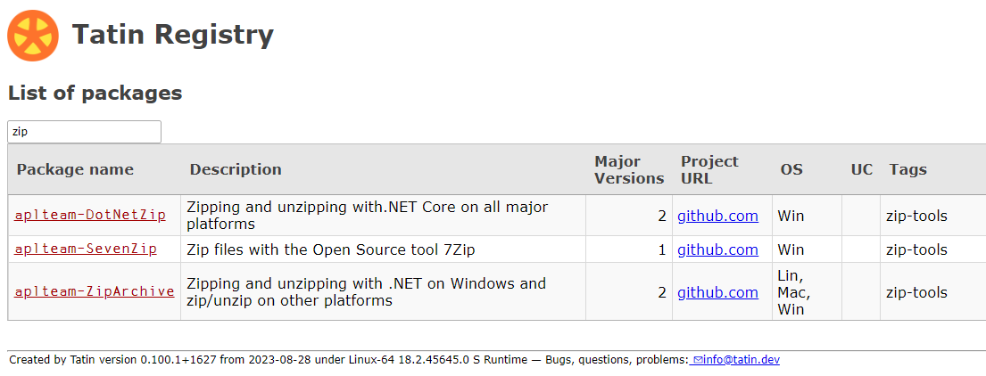
Finding Packages

Slide 68
Finding Packages
We already have enough packages to (sometimes) make it difficult to decide which one to use (and dyalog-APLProcess yet to come ☺)

Slide 69
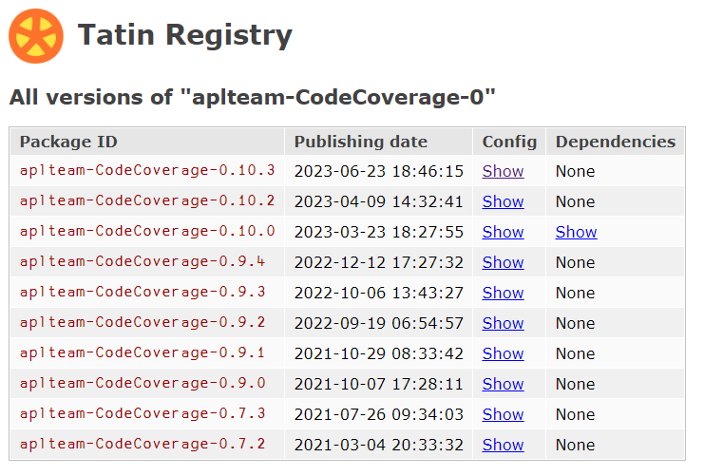
Package Details

Slide 70
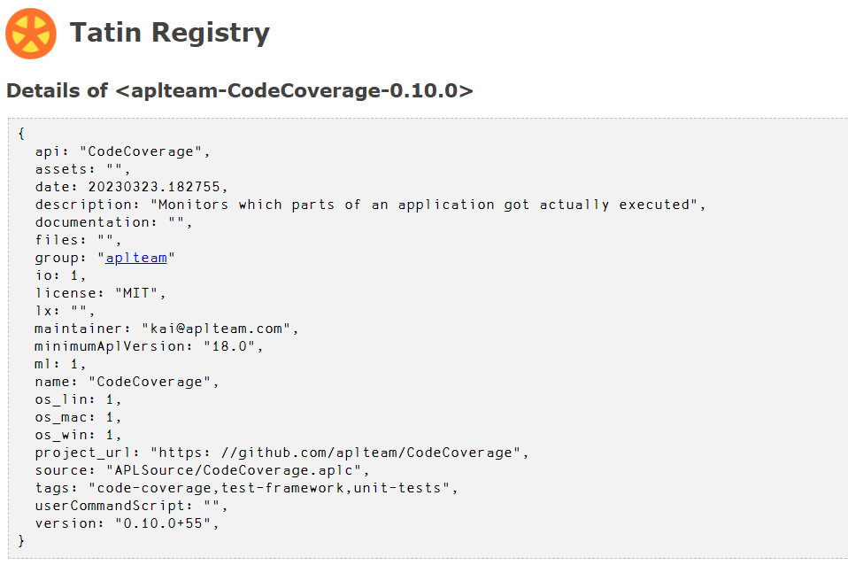
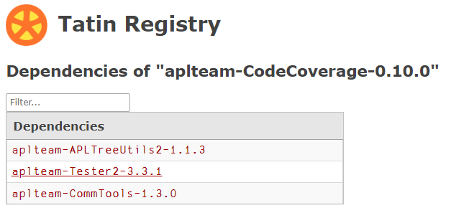

Slide 71
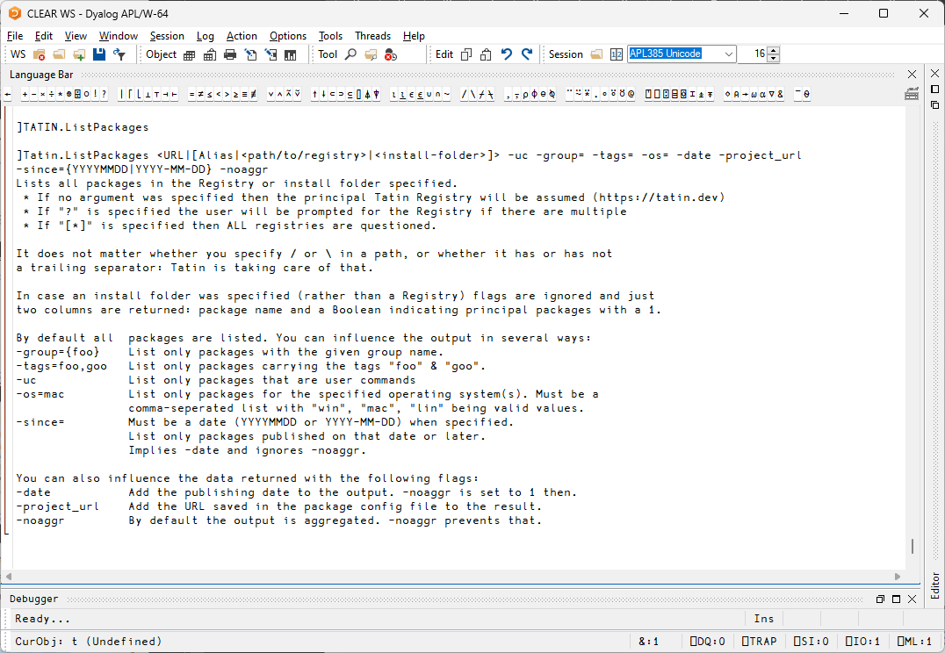

Slide 72
]Tatin.ListPackages
]tatin.listtags
tags from https://tatin.dev
--------------------------
apl-git-interface
build
calculations
chm
code-browsing
code-coverage
code-reviews
command-generation
communication-tools
comparison-tool
comparison-utilities
components
config-files
converter
copy
cryptography
date
dates … … utilities
validation
webservice
windows-event-log
windows-registry
winscp-interface
write
yes-or-no
zip-tools
]Tatin.ListPackages -group=dyalog
Registry: https://tatin.dev
Group & Name # major versions
------------ ----------------
dyalog-HttpCommand 1
dyalog-Jarvis 1
]Tatin.ListPackages -tag=crypto
Registry: https://tatin.dev
Group & Name # major versions
------------ ----------------
aplteam-HashPasswords 1

Slide 73
Adding a Tatin Package
Example: I use HttpCommand in just about every new project
To add it to our Cider project: ]Cider.AddTatinDependencies HttpCommand 1 Tatin dependency added: dyalog-HttpCommand-5.2.0
Since we did not specify a version, we get the latest.
Cider & Tatin create a reference to the loaded package within our project space: D08.HttpCommand.Get 'www.dyalog.com' [rc: 0 | msg: | HTTP Status: 200 "OK" | ≢Data: 22580]

Slide 74
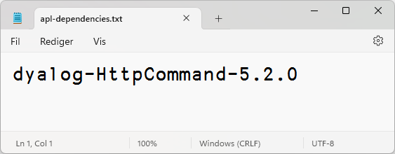
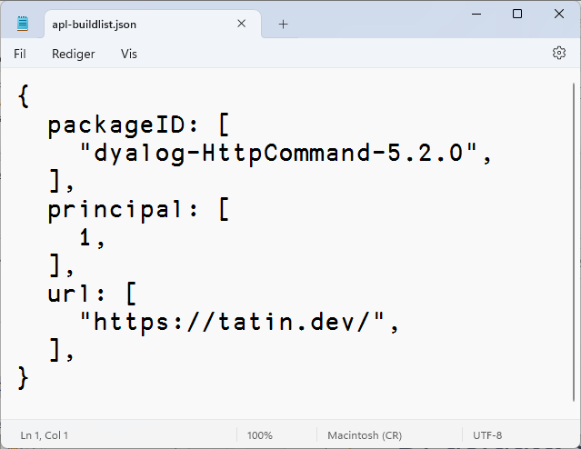
Installing Using Tatin
Tatin.InstallPackages "installs" the package into a folder
(Cider.AddTatinDependencies calls it for you)
Installed packages are registered in apl-dependencies.txt and apl-buildlist.json
Version numbers are major.minor.patch
If you do not specify a complete version number, Tatin fills in the blanks:
No version gives you the latest version
Latest patch if you specify major.minor
Latest minor version if you specify major

Slide 75
Cider with Tatin
By default, Cider directs Tatin to put dependencies in "tatin-packages"
The packages themselves are in sub-folders

Slide 76
Cider - Tatin Collaboration
After:
]cider.openproject c:\tmp\clockproj
Project successfully loaded and established in "#.clockproj"
The following are all equivalent:
]Cider.AddTatinDependencies HttpCommand
]Tatin.InstallPackages dyalog-HttpCommand-5.2.0 ]Tatin.InstallPackages dyalog-HttpCommand c:\tmp\clockproj\tatin-packages
Cider knows how to call Tatin to add packages
Tatin knows where to find the installation folder of an open Cider project
(but you can explicitly specify the target folder if you want)
Tatin will install the latest version of a uniquely identified package

Slide 77
Why are Cider & Tatin Separate?
Cider and Tatin are aware of each other:
]tatin.installpackages will install to the currently open Cider project by default
]tatin.buildpackage/publishpackage will use Cider's distributionPackage setting as a default
Cider can have Tatin packages as dependencies
Cider requires Tatin to load and run (it is a Tatin package)
Cider can ALSO manage NuGet dependencies
Possibly other dependency types to come
Tatin requires Cider during development of Tatin itself
However: At runtime, Cider and Tatin do not require each other

Slide 78
LoadPackages or LoadDependencies?
Tatin.LoadDependencies loads the set of installed "dependencies" into a namespace
… according to apl-dependencies.txt and buildlist.json
When you open a project, Cider calls LoadDependencies for you
It will resolve any sub-dependencies, only loading each package once (more about this later)
You can use LoadPackages to interactively load a package into a running APL session
This is only intended for interactive experimentation

Slide 79
What Happens on Project Open?
Create a namespace according to projectSpace within the specified parent space
Set ⎕IO and ⎕ML according to ciderconfig SYSVARS section
Use Link to load all the source code from the folder named by source
Load Tatin and/or NuGet packages (more about this soon)
Inject CiderConfig namespace containing the config file settings
CiderConfig.HOME is set to the path the project was loaded from
Execute CiderConfig.init if it is non-empty
Execute ExecuteAfterprojectOpen (from GlobalConfig) if non-empty and ignoreUserExec is not set
Display the contents of ToDo variable, if it exists
*If* the project folder is managed by Git, display the result of "git status"

Slide 80
Loading Dependencies
We previously installed a dependency: dyalog-HttpCommand-5.2.0:
]Cider.OpenProject /tmp/anotherproject Project successfully loaded and established in "#.clockproj"
LoadDependencies has created a reference to the HttpCommand class inside our projectSpace, so we can easily reference it:
#.anotherproject.HttpCommand.Get 'https://www.dyalog.com' [rc: 0 | msg: | HTTP Status: 200 "OK" | ≢Data: 22580]
But this is an illusion: in fact, #.anotherproject.HttpCommand is a reference to a space Tatin uses to store *ALL* loaded packages:
#.anotherproject.HttpCommand #._tatin.dyalog_HttpCommand_5_2_0.HttpCommand

Slide 81
Loading Dependencies, Continued
The "host" namespace of a loaded package contains a namespace TatinVars, which contains information about the package (mostly for use by the package code). Despite the name, it contains functions:
#.anotherproject.HttpCommand.##.TatinVars.⎕NL ¯3
ASSETS CONFIG DEPENDENCIES GetFullPath2AssetsFolder HOME ID URI #.anotherproject.HttpCommand.##.TatinVars.(ID URI)
dyalog-HttpCommand-5.2.0+1 https://tatin.dev/
When Cider opens a project which it can see *is* a Tatin package, it injects a TatinVars space so that you can refer to this information both during development and when the package is loaded as a dependency.

Slide 82
Dependencies of Dependencies
Great fleas have little fleas upon their backs to bite 'em, And little fleas have lesser fleas, and so ad infinitum.
Augustus de Morgan
Both Tatin and NuGet will automatically load such
dependencies

Slide 83
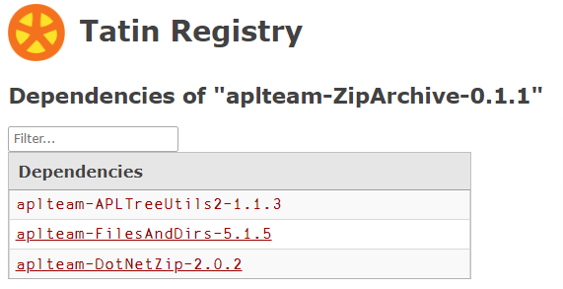
Dependencies of Dependencies
A package that you install can have dependencies of its own
Tatin will automatically install them for you, and load them into the workspace
Only the "Primary" dependency will be made available as a reference in YOUR namespace
The dependency namespace will have references to sub-dependencies, of course

Slide 84
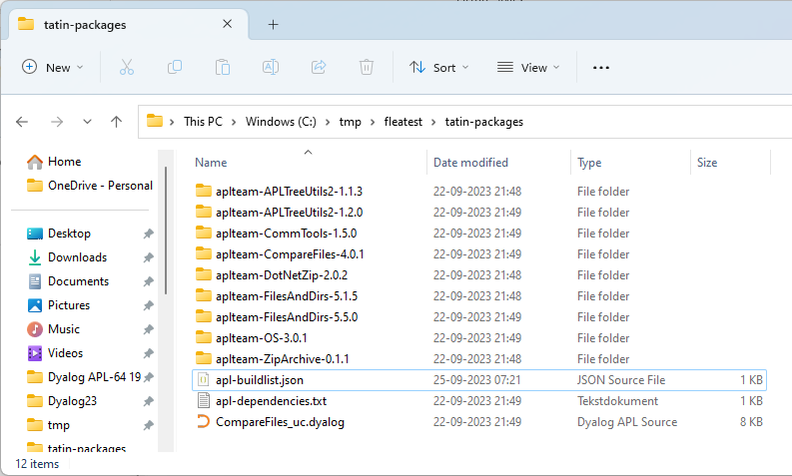
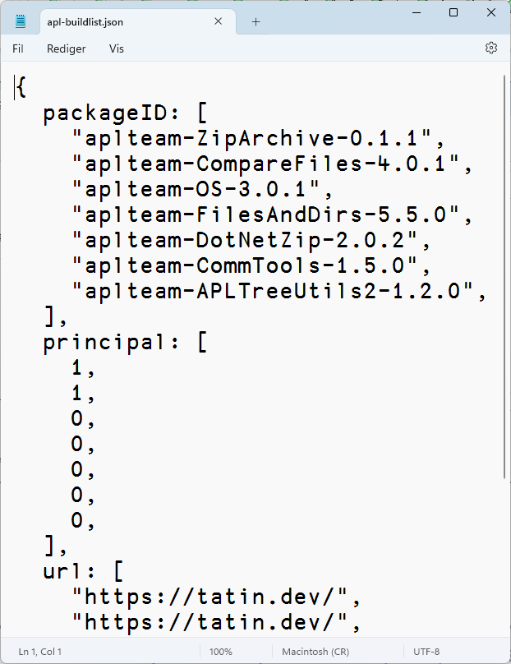
Notice FilesAndDirs-5.1.5 is not deleted
Also notice CompareFiles_uc.dyalog

Slide 85
Where Do Dependencies Go?
]Cider.OpenProject C:\tmp\fleatest
Project successfully loaded and established in "#.fleatest"
)cs fleatest
#.fleatest
⎕NL -9
CiderConfig CompareFiles ZipArchive
CompareFiles
#._tatin.aplteam_CompareFiles_4_0_1.API
⍪#._tatin.⎕nl -9
aplteam_APLTreeUtils2_1_2_0
aplteam_CommTools_1_5_0
aplteam_CompareFiles_4_0_1
aplteam_DotNetZip_2_0_2
aplteam_FilesAndDirs_5_5_0
aplteam_OS_3_0_1
aplteam_ZipArchive_0_1_1
#._tatin.aplteam_CompareFiles_4_0_1.⎕NL -9
API APLTreeUtils2 Admin CommTools ComparisonTools FilesAndDirs TatinVars
Our dependencies

Slide 86
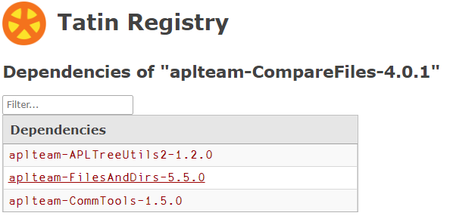
"Minimal Version Selection" (MVS)
A project can have two or more dependencies that in turn depend on the same package
Tatin will use MVS to select a single version which is loaded
In this case, version 5.5.0 of FilesAndDirs is the minimal version that satisfies all "consumers"
Each consumer has declared the minimum version that it can accept:
ZipArchive wants at least 5.1.5
Comparefiles wants at least 5.5.0

Slide 87
]Cider.CreateProject /tmp/fleatest
]Cider.AddTatinDependencies aplteam-ZipArchive-0.1.1
aplteam-ZipArchive-0.1.1
)clear ]Cider.OpenProject /tmp/fleatest
fleatest.ZipArchive.##.FilesAndDirs
#._tatin.aplteam_FilesAndDirs_5_1_5.FilesAndDirs

Slide 88
]Cider.CreateProject /tmp/fleatest
]Cider.AddTatinDependencies aplteam-ZipArchive-0.1.1
aplteam-ZipArchive-0.1.1
)clear ]Cider.OpenProject /tmp/fleatest
fleatest.ZipArchive.##.FilesAndDirs
#._tatin.aplteam_FilesAndDirs_5_1_5.FilesAndDirs
]Cider.AddTatinDependencies aplteam-CompareFiles-4.0.1
aplteam-CompareFiles-4.0.1
)clear
]Cider.OpenProject /tmp/fleatest
fleatest.ZipArchive.##.FilesAndDirs
#._tatin.aplteam_FilesAndDirs_5_5_0.API

Slide 89
"Minimal Version Selection" (MVS)
Pro:
MVS gives reproducible builds:
New versions of FilesAndDirs have no effect
ZipArchive can upgrade to 5.5.0 w/no change to FilesAndDirs
Con:
People struggle to understand MVS
Adding a new dependency can change the version of a sub-dependency that gets loaded
Q:
Do APL applications need MVS? Discuss…

Slide 90
Exercise 3
Open your project and re-read the ToDo
Add HttpCommand as a dependency
Write an application function which does something with HttpCommand
If you have time, write a simple test for your application. If not, write a function which outputs "All tests were successful".
Update the "tests" config parameter, and verify the result of ]Cider.RunTests

Slide 91
NuGet Packages
NuGet is the .NET package manager

Slide 92
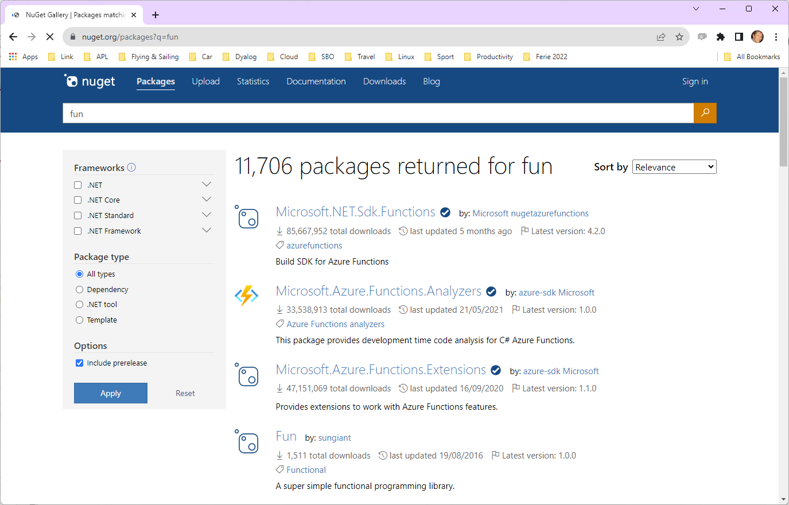
Finding NuGet Packages (HARD!!!)

Slide 93
NuGet Support in Dyalog APL
In v19.0, the namespace ⎕SE.Dyalog.NuGet contains tools for installing and using NuGet packages
For examples of how to use NuGet outside Cider, see the Tests folder at https://github.com/Dyalog/nuget/tree/main/Tests
Cider uses this namespace to add support for NuGet packages, similar to that for Tatin packages
NuGet support currently requires .NET 6.0, 7.0 or 8.0 Support for "Framework" packages MAY follow

Slide 94
Adding a NuGet Package
NuGet support currently requires .NET 6.0, 7.0 or 8.0 Support for "Framework" packages MAY follow
Example: NuGet contains a very simple package called "Clock".
We can add it to our Cider project (by default, we get the latest version): ]Cider.AddNuGetDependencies Clock Clock 1.0.3
A reference to a namespace hosting the .NET package is created: #.clockproj.Clock.UtcNow.(Hour Minute) 14 43
In fact, the namespace is empty except for ⎕USING: ⍪clockproj.Clock.⎕USING ,c:/tmp/clockproj/nuget-packages/published/Clock.dll ,c:/tmp/clockproj/nuget-packages/published/nuget-packages.dll

Slide 95
dotnet command-line tool
Under Windows, Linux and macOS, .NET provides a "dotnet" command which:
Creates .NET projects that we use to define and manage dependencies (complete with a C# class that we never use)
Adds Dependencies
"Publishes" collections of DLLs that implement packages
Dyalog's NuGet support depends heavily on this
We just set ⎕USING to point to the published DLLs
The alternative is to try to replicate poorly documented .NET behaviours

Slide 96
NuGet Packages – Under the Covers
By default, NuGet dependencies go in the nuget-packages folder:
C# Stub created by dotnet tool

Slide 97
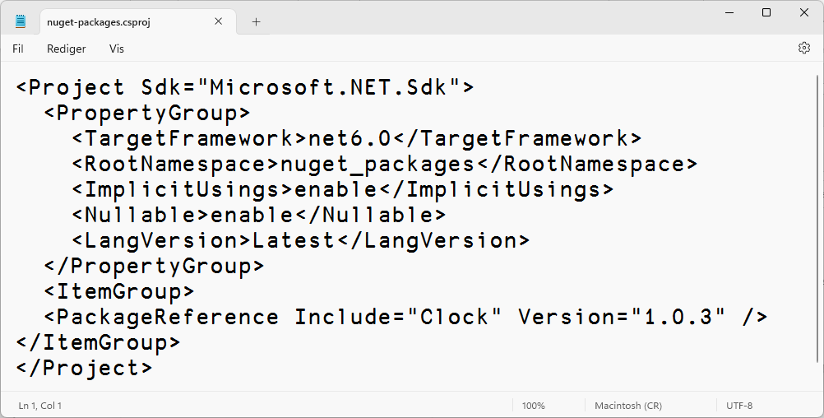
Same Same – But Different
Tatin
NuGet
#.projectSpace.HttpCommand
#.projectSpace.Clock

Slide 98
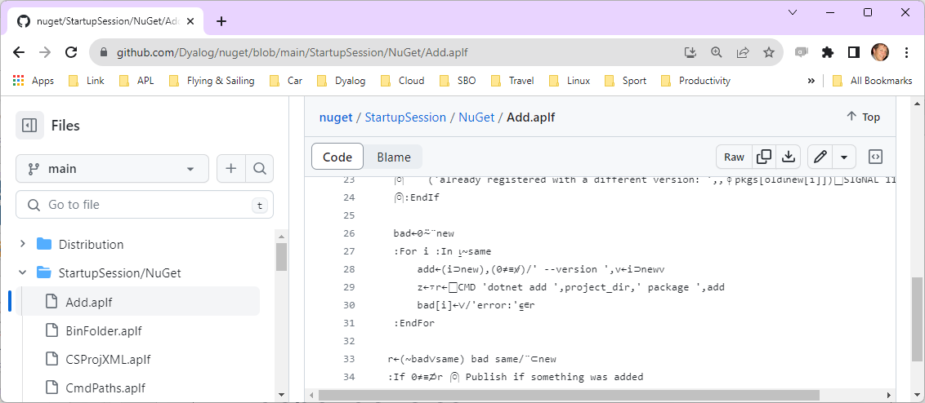
Example of calling dotnet tool
.NET provides a "dotnet" command which
creates .NET projects
add dependencies
"publishes" collections of DLLs
NuGet support depends heavily on this:

Slide 99
C# Stub compiled to a dll
⍪#.clockproj.Clock.⎕USING
,/tmp/clockproj/nuget-packages/published/Clock.dll
,/tmp/clockproj/nuget-packages/published/nuget-packages.dll
#.clockproj.Clock.UtcNow
26-09-2023 15:24:34 +00:00

Slide 100
Dependencies - Reporting
]Cider.OpenProject /tmp/clockproj … established in #.clockproj ]Cider.ListTatinDependencies Source Package-ID Principal URL --------------- ------------------------- --------- ------------------ tatin-packages/ dyalog-HttpCommand-5.2.0 1 https://tatin.dev/ ]Cider.ListNugetDependencies Clock 1.0.3 clockproj.HttpCommand.Get 'www.dyalog.com' [rc: 0 | msg: | HTTP Status: 200 "OK" | ≢Data: 22580]
clockproj.Clock.UtcNow 26-09-2023 15:26:37 +00:00

Slide 101
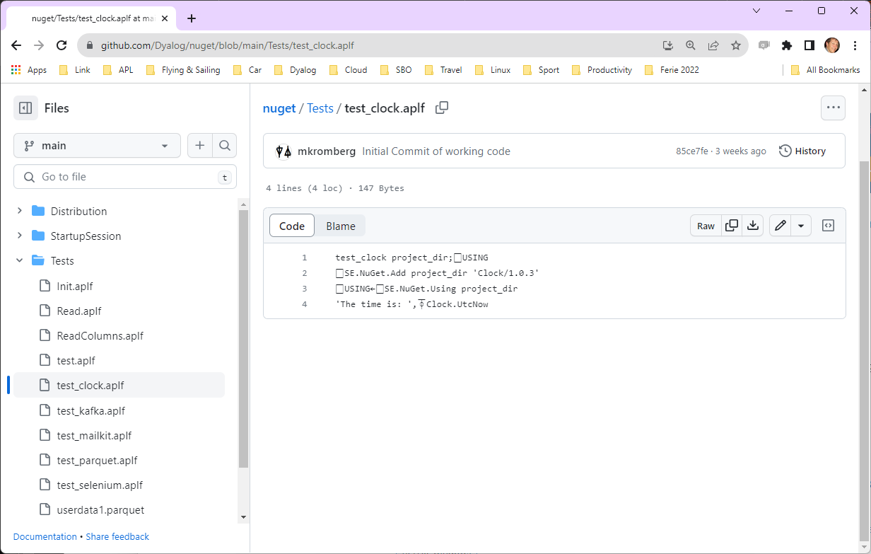
Example of a NuGet Test Case

Slide 102
Exercise 4
Add a NuGet dependency
Morten suggests Parquet files – see the NuGet Tests https://github.com/Dyalog/nuget/tree/main/Tests
Or just go for Clock ☺
Create a project which uses both HttpCommand and your NuGet dependency

Slide 103
Session 3: BYO App + Wrap Up
12:00-13:00 (ish?)
Development Dependencies
Build Your Own App
Recap and Conclusions
Link, Cider and Tatin ToDo Lists
SP1 This Afternoon: Creating your own Packages
Exercise 5: Build Your Own Application

Slide 104
Development Dependencies
Packages that you need during development, but not runtime
At the moment (October 2023), only Tatin dependencies are supported
To add development dependencies, you must edit dependencies_dev in cider.config
You must also name the folder explicitly when adding dependencies. For example, if you set dependencies_dev to 'tatin-dev-packages':
]Cider.AddTatinDependencies Tester2 /tmp/fleatest/tatin-dev-packages

Slide 105
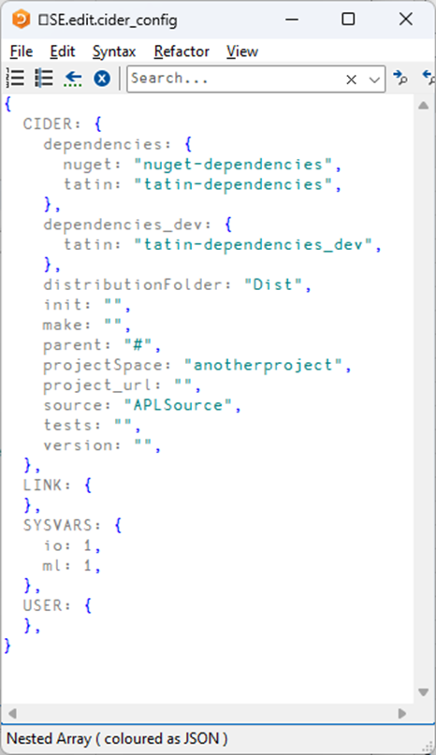
Development Dependencies
OpenProject loads both sets of dependencies
Your runtime application should only load the "normal" dependencies
The separation means that development dependencies will not influence MVS for your runtime dependencies

Slide 106
Cider and Tatin "To Do" lists
Review of Names & Messages
Dyalog to help with Documentation
Shell-callable API for installation
Ability to manage Local / Intermediate package stores within an organisation
Is MVS the right choice?
Do we need "recommended" packages.
Recommended by whom?
Ability to import part of a package (e.g. dfns cmpx)?
Actually running tests and builds for you

Slide 107
Link Road Map
Link v4.0 Highlights
Configuration Files (incl "Global" config)
Link single Class or Namespace file
Create/Export/Import default to current namespace if none supplied
Support for character vectors, matrices and vec-of-vecs in simple text files
Link now being used by APL interpreter to load user code at startup
Link 5 & 6
Crawler which will periodically compare workspace to source folders
Postponed from 3.0 to 4.0
Postponed from 4.0 to 5.0
Create a proper API
(likely to get bumped to v6)

Slide 108
Exercise 5
Build Your Own Application
As a Cider project
Must use at least one dependency

