Slide 1
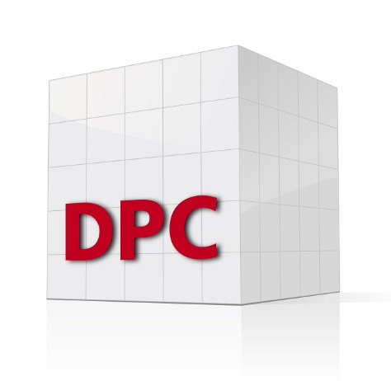
Converting a COM Server to a Jarvis-based Web Service Finn Flug - DPC

Slide 2
Agenda
Overview of the system
Migrating from APL+WIN to Dyalog-APL
Converting to a Jarvis-based web service
Deploying the web service as a Docker container

Slide 3
System Overview – Current State
Application written in Visual Basic 6
Windows Forms GUI
Calculating engine written in APL+WIN
Calculating engine is provided as a COM Server
The Visual Basic app calls the APL as follows (translated to Dyalog): WSengine←⎕NEW'OLEClient'(⊂'ClassName' 'APLW.WSEngine') WSengine.SysCommand⊂'Load /path/to/workspace' WSengine.Call1 'foo’ arg

Slide 4
System Overview – Current State
Database
Windows Forms GUI
VB App
APL+WIN

Slide 5
System Overview – Current State
Database
All of this runs on the user's local machine
Windows Forms GUI
VB App
APL+WIN

Slide 6
System Overview – Current State
Why even change the current system?
Support for Visual Basic 6 is running out
Current architecture of the system does not fit into the infrastructure of the customer
The goal is:
Move to a browser-based solution
Replace the outdated components

Slide 7
System Overview – Goal State
Web Browser
Web App Frontend
Web App Backend
Database
APL Web Service

Slide 8
System Overview – Goal State
Container Platform
Web Browser
Web App Frontend
Web App Backend
Network based
Database
APL Web Service

Slide 9
Roadmap
Migrate from APL+WIN to Dyalog
Convert the calculating engine to a Jarvis-based web service
Run it inside a Docker container

Slide 10
Migrating from APL+WIN to Dyalog
Consider things like Replicate Each:
1 0/¨(1 2)(3 4) ⍝ Dyalog
1 2
1 0/¨(1 2)(3 4) ⍝ APL+WIN
1 3
Replace system functions and system variables
In APL+WIN, all left arguments are optional
…

Slide 11
Converting to a Jarvis-based Web Service
Deciding on a paradigm:
Jarvis supports two paradigms, JSON and REST
We chose the JSON-paradigm because:
It is suitable for functional endpoints
It is easier to implement
Important question: Is the application stateless?
Luckily, the application at hand is!

Slide 12
Converting to a Jarvis-based Web Service
Modifying the existing APL-code:
Endpoints are result-returning, monadic or dyadic APL-functions
Right argument is the request payload
(Optional) left argument is the request object itself
Jarvis handles the conversion between JSON and APL data structures (using ⎕JSON)
One might have to change the structure of the arguments
The APL+WIN application takes strings with parameters separated by semicolons as argument (e.g., 'Finn;1234;5.678')
No changes were required (although this is probably a suboptimal solution)

Slide 13
Converting to a Jarvis-based Web Service
Error handling
Jarvis (with configuration Jarvis.Debug←0) traps all errors and reports them with HTTP response status 500 (internal server error)
Use ⎕DMX since it has thread-scope
We had to expand around the existing error handling
⎕TRAP←(500 'C' '→OldErrorhandler') ⍝ old error handling ⎕TRAP,←⊂(0 'E' '#.Errorhandling.WriteInfoAndResignal') ⍝ new error handling

Slide 14
Converting to a Jarvis-based Web Service
Logging
We log to stdout.
Since we want to run the app inside a container, this allows reporting tools to access the logs

Slide 15
Converting to a Jarvis-based Web Service
Configuration
Configuration parameters can be specified in a JSON-file
We use a configuration similar to the following:
{ AppCloseFn: "myAppCloseFn", // called when Jarvis starts AppInitFn: "myAppInitFn", // called when Jarvis stops CodeLocation: "./APLSource", // by default, all functions in CodeLocation and below are exposed as endpoints ExcludeFns: “Errorhandling.*", // not exposing these functions as endpoints Port: 8000, // port Jarvis is to list on }

Slide 16
Converting to a Jarvis-based Web Service
At this point, we can run our application as a Jarvis-based web service
…at least on localhost
Jarvis.Run '/path/to/config.json'

Slide 17
Creating a Custom Docker Image
Dyalog provides public Docker images for experimentation only.
These are not meant to be used in production.
We used the Dockerfile for the dyalog/jarvis public image as a starting point for our custom image
Key differences are:
the base image
loading of dependencies
some added configuration
Components of the custom image:
Base image
Interpreter
Jarvis
Source code (stored as text files)

Slide 18
Creating a Custom Docker Image
Simplified version of our custom Dockerfile
FROM redhat/ubi8-minimal:8.8
ADD APLSource /app ADD linux_64_18.2.45405_unicode.x86_64.rpm /dyalog.rpm RUN git clone https://github.com/dyalog/Jarvis /Jarvis
ENV JarvisConfig="/app/Config.json“ ENV LOAD="/Jarvis/Source“
ENTRYPOINT dyalog

Slide 19
Creating a Custom Docker Image
Simplified version of our custom Dockerfile
Base Image
FROM redhat/ubi8-minimal:8.8
ADD APLSource /app ADD linux_64_18.2.45405_unicode.x86_64.rpm /dyalog.rpm RUN git clone https://github.com/dyalog/Jarvis /Jarvis
ENV JarvisConfig="/app/Config.json“ ENV LOAD="/Jarvis/Source“
ENTRYPOINT dyalog
Add all components
(specify a version!)
Specify environment variables
Executable which runs at startup

Slide 20
Build & Deploy
Git Repository
Image Registry
Container Platform
Build Pipeline
Promote Pipeline
Jarvis source code
Source code Jarvis config
Dockerfile
+
Interpreter

Slide 21
What Else?
Security
Testing
Updating the components of the image
…
Notes:
21

Slide 22
Summary
Until now, everything runs without issues
App is yet to go into production, but test results are promising
Conversion process went smoothly

