Slide 1
An Implementation of APL Array Notation

Slide 2
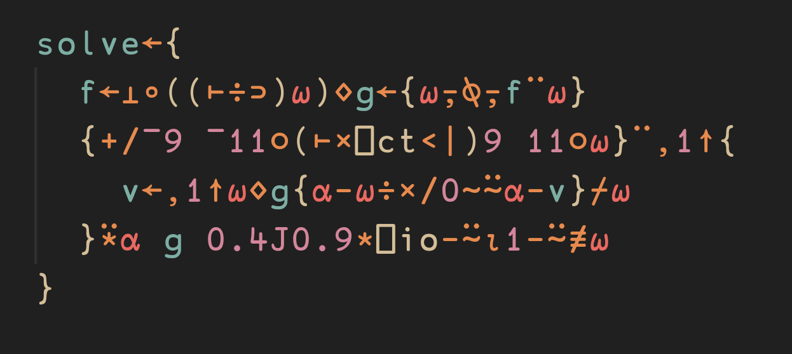
Who am I?
Student @ Saarland University
Intern @ Dyalog Ltd.
A C programmer enamored with APL's applications to mathematics
What if APL was made for solving abstract CS and mathematics problems?
Blog: https://palaiologos.rocks

Slide 3
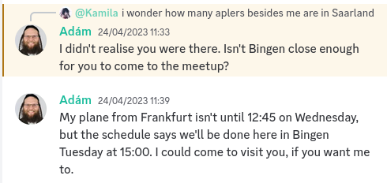
Who am I?
Learned about Array Programming in 2018 from IRC (#jsoftware).
Summer of 2020:
Spring of 2023:

Slide 4
My time at Dyalog
APL Array notation:
62582⌶: Deserialise Array Notation to an APL array/object
62583⌶: Prettify Array Notation
Found a problem with the formal specification
⎕DIFF: Automatic Differentiation.
⍛: Reverse Compose.
Speed up: ⍸⍣¯1, N∘⊥⍣¯1⊢M
Iverson's monadic dot product (e.g. -.× D computes the determinant)
Obverse (f⍫g where f has inverse of g)
Monadic ∨/∧ (demote / promote)
More...

Slide 5
Array Notation?
Implemented by BQN.
Parentheses and brackets may contain many expressions
Parentheses may be empty!
Three basic constructs.
(1⋄2⋄'a'⋄⊢∘-\⍳5⋄'abc') ≡ 1 2 'a' (1 ¯2 3 ¯4 5) 'abc'
(each expression becomes an element in a new vector)
[[1 2 ⋄ 3 4] ⋄ [5 6 ⋄ 7 8]] ≡ 2 2 2⍴⍳8
(each expression becomes a major cell (of rank≥1) in a new array)
(name: 'Kamila' ⋄ birthday: '09-07-2004')
(namespace syntax)

Slide 6
Why Array Notation?
Dyalog has been slowly moving away from workspaces and towards text-based source management.
Easy to use SCM tools to manage your code.
Easy to modify and inspect the code.
…
It is now possible to serialise and deserialise complex structures (imagine ]Repr on steroids).
It is faster than just executing APL, allows for a reasonably formatted multiline array notation and ultimately makes teaching and using APL easier.

Slide 7
What makes the Array Notation fast?
First and foremost: It is statically parseable!
n gets: a, b and c stranded together?
n←a b c
n gets: a and c applied to b?
n gets: c applied to b, and then applied to a?
Meanwhile: we know what (a⋄b⋄c) is!
(Each expression becomes an element in a new vector. This is always a strand.)

Slide 8
What makes the Array Notation fast?
The "fast execute" mechanism: Because the array notation is a subset of APL, we can assume/scan for certain things to determine the value of the expression without executing it.
E.g.: Use 62582⌶ to evaluate constants:
x←⍕÷?⍨1000000⋄y←⍕{'''','''',⍨⎕a[(?10)↑?⍨10]}¨⍳2000⋄z←x,y,x,y,x,y
cmpx '62582⌶x' '⍎x'
62582⌶x → 2.5E¯3 | 0% ⎕⎕⎕⎕⎕⎕⎕⎕⎕⎕⎕⎕⎕⎕⎕
⍎x → 3.3E¯3 | +31% ⎕⎕⎕⎕⎕⎕⎕⎕⎕⎕⎕⎕⎕⎕⎕⎕⎕⎕⎕⎕
cmpx '62582⌶y' '⍎y'
62582⌶y → 1.9E¯4 | 0% ⎕
⍎y → 5.1E¯3 | +2650% ⎕⎕⎕⎕⎕⎕⎕⎕⎕⎕⎕⎕⎕⎕⎕⎕⎕⎕⎕⎕
cmpx '62582⌶z' '⍎z'
62582⌶z → 8.8E¯3 | 0% ⎕
⍎z → 2.0E¯1 | +2221% ⎕⎕⎕⎕⎕⎕⎕⎕⎕⎕⎕⎕⎕⎕⎕⎕⎕⎕⎕⎕

Slide 9
User Story
Scenario: Over 40MB of real-world text and numeric data in Dyalog component files stored as arrays, namespaces, etc...
Problem: One must be able to periodically find differences between old and new versions of the database and make it accessible to software that is not Dyalog APL.
Possible solution: export as JSON? Develop a custom format?
Caveat:
DOMAIN ERROR: the right argument cannot be converted
⎕JSON 2 2⍴4
∧

Slide 10
User Story
Actual solution: Just use the APL Array Notation!
Issue: Current implementation in ⎕SE is problematic:
Poor performance characteristics
Not always correct
Does not handle certain edge cases
…
Solution: A fast deserialiser and serialiser for the Array Notation written in C and integrated into the interpreter.

Slide 11
User Story
cmpx '⎕SE.Dyalog.Array.Deserialise data'
8.9E0 ⍝ 8s 900ms
cmpx '62582⌶data'
5.6E¯1 ⍝ 560ms
wsreq '⎕SE.Dyalog.Array.Deserialise data'
557119736 ⍝ 557MB!
wsreq '62582⌶data'
31706960 ⍝ 31MB
⎕size 'data'
23085216 ⍝ 23MB

Slide 12
User Story
Not so simple: One needs to serialise the Array Notation first.
> We have installed Dyalog on a powerful machine and set MAXWS to 100G. The input array was 5MB, and the output file 9MB. ⎕SE's Serialiser took 55 seconds to run. So, that needed about 16GB of workspace...
The ⎕SE Serialiser is far from perfect, but the task it's performing is remarkably complex:
When do we use APL strands - a b c - and when do we use the Array Notation syntax - (a⋄b⋄c)?
How do we format the resulting array notation?
How to represent tricky APL objects (tacit functions, dfns, scripted namespaces, tradfns, etc...)?
Due to data loss bugs in the past, the result is always cross-checked.

Slide 13
A dive into ⎕SE
Turning APL objects into expressions that result in them is difficult.
Surprisingly: All the complex logic that handles this is not the bottleneck!
> Use the right tool for the job
f←'+'∘- ⋄ g←+∘-
f
+∘-
g
+∘-
⍝ ¯\_(⍨)_/¯
To no surprise: APL is the right tool to write a serialiser. How certain data is represented internally by the C code is very different to how it appears to the APL programmer.
However: APL is not the right tool to write a formatter/prettifier!

Slide 14
A dive into ⎕SE
After replacing the formatter in the serialiser code with the 62583 I-beam, the memory usage went down by more than an order of magnitude. The speed was doubled.
C: Inherently scalar, rarely overcomputes. Formatting an Array Notation string does not call for array logic and is inherently a serial problem.
APL: Array-oriented, often overcomputes. Processing performed as many small steps spanning the whole string.

Slide 15
Briefly about ⎕DIFF
Based on Taylor series, samples a few points around x+∆h.
Implementation detail: more points are being considered increasing accuracy but worsening the behaviour around singularities.
More accurate than the central difference method (definition of derivative).

Slide 16
Briefly about ⎕DIFF
((1∘○)⎕diff - 2∘○) 0.3 ⍝ ⎕FR 645
1.950931461E¯8
((1∘○)⎕diff - 2∘○) 0.3 ⍝ ⎕FR 1287
7.33843311E¯26
Future ideas:
Dual numbers (hypercomplex number system, a + bε where ε^2 = 0 and ε ≠ 0).
Complex derivatives.
Numerical integration (Tanh-Sinh quadrature by default, Gauss-Legendre quadrature for smooth integrands)

Slide 17
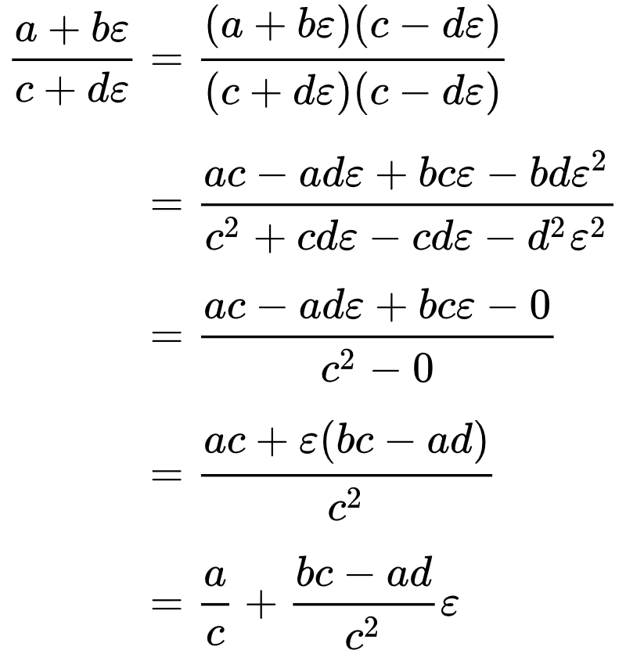
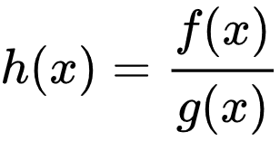
Briefly about ⎕DIFF: Dual numbers
Crucial: a = f(x), b = f'(x), c = g(x), d = g'(x)

Slide 18
Briefly about ⎕DIFF: Complex derivatives
Many ideas:
Frechet derivative.
Complex Finite difference stencils.
...
Simple proof of concept: Use Cauchy-Riemann equations!
(Complex Variables with Applications, Jeremy Orloff, MIT)

Slide 19
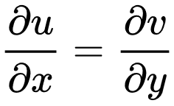
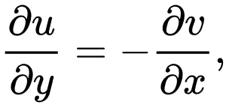
Briefly about ⎕DIFF: CR equations
First step: f(x + iy) = u(x, y) + iv(x, y)
Definition: f is complex differentiable at a complex point if and only if the partial derivatives of u and v satisfy the Cauchy-Riemann equations at that point.
cmpxdiff←{
f←⍺⍺ ⋄ re←9○⍵ ⋄ im←0J1×11○⍵
dudx←{9○f ⍵+im}⎕DIFF re
dvdx←{11○f ⍵+im}⎕DIFF re
dudx+0J1×dvdx
}

Slide 20
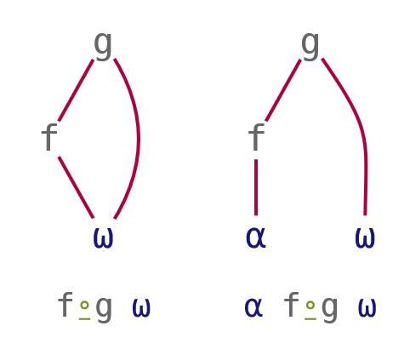
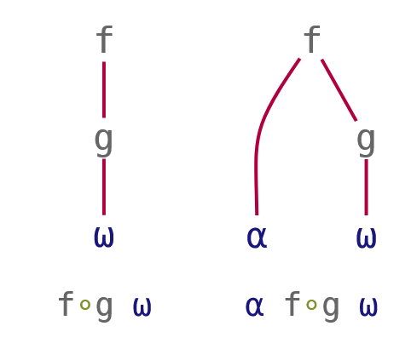
Briefly about ⍛
(f∘g) ⍵ ⇔ f (g ⍵)
⍺ (f∘g) ⍵ ⇔ ⍺ f (g ⍵)
(f⍛g) ⍵ ⇔ (f ⍵) g ⍵
⍺ (f⍛g) ⍵ ⇔ (f ⍺) g ⍵

Slide 21
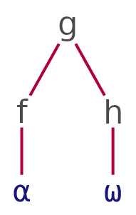
Briefly about ⍛
⍺ (f⍛g∘h) ⍵
Dyalog APL/S-64 Version 20.0.47746
Serial number: 201845
Wed Sep 27 20:13:12 2023
5 ⍳⍛×∘| 5 ¯8 ¯2 ¯5 3
5 16 6 20 15
⍝ I don't like these:
5 (⍳⍤⊣×|⍤⊢) 5 ¯8 ¯2 ¯5 3
5 16 6 20 15
5 ×⍨∘⍳⍨∘| 5 ¯8 ¯2 ¯5 3
5 16 6 20 15

Slide 22
Thoughts? Questions?
z←{(⍎'(',')⍣¯1',⍨((⊂'+⊢×')(1↓∘,,⍤0)⍕¨⌽1↓⍵),⍥∊'+' (⍕⊃⍵) '×⊢')0}
z 1 2 3 4 5 6 (6+⊢×5+⊢×4+⊢×3+⊢×2+1×⊢) ¯1.491797988
¯1.491797988 1.580688469E¯9

