Slide 1
EWC = Everywhere WC
Morten Kromberg

Slide 2
Why EWC?
1. Protect existing investments
Since 1990, ⎕WC has made it possible for domain experts to be ”full stack” developers
⎕WC is perhaps the most important reason why Dyalog has been successful
⎕WC is is restricted to the Microsoft Windows desktop, which is fading

Slide 3
Why EWC?
2. Build New Applications
EWC can easily be extended with JavaScript libraries
Potential migration path for existing code to ”responsive” layout
Replace Posn/Size with Flex CSS
EWC is a uniquely interactive web development environment

Slide 4
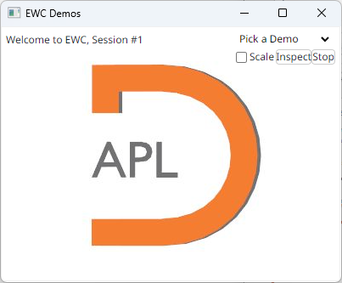
demo.Run 'Desktop'

Slide 5
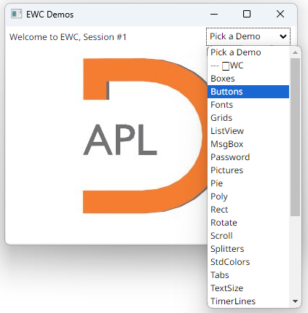
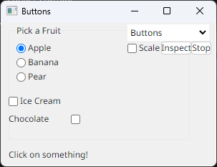

Slide 6
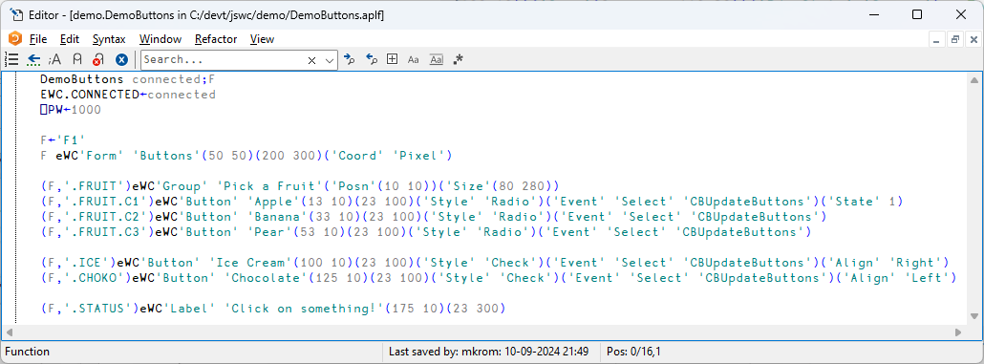

Slide 7
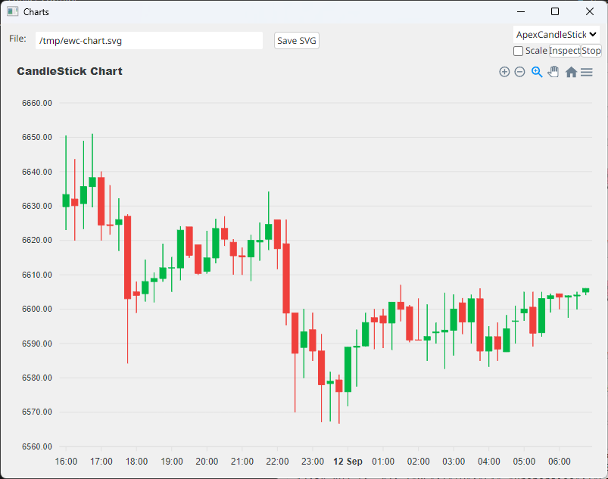
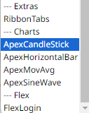
The Demo Application
Demos of Extensions

Slide 8
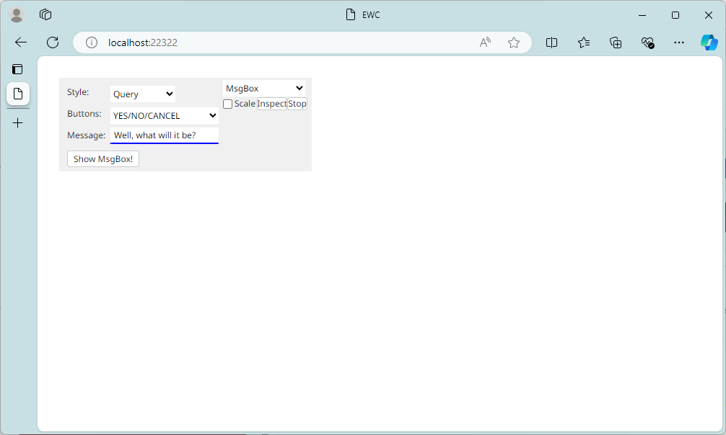
demo.Run 'Browser'

Slide 9
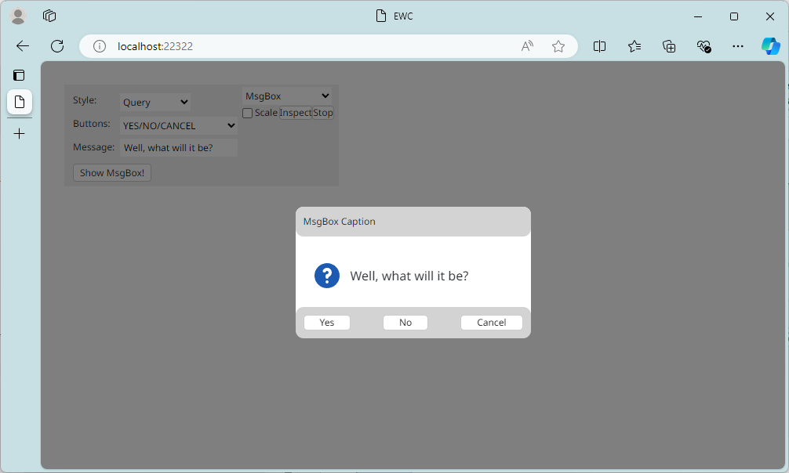

Slide 10
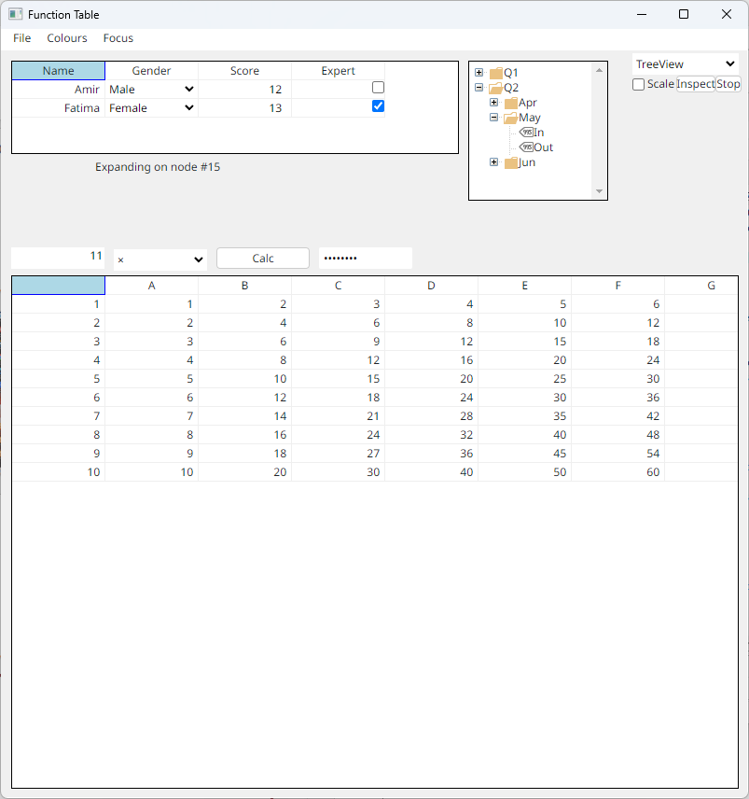
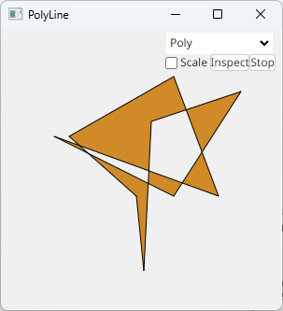
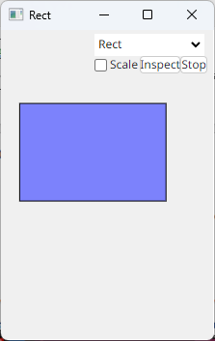

Slide 11
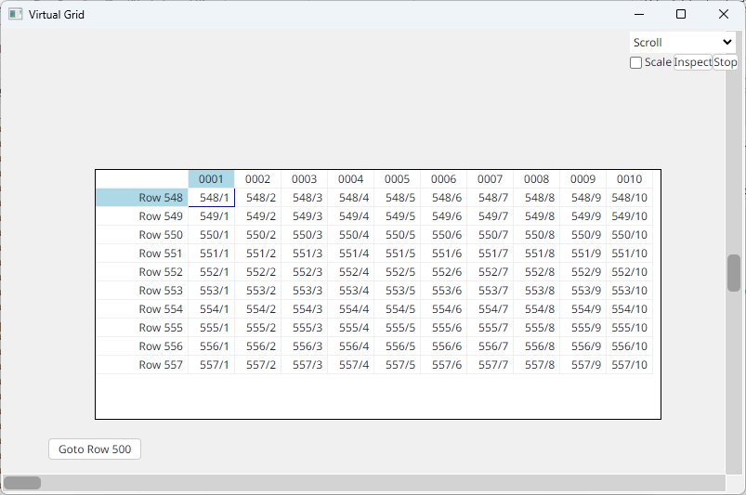

Slide 12
We will document how to create your own extensions

Slide 13
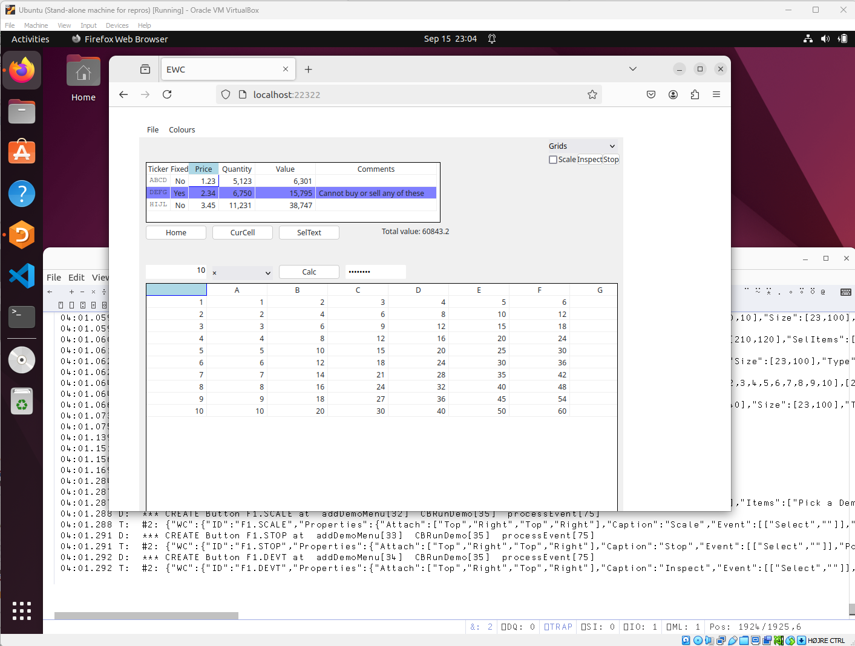

Slide 15
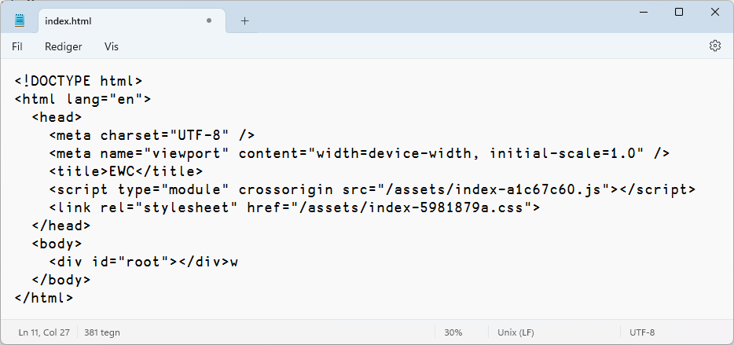
How Does it Work?
Conga server is created listening on port 22322
HTMLRenderer or Web Browser launched at http://localhost:22322/index.html

Slide 16
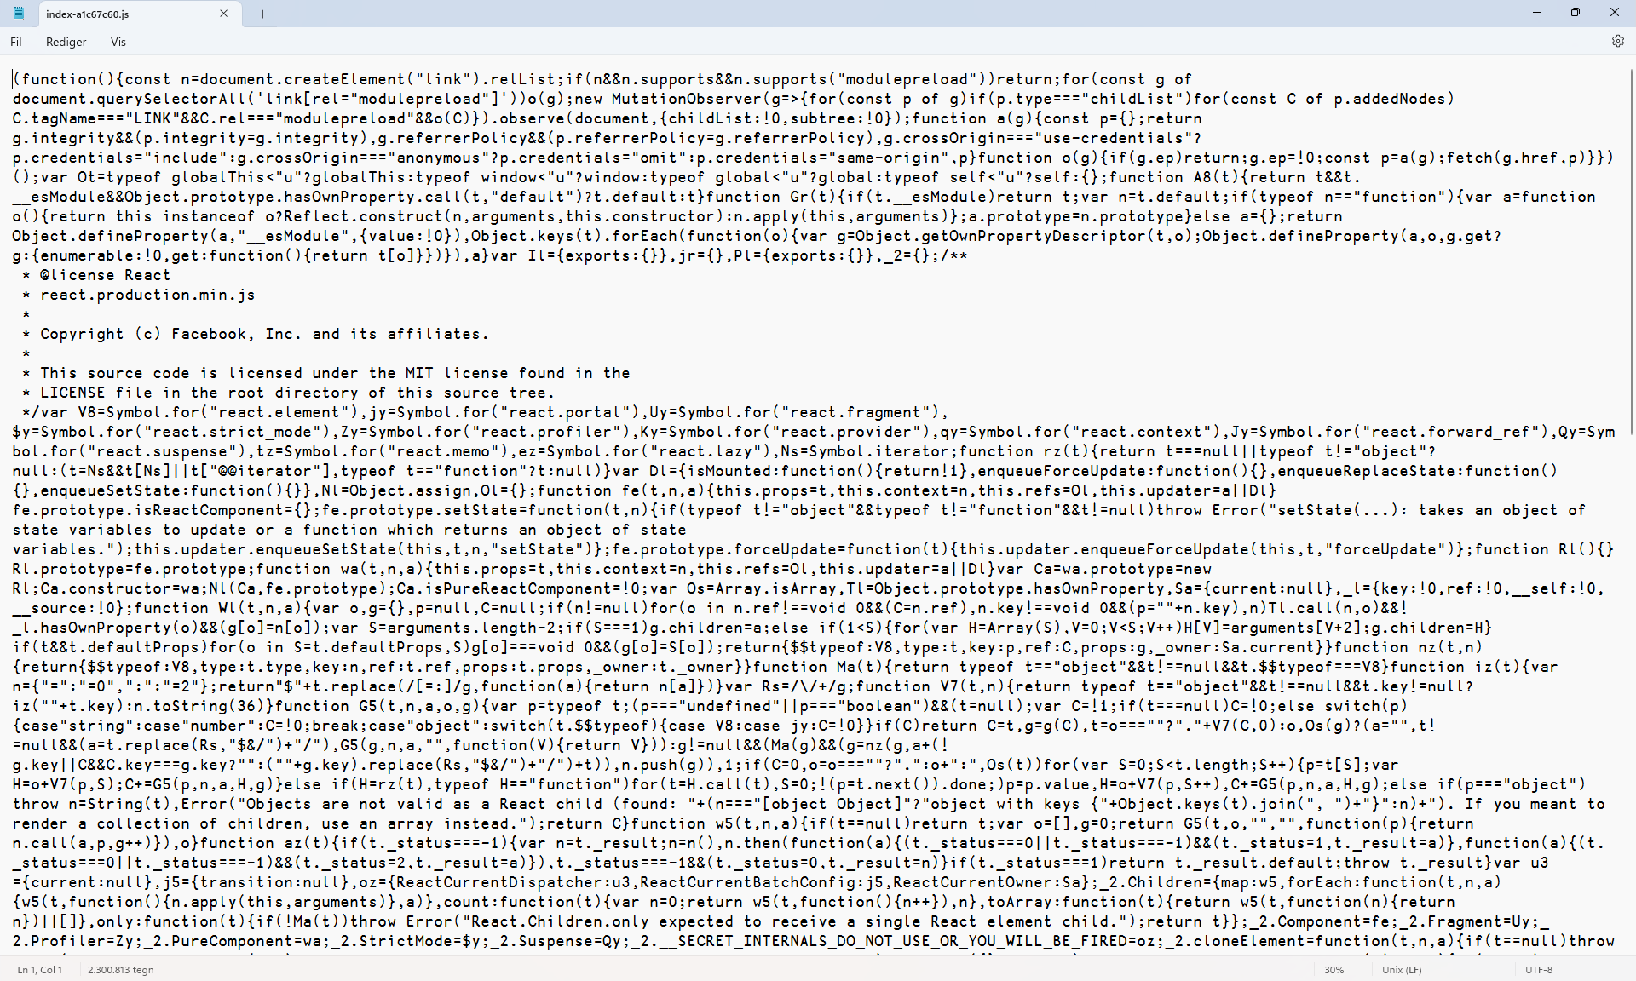
A ”React” application runs...

Slide 17
A WebSocket is Born
Log messages are timestamped mm.ss.ttt since session start. R=Receive, T=Transmit, C=Create 07:53.071 C: Socket connected from [::1]:57082
JavaScript Client tells us something about it’s environment: 07:53.077 R: #2: {"DeviceCapabilities": {"ViewPort":[301,401],"ScreenSize":[1440,2560],"DPR":1,"PPI":200}} 07:53.083 R: #2: {"Initialise": {"Version":"0.2.0","Name":"EWC Client","URL":"http://localhost:22322/"}}
APL Server says how it wants things (you can customise these): 07:53.134 T: {"Options":{"ID":"Locale","Properties":{"Decimal":".", "LongDate":"D. MMMM YYYY","ShortDate":"DD-MM-YYYY","Thousand":","}}} 07:53.190 T: {"Options":{"ID":"Fonts","Properties":{"Scale":1}}}

Slide 18
Typical Web Socket Traffic
'F1' eWC 'Form' 'Buttons' (50 50) (200 300) ('Coord' 'Pixel')
➔ {"WC": {"ID":"F1", "Properties":{"Caption":"Buttons","Coord":"Pixel", "Posn":[0,0],"Size":[200,300],"Type":"Form"}}}
'F1.STATUS' eWC 'Label' 'Click on something!' (175 10) (23 300)
➔ {"WC":{"ID":"F1.STATUS", "Properties":{"Caption":"Click on something!", "Posn":[175,10],"Size":[23,300],"Type":"Label"}}}
(user selects Ice Cream)
⬅ {"Event":{"EventName":"Select","ID":"F1.ICE"}} optstate←'F1.ICE' eWG 'State'
➔ {"WG":{"ID":"F1.ICE","Properties":["State"],"WGID":"7"}} ⍝ Ask client for state of F1.ICE
⬅ {"WG":{"ID":"F1.ICE","Properties":{"State":1},"WGID":"7"}} ⍝ State=1

Slide 19
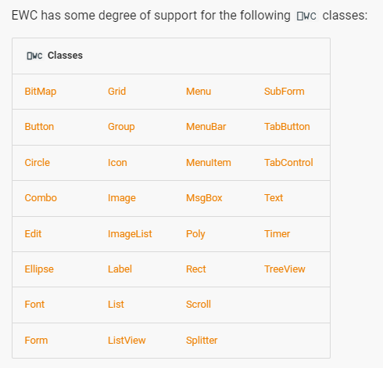
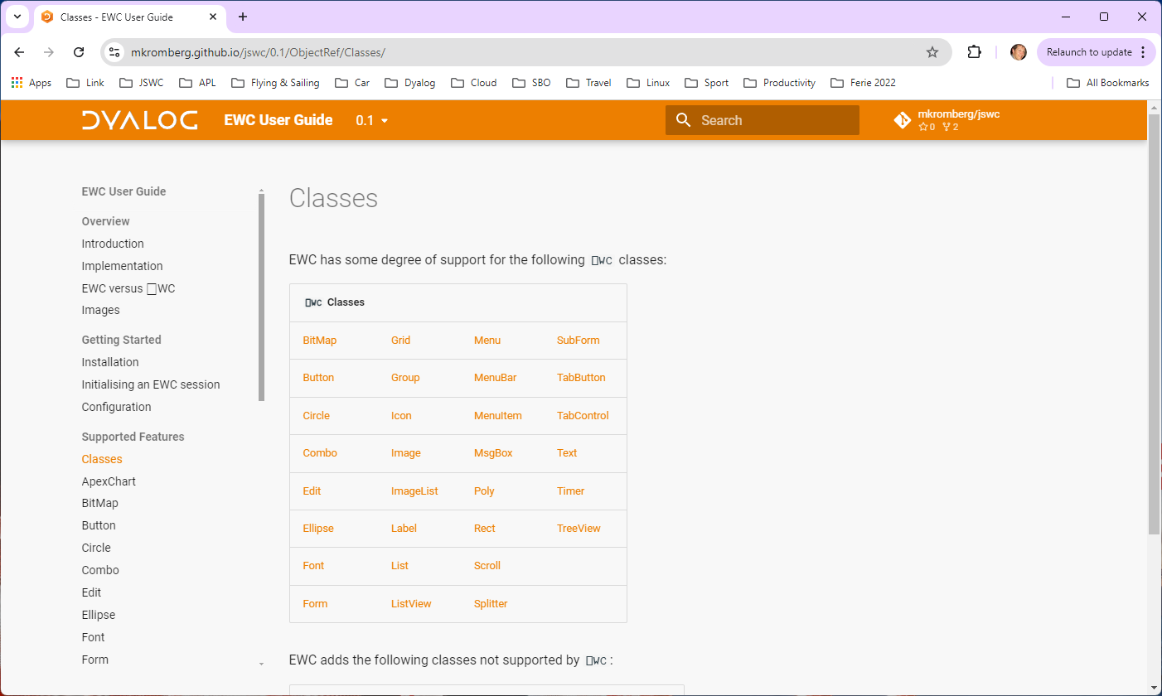
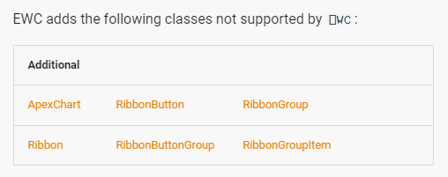

Slide 20
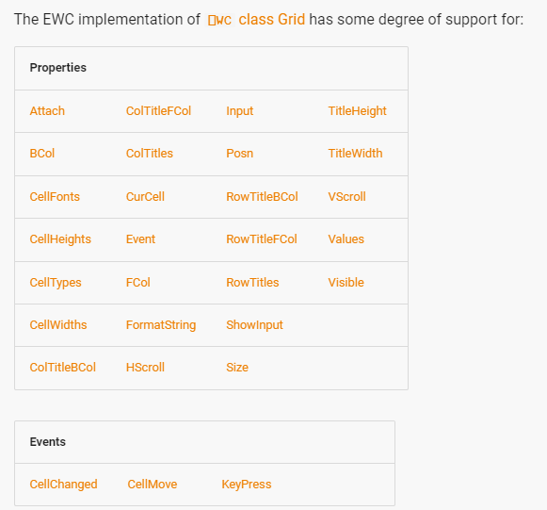
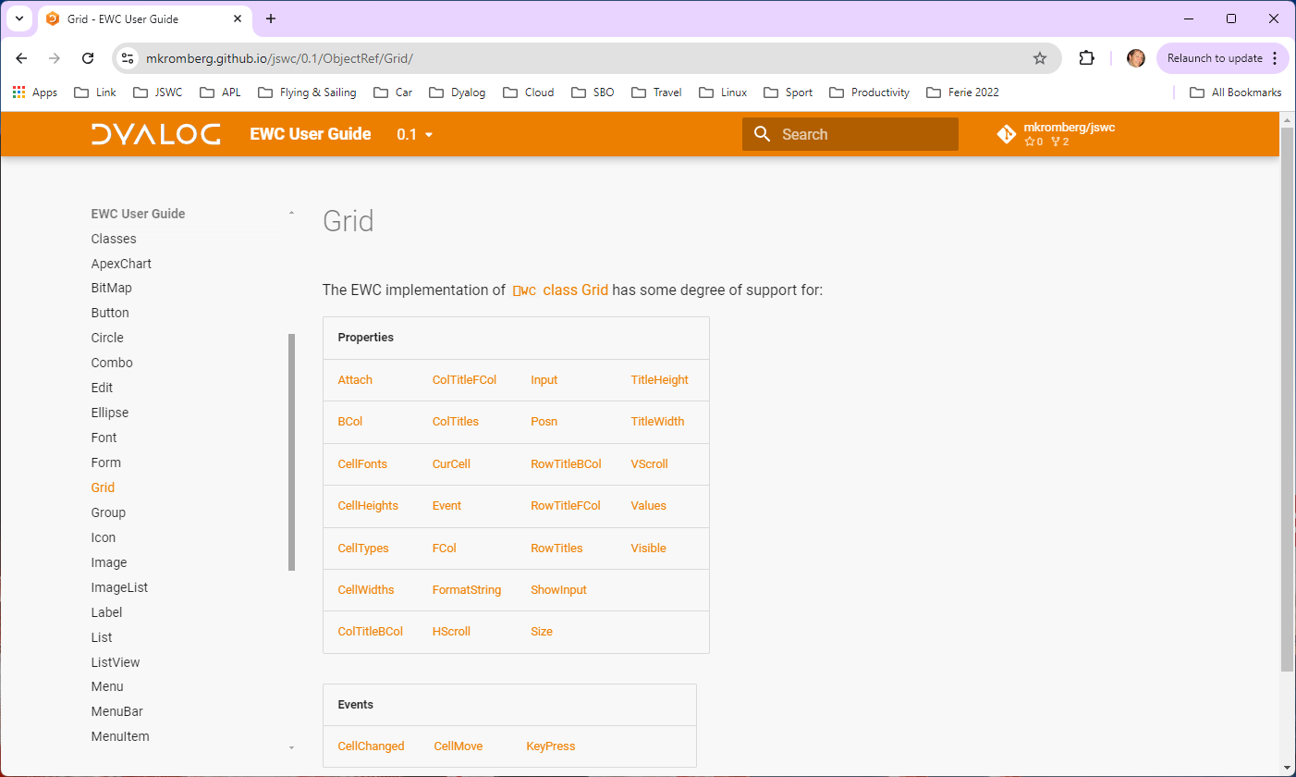
Being added as applications need them.

Slide 21
Significant Limitations
Limited set of Classes & Props
Coord Pixel only
No direct assignment and reference to properties – must use ⎕WS / ⎕WG
No creation using ⎕NEW
Images and ImageLists are handled differently (better!)
Validation and Error Messages weaker / different
⎕NQ may not behave exactly as under Windows
Callbacks returning new event codes is questionable

Slide 22
Unsupported Features
EWC tries to "ignore" use of missing features
Get something up and running
Then modify your code or ask Dyalog to add support
If you try to create an instance of an unsupported class
FOO[7] 'W0' eWC 'Widget' 'Hello World' ('Size' (300 400)) 40:32.702 W: *** Warning: at FOO[7] - WC W0 - unsupported class "widget"
The following still creates a form, ignoring the unsupported feature:
FOO[7] 'F0' eWC 'Form' 'Hello World' ('Size' (300 400)) ('Dockable' 1) 38:58.307 W: *** Warning: at FOO[7] - Unsupported on form: Dockable

Slide 23
Extensions
Ribbon family of controls
ApexCharts
”Flex” instead of Posn + Size
DIY Extensions (KendoUI)

Slide 24
Ribbons

Slide 25
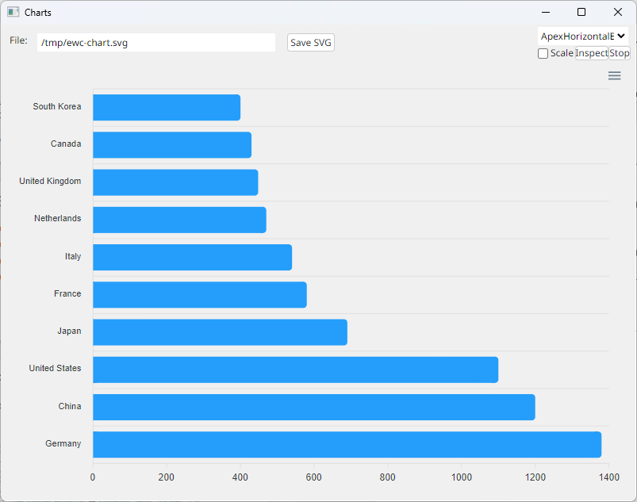
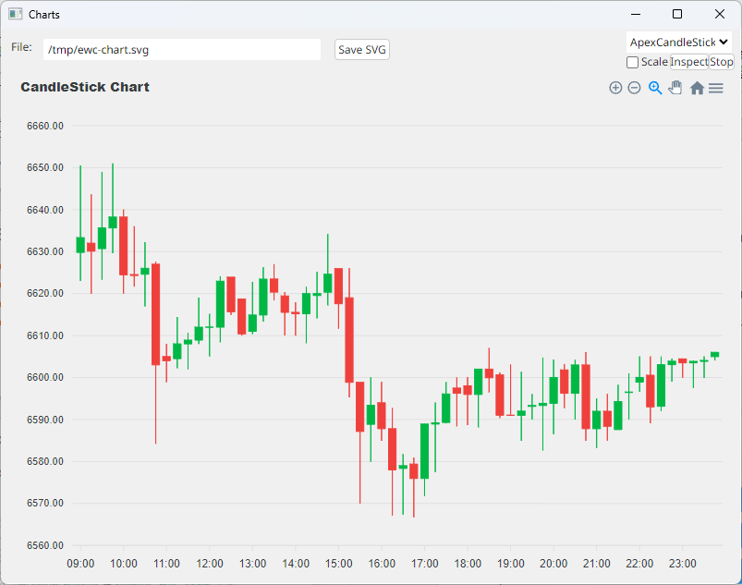
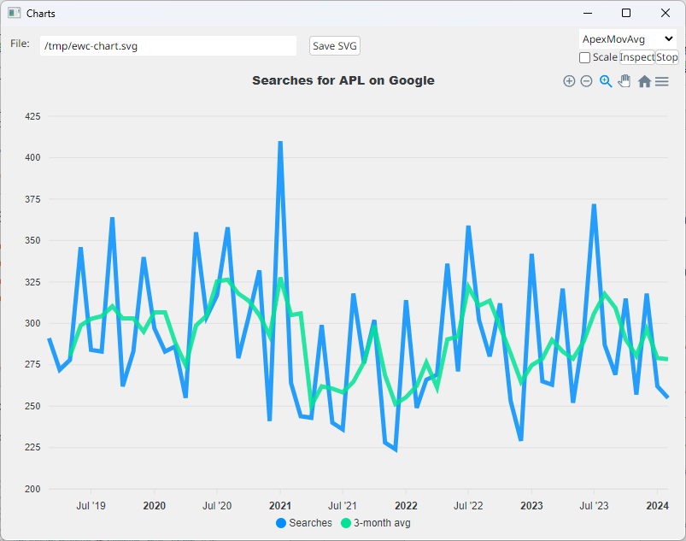
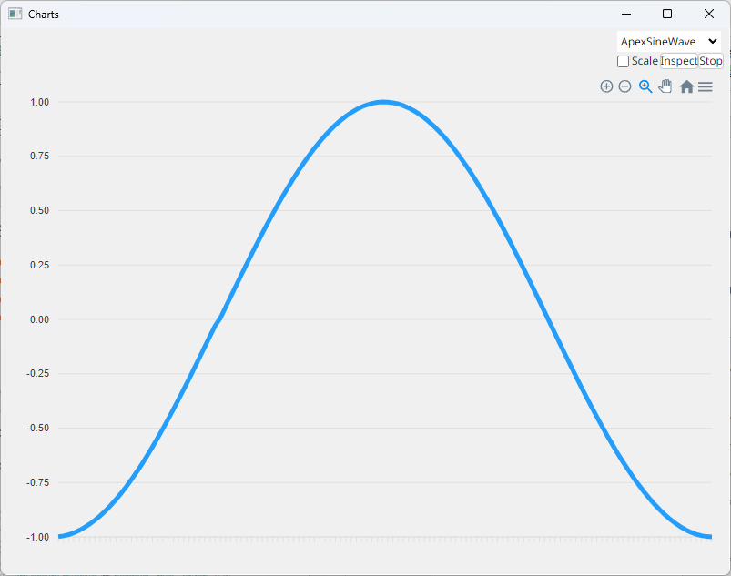
ApexCharts – Four Demos

Slide 26
ApexCharts Design
Options are passed straight through (JSON string or APL namespace)
Series can be in several APL-friendly formats:

Slide 27
ApexCharts SVG Property
The SVG property allows us to retrieve the SVG for the chart
Use ApexCharts in an invisible HTMLRenderer to generate charts
≢svg←'F1.BAR' eWG 'SVG' 29820
4 80⍴svg
<svg id="SvgjsSvg1006" width="780" height="540" xmlns="http://www.w3.org/2000/sv
g" version="1.1" xmlns:xlink="http://www.w3.org/1999/xlink" xmlns:svgjs="http://
svgjs.dev" class="apexcharts-svg" xmlns:data="ApexChartsNS" transform="translate
(0, 0)" style="background: transparent;"><foreignObject x="0" y="0" width="780"

Slide 28
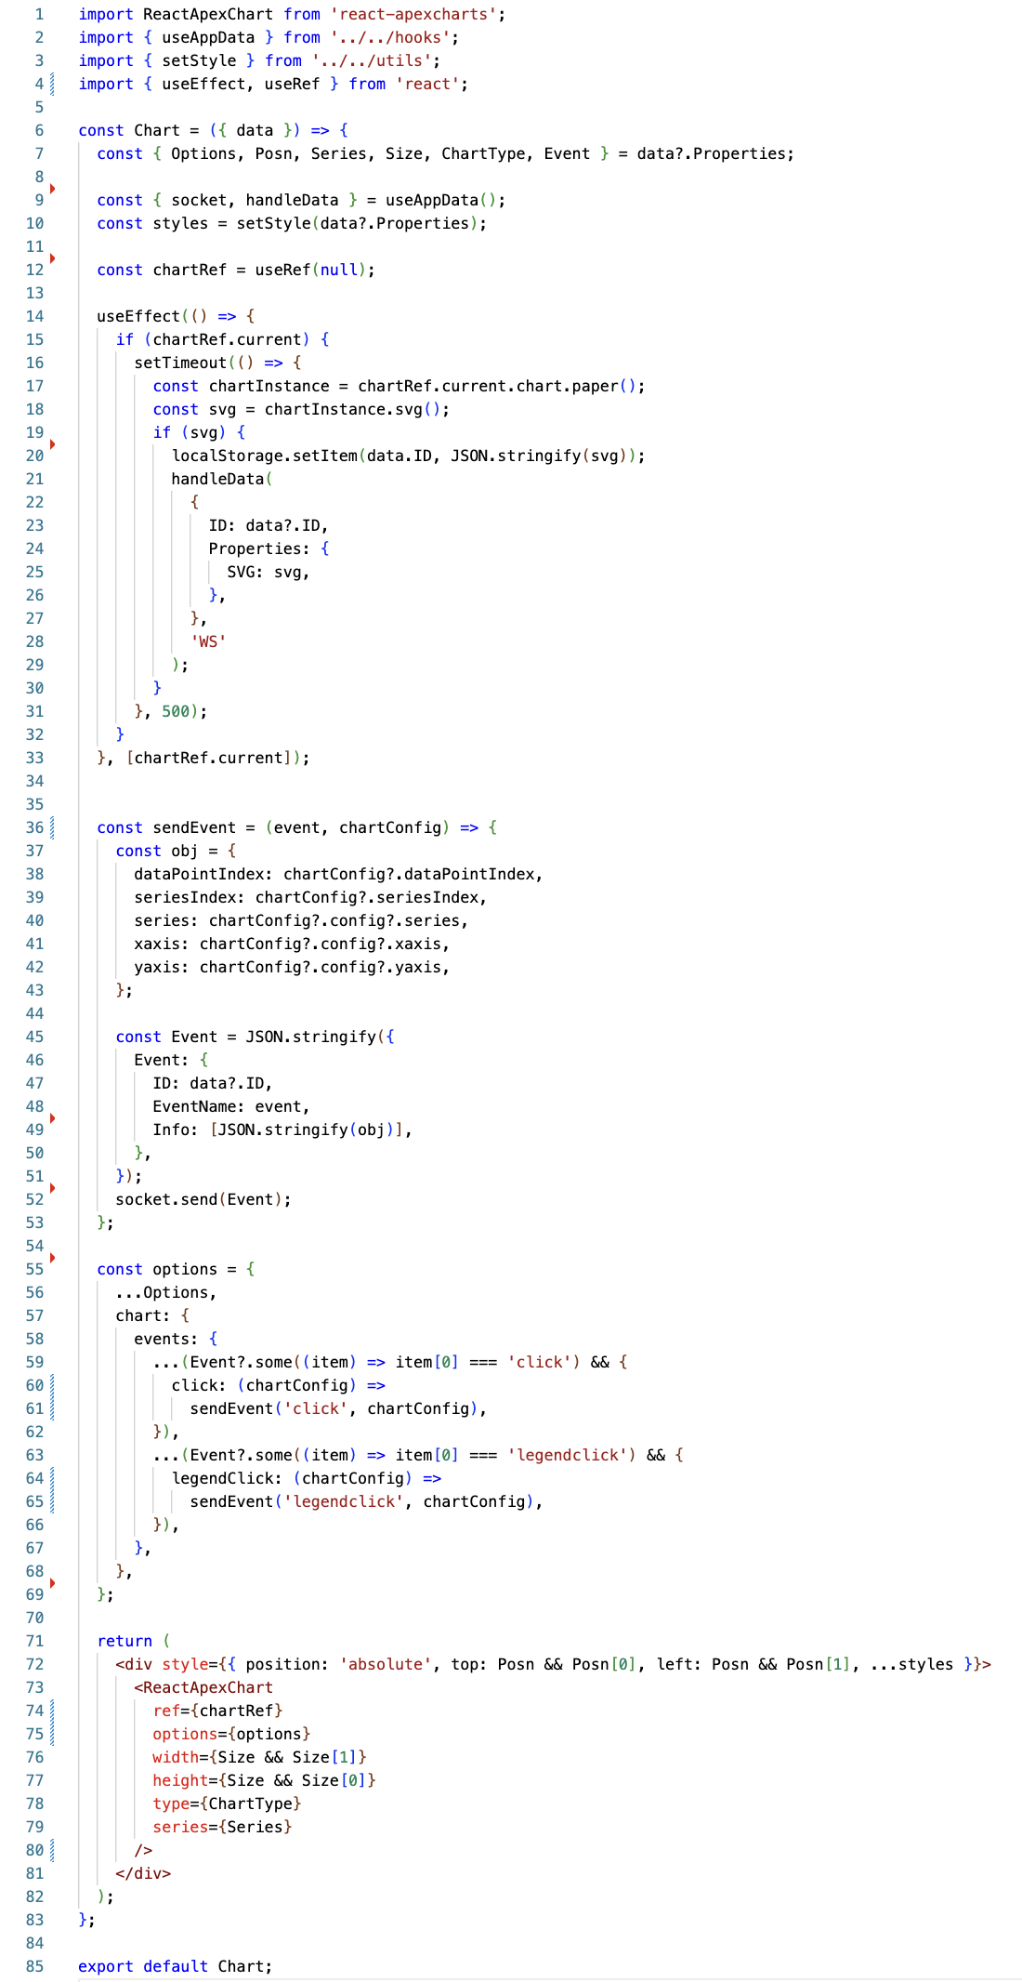
Extending EWC
Slide from Neil on what JS was needed to add ApexCharts will be here

Slide 29
Flex – Instead of Posn & Size
Still VERY experimental – Feedback Please!
The Flex property can be set on containers
'Flex' 'fill' Form should fill the available space (Forms only)
'Flex' 'row' Stack controls horizontally (Any container object)
'Flex' 'column' No comment
By default, 'fill' sets column orientation
CSS property allows you to add additional CSS styling

Slide 30
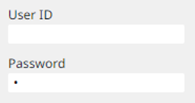
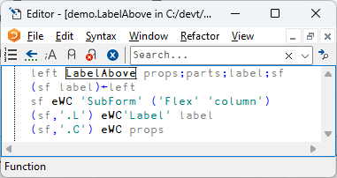
SubForm = "StackPanel"
A Subform with Flex becomes a "StackPanel"

Slide 31
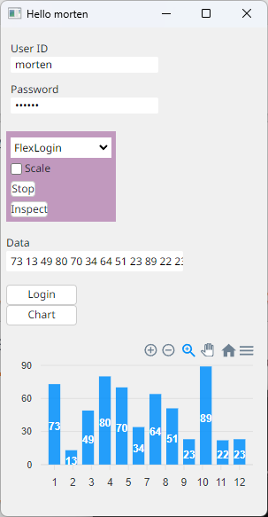
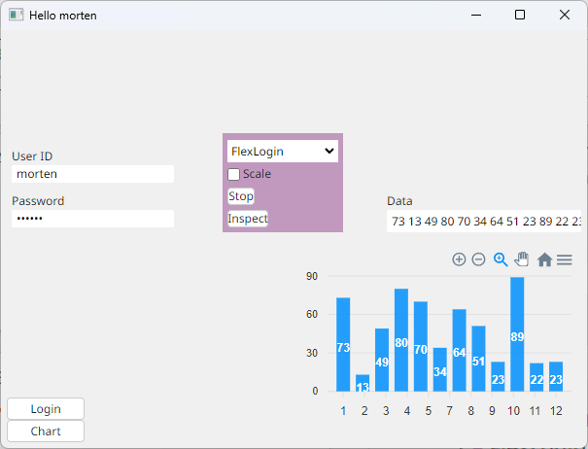

Slide 32
Multi User Mode
Intended for multi-user applications.
EWC.Init 'Multi'
Must be called from a namespace which contains a function names Initialise
Initialise MUST create and eDQ a Form (and demo.Run will do this)
This namespace will be cloned for each new Browser connection, and Initialise will be called on a new thread
Notice each user is suspended in ∆DQ in a namespace named demo_n.
demo.Run 'Multi' (lots of output as two sessions connect) )si
· · #.EWC.∆DQ[42]
· · #.demo_1.Initialise[13]
· &5
· · #.EWC.∆DQ[42]
· · #.demo_2.Initialise[13]
· &6
· [#.EWC.[LIB]] #.EWC.Conga.LIB.Wait[8]
· [#.EWC.[wss]] #.EWC.wss.Listen[2]
· #.EWC.wss.Start[14]
&4

Slide 33
Selenium Testing

Slide 34
Current Status
Supported subset has been driven by the needs of two launch customers
One converting a mature asset management system which needs to move off the Windows desktop
One building new web components in APL to enhance an existing C#/JS based web app
Both of these should be up & running very soon

Slide 35
EWC Status, Continued
Worked on prototype for 12+ months with an external contractor
Now Augmented with a full-time JavaScript developer
Free and Open Source
We will document how to create your own extensions
We expect to add features quickly this winter
Send us sample apps / tell us what you need!

Slide 36
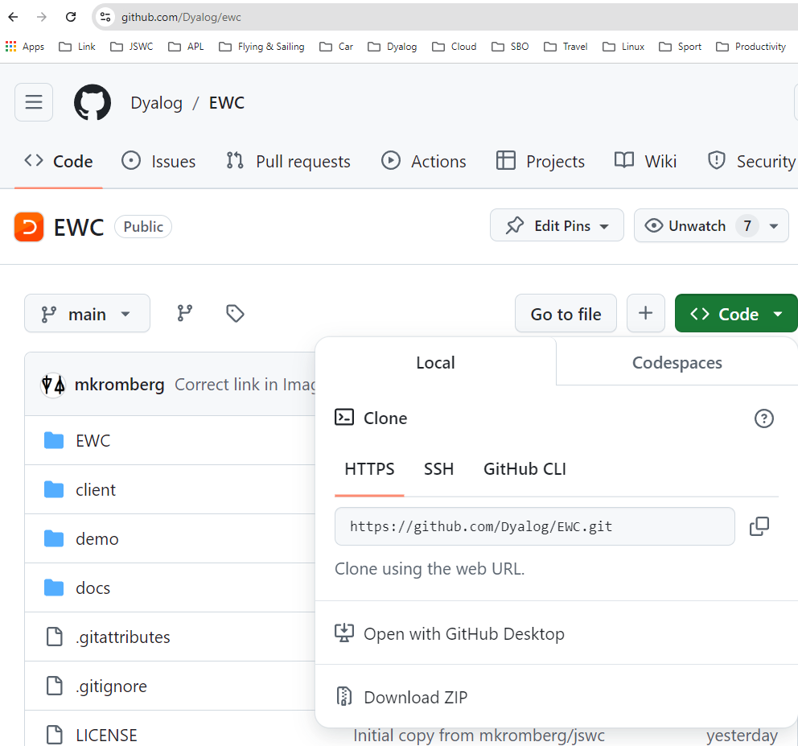
https://github.com/dyalog/ewc
To play...
Clone the repo
OR
UnZip

Slide 37
https://github.com/dyalog/ewc
]link.create # /path/to/ewc
demo.Run 'Desktop'

Slide 38
Thank You!

