Slide 1
Migrating APL+Win Applications Karl Holt, Morten Kromberg

Slide 2
A New Wave of Migrants
Dyalog APL was created by Dyadic Systems Ltd, when the mainframe consulting business faltered (1981)
Most current users of Dyalog APL migrated from SHARP APL, IBM APL2, APL+Win, or APLX (or DEC APLSF, or …)
Waves of migrants
”Death” of mainframes and minicomputers (1980's)
Superior support for Windows GUI (1990's)
Now, "the cloud" (& a few more mainframes being shut down)

Slide 3
From APL2
Relatively straightforward
A few language differences
Each on empty arrays
User Interfaces and file I/O are usually already handled by simple cover-functions and can be emulated “easily”
Linux or Windows apps may be making external calls which will require "tweaking"
We are considering implementing "format by example" but so far it has not been necessary

Slide 4
Recent / Active APL2 Migrations
Insurance company
No UI, manipulates text and Excel files
Handled by European Consulting Partner
Sandvik (Sweden) – in progress: Mainframe APL2 direct to Docker Containers and HTML/svg
Handled by Tiamatica in Malmö (Gilgamesh Athoraya)
BIG Jewellers: Windows
Handled by Mark Wolfson @ BIG "with a little help"

Slide 5
Migrated APL2 Mainframe UI

Slide 6
From APL+Win or MicroAPL APLX
Same language differences as APL2, plus:
Many system functions & control structures not found in Dyalog APL
Double quotes ("Don't do this!")
More advanced Graphical User Interfaces
Calls to external libraries

Slide 7
APLX Migrations
MicroAPL stopped developing APLX in 2016
Dyalog hosts a download of the last free version
Dyalog developed migration tools in 2016
A handful of users migrated using these tools

Slide 8
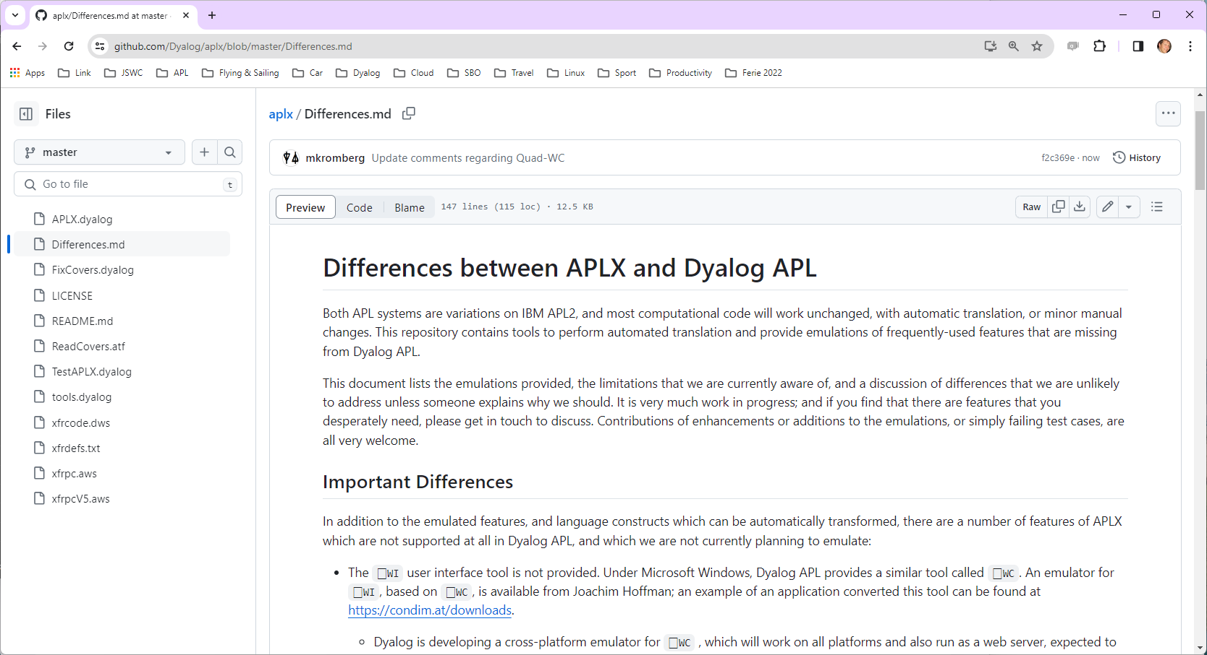

Slide 9
Recent / Active APL+Win Migrations
Two European Insurance companies
One with GUI, completely rewritten in Dyalog APL, the other a pure service converted to Jarvis in Linux containers
Handled by a European consulting partner
METSIM® - in progress
Migration being handled by Dyalog
Will be used to develop tools to automate migration, including the Graphical User Interface
More under discussion

Slide 10
Migrating APL+Win Applications

Slide 11
Step 1: Export Source Code
APL Workspace Transfer format is a standard agreed by APL vendors before 1980
Most APL systems provide user or system commands IN and OUT to read and write this format
The APL+Win user command ]OUT creates a file in Transfer Format: ]OUT /tmp/out ➔ /tmp/out.ATF

Slide 12
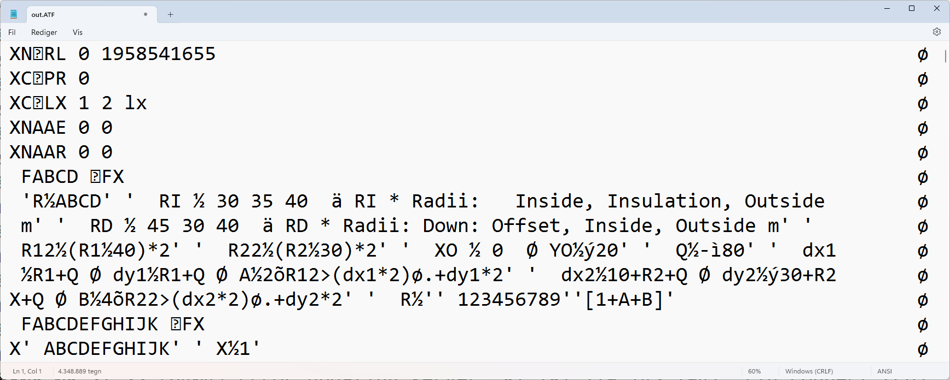
Step 1 – Export Source Code
Result of ]OUT /tmp/out:

Slide 13
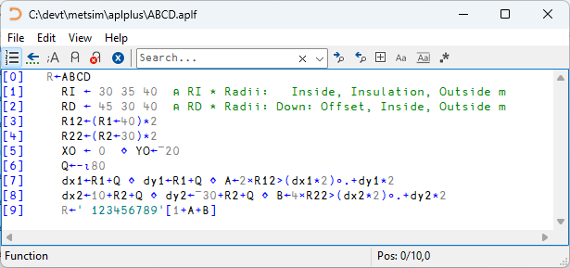
Step 2: Create Text Source
Our new ]IN command can create text source files
]IN /tmp/out.ATF -outdir=/path/aplplus -apl=APLPLUS

Slide 14
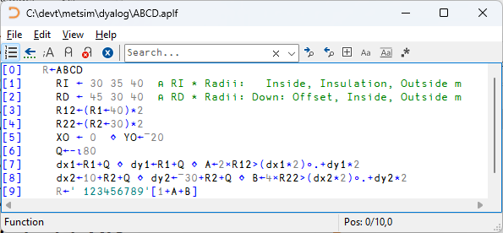
Step 3: Automatic Conversion
Apply automated transformations to the original source
]todyalog /path/aplplus /path/dyalog A2K

Slide 15
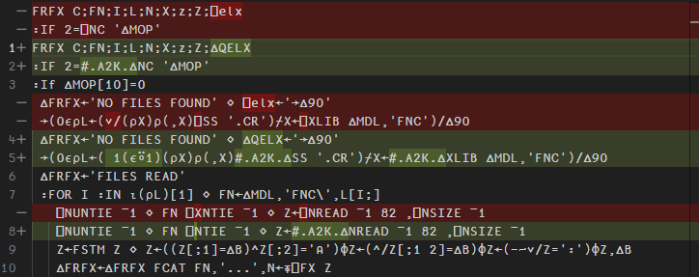
Automatic Substitutions
Many Thanks to VS Code!

Slide 16
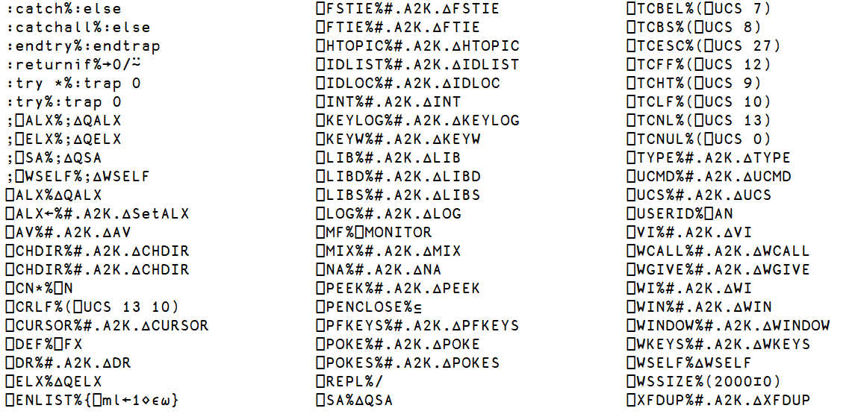
atfmap.txt

Slide 17
System Functions Emulated
⎕XLIB => #.A2K.∆XLIB
R←∆XLIB X
X,←'*'↓⍨≢X
:If 0∊⍴R←↑⊃⎕NINFO⍠1⊢X
:If ∨/'?*'∊X
R←0 0⍴' '
:Else
'XFHOST ERROR FindFirstFile 1 0 3 The system cannot find the path specified.' ⎕SIGNAL 22
:EndIf
:Else
R←R[⍋R;]
:EndIf

Slide 18
Tricky Differences
A B[I]
f.g when f or g are not scalar functions :LeaveIf
A (B[I]) or (A B)[I] ?
Detect and rewrite
Enhance Interpreter?
Static Analysis could help with some of these

Slide 19
Work in Progress
∧/ on empty nested arrays can return a result with a different prototype
The above is a quick hack to allow us to make progress, probably we will map
∧/ to All
∨/ to Any

Slide 20
Manual Steps

Slide 21
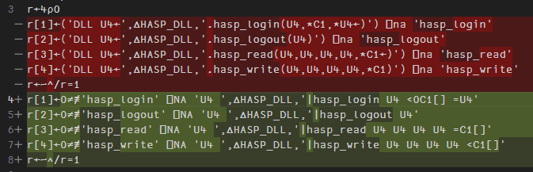
Foreign Function Calls
Mechanical manual translation
We *may* add automated conversion

Slide 22
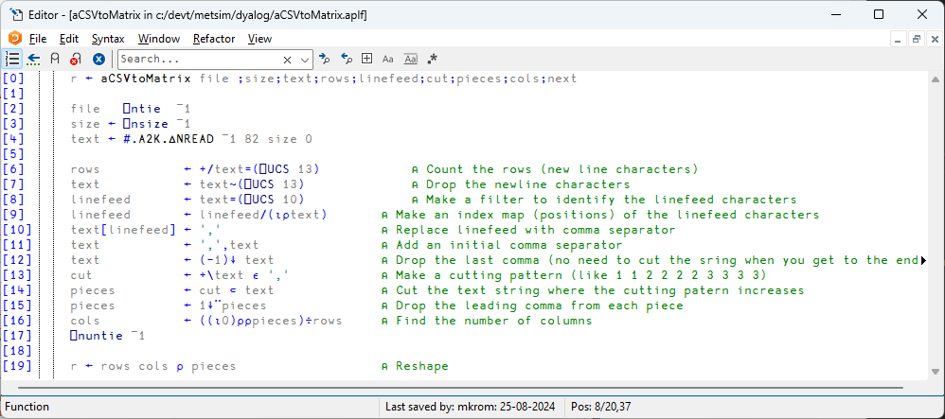
CSV files
⎕CSV

Slide 23
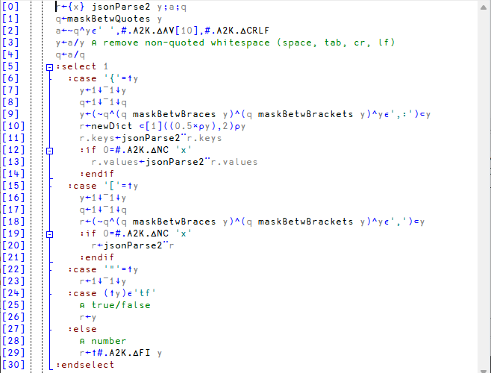
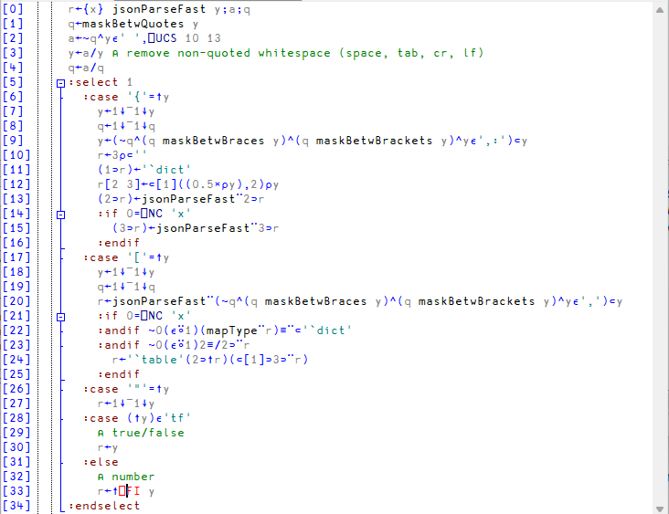
⎕JSON

Slide 24
Component Files
Emulations of ⎕F* system functions which can read and write APL+Win component files directly
Uses an APL+Win runtime application and binary SCAR format via TCP sockets
Allows parallel operation of old + new versions of the application code
Component files can be migrated gradually

Slide 25
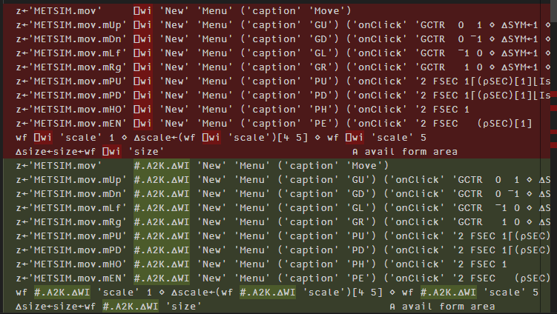
The Hard Part

Slide 26
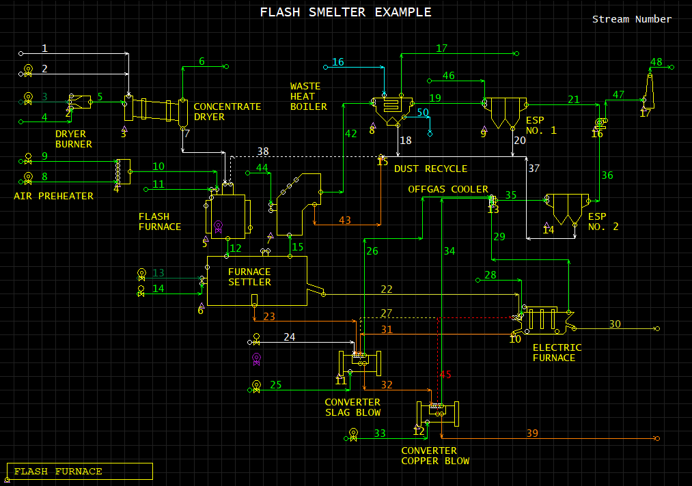

Slide 27
Demo

Slide 28
∆WI Status September 2024
Some Support
No Support
button imagelist picture
check label richedit
combo list scroll
edit listview selector
form menu spinner
frame page timer
activecontrol listview status
activeobject mdiform toolbox
commandbar media trackbar
commandbutton option tree
datetime printer
grid progress

Slide 29
Declaration of Intent
We have hired two new APL developers in 2024
METSIM® migration complete expected around end of 2024
Our partners in Germany, USA and Sweden are gaining experience of migrations

Slide 30
Migration Status
∆WI is close to supporting all of METSIM®
Additional features will be added to support future migrants
We will produce a document enumerating differences and documenting emulation functions
All migration tools and documentation will be free and open source
We *may* also decide to add new features to v20
For example :LeaveIf

