Slide 1
Initialising and Starting from Text Files
Adám Brudzewsky

Slide 2
APL language
Teaching APL
APL in text files
Online communities and services
… plus much more
← discussion group tonight!
Adám Brudzewsky — just call me Adam

Slide 3
Initialising and Starting from Text Files
Adám Brudzewsky

Slide 4
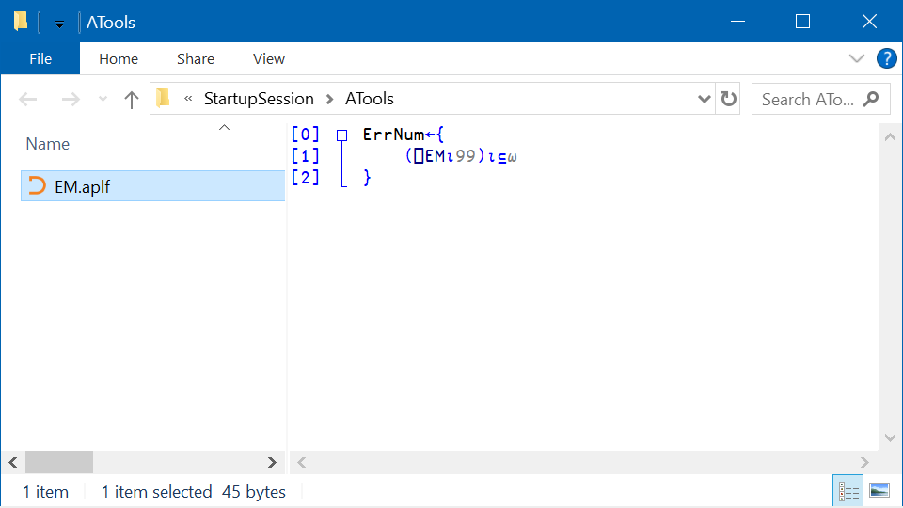

Slide 5
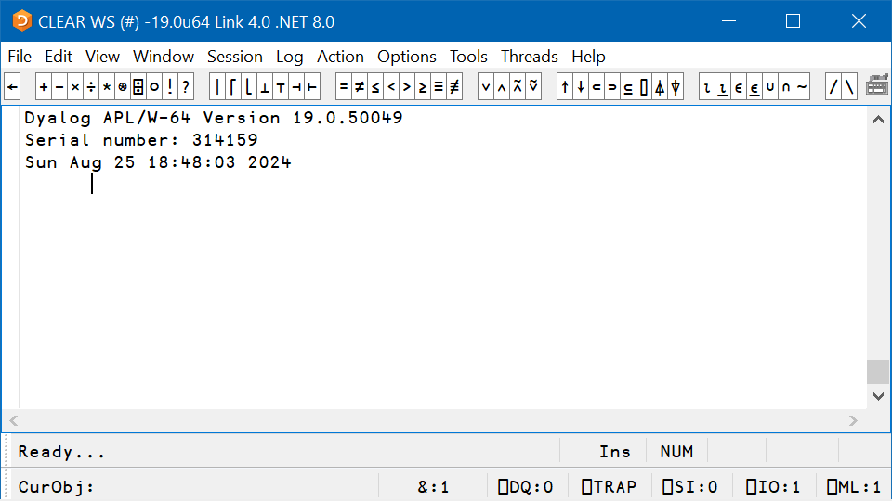

Slide 6
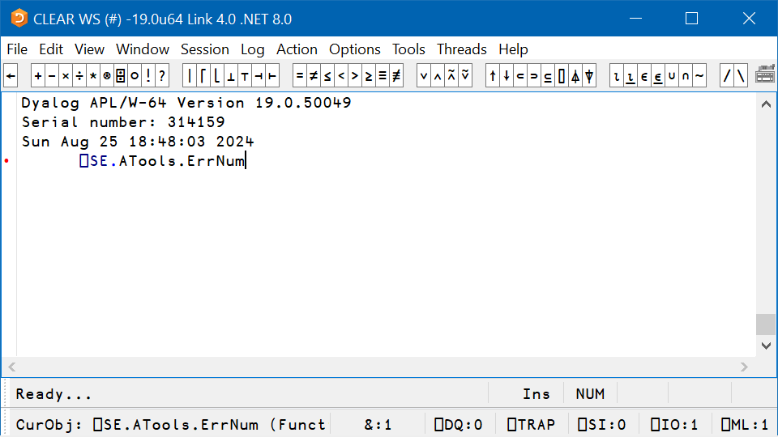

Slide 7
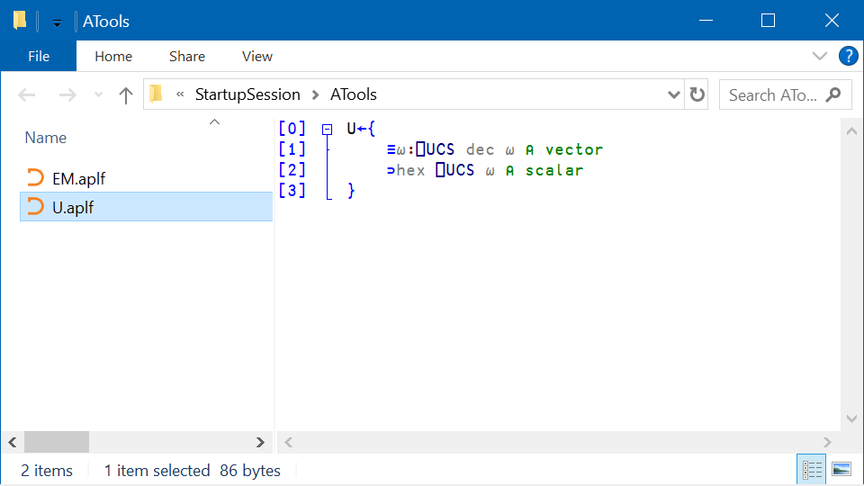
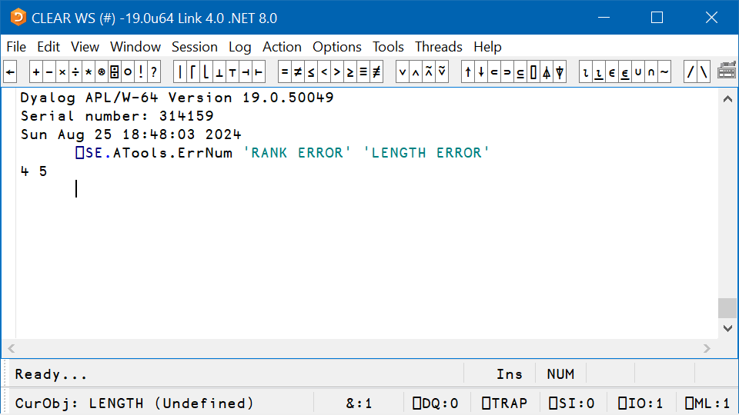

Slide 10
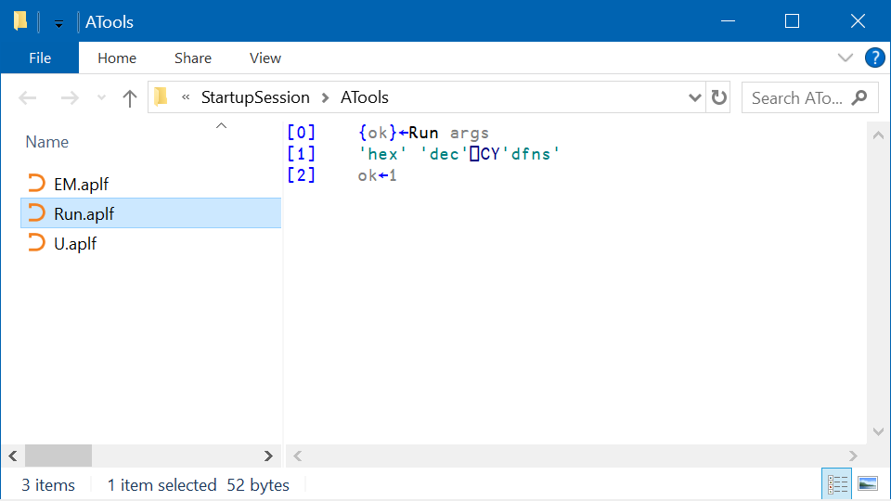

Slide 11
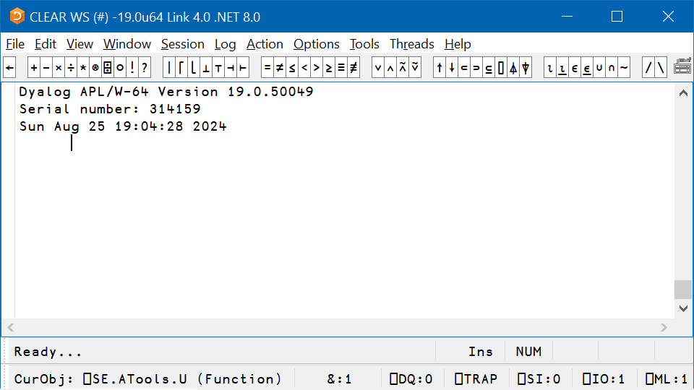

Slide 12
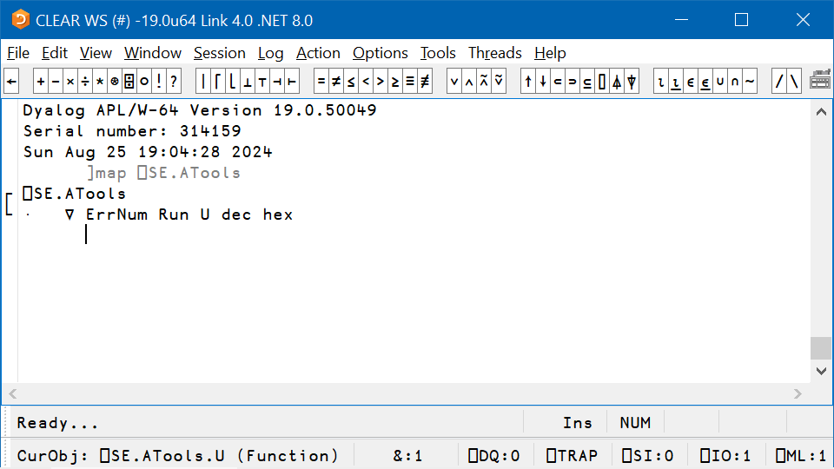

Slide 13
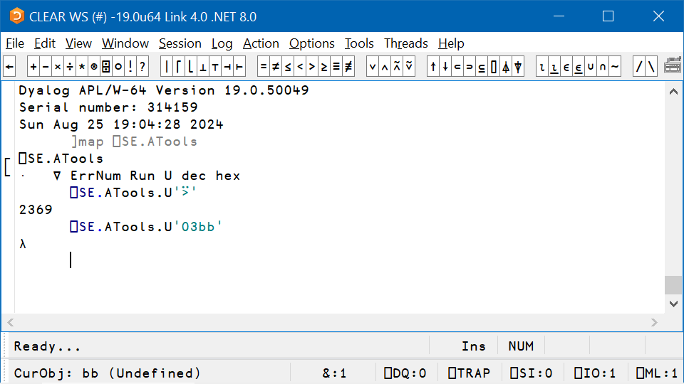

Slide 15
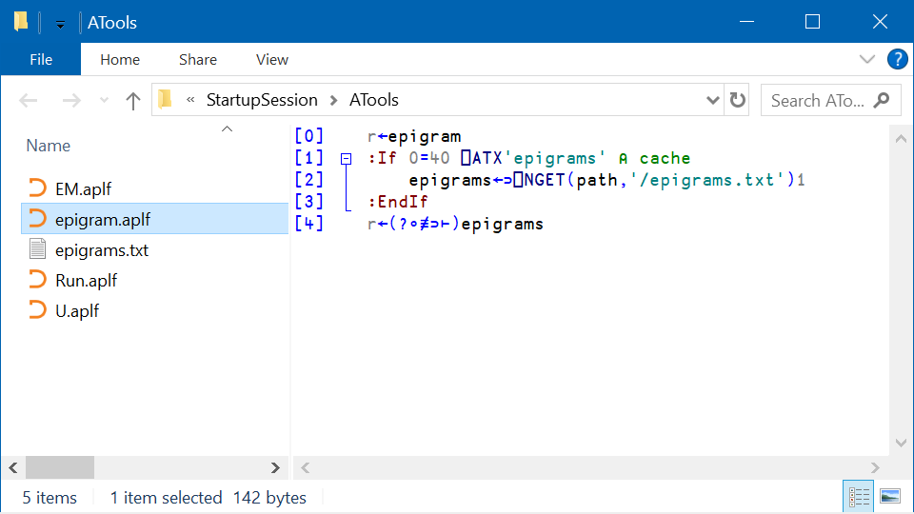

Slide 16
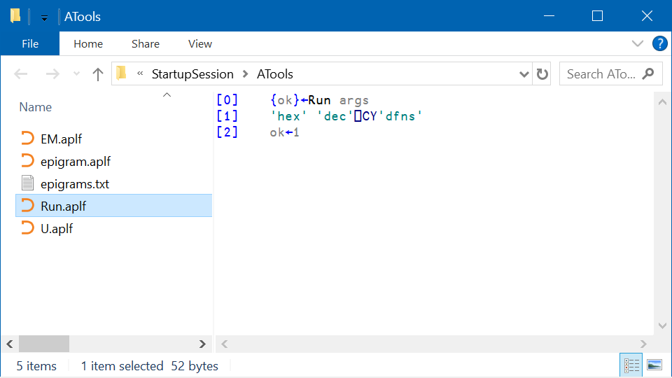

Slide 18
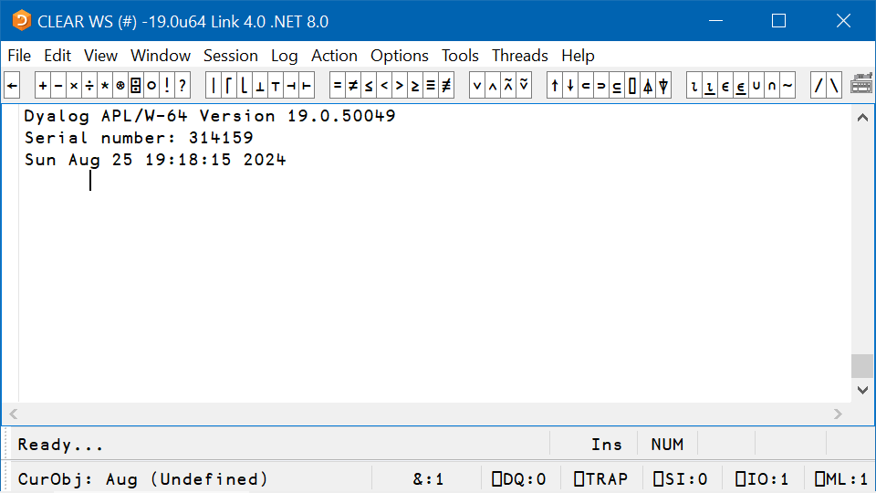

Slide 19
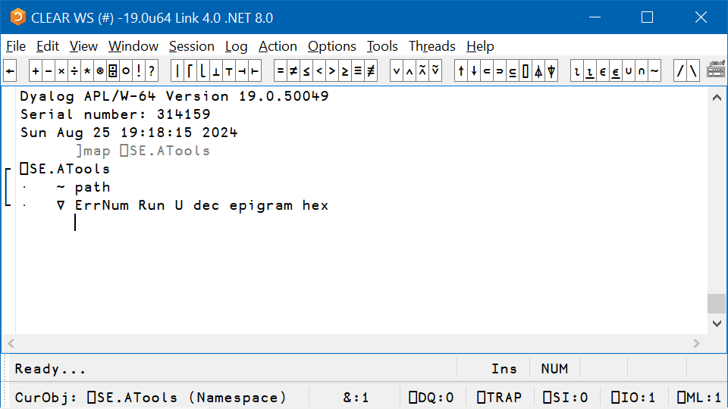

Slide 20
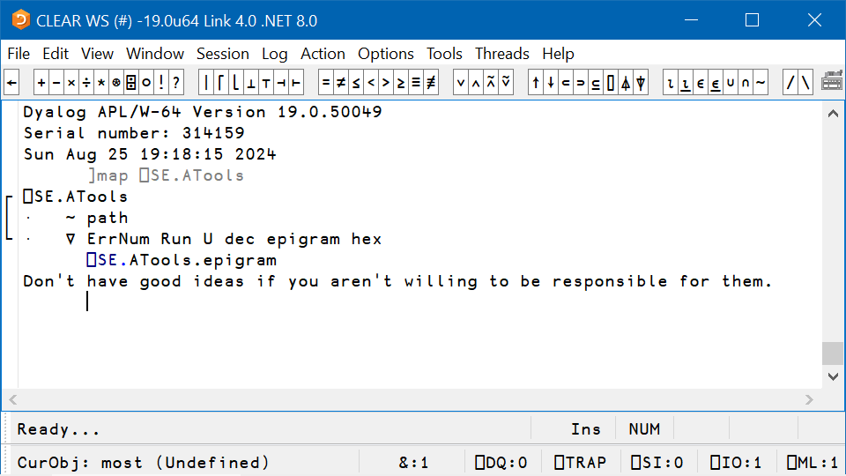

Slide 21
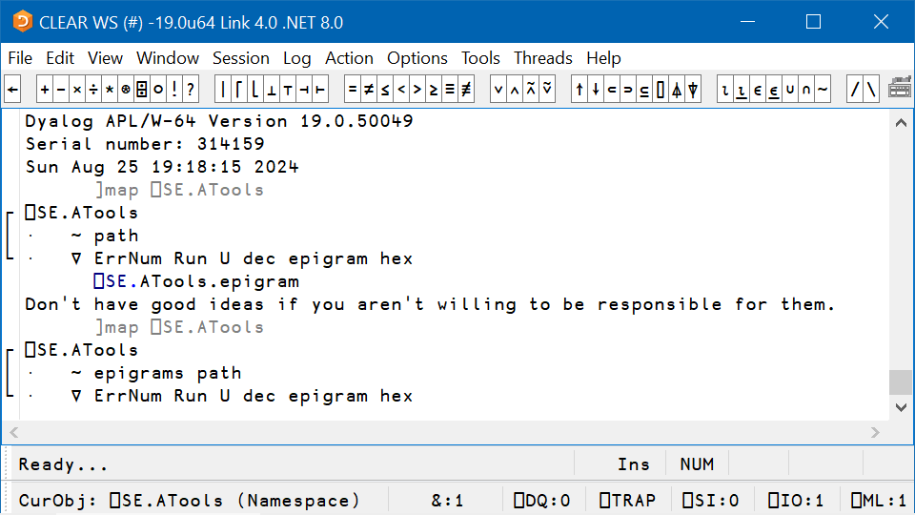

Slide 22
Initialising and Starting from Text Files
Adám Brudzewsky

Slide 23
Initialising and Starting from Text Files
Adám Brudzewsky

Slide 24
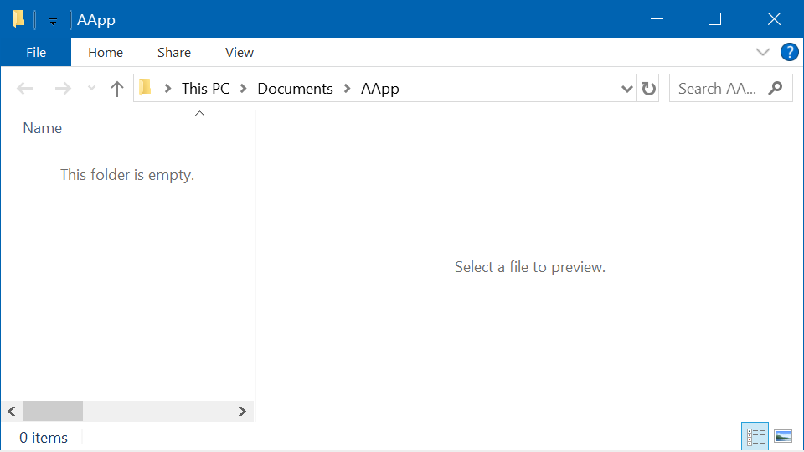

Slide 25
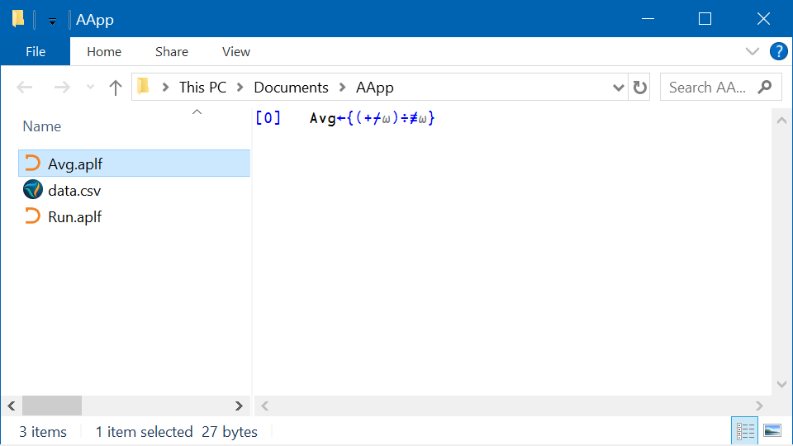

Slide 26
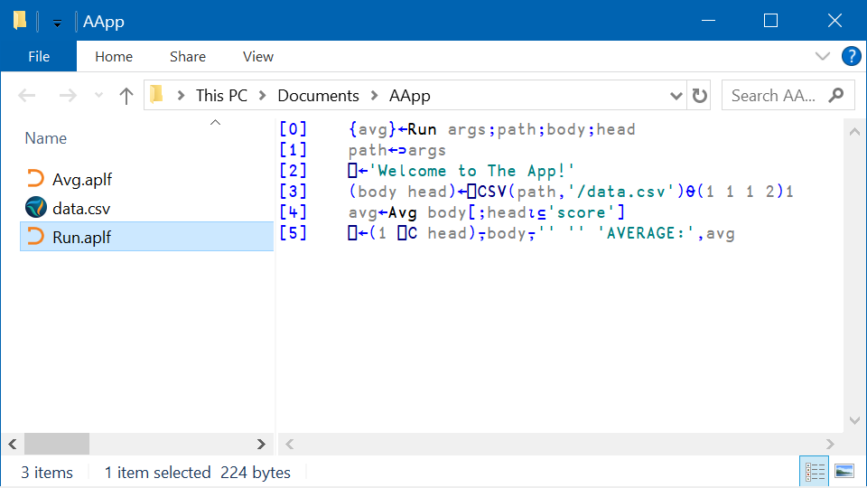

Slide 28
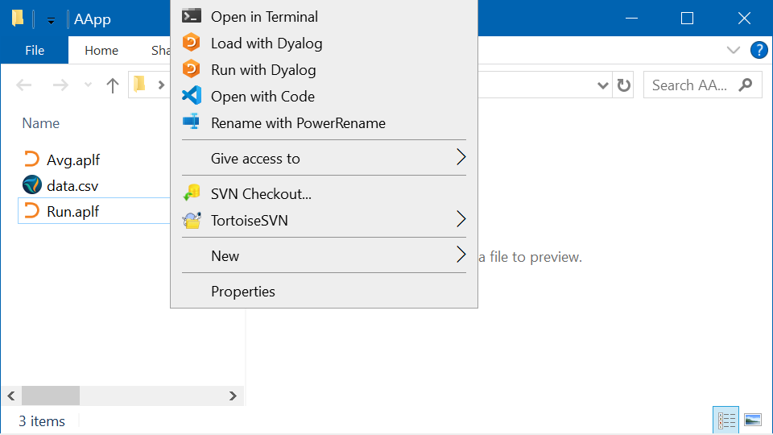

Slide 30
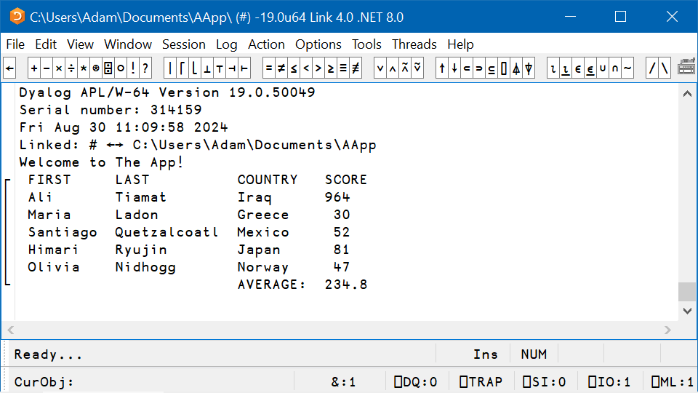

Slide 31
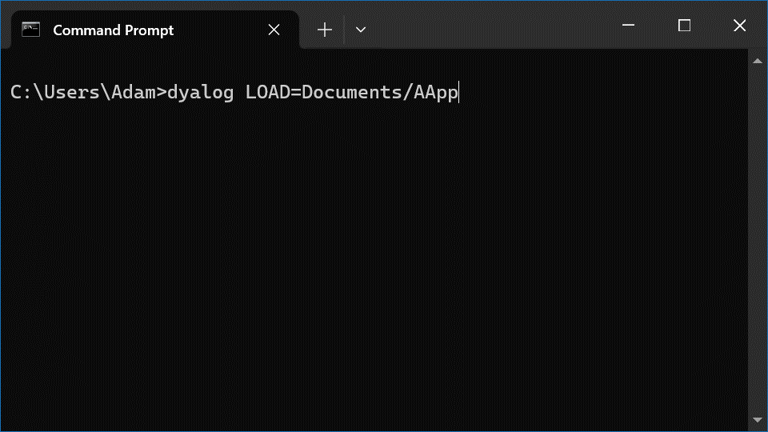

Slide 32
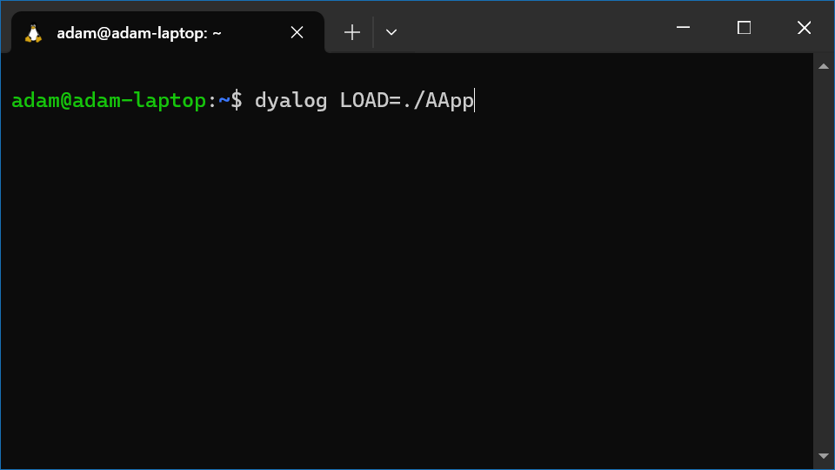

Slide 33
Initialising from Text Files ⎕SE.Dyalog.StartupSession.VerSpec StartupSession/namespace/fn.aplf StartupSession/namespace/Run.aplf
Starting from Text Files /path/to/workspace/fn.aplf /path/to/workspace/Run.aplf
?

