Slide 1
Tacit Programming in Dyalog
Adám Brudzewsky
Rich Park
Stefan Kruger
Notes:
Workshop, not lecture — interrupt and ask!

Slide 2
Tacit Programming in Dyalog
Adám Brudzewsky
Rich Park
Stefan Kruger
Notes:
Workshop, not lecture — interrupt and ask!

Slide 3
Tacit Programming in Dyalog
Adám Brudzewsky ∙ xpqz.github.io/cultivations/Trains
Rich Park ∙ youtu.be/Enlh5qwwDuY “Train Spotting”
Stefan Kruger ∙ xpqz.github.io/learnapl/tacit
Notes:
Workshop, not lecture — interrupt and ask!

Slide 4
What is tacit programming?
Explicit code mentions arguments:
Expression (⌈/N)-⌊/N←3 1 4 1 5
Tradfn ∇ R←Range Y …
Dfn {(⌈/⍵)-(⌊/⍵)}
Tacit code implies arguments:
Tacit (⌈/-⌊/)
Notes:
Guy Steele said one of the disadvantages of APL is that user-defined functions don't look like the core language (some would say that is an advantage).
Tacit programming allows writing more complex functions using just primitives, which gives those functions mnemonic value as set phrases you can learn to do specific things

Slide 5
You already know some
f/ f¨ ∘.g f\ A∘g f⌸ f⍠B
Operators derive tacit functions

Slide 6
Function composition
f⍥g f⍤g f⍨ fgh f∘g
Function composition is plumbing that guides arguments to functions

Slide 7
Benefits
Arguments in operands
Memorable (like ≠⊆⊢ and +⌿÷≢)
Adjacency (like ×- and ∨/⍷)
Brevity (like F⍥⎕C)
DRY (Don’t Repeat Yourself; like ≡⍥⍴)
Just a general feeling of superiority and awesomeness

Slide 8
Overview
Compositional operators (combinators)
Trains (forks and atops)
Tools
Issues
Reading
Plenty of exercises
throughout

Slide 9
⍥ Over
The shape of an outer product ⍺ ∘.f ⍵ is (⍴⍺) , (⍴⍵)
We can write this as ⍺ ,⍥⍴ ⍵
“pre-process both”

Slide 10
∘ Beside
Location of ⍺^{th} 1 in each element of ⍵ is ⍺ ⊃¨ ⍸¨ ⍵
We can write this as ⍺ ⊃∘⍸¨ ⍵
“pre-process right”

Slide 11
⍤ Atop
Any-presence of ⍺ in ⍵ is ∨/ ⍺ ⍷ ⍵
We can write this as ⍺ ∨/⍤⍷ ⍵
“post-process result”

Slide 12
⍨ Commute
A multiplication table of N is (⍳⍵) ∘.× (⍳⍵)
We can write this as ∘.×⍨ ⍳⍵
“selfie”
Notes:
After this slide, handout "function compositions" cheat sheet

Slide 13
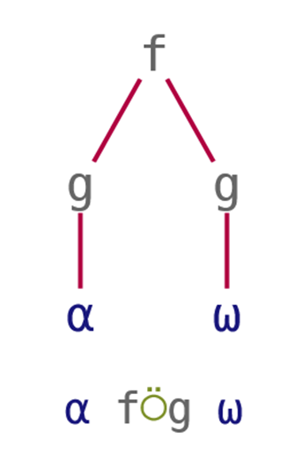
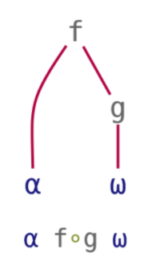
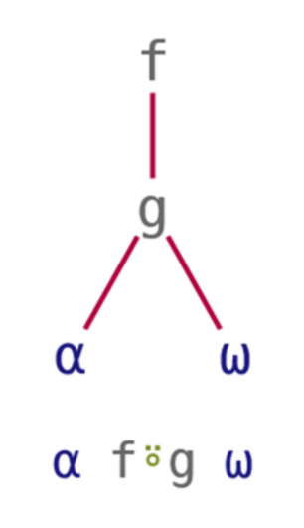
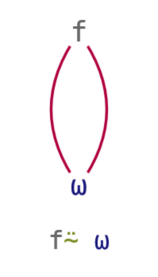
Tacit Techniques Function Compositions
Over | Beside | Atop | Commute
pre-process both | pre-process right | post-process result | selfie

Slide 14
Tasks: Tacify!
'Hello' {(≢⍺)≡(≢⍵)} 'World'
'ab' 'cd' 'ab' {+/⍺∊⍵} 'ab' 'de'
8 100 0 {⍺÷⌊⍵} 2.5
10 4 1 0 {⍺⌊⌊⍵} 2.5
{≠\⍵=⍵} 2 7 1 8 3
1
2
4 50 0
2 2 1 0
1 0 1 0 1
Notes:
≡⍥≢
∧/⍤∊
÷∘⌊
⌊∘⌊
≠\⍤=⍨

Slide 15
Train Introduction
Also a type of composition
Sequence of functions in isolation
Parenthesised: (+⌿÷≢) 3 1 4 1 5
Assigned Avg←+⌿÷≢ Avg 3 1 4 1 5
+⌿÷≢ 3 1 4 1 5
0.2
(+⌿÷≢)3 1 4 1 5
2.8
Most common mistake

Slide 16
Discussion: Writing Trains
(f Y) + (h Y) → (f + h) Y
Notes:
Spotting patterns, like function composition

Slide 17
Discussion: Writing Trains
(f Y) + (h Y) → (f + h) Y
(f Y) + ( Y) → (f + ⊢) Y

Slide 18
Discussion: Writing Trains
(f Y) + (h Y) → (f + h) Y
(f Y) + ( Y) → (f + ⊢) Y
(X f Y) + (X h Y) → X (f + h) Y
Notes:
Everyone OK with left and right tacks?

Slide 19
Discussion: Writing Trains
(f Y) + (h Y) → (f + h) Y
(f Y) + ( Y) → (f + ⊢) Y
(X f Y) + (X h Y) → X (f + h) Y
(X ) + (X h Y) → X (⊣ + h) Y

Slide 20
Discussion: Writing Trains
(f Y) + (h Y) → (f + h) Y
(f Y) + ( Y) → (f + ⊢) Y
(X f Y) + (X h Y) → X (f + h) Y
(X ) + (X h Y) → X (⊣ + h) Y

Slide 21
Discussion: Writing Trains
(f Y) g (h Y) → (f g h) Y
(f Y) g ( Y) → (f g ⊢) Y
g (h Y) → ( g h) Y
(X f Y) g (X h Y) → X (f g h) Y
(X ) g (X h Y) → X (⊣ g h) Y

Slide 22
Discussion: Writing Trains
(f Y) g (h Y) → (f g h) Y
(f Y) g ( Y) → (f g ⊢) Y
g (h Y) → ( g h) Y
(X f Y) g (X h Y) → X (f g h) Y
(X ) g (X h Y) → X (⊣ g h) Y
g (X h Y) → X ( g h) Y

Slide 23
Discussion: Writing Trains
(f Y) g (h Y) → (f g h) Y
(f Y) g ( Y) → (f g ⊢) Y
g (h Y) → ( g h) Y
(X f Y) g (X h Y) → X (f g h) Y
(X ) g (X h Y) → X (⊣ g h) Y
g (X h Y) → X ( g h) Y

Slide 24
Discussion: Writing Trains
(f Y) g (h Y) → (f g h) Y
(f Y) g ( Y) → (f g ⊢) Y
f (g Y) → ( f g) Y
(X f Y) g (X h Y) → X (f g h) Y
(X ) g (X h Y) → X (⊣ g h) Y
f (X g Y) → X ( f g) Y

Slide 25
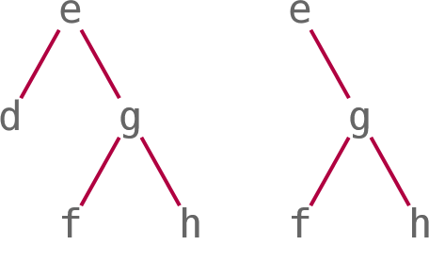
Train Details
Some parts can be arrays:
A g h is {A} g h
Two sub-types of trains:
Fork: f g h and A g h
Atop: f g
Longer trains:
(d e f g h) is (d e (f g h))
(e f g h) is (e (f g h))
Notes:
After this slide, handout "trains" cheat sheet

Slide 26
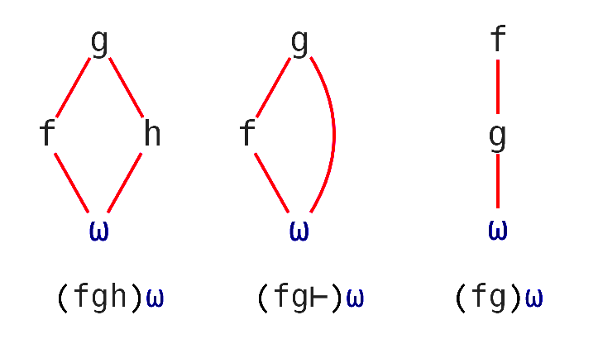
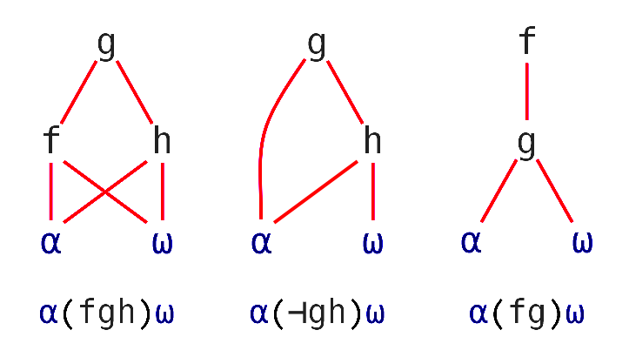
Tacit Techniques Trains
Monadic
(f Y) g (h Y) ↔ (f g h) Y
(f Y) g ( Y) ↔ (f g ⊢) Y
g (h Y) ↔ ( g h) Y
Dyadic
(X f Y) g (X h Y) ↔ X (f g h) Y
(X ) g (X h Y) ↔ X (⊣ g h) Y
g (X h Y) ↔ X ( g h) Y

Slide 27
Example: Writing a Train
{∧/ (⌈\⍵) = ⍵} 1 3 5 6 7
1
{∧/ (⌈\⍵) = (⊢⍵)} 1 3 5 6 7
1
{∧/ (⌈\ = ⊢) ⍵} 1 3 5 6 7
1
{(∧/ ⌈\ = ⊢) ⍵} 1 3 5 6 7
1
(∧/ ⌈\ = ⊢) 1 3 5 6 7
1

Slide 28
Tasks: Convert dfn to tacit
{1+⍵} 2 7 1 8
3 1 4 {(⍺∪⍵)~(⍺∩⍵)} 1 6 1
{∪⍵∨⍳⍵} 10
2 {(⍺⊃⍒⍵)⊃⍵} 2 7 1 8 3
{⍵*2} 2 7 1 8 3
3 8 2 9
3 4 6
1 2 5 10
7
4 49 1 64 9
Bonus: Find 3 ways to do this!
Notes:
1×⊢ 1∘+ ←discuss
∪~∩
∪⊢∨⍳ ∪⍤∨∘⍳⍨
⊃∘⍒⊃⊢ ⊃⍨∘⊃∘⍒⍨
*∘2 ×⍨ 2*⍨⊢

Slide 29
BREAK

Slide 30
Amazing tool: ]box on

Slide 31
]box on |⊢÷+/⍣≡
┌─┬─────────────────┐ │|│┌─┬─┬───────────┐│ │ ││⊢│÷│┌─────┬─┬─┐││ │ ││ │ ││┌─┬─┐│⍣│≡│││ │ ││ │ │││+│/││ │ │││ │ ││ │ ││└─┴─┘│ │ │││ │ ││ │ │└─────┴─┴─┘││ │ │└─┴─┴───────────┘│ └─┴─────────────────┘

Slide 32
]box on –t=… |⊢÷+/⍣≡
-t=box
┌─┬─────────────────┐ │|│┌─┬─┬───────────┐│ │ ││⊢│÷│┌─────┬─┬─┐││ │ ││ │ ││┌─┬─┐│⍣│≡│││ │ ││ │ │││+│/││ │ │││ │ ││ │ ││└─┴─┘│ │ │││ │ ││ │ │└─────┴─┴─┘││ │ │└─┴─┴───────────┘│ └─┴─────────────────┘

Slide 33
]box on –t=… |⊢÷+/⍣≡
-t=box | -t=tree
┌─┬─────────────────┐ │|│┌─┬─┬───────────┐│ │ ││⊢│÷│┌─────┬─┬─┐││ │ ││ │ ││┌─┬─┐│⍣│≡│││ │ ││ │ │││+│/││ │ │││ │ ││ │ ││└─┴─┘│ │ │││ │ ││ │ │└─────┴─┴─┘││ │ │└─┴─┴───────────┘│ └─┴─────────────────┘ | ┌─┴─┐ . | ┌─┼─┐ . ⊢ ÷ ⍣ . ┌┴┐. / ≡. ┌─┘ . + .

Slide 34
]box on –t=… |⊢÷+/⍣≡
-t=box | -t=tree | -t=parens
┌─┬─────────────────┐ │|│┌─┬─┬───────────┐│ │ ││⊢│÷│┌─────┬─┬─┐││ │ ││ │ ││┌─┬─┐│⍣│≡│││ │ ││ │ │││+│/││ │ │││ │ ││ │ ││└─┴─┘│ │ │││ │ ││ │ │└─────┴─┴─┘││ │ │└─┴─┴───────────┘│ └─┴─────────────────┘ | ┌─┴─┐ . | ┌─┼─┐ . ⊢ ÷ ⍣ . ┌┴┐. / ≡. ┌─┘ . + . | |(⊢÷((+/)⍣≡))

Slide 35
Tasks: Convert dfn to tacit
{(⊖⍵)⊥(⊖⍵)} 1 1 1 0 1 1 0 0
',;' {(~⍵∊⍺)⊆⍵} 'ab,de;fgh'
nums←2 7 1 8 3
4 {(⍺+⌿⍵)÷⍺} nums
{(+⌿⍵)÷≢⍵} nums
Bonus task: Combine 3 & 4 into an ambivalent function.
3
ab de fgh
4.5 4.75
4.2
Notes:
⊥⍨⍤⊖ ⊥⍥⊖⍨ +⌿∧⍀
~⍤∊⍨⊆⊢
+⌿÷⊣
+⌿÷≢
and 4. +⌿÷⊣∘≢

Slide 36
Issues
Arguments in operands
Lots of monadic functions
Dotting, Assignment, Recursion
Selection

Slide 37
Issues: Arguments in operands
10 {x←⍺ ⋄ ⌽@{x<⍵}⍵} 1 2 13 14 5 16 7 18
1 2 18 16 5 14 7 13
10 { ⌽@(⍺<⊢)⍵} 1 2 13 14 5 16 7 18
1 2 18 16 5 14 7 13
2 {(⌽⍤⍉⍣⍺)⍵} 3 3⍴⍳9
9 8 7
6 5 4
3 2 1

Slide 38
Issues: Lots of monadic functions
{⌽+⌿↑⌽¨⍵}
⌽⍤(+⌿)⍤↑⍤(⌽¨)
⌽(+⌿(↑⌽¨))
⌽+⌿⍤↑⍤(⌽¨)
⌽(+⌿⍤↑⌽¨)

Slide 39
Issues: Recursion, Assignment, Dotting
Namespace “dotting”
Assignment
Recursion
┐
│
┐ │
│ │
┐ │ │
│ │ │
{9≠⎕NC'⍵':⍵ ⋄ n,⍪∇¨⍵⍎¨n←⍵.⎕NL-2 9}

Slide 40
Issues: Selection
{(3>⍵)⌿⍵} 3 1 4 1 5
4 5
(3∘>⌿⊢) 3 1 4 1 5
SYNTAX ERROR
(3∘>⌿ ⊢) 3 1 4 1 5
SYNTAX ERROR
(3∘> ⊢⍤⌿ ⊢)3 1 4 1 5
4 5
3∘>⍛⌿ 3 1 4 1 5
20.0 Conference Edition

Slide 41
Issues: Selection
'aeiou' {⍵[⍺⍋⍵]} 'hello world'
eoohll wrld
'aeiou' {⍵⌷⍨⍺⍋⍵} 'hello world'
LENGTH ERROR
'aeiou' {⍵⌷⍨⊂⍺⍋⍵} 'hello world'
eoohll wrld
'aeiou' (⊂⍤⍋⌷⊢) 'hello world'
eoohll wrld
'aeiou' (⍋⊇⊢) 'hello world'
21.0?

Slide 42
Reading Tacit
operator scope
trains
putting it all together

Slide 43
Reading Tacit: operator scope
=∘⌽⍤0 1⍨∘⍳5

Slide 44
Reading Tacit: operator scope
=∘⌽⍤0 1⍨∘⍳5

Slide 45
Reading Tacit: operator scope
=∘⌽⍤0 1⍨∘⍳5

Slide 46
Reading Tacit: operator scope
=∘⌽⍤0 1⍨∘⍳5

Slide 47
Reading Tacit: operator scope
=∘⌽⍤0 1⍨∘⍳5

Slide 48
Reading Tacit: operator scope
=∘⌽⍤0 1⍨∘⍳5

Slide 49
Reading Tacit: operator scope
=∘⌽⍤0 1⍨∘⍳5

Slide 50
Reading Tacit: operator scope
=∘⌽⍤0 1⍨∘⍳5

Slide 51
Reading Tacit: operator scope
=∘⌽⍤0 1⍨∘⍳5
((((=∘⌽)⍤0 1)⍨)∘⍳)5

Slide 52
Reading Tacit: operator scope
=∘⌽⍤0 1⍨∘⍳5
((((=∘⌽)⍤0 1)⍨)∘⍳)5

Slide 53
Reading Tacit: operator scope
=∘⌽⍤0 1⍨∘⍳5
((((=∘⌽)⍤0 1)⍨)∘⍳)5

Slide 54
Reading Tacit: operator scope
=∘⌽⍤0 1⍨∘⍳5
((((=∘⌽)⍤0 1)⍨)∘⍳)5

Slide 55
Reading Tacit: operator scope
=∘⌽⍤0 1⍨∘⍳5
((((=∘⌽)⍤0 1)⍨)∘⍳)5

Slide 56
Writing Tacit: operator scope
1 {⍺⌈+/⍵} 3 1 ¯4 1 ¯5
1 ⌈∘+/ 3 1 ¯4 1 ¯5
1 ⌈∘+/ 3 1 ¯4 1 ¯5
1 (⌈∘+)/ 3 1 ¯4 1 ¯5
1 ⌈∘(+/) 3 1 ¯4 1 ¯5
1 {⍺⌈+/⍵} 3 1 ¯4 1 ¯5

Slide 57
Tasks: Convert tacit to dfn
Monadic ≠∘+⍨
Monadic ↑⍤,⍥⊂
Dyadic ↑⍤,⍥⊂
Dyadic +∘÷⍣≡
Bonus tasks:
Combine 2. and 3. into a single ambivalent function Hint: use the {⍺←… ⋄ ...} syntax
Notes:
{⍵≠+⍵}
{↑,⊂⍵}
{↑⍺⍵}
{⍺{⍺+÷⍵}⍣≡⍵}
{⍺←,⊂ ⋄ ↑⍺⍵} {⍺←⍣0 ⋄ ↑(⊂⍺),⊂⍵}

Slide 58
BREAK

Slide 59
Reading Tacit: trains
(+,-) 44
4 ¯4 .

Slide 60
Reading Tacit: trains
((+4),(-4)) .
4 ¯4 .

Slide 61
Reading Tacit: trains
(4,¯4).
4 ¯4 .

Slide 62
Reading Tacit: trains
1100 (+,-) 44 .
14 6 .

Slide 63
Reading Tacit: trains
((10+4),(10-4)) .
14 6 .

Slide 64
Reading Tacit: trains
(14,6) .
14 6 .

Slide 65
Reading Tacit: trains
(|+⌿÷1⌈≢) 3 ¯1 ¯4 1 ¯5

Slide 66
Reading Tacit: trains
(| +⌿ ÷ 1 ⌈ ≢) 3 ¯1 ¯4 1 ¯5

Slide 67
Reading Tacit: trains
(| +⌿ ÷ 1 ⌈ ≢) 3 ¯1 ¯4 1 ¯5
(| (+⌿3 ¯1 ¯4 1 ¯5) ÷ 1 ⌈ (≢3 ¯1 ¯4 1 ¯5))
(| ¯6 ÷ 1 ⌈ 5 )
(| ¯6 ÷ 5 )
(| ¯1.2 )
1.2.

Slide 68
Reading Tacit: trains
(| +⌿ ÷ 1 ⌈ ≢) 3 ¯1 ¯4 1 ¯5
(| (+⌿3 ¯1 ¯4 1 ¯5) ÷ 1 ⌈ (≢3 ¯1 ¯4 1 ¯5))
(| ¯6 ÷ 1 ⌈ 5)
(| ¯6 ÷ 5)
(| ¯1.2)
1.2

Slide 69
Reading Tacit: putting it all together
(⊂⍤?⍨∘≢⌷⊢) 'AEIOU'

Slide 70
Reading Tacit: putting it all together
(⊂⍤?⍨∘≢ ⌷ ⊢) 'AEIOU'

Slide 71
Reading Tacit: putting it all together
(⊂⍤?⍨∘≢ ⌷ ⊢) 'AEIOU'
((⊂⍤?⍨∘≢ 'AEIOU') ⌷ (⊢'AEIOU'))

Slide 72
Reading Tacit: putting it all together
(⊂ ⍤?⍨∘≢ ⌷ ⊢) 'AEIOU'
((⊂ ⍤?⍨∘≢ 'AEIOU') ⌷ (⊢'AEIOU'))
((⊂ ⍤?⍨ 5 ) ⌷ 'AEIOU' )

Slide 73
Reading Tacit: putting it all together
( ⊂ ⍤?⍨∘≢ ⌷ ⊢) 'AEIOU' .
(( ⊂ ⍤?⍨∘≢ 'AEIOU') ⌷ (⊢'AEIOU')) .
(( ⊂ ⍤?⍨ 5 ) ⌷ 'AEIOU' ) .
((5 ⊂ ⍤? 5) ⌷ 'AEIOU' ) .

Slide 74
Reading Tacit: putting it all together
( ⊂ ⍤ ?⍨∘≢ ⌷ ⊢) 'AEIOU' .
(( ⊂ ⍤ ?⍨∘≢ 'AEIOU') ⌷ (⊢'AEIOU')) .
(( ⊂ ⍤ ?⍨ 5 ) ⌷ 'AEIOU' ) .
((5 ⊂ ⍤ ? 5) ⌷ 'AEIOU' ) .
(( ⊂ 5 ? 5) ⌷ 'AEIOU' ) .

Slide 75
Reading Tacit: putting it all together
( ⊂ ⍤ ?⍨∘≢ ⌷ ⊢) 'AEIOU' .
(( ⊂ ⍤ ?⍨∘≢ 'AEIOU') ⌷ (⊢'AEIOU')) .
(( ⊂ ⍤ ?⍨ 5 ) ⌷ 'AEIOU' ) .
((5 ⊂ ⍤ ? 5) ⌷ 'AEIOU' ) .
(( ⊂ 5 ? 5) ⌷ 'AEIOU' )

Slide 76
Tasks: Convert tacit to dfn
Monadic ××⌊⍤|
Dyadic ⌊∘≢↑⊢
Dyadic ≡⍥(⎕C~∘' ')
Monadic +/⊢>+/÷≢
Bonus task:
Monadic ⌽≡⊢⊢≡⌽
Notes:
{(×⍵)×⌊|⍵}
{(⍺⌊≢⍵)↑⍵}
{F←{⎕C⍺~' '} ⋄ (F⍺)≡(F⍵)}
{+/⍵>(+/⍵)÷≢⍵}
{⍵≡⌽⍵} but technically {⌽(≡⍵)⊢⍵≡⌽⍵}

Slide 77
Tasks: Determine valence
1+⍴⊥¯1∘+
+/∧\⍤=
|¯11|1⊥+\
1 1⍉∘.+
,⍥⍉
/⍥,
Notes:
Monadic
Dyadic
Monadic
Dyadic
Ambivalent
Dyadic

Slide 78
Reading Tacit: tacit.help

Slide 79
Task: Working with tacit code
This dyadic function is like ⍳ but gives 0 for “not found”:
(⍳×≢⍤⊣≥⍳)
Make it more efficient by:
Breaking out ⍳ from the parenthesis Hint: Pass all the data you need to the inner function
Then simplify it by:
Using ⍤ instead of ∘ and adjusting the rest as necessary
Notes:
(⍳×≢⍤⊣≥⍳)
(⊣(⊢×≢⍤⊣≥⊢)⍳)
(⊣(⊢×≢⍤⊣≥⊢)⍳)
(⍳(⊣×≢⍤⊢≥⊣)⊣)
(⍳(⊣×⊣≤≢⍤⊢)⊣)
(⍳(⊣×⊣≤∘≢⊢)⊣)
(⍳(⊣×≤∘≢)⊣)
(⊣(⊢×≢⍤⊣≥⊢)⍳)
(≢⍤⊣(⊢×⊣≥⊢)⍳)
(≢⍤⊣(⊢×≥)⍳ )
(≢⍤⊣(≥×⊢)⍳ )

Slide 80
Task: Working with tacit code
This function is applied to a non-empty numeric vector:
(+\∊⍨∘⍳+/)
Make it more efficient by:
Breaking out +\ from the parenthesis
Computing what would be +/ from +\ Hint: +/ is the last element of +\
Notes:
(+\∊⍨∘⍳+/)
((⊢∊⍨∘⍳⊢/)+\)
((⊢∊⍨∘⍳⊃⍤⌽)+\)
((⊢∊⍨∘⍳⊃⍤⌽)+\)
((⍳⍤⊃⍤⌽∊⊢)+\)
(⍳⍤⊃∘⌽⍛∊+\) in v20.0

Slide 81
Function composition:
⍥ Pre-process both
∘ Pre-process right
⍤ Post-process
⍨ Selfie
Operators: long left scope
Trains: odd-even from right
Tools: ]box on -t=…
tacit.help
Issues with tacit:
Arguments in operands
Lots of monadic functions
Namespace “dotting”
Assignment
Recursion
Selection: ⊢⍤⌿
⊂⍤… ⌷ …

