Slide 1
Migrating Your ⎕WC GUI to Linux, macOS, and the Cloud
Morten Kromberg
Karl Holt

Slide 2
Goals
Show you how to install ”Everywhere WC”
Give you some time to play with it
Get input on priorities – which missing features to attack first?

Slide 3
What is "Everywhere" WC?
An implementation of a subset of ⎕WC, which can run on any Dyalog platform
Windows, Linux, MacOS Desktops using HTMLRenderer
As a web server served up by any Dyalog interpreter
Also extends ⎕WC, adding
A native Ribbon control
ApexCharts Graphics
”Any widget library you want”

Slide 4
Why EWC?
1. Protect existing investments
Since 1990, ⎕WC has made it possible for domain experts to be ”full stack” developers
⎕WC is perhaps the most important reason why Dyalog has been successful
⎕WC is is restricted to the Microsoft Windows desktop, which is fading

Slide 5
Why EWC?
2. Build New Applications
EWC can easily be extended with JavaScript libraries
Potential migration path for existing code to ”responsive” layout
Replace Posn/Size with Flex CSS
EWC is a uniquely interactive web development environment

Slide 6
Current Status
Worked on prototype for 12 months with an external contractor
Hired a full-time JavaScript developer – Welcome Neil!
Free and Open Source
We will document how to create & share your own extensions
We expect to add features quickly this winter
Send us sample apps / tell us what you need

Slide 7
Current Status
Supported subset has been driven by the needs of two launch customers
One converting a mature asset management system which needs to move off the Windows desktop
One building new web components in APL to enhance an existing C#/JS based web app
Both of these should be up & running very soon
Many features are still being developed
NB: The list of missing & supported features is likely to be out of date within a few days of this workshop!

Slide 8
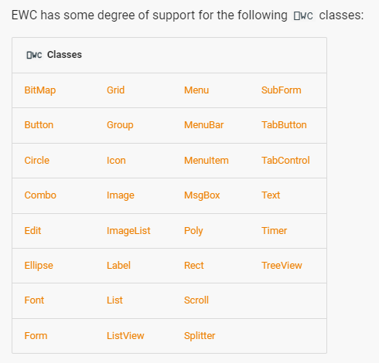
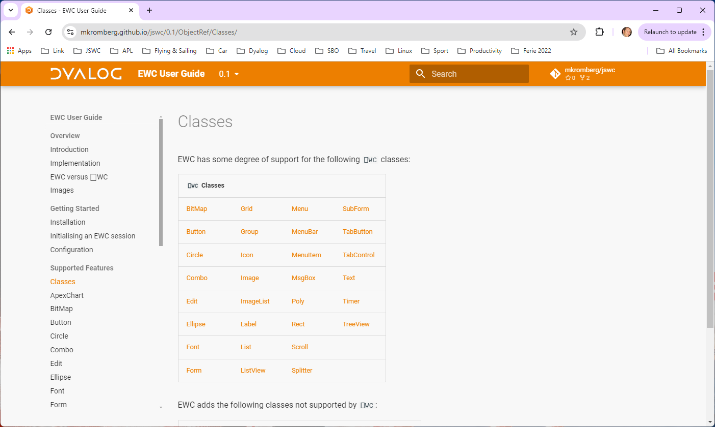
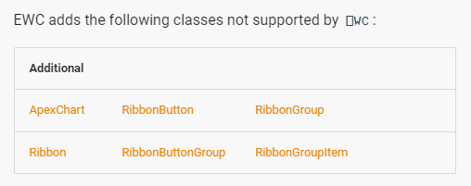

Slide 9
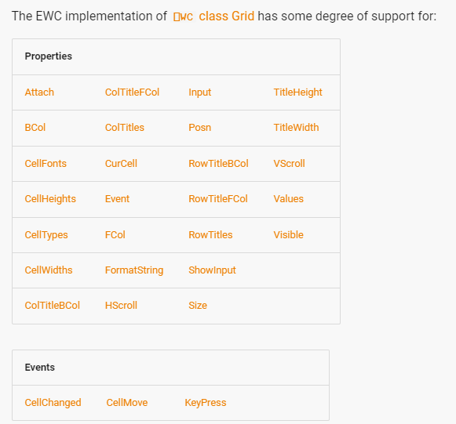
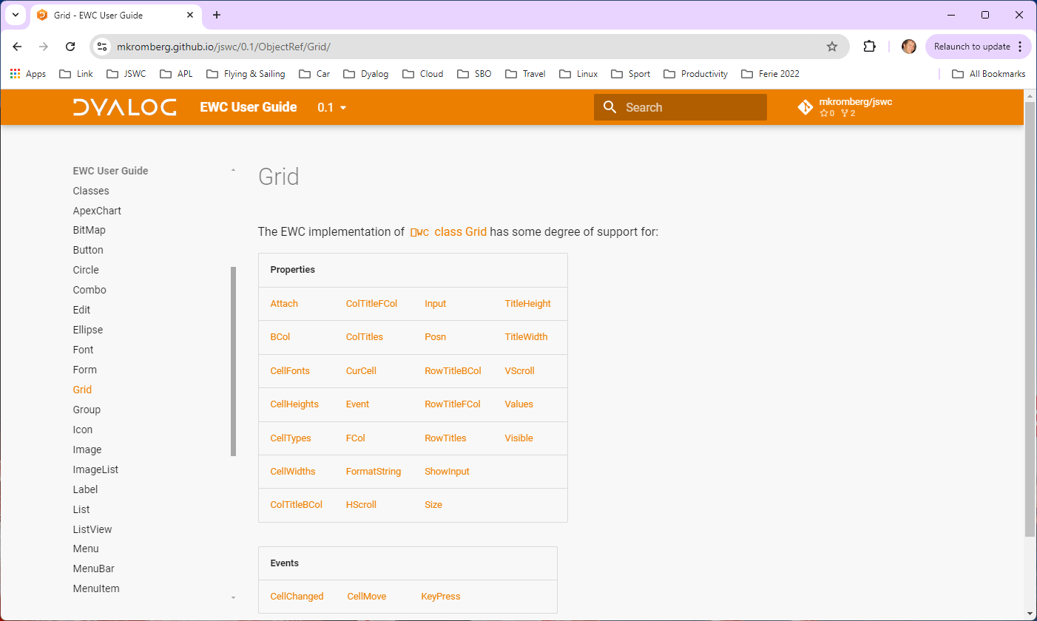
Being added as applications need them.

Slide 10
Exercise 1 - Installation
Clone the github repository
https://github.com/dyalog/ewc
Or download and unzip the zip file from the repo (see next slide)

Slide 11
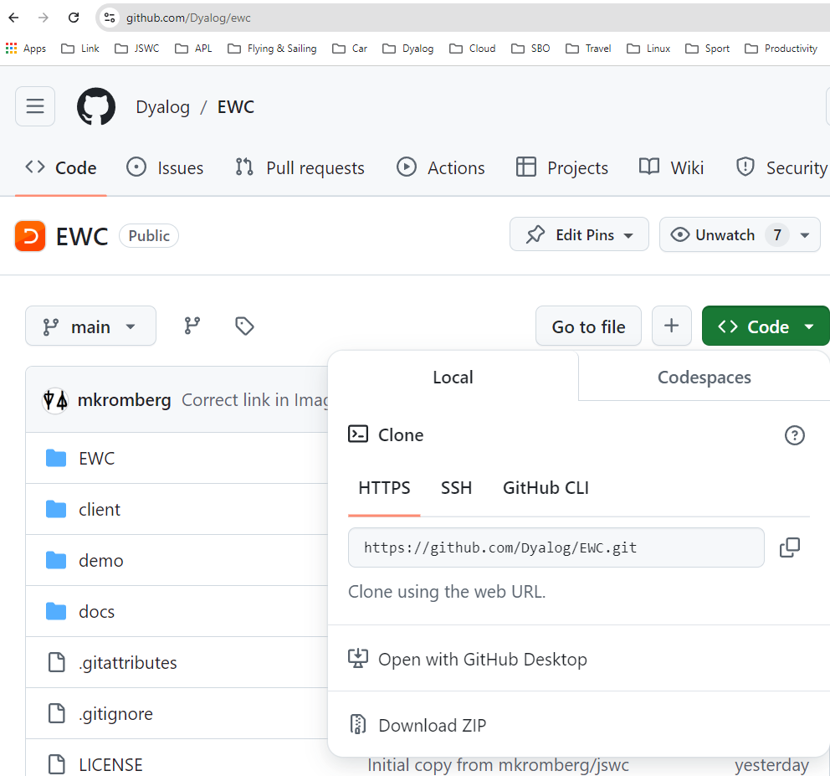
Exercise 1 - Installation
Clone the github repository
Or download and unzip the zip file
Verify installation:
]link.create # /path/to/ewc demo.Run 'Desktop'

Slide 12
Exercise 1a - Installation
Verify installation:
]link.create # /path/to/ewc
EWC.Version EWC Server: 0.1.1, Client: Unknown
demo.Run 'Desktop'
NB: You *must* place EWC in the root (#.EWC)

Slide 13
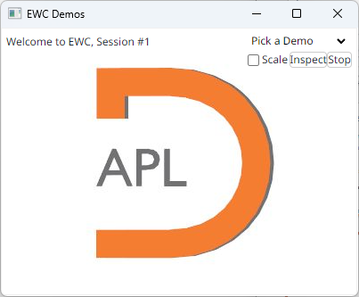

Slide 14
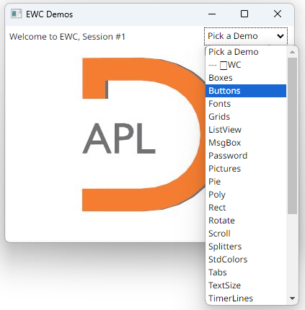
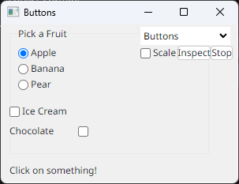

Slide 15
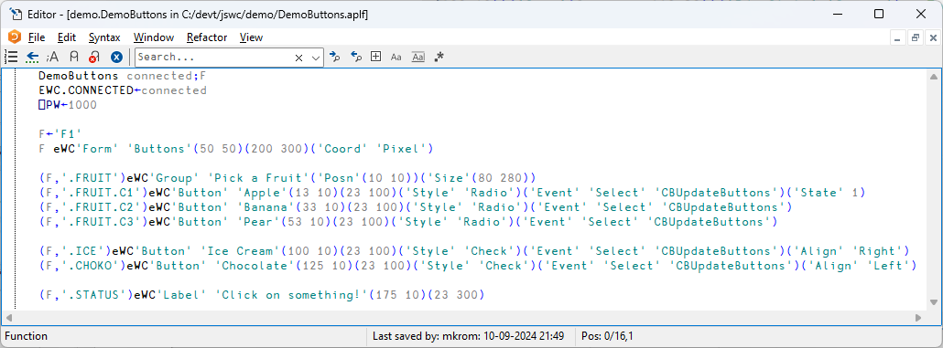

Slide 16
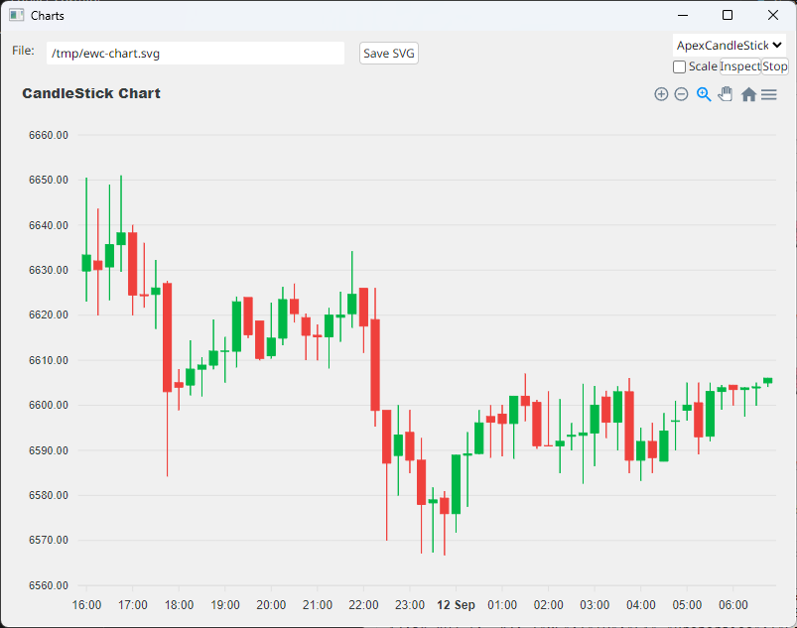
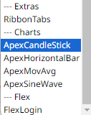
The Demo Application
Demos of Extensions

Slide 17
Exercise 1b – Find Documentation
Navigate to https://dyalog.github.io/EWC
Notice that when you click on the name of a property, it opens the ⎕WC documentation.
The EWC documentation describes differences between EWC and ⎕WC

Slide 19
Exercise 2 – Hello World
Create a new namespace for your application
Write your own function which
Calls #.EWC.Init 'Desktop'
Creates a Form with a Button on it and a callback on Select
NB: you want to experiment interactively rather than having your function call eDQ, you must set EWC.NOIDQ←0 ⍝ Enable Interactive DQ

Slide 20
How does it work?

Slide 21
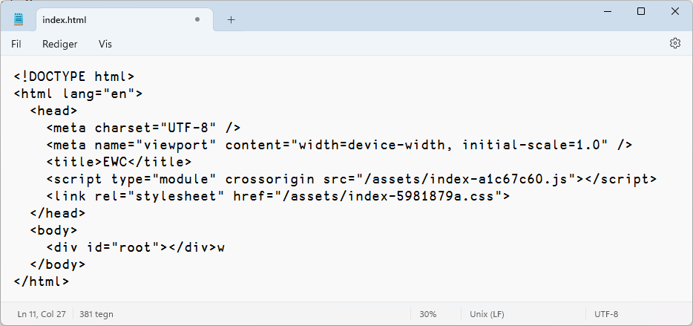
How Does it Work?
Conga server is created listening on port 22322
HTMLRenderer or Web Browser launched at http://localhost:22322/index.html

Slide 22
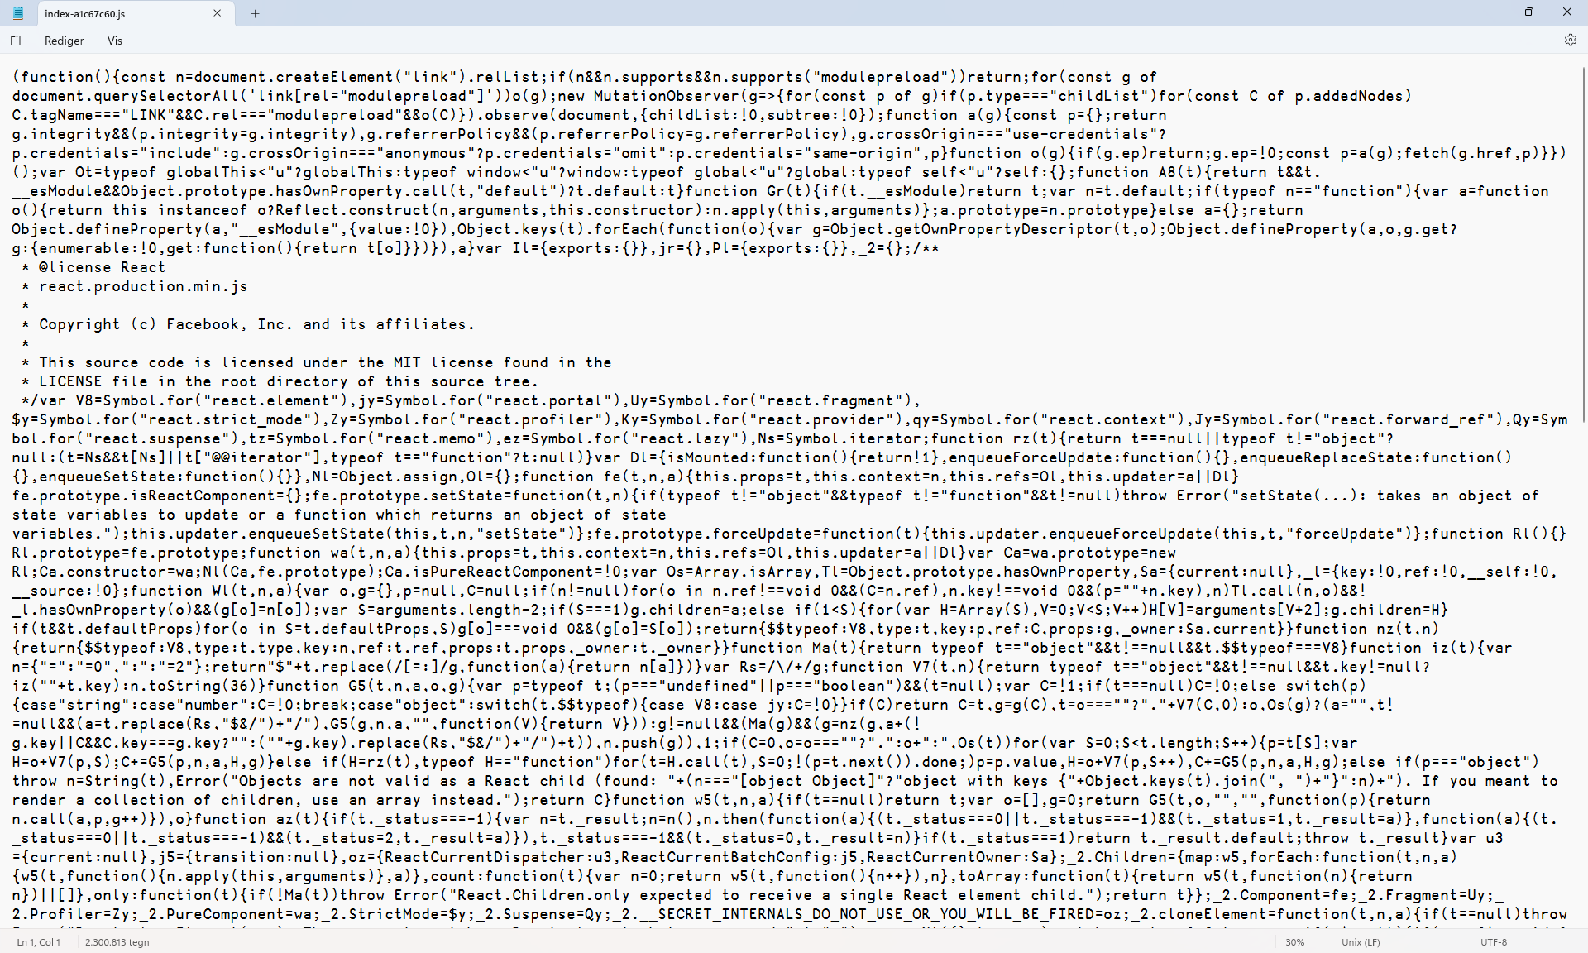
A ”React” application runs...

Slide 23
A WebSocket is Born
Log messages are timestamped mm.ss.ttt since session start. R=Receive, T=Transmit, C=Create 07:53.071 C: Session 1 created, socket 2, connected from [::1]:57082, key: LIZpDGotmvS+MjRF1uu//g==
JavaScript Client tells us something about it’s environment: 07:53.077 R: #2: {"DeviceCapabilities":{"ViewPort":[301,401],"ScreenSize":[1440,2560],"DPR":1,"PPI":200}} 07:53.083 R: #2: {"Initialise":{"Version":"0.2.0","Name":"EWC Client","URL":"http://localhost:22322/"}}
APL Server says how it wants things (you can customise these): 07:53.127 T: {"Options":{"ID":"Mode","Properties":{"Desktop":1}}} 07:53.134 T: {"Options":{"ID":"Locale","Properties":{"Decimal":".", "LongDate":"D. MMMM YYYY","ShortDate":"DD-MM-YYYY","Thousand":","}}} 07:53.139 T: {"Options":{"ID":"Colors","Properties":{"Standard":[[-1,"Scrollbar",[200,200,200]],[-2,"Background",[0,0,0]], [-3,"ActiveTitle",[153,180,209]],[-4,"InactiveTitle",[191,205,219]],blablabla,[-21,"ButtonHilight",[255,255,255]]]}}} 07:53.190 T: {"Options":{"ID":"Fonts","Properties":{"Scale":1}}}

Slide 24
Typical Web Socket Traffic
'F1' eWC 'Form' 'Buttons' (50 50) (200 300) ('Coord' 'Pixel')
➔ {"WC": {"ID":"F1", "Properties":{"Caption":"Buttons","Coord":"Pixel", "Posn":[0,0],"Size":[200,300],"Type":"Form"}}}
'F1.STATUS' eWC 'Label' 'Click on something!' (175 10) (23 300)
➔ {"WC":{"ID":"F1.STATUS", "Properties":{"Caption":"Click on something!", "Posn":[175,10],"Size":[23,300],"Type":"Label"}}}
(user selects Ice Cream)
⬅ {"Event":{"EventName":"Select","ID":"F1.ICE"}} optstate←'F1.ICE' 'F1.CHOKO' eWG¨ ⊂'State'
➔ {"WG":{"ID":"F1.ICE","Properties":["State"],"WGID":"7"}} ⍝ Ask client for state of F1.ICE ⬅ {"WG":{"ID":"F1.ICE","Properties":{"State":1},"WGID":"7"}} ⍝ State=1
➔ {"WG":{"ID":"F1.CHOKO","Properties":["State"],"WGID":"8"}} ⬅ {"WG":{"ID":"F1.CHOKO","Properties":{"State":0},"WGID":"8"}}

Slide 25
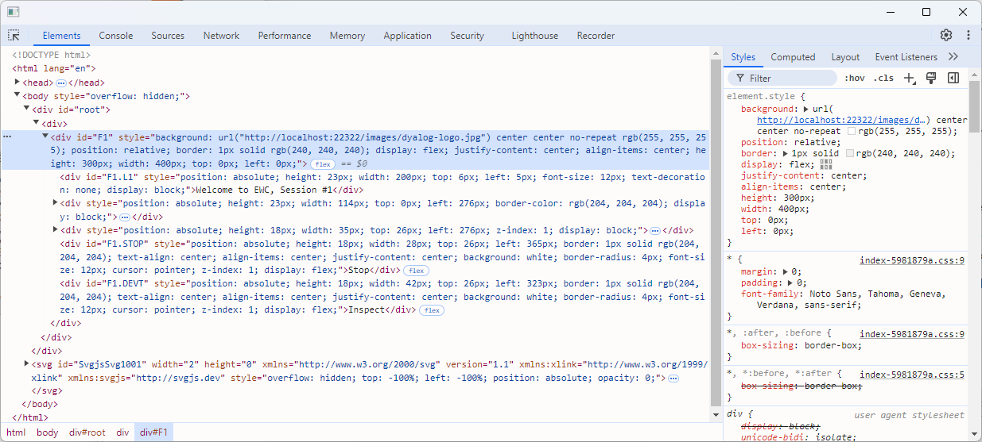
For the really Curious
Inspect what the React code has generated

Slide 26
Configuration

Slide 27
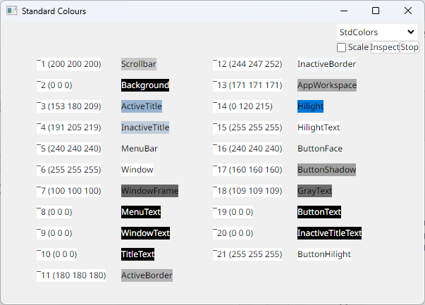
Changing the Colour Scheme
This is a hack, need better method
NB: EWC controls do not currently always use the correct colours
EWC.settings.Colors.Standard ¯1 Scrollbar 200 200 200 ¯2 Background 0 0 0 ¯3 ActiveTitle 153 180 209 ¯4 InactiveTitle 191 205 219 ¯5 MenuBar 240 240 240 ¯6 Window 255 255 255 ¯7 WindowFrame 100 100 100 ¯8 MenuText 0 0 0 ¯9 WindowText 0 0 0 ¯10 TitleText 0 0 0 ¯11 ActiveBorder 180 180 180 ¯12 InactiveBorder 244 247 252 ¯13 AppWorkspace 171 171 171 ¯14 Hilight 0 120 215 ¯15 HilightText 255 255 255 ¯16 ButtonFace 240 240 240 ¯17 ButtonShadow 160 160 160 ¯18 GrayText 109 109 109 ¯19 ButtonText 0 0 0 ¯20 InactiveTitleText 0 0 0 ¯21 ButtonHilight 255 255 255

Slide 28
Changing Locale Settings
Not terribly well tested
But if it doesn’t work, we will fix it ☺
⎕JSON⍠'Compact' 0⊢EWC.settings.Locale { "Decimal": ".", "LongDate": "D. MMMM YYYY", "ShortDate": "DD-MM-YYYY", "Thousand": ",” }

Slide 29
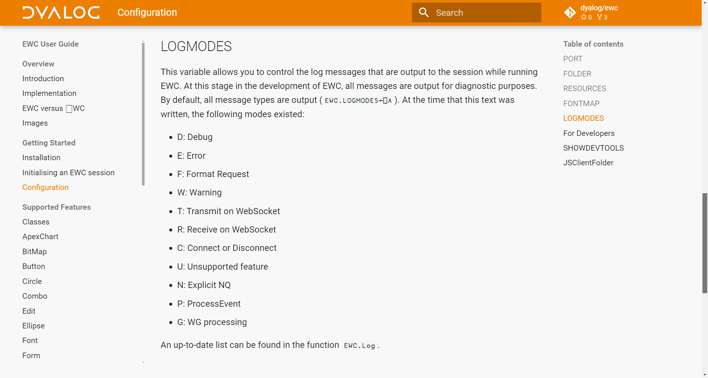

Slide 30
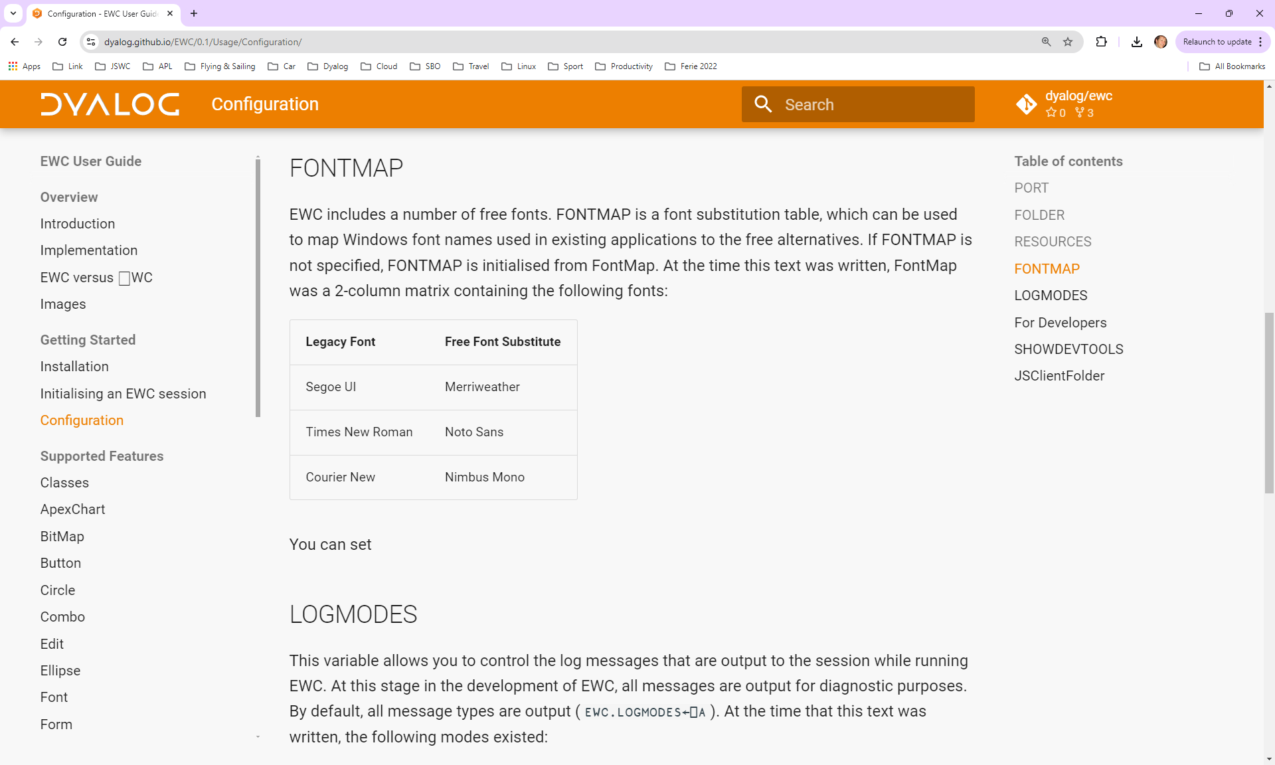

Slide 31
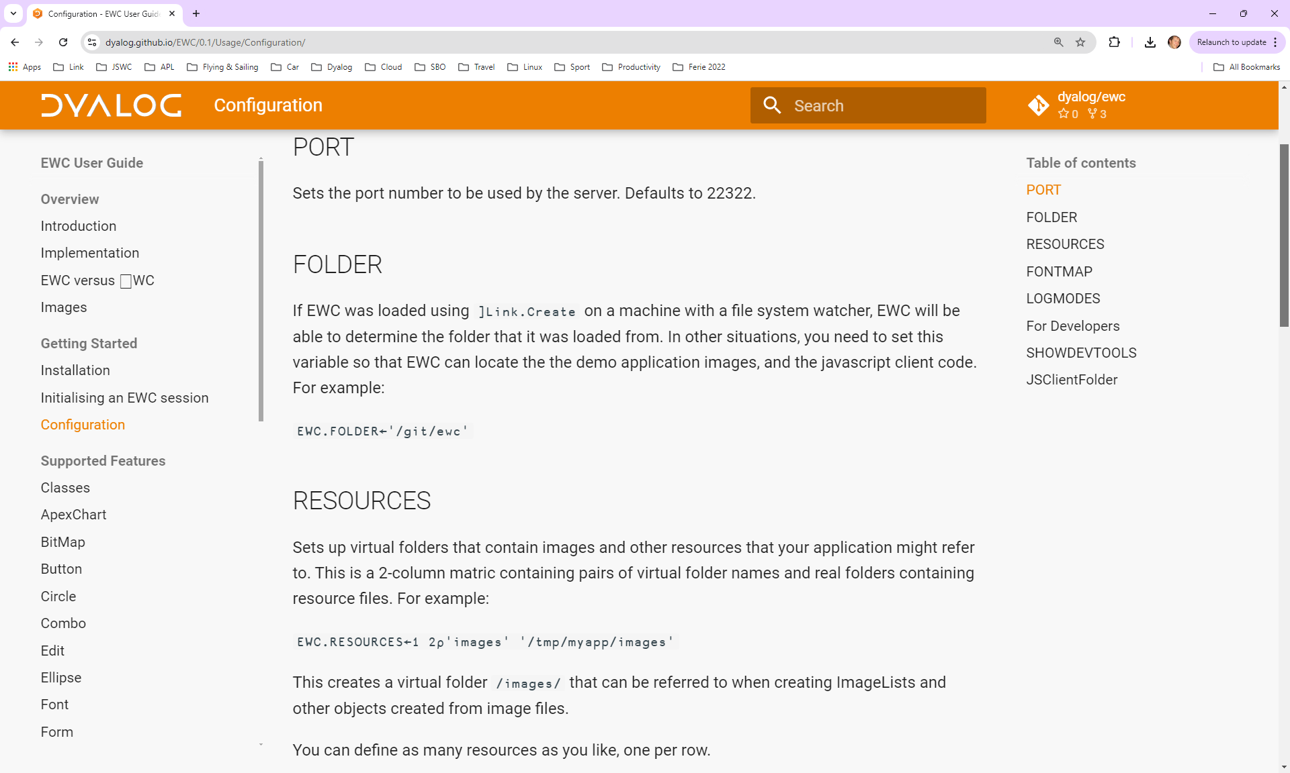

Slide 32
Images
All images must reside on the server
Adding hundreds or thousands of anonymous bitmap children to ImageList objects works fine on the desktop, but ...
EWC ImageLists are simply a list of file names
This will require code changes
Hopefully only a few lines during startup
More file types supported – anything a browser can render

Slide 33
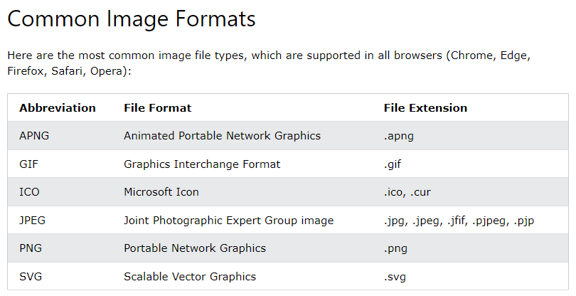
Images

Slide 34
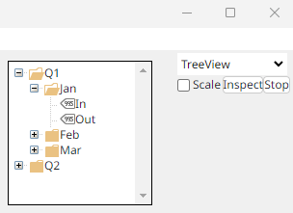
EWC ImageLists
DemoTreeView connected;... ... ... imagefiles←'/images/'∘,¨'Folder-Closed.png' 'Folder-Open.png' 'Price-Ticket.png' 'IL' eWC 'ImageList'('Size'(16 16))('Masked' 2)('Files' imagefiles) ... ... 'F1.Months' eWC 'TreeView' periods (10 500)(150 150) ('Depth'(20⍴0,9⍴1 2 2)) ('ImageListObj' '#.IL') ('ImageIndex' (imix←20⍴1,9⍴1 3 3)) ...

Slide 35
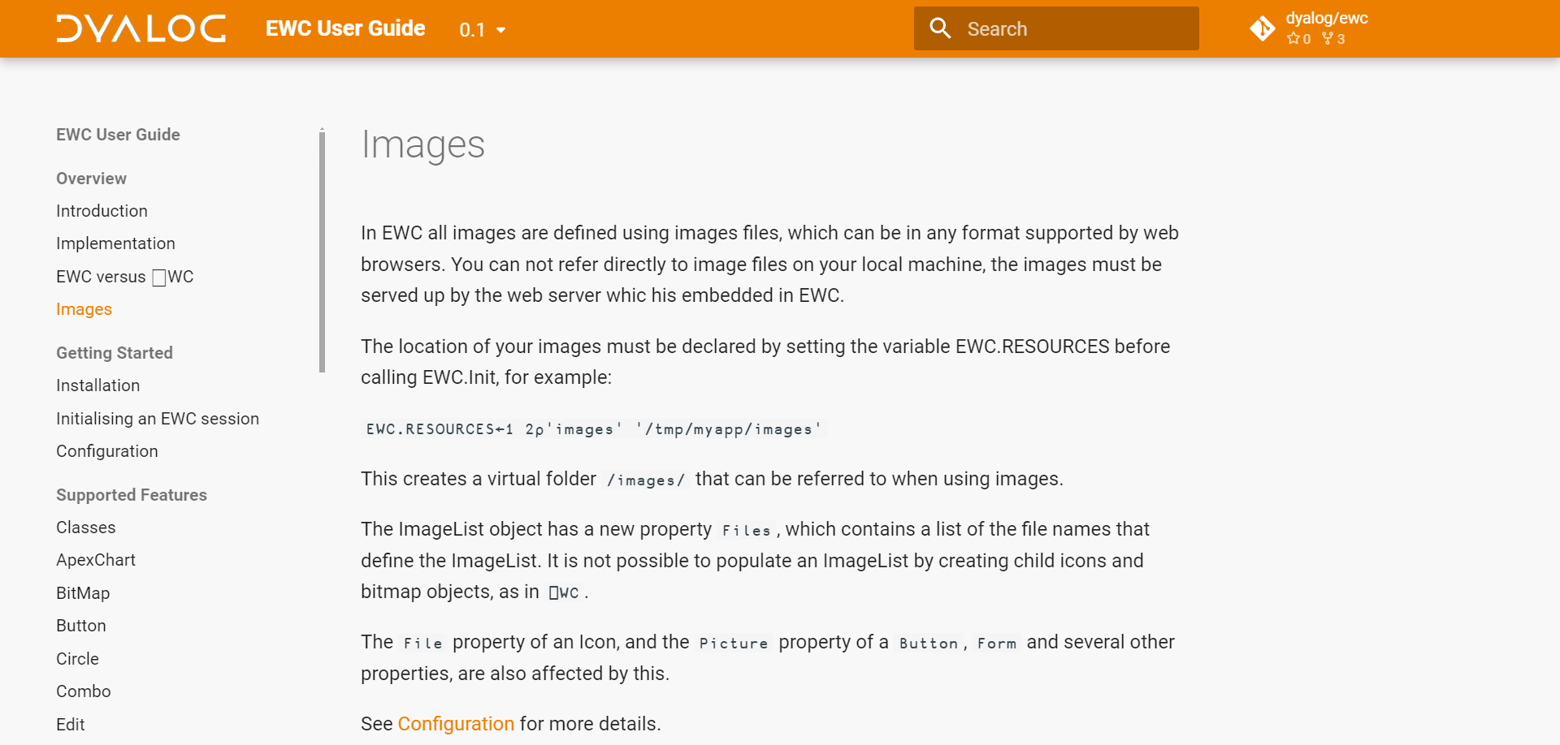
Images

Slide 36
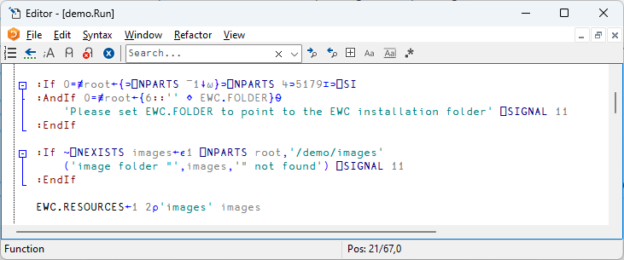
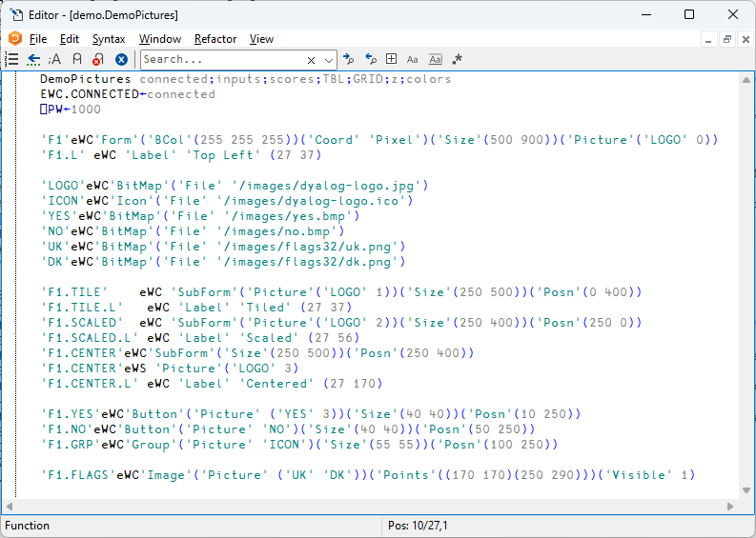

Slide 37
Exercise 3 – Images
Place an image in a folder
Set EWC.RESOURCES to point to it before you call EWC.Init.
Use EWC.Stop to shut down an existing server
Add an object which uses your image
ImageList BitMap Icon ...
Add something to the form which uses that
Hint: See DemoPictures or DemoTreeView

Slide 38
Current Limitations / Differences
Limited set of Classes & Props
Coord Pixel only
No direct assignment and reference to properties – everything must go through ⎕WS / ⎕WG
No creation using ⎕NEW
Close & Resize of HTMLRenderer not working under eDQ
Images and ImageLists are handled differently (better!)
Validation and Error Messages weaker / different
⎕NQ may not behave exactly as under Windows
Callbacks returning new event codes is questionable
EWC must be #.EWC and eWC is only instantiated in one place

Slide 39
Unsupported Features
EWC tries to "ignore" use of missing features,
Get something up and running and either modify your code or ask Dyalog to add support
If you try to create an instance of an unsupported class
FOO[7] 'W0' eWC 'Widget' 'Hello World' ('Size' (300 400)) 40:32.702 W: *** Warning: at FOO[7] - WC W0 - unsupported class "widget"
The following still creates a form, ignoring the unsupported feature:
FOO[7] 'F0' eWC 'Form' 'Hello World' ('Size' (300 400)) ('Dockable' 1) 38:58.307 W: *** Warning: at FOO[7] - Unsupported on form: Dockable

Slide 40
Extensions
Ribbon family of controls
ApexCharts
”Flex” instead of Posn + Size
DIY Extensions (KendoUI)

Slide 41
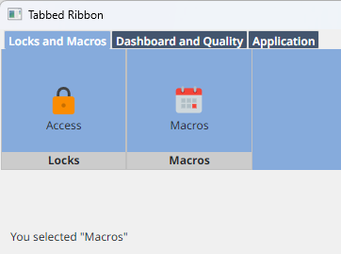
Ribbons
DemoRibbonTabs

Slide 42
Ribbons

Slide 43
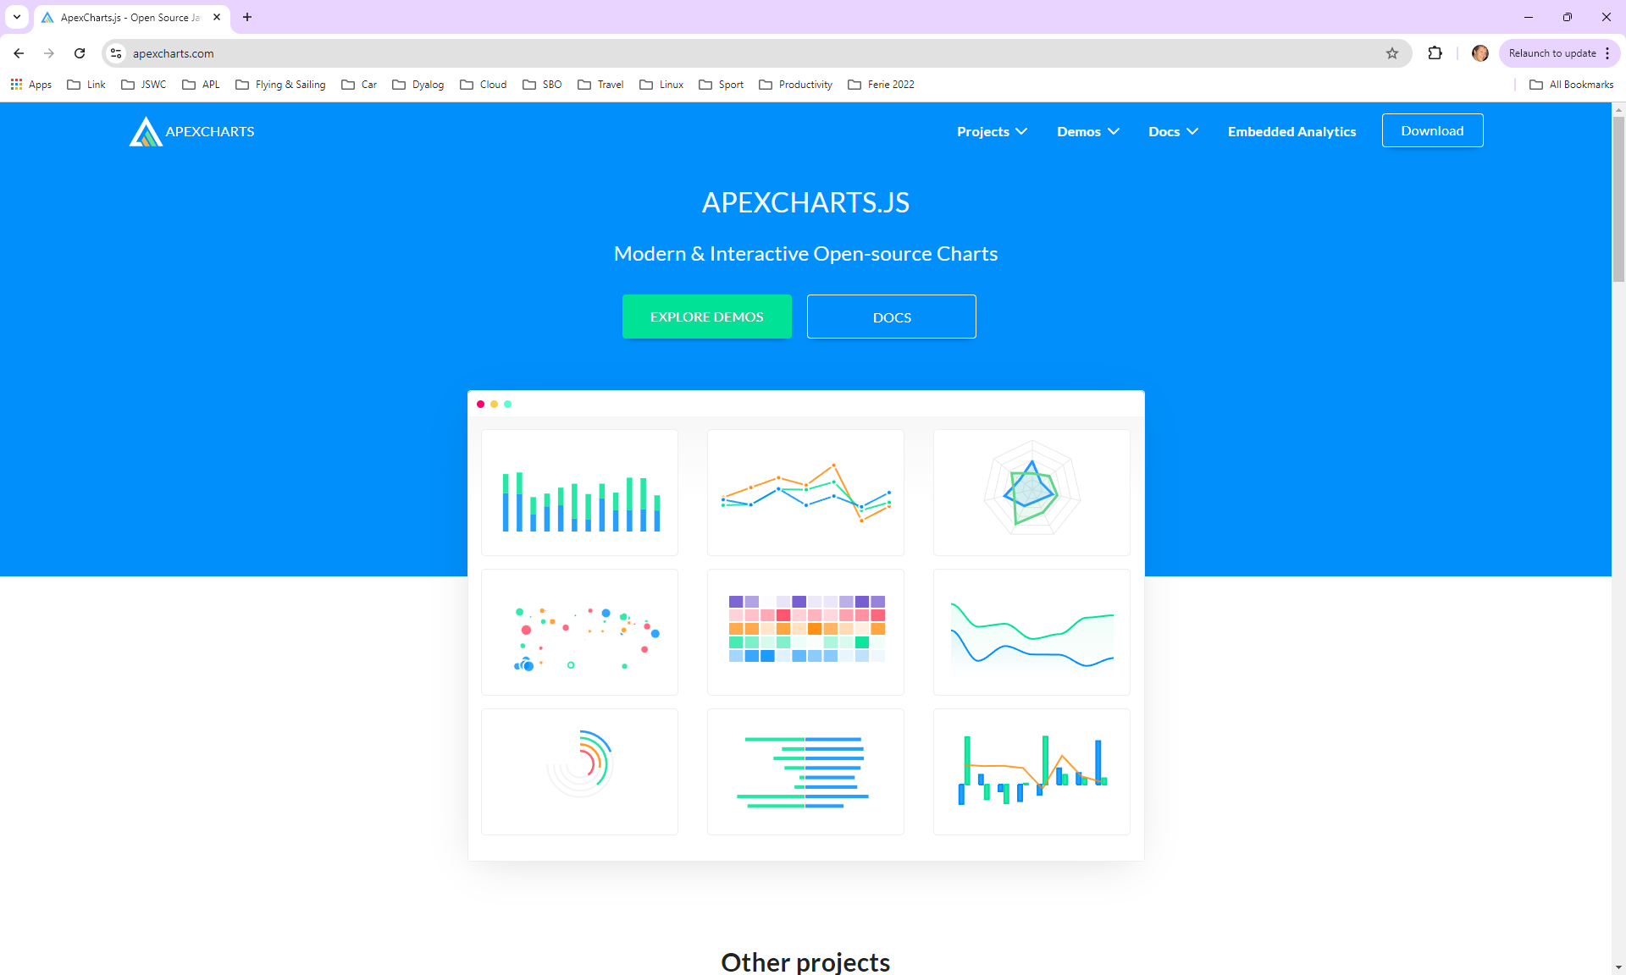
ApexCharts

Slide 44
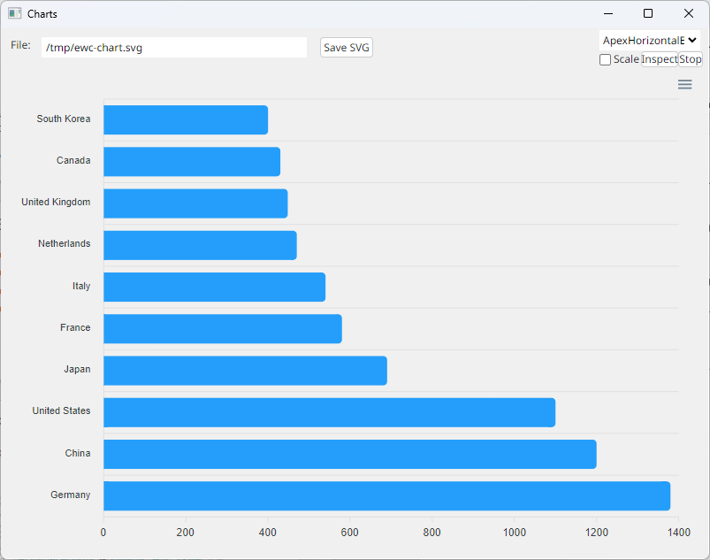
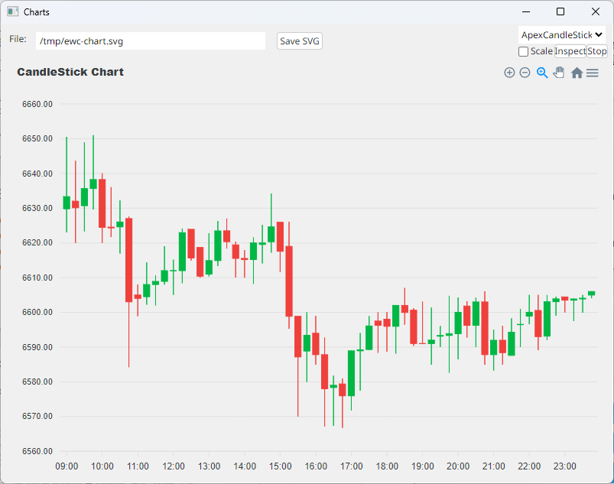
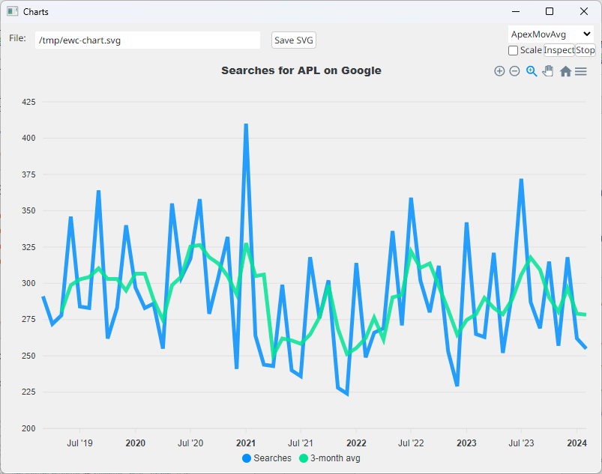
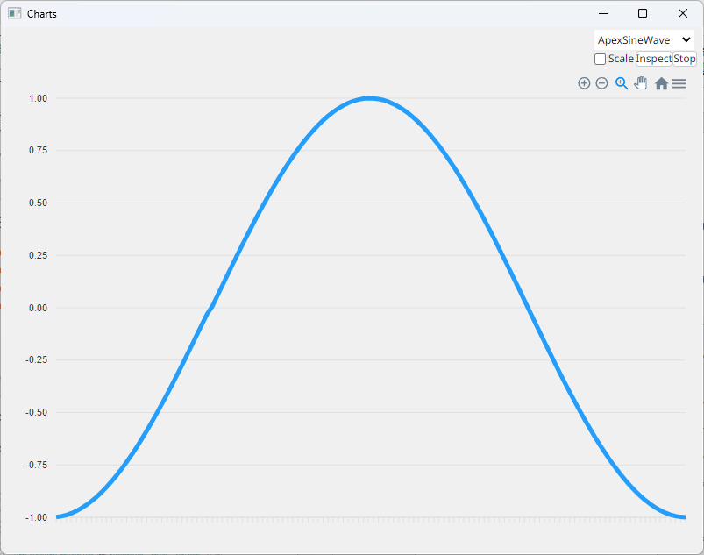
ApexCharts – Four Demos

Slide 45
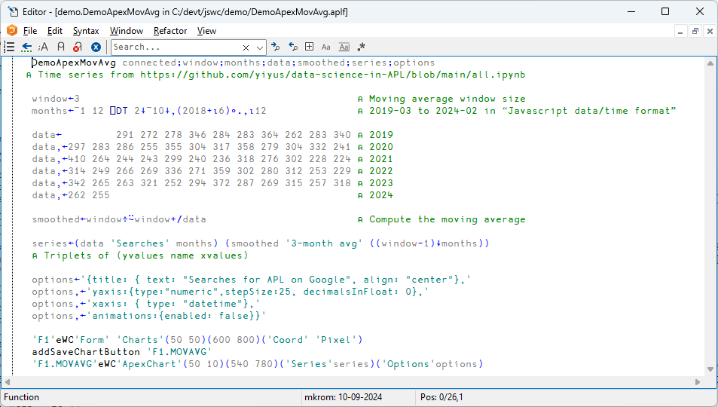

Slide 46
{"WC":{"ID":"F1.MOVAVG","Properties": {"Options":{"animations":{"enabled":false},"title":{"align":"center","text":"Searches for APL on Google"}, "xaxis":{"type":"datetime"},"yaxis":{"decimalsInFloat":0,"stepSize":25,"type":"numeric"}}, "Posn":[50,10], "Series":[{"data":[ {"x":1551398400000,"y":291},{"x":1554076800000,"y":272},{"x":1556668800000,"y":278}, {"x":1559347200000,"y":346},{"x":1561939200000,"y":284},{"x":1564617600000,"y":283}, {"x":1567296000000,"y":364},{"x":1569888000000,"y":262},{"x":1572566400000,"y":283}, ...

Slide 47
ApexCharts
This only took 1-2 days to set up(!)
Options are passed straight through (JSON string or APL namespace)
Series can be in several APL-friendly formats:
HorizontalBar
CandleStick
MovAvg

Slide 48
ApexCharts SVG Property
The SVG property allows us to retrieve the SVG for the chart
Use ApexCharts in an invisible HTMLRenderer to generate charts
≢svg←'F1.BAR' eWG 'SVG' 29820
4 80⍴svg
<svg id="SvgjsSvg1006" width="780" height="540" xmlns="http://www.w3.org/2000/sv
g" version="1.1" xmlns:xlink="http://www.w3.org/1999/xlink" xmlns:svgjs="http://
svgjs.dev" class="apexcharts-svg" xmlns:data="ApexChartsNS" transform="translate
(0, 0)" style="background: transparent;"><foreignObject x="0" y="0" width="780"

Slide 49
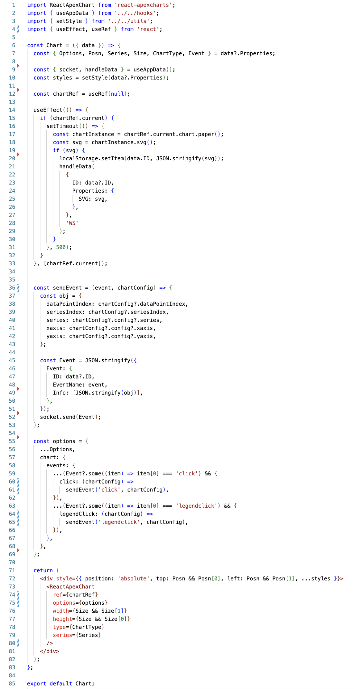
Extending EWC
Slide from Neil on what JS was needed to add ApexCharts will be here

Slide 50
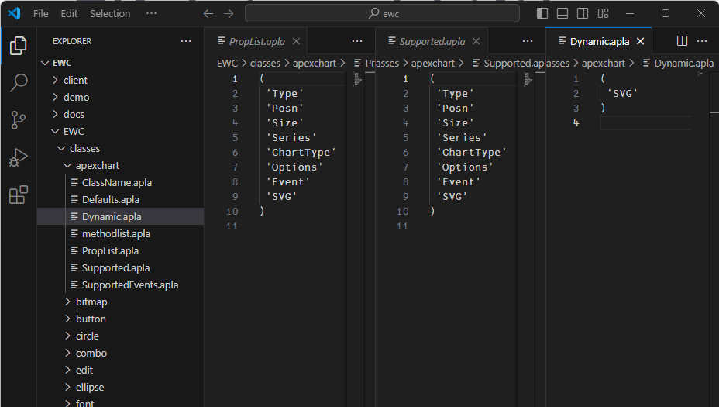
Add Metadata for new Class

Slide 51
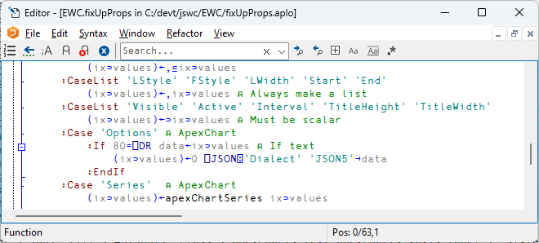
+ Optional Property Handler

Slide 52
+ Optional Property Handler

Slide 53
+ Optional Property Handler

Slide 54
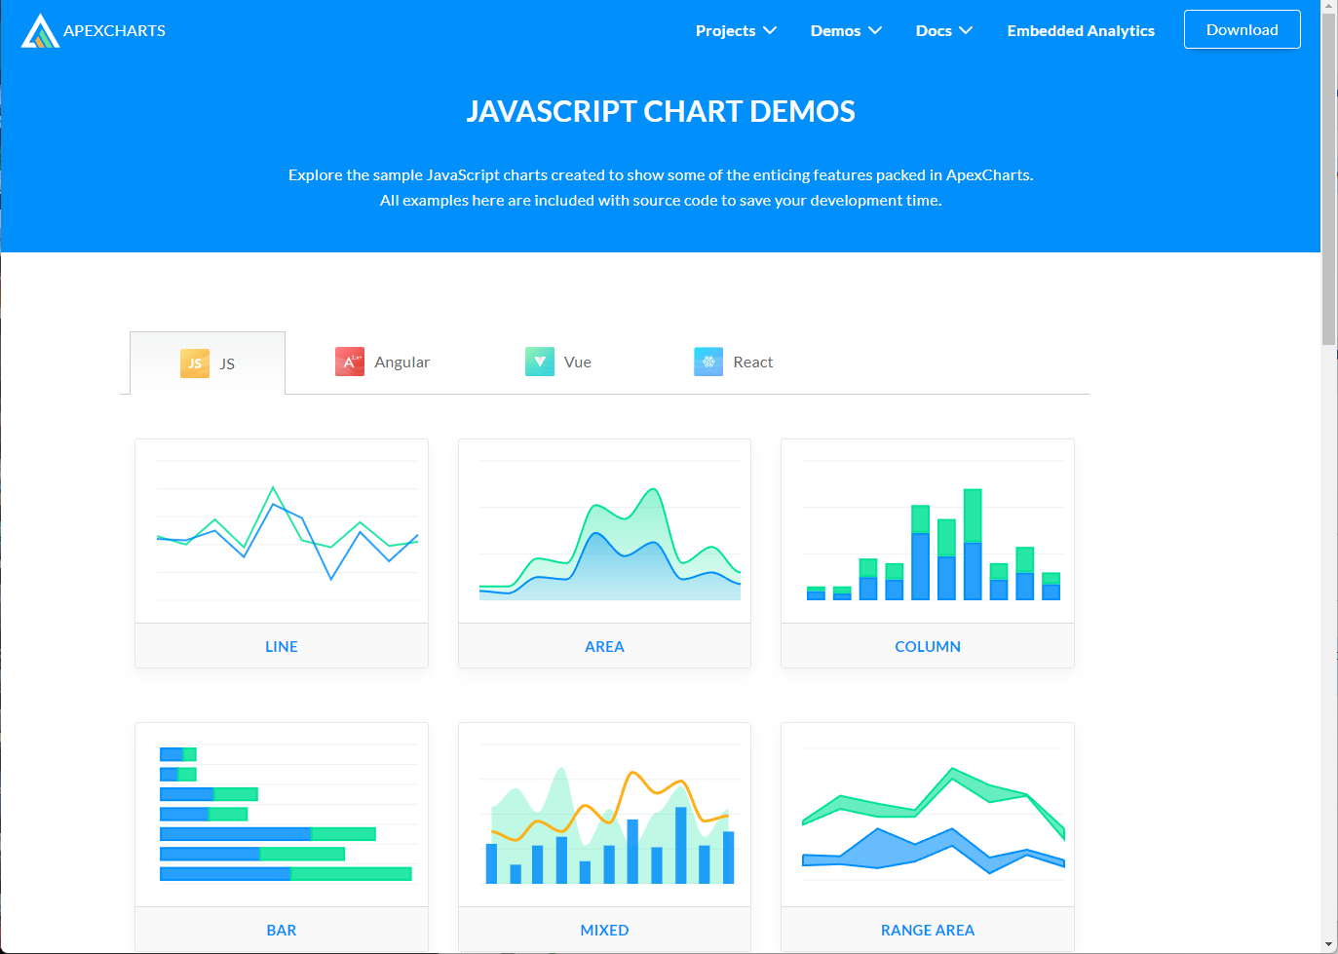
Exercise 4 – ApexCharts
Browse the ApexChart demos
Add a Line chart to your application
More than one line, with a legend?
https://apexcharts.com/javascript-chart-demos/

Slide 55
Flex – Instead of Posn & Size
Still VERY experimental – Feedback Please!
The Flex property can be set on containers
'Flex' 'fill' Form should fill the available space (Forms only)
'Flex' 'row' Stack controls horizontally (Any container object)
'Flex' 'column' No comment
By default, 'fill' sets column orientation
CSS property allows you to add additional CSS styling

Slide 56
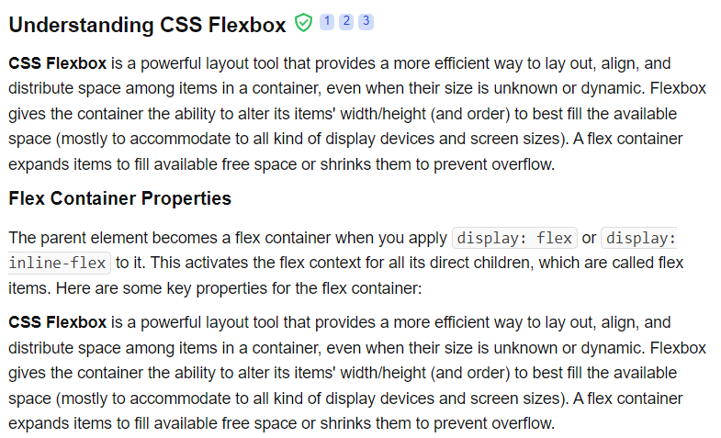

Slide 57
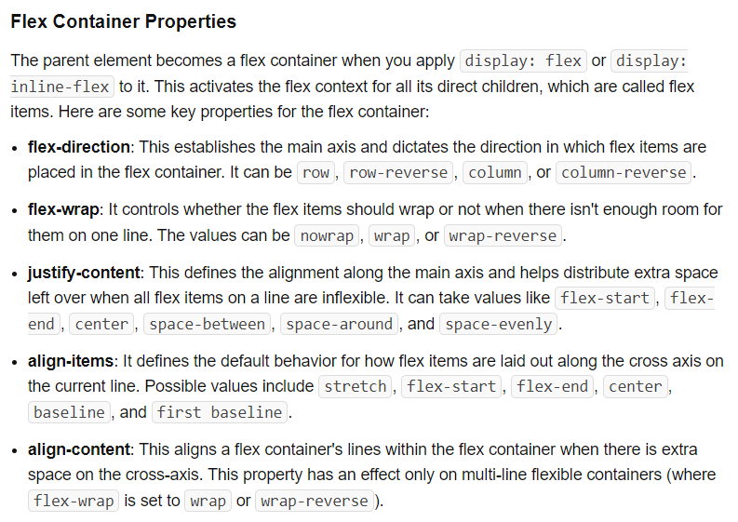

Slide 58
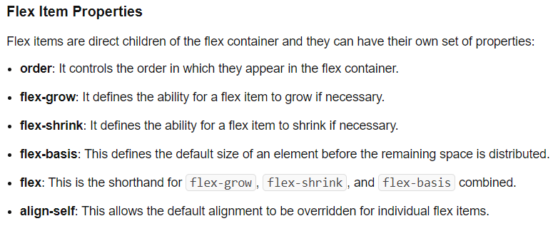
Not Yet Supported

Slide 59
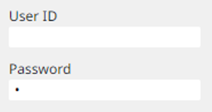
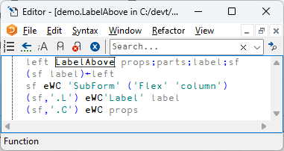
SubForm = "StackPanel"
A Subform with Flex becomes a "StackPanel"

Slide 60
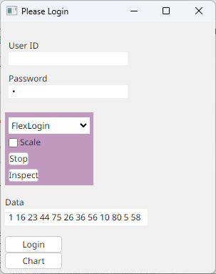
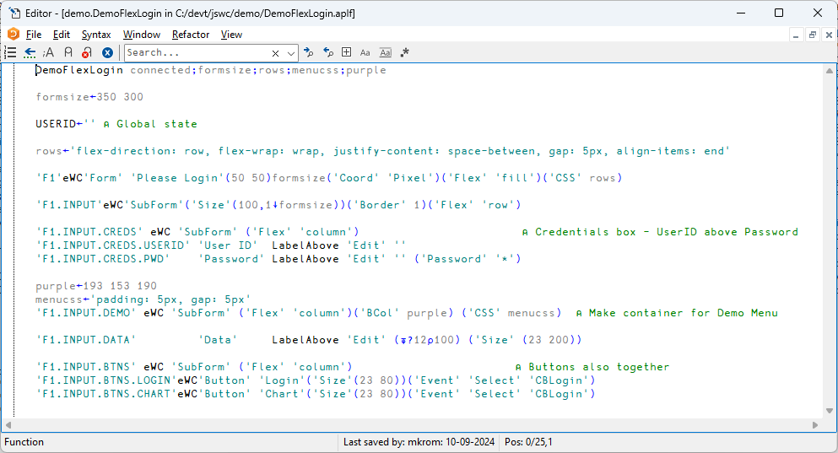
FlexLogin
Probably no Exercise

Slide 61
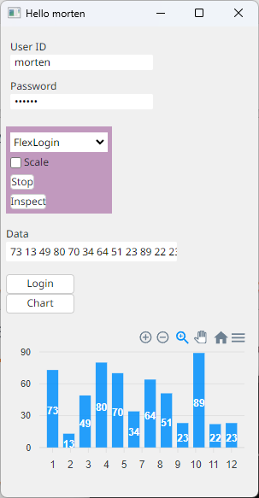
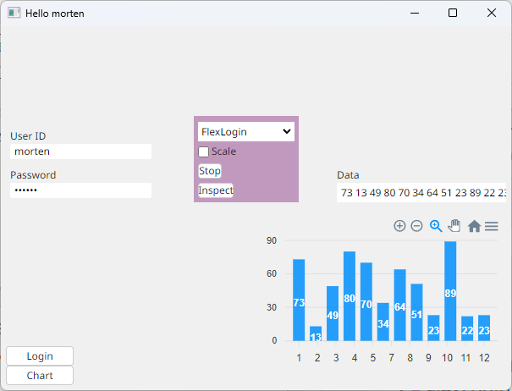

Slide 62
Exercise ?
No Flex Exercise
Design still subject to change
We can play with this at the end if we have time

Slide 63
Browser Mode
Intended for single-user web applications and testing
In Desktop mode, each Form or modal object like a MsgBox appears in a separate HTMLRenderer window
In Browser mode (after EWC.Init 'Browser')
You connect a browser and the UI appears in it
You can currently only have one Form at a time
You can still pop up modal objects like MsgBox

Slide 64
Exercise 5 – Browser mode
Try demo.Run 'Browser’
Connect a browser and run some demos, notice how everything looks (kind of) the same
Stop the demo
Now run EWC.Init 'Browser' and reconnect the browser
Note that nothing happens (but you should see log messages)
Try some interactive uses of eWC, for example
'F1' eWC 'Form' 'Hello Browser' (10 10)(300 499)('Bcol' (193 153 190))

Slide 65
Multi Mode
Intended for multi-user applications.
EWC.Init 'Multi'
Must be called from a namespace which contains a function names Initialise
Initialise MUST create and eDQ a Form (and demo.Run will do this)
This namespace will be cloned for each new Browser connection, and Initialise will be called on a new thread
Notice each user is suspended in ∆DQ in a namespace named demo_n.
demo.Run 'Multi' (lots of output as two sessions connect) )si
· · #.EWC.∆DQ[42]
· · #.demo_1.Initialise[13]
· &5
· · #.EWC.∆DQ[42]
· · #.demo_2.Initialise[13]
· &6
· [#.EWC.[LIB]] #.EWC.Conga.LIB.Wait[8]
· [#.EWC.[wss]] #.EWC.wss.Listen[2]
· #.EWC.wss.Start[14]
&4

Slide 66
Exercise 6 – Multi mode
Write a function called Initialise which creates and eDQ’s a form which displays (⍕⎕THIS)
Run EWC.Init 'Multi'
Connect two browsers at the same time
Experiment with using )TID to switch into the two threads and inspect the contents, and perhaps modify your form using eWS.

Slide 67
QUERY and HDRS
When your application namespace is duplicated, a namespace called _EWC is injected
It contains (amongst other things)
URL: the URL that the browser navigated to
QUERY: A 2-column matrix of query parameter names and values
HDRS: A 2-column matrix of header names and values
You can use HDRS for authentication and QUERY to drive the initial behaviour of the application
For example, the demo application supports e.g. http://localhost:22322?Demo=Buttons

Slide 68
Exercise 7 – QUERY
Modify your Initialise function to create a grid with content decided by _EWC.QUERY
Launch two browser sessions with different queries and verify the behaviours
Also inspect the contents of _EWC.HDRS (and the rest of _EWC)

Slide 69
Selenium Testing
Selenium is a framework for testing HTML-based applications
Michael Baas has been experimenting with testing first MiServer/DUI and now EWC
The same names used to create objects (e.g. 'F1.BTN1') can be found in the HTML "DOM"
It is "straightforward" to have automated testing of EWC frontends
Next Year, perhaps a workshop on Selenium?

Slide 70
Selenium Testing

Slide 71
Migrating - Live
Four participants declared the intention to bring code for "live" conversion
Three of them used a lot of either ⎕NEW or assignment of properties
All of them will be used to prioritise continued development
One of them looked "easy"

Slide 72
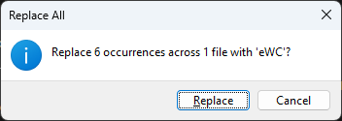
flatview

Slide 73
'Coord' 'Pixel' only
➔ Fake it

Slide 74
No Edit 'Style' 'Multi'
➔ Create editable Grid instead

Slide 75
No MouseUp on Edit
➔ Create an extra button to click on ☺

Slide 76
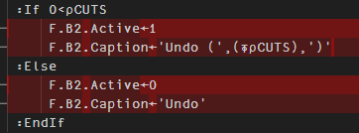
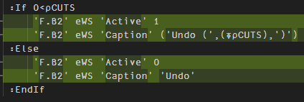
No Direct Property Manipulation
➔ Use eWG / eWS

Slide 77
Significant Problems
'Coord' 'Prop' not supported
'Style' 'Multi' not supported on Edit
No 'MouseUp' event on Edit
Direct property assignment & references

Slide 78
Less Significant Problems
EWC.LOGMODES←'EW' ⍝ Errors and Warnings only
07:00.682 W: *** Warning: at Run[4] Start[9] - Unsupported on font: Fixed
07:01.164 W: *** Warning: at Run[18] Start[9] - Unsupported on button: Active
07:01.170 W: *** Warning: at Run[19] Start[9] - Unsupported on button: Active

