Slide 1
Link and the Basics of APL Source in Text Files
Morten Kromberg

Slide 2

Materials
Copy the folder 2024-TP3 from the USB drive
One workspace (stats.dws)
One Cider project (ReadMail folder)
One Powerpoint presentation
One zip file containing Link 4.0.20
If you cannot use USB, unzip the latest release from
https://github.com/dyalog-training/2024-TP3/releases/tag/v1.0.0
NB: Exercises assume Link v4.0.20 or later

Slide 3

Goals
Give an introduction to Link
Give you time to experiment with Link
Focus on the process of moving source from a workspace to text files
  And rebuilding the runtime environment
If we have time: Using Cider to manage Tatin and NuGet Packages

Slide 4
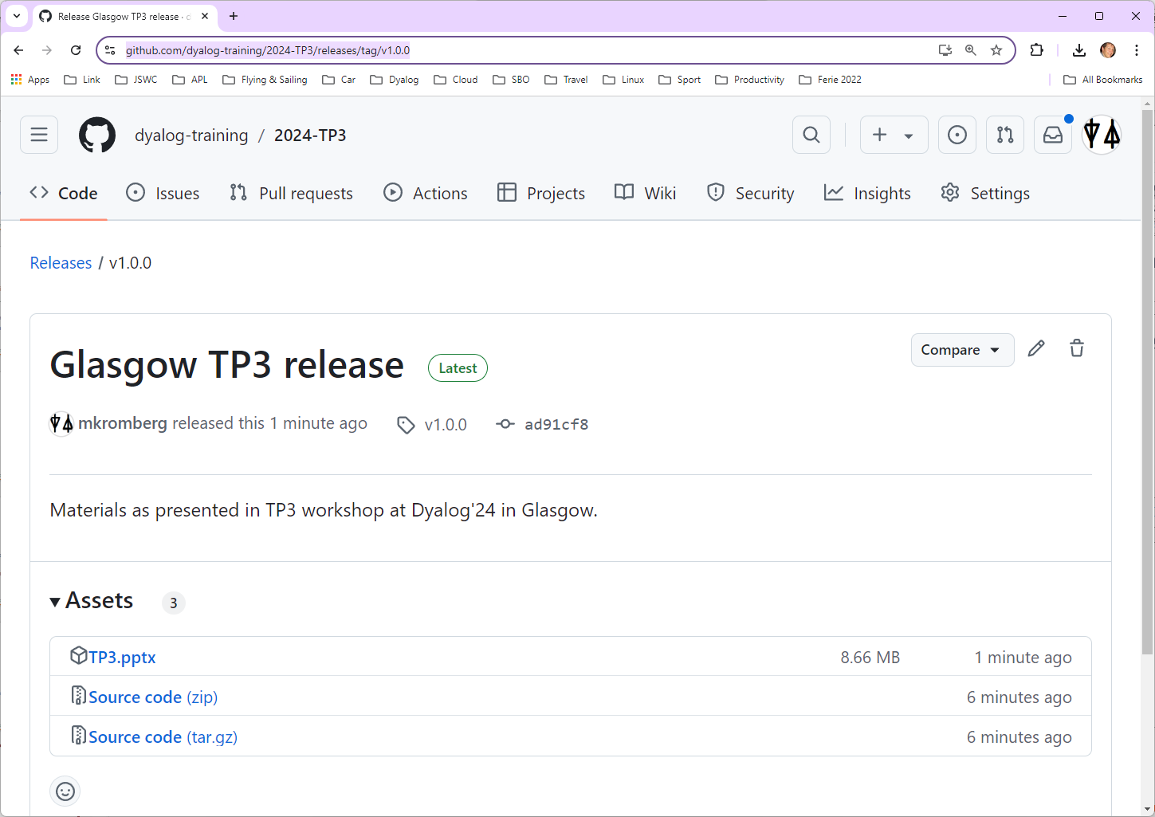


Slide 5
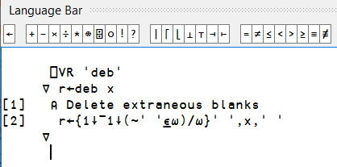
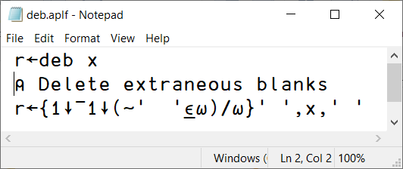

What exactly is Link?
Each code item in the active workspace is linked to a file
  Functions, Operators, Classes and "Scripted" Namespaces – and optionally variables
  "Unscripted" Namespaces (namespaces with no source text) map to directories
If the item is edited using the APL editor, the file is updated
If the file is changed, the workspace is updated

Slide 6
”Old Timers”: Link replaces SALT
Link replaces SALT
  (SALT will be available until no longer used)
  Eventually, I hope that most of Link will also disappear and be replaced by functionality in the interpreter
With Link…
  The interpreter is tracking the relationships
  between objects and files
  A File System Watcher responds to external changes (requires .NET, supported under Windows, Mac & Linux)

Slide 7
About the File System Watcher
Runs a callback function in APL each time a file changes in a linked folder
Designed to capture changes made in an external editor
Should be able to handle ”small” git actions
  Code still being improved
Not appropriate for handling "bulk" changes, such as
  Unzipping lots of files into a watched folder
  Doing a large checkout/revert
  Network drives
Requires .NET - not available under AIX

Slide 8


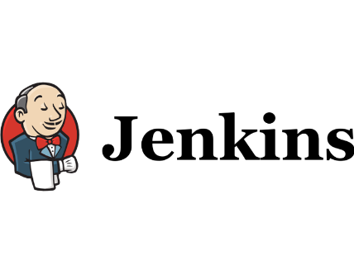
Why is Link ?
Important
With source code in text files we can use extremely attractive tools developed outside the APL community
  Tools for editing, comparing, mergeing, refactoring, sharing, building, testing, computing statistics, …
… in addition to all our own tools
… without losing any of what is good about interactive development

Slide 9










Why is Link ?
Important

Slide 10
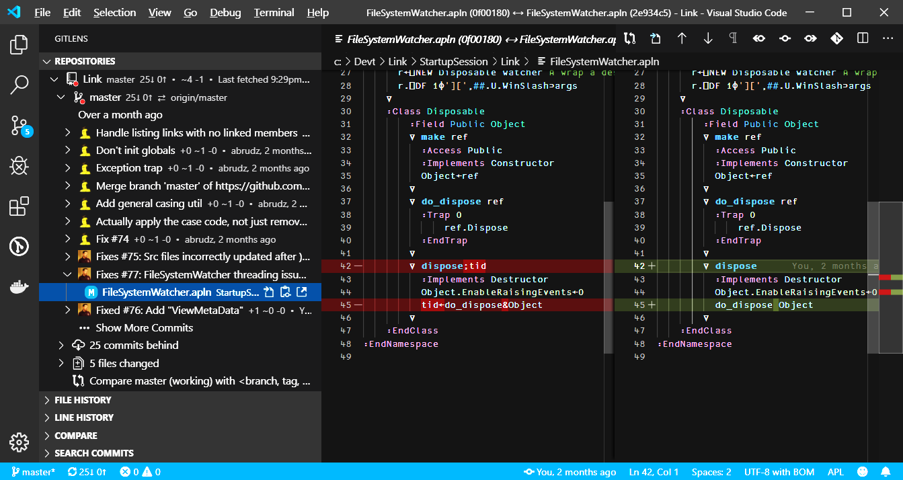
Screen Shot from Mortens SA1 Slides
Showing VS Code with Git History and a diff

Slide 11
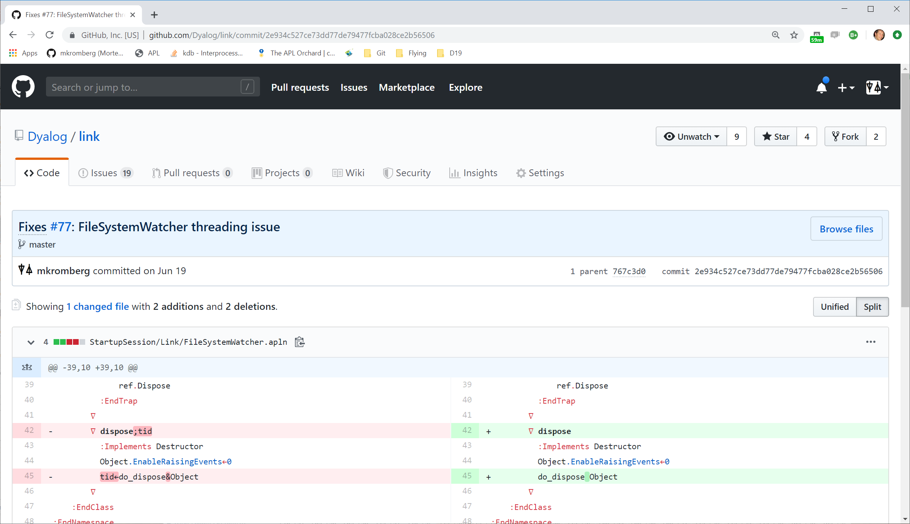

Slide 12
Other Benefits of Text Source
Easily share code between APL versions
  Text files are backwards and forwards compatible
Laugh at syserrors
Drawbacks of Text Source
This space intentionally left blank

Slide 13
Link in 2024 – Version 4.0
Link 4.0 was shipped with 19.0
  Also works with 18.2
  Link 3.0 was shipped with 18.2 and works with 18.0
  Link 2.0 for 18.0 and 17.1
Rapidly growing user base
Decent documentation
”Mature”

Slide 14
Link is a GitHub Project
https://github.com/dyalog/link

Slide 15
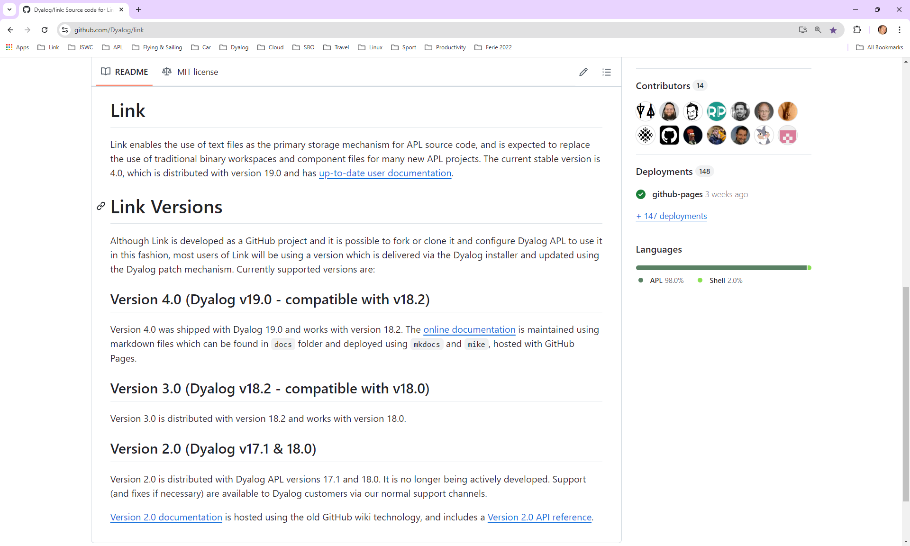



Slide 16
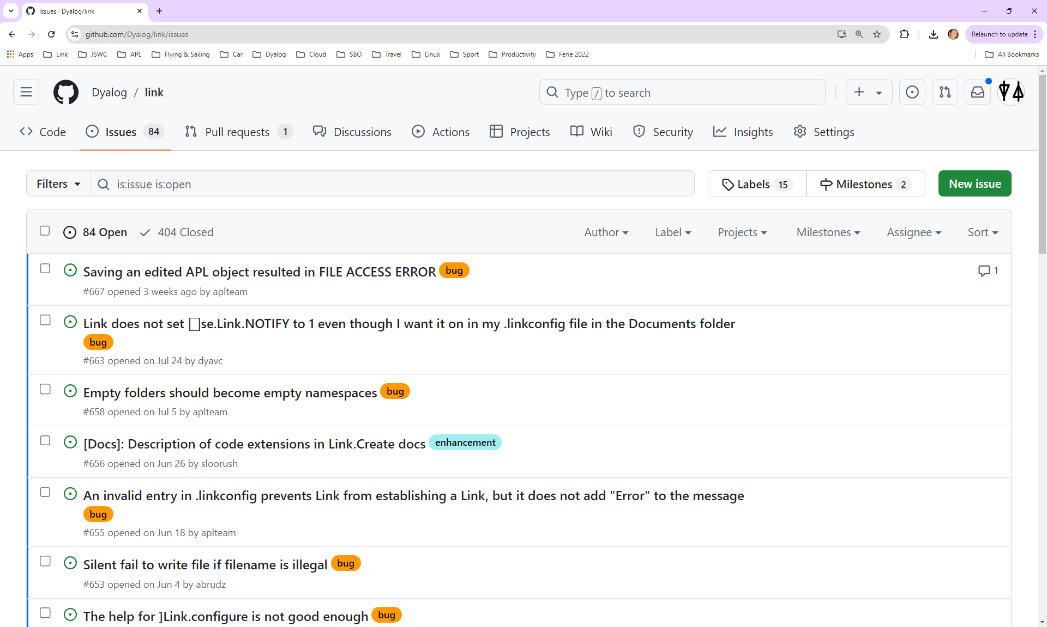

Slide 17
Link is a GitHub Project
https://github.com/dyalog/link
You *can* install Link yourself
  This was important up to 3.0, when there were regular significant fixes
  Still relevant if you want Link 4.0 with Dyalog 18.2
  The day after writing the above, I found a couple of bugs related to configuration files, so still relevant ☹
We will install Link 4.0.20

Slide 18
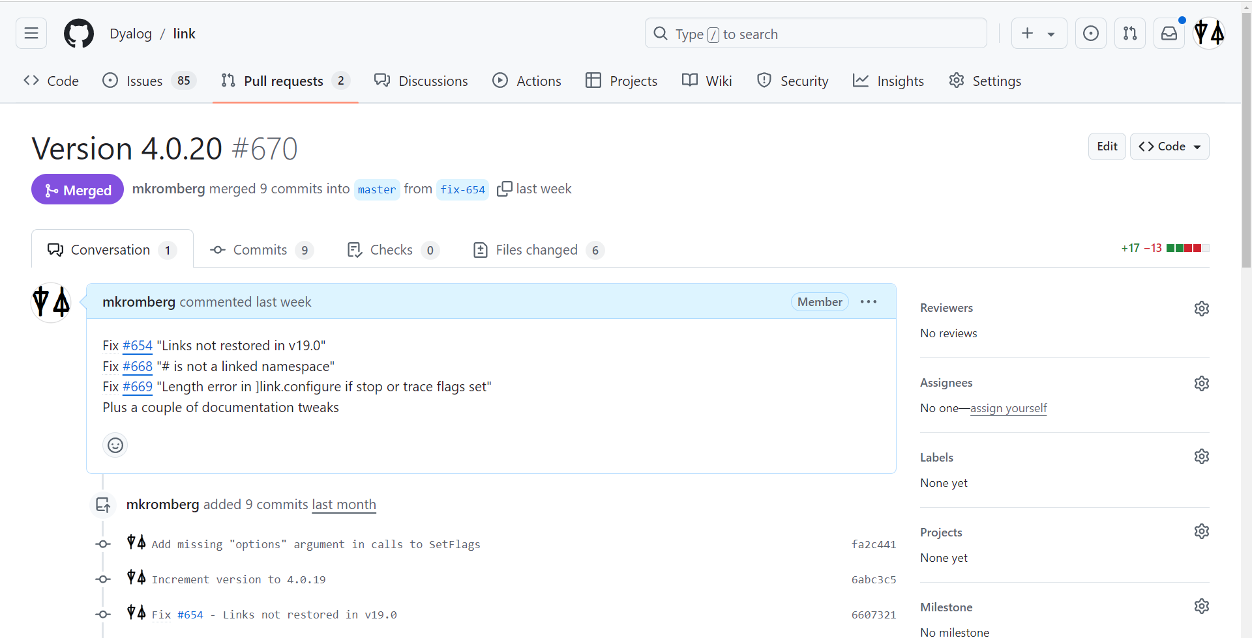

Slide 19
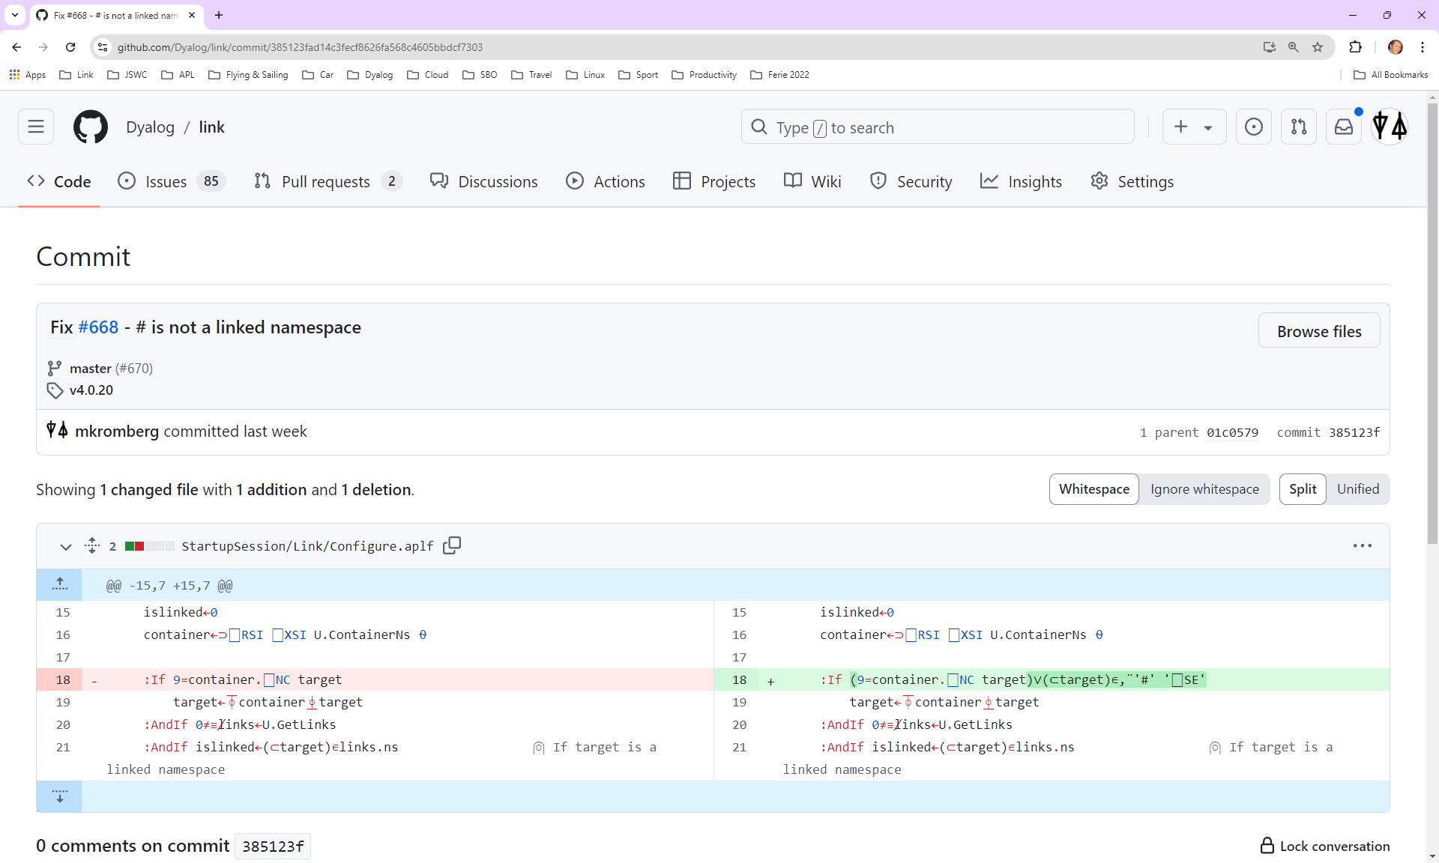

Slide 20
Verify Link Version
Start APL, and inspect:
If you do not have version 4.0.20, follow the instructions at
https://dyalog.github.io/link/4.0/Usage/Installation/
⎕SE.Link.Version
4.0.20

Slide 21
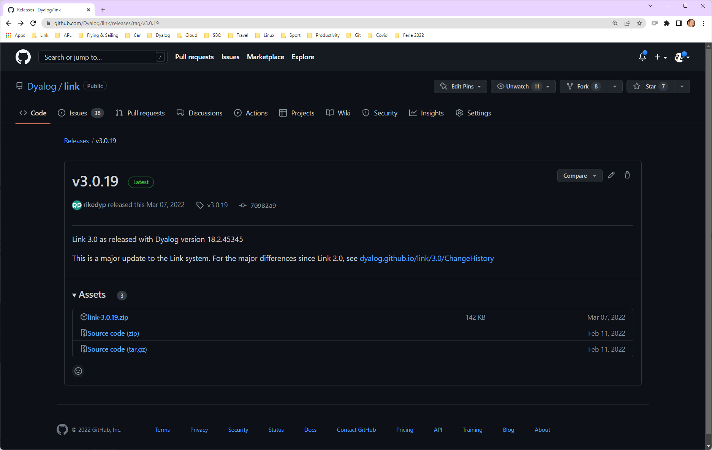
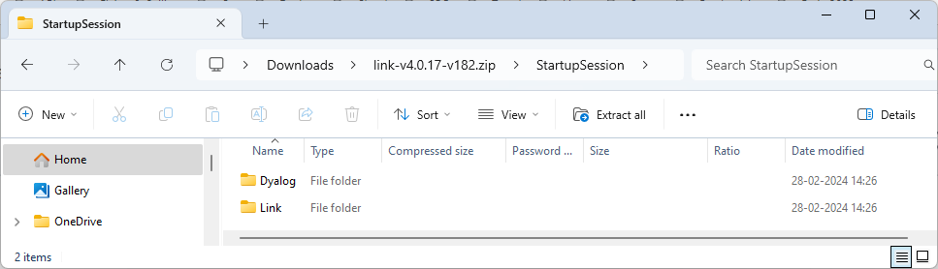
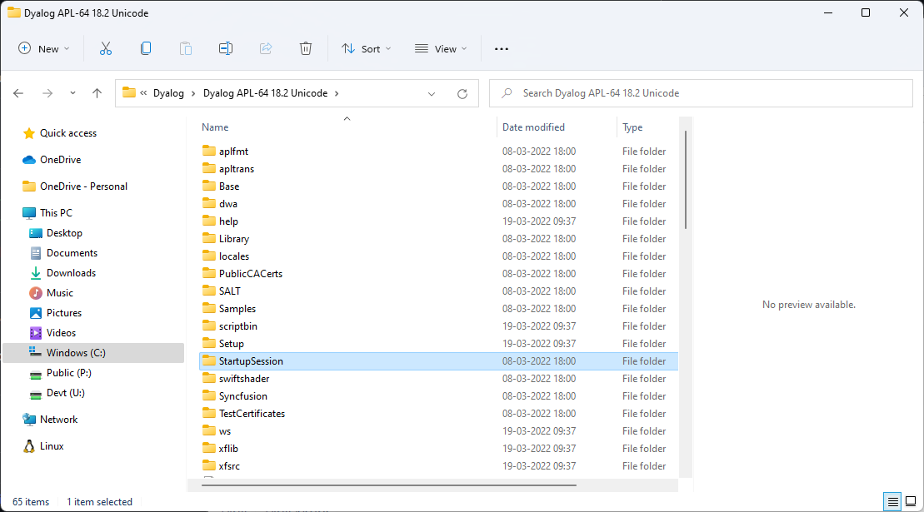

Slide 22
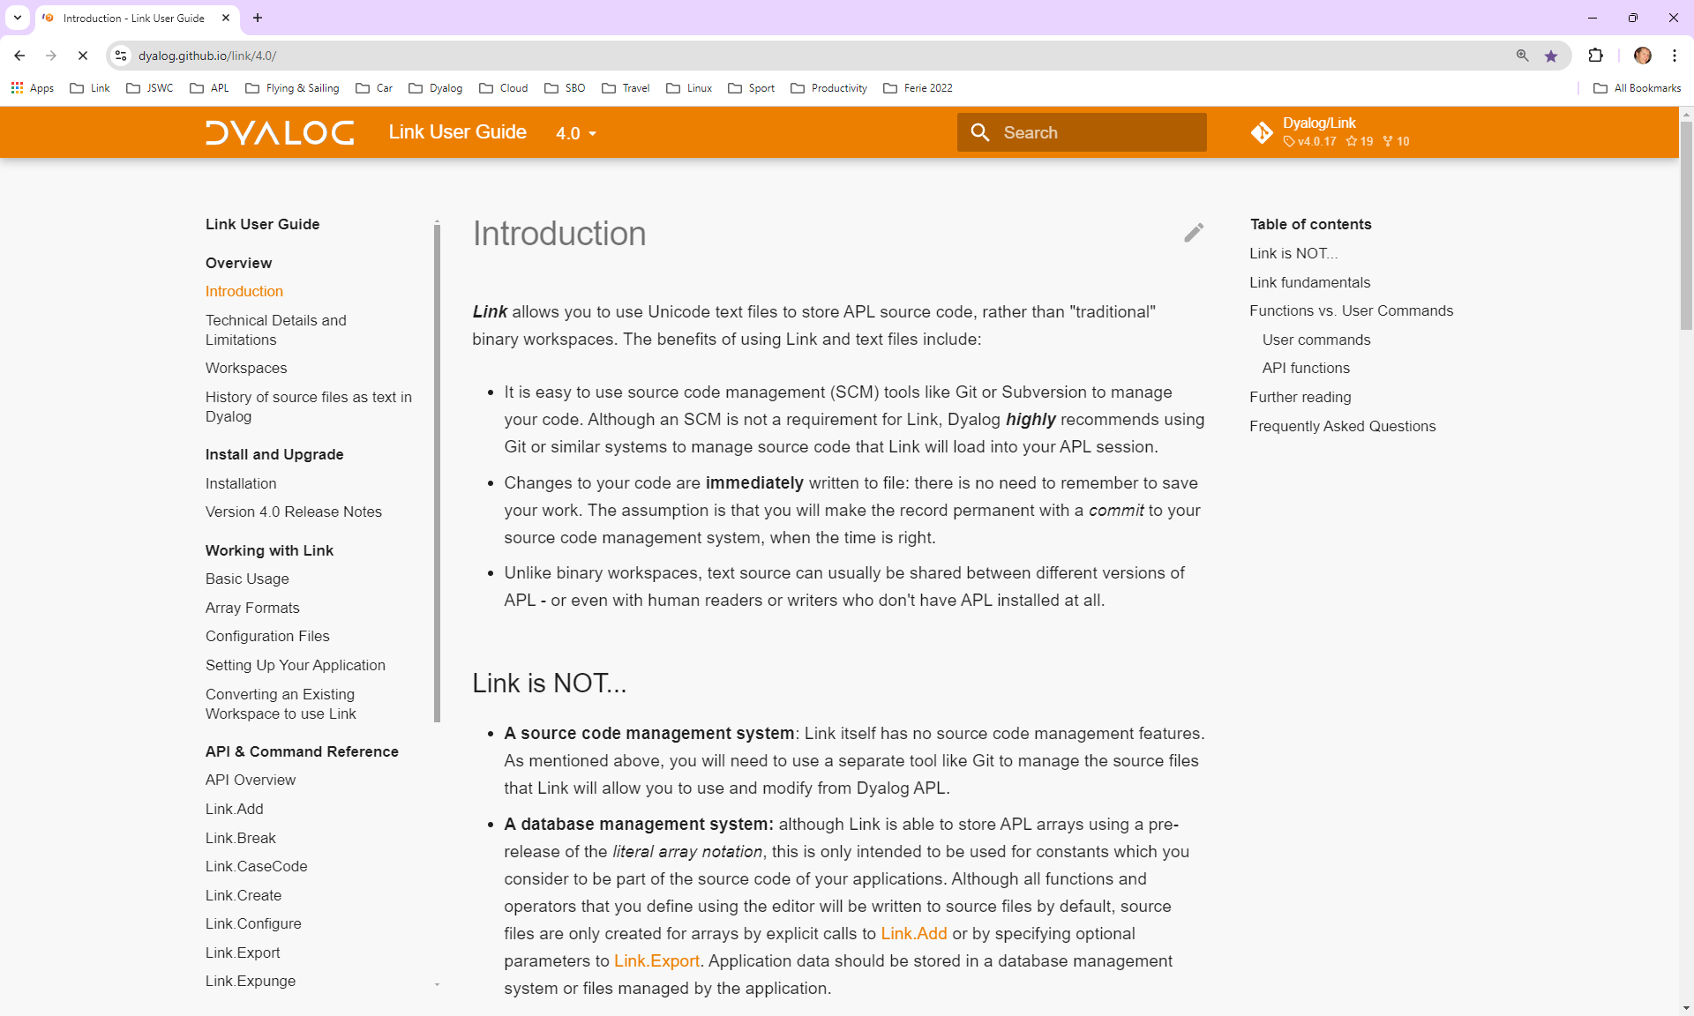

Slide 23
Starting a New Project
To start a new project
)ns myns
]link.create myns /my/dir
At least one of myns or /my/dir must exist
Only one of myns or /my/dir may be populated

Slide 24
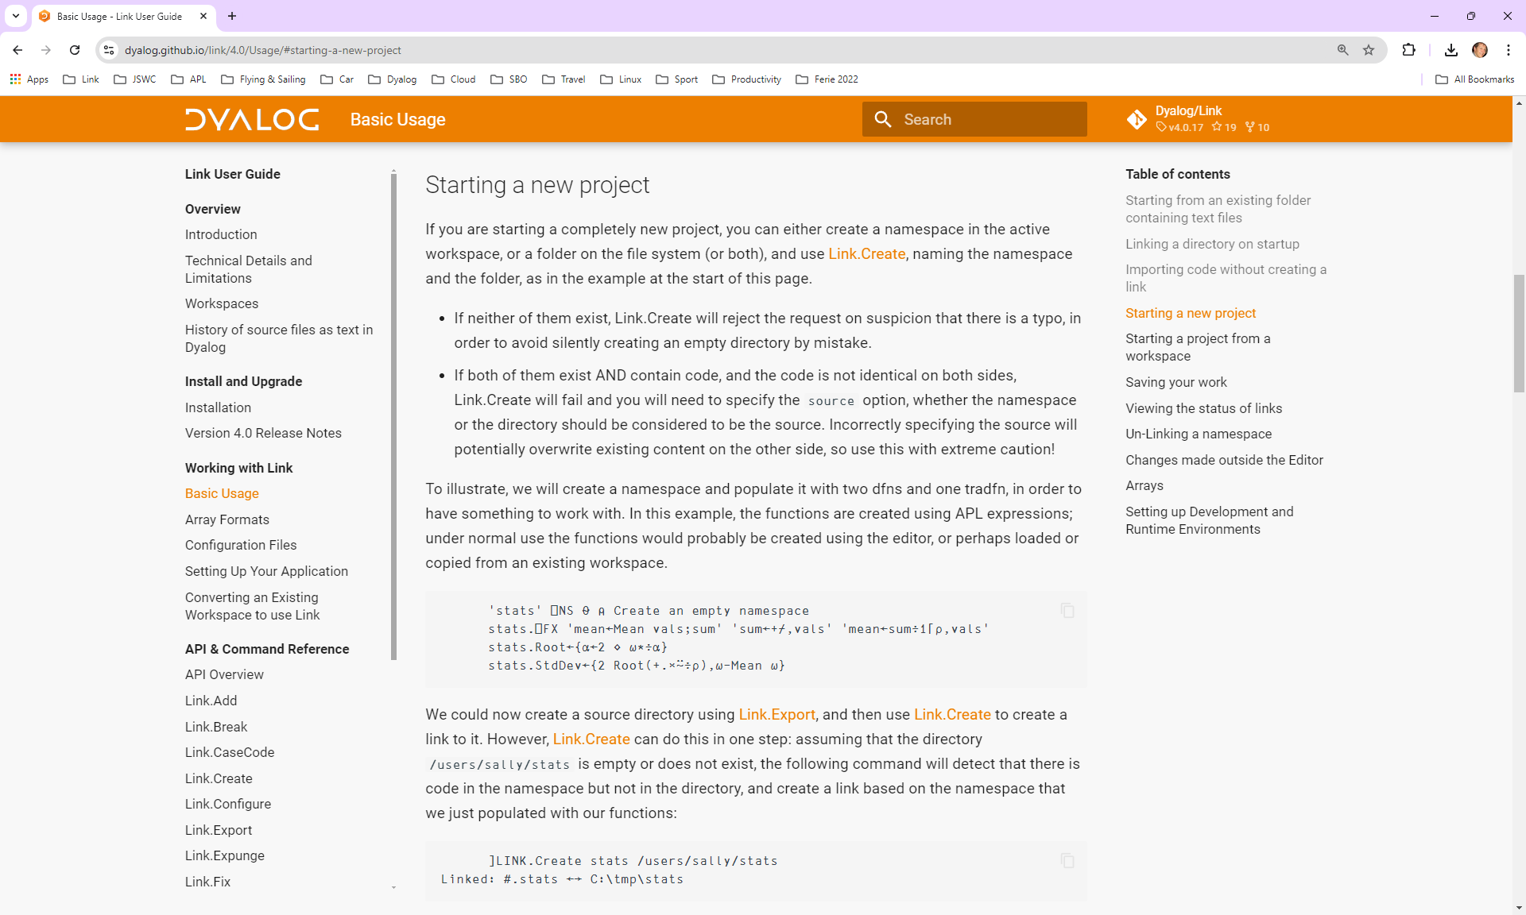

Slide 25
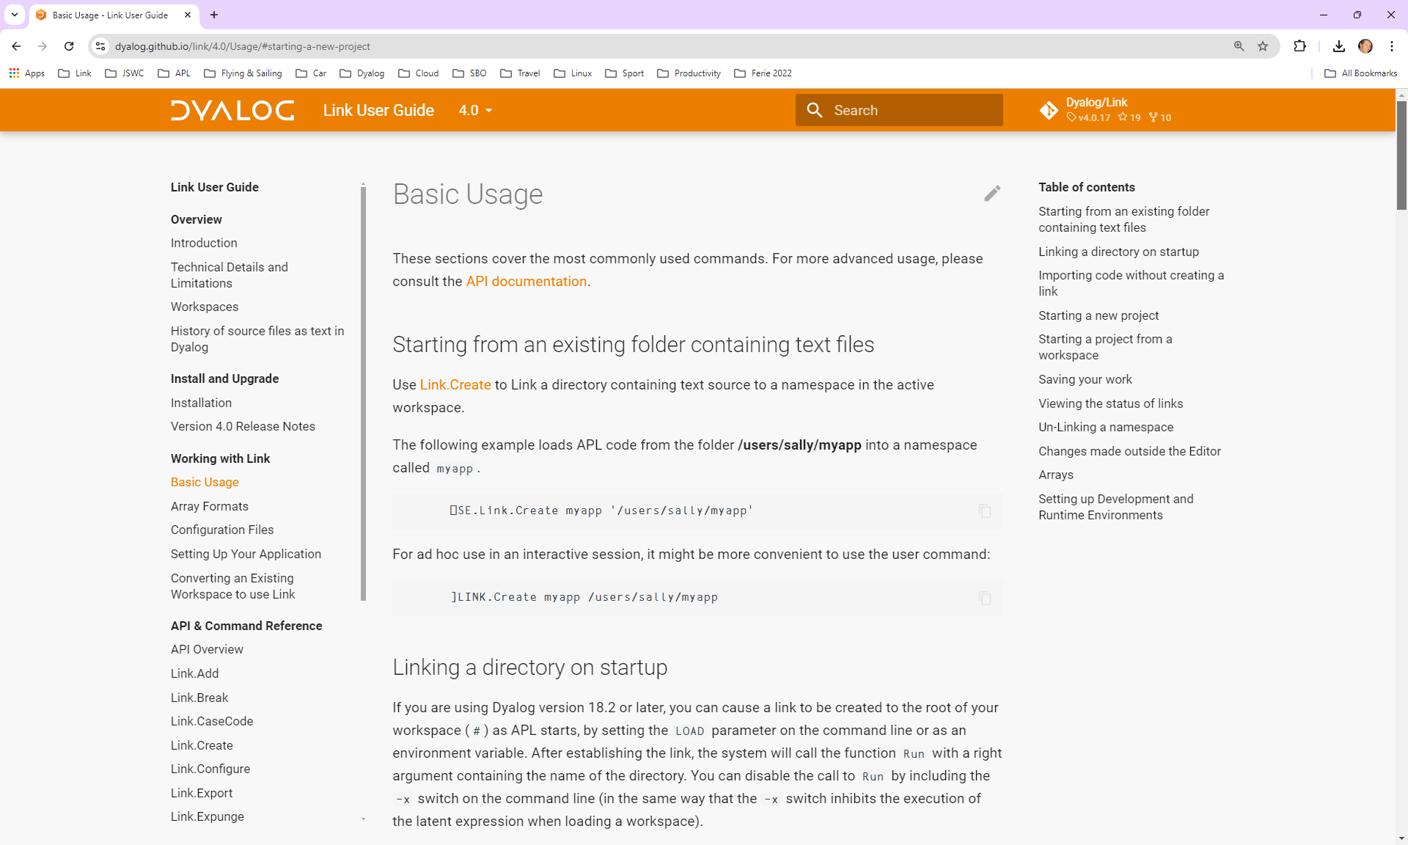

Slide 26

Exercise 1
Read the general guidelines on the use of Link API Functions and User Commands at https://dyalog.github.io/link/4.0/API/
Create an empty namespace
Create a link to a directory which does
not already exist
)ED a function in the namespace
Verify that a source file is created in the directory
Edit the file using notepad or another external editor
Verify that the function is updated in the WS
)CLEAR, and re-create the link
Verify that your code is loaded

Slide 27
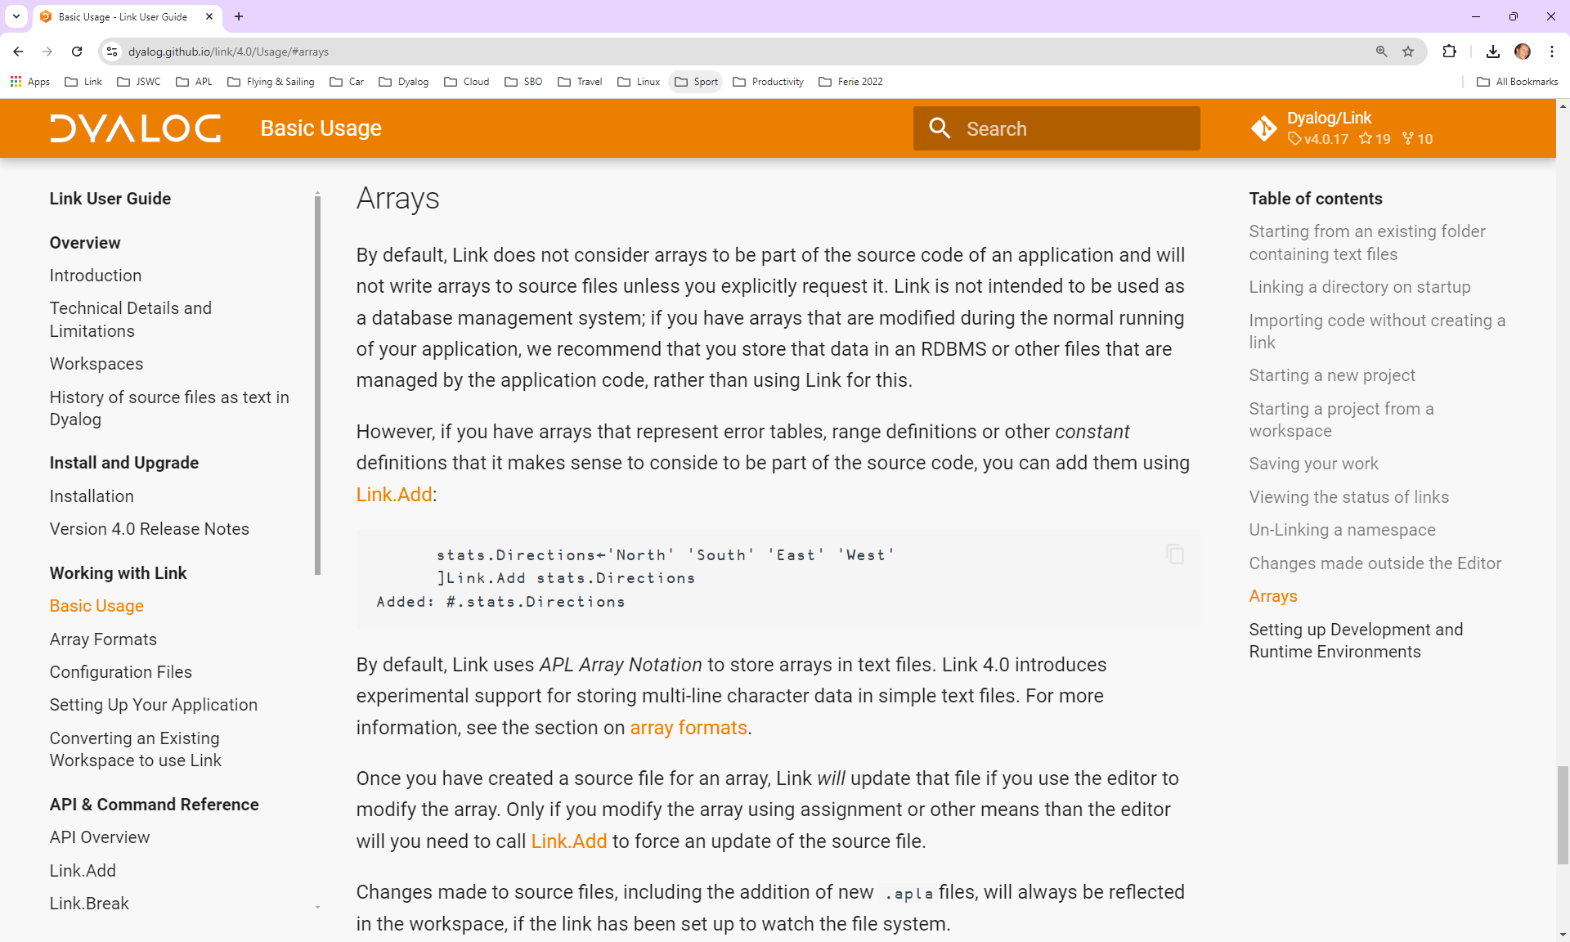
Variables

Slide 28
Exercise 2
Create a variable containing a constant that your application needs
Cause it to be written to a file using ]Link.Add
Inspect the file, edit it, and verify that the new value appears in the workspace
Can you write system variables to file?

Slide 29
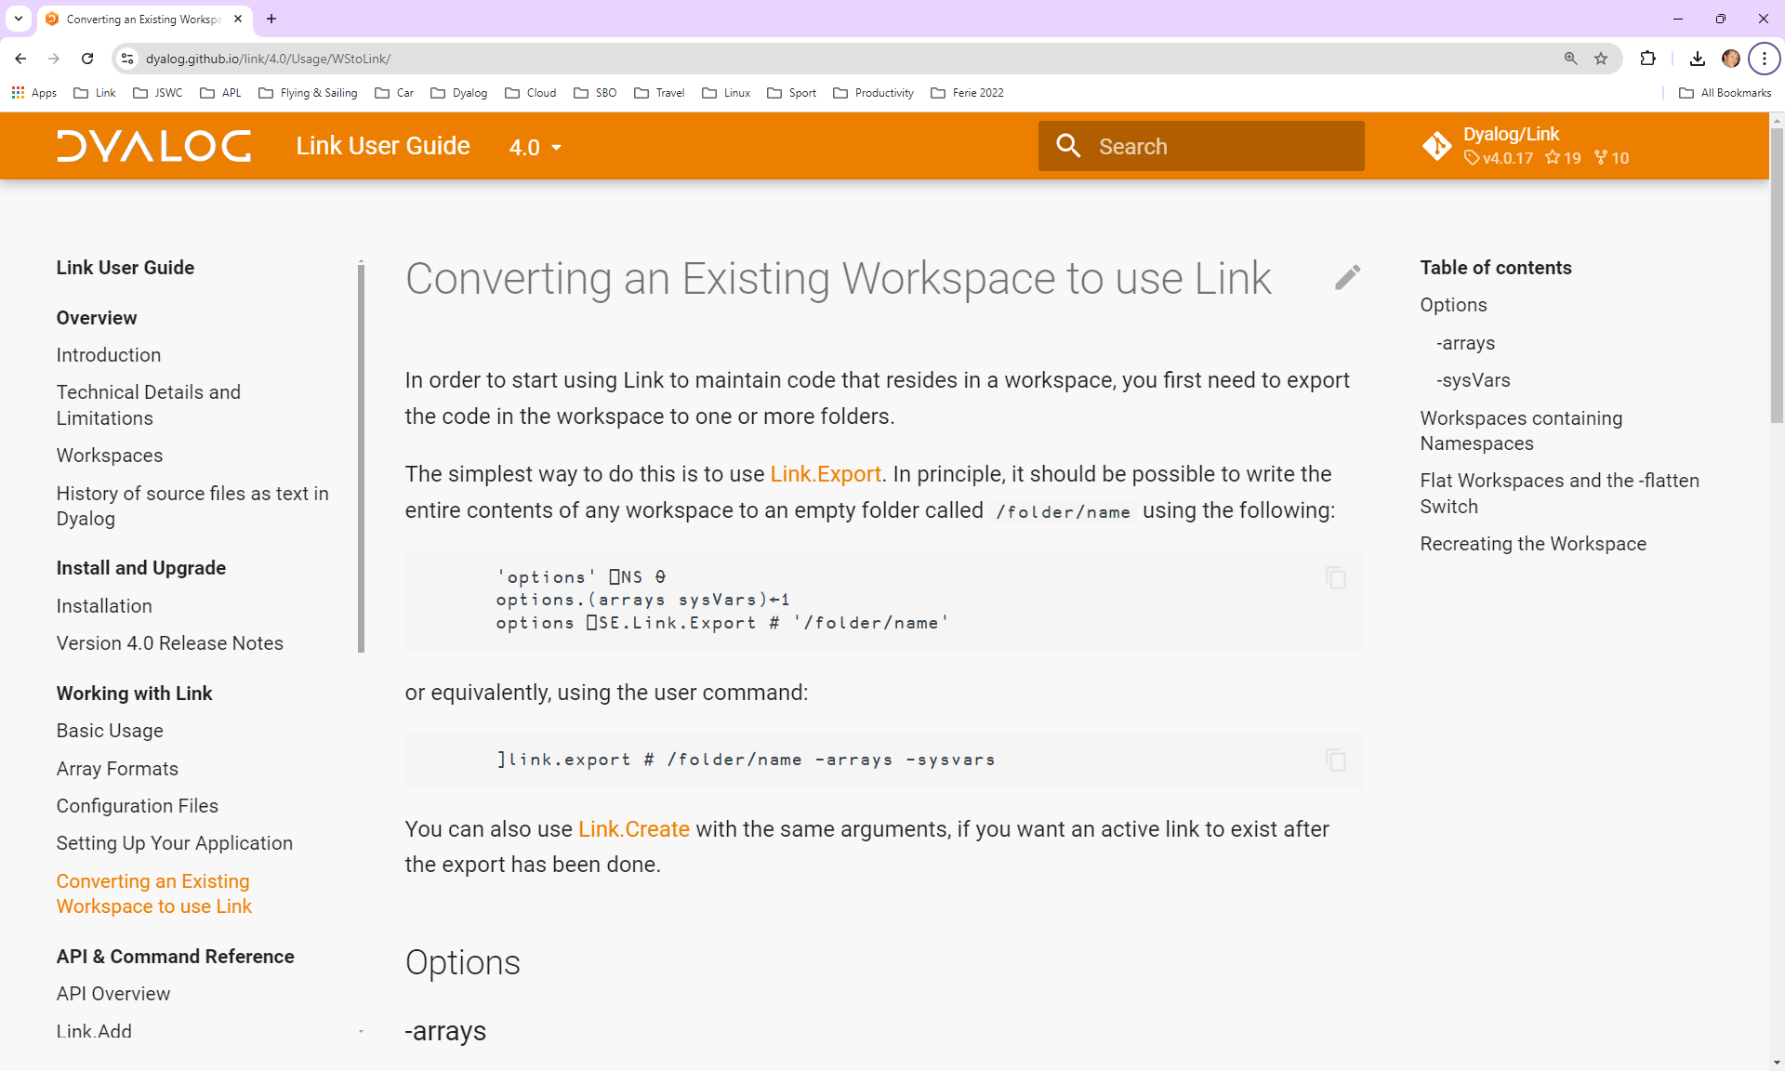
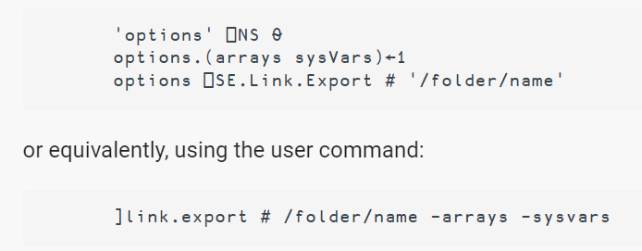
Converting an Existing Workspace

Slide 30
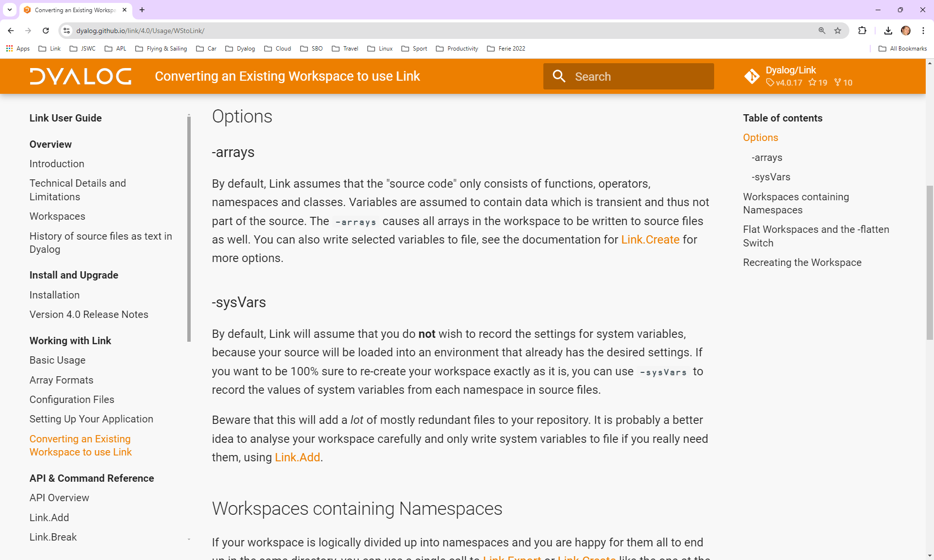

Slide 31
]Link.Add
Link updates source files when you "fix" in the Editor
Link will NOT react to changes to source made via other mechanisms, e.g.
  life←42 ⋄ dup←{⍵⍵}
  )copy dfns cmpx
  ⎕FX 'r←dup x' 'r←x x'
You can (must) use ]link.add to notify Link that source files should be updated
When writing tools that modify source code, use ⎕SE.Link.Fix in place of ⎕FX.
Changes made to source files will always be actioned
*IF* you are using the file system watcher

Slide 32
Namespace ←→ Folder
Each function, operator or array is linked to a file
  ”Scripted” namespaces and classes also link to one file per object
Each ”Unscripted” (aka ”Regular”) namespace links to a directory
If an exported namespace contains sub-namespaces
  Each one becomes a sub-directory
If an imported directory contains subdirectories
  Each one becomes a namespace

Slide 33
Exercise 2.5
Create a subdirectory in your source
Verify that a corresponding namespace is created in the workspace
)ED a function in the namespace
Rename the subdirectory
Verify the effect in the workspace

Slide 34
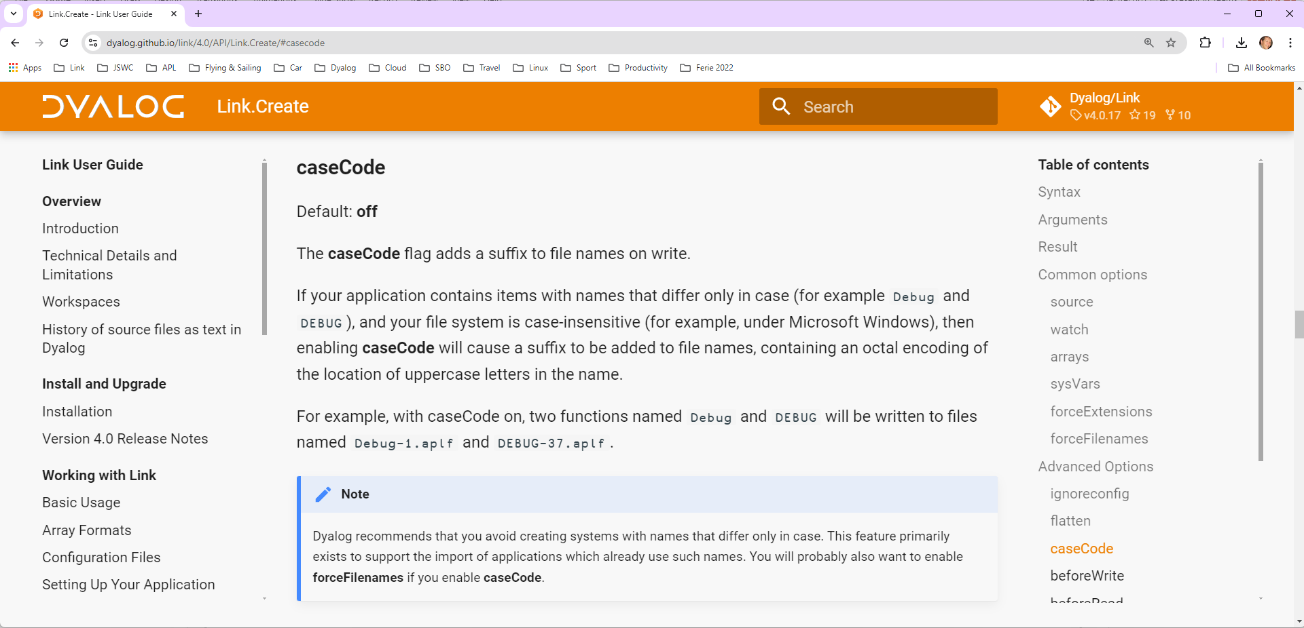
caseCode

Slide 35
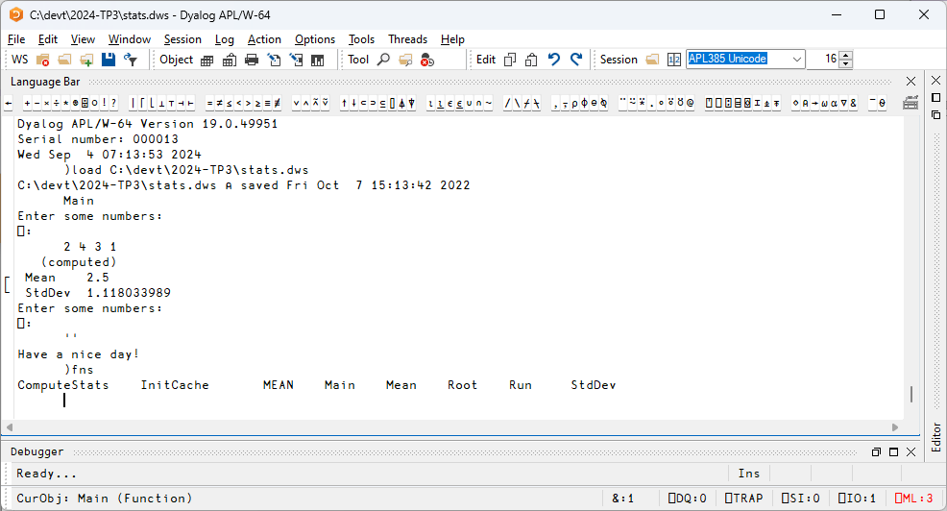

Slide 36
Exercise 3
Export the workspace stats.dws
Note that
  It contains two variables
  Has a non-default ⎕ML
  Has two names which differ only in case

Slide 37
Exercise 3 - Discussion
Use -caseCode or rename?
Which variables should be considered "source”?
⎕ML=3:
  –sysvars
  ]link.add ⎕ML
  Rewrite?

Slide 38
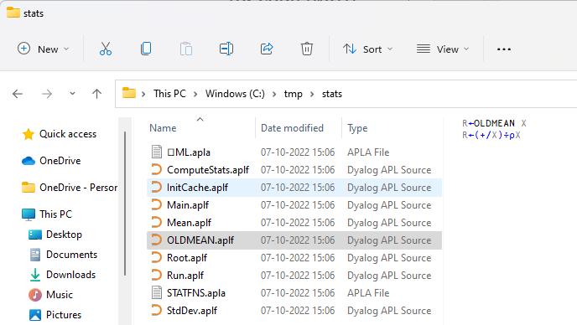
Exercise 3 – Morten's Solution
)load c:\devt\2024-TP3\stats
c:\devt\2024-SA3\stats.dws ⍝ saved Tue Oct 4 22:59:08 2022
)fns
ComputeStats InitCache MEAN Main Mean Root Run StdDev
)ed MEAN ⍝ rename to OLDMEAN
)erase MEAN
)vars
RESULTS STATFNS
⊃RESULTS
1 2 3 1 2 3 4 2 4 3 1
Mean 2 Mean 2.5 Mean 2.5
StdDev 0.8164965809 StdDev 1.118033989 StdDev 1.118033989
STATFNS
Mean StdDev
]link.export # c:\tmp\stats
Exported: # → c:\tmp\stats
]link.export ⎕ML c:\tmp\stats
Exported: #.⎕ML → c:/tmp/stats/⎕ML.apla
]link.export STATFNS c:\tmp\stats
Exported: #.STATFNS → c:/tmp/stats/STATFNS.apla

Slide 39
Non-Representable Objects
Some objects that CAN be saved in a Dyalog workspace have no meaningful textual representation
  GUI & COM objects
Saving such "binary" objects is a bad idea
  They cannot be transferred between 32/64 or classic/unicode
You must write code which creates these objects at run or build time

Slide 40
Create an OLE Server…
Example of explict creation of an otherwise un-saveable object:
∇ R←MakeOLEServer;ns;spec
[1] ⍝ Recreate the OLE Server before WS is built
[2] ns←#.StatsServer
[3] ns.⎕WC'OleServer'('ClassID' '{395E64DF-6B44-4515-B409-6A0A2E1ACD9B}')
('RunMode' 'SingleUse')
[4] spec←⊂'This function returns the mean' 'VT_VARIANT'
[5] spec,←⊂'InputNumbers' 'VT_VARIANT'
[6] ns.SetFnInfo'Mean'spec
[7] R←0
∇

Slide 41

The –flatten switch
Even if your "legacy" workspace is "flat"…
It may contain modules that can benefit from being organised into separate directories
The -flatten allows you to load code organised into directories into a flat workspace
If you edit a function, the editor and Link know from whence it came

Slide 42
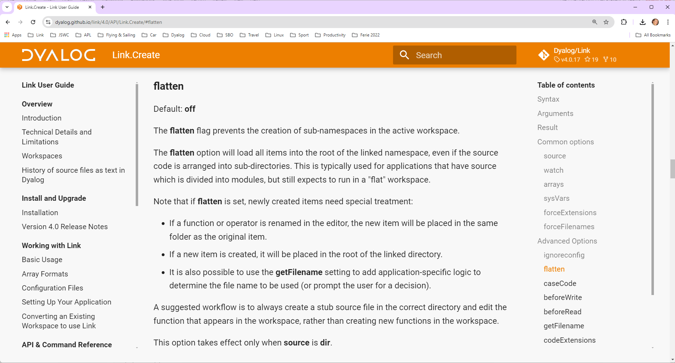

Slide 43
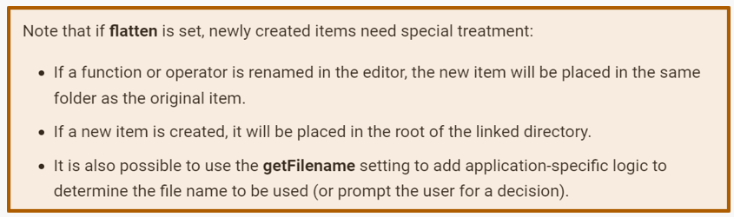

Slide 44
Exercise 4
Move the source files for the statistical functions (Mean, StdDev, Root) to a sub-directory called "statfns"
Get the application to run again

Slide 45
Exercise 4 - Discussion
-flatten or refactor?

Slide 46
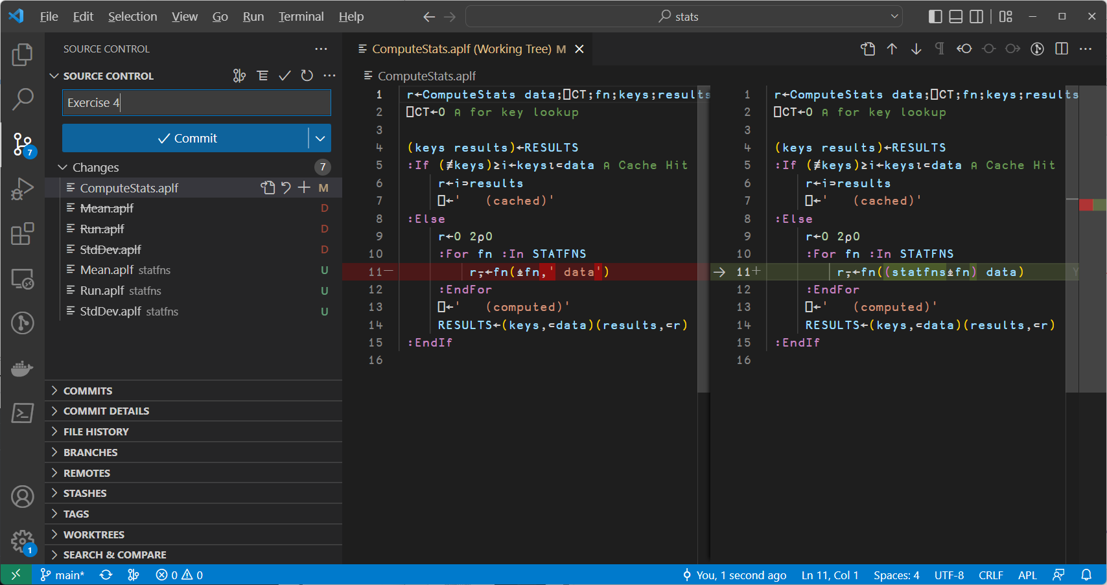

Slide 47
Highlights of Link 4.0
Configuration files (user or folder specific)
  Also used to record Stop and Trace settings
Default to current namespace as source or target (Create, Import, Export)
Search Installed Library folders
Multi-Line Character Data
Transfer file timestamps to workspace
Create Link from single Class or NS

Slide 48
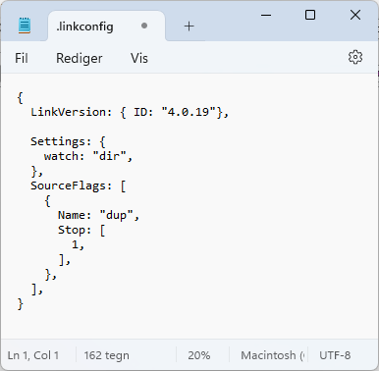
Configuration Files
]link.configure # watch:dir
Was watch:
]link.stop dup 1
Was dup ⍬
ns or dir
]link.configure c:\tmp\dup
Contents of "c:\tmp\dup/.linkconfig":
Settings : watch:dir
Stop/Trace:
dup[1/]
* = User
]link.configure *
No configuration options set in "C:\Users\mkrom\Documents\.linkconfig"

Slide 49
Default to Current NS
)cs dup
]link.export c:\exports\dup
Import, Export and Create default to current namespace if given a single argument
In Link 3.0, you always had to write
]link.export dup c:\exports\dup

Slide 50
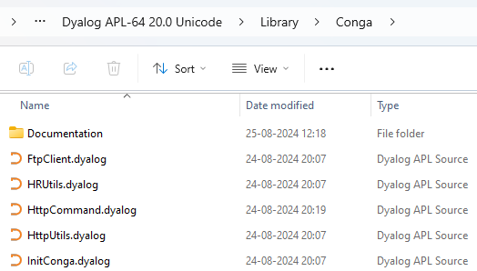
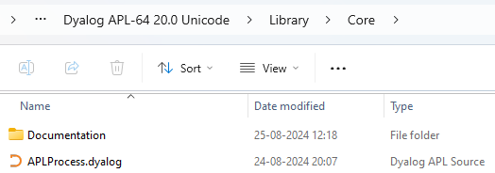
Search Library Folders
Also: Linking single source file
]link.import HttpCommand
Imported: #.HttpCommand ← C:\Program Files\Dyalog\
Dyalog APL-64 20.0 Unicode\Library\Conga\HttpCommand.dyalog

Slide 51
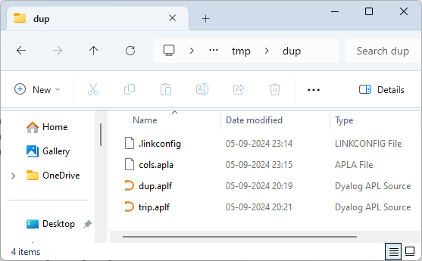
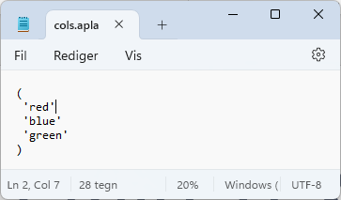
Plain Text Formats
Array Notation is not the best
way to represent matrices or
vectors or character vectors:
cols←'red' 'blue' 'green'
]link.add cols
Added: #.cols

Slide 52
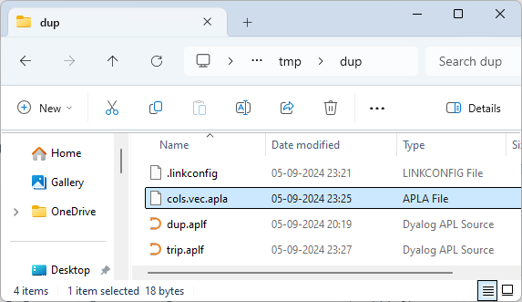
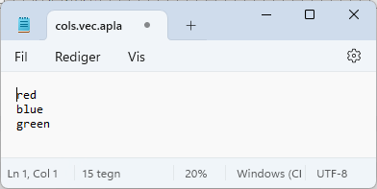
Plain Text Formats
]link.configure # text:plain
Was text:
cols←'red' 'blue' 'green'
]link.add cols
Added: #.cols

Slide 53
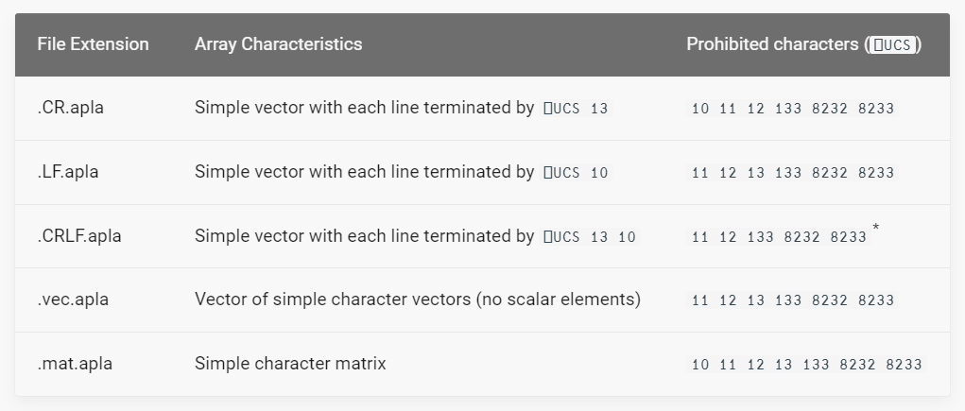
Plain Text Formats
Penultimate segment of name decides target representation
  This feature is still considered experimental

Slide 54
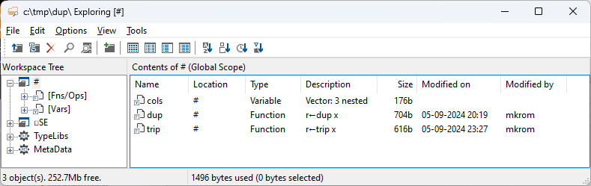
File TimeStamps
Link.Create sets ”AT” information using file timesamps
]link.create # c:\tmp\dup
mod←(2÷24)+21 ⎕ATX fns←'dup' 'trip'
fns,⍪'DD-MM-YYYY hh:mm' (1200⌶) mod
dup 05-09-2024 20:19
trip 05-09-2024 23:27

Slide 55
Exercise 5 – text:plain
Set the configuration for your project to use text:plain
)CLEAR and re-create the Link
Notice that statfns.apla still exists and has been loaded
  The setting only affects how NEW files are created
Create a new variable which is plain text – either a matrix or a vector of vectors
Use ]link.add to save it and inspect the file

Slide 56
Saved Workspaces with Links
If you need to take a break...
Or a batch job crashes and saves a workspace
You can )SAVE with active links
  (Since Link 3.0)
... and pick up where you left off ...

Slide 57
Saved Links
Create a Source Folder & Do some work
⎕MKDIR 'c:\tmp\dup'
(⊂'r←dup x' 'r←x x') ⎕NPUT 'c:\tmp\dup\dup.aplf'
]link.create # c:\tmp\dup
Linked: # ←→ c:\tmp\dup
)save c:\tmp\dup
c:\tmp\dup.dws ⍝ saved Thu Sep 5 20:19:10 2024
)off ⍝ Go to Lunch
Someone Edited the File While we were at Lunch
(⊂'r←dup x' 'r←x x ⍝ duplicate x') ⎕NPUT 'c:\tmp\dup\dup.aplf' 1
We return from Lunch
)load c:\tmp\dup
c:\tmp\dup.dws ⍝ saved Thu Sep 5 20:19:10 2024
Link Warning: IMPORTANT: 1 namespaces linked in this workspace: #
Link Warning: IMPORTANT: Link.Resync is required

Slide 58
Saved Links
”Resync is Required”
]link.resync
1 update required: use -proceed option to synchronise
Name Direction File Comments
#.dup ← c:/tmp/dup/dup.aplf File is dated Now, WS copy is dated 1 minute ago
Instead, we mess things up a bit more...
)copy dfns cmpx
]link.resync
2 updates required: use -proceed option to synchronise
Name Direction File Comments
#.cmpx → Item has no corresponding file
#.dup ← c:/tmp/dup/dup.aplf File is dated Now, WS copy is dated 1 minute ago
Finally, clean up:
]link.resync –proceed
1 file read, 1 file updated

Slide 59
Exercise 6 – )SAVE with Links
)SAVE your workspace
)CLEAR or )OFF
Edit and change one of the source files using notepad or similar
)LOAD the workspace and sort things out

Slide 60
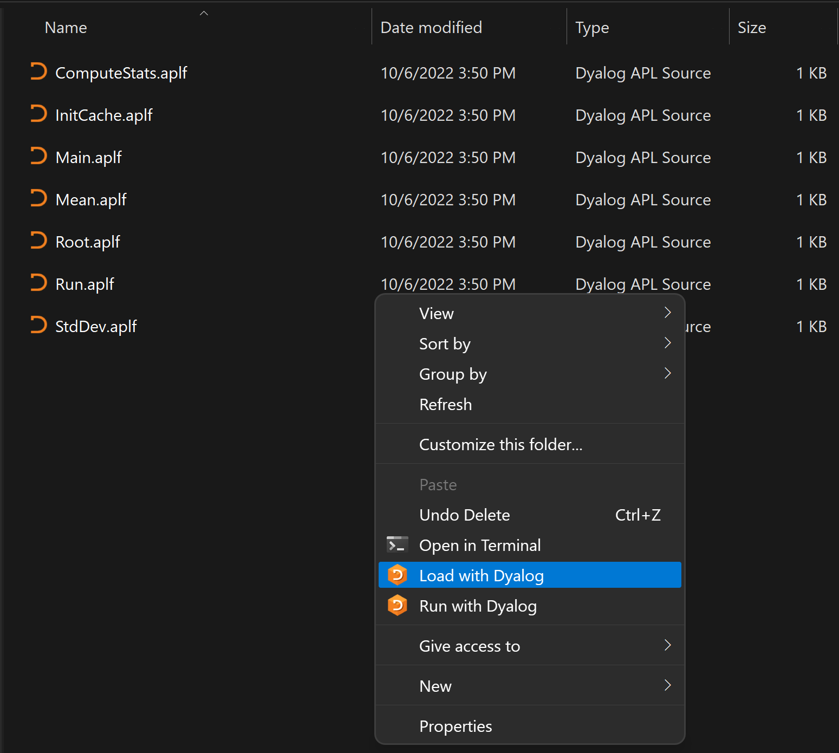
Launch from Source
Windows only, v18.2 or later:
Right click in the file explorer
  "Load with Dyalog" will do a Link.Create on a selected folder, or import a selected file
  "Run with Dyalog" will look for a function called Run and invoke it if it exists after the link has been created.
]FileAssociations can be used to select the default APL version

Slide 61
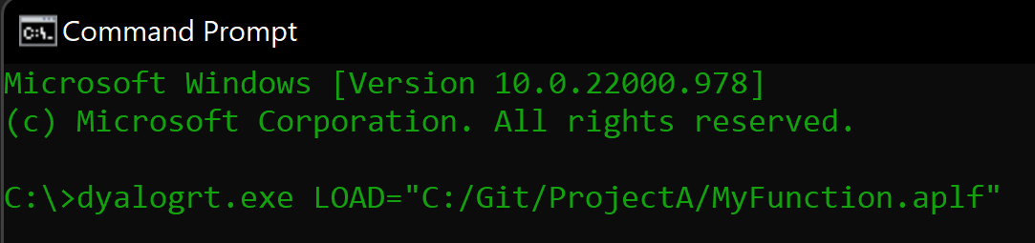
LOAD= Parameter
Point to a file, or a directory
Can be specified on the command line, or in a .dcfg file
Add LX='' to disable startup (just setting LOAD is actually equivalent to "Run with Dyalog")
Example .dcfg file
{
Settings: {
AutoPW: 1,
MaxWS: "512M",
LOAD: "C:/Git/stats"
}
}
Notes:
When LOAD points to a directory, it will run “Run ,⊂<Load>”
When LOAD points to a single file name, it will run “filename 0⍴⊂’’ or filename.Run 0⍴⊂’’ for classes/namespaces

Slide 62
Boot or Build?
It is fine (even encouraged!) to dynamically load text source during development
It is NOT recommended to dynamically load source from large numbers of text files in production environments
Break links (or use Import rather than Create) and )SAVE to build workspace for production use

Slide 63
Exercise 7
Write a "Build" function

Slide 64
First There Was The Workspace
APL
Workspace

Slide 65

Then There was Link
APL
Workspace
Source Code
in Text Files
Link

Slide 66

Then There was Link (and git/svn etc)
APL
Workspace
Source
History
Source
History
Source Code
in Text Files
Source
History
Link

Slide 67
Packages
We have our own code under control
The next step is to add tools to manage ”other people’s code”
  A PACKAGE manager
To integrate the packages into our application, we need
  A PROJECT manager

Slide 68
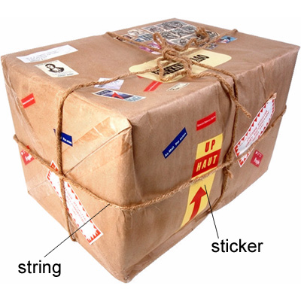
So… What is a Package?
(From Longman Dictionary of Contemporary English)

Slide 69

A Project is…
Source Code +
Dependencies (packages) loaded from a package manager
Environment configuration
Development tools and processes
Can be opened and "set up" by a Project Manager
We will use ”Cider”
A Package is…
A "build" of a project...
In a standard format
Can be found, downloaded and installed by a
"Package Manager"
Cider supports the development of Tatin Packages
Cider can load Tatin + NuGet Packages

Slide 70
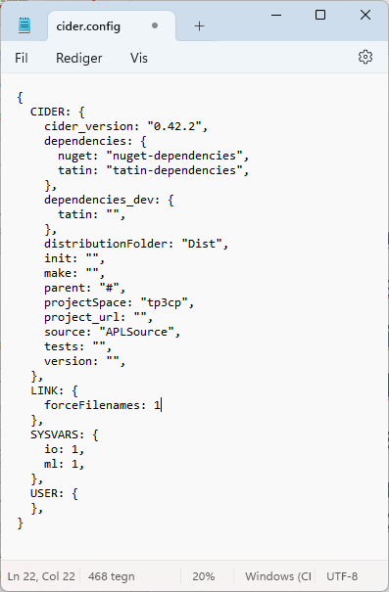
Introducing Cider
Load other code that we depend on
Run some code on opening the project
Run a build function
Decide where to load the code
Run tests
Set Link options to be used when loading the source code
Set ⎕IO, ⎕ML

Slide 71
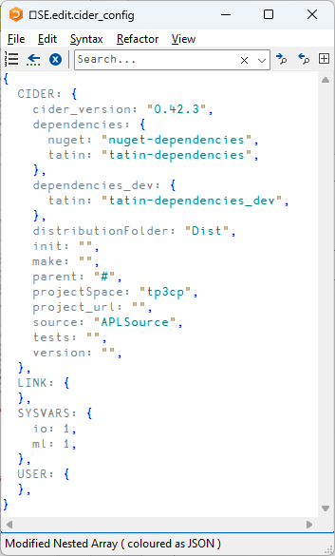
Creating a Project
]cider.createproject /tmp/tp3cp
When done, you should have:
)obs
tp3cp
So now you can
)ed tp3cp.Foo

Slide 72
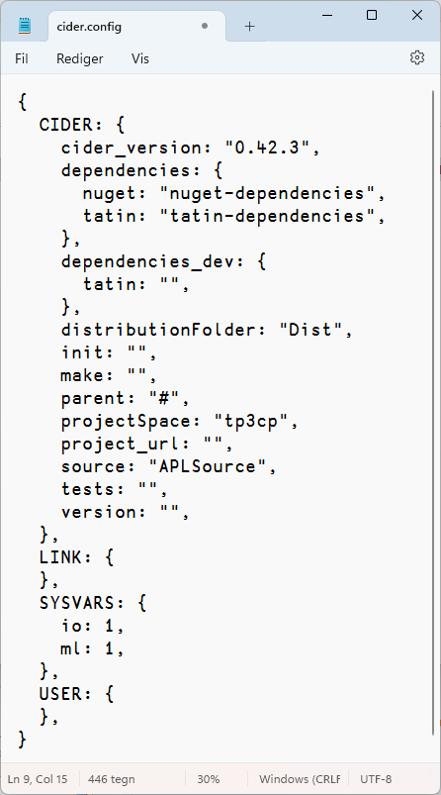
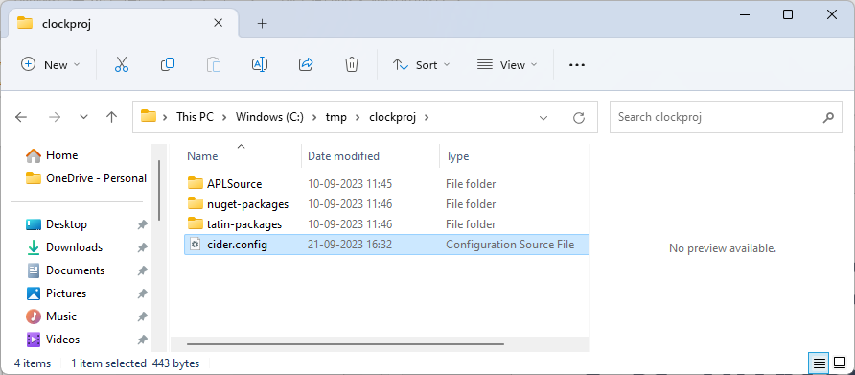
A Cider Project Folder

Slide 73
Exercise 8
If you have not already done it, activate Cider and Tatin
  ]Tools.Activate all
  restart APL
  ]UReset
  ]Cider.Version
Create a Cider project
  ]Cider.CreateProject /folder/name
  Inspect the contents of the folder
  Create a function in the project namespace
)CLEAR and ]Cider.OpenProject

Slide 74



Tatin
Package manager for Dyalog APL
A tasty way to package APLs
48 Packages
NuGet
Package manager for .NET
Related to "Chocolatey"
361,905 416,844 Packages
2023
2024
]z←tatin.listPackages
{⍺,≢⍵}⌸{(¯1+⍵⍳'-')↑⍵}¨3↓z[;1]
aplteam 42
davin 4
dyalog 2
]z←tatin.listPackages
{⍺,≢⍵}⌸{(¯1+⍵⍳'-')↑⍵}¨3↓z[;1]
aplteam 44
davin 4
dyalog 5 ⍝ 150% growth!
¯2↑z
dyalog-HttpCommand 1
dyalog-Jarvis 1
¯5↑z
dyalog-APLProcess 1
dyalog-HttpCommand 1
dyalog-Jarvis 1
dyalog-NuGet 1
dyalog-OpenAI 1

Slide 75
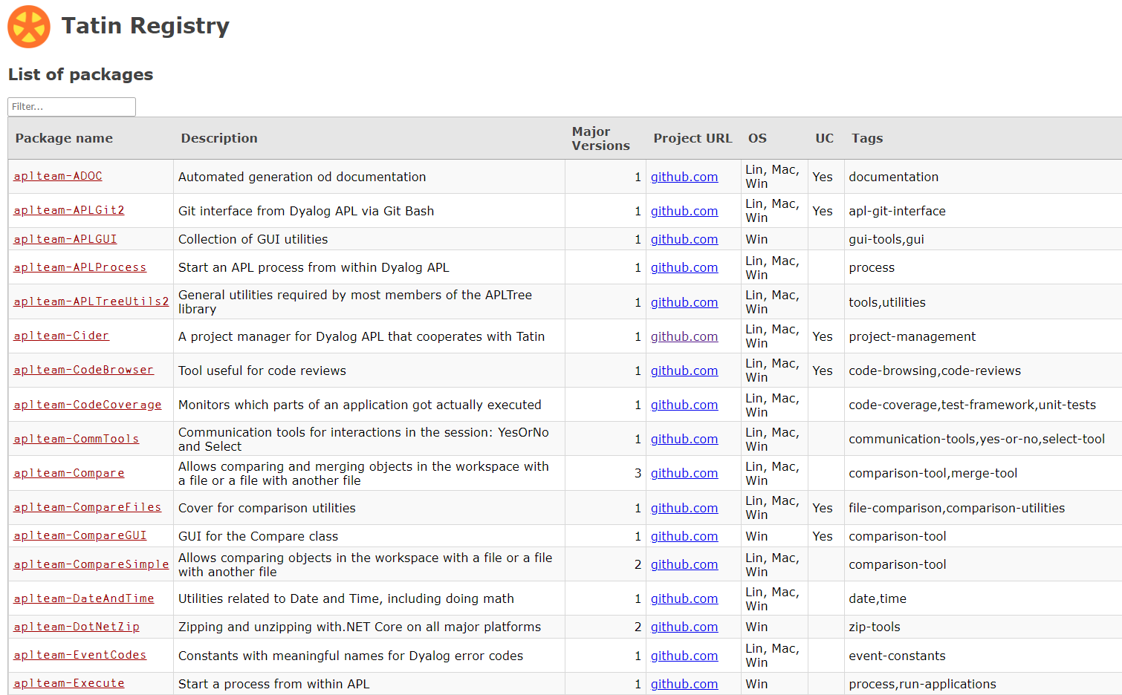
Finding Packages – www.tatin.dev

Slide 76
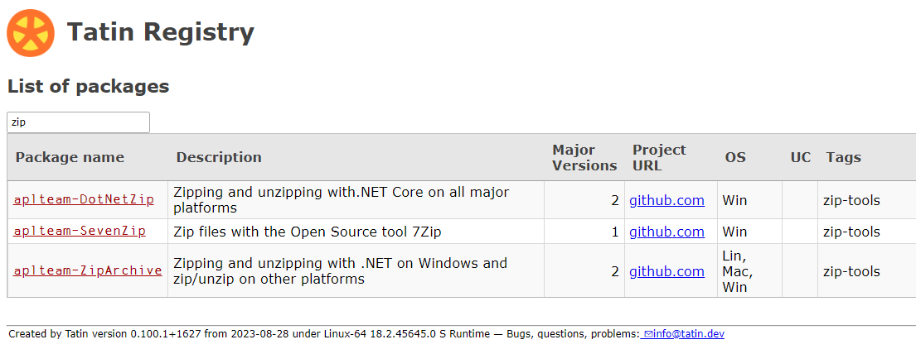
Finding Packages

Slide 77
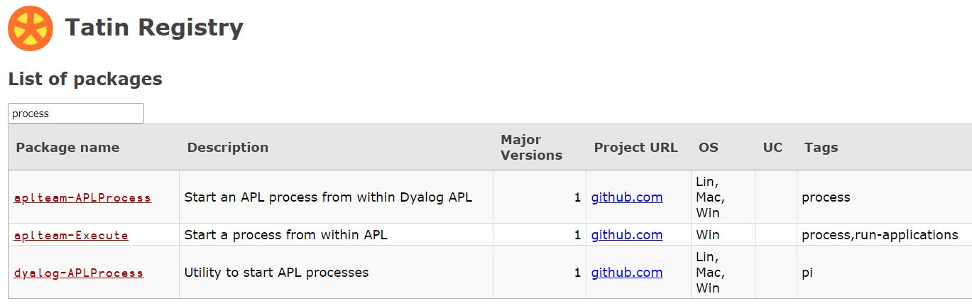
Finding Packages
53 packages is enough to (sometimes) make it difficult
to decide which one to use

Slide 78
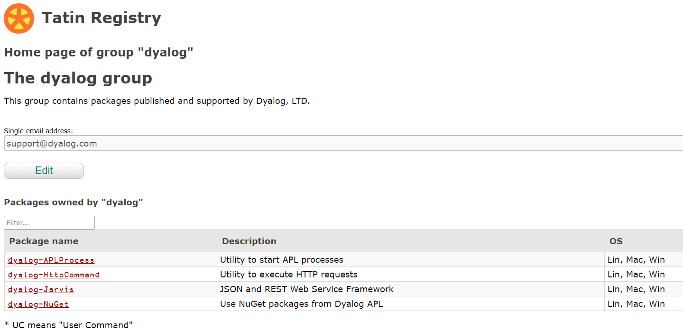

Slide 79
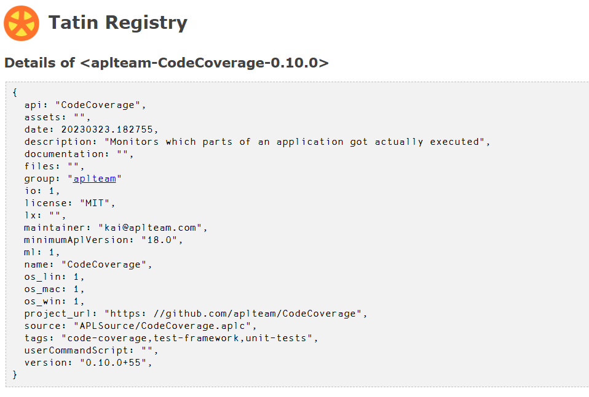
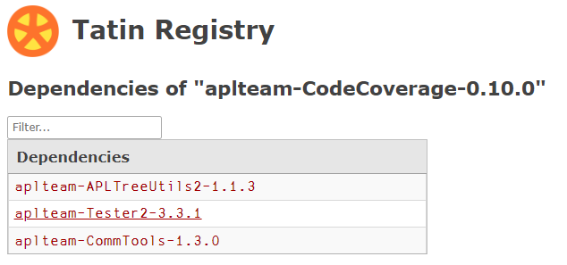

Slide 80
]Tatin.ListPackages
]tatin.listtags
tags from https://tatin.dev
--------------------------
apl-git-interface
build
calculations
chm
code-browsing
code-coverage
code-reviews
command-generation
communication-tools
comparison-tool
comparison-utilities
components
config-files
converter
copy
cryptography
date
dates
…
…
utilities
validation
webservice
windows-event-log
windows-registry
winscp-interface
write
yes-or-no
zip-tools
]Tatin.ListPackages -group=dyalog
Registry: https://tatin.dev
Group & Name # major versions
------------ ----------------
dyalogAPLProcess 1
dyalog-HttpCommand 1
dyalog-Jarvis 1
dyalog-NuGet 1
dyalog-OpenAI 1
]Tatin.ListPackages -tag=crypto
Registry: https://tatin.dev
Group & Name # major versions
------------ ----------------
aplteam-HashPasswords 1

Slide 81
Adding a Tatin Dependency
Example: I use HttpCommand in just about every new project
To add it to our Cider project:
]Cider.AddTatinDependencies HttpCommand
1 Tatin dependency added:
dyalog-HttpCommand-5.2.0
Since we did not specify a version, we get the latest.
A reference is created to the loaded package within our project space:
tp3cp.HttpCommand.Get 'www.dyalog.com'
[rc: 0 | msg: | HTTP Status: 200 "OK" | ≢Data: 22580]

Slide 82
Exercise 9
Add HttpCommand (or some other Tatin Package) to your project
Inspect your project folder
Close and reopen the project to convince yourself that it all works
Update your function to use your new package

Slide 83
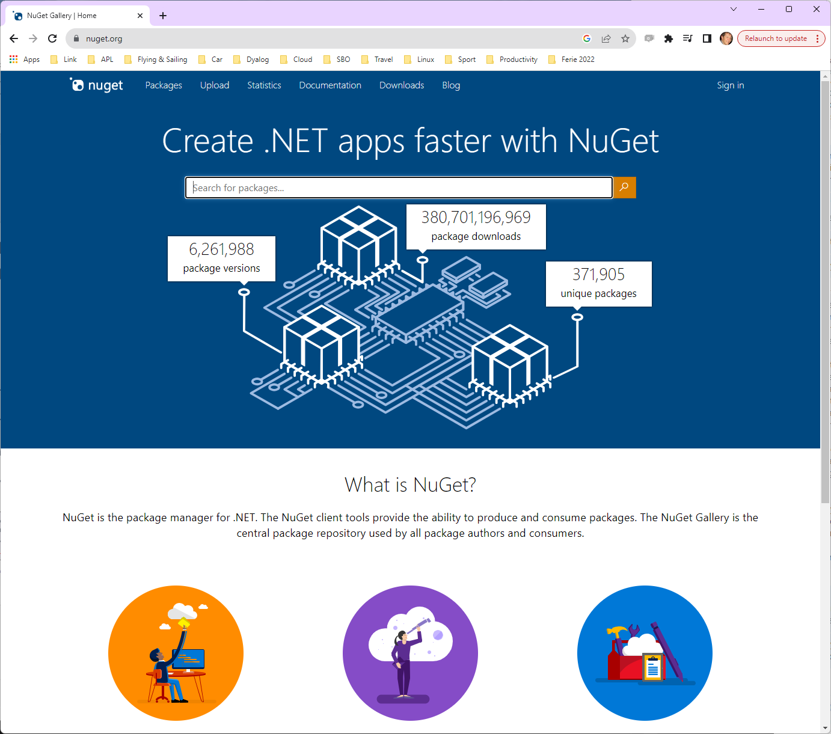
NuGet
NuGet is the .NET
package manager
You can use NuGet packages from Dyalog APL,
with .NET 6.0 or later

Slide 84
Adding a NuGet Package
NuGet support currently requires .NET 6.0, 7.0 or 8.0
Support for "Framework" packages MAY follow
You must have .NET 6.0 or later, and Dyalog APL configured to use it
(DYALOG_NETCORE=1).
⎕USING←''
System.Environment.Version
8.0.8

Slide 85
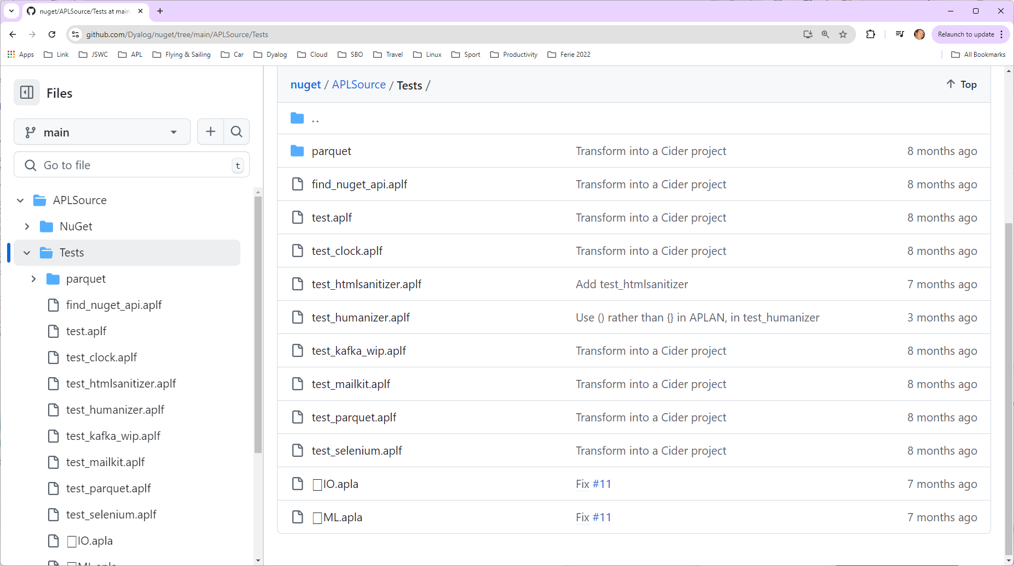
NuGet Tests

Slide 86


Slide 87
Adding a NuGet Package
We can add Clock to our Cider project (by default, adds the latest version):
]Cider.AddNuGetDependencies Clock
Clock 1.0.3
A reference to a namespace hosting the .NET package is created:
tp3cp.Clock.UtcNow.(Hour Minute)
14 43
In fact, the namespace is empty except for ⎕USING:
tp3cp.Clock.⎕USING
,c:/tmp/tp3cp/nuget-packages/published/Clock.dll

Slide 88
Exercise 10
Add Clock (or another NuGet package
of your choice) to your project
Possible inspiration at
https://github.com/Dyalog/nuget/tree/main/APLSource/Tests

Slide 89
Morten’s Solution
We can add Clock to our Cider project (by default, adds the latest version).
But more interesting:
]cider.addNuGetDependencies MailKit,MimeKit
Would you like to (re-)load all NuGet dependencies? (Y/n) y
MailKit MimeKit
See the "ReadMail" Cider project in the TP3 folder:
]cider.openProject c:\devt\2024-TP3\ReadMail

Slide 90

We asked for these – what are the others?

Slide 91

Dependencies of Dependencies
Great fleas have little fleas upon their backs to bite 'em,
And little fleas have lesser fleas, and so ad infinitum.
Augustus de Morgan
Both Tatin and NuGet will
automatically load such
dependencies

Slide 92


"Principal" dependencies (that we added)

Slide 93
"Lesser" fleas

Slide 94
"Principal" dependencies (that we added)

Slide 95
Where Do Dependencies Go?
]Cider.OpenProject C:\tmp\fleatest
Project successfully loaded and established in "#.fleatest"
)cs fleatest
#.fleatest
⎕NL -9
CiderConfig CompareFiles ZipArchive
CompareFiles
#._tatin.aplteam_CompareFiles_4_0_1.API
⍪#._tatin.⎕nl -9
aplteam_APLTreeUtils2_1_2_0
aplteam_CommTools_1_5_0
aplteam_CompareFiles_4_0_1
aplteam_DotNetZip_2_0_2
aplteam_FilesAndDirs_5_5_0
aplteam_OS_3_0_1
aplteam_ZipArchive_0_1_1
#._tatin.aplteam_CompareFiles_4_0_1.⎕NL -9
API APLTreeUtils2 Admin CommTools ComparisonTools FilesAndDirs TatinVars
Our Dependencies
Lesser Fleas

Slide 96
dotnet command-line tool
Under Windows, Linux and macOS, .NET provides a "dotnet" command which:
  Creates .NET projects that we use to define and manage dependencies (complete with a C# class that we never use)
  Adds Dependencies
  "Publishes" collections of DLLs that implement packages
Dyalog's NuGet support depends heavily on this
  We just set ⎕USING to point to the published DLLs
  The alternative is to try to replicate poorly documented .NET behaviours

Slide 97

NuGet Packages – Under the Covers
NuGet DLL's go in a folder called "published"

Slide 98

NuGet Packages – Under the Covers
The dotnet command line tool has created some C# code which "pretends" to use the NuGet packages

Slide 99


NuGet Packages – Under the Covers
The dotnet command line tool has created some C# code which "pretends" to use the NuGet packages

Slide 100


Same Same but Different
Tatin
NuGet
#.projectSpace.HttpCommand
#.projectSpace.Clock

Slide 101





The Cast, in order of appearance
Link Synchronises Source Files and Workspace
The workspace and source files are "Linked"
Cider is a Project Manager
A Project is a linked source folder,
a config file, plus optional dependencies
Tatin is the APL Package Manager
A Package is a project wrapped up for consumption by others
NuGet is the .NET Package Manager
The Dyalog.NET Bridge allows APL to use .NET libraries

