Slide 1
Protobuf
Sandra Persson

Slide 2
What is Protobuf?
Protocol Buffers
A format for serializing structured data developed by Google
Designed to be small, fast and simple
Language-neutral, platform-neutral, open-source
Where is it used? gRPC
Protobuf
Protocol buffers
{JSON} <XML> CSV Avro…

Slide 3
Protobuf vs. JSON
Protocol Buffers
Bytes sequence:
10 5 67 97 106 97 108 16 2 26 21 114 97 109 111 110 121 99 97 106 97 108 64 103 109 97 105 108 46 99 111 109
Breakdown:
tag length C a j a l
5 67 97 106 97 108
tag 2
2
tag length ramonycajal@gmail.com
26 21 114 97 109 111 110 121 99 97 106 97 108 64 103 109 97 105 108 46 99 111 109
{
"name": "Cajal”,
"id": 2,
"email": "ramonycajal@gmail.com"
}
Fieldnr type
0 0 0 0 1 0 1 0

Slide 4
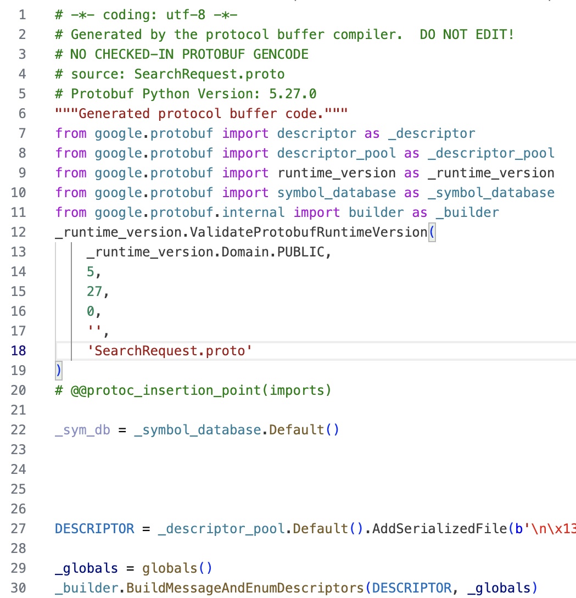
Define your data structure in a .proto file
Generate code
with protoc
compiler
Compile PB
code with your
project code
Use PB classes
to serialize,
share and
deserialize data
.proto file:
message Person {
optional string name = 1;
optional int32 id = 2;
repeated string email = 3;
}
10 5 67 97 106 97 108 16 2 26 21 114 97
109 111 110 121 99 97 106 97 108 64 1
03 109 97 105 108 46 99 111 109

Slide 5
Advantages and disadvantages
Compact = Small and fast
Schema as documentation
Forward- and backward compatibility
Not readable by humans
Better for statically typed languages
How much faster?

Slide 6
Supported languages
Languages supported directly by Google:
C++, C#, Java, Kotlin, Objective-C, PHP, Python, Ruby, Dart, Go
Third party:
C, Haskell, Javascript, Julia, Matlab, Perl, PHP, R, Rust, Scala, Swift, Typescript…
APL?

Slide 7
Can it be implemented in APL?
As a Proof of concept
As a project to learn APL
Obstacles = lots of learning
Double
Float
Int64
Uint64
Int32
Fixed64
Fixed32
Bool
String
Message
Bytes
Uint32
Enum
Sfixed32
Sfixed64
Sint32
Sint64

Slide 8
Demo
syntax = "proto3";
package AddressBook;
message Person {
optional string name = 1;
optional int32 id = 2;
optional string email = 3;
enum PhoneType {
PHONE_TYPE_UNSPECIFIED = 0;
PHONE_TYPE_MOBILE = 1;
PHONE_TYPE_HOME = 2;
PHONE_TYPE_WORK = 3;
}
message PhoneNumber {
optional string number = 1;
optional PhoneType type = 2;
}
repeated PhoneNumber phones = 4;
}
message AddressBook {
repeated Person people = 1;
}
Serializing from Python
Parsing in APL
And then serializing again

Slide 9
Thanks for listening

