Slide 1
Telemetry and APL
Exploring telemetry solutions in distributed systems and an implementation in Dyalog APL
Gilgamesh Athoraya

Slide 2
Telemetry ChatGPT
What the computer says about Telemetry:
Telemetry in distributed applications refers to the process of collecting and transmitting data about the performance, usage, and health of various components across the system for monitoring and analysis purposes.

Slide 3
Telemetry 3 Pillars
The three pillars of telemetry:
Logs
Metrics
Traces

Slide 4
Telemetry Logs
Structured logs describing discrete events
Timestamp
Source
Description
Other useful data

Slide 5
Telemetry Metrics
High level aggregations, counts and measures of various indicators:
CPU
Memory
Jobs/Requests handled
Etc.

Slide 6
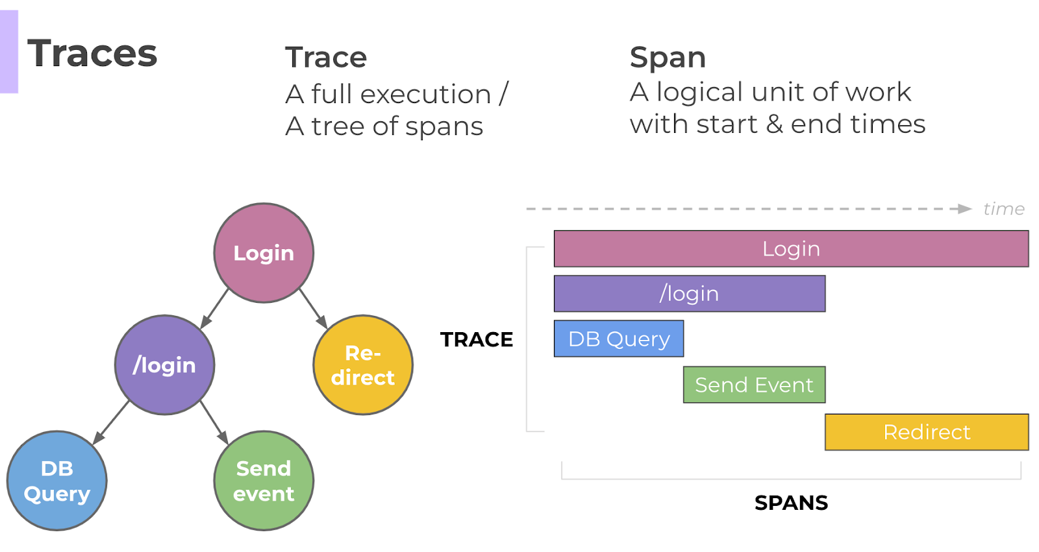
Telemetry Traces
A trace represents the complete path through the system when handling a request or executing a job.

Slide 7
Telemetry Setup
Applications and services emit telemetry data
Need a backend to store the data
Need a frontend to visualize
Maybe a monitoring tool to alert on certain triggers?

Slide 8
Telemetry Standard
OpenTelemetry
Observability framework
Vendor- and tool-agnostic
Open source
Collection of tools, APIs, SDKs and protocols

Slide 9
OpenTelemetry Vendors
Long list of vendors that support OpenTelemetry:
AWS
Azure
Google Cloud Platform
Jaeger
SigNoz
https://opentelemetry.io/ecosystem/vendors/

Slide 10
OpenTelemetry Collector
Vendor-agnostic implementation of how to receive, process and export telemetry data.
Local agent receives telemetry data from application
Receiver supports multiple forms of the OpenTelemetry Protocol (OTLP)
grpc
http + protobuf
http + json

Slide 11
Process flow using OtelCollector
APL
Metrics
Logs
Otel Collector
Filter
Enrich
Telemetry
Service
Visualize
Search
Traces
Modify
Batch
Alert

Slide 12
OpenTelemetry with APL
To use OpenTelemetry from APL we need an APL SDK that implements:
the specification
APIs
Emits telemetry data

Slide 13
OpenTelemetry with APL
Send telemetry data using OTLP over HTTP+JSON to local Otel Collector agent
Configure Otel Collector to batch messages and export to one or more backends
Use local backend during test/development

Slide 14
Demo
Simple example app that emits telemetry
Use docker to start a local OtelCollector and backend

Slide 15
Summary
OpenTelemetry is adopted by a large number of vendors
SDKs available for many languages (APL is missing on the list)
Recommendation is to use a local OtelCollector:
Low latency
Many extensions available as contribution plugins
It supports HTTP+JSON, meaning no need to implement grpc and protobuf support in APL

Slide 16
Thanks for listening

