Slide 1
raylib-apl
A Simple Cross-Platform Library to develop applications
+
=
Presented by Brian Ellingsgaard

Slide 2
raylib
A Simple Cross-Platform Library to develop applications

Slide 3
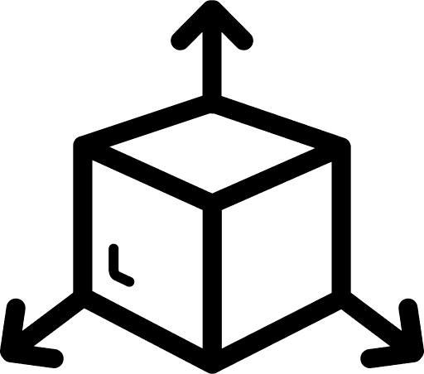
raylib
A Simple Cross-Platform Library to develop applications
AB

Slide 4
raylib
A Simple Cross-Platform Library to develop applications
AB

Slide 5
raylib
A Simple Cross-Platform Library to develop applications
AB

Slide 6
raylib platforms

Slide 7
My passion

Slide 8
My passion
answer ← 6?6
Ask ← {+/answer=⍵}

Slide 9
My passion
answer ← 6?6
Ask ← {+/answer=⍵}
Ask 1 2 2 2 2 2 1

Slide 10
My passion
answer ← 6?6
Ask ← {+/answer=⍵}
Ask 1 2 2 2 2 2 1
Ask 3 4 4 4 4 4
2

Slide 11
My passion
answer ← 6?6
Ask ← {+/answer=⍵}
Ask 1 2 2 2 2 2 1
Ask 3 4 4 4 4 4
2
Ask 3 4 5 2 1 6
6

Slide 12
⎕WC

Slide 13
⎕WC

Slide 14
⎕WC
black blue ← 0 255
stripes ← 16⌿16/16 16⍴black blue
'f' ⎕WC 'Form'
'b' ⎕WC 'Bitmap' ('CBits' stripes)
'f.i' ⎕WC 'Image'(0 0)('Picture' 'b')
{b.CBits⌽⍨←1 ⋄ ⎕DL÷60}¨⍳200

Slide 15
⎕WC
black blue ← 0 255
stripes ← 16⌿16/16 16⍴black blue
'f' ⎕WC 'Form'
'b' ⎕WC 'Bitmap' ('CBits' stripes)
'f.i' ⎕WC 'Image'(0 0)('Picture' 'b')
{b.CBits⌽⍨←1 ⋄ ⎕DL÷60}¨⍳200

Slide 16
⎕WC
black blue ← 0 255
stripes ← 16⌿16/16 16⍴black blue 'f' ⎕WC 'Form'
'b' ⎕WC 'Bitmap' ('CBits' stripes)
'f.i' ⎕WC 'Image'(0 0)('Picture' 'b')
{b.CBits⌽⍨←1 ⋄ ⎕DL÷60}¨⍳200

Slide 17
⎕WC
black blue ← 0 255
stripes ← 16⌿16/16 16⍴black blue 'f' ⎕WC 'Form'
'b' ⎕WC 'Bitmap' ('CBits' stripes)
'f.i' ⎕WC 'Image'(0 0)('Picture' 'b')
{b.CBits⌽⍨←1 ⋄ ⎕DL÷60}¨⍳200

Slide 18
⎕WC
{b.CBits⌽⍨←1 ⋄ ⎕DL÷60}¨⍳200

Slide 19
raylib-apl
Now showing stripes video made with raylib-apl
Screen 2

Slide 20
rl←0⎕Fix'path/to/raylib.apln'
rl.Init ⍬
blue ← 8↑0 0 255 255
black ← 8↑0 0 0 255
poses ← 32×1-⍨⍳11
rl.InitWindow 800 800 'Hello!!!'

Slide 21
rl←0⎕Fix'path/to/raylib.apln'
rl.Init ⍬
blue ← 8↑0 0 255 255
black ← 8↑0 0 0 255
poses ← 32×1-⍨⍳11
rl.InitWindow 800 800 'Hello!!!'

Slide 22
⍝ For every frame till user closes the window
:While ~rl.WindowShouldClose
poses +← 1
poses |⍨← 32×9
rl.BeginDrawing ⍝ Drawing a new frame
⍝ We want black background
rl.ClearBackground ⊂black
rl.BeginScissorMode 0 0 256 256 ⍝ Only draw in area
rl.DrawRectangle¨ (poses-32),¨⊂0 16 256 blue
rl.EndScissorMode
rl.DrawFPS 260 0
rl.EndDrawing
:EndWhile
rl.CloseWindow

Slide 23
rl.SetTargetFPS 314159

Slide 24
raylib-apl
Now showing FAST stripes video made with raylib-apl
Screen 3

Slide 25
raylib-apl
Now showing duck with raylib-apl
Screen 4

Slide 26
rl.InitWindow 800 800 'Hello!!!'
rl.DisableCursor
proj ← rl.CameraProjection.CAMERA_PERSPECTIVE
camera ← (50 50 50) (0 10 0) (0 1 0) 45 proj 0 0 0 0
⍝ Define the camera to look into our 3d world
⍝ Camera position
⍝ Camera looking at point
⍝ Camera up vector (rotation towards target)
⍝ Camera field-of-view Y
⍝ Camera mode type
⍝ Duck model
model _ ← rl.LoadModelRetPtr ⍬ 'OBJ/RubberDuck_LOD0.obj'

Slide 27
⍝ For every frame till user closes the window
:While ~rl.WindowShouldClose
⍝ Look for keystrokes from user, move the camera
camera ← rl.UpdateCamera(,⊂camera)
Drawing...
:EndWhile
⍝ Unloading model, freeing up memory
rl.UnloadModel ,⊂model
⍝ Application finished, window closed
rl.CloseWindow

Slide 28
⍝ draw the frame with white background
rl.BeginDrawing
rl.ClearBackground ⊂8↑rl.color.white
rl.DrawFPS 40 40 ⍝ Draws FPS at x=40 y=40
⍝ Draw 3d stuff relative to the camera
rl.BeginMode3D ⊂camera
⍝ draws grid
rl.DrawGrid 20 10
⍝ Draw the duck model at position
position ← 0 0 0 ⋄ scale ← 1
rl.DrawModel model position scale (8↑rl.color.white)
rl.EndMode3D ⍝ Stop drawing 3d
⍝ wait till next frame is needed, then switch to our drawing
rl.EndDrawing

Slide 29
raylib-apl
Now again showing duck
with raylib-apl
Screen 4

Slide 30
VR showcase video
Screen 5

Slide 31
raylib showcase video
Screen 6

Slide 32
Extra bits
raylib-apl adapts to breaking changes

Slide 33
Extra bits
raylib-apl adapts to breaking changes

Slide 34
Extra bits
raylib-apl adapts to breaking changes

Slide 35
When raylib-apl,
and when not.
Good reasons
- Game
- 3D
- Control
Bad reasons
- OOP
- GUI
- In production now

Slide 36
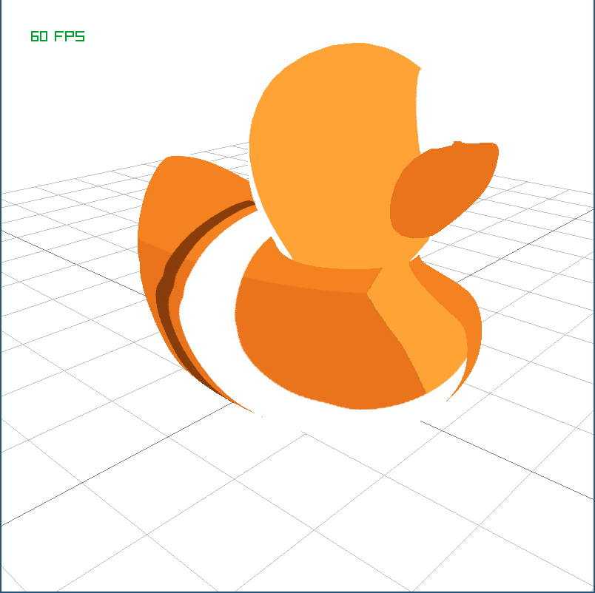
Recap
A Simple Cross-Platform Library to develop applications
+
=
AB

Slide 37
Questions?
+
=
AB

