Slide 1
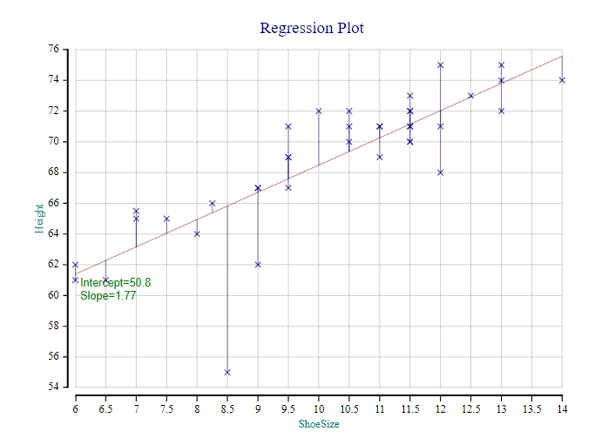
Taming Regression
Dr. Stephen Mansour
Dyalog 24, Glasgow, Scotland
September 17, 2024

Slide 2
Taming Regression: A Case Study in How To
Market your Dyalog APL application:
Make APL Syntax user friendly to non-APL users.
Create Things that Competitors can’t do in other languages.
Design user functions and operators to be consistent with APL primitives.
Provide APL Programmers with Useful Source Code for other Apps.

Slide 3
Over 300 attendees
3 or 4 parallel sessions
35 attended my presentation “Taming Regression”
Comments:
I assume your program does least-squares regression. Can you also do maximum likelihood?
When will the web version be out? My students are reluctant to install a program, but they would be more likely to use a web app.

Slide 4
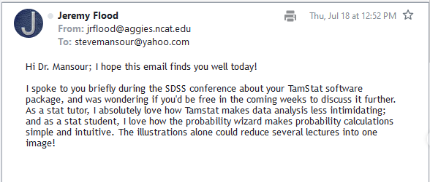

Slide 5
Planning a Wedding
Key:
known
unknown
Costs are:
$500 to rent the hall
$100 per guest
What is the final cost for 35 guests?
How many guests can you invite with a budget of $8000?
You are in the catering business. How much do you charge for the venue? Per person?
Model: $f\left(x\right)=β_{0}+β_{1}x$
f←500∘+100∘×
1. Arithmetic: $y=f\left(x\right)$
f 35 ←→ 4000
2. Algebra: $y=f\left(x\right)$
f⍣¯1⊢8000 ←→ 75
Regression: $y=f\left(x\right)$
Check sales records from other caterers for total costs and number of guests.
COST⌹1,⍪GUESTS ←→ 500 100

Slide 6
Some issues with regression
Not just coefficients, but an executable function.
Confidence or prediction intervals.
Non-linear relationships between $X$ and $Y$.
Non-constant variance over the range of $f$.
Qualitative variables.
Meaningful variable names in multiple regression.

Slide 7
The regress Operator*
The regress operator in TamStat can perform:
Simple linear regression
Multiple linear regression
Regression with indicator variables
Polynomial regression
Variance Stabilizing Transformations
Multiplicative Regression
Logistic Regression
General non-linear regression
*If not specified, operand assumed to be linear

Slide 8
MODEL: NameSpace Result of regress
B: Coefficients – Numeric Vector $\left({\hat{β}}_{0}{,\hat{β}}_{1},⋯\text{, }{\hat{β}}_{k}\right)$
RSq: R-Squared - Positive Scalar
S: Standard Error – Positive Scalar
YHAT: Fitted Values – Numeric Vector $\left({\hat{y}}_{1},⋯{\hat{y}}_{n}\right)$
E: Residuals – Numeric Vector $\left(e_{1},⋯e_{n}\right)$
AnovaTable: Matrix showing Analysis of Variance
f: Linear Function relating X to Y: $y=f\left(x\right)$

Slide 9
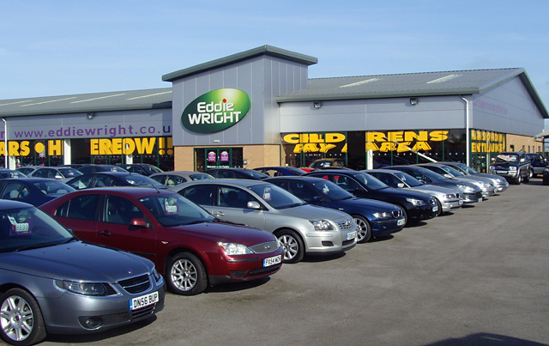
Simple Regression Example
A car dealer runs television ads for five weeks and records the number of cars sold that week.
He would like to predict sales from the number of ads run.
Week | Television Ads Run | Cars Sold
1 | 1 | 14
2 | 3 | 24
3 | 2 | 18
4 | 1 | 17
5 | 3 | 27
This Photo by Unknown Author is licensed under CC BY-SA

Slide 10
Simple Linear Regression in TamStat
⍝ Predictor Variable
ADS←1 3 2 1 3
⍝ Response Variable
SALES←14 24 18 17 27
MODEL←SALES regress ADS
MODEL.B ⍝ Coefficents
10 5
MODEL.Equation
Y←10+(5×X1)+E
MODEL.f 2 ⍝Sales=f(Ads)
20
⍝ Estimate mean sales
MODEL.f confInt 2
16.925 23.075
.99 MODEL.f confInt 2
14.357 25.643
MODEL.f 1 2 3
15 20 25
⍝ Predict dealer sales
MODEL.f predInt 1 2 3
6.7216 23.278
12.469 27.531
16.722 33.278

Slide 11
Two Regression Wizards
Univariate Regression
One predictor variable
Simple or non-linear regression
Output graphic: scatterplot with regression line and confidence bounds
Multivariate Regression
One or more predictor variables
Linear regression
Expressions are allowed
Separate screen for confidence and prediction intervals

Slide 12
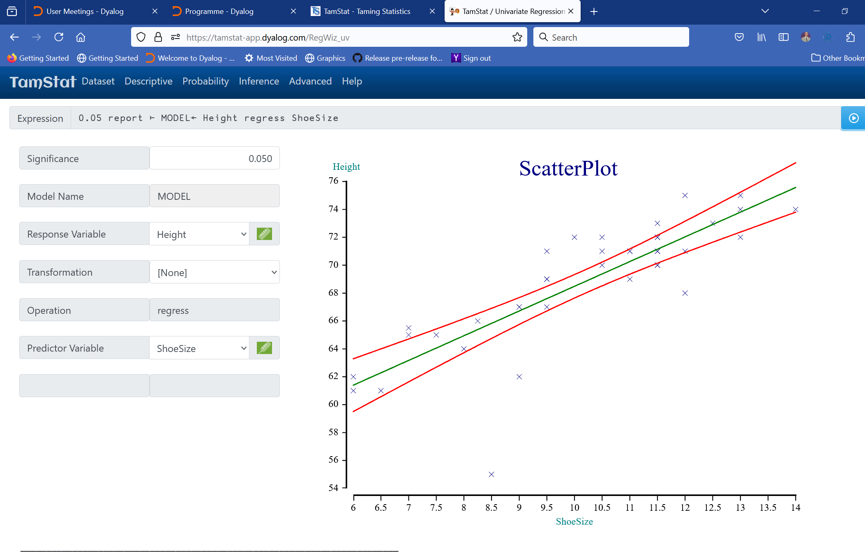

Slide 13
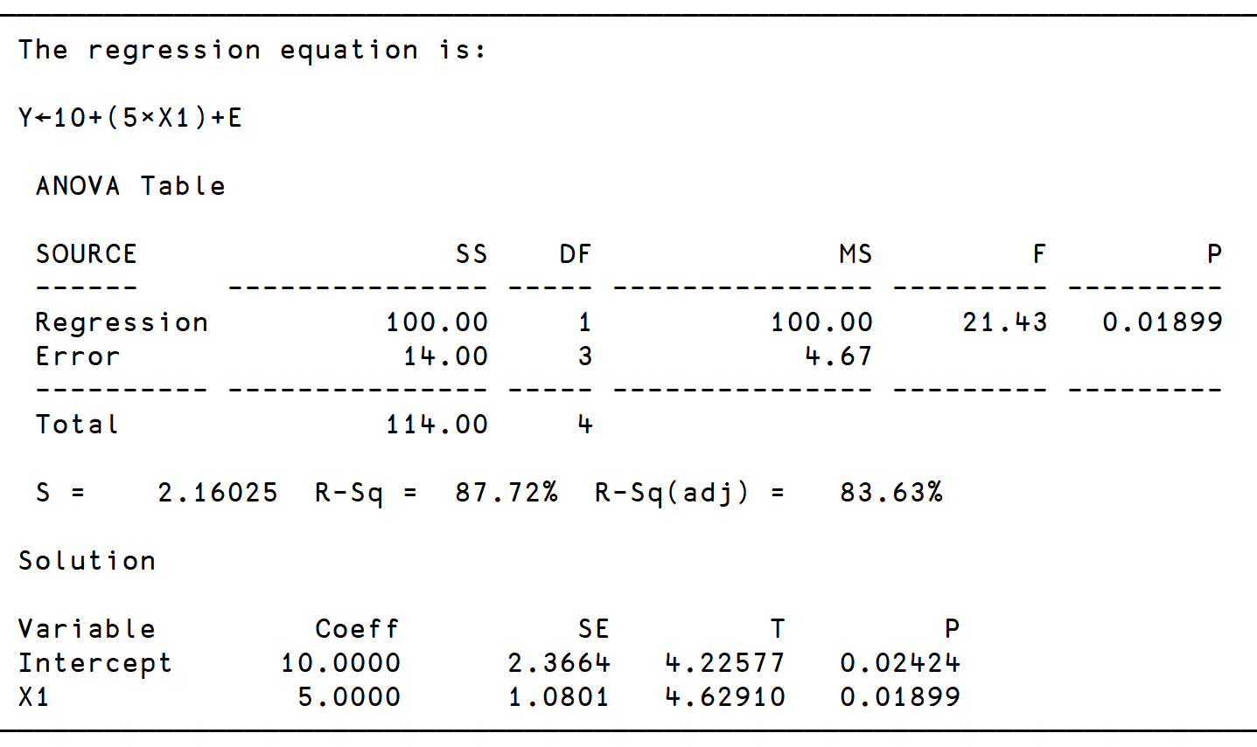
report MODEL

Slide 14
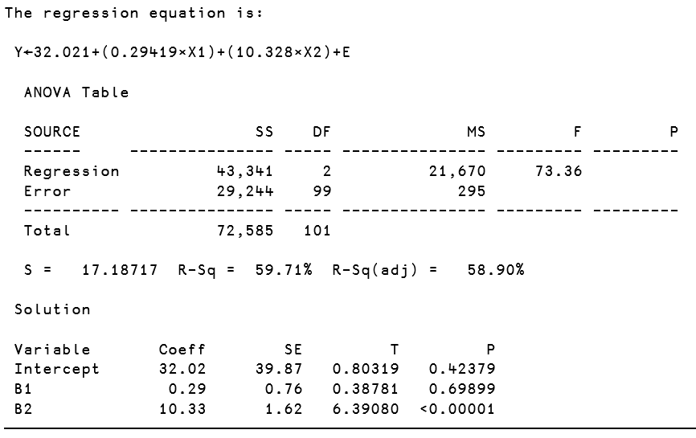
Multiple Regression
⍝ Variable List
MODEL←Weight regress Height ShoeSize
report MODEL
Multiple regression in TamStat requires the right argument to take on one of three forms:
Variable List
Matrix
Namespace
For both variable list and matrix examples, the left argument represents the response variable, and the right argument represents the predictor variables

Slide 15
Multiple Regression (Continued)
⍝ Using a Namespace
V←'Weight Height ShoeSize'
DB←V selectFrom SD
MODEL←'Weight' regress DB
MODEL.f 68 9.5
158.84
.9 MODEL.f predInt 68 9.5
114.95 202.72
report MODEL

Slide 16
Indicator Variables
Character fields are treated as indicator variables.
Two categories: Creates a Boolean variable whose name is the value with the highest mean response value . 1=the value, 0=not the value.
More than two categories: TamStat creates multiple indicator variables, one less than number of categories.
Base Case:
Category with minimum average response.
This Photo by Unknown Author is licensed under CC BY-NC

Slide 17
CSI Scranton
You are investigating a murder.
You find a bloody footprint near the body.
It is of a man’s shoe, size 9-1/2.
What is the height of the suspect?
This Photo by Unknown Author is licensed under CC BY-NC-ND

Slide 18
Indicator Variables (Continued)
V←'Height Sex ShoeSize'
DB←V selectFrom D
MODEL←'Height' regress DB
MODEL.Equation
Height←52.242+(2.9777×M)+(1.4031×ShoeSize)+E
MODEL.f 1 9.5 ⍝ Point Estimate
68.549
⍝ 90% prediction interval
0.9 MODEL.f predInt 1 9.5
64.454 72.645
Conclusion:
Suspect is between 5’5” and 6’1”.

Slide 19
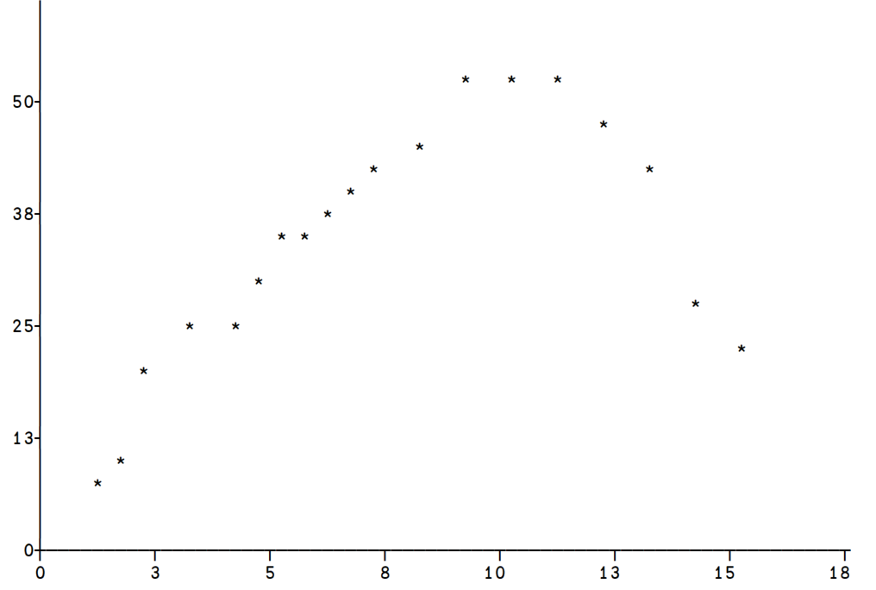
Non-Linear Regression – Polynomial scatterPlot show Y X
Y=Tensile Strength (PSI)
X = Hardwood % Concentration

Slide 20
Quadratic Regression (Operand: quad)
MODEL←Y quad regress X
MODEL.B
45.295 2.5463 ¯0.63455
⍝ ↑ ↑ ↑
⍝ Int Linear Square
MODEL.g 7 10 15
44.581 47.511 27.012
MODEL.g confInt 10
44.402 50.619
MODEL.g predInt 15
15.752 38.273
MODEL.Equation
Y←45+(2.6×X-7.3)+(¯0.6×(X-7.3)*2)+E
MODEL.Coeff
Variable Coeff SE T
Intercept 45.29 1.48 30.55
X1 2.55 0.25 10.03
X2 ¯0.63 0.06 ¯10.27

Slide 21
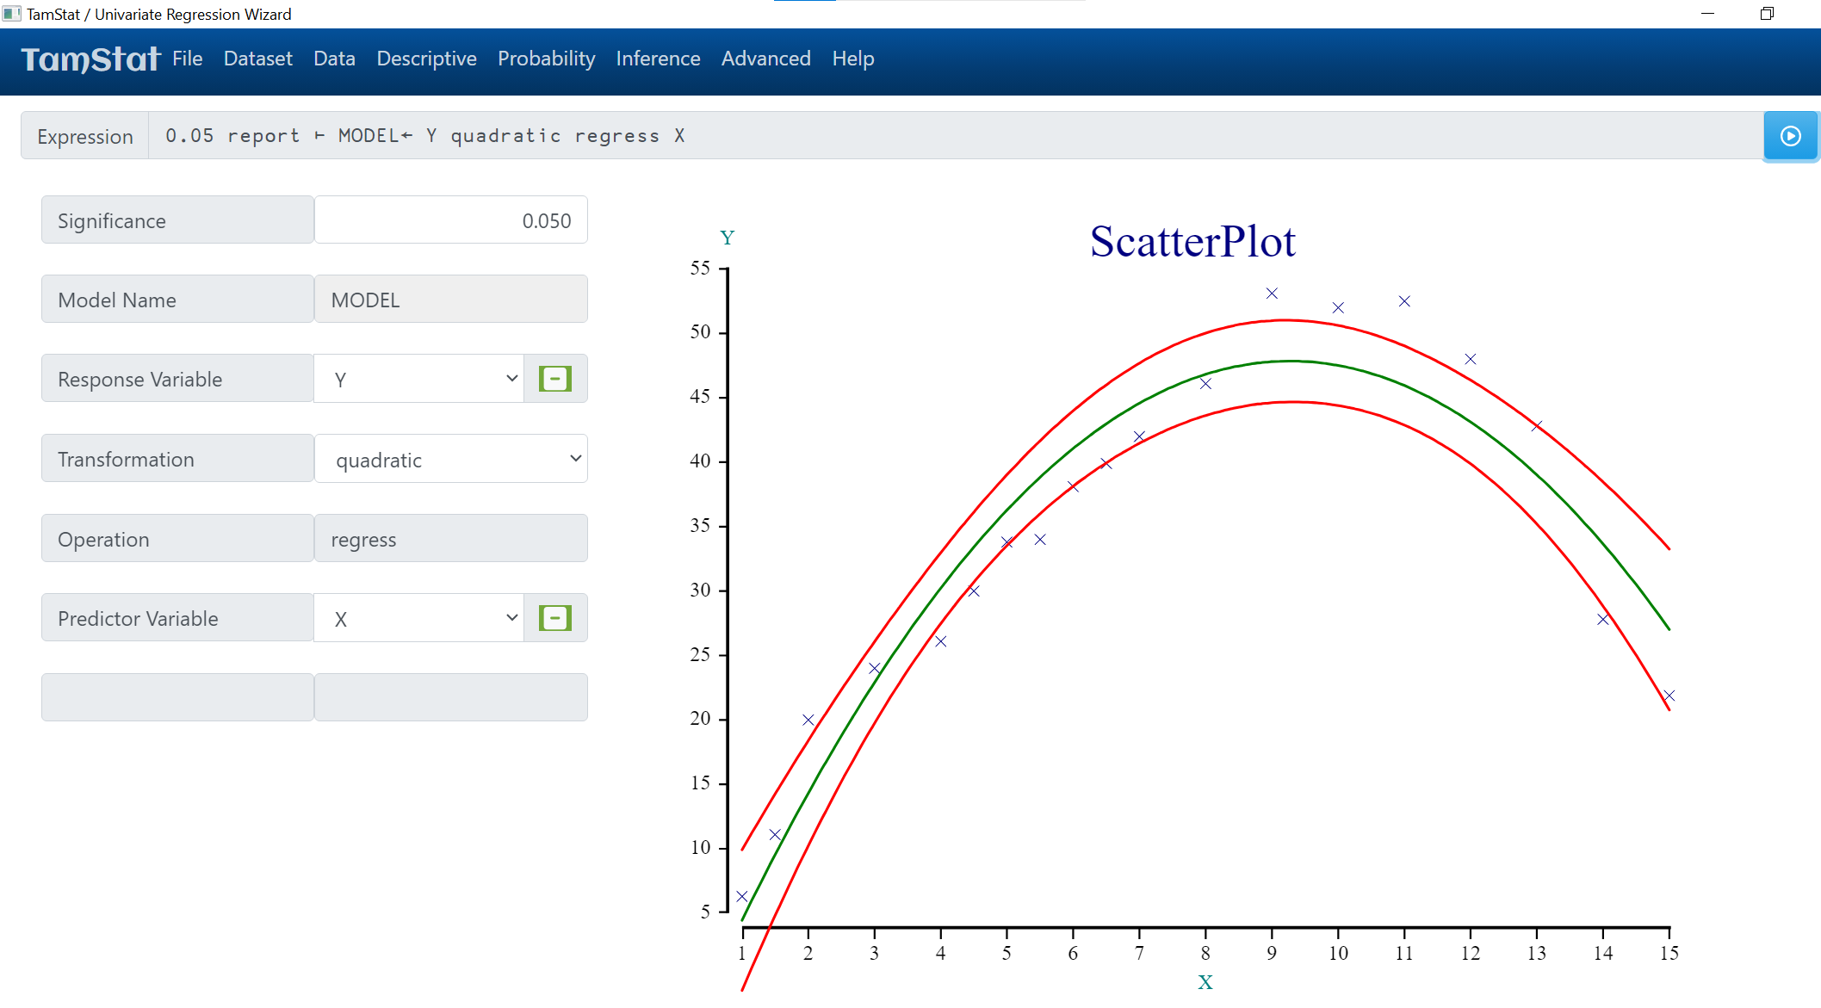
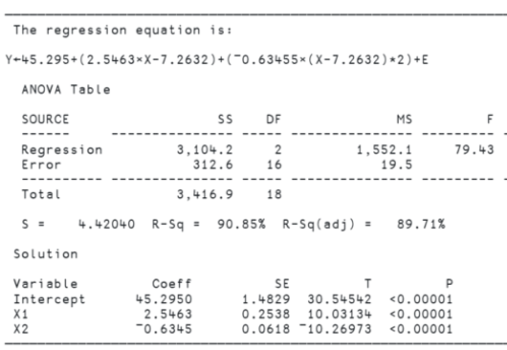

Slide 22
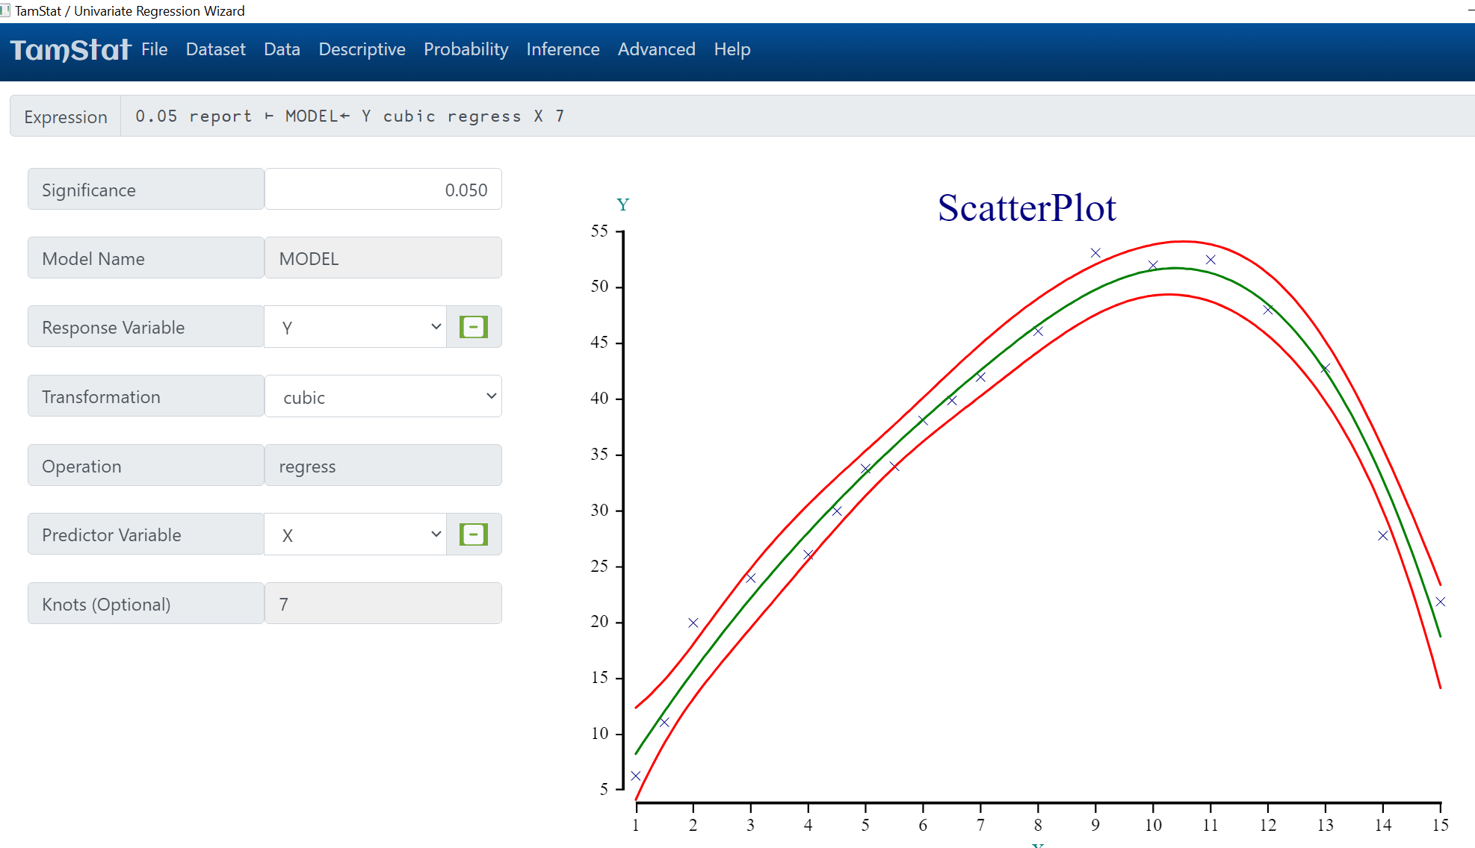
Cubic Spline Model

Slide 23
Logistic Regression – Boolean Response Variable
Can you predict a person’s sex based on height?
Let Y←Sex eq 'M' and X←Height
Logistic regression uses the following formula:
YHAT←÷1+*-B+.×1,X
YHAT is between 0 and 1 and represents the probability that Y=1.
The slope and intercept in B must be solved numerically by providing a starting point.
B←0.2 0.001 ⍝ Guess
ML←Y logit regress X B
ML.B ⍝ Intercept,Slope
¯34.568 0.53083
ML.g 68 ⍝ P(Male|68”)
0.8218

Slide 24
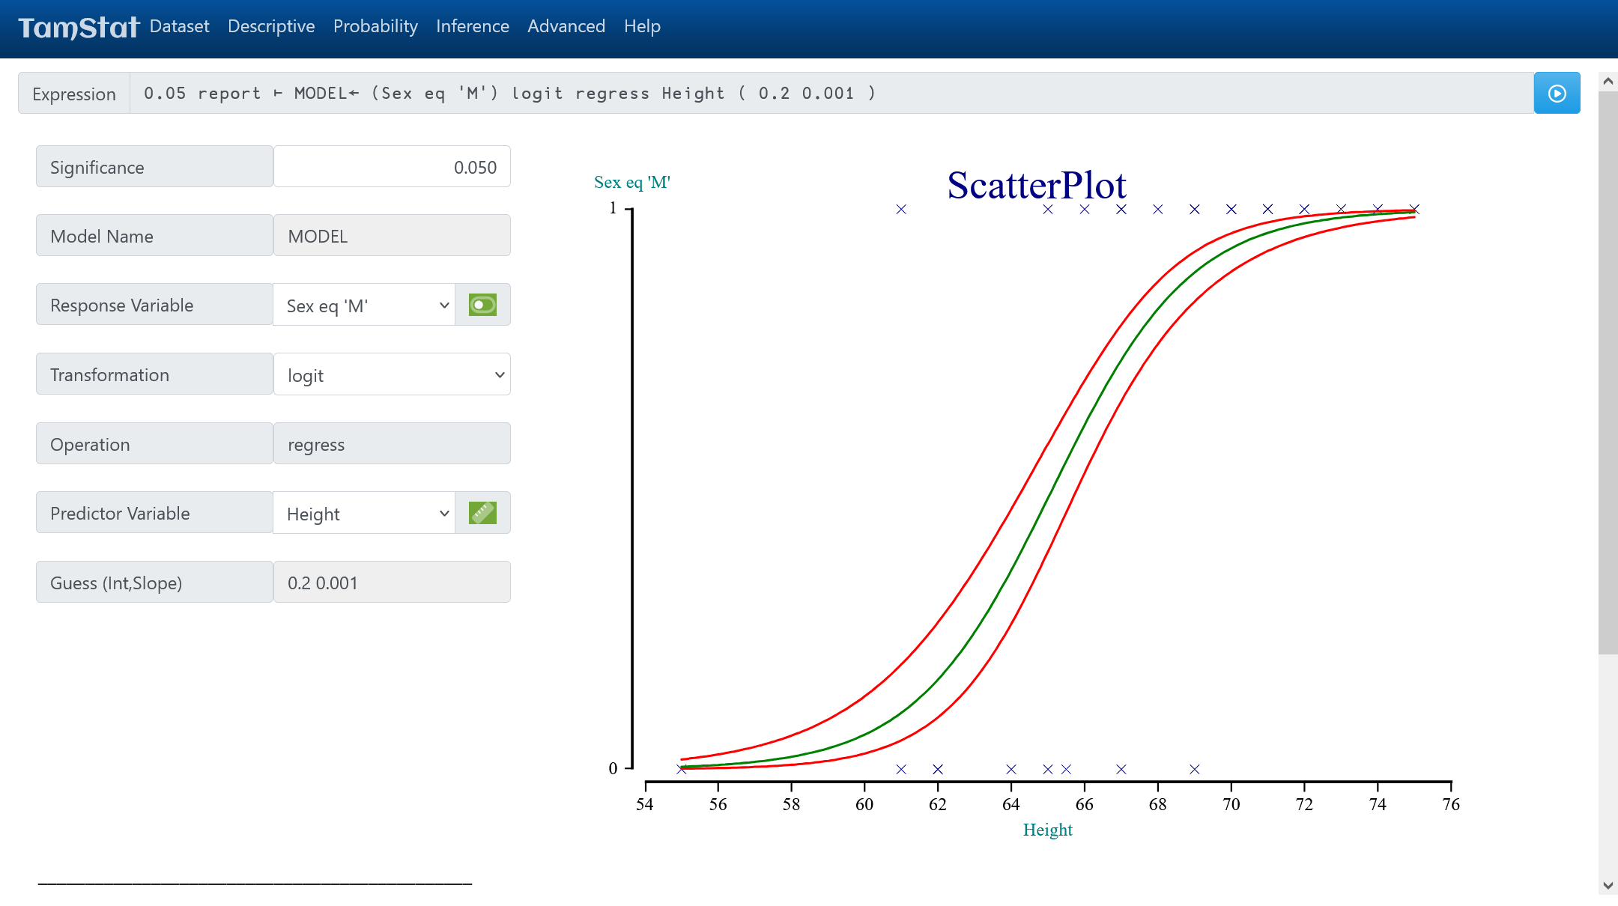

Slide 25
How to Download and Install TamStat
TamStat runs on Windows and the Mac, is free to use, and can be downloaded from the following website:
https://tamstat.dyalog.com
A Web Version is also available on the site.

Slide 26
Conclusion
Market your Dyalog APL application
Go to conferences where there are domain experts.
Bring a laptop and demo your software during refreshment breaks
Create Graphics that will “wow” the customer.
Make APL Syntax user friendly to non-APL users.
Make functions flexible and use English-like syntax
Create Things that Competitors can’t do in other languages.
Use operators and create functions dynamically
Design user functions and operators to be consistent with APL primitives.
Where appropriate, many defined functions can be made to behave just like scalar functions.
Create ambi-valent functions which supply default values.
Provide APL Programmers with Useful Source Code for other Apps.
TamStatCore functions are available on GitHub

