Slide 1
APL MOOC
An online course for university students

Slide 2
~$> cat /etc/group | grep aplmooc
Dani Adham
https://github.com/danii06
dani.adham@helsinki.fi
Hex
https://github.com/Hexadecimaaal
Sergey Ichtchenko
https://github.com/PixelSergey
sergey@sergey.fi

Slide 3
~$> whoami
BSc in Mathematics at the University of Helsinki (2022-2024)
MSc in Mathematics at the University of Oxford (2024-2025)
Cyber security consultant at WithSecure (F-Secure)
Novice APLer
Contact: @PixelSergey / sergey@sergey.fi
Hi! I'm Sergey.

Slide 4
~$> whoami

Slide 5
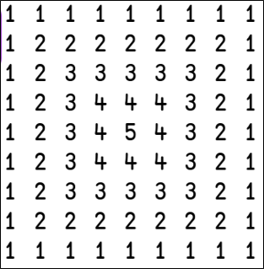
~$> whoami

Slide 6
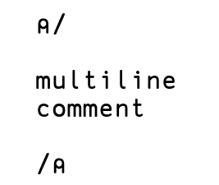
~$> whoami

Slide 7
Other languages have an unfair advantage

Slide 8
They are taught in schools

Slide 10
MOOC.fi

Slide 11
M O O C

Slide 12
Massively Open Online Course

Slide 13
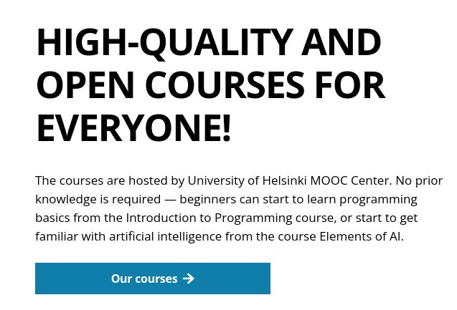

Slide 14
Automatic grading

Slide 15
Official study credits

Slide 16
5cr / 180cr = 2.778%

Slide 17
Haskell Python Algorithms Databases etc

Slide 18
What would it take to add APL?

Slide 19
My story with APL

Slide 20
Inspiration
tutorial.dyalog.com

Slide 24
✨THE PLAN✨
7 chapters of content
Review + read exercises + write exercises in each chapter
Write exercises award points, enough points gives you a grade (and CREDITS)
Final chapter is about software development, implementing a larger project
Uses TryAPL/Dyalogscript/Dyalog/Ride
Cover most APL glyphs

Slide 25
✨THE PLAN✨
Free and open for everyone worldwide
Finnish (maybe European?) students can get credits
Credit-hungry students + free credits = EXPONENTIAL GROWTH OF APL'ERS
If feedback is good, we can make a part 2 (as many MOOCs)

Slide 26
aplmooc.fi

Slide 27
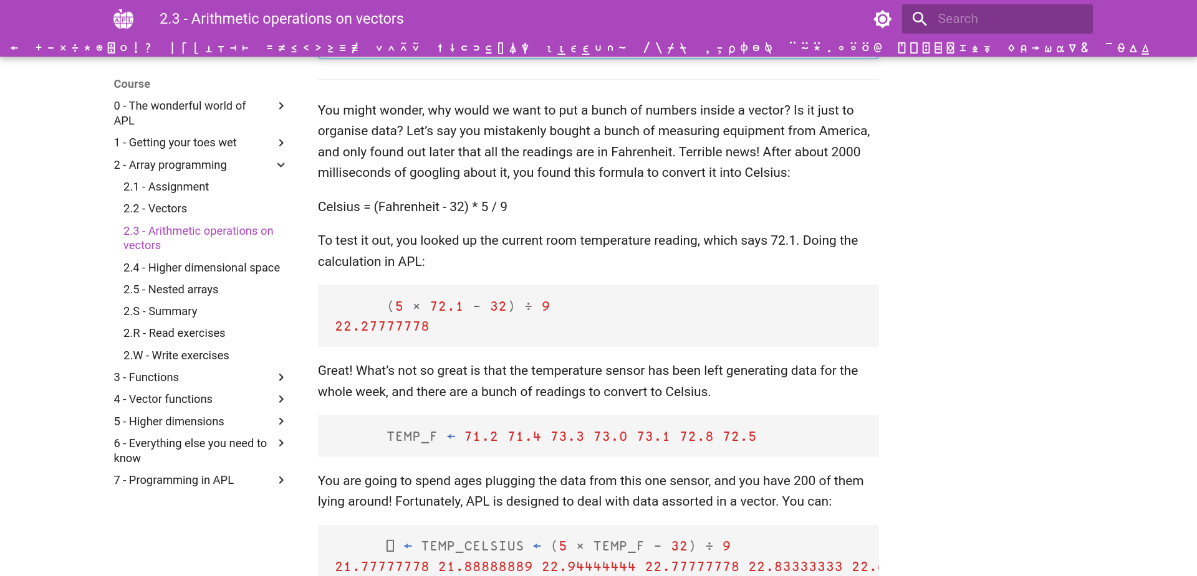

Slide 28
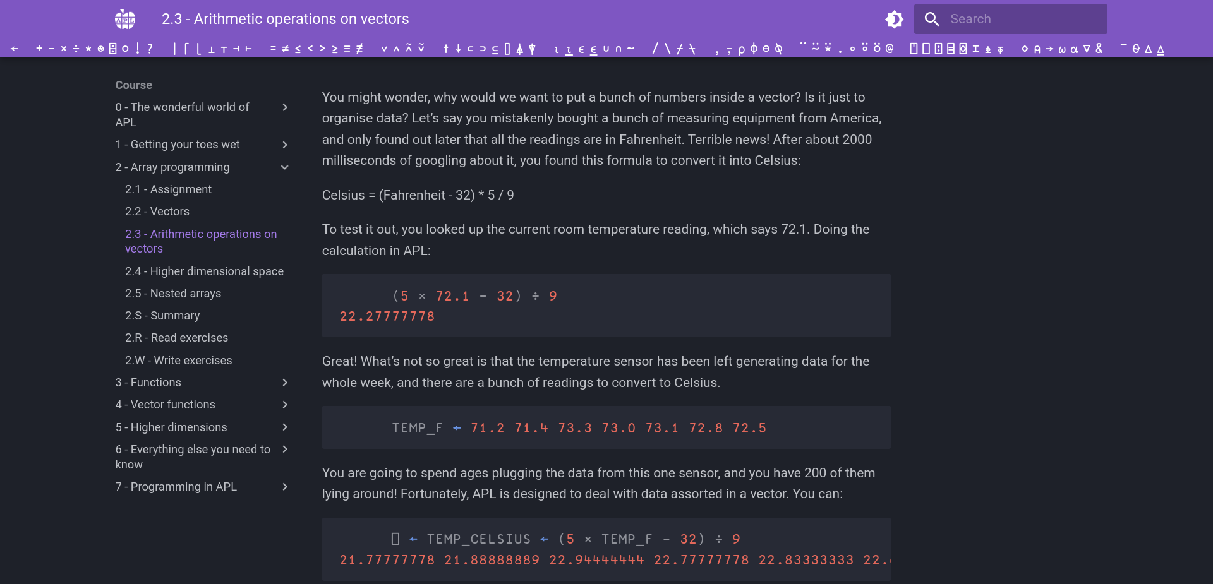

Slide 29
Course structure
0. The wonderful world of APL
Getting your toes wet
Array programming
Functions
Vector functions
Higher dimensions
Everything else you need to know
Programming in APL

Slide 30
1. Getting your toes wet
Immediate execution mode (tryapl.org)
Arithmetic operations on scalars
Typing APL glyphs
Order of execution
Error handling

Slide 31
2. Array programming
Assignment operator
1D vectors and arithmetic operations
Higher dimensional space
Nested arrays

Slide 32
3. Functions
Dfns
Math functions
Relational and logical functions
Recursion
3-trains
NO TRADFNS

Slide 33
4. Vector functions
Vector generating functions
Reductions and scans
Randomisation, grade up/down, windowed reduce
All the different ways of selecting from a vector
Searching in a vector

Slide 34
5. Higher dimensions
Set operations
Enclose/disclose/nest/each/tally
Operations on different axes
Transpose/reverse/rotate
Cross-tabulation

Slide 35
6. Everything else you need to know
String manipulation (partition, partitioned enclose, interval index)
Inner and outer products
Encode and decode
Operators (repeat, masking)
4- and 5-trains

Slide 36
7. Programming in APL
Installing Dyalog (RIDE? Dyalogscript? Idk yet)
Tradfns, finally
Interactivity
File I/O
Libraries
Programming project

Slide 37
Bonus content
Creating randomised audio data in APL
Rotating an image
Computer graphics in APL
Minesweeper in APL and Python (pynapl)

Slide 38
This is all subject to change*

Slide 39
The infrastructure

Slide 40
MD/JS Frontend
Python backend
SQLite DB
User
Log in with mooc.fi
dyalog.run

Slide 41
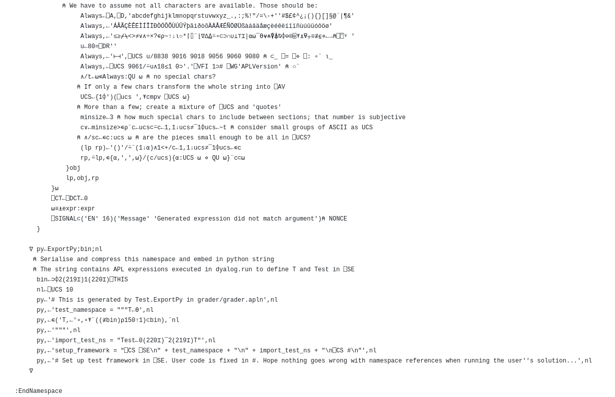

Slide 42
MD/JS Frontend
TestMyCode
+ APL Plugin
User
Log in with mooc.fi

Slide 43
Roadmap
TMC integration (it's written in Rust lol)
Completing chapters 5-7
Piloting with a small group of students / oldies
Release on mooc.fi

Slide 44
We are all novice APL'ers

Slide 45
We need your help

Slide 46
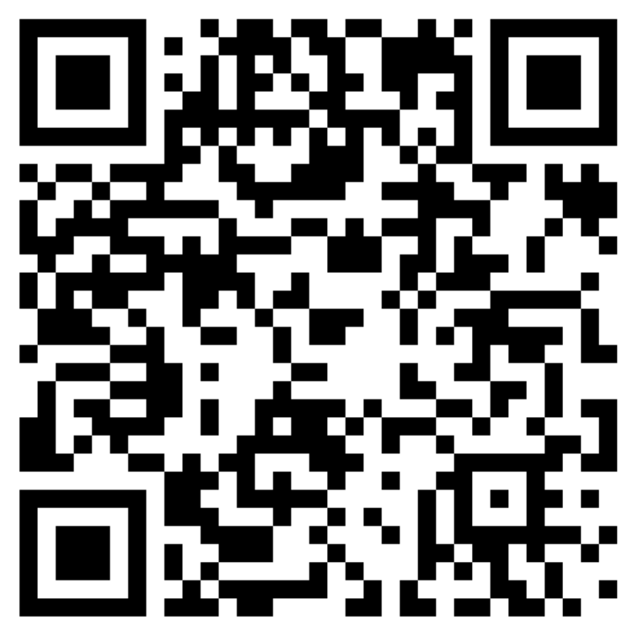

Slide 47
aplmooc.fi

Slide 48
APL MOOC
Thank you!

