Slide 1
Technical Road Map Update
Morten Kromberg, CTO

Slide 2
Show of Hands
Workshops Today:
Putting Dyalog’s Latest Features to Use
MiServer 3.0 – A Framework for Web-Enabled and Cross-Platform Applications
Tomorrow:
Parallel Programming with Futures and Isolates
Modern Application Architectures in Dyalog

Slide 3
(Same Old) Focus Areas
Performance
(includes parallel computing)
Portability
(includes user interfaces)
Language
(includes increased focus on functional programming)
Tools for Application Building

Slide 4
Bets We Are Placing
Parallel Processing is getting Critical
New Platforms will soon be Important
The future of User Interfaces is HTML5/JS and some WPF/XAML

Slide 5
1. Parallel Processing
Bang for the buck, here and now
Futures and Isolates
Allow developer to easily identify and manage parallel sections of code
Dyalog Compiler
Minimise interpreter overhead
Optimisations to be added over time (constant folding, flexible idiom recognition, common expression elimination, etc)
Designed to require minimal re-coding of existing applications

Slide 6
1. Parallel Processing, …
Co-Dfns Compiler
Externally funded research
Performed by Aaron Hsu at University of Indiana
Focus on purely functional code (d-fns only)
Will require application refactoring
Few system functions and ”external” interfaces
If successful, will enable very highly parallel applications
Targets GPUs / massively parallel architectures

Slide 7
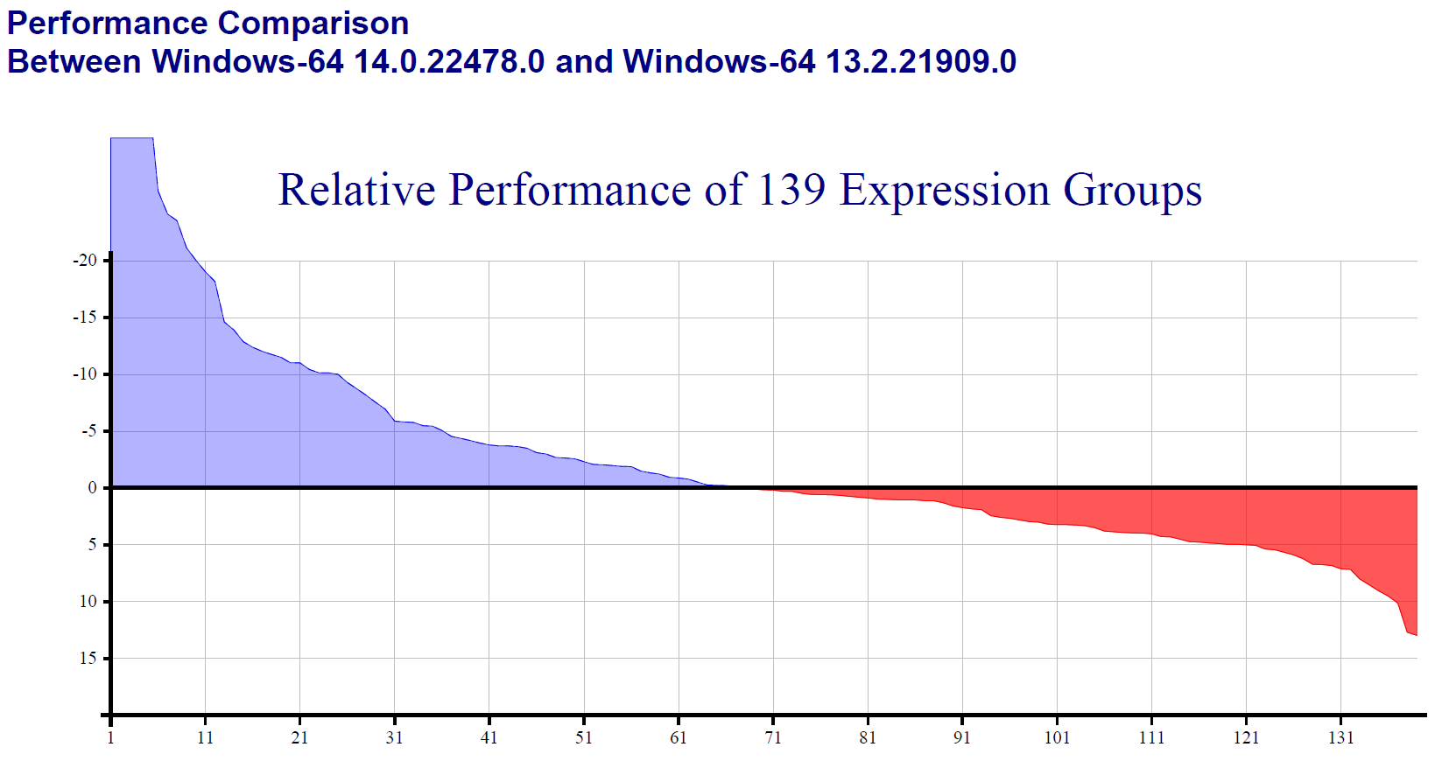
Version 14.0 Core Performance
The “Hui Effect”: v14.0 runs apps 15-30% faster

Slide 8
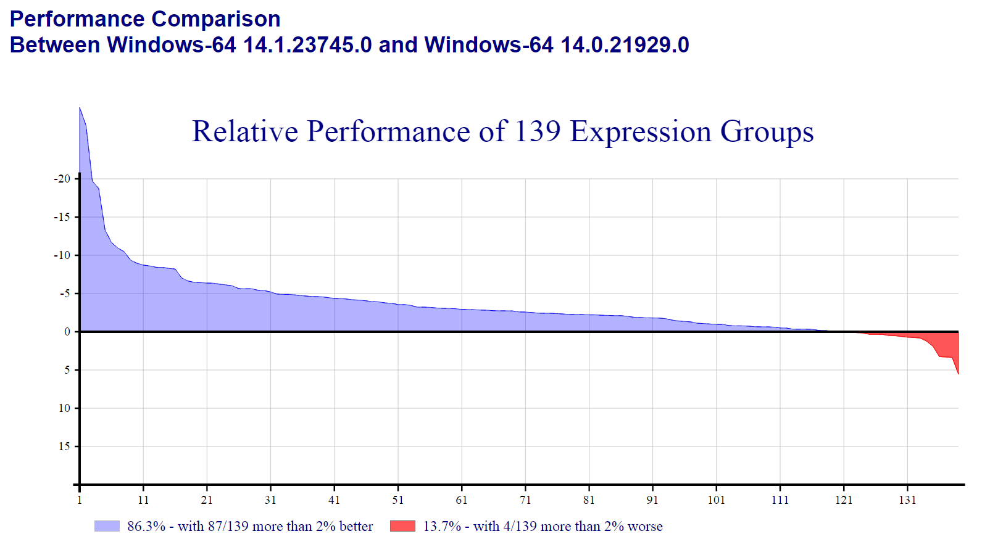
Version 14.1 Core Performance

Slide 9
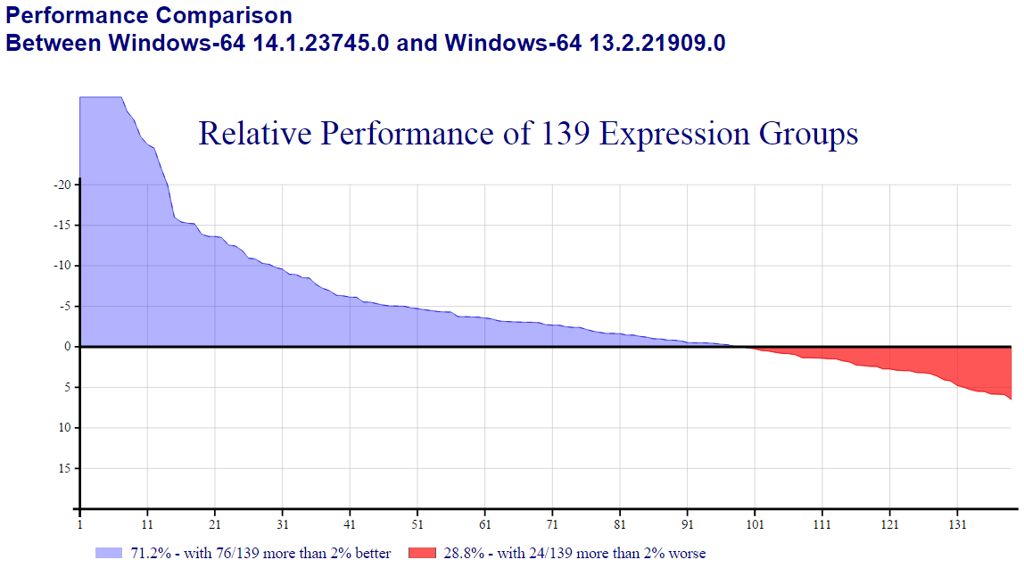
14.0 + 14.1

Slide 10
V14.1 Performance Features
“Special Code” added or enhanced
Idioms: ≢⍴ ⊣/ ⊢/ (?⍴)
∧.= ∨.≠ ∘.= n⍴scalar bool⊂ ⍋bool
Compiler enhanced to handle global names and control structures:
Now compiles 59% of functions in “a major application” (up from ~1% in v14.0)
Compiled code speeds up by factor of 2 on small args
NB: Most arguments ARE small

Slide 11
2. New Platforms
Many ”UNIX variants”
ARM Linux (Raspberry Pi)
Apple OS X
Android
(and then there are new Windows variants, for ARM, and for Win32-less servers, etc)
New tools are designed to be cross-platform
RIDE, MiServer, SAWS, R-Connect, DyaCrypt
Some old ones too: Conga, SQAPL, …
Our goal is to allow you to:
Develop on any platform
Deploy on all platforms

Slide 12
Introducing Dyalog 14.1 for OS X
Complete 64-bit Unicode Dyalog engine
100% compatible and inter-operable with other Dyalog variants
Includes CONGA, SAWS, MiServer, RConnect, (SQAPL to come soon)
Development environment is RIDE 2.0.
No emulation of ⎕WC GUI.
Use MiServer or write [web] services.

Slide 13
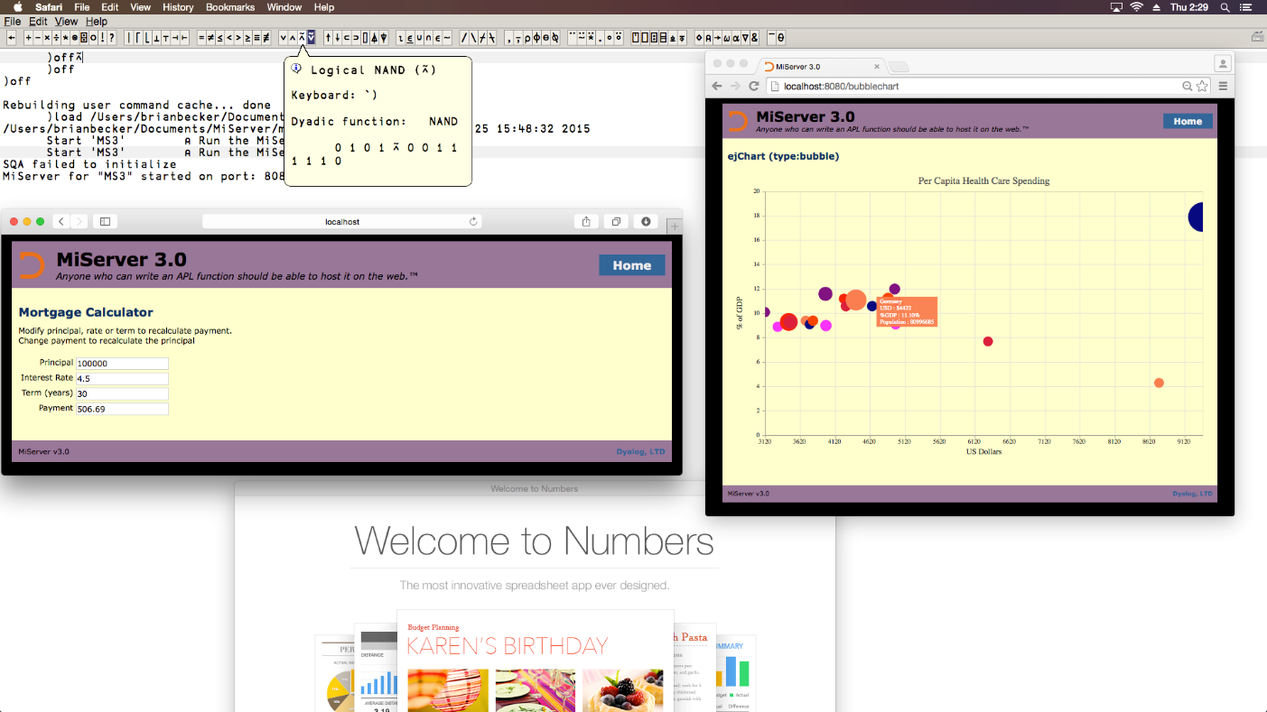
Introducing Dyalog for OS X

Slide 14
What Next?
Probably Android
Perhaps Microsoft Windows “Modern”
Perhaps iOS

Slide 15
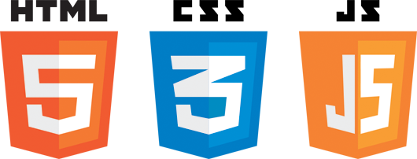
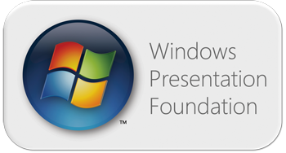
3. User Interfaces
Cross-platform apps will use HTML5 and Javascript to define the user interface (for at least 5 years)
New Microsoft Desktop applications will use Windows Presentation Foundation (WPF)
Or ”equivalent” on the mobile platforms
We aim to support data binding and ”Model-View-ViewModel” style application building with both these tools

Slide 16
Model View ViewModel (MVVM)
List←'Andy Shiers' 'Bjørn Christensen’ 'Brian Becker' …
Filter←'R'
FilteredList
Jason Rivers Richard Smith Roger Hui

Slide 17
Portable User Interfaces
Dyalog APL Server
Dyalog APL + RIDE (Windows, UNIX, Mac, Android, etc)
MiServer or other HTML/JS Generator
MiServer or other HTML/JS Generator
Internet
HTML Engine
Web Browser

Slide 18
New Language Features
Version 14.0
Rank (⍤), Key (⌸), Tally (≢)
Trains: (avg←+/ ÷ ≢) (flipenc←⍉⊤)
Dyadic Iota on higher-rank arrays (and 8⌶ for inverted tables)
Parallel: Futures and Isolates
Microsoft.Net data binding
Version 14.1
Only real language feature is :Disposable
Experimental JSON Parser
External Workspace Files (Memory Mappable)

Slide 19
Language
There are still many ideas worth adding to the (Dyalog) APL Language
We want to move in a functional direction
Supports parallel computing
Is ”cool” – John Scholes and I have both felt very welcome at functional events
../FC2014 Social Media Capture.pdf

Slide 20
New Frontiers: Language
Still “one or two” things left to do:
Operators Cut / Tesselate, Merge and Dual
Closures (“functional objects”)
Notations for Namespace and Array Constants
Potential New Data Types and Related Functions:
Rational Numbers (Prime Number Functions)
High Precision Floats (Rounding)
Scalar String Type (0=≡"Hello World")
Objects with Array Semantics (sparse / inverted)
We will publish proposals for new features over the summer.
Follow us on Twitter, Like us on Facebook, etc ☺ - come to Dyalog’15

Slide 21
Tools for Application Building
SAWS – Stand-Alone Web Service
MiServer – Stand-alone Web Server
Build HTML5/JS UI in APL
SAWS will soon become part of MiServer
LoadData – Data import tools for Excel, XML, CSV, SQL/ODBC
RConnect – integrates the R statistical framework with Dyalog APL
DyaCrypt – Cryptographic Library
NB: All new tools work cross-platform

Slide 22
New Frontiers: Tools
Module Mechanism: Easy way to declare dependencies on tools
Standard Project Structure for development and deployment of new applications
Standard Cross-Platform Libraries
files, strings, dates, xml, json, sql, parsing, e-mail, error logging, etc.
All to be provided as open-source repositories (https://github.com/dyalog)
RIDE “process manager”: Monitor and debug large collections of server processes
Follow up on “External Workspaces” with a mechanism for sharing data between processes.

Slide 23
Evangelism
FuConf’14, Bangalore FuConf’15, Bangalore
StrangeLoop’15, St.Louis (maybe)

Slide 24
Dyalog is…
“… a modern, array-first, multi-paradigm programming language, which supports functional, object-oriented and imperative programming, based on an APL language kernel.”

Slide 25
After the Break
RIDE 2.0 and Dyalog 14.1 “In Depth”

