Slide 1
vecdb The Dyalog Vector Database
Workshop W2: Managing Data with Dyalog Morten Kromberg, CXO

Slide 2
Inverted Databases
┌───────────────────┐
│┌───┬─┬───────────┐│
││ABC│4│203.9034382││
│└───┴─┴───────────┘│
├───────────────────┤
│┌───┬─┬───────────┐│
││ABC│3│300.9898292││
│└───┴─┴───────────┘│
├───────────────────┤
│┌───┬─┬───────────┐│
││DEF│4│146.0736925││
│└───┴─┴───────────┘│
└───────────────────┘
Traditional relational databases focus on being able to read a single record quickly, and preserve its integrity during updates
“Inverted” or databases organize data by column: All the data for one column is adjacent
Examples:
On the mainframe: Hydra, Mabra, …
In modern times:
The k language has kdb+
J has jd
Paul Mansour has flibdb
.. and now there is vecdb
┌─────┬─┬───────────┐
│┌───┐│4│203.9034382│
││ABC││3│300.9898292│
│├───┤│4│146.0736925│
││ABC││ │ │
│├───┤│ │ │
││DEF││ │ │
│└───┘│ │ │
└─────┴─┴───────────┘

Slide 3
Advantages of Inverted DBs
Each column is a simple, memory-mappable structure
Much lower storage and memory requirements due to simpler structure (typically an order of magnitude)
Searching and summarizing large numbers of records is often several orders of magnitude faster
Record oriented DBs will sometimes invert or hash selected “key” columns: In an inverted DB *all* columns are fast
Array language primitives (APL, J, k) can operate directly on memory-mapped arrays
Extremely simple implementation
Take advantage of all the clever work done by Hui, Foad, Whitney and others
┌─────┬─┬───────────┐
│┌───┐│4│203.9034382│
││ABC││3│300.9898292│
│├───┤│4│146.0736925│
││ABC││ │ │
│├───┤│ │ │
││DEF││ │ │
│└───┘│ │ │
└─────┴─┴───────────┘

Slide 4
Weaknesses of Inverted DBs
Typically do not fully support “transactions” (except sometimes for append operations).

Slide 5
Goals of vecdb
Provide simple, fast storage mechanism for “a few gigabytes” of data
Distributed, “sharded” database
Allows (highly) parallel queries
Integrated with Dyalog APL / Free to all users
Open source project: https://github.com/Dyalog/vecdb

Slide 6
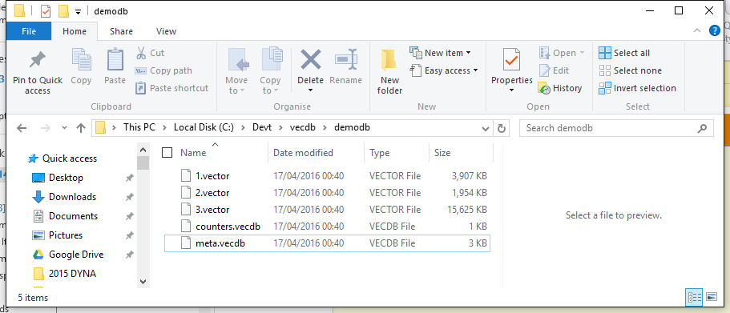
Create a Database
date←100/⍳1E4 ⍝ 100 trades/day
key←?1E6⍴10 ⍝ 10 different keys in random order
volume←1000×?1E6⍴0 ⍝ lots of noise
⎕←⍪¨5↑¨date key volume
1 4 203.9034382
1 3 300.9898292
1 4 146.0736925
1 10 303.0208711
1 1 5.828660818
columns←'date' 'key' 'volume'
types←'I2' 'I1' 'F'
options←⎕NS '' ⋄ options.BlockSize←2E6
folder←'c:\devt\vecdb\demodb'
db←⎕NEW #.vecdb ('demo' folder columns types options (date key volume))

Slide 7
Queries
where←('date' 1)('key' 1) ⍝ date=1 and key=1
select←'date' 'key' 'volume' ⍝ columns to read
db.Query where select db.Query ⍬ 'sum volume' 'key' ⍝ select sum(volume) group by key

Slide 8
Sharding
You can partition, or “shard” the database based on any computation, for example:
options.(ShardCols ShardFn)←1 '{⌈(⊃⍵)÷5000}' options.ShardFolders←'/history' '/recent'
The above uses column number 1 as input, and put the first 5000 values into the first shard, the next 5000 values in the next shard, etc.
Shard folders can be located on separate machines
Parallel queries can run on the machine where each shard is located

Slide 9
Demo…

Slide 10
Current Status
Available now
Unit Test Suite provides “Specification”
In “production” use in one development project
Under evaluation for a couple more
Open Source is working: https://github.com/Dyalog/vecdb/graphs/contributors

Slide 11
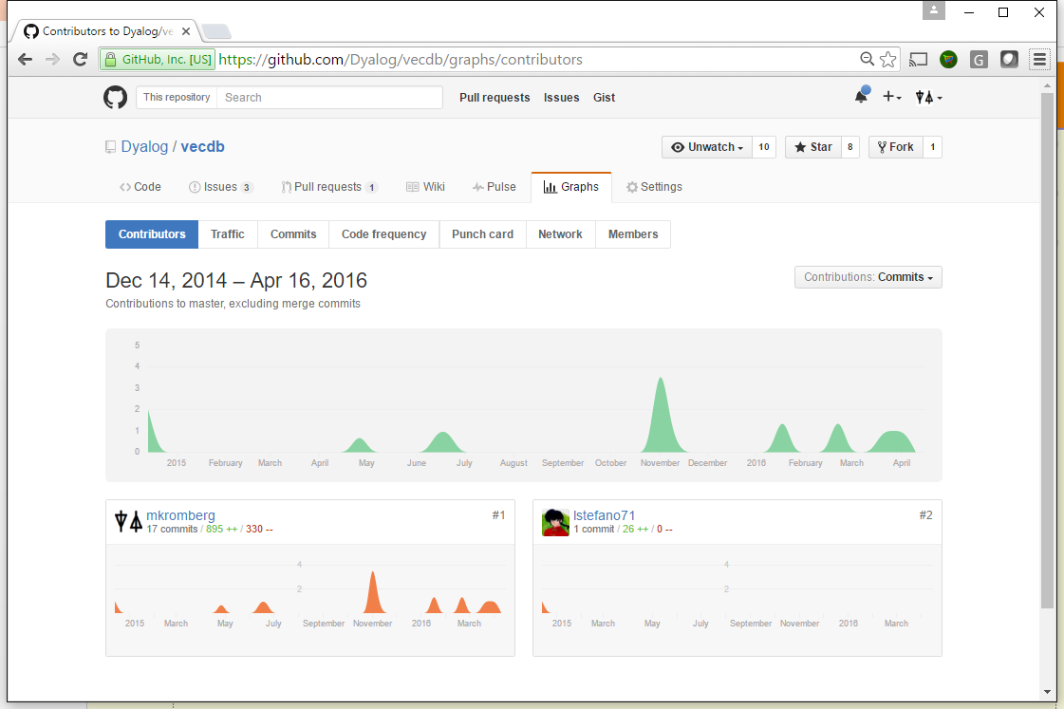
Current Status
Available now
Test Suite provides “Specification”
In “production” use in one development project
Under evaluation for a couple more
Open Source is working: https://github.com/Dyalog/vecdb/graphs/contributors

Slide 12
To Come…
Extend datatype support
Current: Bool, I1, I2, I4, Float, Char
Char type limited to 16,767 different string (I2 index into list of strings).
More Char types next up
Simple joins of tables on a shared key (databases must be “equally” sharded)
Parallel execution of queries
Hook up SQAPL Server for ODBC/ ADO/ JDBC driver access

