Slide 1
Welcome & Introduction
Morten Kromberg, CTO

Slide 2
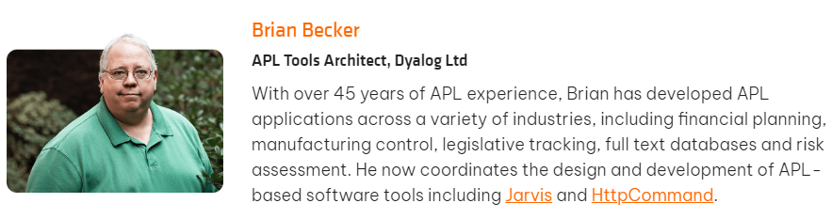
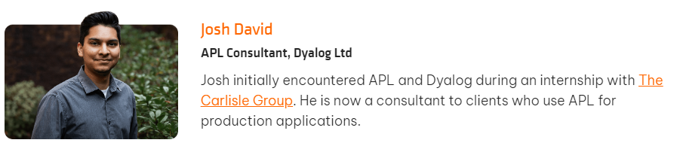
Introducing the Cast

Slide 3
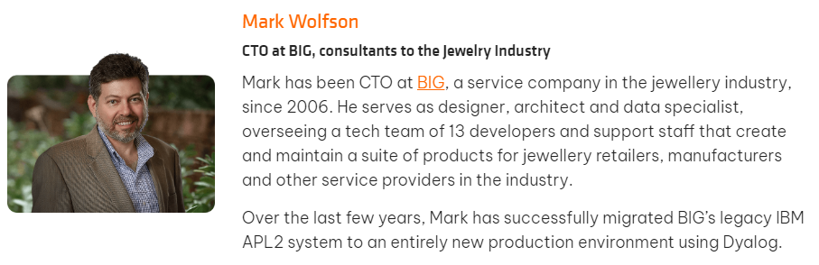
Introducing the Cast

Slide 4
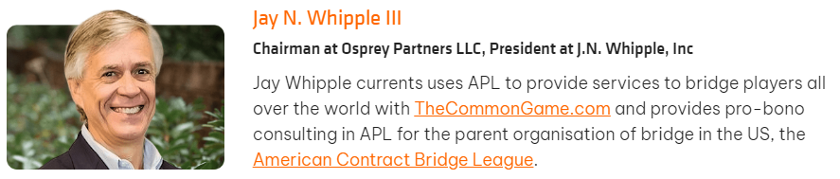
Introducing the Cast

Slide 5

Morten Kromberg
CTO of Dyalog since 2005
CTO of Adaytum Software 1995-1999 (BI vendor)
  (20 => 200 employees, sold to Cognos for $160M)
APL Consultant for ~20 years
  Focus on interfacing/integration, client/server architectures and developer tools / frameworks
Met APL in 1979 while at High School
  Finally dropped out of University in 1985
Born in the same year as APL (1962)

Slide 6

Introducing Dyalog
Dyalog is the ”New Kid” on The APL Block
  Only 40 years since release of Dyalog version 1.0 in 1983
  Has emerged as the Market Leader for APL
  Still relatively unknown in North America
”Management Buy-In” in 2005
  Financed by two clients and an APL distributor / consulting firm

Slide 7
The Last 20 Years
Headcount and Turnover Quadrupled Quintupled
  Headcount now ~26 full time equivalents
  Steadily increasing R&D budget
  First generation of interpreter developers retired;
  Second productive; Third recruited
  Largest sustained investment in APL technology in history

Slide 8
The Last 20 Years
Trading Profit in every year since 2005. Sources:
  Growing partnerships with major customers
  Increasing share of APL market ("unfortunately" accelerating)
  A small number of completely new APL systems (so far)
Manoevering towards re-launching APL as a modern tool for prototyping and rapid application development

Slide 9
Financial Status
Owners | 2008 | 2018 | Present
SimCorp (Denmark) | 32.33% | 40% | 24%
APL Italiana (Italy) | 32.33%
Management & Employees | 35.33% | 60% | 76%
Ownership
  24% owned by SimCorp (itself acquired by Deutsche Börse)
  76% owned by management and employees
Revenue steadily increasing:
Profitable every year
since acquisition in 2005
5-year period | Growth
2017-2023 | 35%
2012-2017 | 8%
2007-2012 | 57%

Slide 10
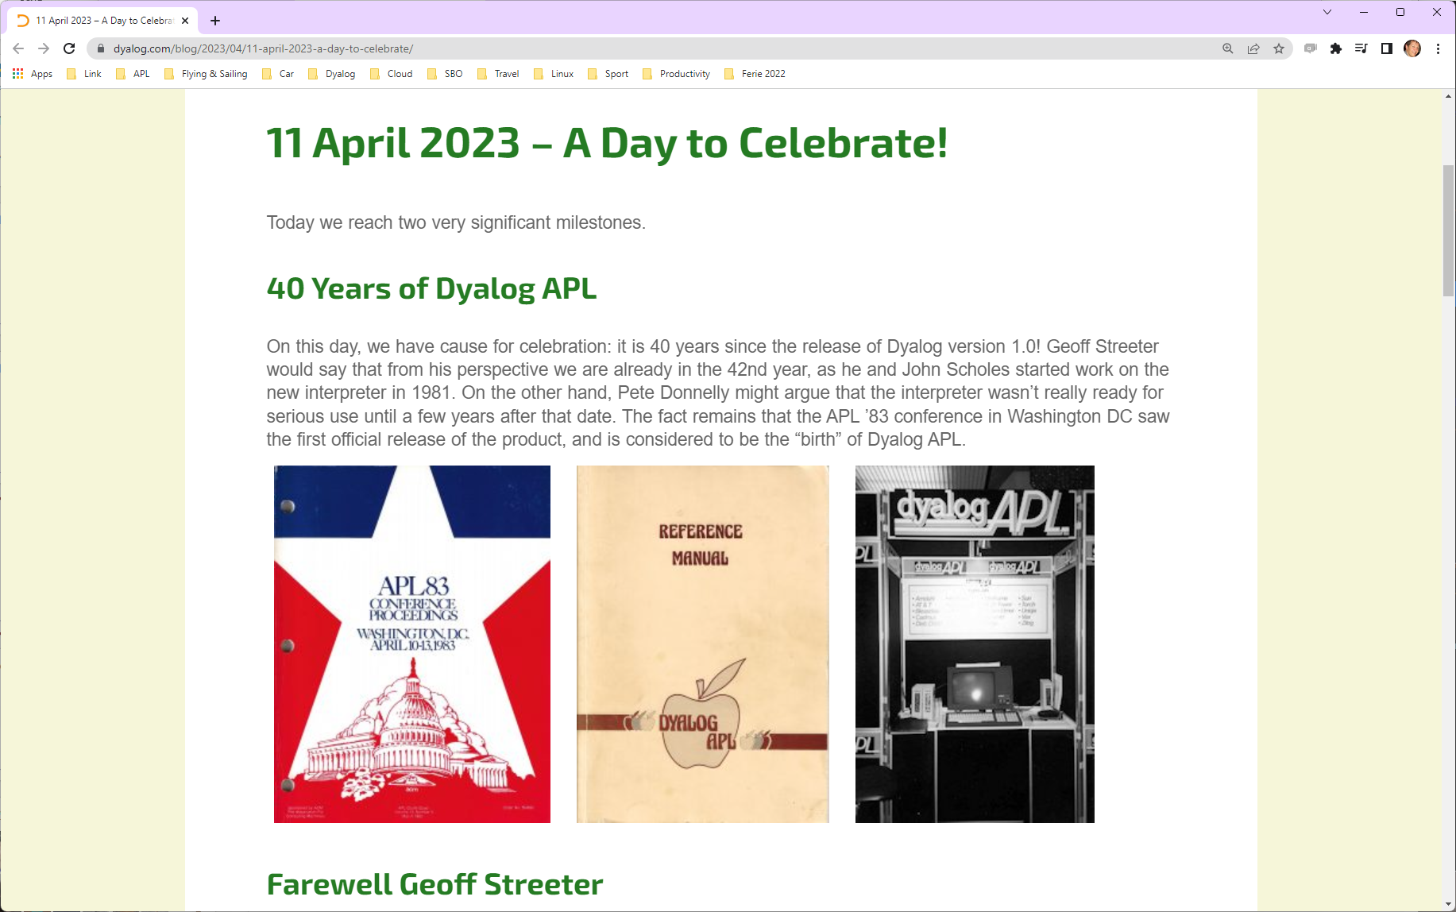

Slide 11
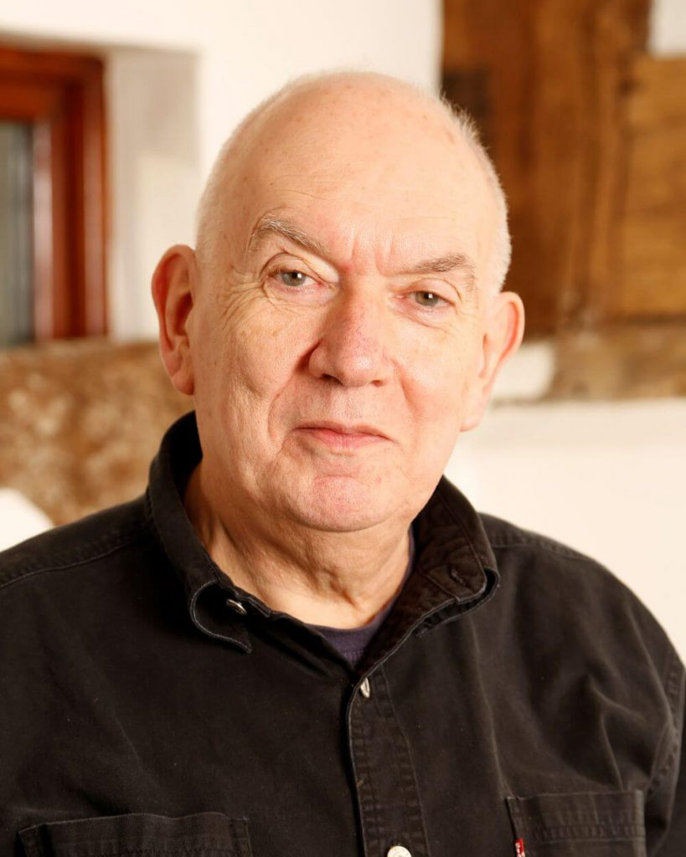

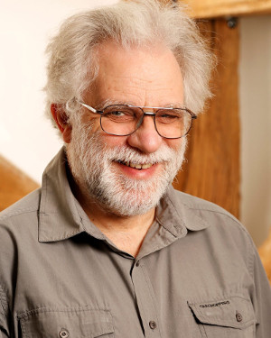
We Stand on the Shoulders of Giants
John Scholes (1948-2019)
Roger Hui (1953-2021)
Geoff Streeter (retired 2023)
https://rogerhui.rip https://johnscholes.rip

Slide 12
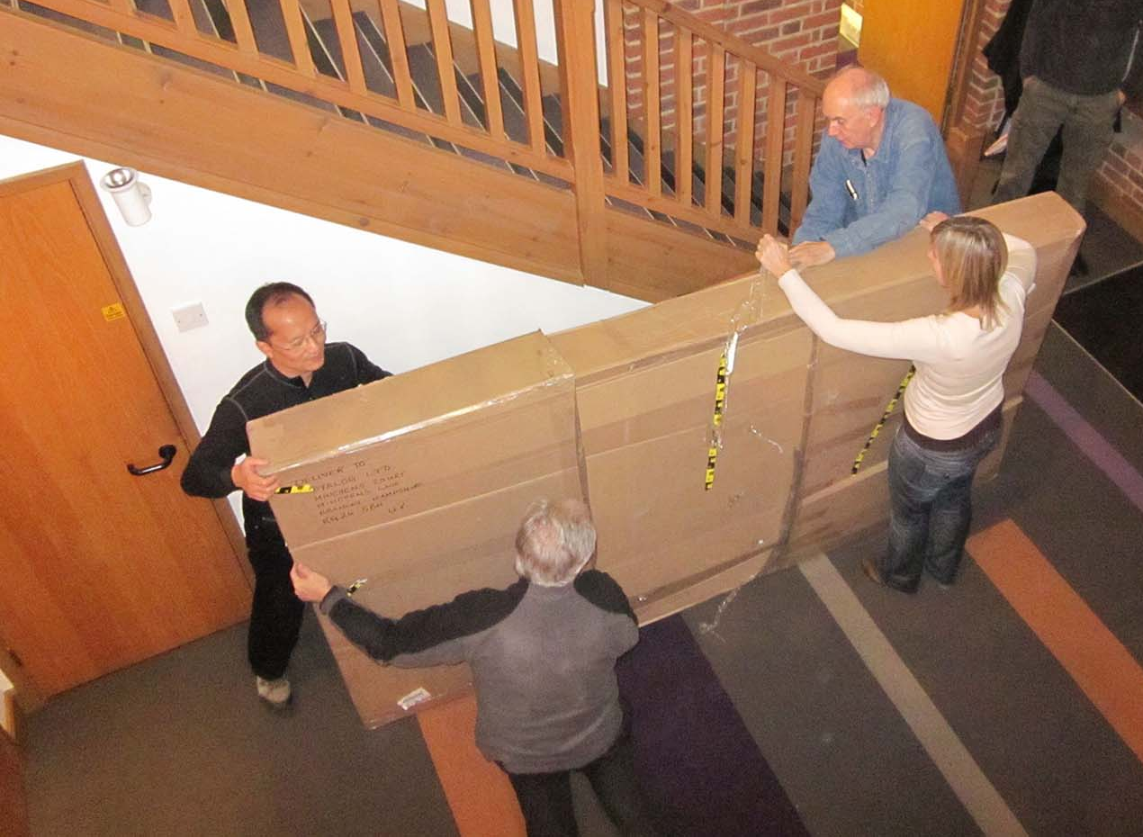
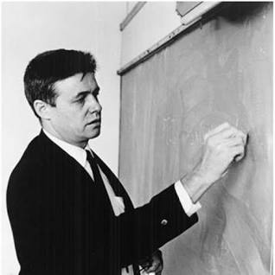
Ken Iverson's Blackboard
arrives in Bramley (2010)

Slide 13







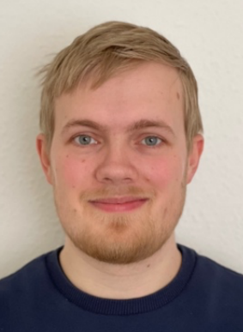

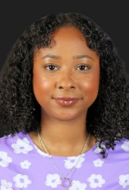






Dyalog – The Next Generation
2010-2021
New
CEO
2022
2023
2023 Summer Interns

Slide 14
Selected Customers
Carlisle Group (US)
  Collateral and Securitization for Global Capital Markets
CompuGroupMedical (Sweden)
  Worlds Largest “Patient Record” system: 40,000 users
  and 2.5 million patients records at largest hospital in Scandinavia
A major OilEnergy Company (US)
  Optimizes the “Cracking” of Petroleum Products and research into lubricants using APL
Sandvik Coromant (Sweden)
  Computer Aided Design and Production Management of Machine Tools
SimCorp (Denmark), APL Italiana (Italy), InvestCloud Financial Supermarket (US)
  Leaders in various markets for Asset Management Systems

Slide 15
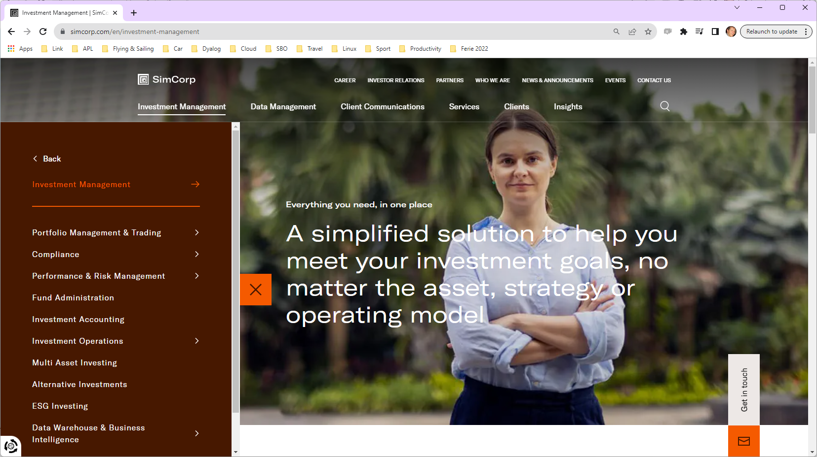

Slide 16
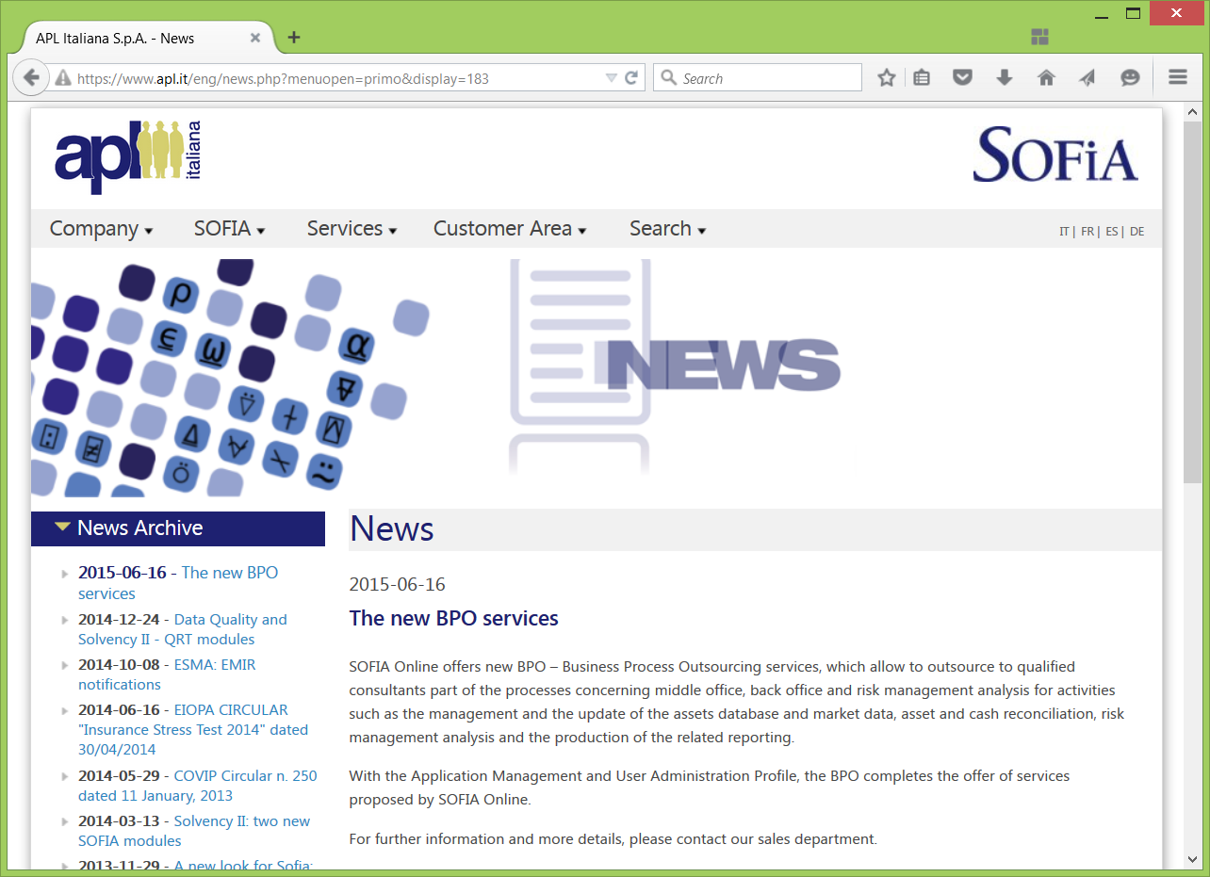

Slide 17
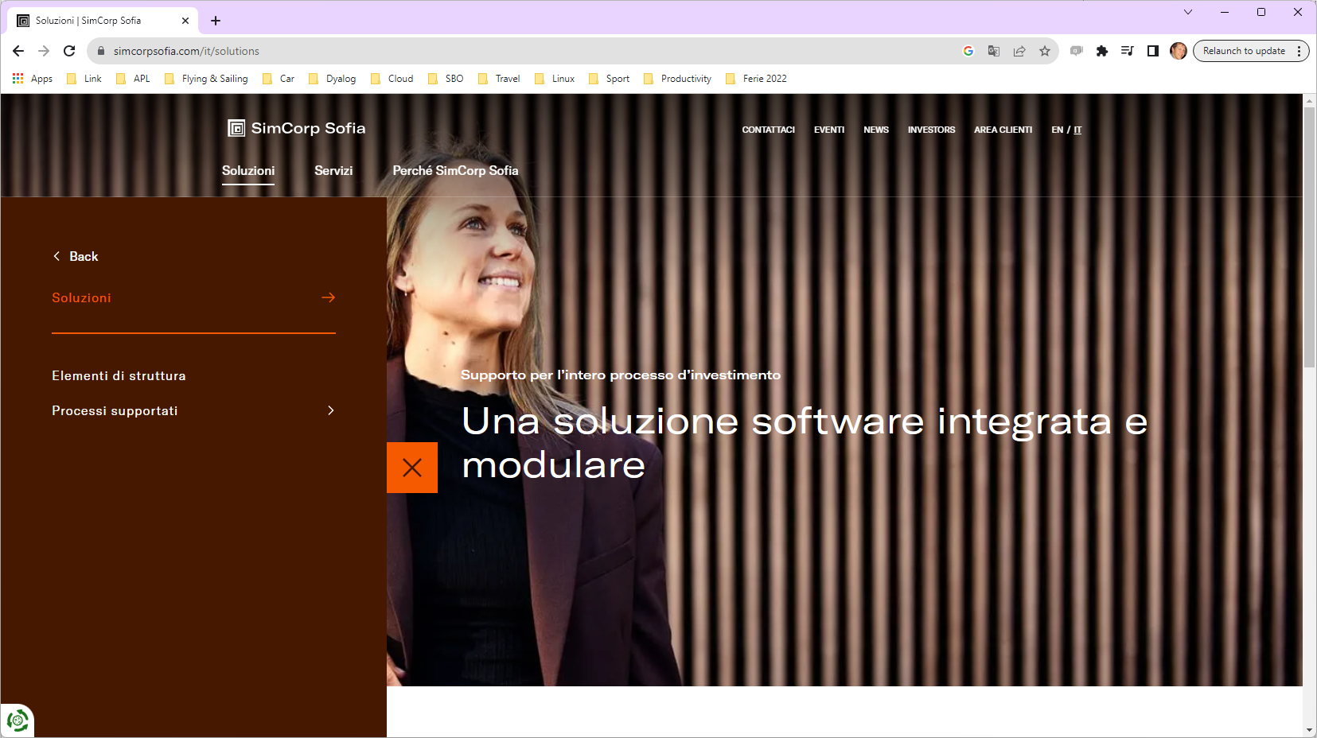

Slide 18
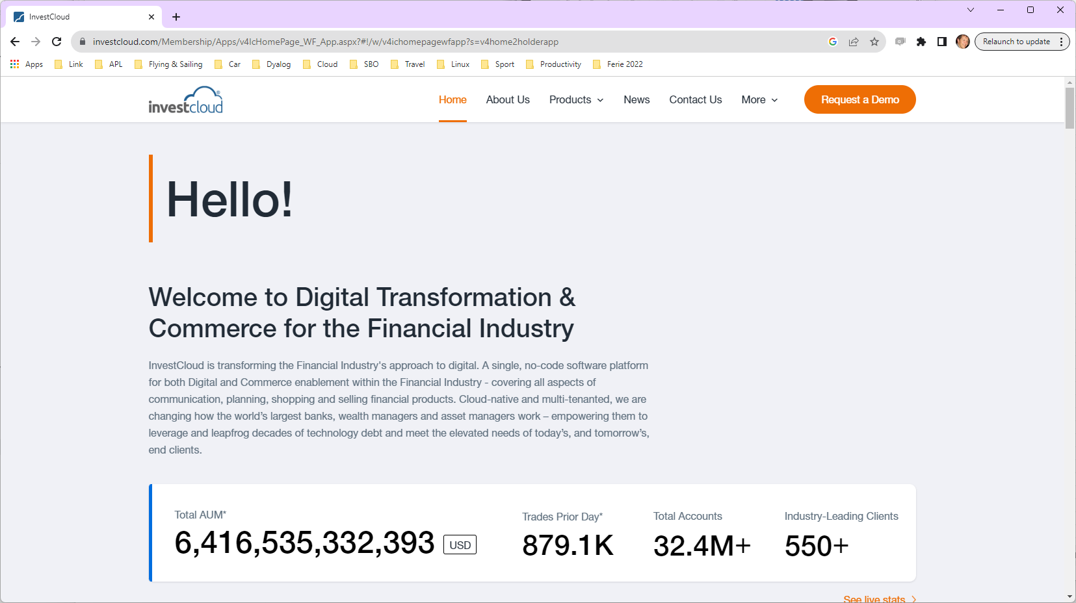
Previously known as…
Tegra118
Fiserv Investment Services
CheckFree Corp
SecurityAPL

Slide 19
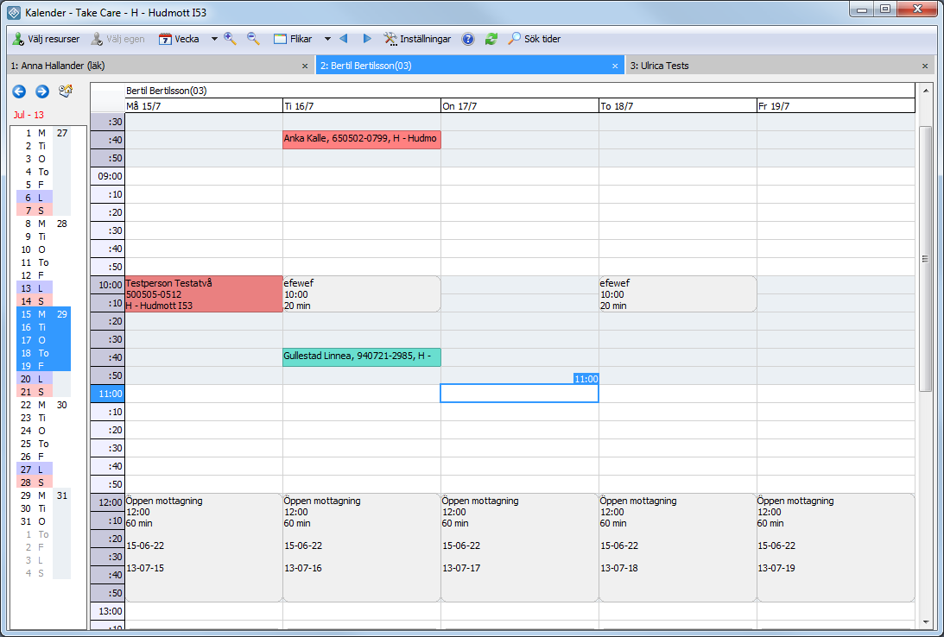


Slide 20
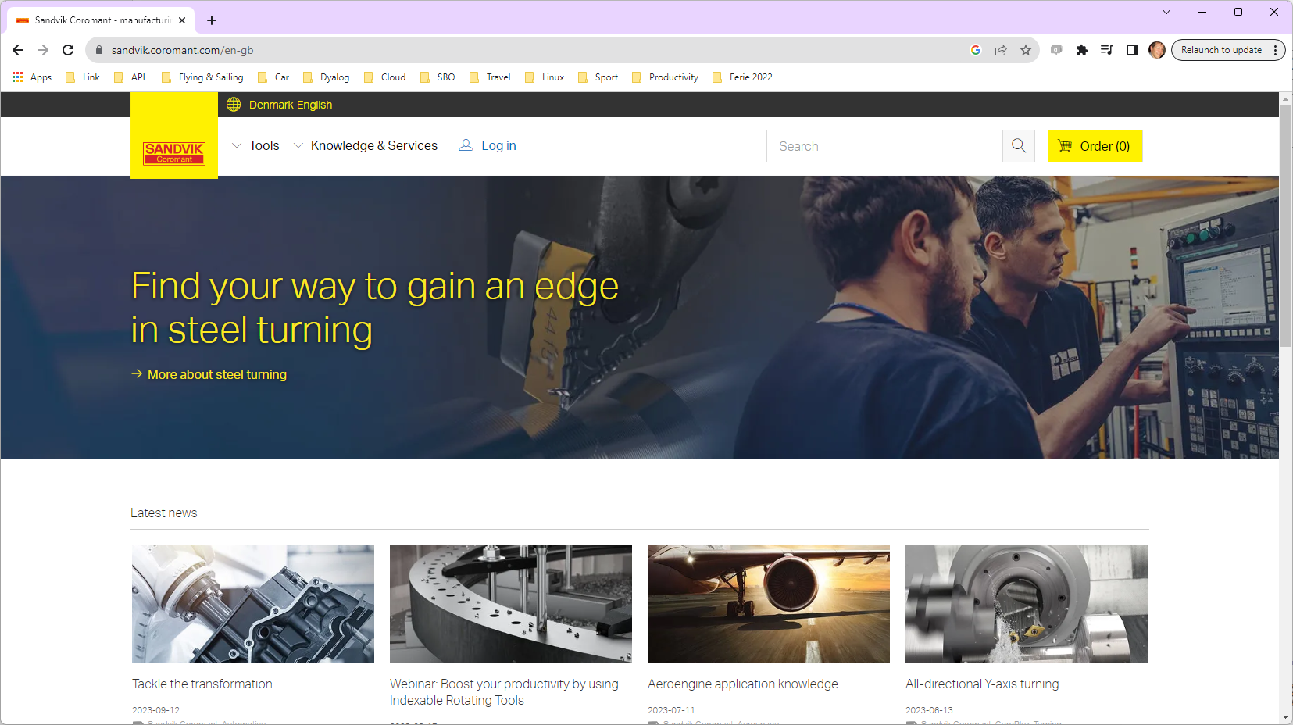

Slide 21
Revenue Splits
Very Roughly
USA vs ROW: 40/60
UNIX & Linux vs Windows: 25/75
  UNIX revenue is currently 90% AIX
  We expect Linux to grow, replacing both AIX and Windows
USA and UNIX: a smaller number of larger clients
  Migrants to Dyalog APL from US-based APL vendors

Slide 22

The Market
We believe that the key strength of APL is and always has been that it allows the ”Domain Expert” to be - or to work closely with - the ”Programmer”
This is getting more important as requirements grow in compexity and time-to-market grows in importance
Recently, keeping auditors happy about security and best practices has become critical

Slide 23

Strategy - Part 1
Support the Domain Expert
Provide Tool of Thought for subject matter experts
Provide simple interfaces to:
Microsoft Office
Databases, XML, JSON
Statistical / computational packages R, MatLab, Python, …
GUI, Charting Tools

Slide 24
Strategy – Part 2
Keep IT, Auditors & Software Engineers Happy
Provide interfaces and documentation required to satisfy the IT organization:
Integrate with popular or ”mainstream” development platforms
Perform well and scale across multiple Cores and Machines
Support Containerization & Service Orientation
Enable Source Code Management and Continuous Integration
Be Secure, Maintainable and Auditable
  Allow our users to achieve the same for applications written in Dyalog APL

Slide 25
Marketing Strategy
Above all, keep existing clients Happy and Safe!
Documentation and Tutorials
Make it free to get started with APL
Open-Source all Tools
Evangelism: Non-APL conferences and social media
Understand the needs of the modern "Data Scientist"
  (Python and R users)
Pave way for the Second Coming of APL

Slide 26
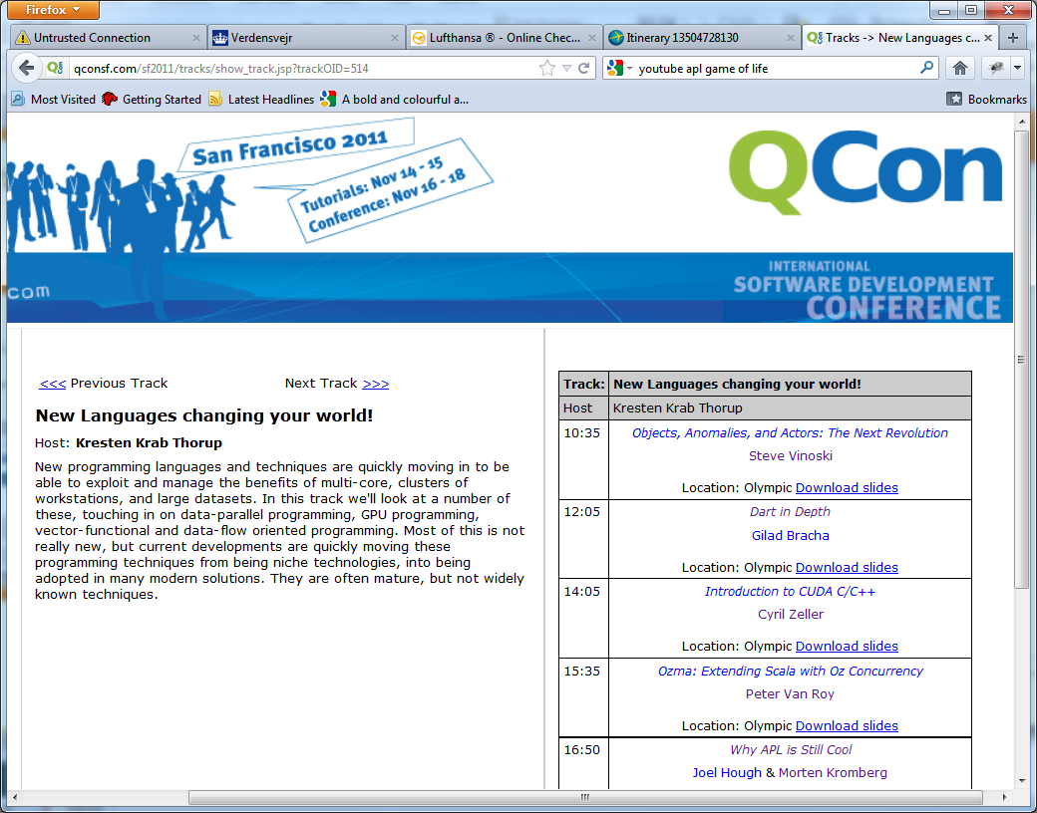

Slide 27
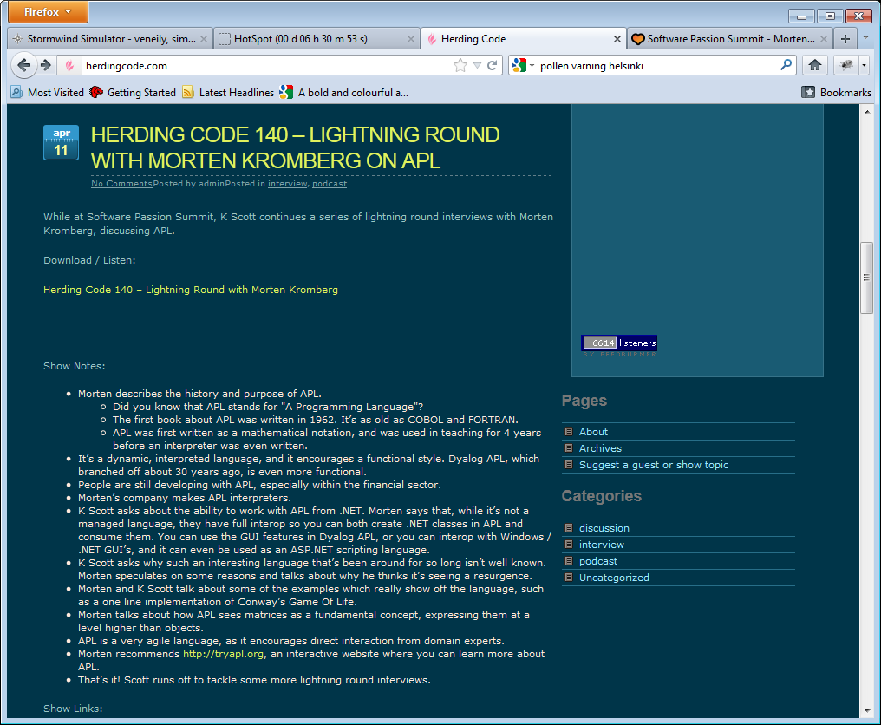

Slide 28
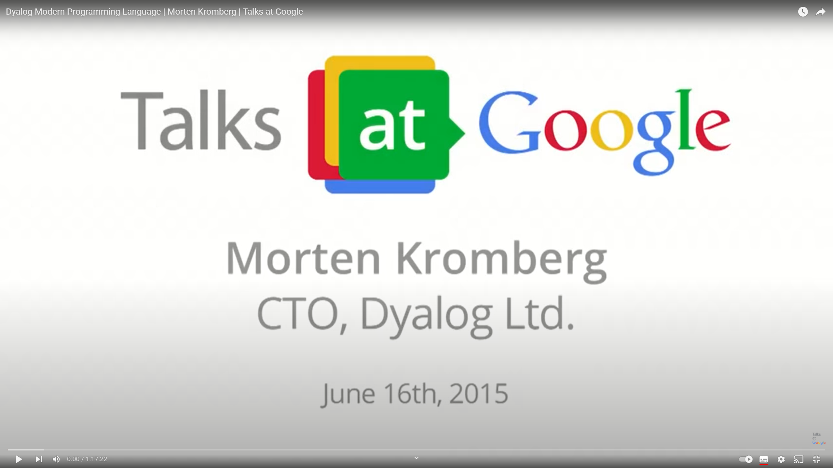

Slide 29
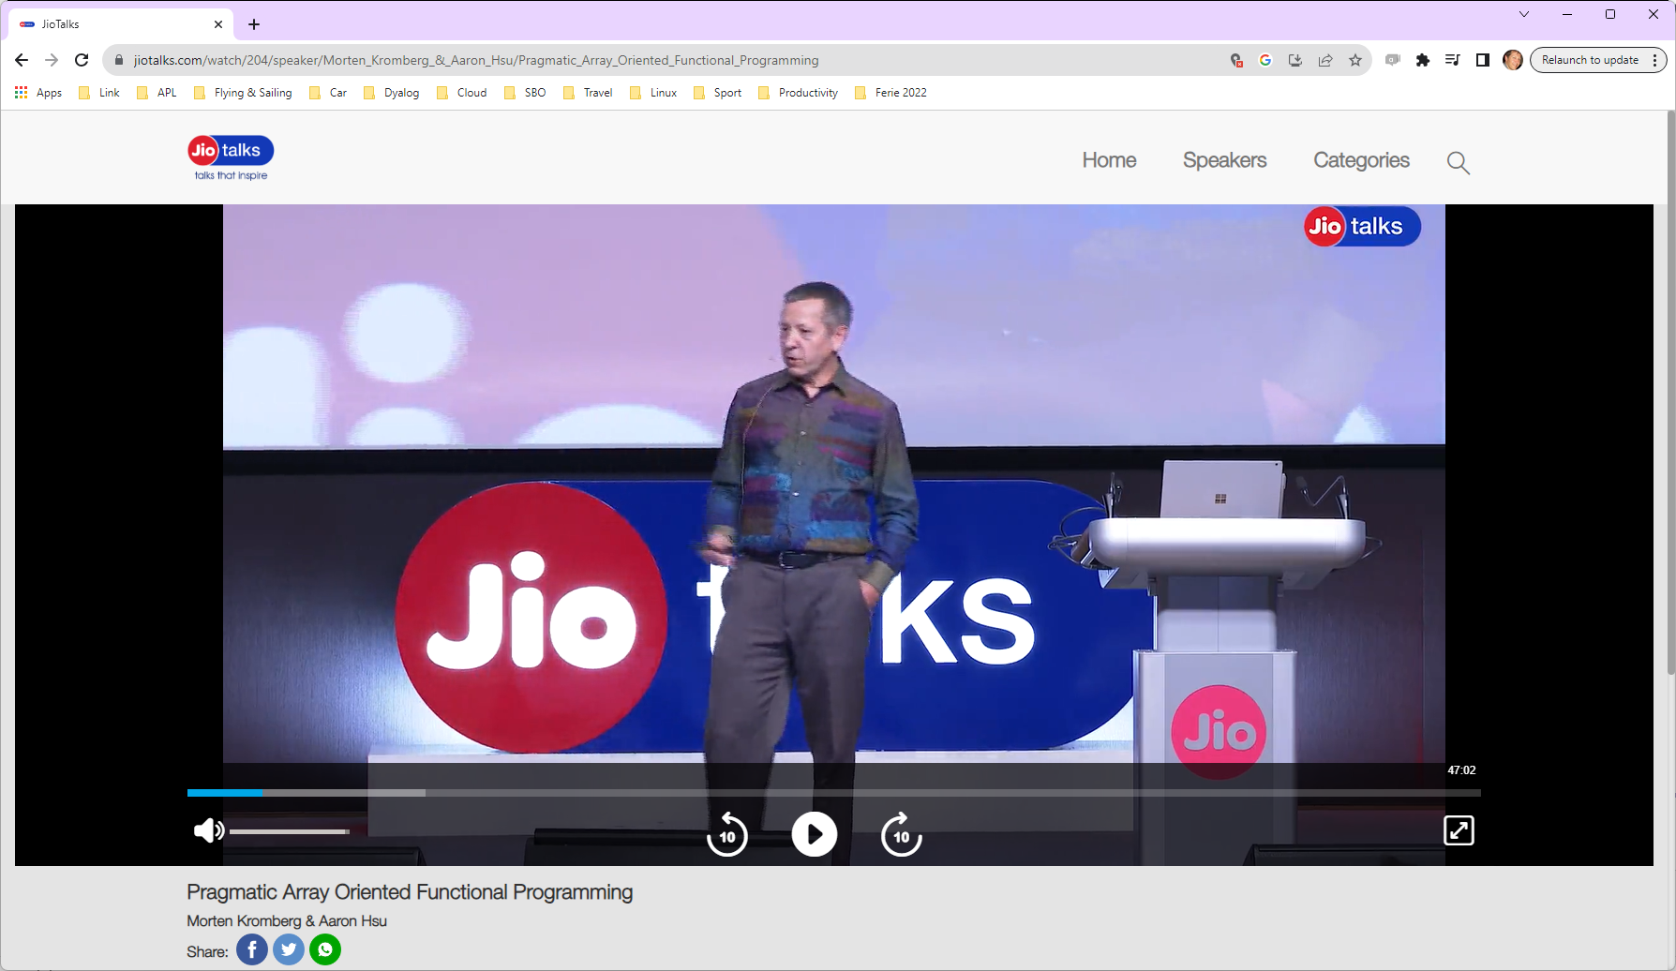

Slide 30
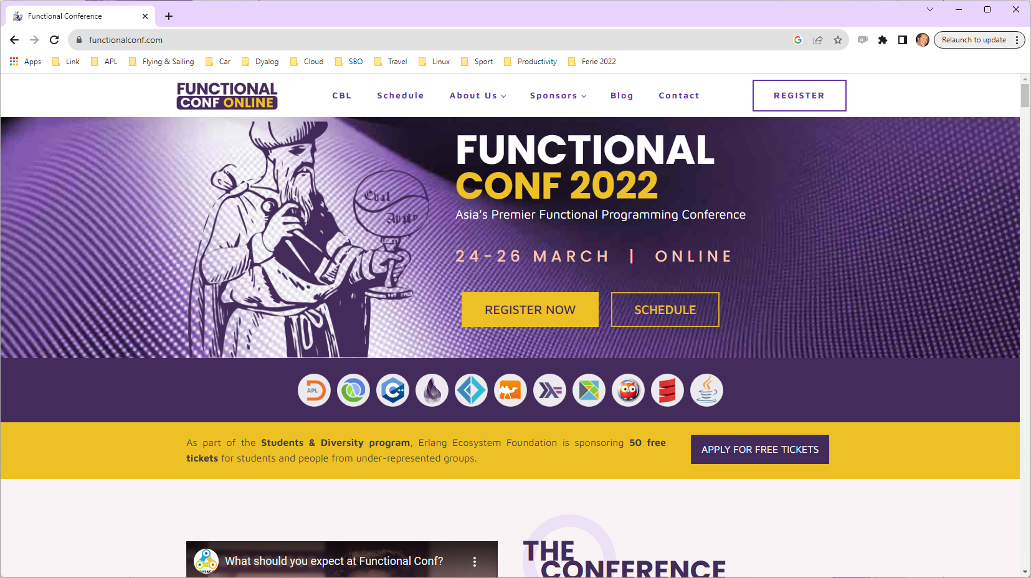

Slide 31
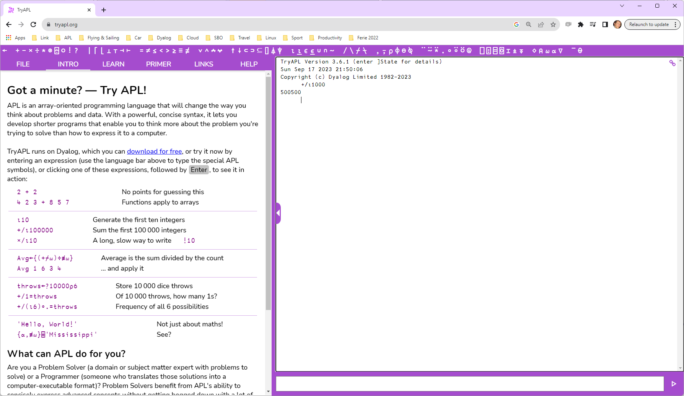

Slide 32
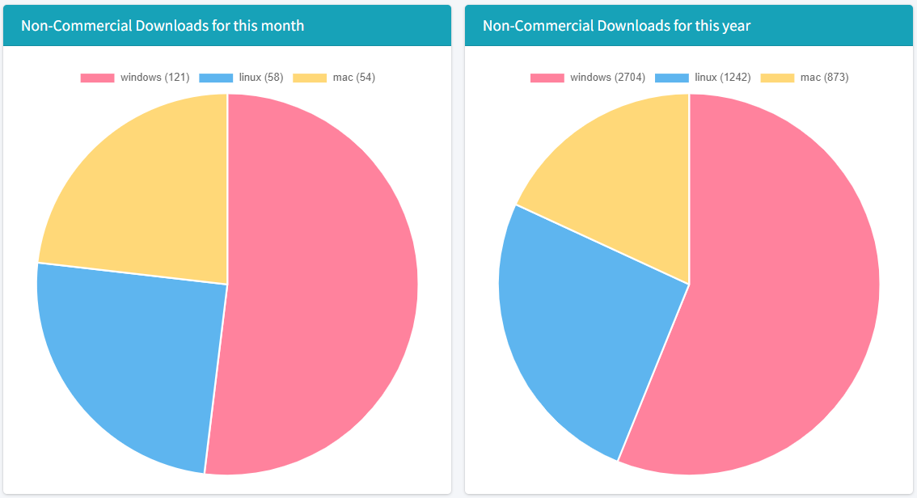
Non-Commercial Downloads
(snapshot September 18th, 2023)

Slide 33
Academic Collaboration
Directly Funded by Dyalog
University of Rome: Masters Level Financial Mathematics using Dyalog APL
National University of Ukraine in Kiev started teaching introductory course in APL in 2011
Herriot University (Scotland) and University of Copenhagen: Research into APL as a model for data-parallel computation
  Compiling APL for GPGPUs etc
University of Indiana: Research into APL as a model for ”deterministic task parallel computation”
  Aaron Hsu's Co-dfns compiler
Jesús Galán López (Ghent University)
  Metallurgy with APL
Santiago Núñez-Corrales, PhD
  National Center for Supercomputing Applications

Slide 34
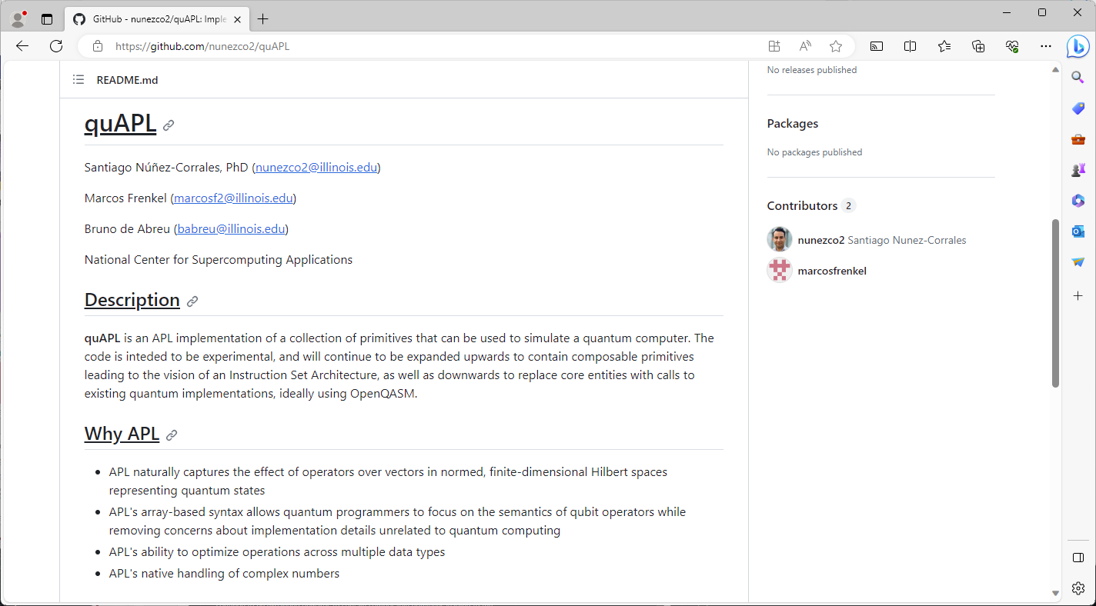

Slide 35
Selected Features 2006-2024
Web Server and Web Service Frameworks
Run APL as a Windows Service
Public Docker Containers
Remote IDE for debugging service processes
Health Monitor for monitoring collections of processes
Parallel and Asynchronous Execution
New Data Types:
  128-bit Decimal Floating Point
  Complex Numbers
Functional Programming (dfns)
New primitives: Key, Stencil, Where, …
Significant steps towards an APL compiler
Many speed-ups of interpreter algorithms
Object Orientation
Microsoft.Net Integration
HTMLRenderer object embeds Chromium Web Browser engine
64-bit: *NO* workspace or component file size limits
Unicode Support incl APL Source in Text Files
Secure TCP Sockets w/ IPv6 Support
Encryption Toolkit
Regular Expressions (PCRE) built-in to APL
XML and JSON parsers for fast conversion to (and from) APL structures
Vast majority of features are identical across all platforms

Slide 36
Summary
Dyalog has emerged as the leader of the APL technology market
  Continuously gained market share since early 1990’s.
  Dyalog APL allows domain experts to participate in rapid application development using recognized best practices
APL can easily be integrated into any development environment as a client or server component using:
  Web Service (SOAP/REST – HTTP/JSON) or Web Server (HTTP)
  .NET and Microsoft.NET Framework
  ODBC/ADO/ADO.NET
  (Still support COM / ActiveX, even DDE)
We are just getting started after 40 years!

Slide 37
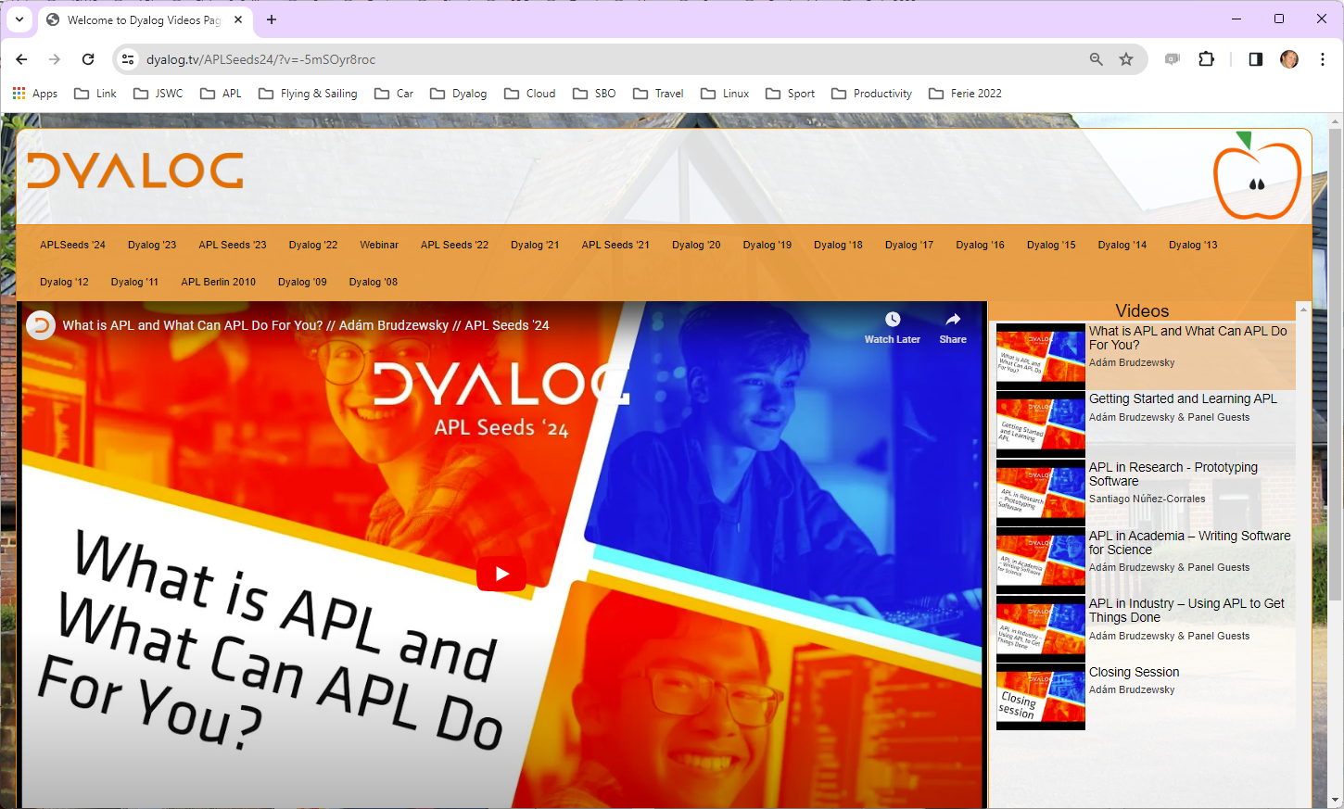
Videos from User Meetings
dyalog.tv

Slide 38
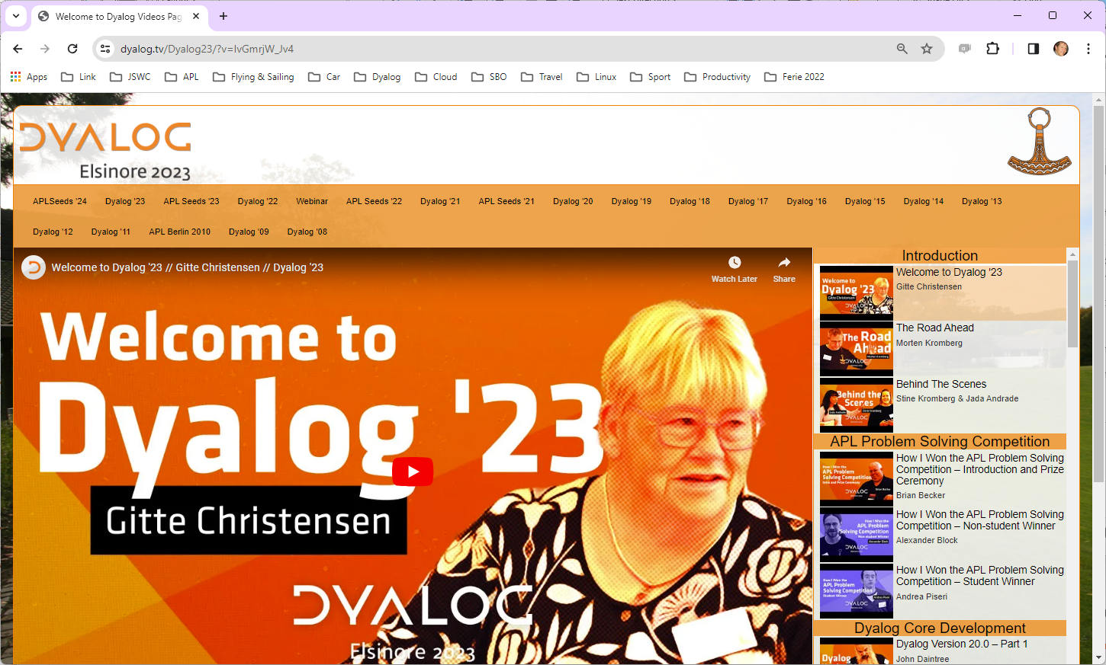

Slide 39
The Real Reason to Pick Dyalog APL

