Slide 1
Migrating to Dyalog
Morten Kromberg, CTO

Slide 2
A New Wave of Migrants
Dyalog APL was created by Dyadic Systems Ltd, when the mainframe business faltered (1981)
Almost all users of Dyalog APL migrated at some point, from SHARP APL, IBM APL2, APL+Win, or APLX (or DEC APLSF, or …)
Waves of migrants
  Death of mainframes and minicomputers (1980's)
  Superior support for Windows GUI (1990's)
  Now, "the cloud" (& a few more mainframes being shut down)

Slide 3
Why migrate to Dyalog?
Dyalog re-invests 90-95% of revenues in
  Enhancing APL core technology
  Creating tools for APL developers
  Marketing APL outside the current APL community
Headcount now 26, up from 4 before the acquisition in 2005
  Next generation of developers and toolsmiths has been hired
Combined revenues of products and services based on Dyalog APL exceeds $1Bn per year – and is growing

Slide 4
Why migrate to Dyalog?
  The largest sustained investment in APL technology
  in the history of the language.
  Morten Kromberg

Slide 5
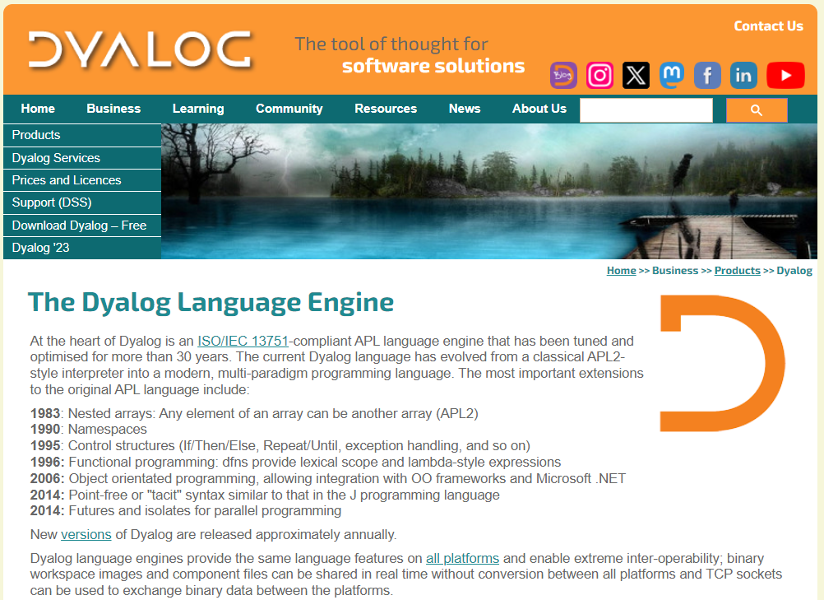

Slide 6

Selected Features 2006-2024
Web Server and Web Service Frameworks
Run APL as a Windows Service
Public Docker Containers
Remote IDE for debugging service processes
Health Monitor for monitoring collections of processes
Parallel and Asynchronous Execution
New Data Types:
  128-bit Decimal Floating Point
  Complex Numbers
Functional Programming (dfns)
New primitives: Key, Stencil, Where, …
Significant steps towards an APL compiler
Many speed-ups of interpreter algorithms
Object Orientation
Microsoft.Net Integration
HTMLRenderer object embeds Chromium Web Browser engine
64-bit: *NO* workspace or component file size limits
Unicode Support incl APL Source in Text Files
Secure TCP Sockets w/ IPv6 Support
Encryption Toolkit
Regular Expressions (PCRE) built-in to APL
XML and JSON parsers for fast conversion to (and from) APL structures
Vast majority of features are identical across all platforms

Slide 7
Why Migrate to Dyalog?
Dyalog is 100% Cross Platform
Born under UNIX (Solaris, AIX, …)
  Ported to DOS, Windows, Linux (ARM, Intel), MacOS (Intel, Mx)
Single source for all platforms
  Workspaces and component files compatible across all platforms
All tools are tested on all platforms
  Exceptions where O/S does not provide a feature
  .NET not under AIX, many Windows features like DDE, COM/OLE, GUI

Slide 8
Remote IDE (RIDE)
From Windows, Linux or MacOS
Connect to and debug Dyalog APL running on any platform

Slide 9
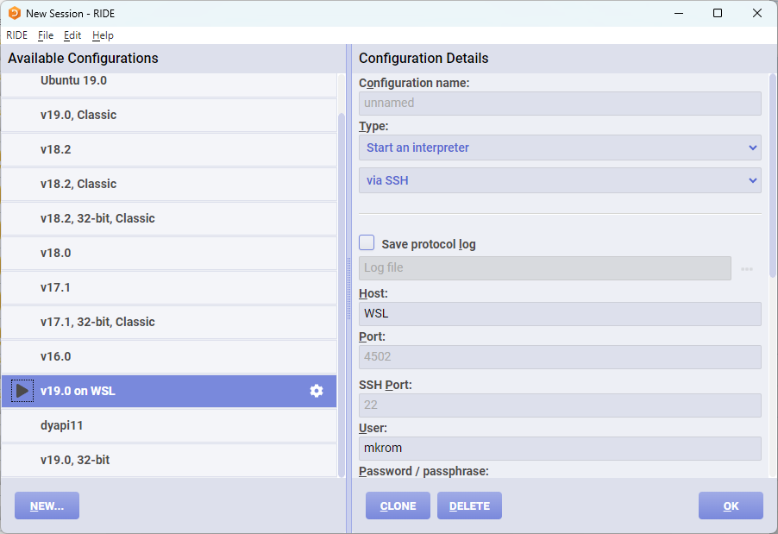

Slide 10
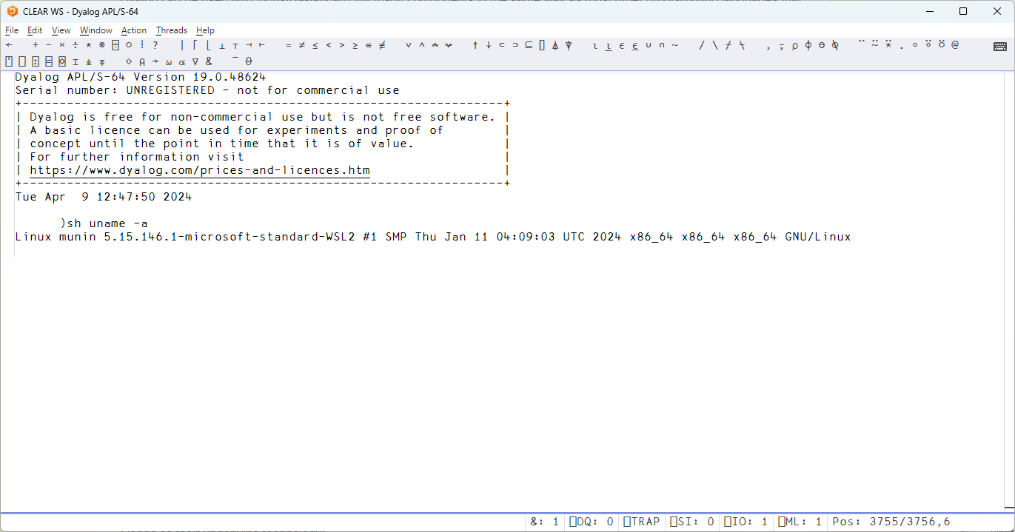
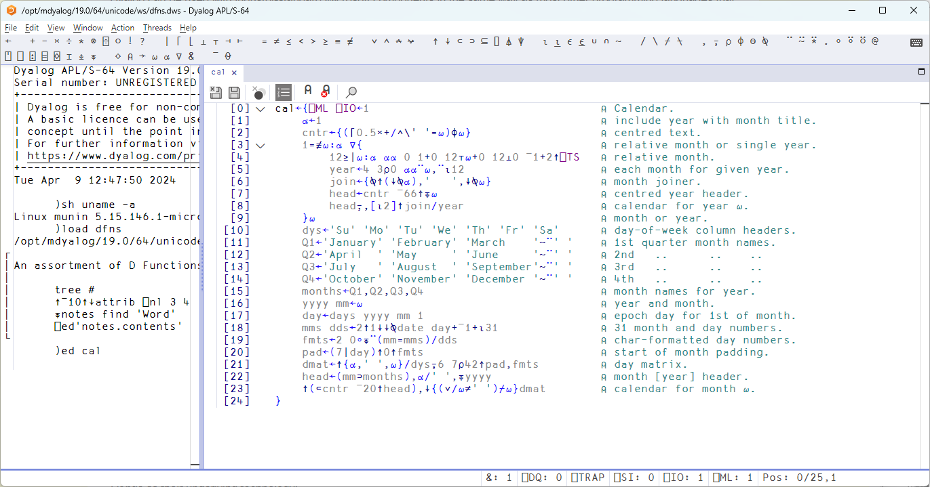

Slide 11
Remote IDE (RIDE)
Connect to and debug Dyalog APL running on any platform
From Windows, Linux or MacOS
Or indeed a browser running anywhere…
  "Zero Footprint RIDE"

Slide 12
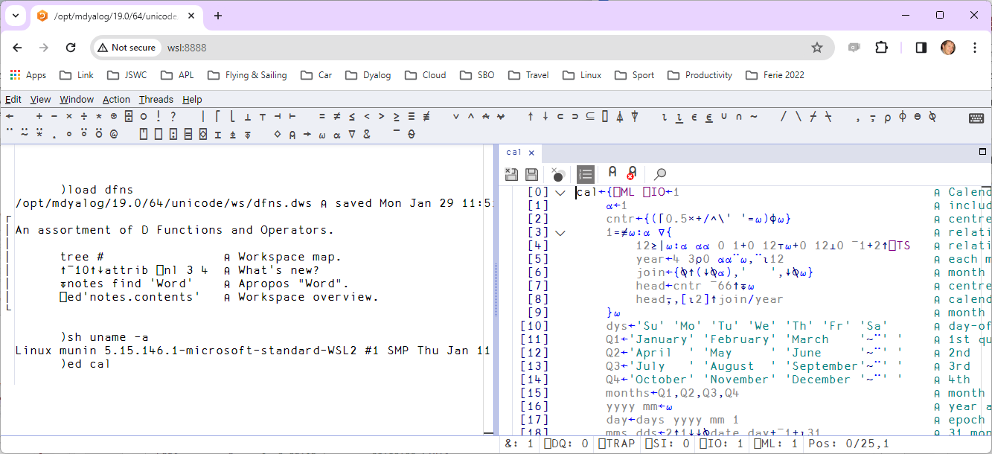
RIDE running in a browser

Slide 13
Why Migrate to Dyalog?
Dyalog is "Cloud Ready"
ARM and Intel Linux versions
Public Docker containers
Did I mention the "Remote IDE" ?
Text-based source supports "Continuous Integration"
  Build & deploy containers on commit or push
User community starting to gain significant experience
Working on tools to port Windows GUI to HTML/JS

Slide 14
Why Migrate to Dyalog?
Multiple published licencing models
  Custom contracts available
Free basic licence for commercial use up to annual revenues of GBP 5,000
Free download without providing personal details
Unlimited support (within reason ☺) for users with any type of license

Slide 15
Why Migrate to Dyalog?
Developer tools are free, cross-platform and mostly open source:
Name | Description
SQAPL | ODBC Interface (also ADO and ADO.NET)
Jarvis | HTTP/JSON and REST service framework
HttpCommand | HTTP client
SAWS | SOAP service framework
Conga | TCP and UDP layer
SharpPlot | Business and Technical graphics
⎕XML, ⎕JSON, ⎕CSV | Built in to intepreter
Name | Description
RConnect | Interface to R
MiServer / DUI | Web Application Framework
Docker Containers | Published examples
Link | Interface to source code management
APLProcess | And isolates

Slide 16
Why Migrate to Dyalog?
Emerging Tools
Separately Licensed Tools
Name | Description
Link | Interface to source code management
Cider | Project Management
Tatin | Package Manager
NuGet | Interface to .NET Packages
Selenium | Automated GUI testing
Jupyter | Jupyter notebooks containing APL
eWC | JavaScript emulation of Win32 GUI
Arrow & Parquet | Data Science data formats
Name | Description
DFS | Dyalog File Server ("SHAREFILE")
Static Analysis | Static Analyisis of APL Code (code linting and vulnerability detection) Planned for 2025

Slide 17
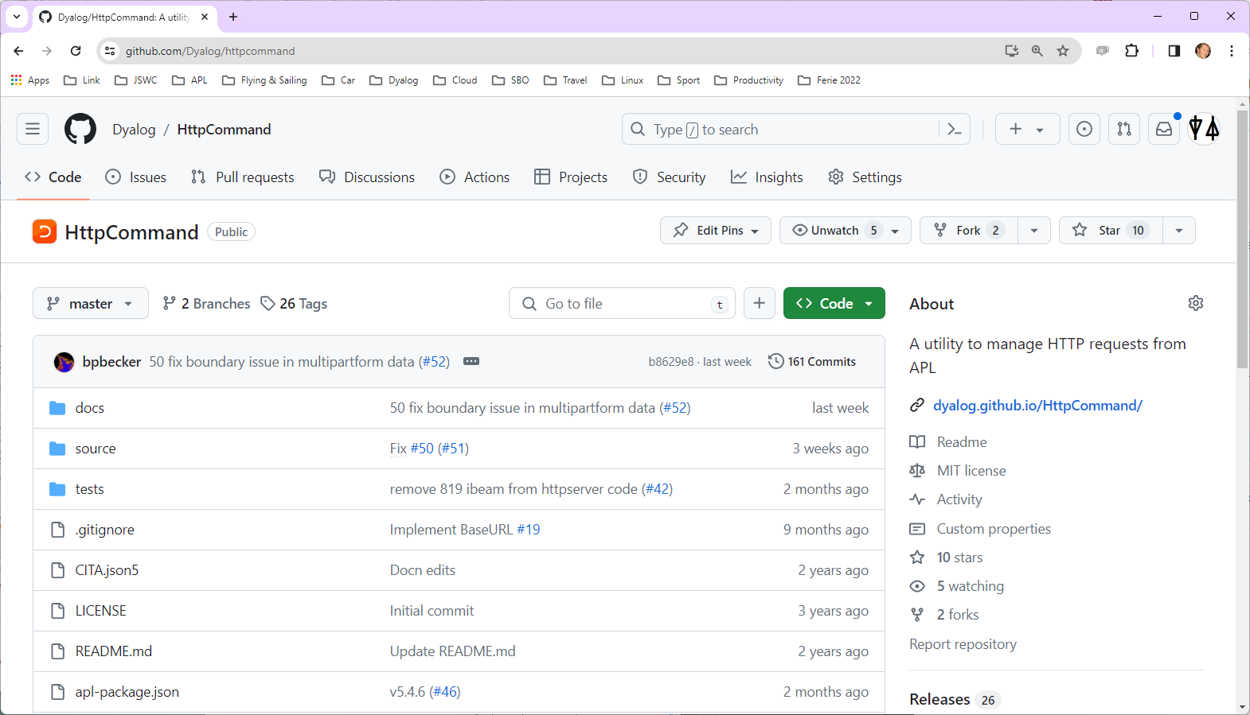

Slide 18
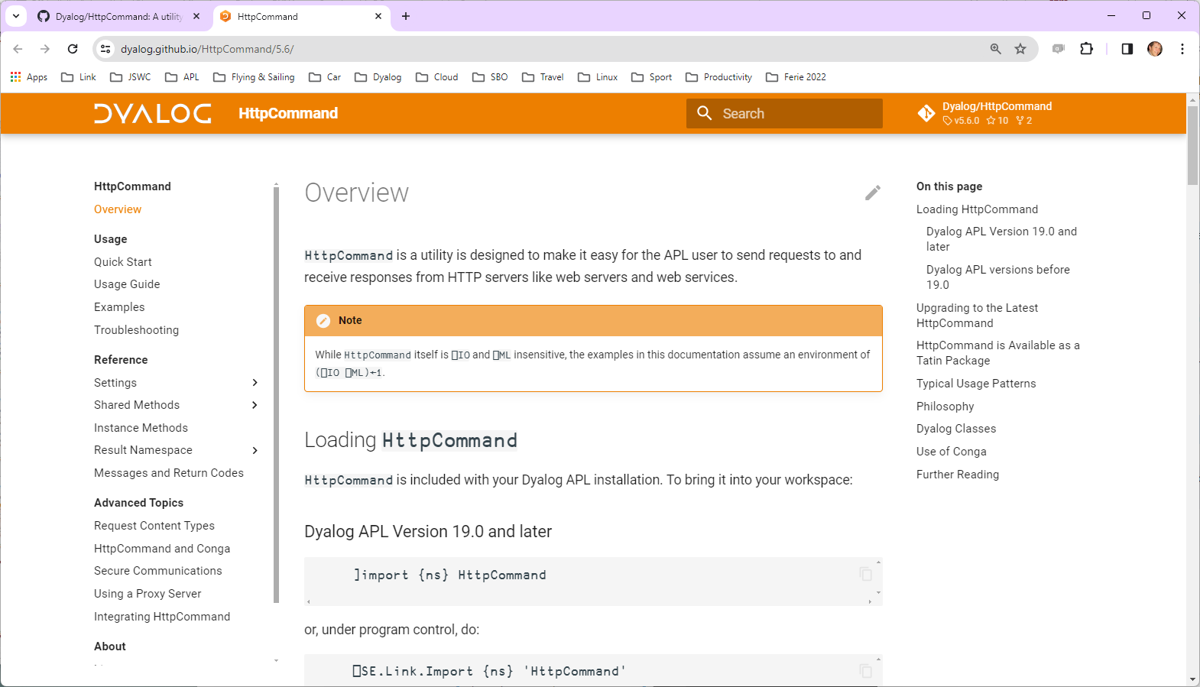

Slide 19
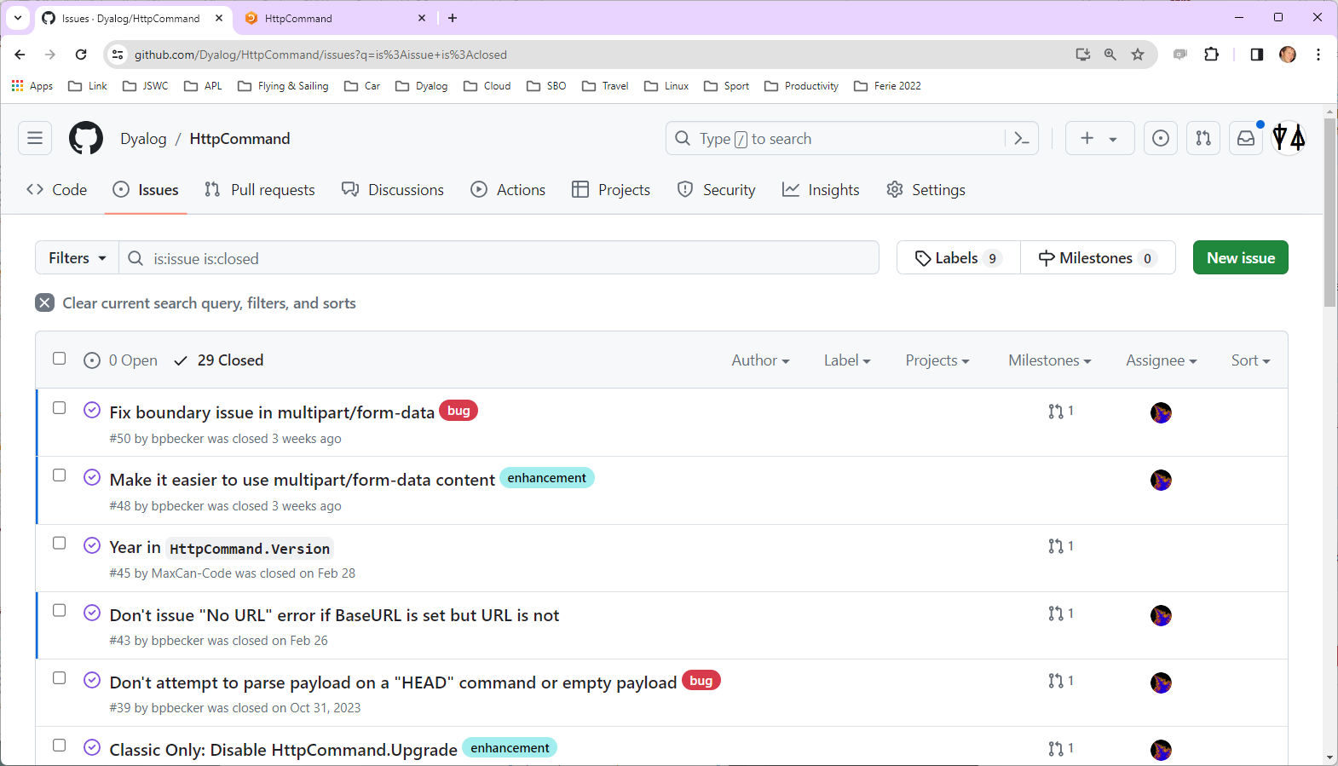

Slide 20
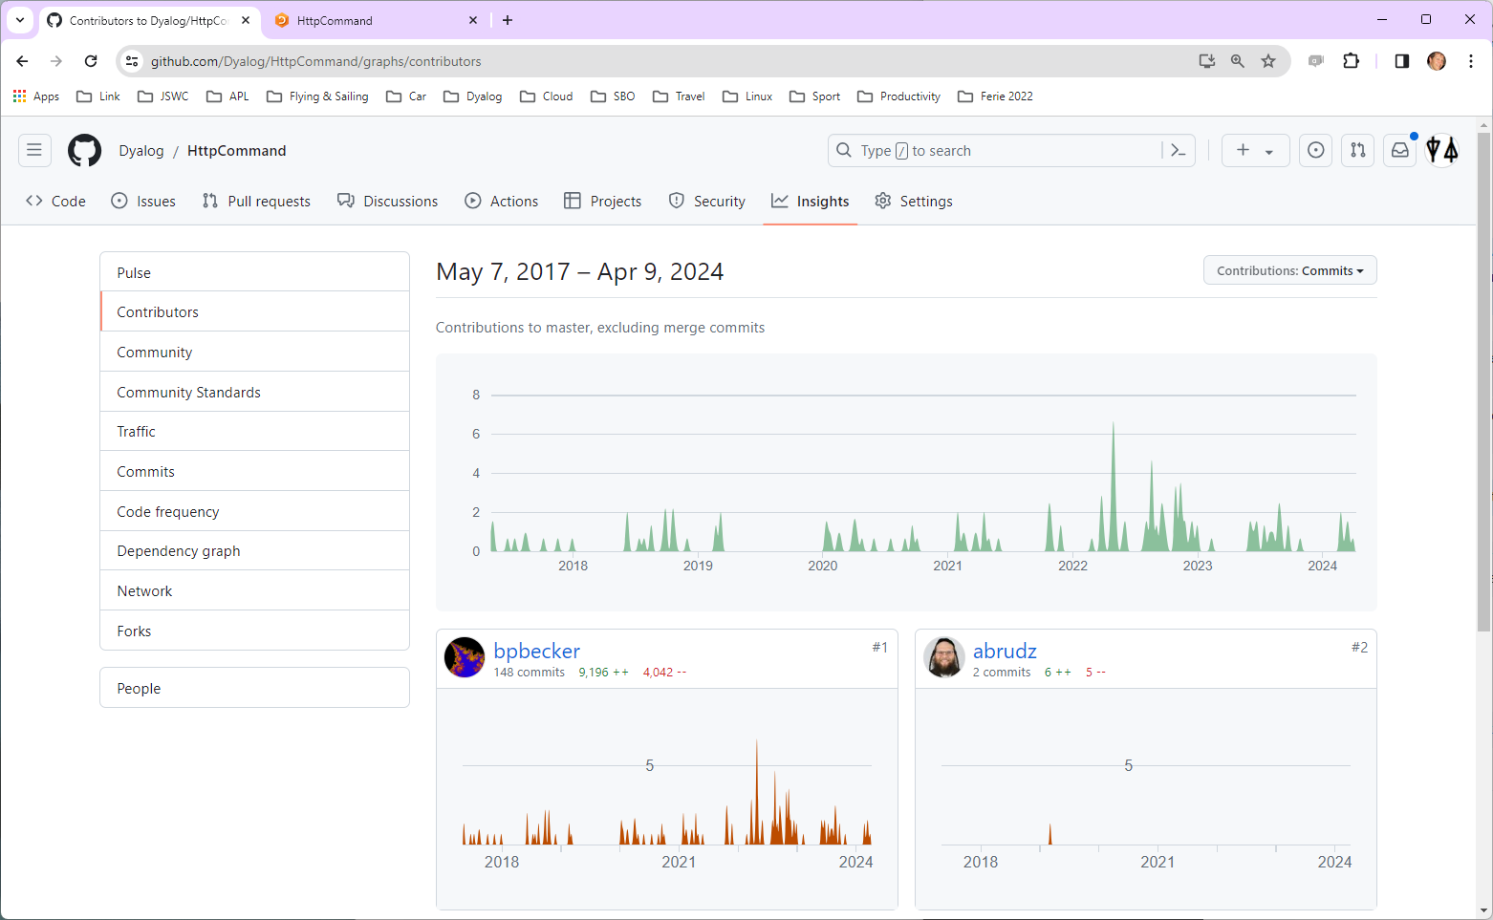

Slide 21
Why Migrate to Dyalog?
Dyalog APL is carefully designed to last. For example:
Dyalog APL is tightly integrated with .NET
  … and still supports the old .NET Framework
  However, Dyalog APL does not and WILL NOT depend on .NET
  It also runs under IBM AIX, where .NET does not exist
Dyalog *will* remain very portable and independent of "temporary" frameworks

Slide 22
Why Migrate to Dyalog?
Dyalog APL is fast!
Core algorithms regularly updated to take advantage of new hardware and new theory
Research into a compiler continues

Slide 23
















The Real Reason to Pick Dyalog APL

Slide 24
HOW to Migrate to Dyalog APL
From IBM / Logon APL2
From APL+Win or MicroAPL APLX

Slide 25
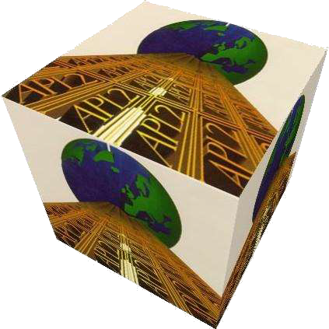
From APL2
Relatively straightforward
A few language differences
User Interfaces and file I/O are usually handled by cover-functions and possible to emulate automatically
Linux or Windows apps may be making external calls which will require "tweaking"
We are considering implementing "format by example" but so far it has not been necessary

Slide 26
Recent / Active APL2 Migrations
Insurance company
  No UI, manipulates text and Excel files
  Handled by European Consulting Partner
Sandvik (Sweden) – in progress: Mainframe APL2 direct to Docker Containers and HTML/svg
  Handled by Tiamatica in Malmö (Gilgamesh Athoraya)
BIG Jewellers: Windows
  Handled by Mark Wolfson himself "with a little help"
Two more under discussion
  (Germany, Canada)

Slide 27
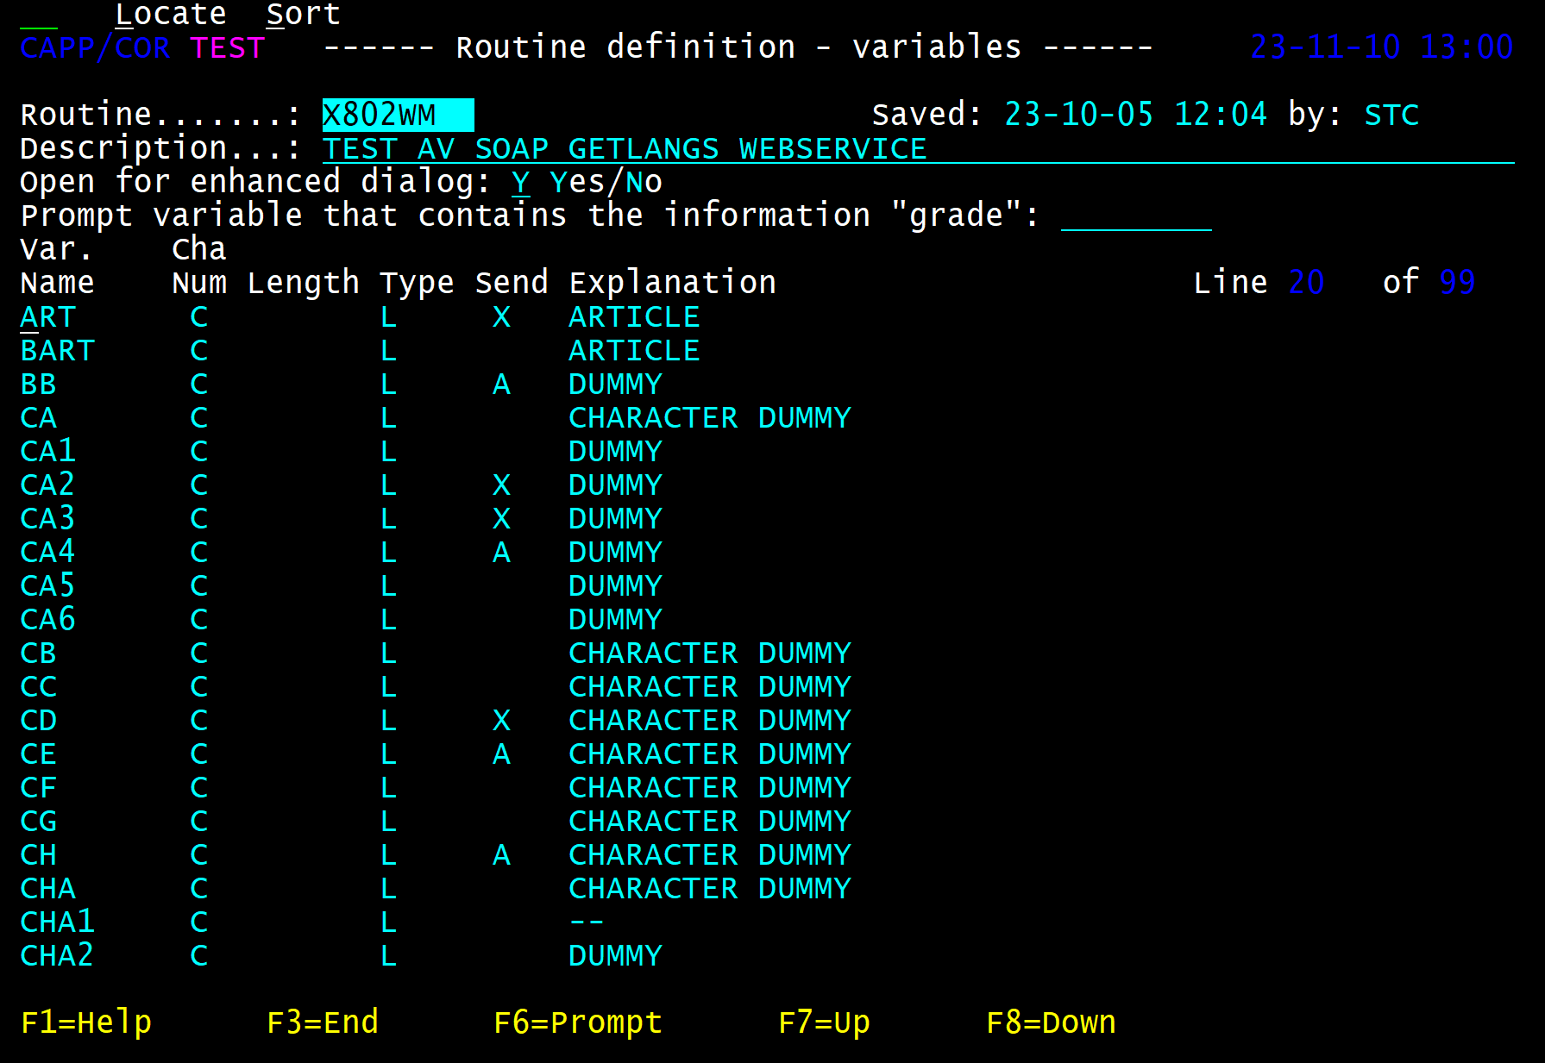
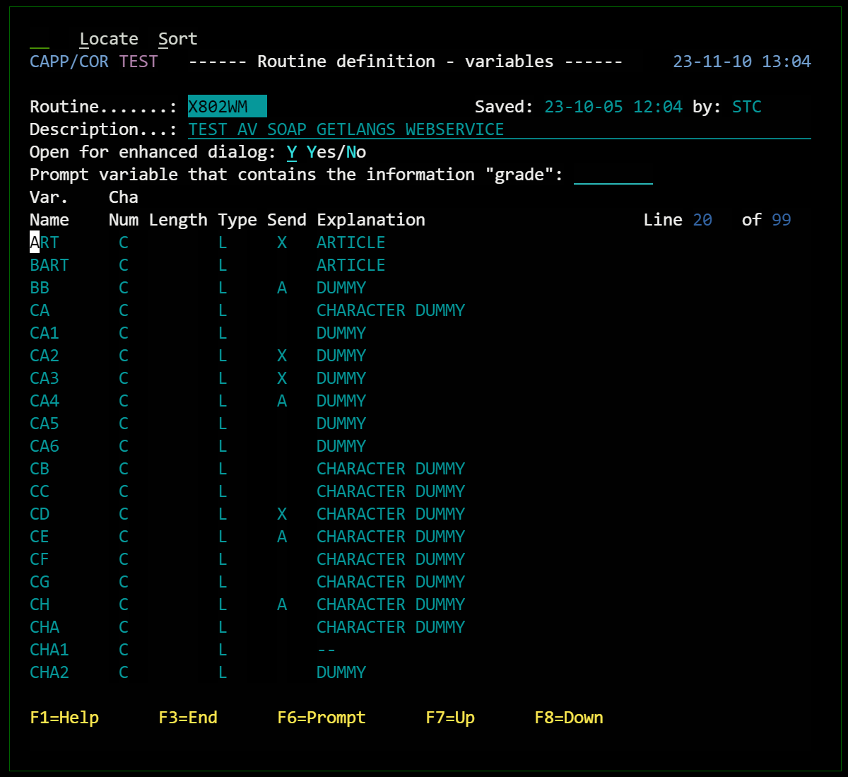
Migrated APL2 Mainframe UI

Slide 28
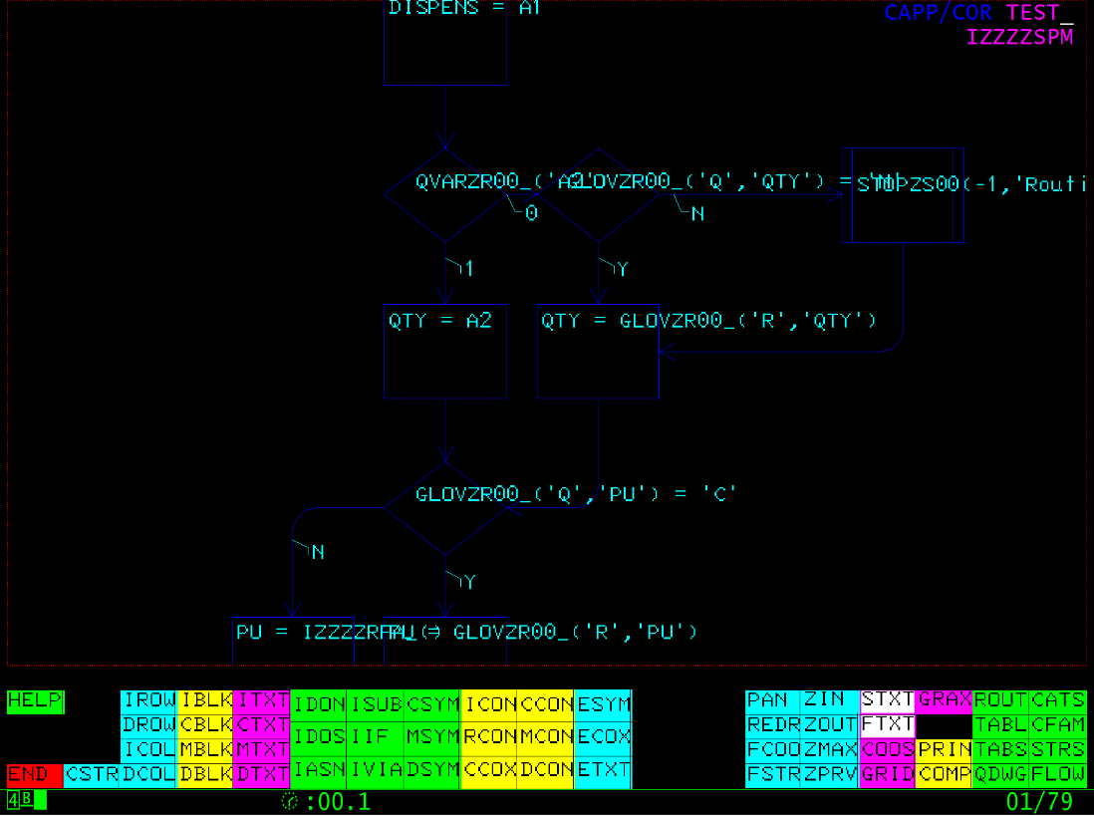
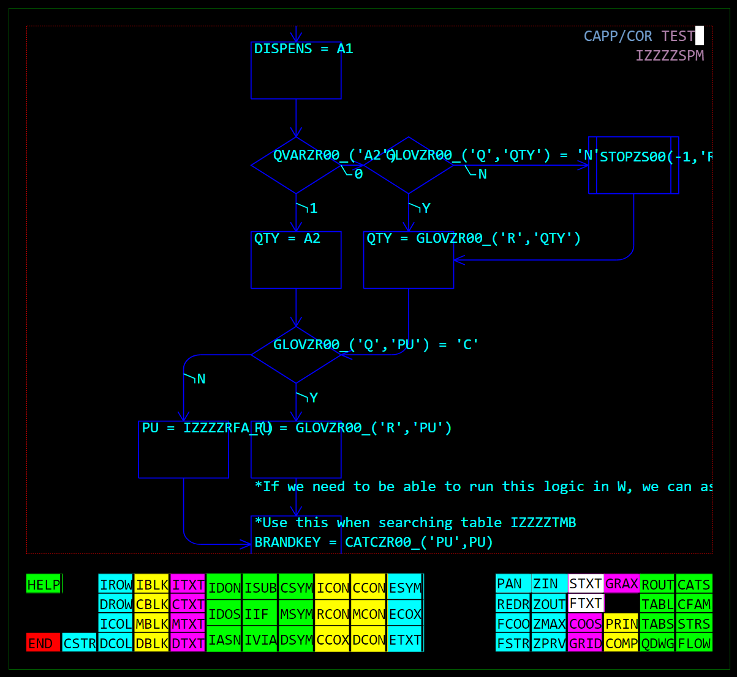
Migrated APL2 Mainframe UI

Slide 29

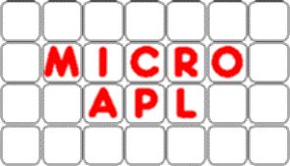
From APL+Win or MicroAPL APLX
Same language differences as APL2, plus:
Many system functions & control structures not found in Dyalog APL
Double quotes ("Don't do this!")
More advanced Graphical User Interfaces
Calls to external libraries

Slide 30
APLX Migrations
MicroAPL stopped developing APLX in 2016
  Dyalog hosts a download of the last free version
Dyalog developed migration tools in 2016
A handful of users migrated using these tools

Slide 31
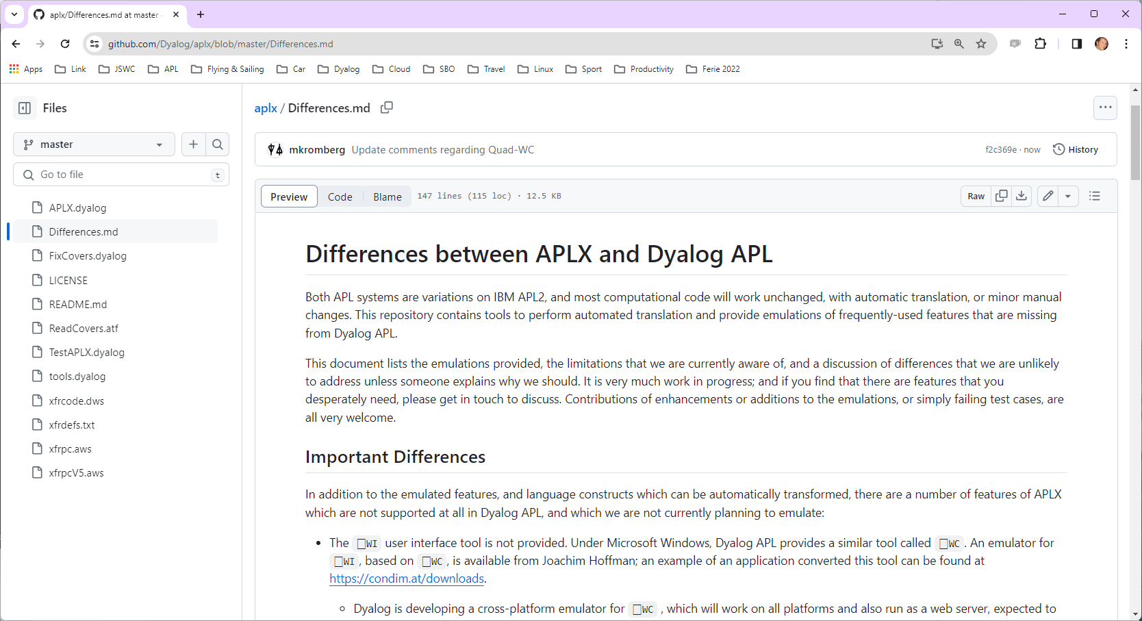


Slide 32
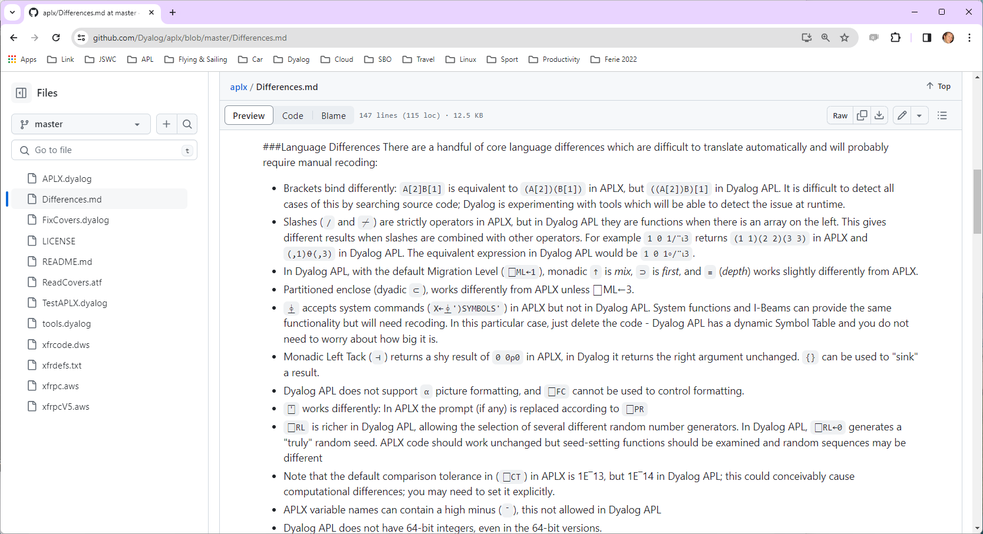

Slide 34
Recent / Active APL+Win Migrations
Two European Insurance companies
  One with GUI, completely rewritten in Dyalog APL, the other a pure service converted to Jarvis in Linux containers
  Handled by a European consulting partner
METSIM® - in progress
  Migration being handled by Dyalog
  Will be used to develop tools to automate migration, including the Graphical User Interface
Meeting one more potential migrant next week

Slide 35
Differences which are "easy"
1 0 1/¨'ABC' 'DEF' 'GHI'
←Y
'ABC' 'DEF' 'GHI' vs
'ABC' 'GHI'
Convert /¨ to ∘/¨
Not supported in Dyalog
Convert to {}Y

Slide 36
Other "Easy" Differences
⎕XLIB
System function not in Dyalog
R←∆XLIB X
X,←'*'↓⍨≢X
:If 0∊⍴R←↑⊃⎕NINFO⍠1⊢X
:If ∨/'?*'∊X
R←0 0⍴' '
:Else
'XFHOST ERROR FindFirstFile 1 0 3 The system cannot find the path specified.'
⎕SIGNAL 22
:EndIf
:Else
R←R[⍋R;]
:EndIf

Slide 37
Difficult Differences
A B[I]
f.g when f or g
are not scalar functions
:LeaveIf
A (B[I]) or
(A B)[I] ?
Detect and rewrite
Enhance Interpreter

Slide 38
The Hard Parts
User Interfaces (especially Graphical)
Component Files
Other I/O (e.g. SQL Databases)
External Library Calls

Slide 39
The Elephant in the Room: ⎕WI ?
Austrian APL consultant Joachim Hoffman has an emulator for sale as part of consulting projects
Dyalog is building a new emulator for the METSIM® migration
  Our goal is that no significant changes to application code will be required
  METSIM® screen shots follow
    Many thanks to Alex Holtzapple, CEO of MSI

Slide 40
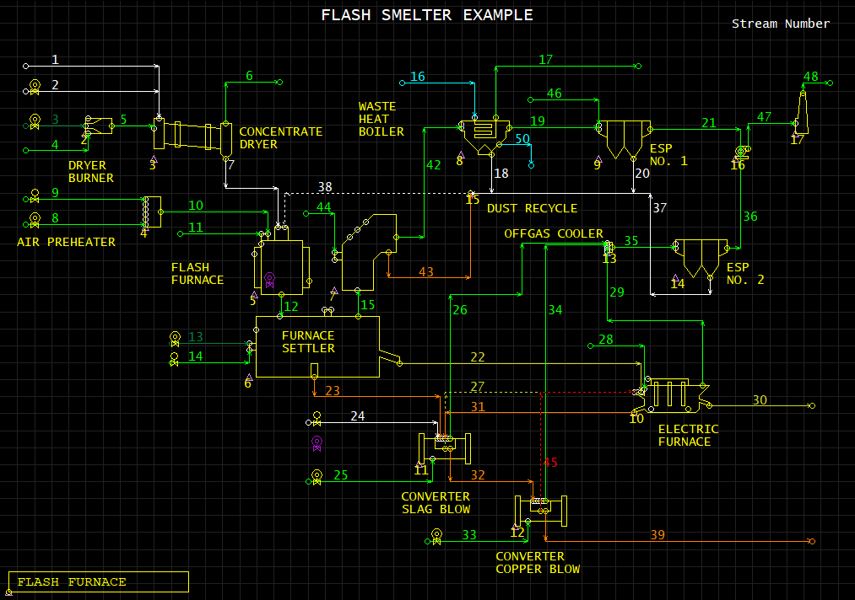

Slide 41
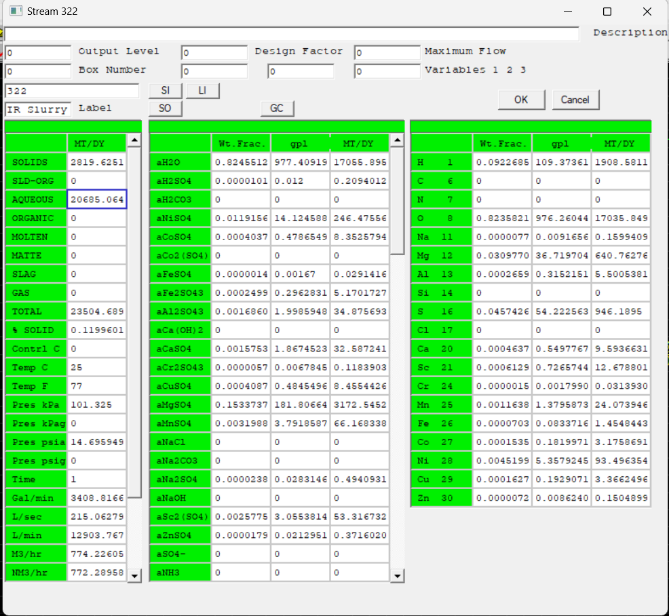

Slide 42
Status
We just started reworking and enhancing the APLX tools
Will enumerate differences between APL+Win and Dyalog
Will create emulation functions as required
We *may* also decide to add new features to Dyalog v20 (which should start user testing in late 2024)
  For example :LeaveIf

Slide 43
Status
Dyalog has been contracted to port the METSIM® application
Hired one new APL developer, thinking about another
We will have ~1.5-2 full time equivalent resources working on migration tools until further notice
All the resulting tools and documentation will be
free and open source

Slide 44
Limbering Up
APL+WIN comes with a handful of GUI demonstration applications

Slide 45
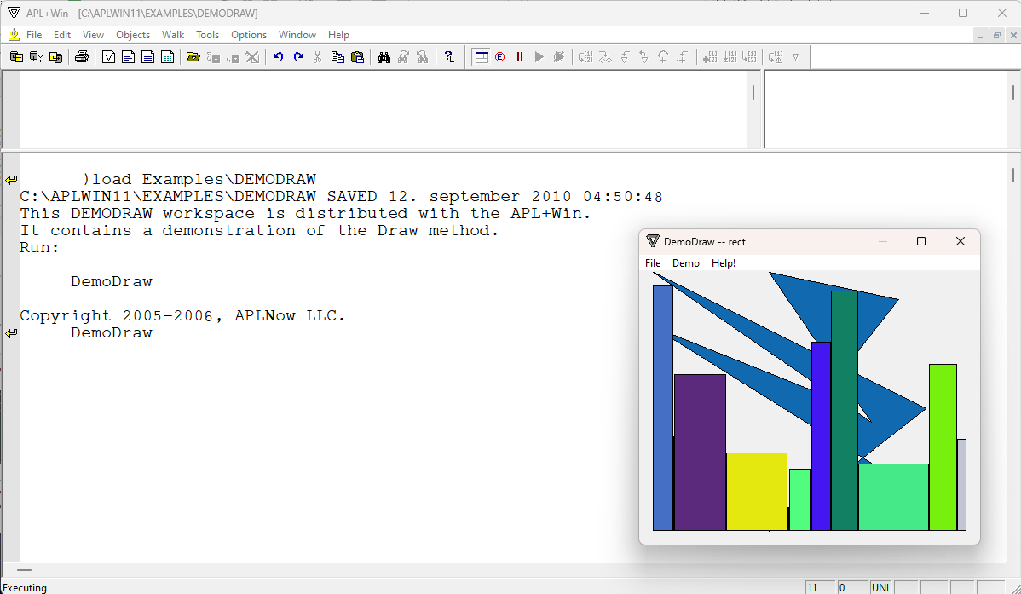
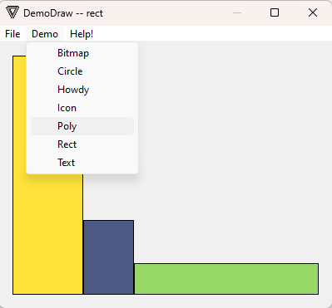
My copy of APL+Win is a little dated…

Slide 46

Now export the APL+Win code to APL Transfer Format

Slide 47
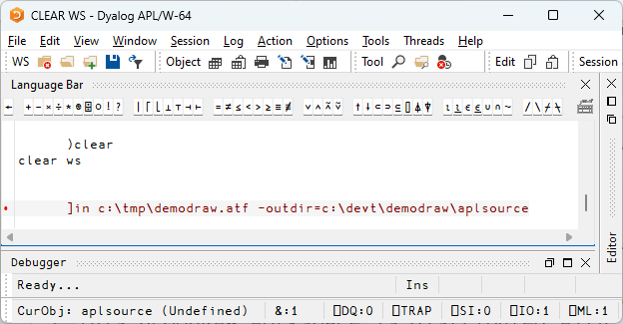
Convert the ATF file to Dyalog Source files

Slide 48
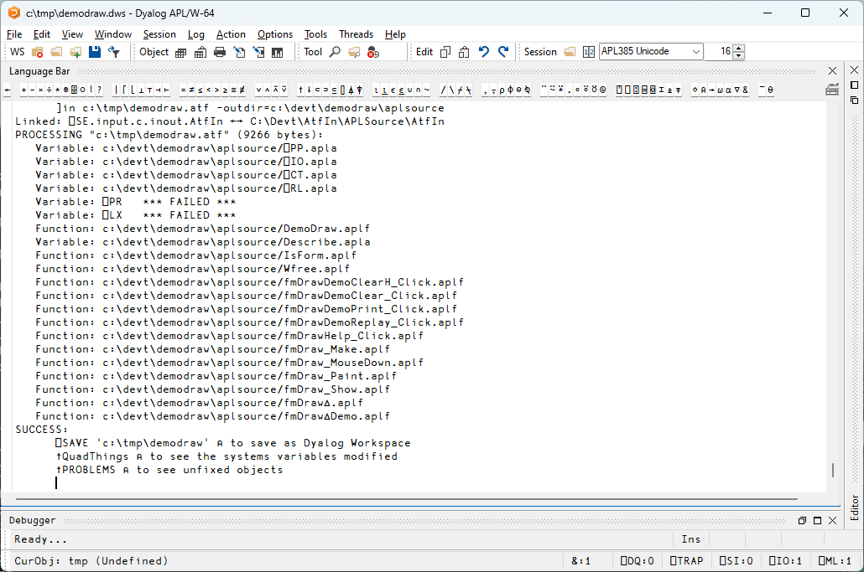

Slide 49
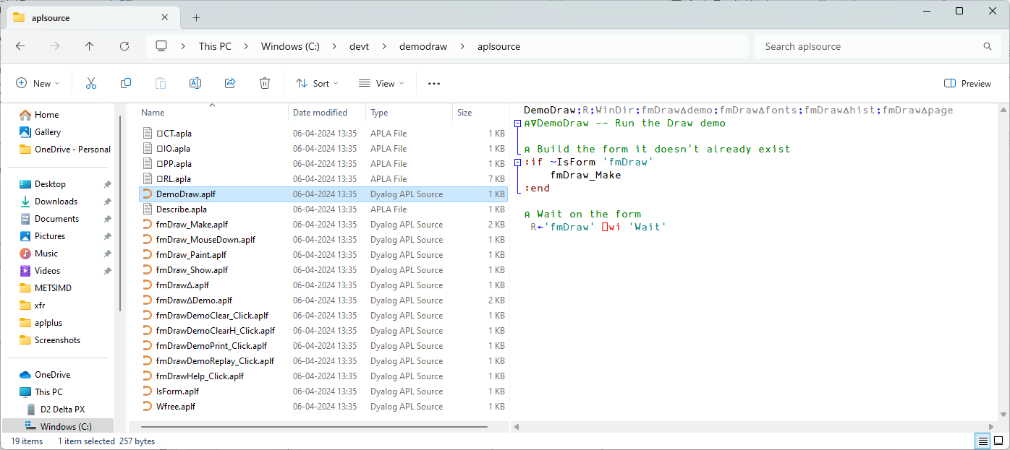
NB this is original APL+Win Source
For METSIM®, we plan to update the
APL+Win environment to run off
text files too.

Slide 50
APL Source in Text Files
Text files are now the recommended vehicle for
Dyalog APL source code
Workspaces will continue to be supported "forever"
  For distribution
  For crash dump analysis
  For old timers who refuse to change ☺
Extension | Content
.apla | Array
.aplc | Class
.aplf | Function
.apln | Namespace
.aplo | Operator

Slide 51
Benefits of Text Source
New developers will feel at home immediately
Apply mainstream Source Code management tools
  Git, Subversion, Mercurial, …
Also use 3rd party frameworks for Continuous Integration, Testing
Your auditors will be pleased

Slide 52
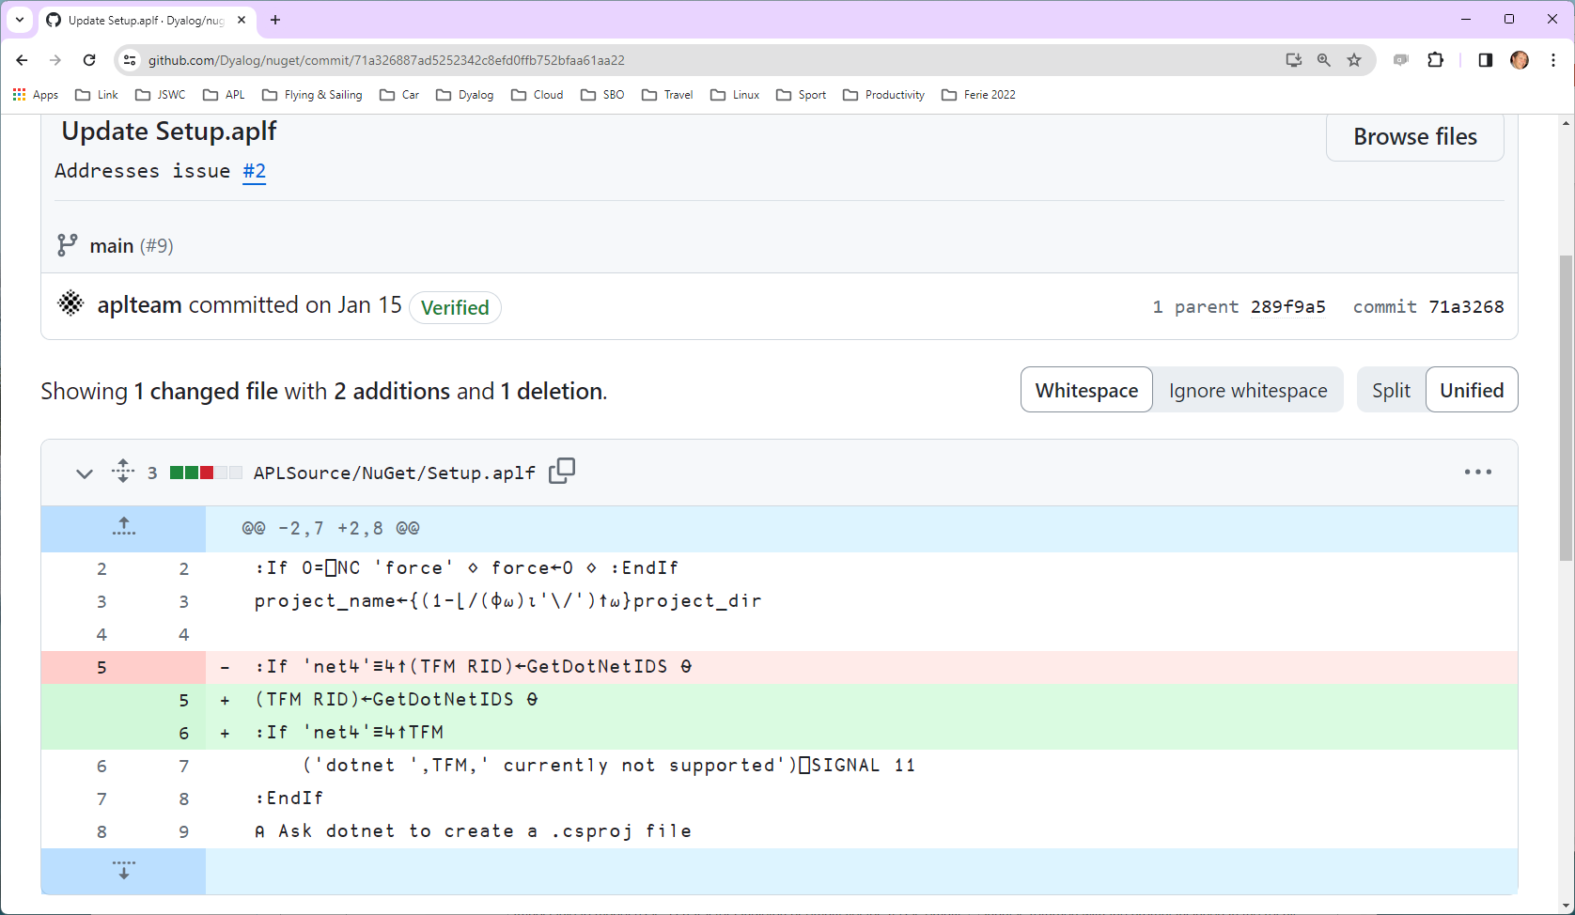

Slide 53
Next, map code from APL+Win to Dyalog
]todyalog aplsource c:\devt\demodraw\dyalog a2k
Using c:\devt\demodraw\aplsource\atfmap.txt
20 files processed

Slide 54
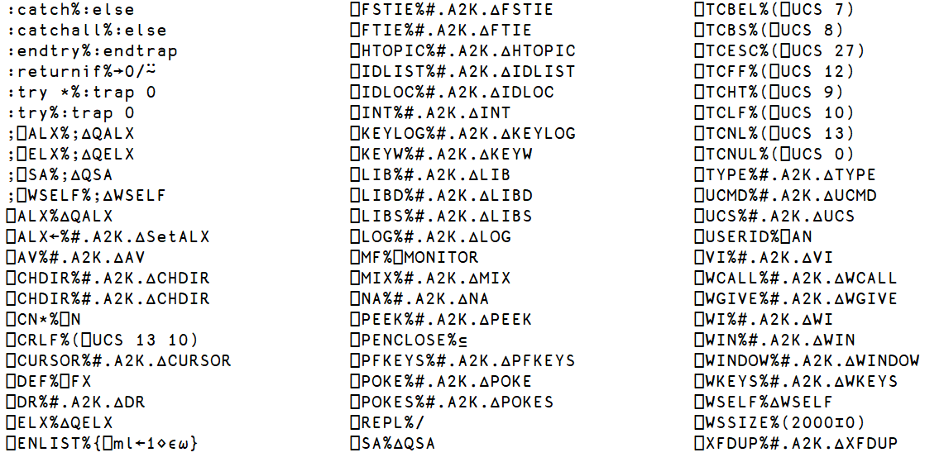
atfmap.txt

Slide 55
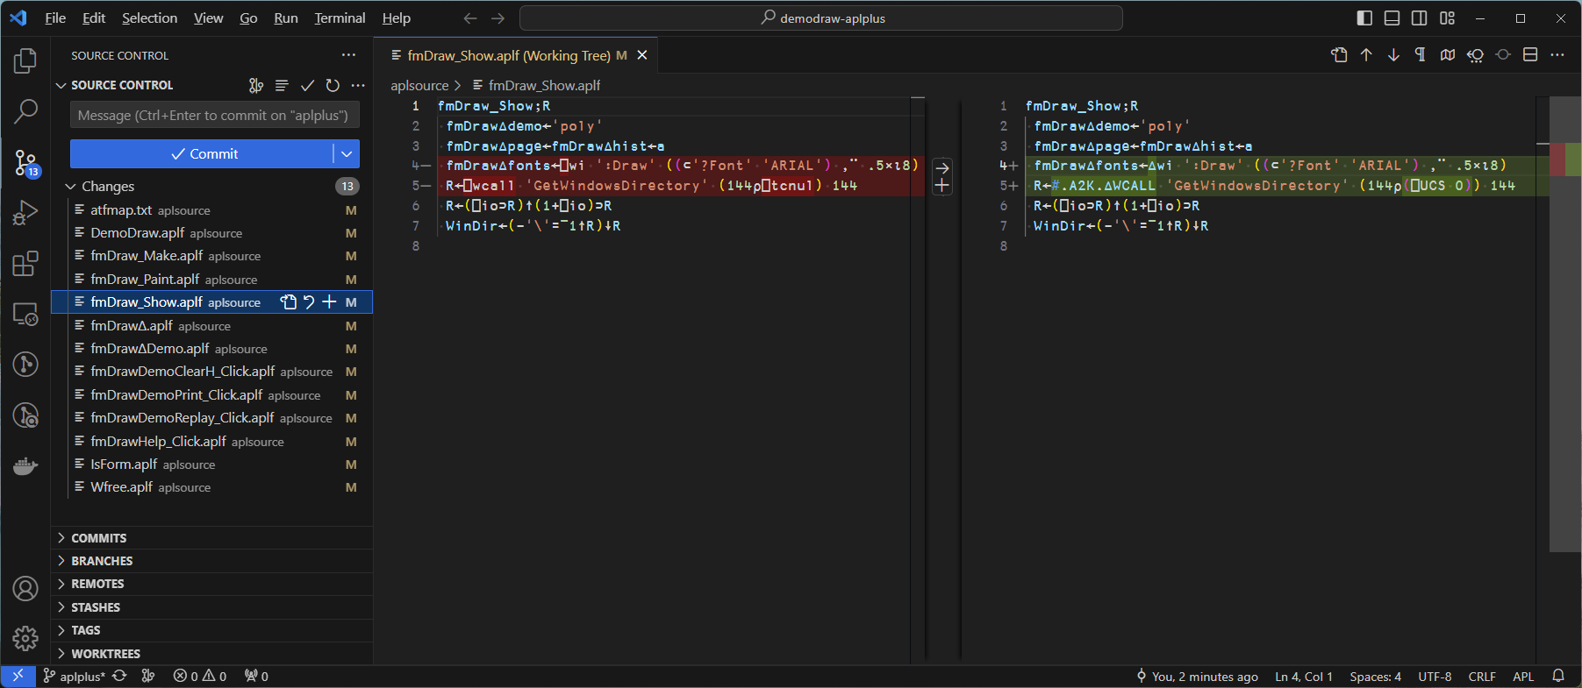
Take advantage of Git and VS Code

Slide 56
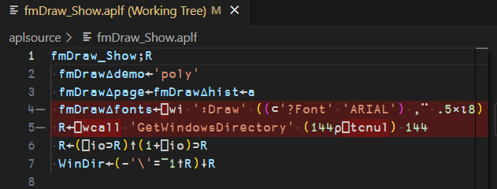
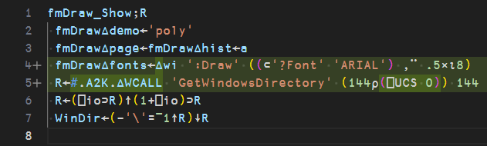
Original
APL+Win code
Converted to
Dyalog
So what is #.A2K.∆WCALL ?

Slide 57
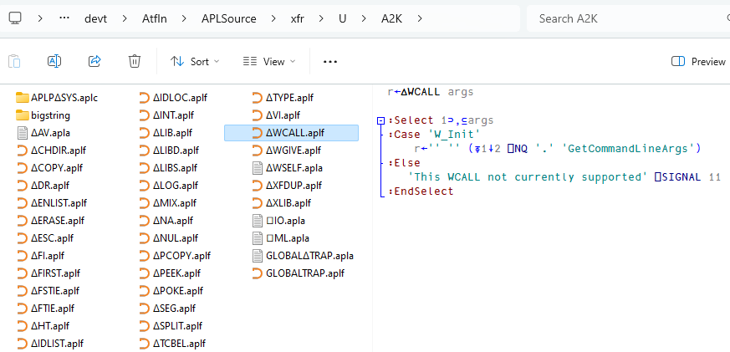
∆
So what is #.A2K.∆WCALL ?

Slide 58
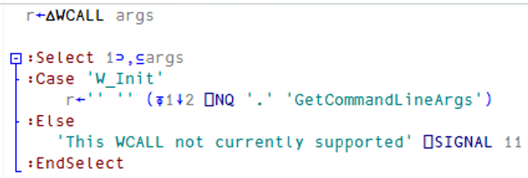

Slide 59
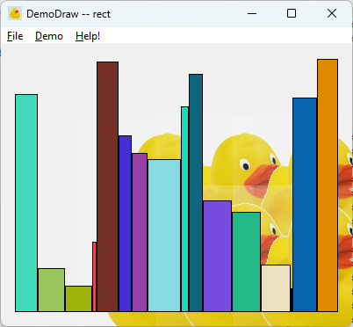

Slide 60
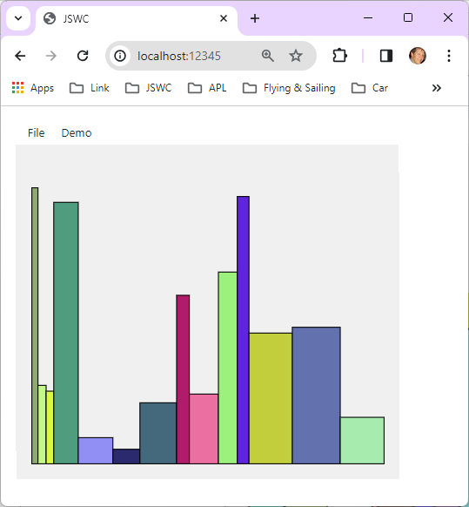

Slide 61
"DeltaWi" status
We started a few weeks ago, while also training a new APL recruit
Priorities will be driven by METSIM® migration
  (and any samples that you send us to help us prepare)

Slide 62
Component Files
We are planning to develop an APL+Win COM server that will allow the use of APL+Win component files from Dyalog APL
Avoid the need for "big bang" data migrations
  Component files can be migrated over time
You may need a runtime license for APL+Win

Slide 63
Planning a Migration
1:1 GUI emulation of APL+Win GUI?
  Grid components may demand some recoding
Service Orientation
Cloud Deployment
Web-based UI
64-bit?
Unicode?

Slide 64
Preparing for a Migration
Will you need to run the original and migrated versions in parallel?
  In most cases, this *will* be necessary for some weeks, months – or years
Will the original code continue to change during the period?
  Consider a compatibility layer to insulate code from platform differences
  Consider using Git to merge changes from old to new platform

Slide 65
Preparing for a Migration
While you wait for the migration to start, write regression tests (if you don't already have them)
The value of this cannot be overstated
Regression tests will be useful before the migration, of course ☺

Slide 66
Let us know your plans!
We're actively working on a migration now
Knowledge about other potential migrations will help us get ready for yours

